Slide 1


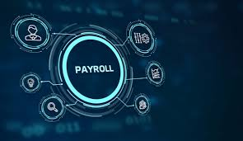
CSA0912-JAVA PROGRAMMING
PAYROLL MANAGEMENT SYSTEM
Guided By:
Dr. Jayasakthi Velmurugan
(Course Faculty)
CSA0912-Programming in Java
Saveetha School of Engineering
P. SaiKumar
( 192211420)
Java Programming
Saveetha School of Engineering

Slide 2
ABSTRACT
The Payroll Management System is an application designed to automate the process of managing employee payrolls. This system is crucial for businesses of all sizes to ensure accurate and timely payment to employees while maintaining compliance with tax regulations and other financial obligations. This abstract outlines the design, development, and implementation of a payroll management system using Java and related technologies.
Keywords : Payroll management, java, Spring Boot, JavaFX, Automation, Employee Records, Salary Calculation, Deductions, Bonuses, Data Security.

Slide 3
INTRODUCTION
Payroll software is a particular computer program designed to reorganize and automate the process of managing employee compensation, including salaries, wages, bonuses, and deductions.
Here are some key aspects and features commonly found in payroll software are employee data management, salary calculations, Tax compliance, marking attendance etc.
In this digital era, businesses are increasingly adopting automated solutions to enhance operational efficiency and reduce manual workload.
This Payroll Management System will encompass various features, including employee data management, salary calculations, tax deductions, allowances, and reporting.
Through automation, accuracy, and scalability, this system promises to revolutionize payroll processing, enabling businesses to focus on strategic initiatives while ensuring employee satisfaction and financial integrity

Slide 4
APPLICATIONS :
Paymaster Pro
EZPayroll
SalarySync
PayrollPlus
BENEFITS :
Automated Payroll Processing
Enhanced Accuracy and Efficiency
Comprehensive Financial Reporting
Streamlined Compliance Management

Slide 5
LITERATURE REVIEW
AUTHOR/YEAR | TITLE | FINDINGS
AM Ahmed, CN Mohammed, AM Ahmad. 2023 | Web-based payroll management system and design implementation | Payroll Management over Cloud Network for easy access of data
M Zhao, K Rabiei - Kybernetes, 2023 - emerald.com | Feasibility of implementing the human resource payroll management system | Importance of payroll Management for Personal data stroage
M Arora, D Chakrabarti - 2013. | Application of business intelligence: A case on payroll management | The implementation of HR Payroll Management as BI Tool.

Slide 6
AUTHOR/YEAR | TITLE | FINDINGS
G Singh - International Journal of Research, 2014 | Implementation and Development of a Proposed Payroll System | the help of payroll software and we show all the visual basic forms of payroll system
B Monks. 2013 | Public Sector Payroll Management | payroll management in some broader sense do not change.
SK Ong - 2004 | Boss payroll management system/Ong Siew Kheng | Payroll Management System tracks calculation, type of report printed and returned form Human Resource Department.

Slide 7
PROBLEMS IDENTIFIED
Discovery: The system faces complexities in understanding varied payroll requirements, technical issues with system integration, and challenges in scaling for more employees and complex scenarios.
Data Quality: Manual data entry errors, incomplete records, and inconsistent data updates can lead to incorrect payroll calculations, inaccuracies, and compliance issues.
Storage: Efficient management of large payroll datasets, regular backups, and robust recovery processes are crucial for performance, accessibility, and continuity.
Security: Protecting sensitive data, ensuring compliance with GDPR and HIPAA, and safeguarding against cybersecurity threats are crucial for system integrity and trust.

Slide 8
CURRENT TRENDS
Based on the information provided, here are the top current trends for payroll management system:
Cloud-Based Solutions: Increasing adoption of cloud-based payroll systems for accessibility, scalability, and cost efficiency.
Automation: Use of automation for processing payroll, reducing manual errors, and streamlining operations.
Data Analytics: Integration of advanced analytics for insights into payroll data, improving financial planning, and decision-making.
Employee Self-Service: Providing employees with self-service portals to access payslips, manage personal information, and request time off.
Compliance and Security: Enhanced focus on data security and compliance with evolving regulations such as GDPR and local labor laws.

Slide 9
Integration with HR Systems: Seamless integration with HR, accounting, and time-tracking systems for unified management and reporting.
Mobile Access: Development of mobile-friendly solutions allowing employees and managers to manage payroll-related tasks on the go.
AI and Machine Learning: Leveraging AI for predictive analytics, anomaly detection, and process optimization in payroll management.
Payroll management systems are essential across industries such as retail, hospitality, healthcare, manufacturing, finance, professional services, education, and technology for handling complex payroll needs efficiently.

Slide 10
EXISTING SYSTEM
Cloud-Based Payroll Systems : Modern solutions offer scalable, accessible, and cost-efficient payroll management with real-time updates and remote accessibility from any device.
Integrated Payroll Solutions : Combines payroll with HR, accounting, and time-tracking systems for seamless data flow, improved accuracy, and comprehensive reporting capabilities.
Employee Self-Service Portals : Allows employees to access payslips, manage personal information, and request time off, enhancing convenience and reducing administrative workload.
Disadvantages:
It includes high initial costs, complex integration, data security risks, training requirements, and potential system downtime.

Slide 11
PROPOSED SYSTEM
Cloud-Based Platform: Utilizes a scalable, secure cloud infrastructure to ensure accessibility, cost-efficiency, and real-time updates from any device.
Seamless Integration: Integrates with existing HR, accounting, and time-tracking systems to streamline data flow and enhance accuracy.
Advanced Security Features: Implements robust encryption, multi-factor authentication, and regular audits to protect sensitive payroll data from breaches.
User-Friendly Interface: Provides an intuitive interface for easy navigation, minimizing training time and enhancing user experience for both employees and administrators.
Automated Compliance Updates: Regularly updates payroll calculations and tax tables to comply with evolving regulations, reducing manual errors and ensuring legal adherence.

Slide 12
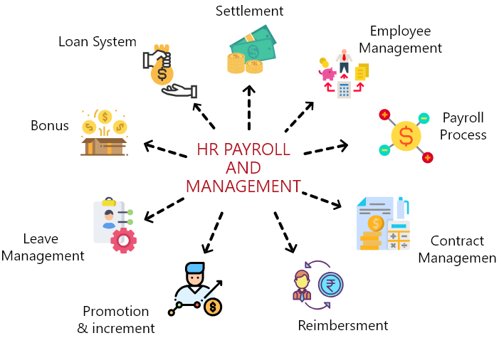
SYSTEM ARCHITECTURE

Slide 13
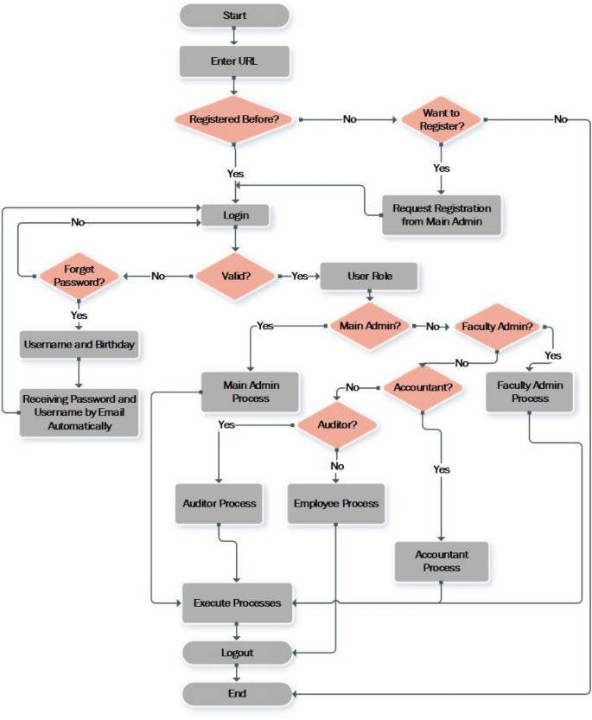
FLOWCHART

Slide 14
Modules:
Employee Management Module: Handles employee data, including personal details, job roles, compensation structures, and payroll history.
Payroll Processing Module: Calculates salaries, deductions, bonuses, taxes, and generates pay slips, ensuring accurate and timely payroll execution.
Tax and Compliance Module: Manages tax calculations, compliance with local and federal regulations, and generates necessary reports for regulatory bodies.
Reporting and Analytics Module: Provides insights through various reports and analytics on payroll expenses, employee compensation, and financial trends for better decision-making.

Slide 15
ADVANTAGES
Increased Accuracy
Time Efficiency
Regulatory Compliance
Enhanced Security
Scalability
Improved Reporting
Employee Self-Service
Integration Capabilities

Slide 16
LIMITATIONS
Costly Implementation and highly expensive.
Integrating with existing systems or third-party services can cause technical challenges and incur additional costs.
Online storage of payroll data increases vulnerability to breaches, requiring robust security measures.
Extensive training required, affecting productivity.
Disruptions from technical issues and outages.
Ongoing updates and support require additional expenses and dedicated resources.

Slide 17
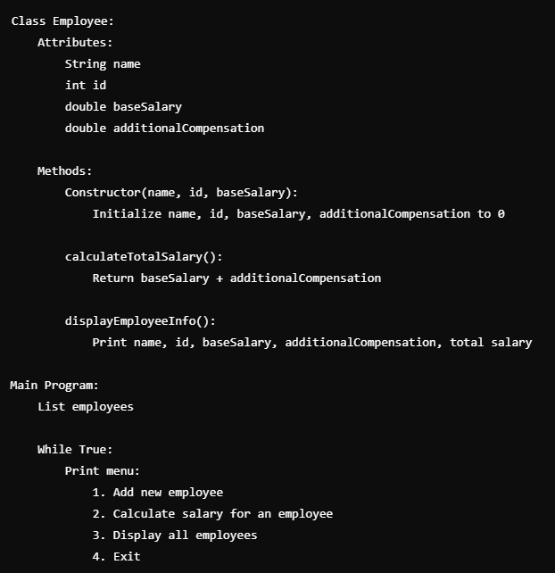
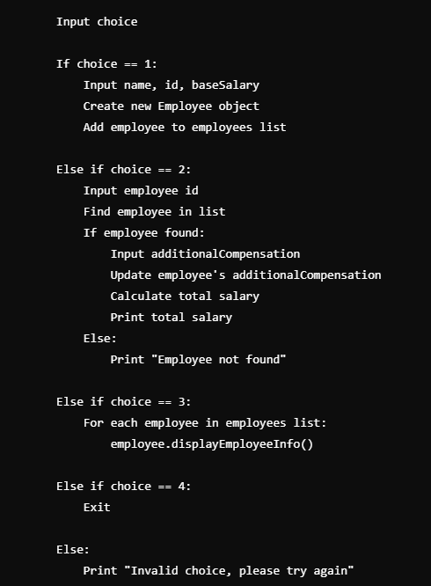

Slide 18
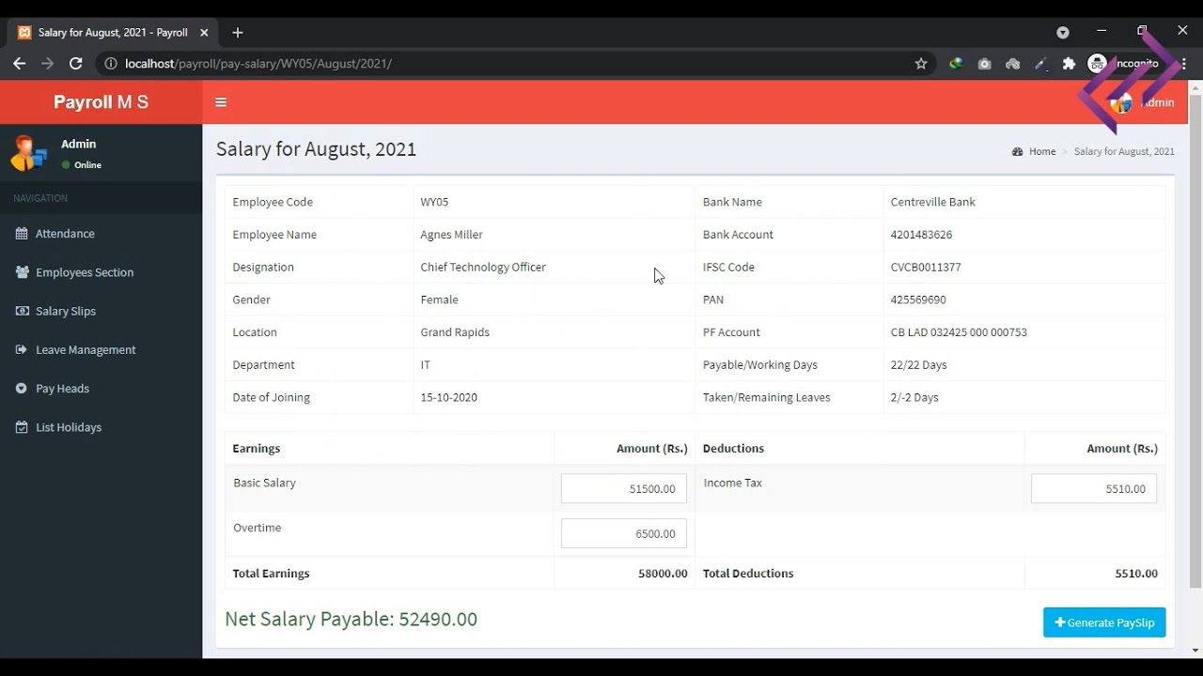
ADMIN PAGE

Slide 19
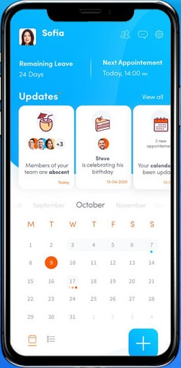
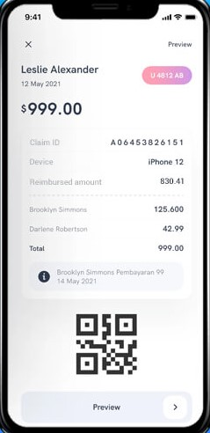
RESULTS
The first image Fig. 1 showcases the Home page of a Payroll management application. It provides users with a clear overview of their work and number of days to work. It enables users to calculate the amount they got for their work.
The second image Fig. 2 depicts the user-friendly interface for adding more information related to work, allowing users to remember the data and note the amount they earned. With customizable fields and efficient data entry features, users can maintain organized and up-to-date payment details and work.
Fig .1
Fig .2

Slide 20
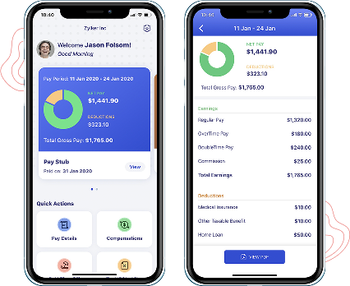
RESULTS
The third image Fig. 3 showcases the stats of the Payroll Management Application, make users to identify the amount of time and pay details. Additionally, users can compare with previous works and provides the some quick actions.
The fourth image Fig. 4 presents the work process from a set of days, in that It shows hours worked and amount you earned and also it shows the balance amount and work. It also shows the tax and other beneficiary details.
Fig .4
Fig .3

Slide 21
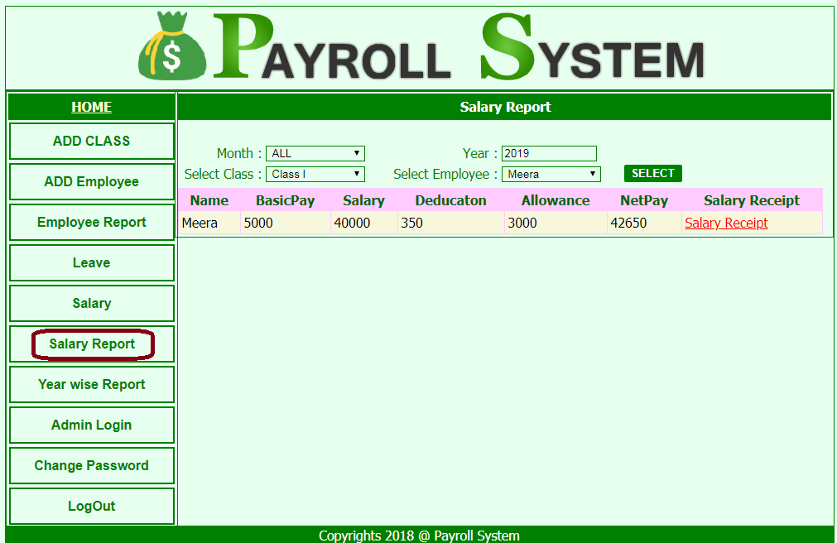
REAL TIME EXAMPLE

Slide 22
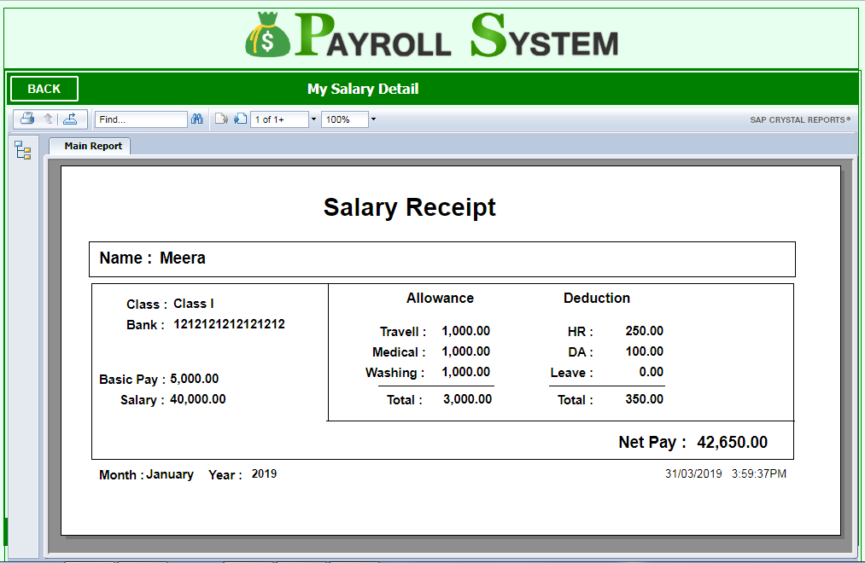

Slide 23
CONCLUSION
In conclusion, a modern payroll management system significantly enhances organizational efficiency by automating payroll processing, ensuring accuracy, and improving compliance with regulations. By integrating advanced technologies such as AI, blockchain, and advanced analytics, these systems offer secure, scalable, and innovative solutions tailored to both employee needs and business growth. Despite challenges like high initial costs and data security concerns, the ongoing evolution of payroll systems promises greater flexibility, enhanced reporting capabilities, and improved global compliance, making them a vital tool for businesses aiming to streamline operations and ensure accurate, timely compensation.

Slide 24
FUTURE SCOPE
The future of payroll management systems involves leveraging AI and machine learning for enhanced accuracy and efficiency.
Blockchain technology will provide secure and transparent payroll transactions. Advanced analytics will offer better financial forecasting and decision-making capabilities.
Personalized employee experiences will be created through tailored self-service features and benefits management.
Additionally, systems will expand to handle complex global compliance requirements and multi-currency processing.

Slide 25
REFERENCES
Abdulrazaq MB, Mustafa OM (2017) Designing and implementing of an online library management system. Sci J Univ Zakho 5(3):278–284
Jacksi K, Ibrahim F, Ali S (2018) Student attendance management system. Sch J Eng Technol SJET 6(2):49–53
Singh AV, Chaphekar SV, Sawant YS (2016) Automated payroll system (A-PAY). Int J Mod Trends Eng Res 3(2):548–553
Hikmah IN, Muqorobin M (2020) Employee payroll information system on company web-based consultant engineering services. Int J Comput Inf Syst IJCIS 1(2):27–30
Winanda A, Rizal A (2014) Salary information system (case study at Sme’s tiara handicraft). Brawijaya University, Malang

Slide 26


