Slide 1
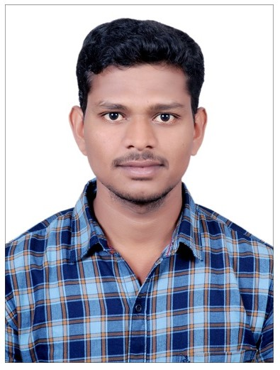
Saikumar Payasam
4+ years of experience in Java (Spring/Spring-Boot/Hibernate/JPA) Development. Highly analytical, Self-motivated Associate with ability to understand and build complex systems using innovative technical solutions. Involved in Development, delivery, security implementation, migration & adoption. Focuses relentlessly on removing impediments and delivering customer-centric products and features using Agile.
CONTACT
Experience Summary
Phone No: +91-9392421442
Email Id: saikumar.payasam@cognizant.com
Location: Bangalore
UTS and AIA CDIT-Engineering Migration-Hartford
Year 2023 – Till Now
Associate - Java Backend Developer
Designed a project with multi maven module base architecture with Spring boot, JPA and Oracle as a database.
Developed Microservices using the Spring Boot.
Involved in all Agile ceremonies and design functional document for development purpose.
Configured the backend application with Swagger.
GIT was used for project code tracking by creating branch Development, Test and Production.
Used Jenkin for Internal deployment
Security configuration changes were done for server level.
Mentored junior developers in best practices for development.
EDUCATION
Jawaharlal Nehru Technological University, Anantapur, AP 2013 – 2017
TECHNICAL SKILLS
Dealer Management System - Maruti
Year 2020 – 2023
Java/J2EE, Spring, Spring Boot, Hibernate, REST API, JPA, Streams, Collections.
Knowledge of Microservice
Databases –Oracle and SQL Server,
Agile – Scrum
Role - Java Backend Developer
Developed a project with Spring framework, Hibernate and Oracle as a database.
Integrating MSIL with Java project with libraries and implemented multiple functionalities using REST API’s.
Modified existing database and implemented store-procedure for report generation.
Migrated the application from Oracle ADF to Java and implemented form scheduler to fetch records from MSIL.
Provided the required changes at tomcat level for application security like Https, default port changes and to prevent like vulnerabilities attack like click jacking
OTHER SKILLS
Bajaj FinServ – Bajaj
Year 2019 – 2020
Problem solving, Time management, Critical Thinking, Communication and Interpersonal skills.
Role – Java Backend Developer
Application developed with Spring framework, Hibernate and Oracle as a database configuration.
Implement REST API to generate report for end user base on provided format in Excel and PDF files.
Implemented store-procedure for report generation.
Involved in requirement discussion with client
GIT, Jenkin was used for development server deployment and production deployment was done by accessing WinSCP and putty.

