Slide 1
Use case and POC - Content Moderator in Cognitive services.
Hema Sai Kumar Divvela

Slide 2
Agenda
About Me
Understand each AI and ML services in Azure and suggest some use cases.
Understand ARM templates
Use ARM templates to deploy service in Azure
Create Cognitive Service in azure
Monitoring for Content Moderator service
RBAC in Content Moderator
Network Security features for Content Moderator
Backup and Disaster Recovery plans for Content Moderator

Slide 3

About me
Name: Hema Sai Kumar Divvela(you can call me Sai)
Hometown: Chirala, Andhra Pradesh.
Education: I was graduated in the stream of CSE in Hindustan University, Chennai.
Interests: web development, Coding, drawing pictures and photography.
Hobbies: Browsing, playing games, cooking, reading books.
Languages known: Telugu, Hindi, English and Tamil.

Slide 4

ARTIFICIAL INTELLIGENCE It is an advanced technology by using that we can create intelligent machines which can behave like a human, think like humans, and able to make decisions. MACHINE LEARNING Machine Learning is an important element of AI. It gives computers the capability to learn without being explicitly programmed.
Task-1
Introduction to AI and ML services in Azure and sample use cases

Slide 5
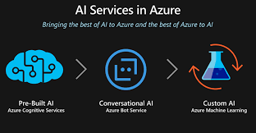
Task-1 continued...
AI and ML Services provided by Azure:
Bot services
Cognitive services
Genomics
Bonsai
Machine Learning Service

Slide 6
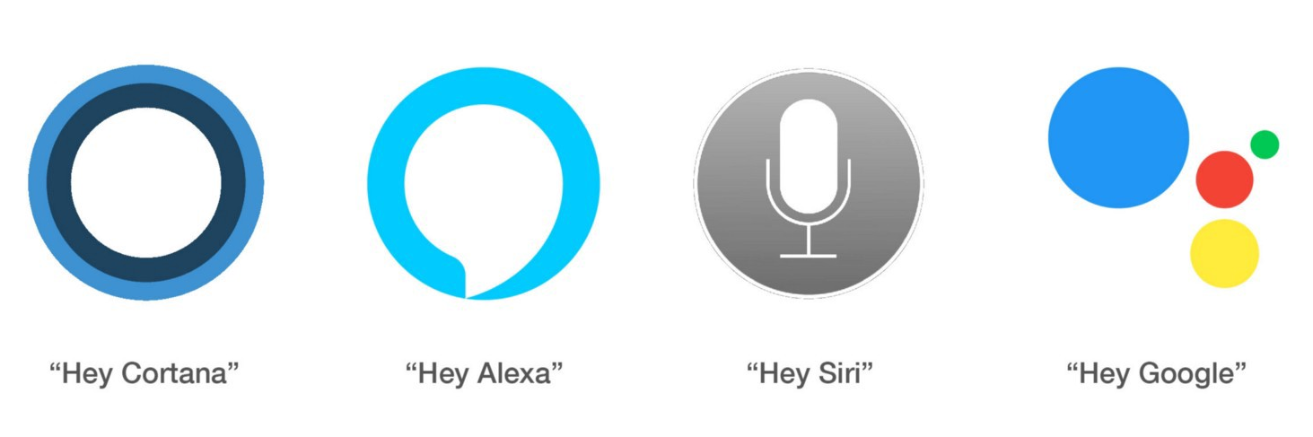

Task-1 continued...
Use Cases
Online Payment Fraud Detection
Predictive maintenance of Machines
Weather Predictions
Bot assistants
Email Spam and Malware Filtering
Search Engine Result Refining
Product Recommendations

Slide 7
Task-2
Understand ARM templates and create one sample template
What is ARM Template?
ARM Templates are a way to declare the objects you want, the types, names and properties in a JSON file which can be checked into source control and managed like any other code file.
{
"$schema": "https://schema.management.azure.com/schemas/2019-04-01/deploymentTemplate.json#",
"contentVersion": "1.0.0.0",
"parameters": {},
"functions": [],
"variables": {},
"resources": [],
"outputs": {}
}
We prepare one storage ARM Template in visual studio with some custom parameters and deployed storage account in Azure.

Slide 8
Task-3
Deploy Azure Content moderator using ARM template
Created an ARM template to deploy Content moderator using VS Code.
Save the template in the portal.
Deploy the template in the portal and provide all necessary inputs.
Required values in the arm template:
"type": "Microsoft.CognitiveServices/accounts",
"apiVersion": "2017-04-18",
"name": "[parameters('accountName')]",
"location": "East US",
"sku": {"name": "F0" },
"kind": "Content Moderator",
"properties": {"customSubDomainName":}

Slide 9
Create Cognitive Service in azure
Task-4
Cognitive services:
Decision - Make smarter decisions faster.
Language - Extract meaning from unstructured text.
Speech - Integrate speech processing into apps and services.
Vision - Identify and analyze content within images, videos and digital ink.
Search - Find what you’re looking for from the world-wide-web

Slide 10
API’s in azure cognitive services
Task-4 continued...
Decision | Anomaly detector
 | Content Moderator
 | Matrix Advisor (preview)
 | Personalize
Language | Translator
 | Text Analysis
 | QnA maker
Speech | Speech to text/text to speech, Speech translation
Vision | Computer vision
Web Search | Azure search/ bing search

Slide 11
How azure is offering cognitive services.
Task-4 continued…
Azure-Application program Interface(API).
Creating keys and endpoints.
Insert this azure API’s in our applications.
If we create any Application using C#, java, Python etc. In that we insert our API.
No need of AI knowledge and development is required.

Slide 12
Pricing tier
Task-4 continued…
Free(f0):
It is free in every region there is no region dependency for this tier. It calculates Transaction per second(TPS). In this tier, it calls 1 transaction per second.it has some limitation for transaction.
Standard(S0):
It is standard and not free, it is more moderate than free version. In this tier it calls 10 transactions per second and it has no limitations. It calculates and utilize pay as you go per each number of transactions.
The following prices given below for each no. of calls:
0-1M transactions - ₹66.097 per 1,000 transactions.
1M-5M transactions - ₹49.573 per 1,000 transactions.
5M-10M transactions - ₹39.658 per 1,000 transactions.
10M+ transactions - ₹26.439 per 1,000 transactions.

Slide 13
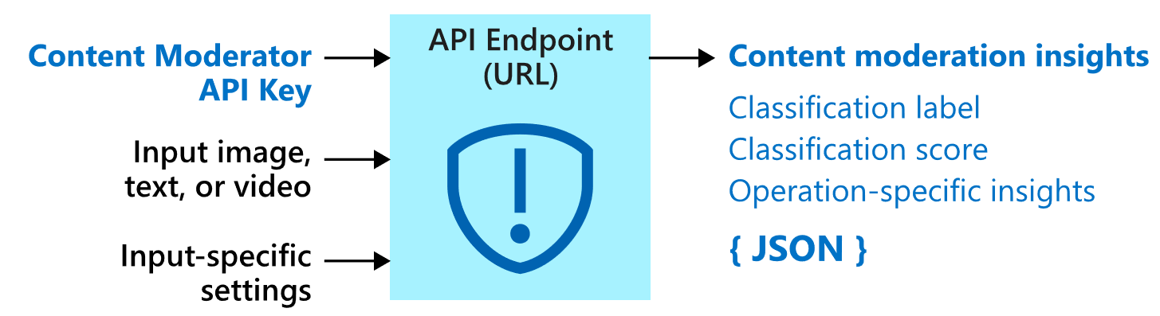
Azure Content moderator
Task-4 continued…
Azure Content Moderator is an AI service that lets you handle content that is potentially offensive, risky, or otherwise undesirable.
It includes the AI-powered content moderation service which scans text, image, and videos and applies content flags automatically.
As well as the Review tool, an online moderator environment for a team of human reviewers.

Slide 14
Monitoring the content Moderator in azure.
Task-5
To monitor the cognitive services, we have native azure monitor.
It costs and monitor according to the calls and we can see that in monitor section.
We can create one log analytical space and audit to the content moderator resource.
If needed, we connect storage and hub for streaming.
We have metrics to visualize the data in the monitoring section.
Can Manage Alerts in the Azure Monitoring.

Slide 15
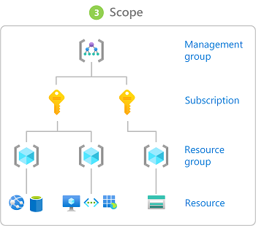
Role Based Access Control
Task-6
The way you control access to resources using Azure RBAC is to create role assignments.
A role assignment consists of three elements: security principal, role definition, and scope.
Security principle-User, Group, Service principle, Managed identity
Role definition- Owner, Contributor, Reader
Scope
We can create custom roles if we want in RBAC.

Slide 16
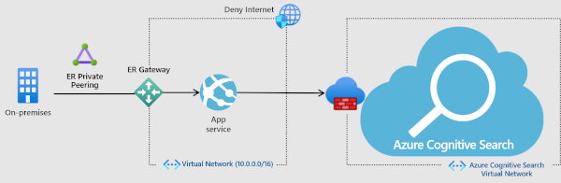
Network Security in Content Moderator
Task-7
Transport Layer Security (TLS)
Support TLS 1.2
To make the https call need to specify TLS1.2
as a part of the request.
Firewalls and virtual networks in azure
DDOS protection
Use private endpoints

Slide 17
Task-8
Backup and Disaster recovery solutions for Cognitive service
Backup:
We do not have backup for the Content Moderator.
But if we configure any application in the way of data processing storage, we can achieve backup in Content Moderator.
Disaster Recovery: To offer high availability, we can create two cognitive service accounts in two different locations. If one API is not active, it will call 2nd API. To achieve disaster recovery.
yes
Central us API
If API 1 is active
Application
West UK API
no

Slide 18
Task-8 continued…
Backup plan:
API call
Application
Users
processing data
processing data
Storage
Backup

Slide 19
Demo

Slide 20
Any Questions?

Slide 21
Thank you.

