Slide 1

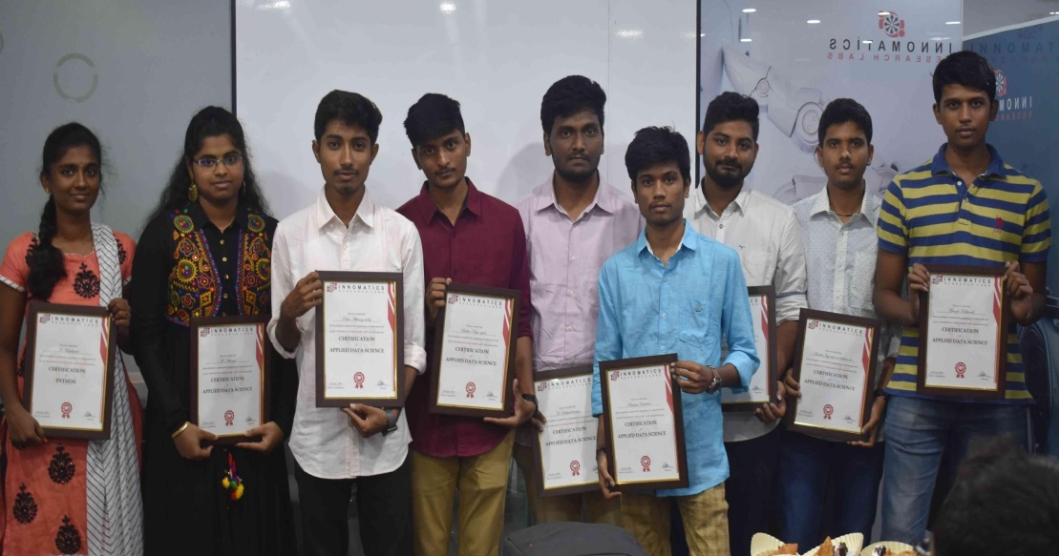
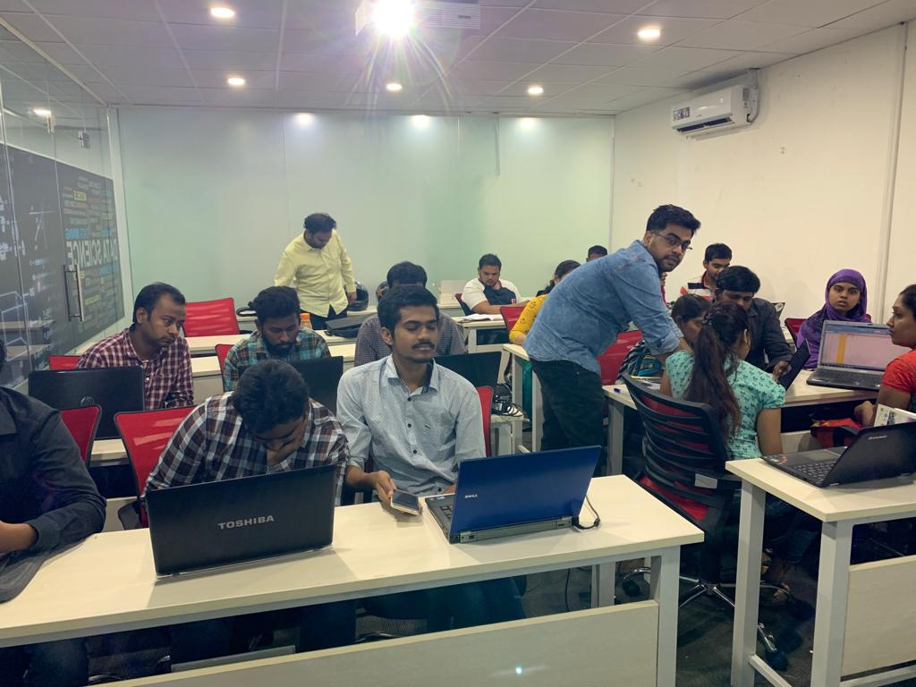

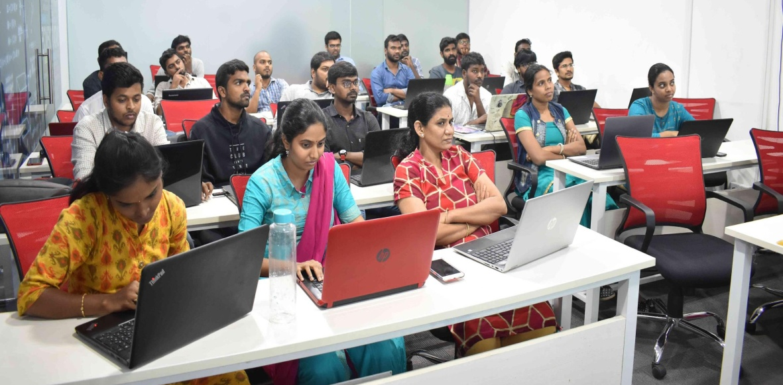
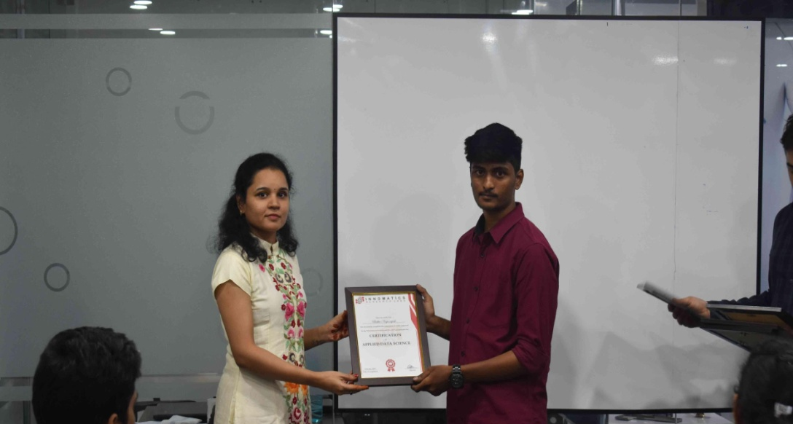
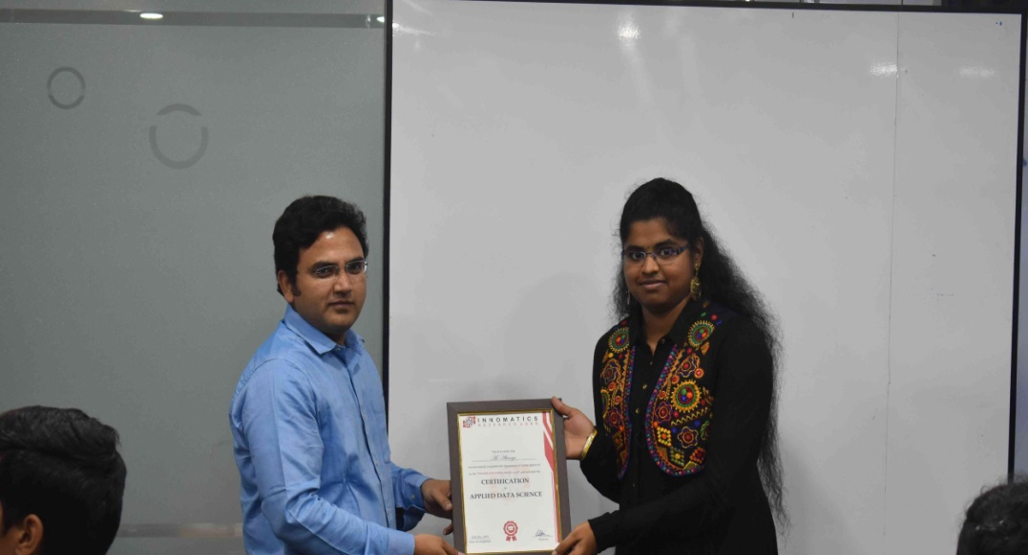

Slide 2
V Adithya Sai-IN30081 Param Choksi-IN30046 Aditya kumar-IN30121 Sadhula Saikumar-IN30149 Amardeep Honmane-IN30101

Slide 3
Music Recommender System
- Using Million Song Database

Slide 4
About me
Name - Amardeep Honmane
Qualification - BE(Comp. 3rd Year)
Why You Want To Learn Data Science -Data is the new oil and Data Science is the way of making
money out of it and off-course I like digging the data and knowing the unknowns.
Any work experience – I’m Fresher and looking for opportunity to get an experience.
What like you about Innomatics Research lab – I’m Very Thankful To Innomatics Research Lab For Giving Me Internship Opportunity. Teacher ( Kanav Bansal sir ) is very good at teaching and very Cooperative.

Slide 5
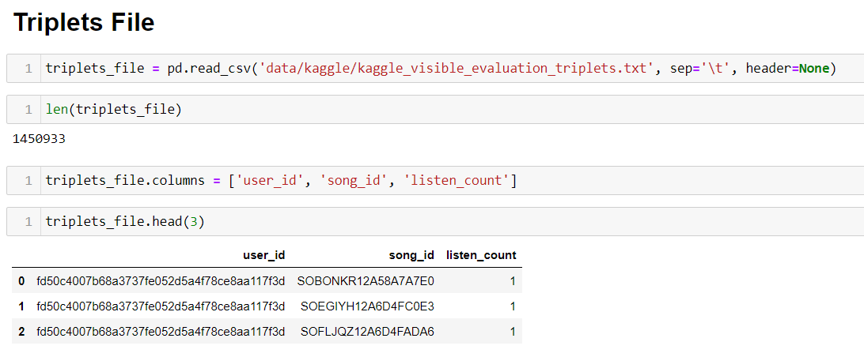
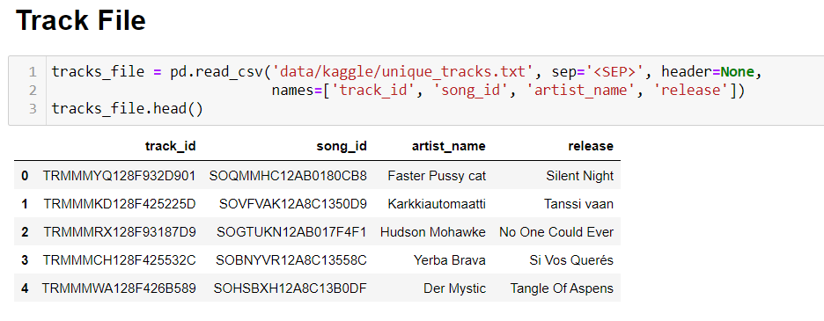
Importing dataset:
Triplets file contains the
Features user_id, song_id
And Listen frequency of
particular song
Track File contains the
Features track_id, song_id,
Artist_name and release

Slide 6
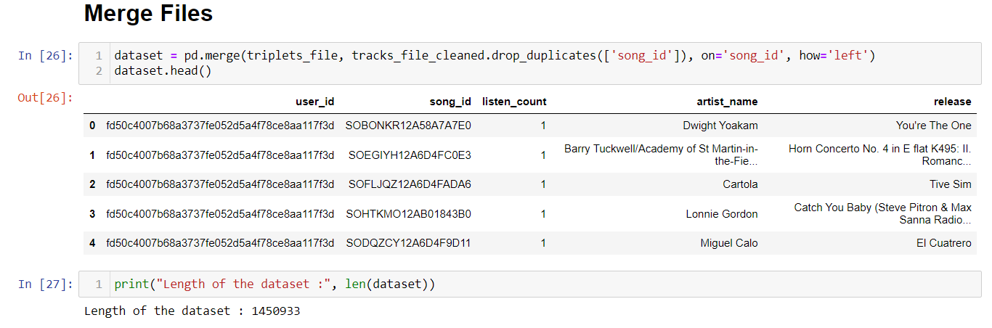
Combining the data:
Since we are having multiple datasets need to combine them, here we are combining triplets file and unique_track file. From the two files we got song_id column similar so selecting it as key column need to merge the datasets

Slide 7
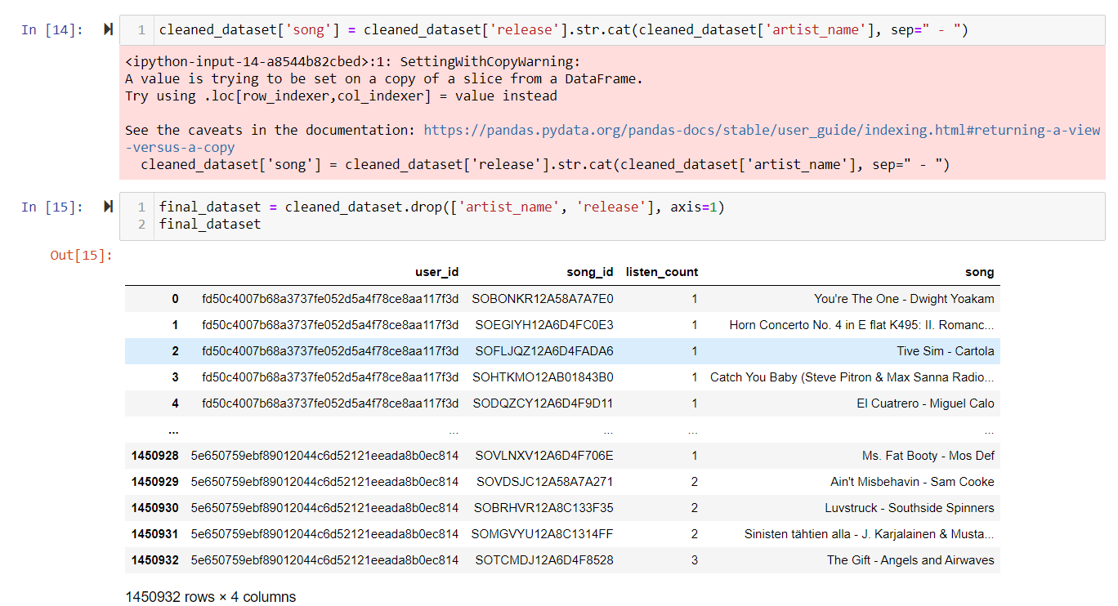
Creating New Column Based on the Existing Columns

Slide 8
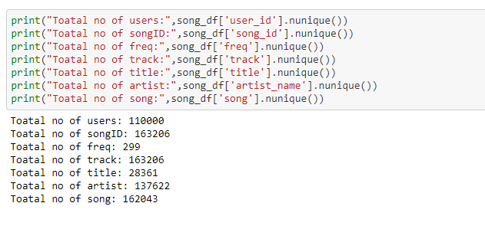
Basic statistics:

Slide 9
About me
Name - S Saikumar
Qualification - MSc(statistics)
Why You Want To Learn Data Science -Data Science Is A Good Option For Statistics Students
Any work experience – I’m Fresher
What like you about Innomatics Research lab –
I’m Very Thankful To Innomatics Research Lab For Giving Me Internship Opportunity.

Slide 10
Model Development
We have worked in three different Recommender Systems:
1. Popularity Based Recommender System
2. Content Based Filtering Recommender System
Model Developed using three different ways
A. using oops
b. using KNN
C. Pearson Correlation
3. Collaborative Based Recommender System
Model Here are of two types
A. Memory Based Model ( can be Developed Using Oops or Non Parametric Machine Learning
approaches like KNN)
B. Model Based Model

Slide 11
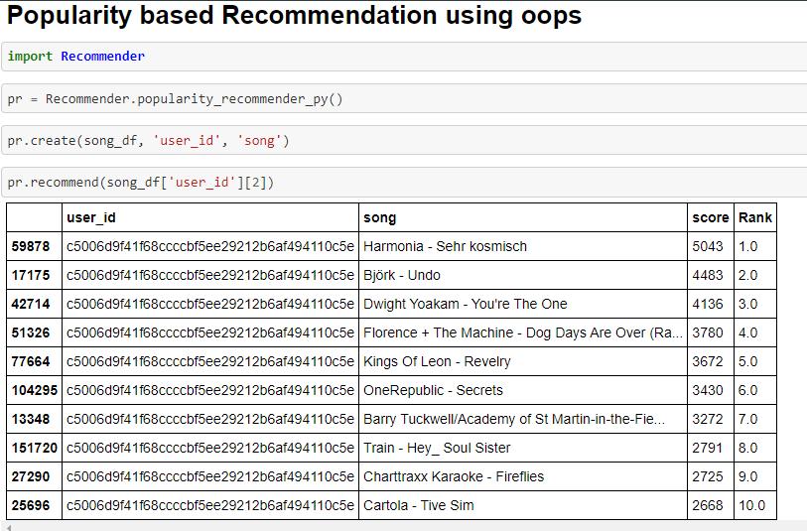
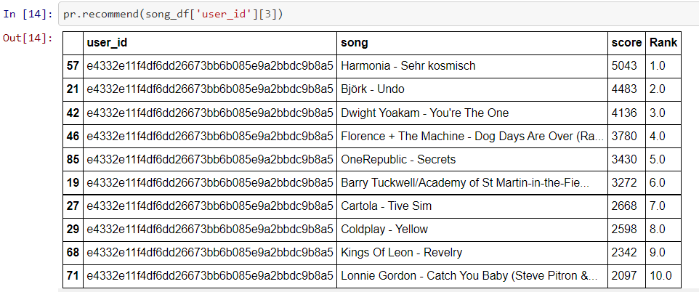
Popularity based Recommendation using oops
From Both The Images We Can See Irrespective To The User The Songs Recommended Were
Same and these were The popular songs so far according to the listen history

Slide 12
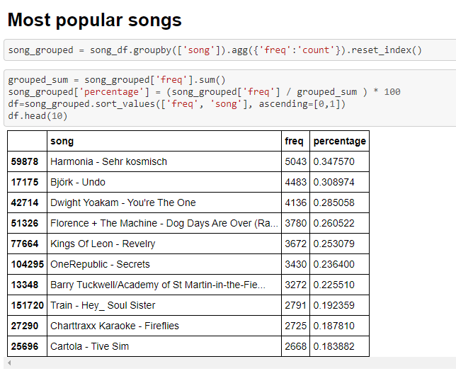
Popularity Based Recommendation System :

Slide 13
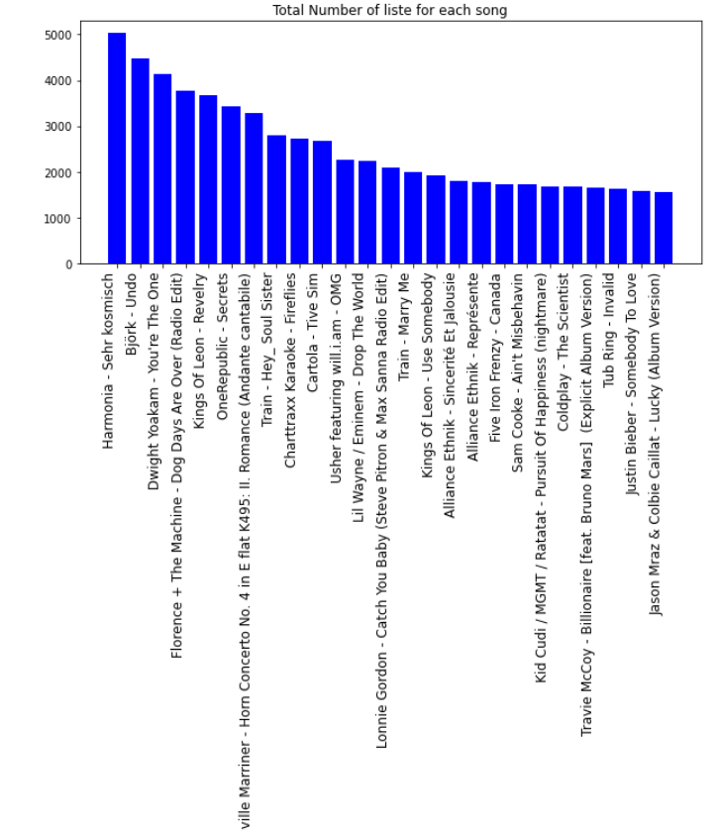
Plot Stating the Popularity of the song

Slide 14
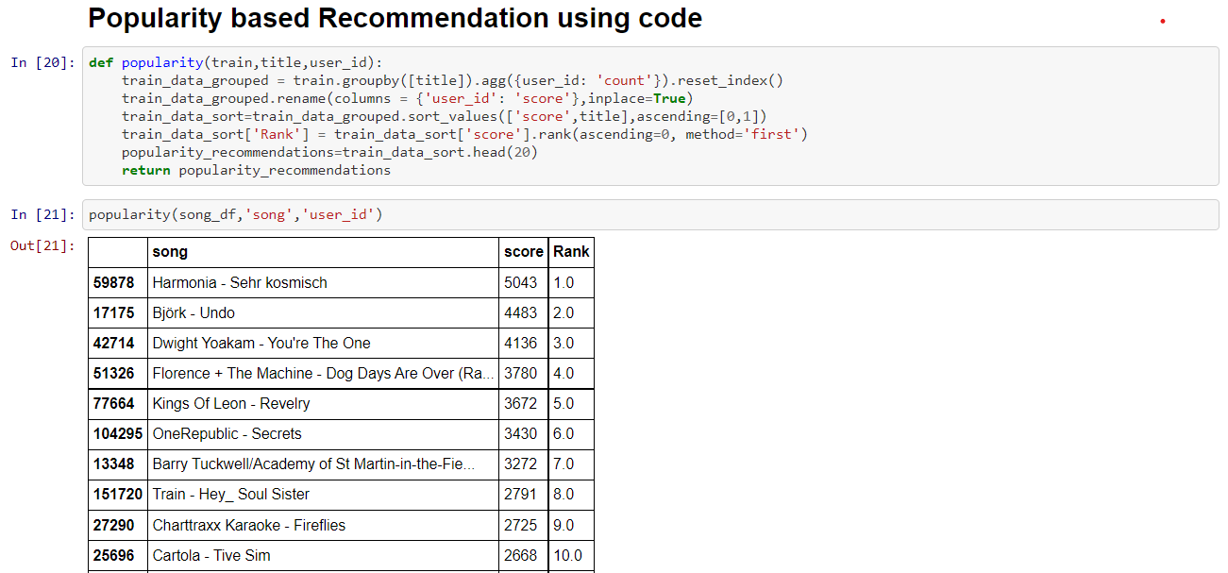
Popularity based Recommendation using code

Slide 15
About me
Name – Aditya Kumar
Qualification - B.Tech Final Year
Why You Want To Learn Data Science – Since Data Science Has Great opportunities in the future, to build my career in the future so I want to learn Data Science
Any work experience – I’m Fresher
What like you about Innomatics Research lab - I’m very thankful to Innomatics Research lab for giving me internship opportunity

Slide 16
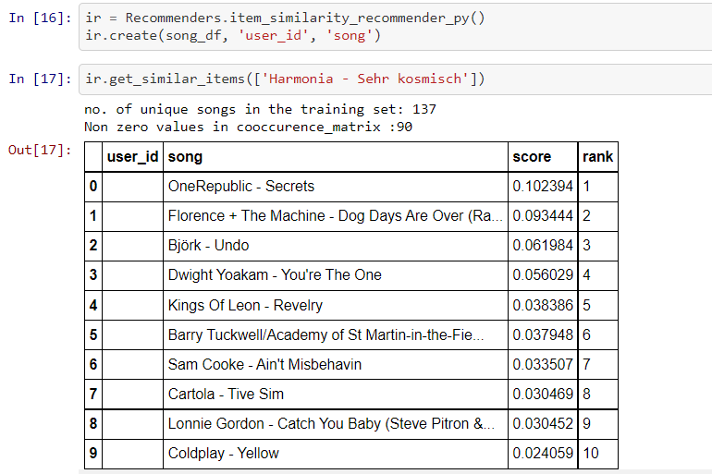
Content Based Filtering Recommender Systems using oops
We can see in content based filtering the
The recommendation is purely based on
The input Song.
It will just find the score for all the songs
With the input song and will recommend
The top songs related to the input song.

Slide 17
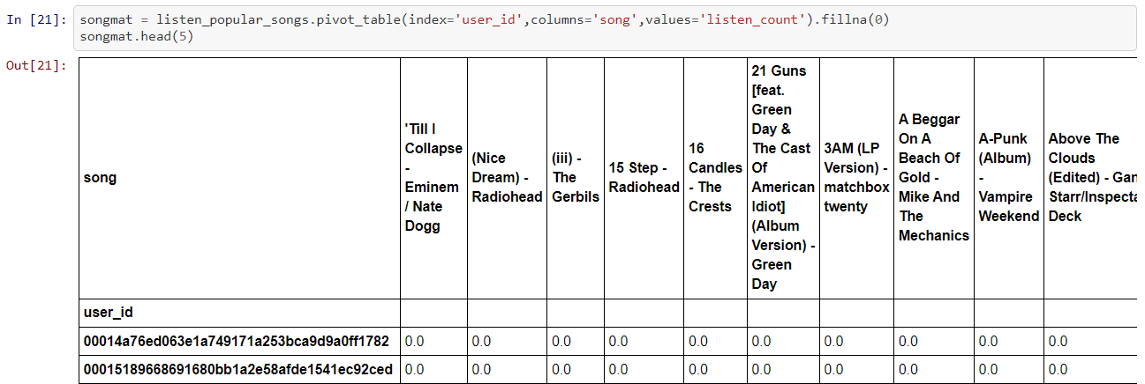
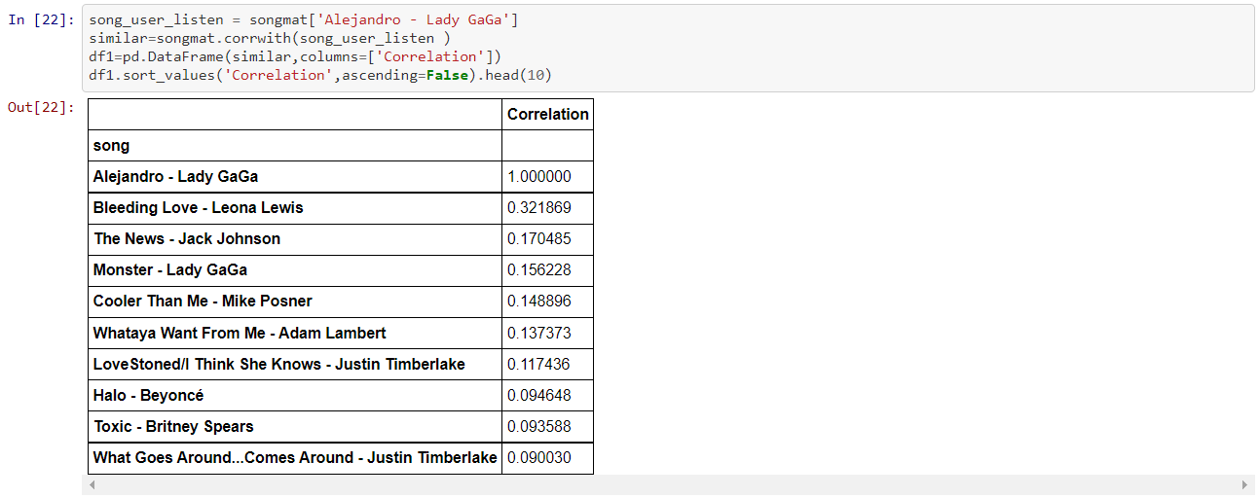
Content Filtering Based Recommender Systems using Pearson Correlation

Slide 18
About me
Name – Param Choksi
Qualification – BE - Computer Engineering (2021 Pass-out)
Why You Want To Learn Data Science – Before I started learning Data Science I didn’t know how data is useful. During the learning I realize that data is everywhere, In future also data will increase drastically and I got interest to explore more in this field. So I think I should learn this and be with the technology.
Any work experience – I’m Fresher and Looking for more experience.
What like you about Innomatics Research lab – I’m Very Thankful To Innomatics Research Lab For Giving Me Internship Opportunity. During the project I feel that I am working in some industry, every week we have to present project progress and getting some good suggestions to improve our work. I also learnt a team work in this internship and little better to my communication skill. All thanks to the Innomatics Research Lab and my Team.

Slide 19
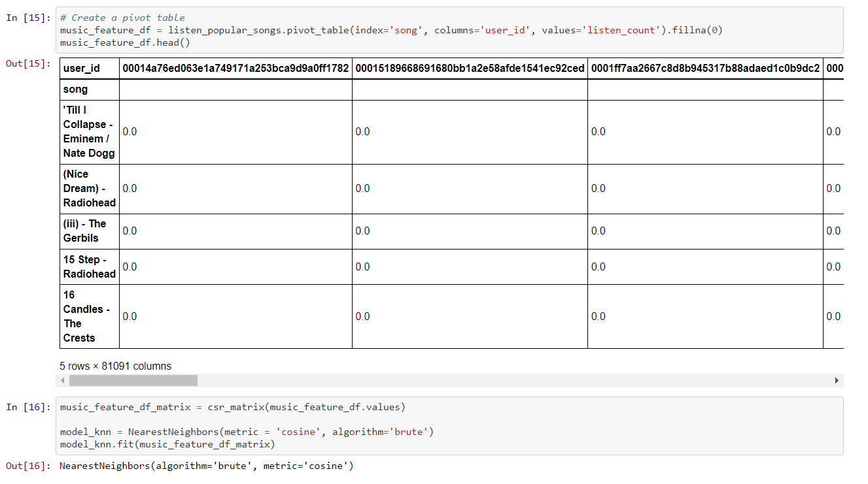
Content Filtering Based Recommender Systems using KNN

Slide 20
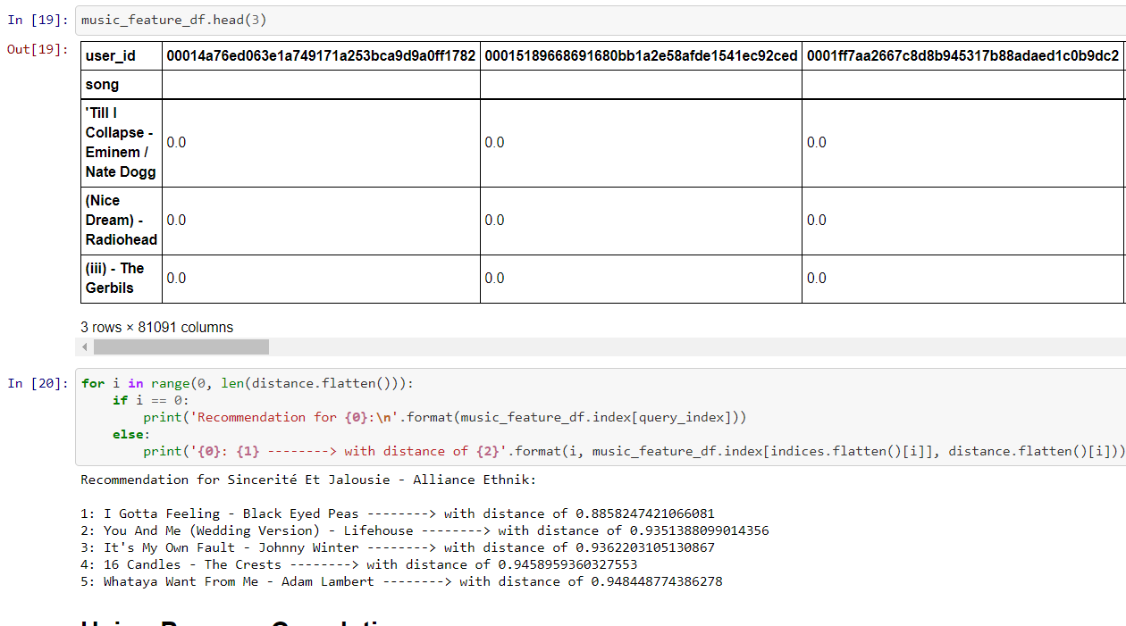
Result using KNN

Slide 21
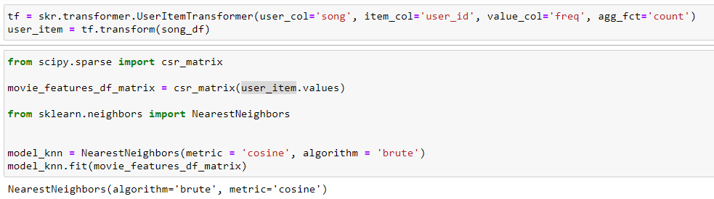
Content Filtering Based using sklearn_recommender library
import sklearn_recommender as skr

Slide 22
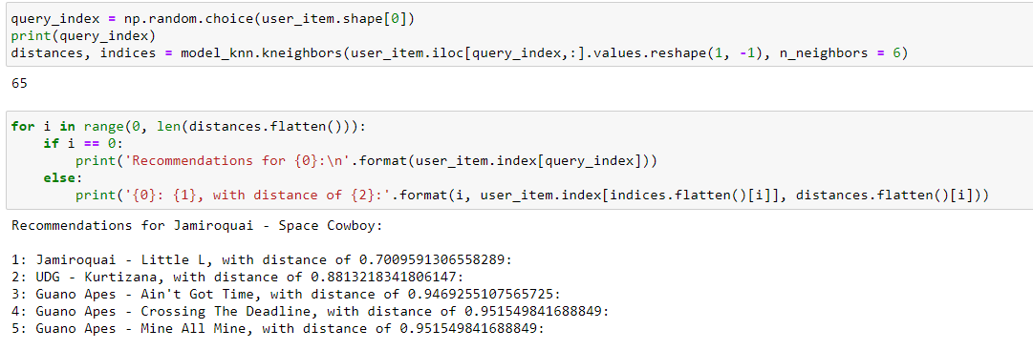
Result using sklearn library
Result form sklearn library

Slide 23
About me
Name - V Adithya Sai
Qualification - B.Tech Final Year
Why You Want To Learn Data Science –Since the future depends on data, there were plenty of Opportunities ahead to work, with considering this I feel to learn the technology related to handle this data and to build my career in the future. so I thought to learn Data Science.
Any work experience – I’m Fresher Looking for the opportunities
What like you about Innomatics Research lab - I’m very thankful to Innomatics Research lab for giving me internship opportunity and thanks to Kanav sir and my mentor Akhila mam for your help towards the program to gain the Knowledge.

Slide 24
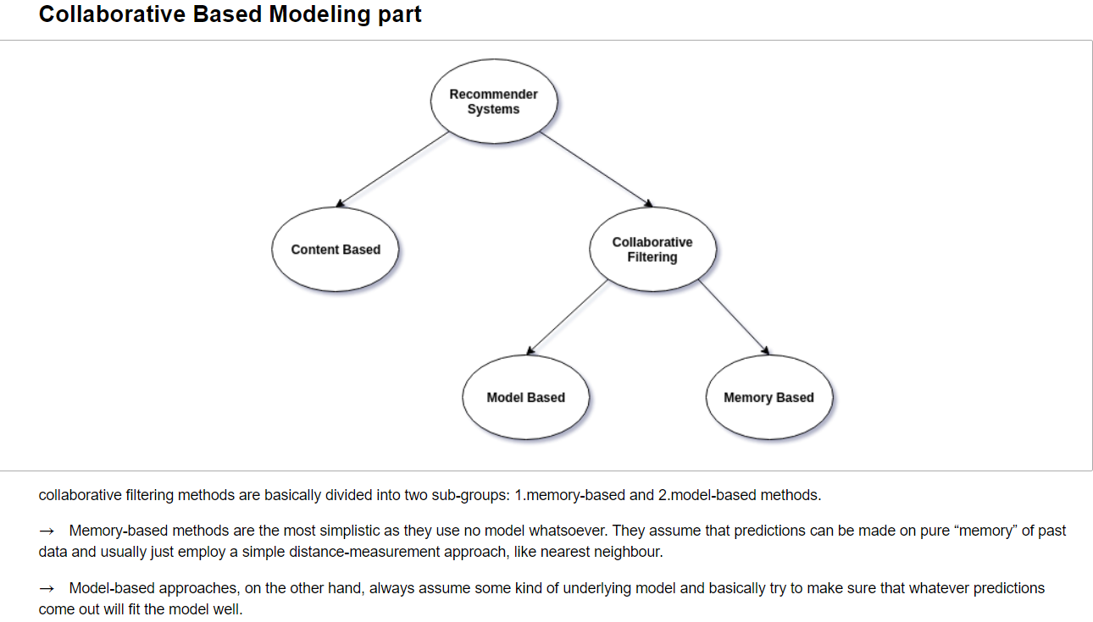
Collaborative Based Modelling Part

Slide 25
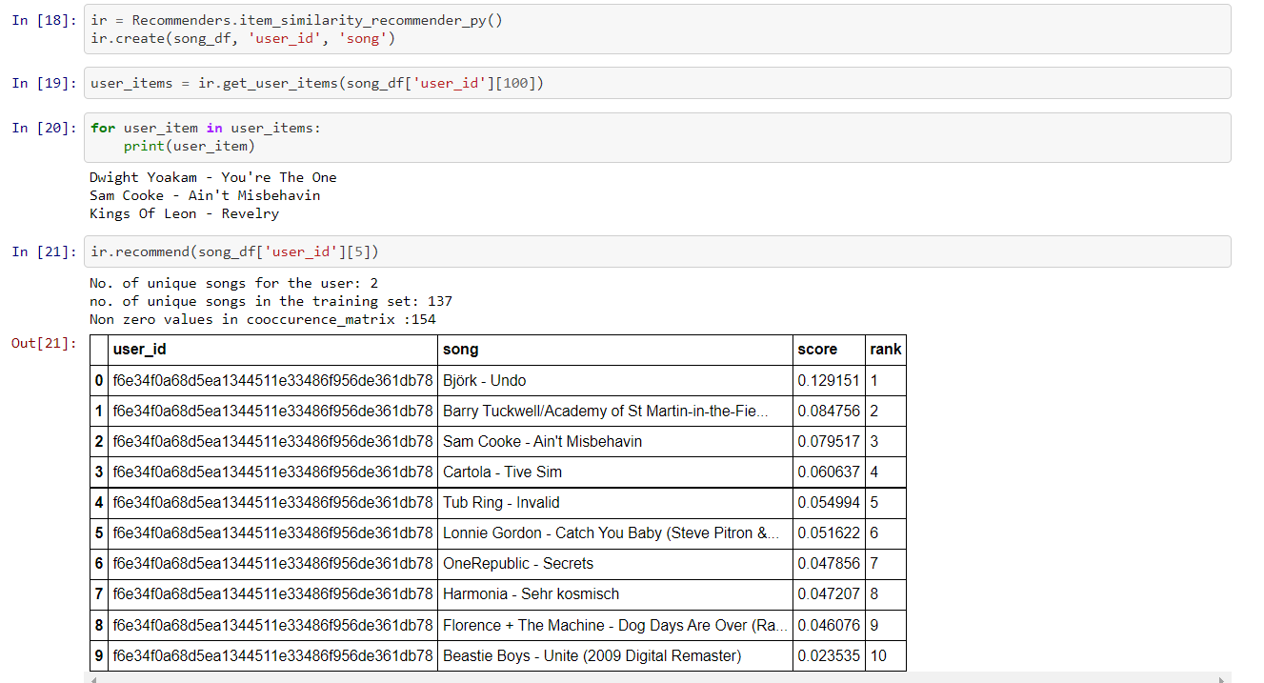
Collaborative Filtering Based Recommendation System - Memory Based Model

Slide 26
Insights and Future scope
Content-based filtering outperforms user collaborative filtering.
With content based approach you don’t need data about other users in order to make recommendations.
Demerits of collaborative filtering is that when a unique user has a unique taste, there might not be similar matches of other users.
The Future Scope Of this Project can be developed by integrating both collaborative and content based filtering.
Thus the Developed Model can able to recommend the songs to users based on user-user Similarity, Song-Song Similarity and User-Song Similarity which is more affective than the previous Models

Slide 27

THANK YOU

