Slide 1
SENTIMENT ANALYSIS ON PRODUCT & MOVIE REVIEWS
Final Project Review | Department of Computer Science & Engineering | [KL UNIVERSITY]
TEAM MEMBERS
Sravanth | 2420030079
Saikumar | 2420030077
Vishnu | 2420030110
GUIDE: DR N SUNANDA Academic year 2026-27
Notes:
Title slide. Replace all bracketed text. Use the full project title, list every team member with registration number, and name your guide. Insert the institution logo in the dashed box.

Slide 2



Introduction & Problem Statement
Examples: “Excellent picture quality!” → POSITIVE
“The battery stopped working.” → NEGATIVE
“The movie was okay.” → NEUTRAL (if supported by the dataset)
Background
Online reviews influence what people buy and which movies they watch. Sentiment analysis is an NLP technique that identifies opinions in text and classifies them as positive, negative or neutral.
Problem Statement
Reading thousands of reviews manually is slow and inconsistent. This project processes product and movie review text and predicts the sentiment of each review so that overall public opinion can be understood quickly.
Motivation / Need
Customers can compare opinions quickly, businesses can discover product issues, and movie teams can understand audience reactions. Automated analysis saves time and reduces the effort needed to summarise large review collections.
Notes:
State the domain, the exact problem and why it matters. Keep it to about 2 minutes. Add one real-world statistic if you can, with a citation.

Slide 3


Objectives & Scope
Objectives
1
Collect labelled product and movie reviews from suitable datasets.
2
Clean review text by handling missing entries, HTML, punctuation and duplicate records.
3
Convert text into numerical features using TF-IDF and train sentiment classification models.
4
Evaluate predictions using accuracy, precision, recall, F1-score and a confusion matrix.
Notes:
Objectives should be measurable and start with action verbs. The scope slide tells the panel what you did and did not attempt.

Slide 4

Literature Survey
S.No | Author(s) & Year | Method / Technique | Key Findings | Limitation / Gap
1 | Pang, Lee & Vaithyanathan (2002) | Naive Bayes, Maximum Entropy and SVM | Compared machine-learning methods for classifying movie-review sentiment. | Early benchmark; performance may vary on modern product reviews.
2 | Maas et al. (2011) | Unsupervised word vectors + supervised classifier | Introduced a widely used labelled IMDb movie-review dataset. | Movie-focused dataset; product-domain language differs.
3 | Liu (2012) | Opinion mining and sentiment-analysis survey | Explains sentiment classification, opinion extraction and common challenges. | Broad survey; does not evaluate this project’s combined workflow.
4 | Devlin et al. (2019) | BERT contextual language representations | Context-aware language representations can capture meaning beyond word counts. | Requires more computation and careful fine-tuning.
Research Gap
Research Gap: Many studies focus on one domain or one model. This project applies a consistent preprocessing and evaluation pipeline to product and movie reviews, compares traditional text-classification models, and highlights where domain vocabulary affects performance.
Notes:
Summarise four to six relevant papers or existing systems. End with the research gap, because that gap justifies your project.

Slide 5





Proposed System & Methodology
STEP 1
STEP 2
STEP 3
STEP 4
STEP 5
Define Problem
Collect Data
Design
Implement
Test & Evaluate
Define the task, sentiment labels, dataset scope and evaluation measures.
Use labelled product-review and movie-review datasets in CSV format. Record the dataset name, source URL, row count and label definitions actually used.
Choose Python, text cleaning, TF-IDF and classifiers such as Naive Bayes, Logistic Regression and Linear SVM.
Load data, clean reviews, split the data, train models, predict sentiment and display a summary.
Test on held-out reviews. Report accuracy, precision, recall, F1-score and a confusion matrix for each model.
Key Novelty / Contribution
The main contribution is a shared workflow for two review domains and a fair model comparison using the same evaluation metrics. The final model is selected from measured test results—not assumed in advance.
Notes:
Walk through the five steps left to right. Rename the steps to match your project (for example, Requirement Analysis, Design, Coding, Testing, Deployment). End with your novelty.

Slide 6
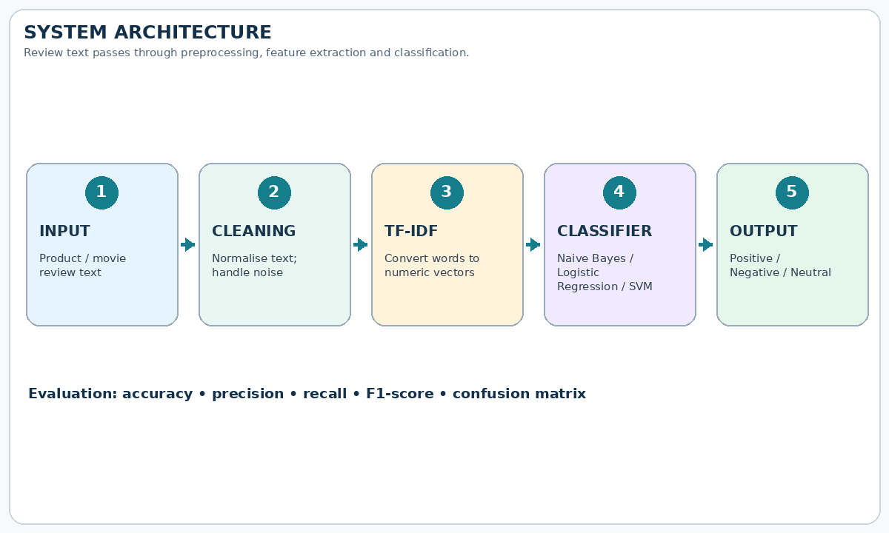
System Architecture
Components
1
1. Review Input
Accept a review typed by the user or loaded from a CSV dataset.
2
2. Text Preprocessing
Remove unwanted HTML/noise, standardise case and handle empty text consistently.
3
3. Feature Extraction
Use TF-IDF to convert cleaned words and word pairs into numeric features.
4
4. Prediction & Report
Classify each review and summarise counts or evaluation metrics for the dataset.
Notes:
Insert a clear block diagram: input, processing, storage, output. Number each block and explain them on the right. Redraw the figure yourself rather than copying it.

Slide 7


Hardware & Software Requirements
Hardware
Software & Tools
Libraries / Frameworks
Hardware
• Laptop or desktop computer
• 4 GB RAM minimum; 8 GB recommended
• Storage for CSV datasets and saved models
• Internet connection for downloading packages
• No special sensors or GPU required for baseline models
Software & Tools
• Windows or Linux
• Python 3.x
• Jupyter Notebook, Google Colab or VS Code
• Git / GitHub for version control (optional)
• CSV files for datasets
Libraries / Frameworks
• pandas and NumPy – data handling
• scikit-learn – TF-IDF, classifiers and metrics
• NLTK – optional text-processing tools
• Matplotlib – plots and confusion matrix
• Optional: Transformers for BERT-based experiments
Deployment / Platform: Google Colab or a local Python environment. A web interface can be added as a future enhancement.
Notes:
List only what you actually used, with versions. For a pure software project, shorten the hardware list and add cloud or deployment resources.

Slide 8
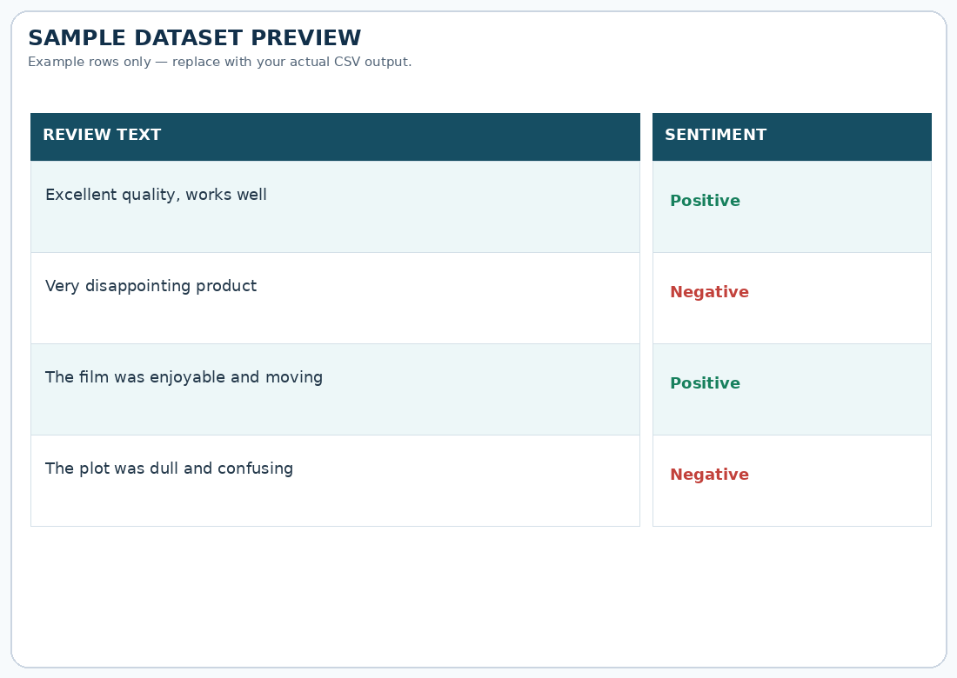
Dataset / Data Understanding
Dataset size
Enter the actual number of rows after loading your CSV.
Input features
Review text plus any available metadata such as rating or domain.
Records (rows)
Features (columns)
Missing values
Count missing or blank reviews after inspecting the real dataset.
2 sentiment classes
Positive and negative (use 3 only if neutral labels exist).
Missing values
Target classes
Source: Labelled IMDb movie-review dataset and a labelled product-review CSV. Add the exact dataset titles and URLs used.
Features: review text; target: sentiment label. Optional metadata: rating, product category or domain.
Quality checks: count rows, inspect missing/blank reviews, duplicates, label balance and text encoding. Do not report assumed row counts.
Notes:
Explain where the data came from and what it contains. Show a screenshot of the first rows or the info summary. For non-data projects, replace this slide with “Requirement Analysis” or “Input Specification”.

Slide 9
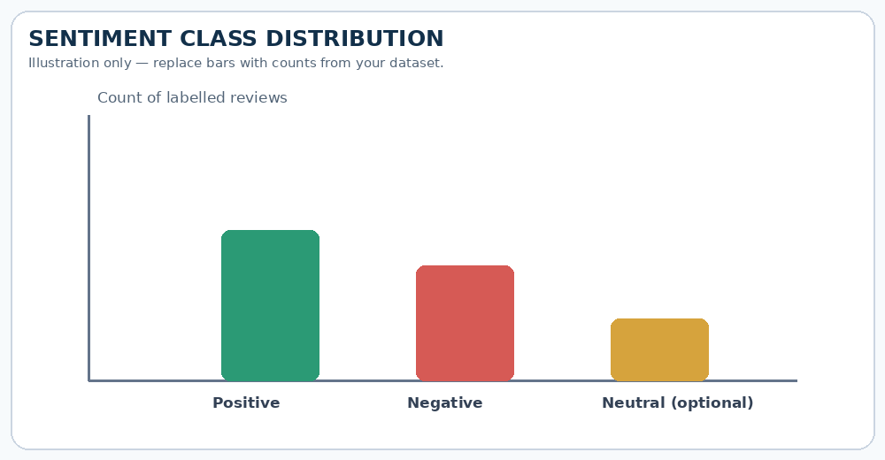
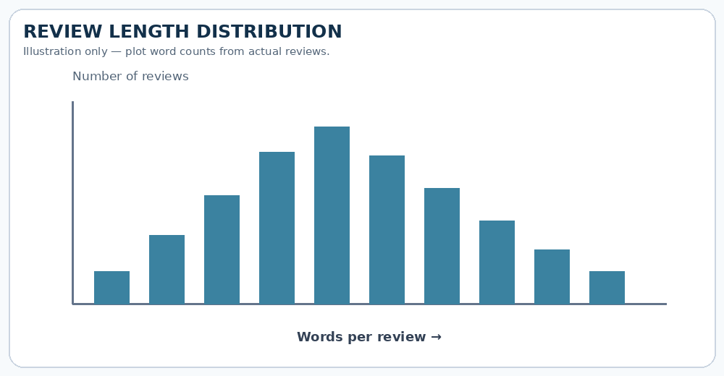



Data Preprocessing & Exploratory Analysis
Cleaning
Transformation
Feature Selection
Remove blank reviews; inspect duplicate rows; remove HTML tags and extra spaces; verify labels and keep a record of rows removed.
Convert text to lowercase and clean unwanted symbols. Tokenise as required. Apply the same cleaning rules to training and test text.
Use TF-IDF unigrams and bigrams as input features. Fit the vectoriser on training data only to avoid data leakage; report the final vocabulary size.
Notes:
Show two or three plots that tell a story: distributions, correlations, outliers. Explain what each plot told you and what you did about it.

Slide 10
Module-wise Description
1
Data Collection
2
Text Preprocessing
Purpose: Load datasets and check columns and labels.
Input → Output: CSV files → validated review table.
Owner: Sravanth
Purpose: Standardise text and handle blank or noisy reviews.
Input → Output: raw reviews → clean review text.
Owner: Saikumar
3
Feature Extraction & Training
4
Sentiment Prediction
Purpose: Convert text to TF-IDF vectors and train classifiers.
Input → Output: clean text + labels → trained models.
Owner: Vishnu
Purpose: Predict labels and calculate evaluation metrics.
Input → Output: unseen review → sentiment + report.
Owner: All team members
Notes:
Divide the project into three to five modules. For each, state its purpose, inputs, outputs and who built it. Duplicate a card if you have more modules.

Slide 11

Algorithms & Technologies Used
TF-IDF Vectorisation
Multinomial Naive Bayes
Logistic Regression
Why chosen: TF-IDF gives more weight to informative terms and down-weights very common words.
Key settings: ngram_range=(1,2); max_features and min_df tuned using training/validation data.
Why chosen: Multinomial Naive Bayes is fast and works well as a baseline for sparse word-count/TF-IDF features.
Key settings: smoothing parameter alpha; tune on validation data.
Why chosen: Logistic Regression is a strong, interpretable linear classifier for high-dimensional text.
Key settings: regularisation C, max_iter and class_weight if needed; tune on validation data.
Selection criteria: Compare validation F1-score and accuracy, then check precision/recall, inference speed and simplicity. Use the same split for each model and report measured results only.
Notes:
Name each model, algorithm or technology, say why you chose it, and list the key settings. Then explain how you picked the final one.

Slide 12
Implementation / Model Building
Feature Selection
Code snippet / pseudocode
Input: review text. Target: sentiment label. Remove identifiers or metadata that do not belong in the model input.
X_train, X_test, y_train, y_test = train_test_split(
reviews, labels, test_size=0.2,
stratify=labels, random_state=42)
# Convert text to TF-IDF and train a model
model = Pipeline([
("tfidf", TfidfVectorizer(ngram_range=(1, 2)),),
("classifier", LogisticRegression(max_iter=1000))
])
model.fit(X_train, y_train)
# Predict the test reviews
predictions = model.predict(X_test)
Preprocessing Pipeline
Clean text → split into train/test sets → fit TF-IDF on training text → transform both sets → train model → predict test labels.
Data Splitting
Recommended starting point: 80% training and 20% testing with stratification. Record the actual row counts and use validation/cross-validation for tuning.
Configuration
Use a fixed random_state for reproducibility. Tune model settings only on training/validation data; do not use test data to select parameters.
Notes:
Describe the build in the order you did it. Paste only the most important code or pseudocode, not entire files. For hardware projects, show the circuit or wiring summary instead.

Slide 13
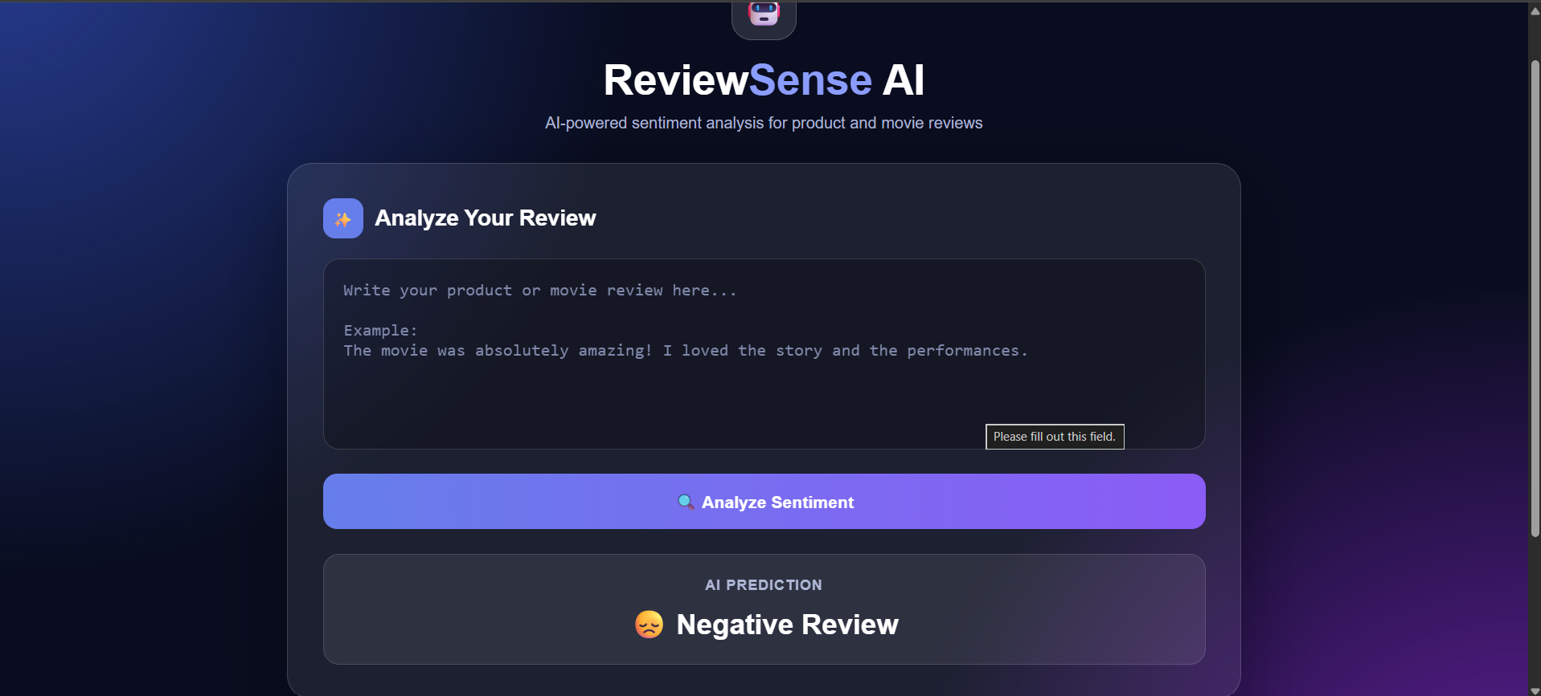
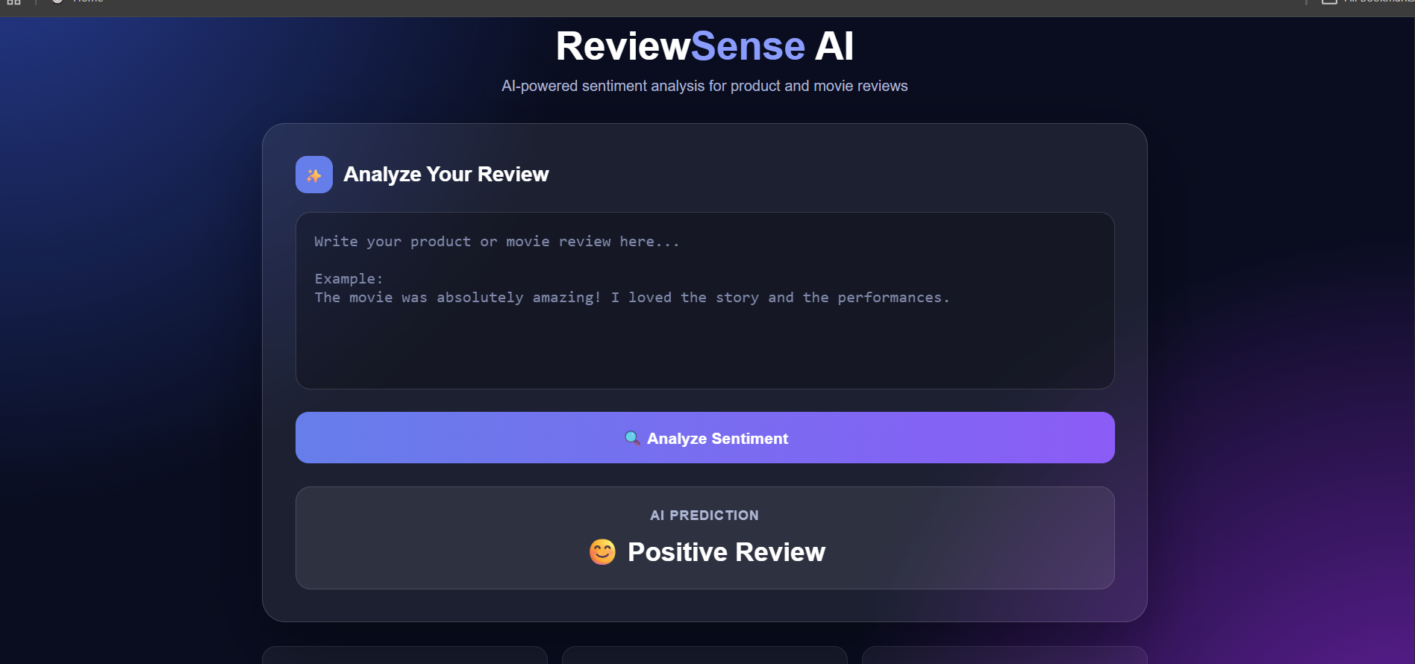
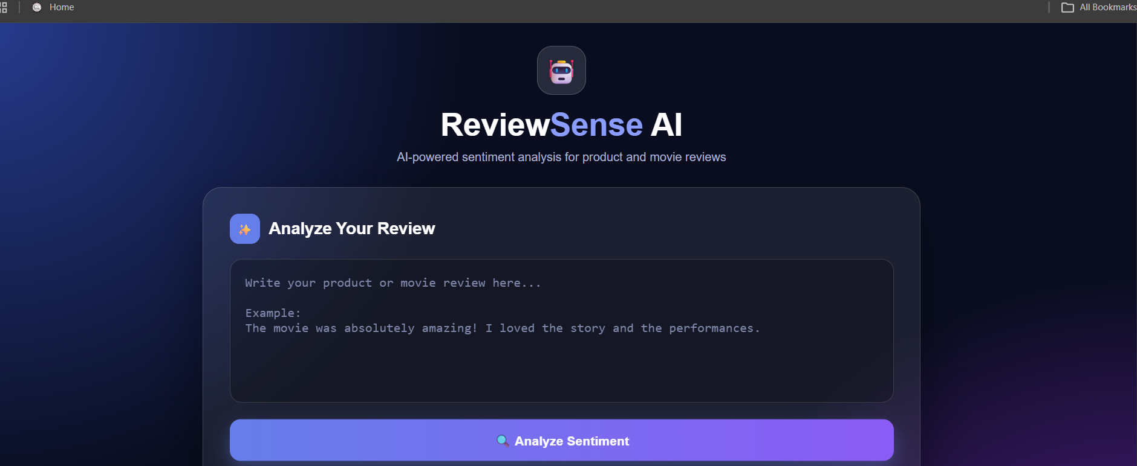
Working Prototype / Output Screens
Notes:
Show real screenshots, photos of the hardware or a short demo video link. Caption each one with what the viewer should notice.

Slide 14
Results & Performance Comparison
Metric | Naive Bayes | Logistic Reg. | Linear SVM
Accuracy | Measure | Measure | Measure
Precision | Measure | Measure | Measure
Recall | Measure | Measure | Measure
F1-score | Measure | Measure | Measure
ROC-AUC | Optional | Optional | Optional
Best model: To be determined from the actual test results. Compare F1-score and accuracy, and inspect precision/recall before selecting the final model.
No experiment results were provided with the template. Run the models and replace “Measure” with the actual scores. Do not present illustrative numbers as measured results.
Notes:
Right-click the chart and choose Edit Data to enter your real numbers. Replace the metrics with the ones that fit your project (accuracy, latency, power, throughput, user rating). State clearly which option performed best.

Slide 15
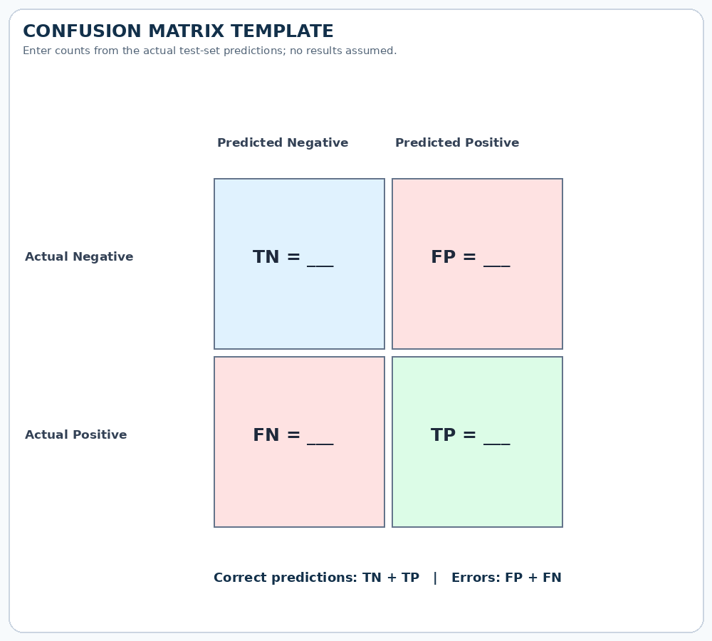
Analysis & Key Findings
TBD
Actual test accuracy: calculate after model evaluation; do not enter an estimated percentage.
Interpretation: Identify which sentiment class is predicted most accurately.
Error analysis: Inspect misclassified reviews, sarcasm, mixed opinions, slang and domain-specific terms.
Key drivers: Review words and phrases represented by TF-IDF features; do not claim feature importance without analysis.
Notes:
Explain what the numbers mean. Use a confusion matrix, ROC curve, feature-importance chart or output comparison. Be honest about weak results; panels value that.

Slide 16

Testing & Validation
Test ID | Test Description | Expected Result | Actual Result | Status
TC-01 | Positive review input | Positive label | Run and record output | Pending
TC-02 | Negative review input | Negative label | Run and record output | Pending
TC-03 | Empty review input | Clear validation message | Run and record output | Pending
TC-04 | CSV batch input | One prediction per valid row | Run and verify row count | Pending
Functional Testing
Validation Method
Performance Testing
Test single reviews, empty input, unknown words and CSV batch uploads. Confirm the application handles each case without crashing.
Use a stratified held-out test set. Optionally apply cross-validation to the training set for a more stable model comparison.
Measure accuracy and F1-score; record prediction time; rerun tests with a fixed configuration to check reproducibility.
Notes:
List representative test cases with expected and actual outcomes. Name the validation methods you used. Delete rows you do not need.

Slide 17


Challenges & Limitations
Challenges Faced
Limitations
1. Noisy text → remove HTML, extra spaces and unwanted symbols.
2. Domain-specific vocabulary → evaluate product and movie reviews separately as well as together.
3. Uneven class counts → inspect label balance and consider stratified splitting or class weights.
1. Sarcasm and context may be misclassified by word-based models.
2. Results depend on dataset size, quality and label definitions.
3. English or limited-domain data may not generalise to other languages, products or movie genres.
Notes:
Be candid. Pair every challenge with how you solved it, and list limitations that the panel would otherwise spot themselves.

Slide 18

Conclusion
The project defines an NLP workflow that reads labelled product and movie reviews and predicts their sentiment.
1
Final Outcome
The pipeline includes text cleaning, TF-IDF feature extraction, model training and evaluation using held-out data.
To be measured
2
Actual metric: add test accuracy/F1-score after running the model.
Objectives achieved: confirm after testing and documenting results.
The system can speed up review analysis and provide a quick overview of customer and audience opinion once validated on real data.
3
Notes:
Revisit each objective and say whether you met it. Quote your headline result with numbers. Do not introduce new material here.

Slide 19



Future Scope & Applications
Improve Performance
Tune vectoriser and classifier parameters; compare linear models with a transformer model if resources allow.
Applications
Applications
• Product feedback and quality analysis
• Movie audience opinion summaries
• Customer-support trend monitoring
Users: shoppers, sellers, review platforms and movie analysts.
Expand Data / Features
Add more products, movie genres, recent reviews and additional languages with reliable labels.
Deploy & Build an Interface
Create a simple web page for entering one review or uploading a CSV for batch predictions.
Scale & Secure
Monitor prediction quality, document model limitations and avoid collecting unnecessary personal data.
Notes:
Give concrete next steps, ideally tied to the limitations. Then name two or three real-world uses.

Slide 20
Team Contribution
Reg. No. | Name | Contribution / Modules Handled
2420030079 | Sravanth | Dataset collection, data inspection and literature survey
2420030077 | Saikumar | Text cleaning, preprocessing and exploratory analysis
2420030110 | Vishnu | TF-IDF features, classifier training and model comparison
— | All Members | Integration, final testing and presentation (shared)
Notes:
Show that work was planned and shared. Every member should be able to explain their own module.

Slide 21

References
[1] B. Pang, L. Lee, and S. Vaithyanathan, “Thumbs up? Sentiment Classification Using Machine Learning Techniques,” Proceedings of EMNLP, 2002.
[2] A. L. Maas et al., “Learning Word Vectors for Sentiment Analysis,” Proceedings of ACL, 2011.
[3] B. Liu, Sentiment Analysis and Opinion Mining, Morgan & Claypool, 2012.
[4] J. Devlin et al., “BERT: Pre-training of Deep Bidirectional Transformers for Language Understanding,” NAACL-HLT, 2019.
[5] scikit-learn documentation: https://scikit-learn.org/stable/
[6] Add the exact URLs and access dates for the datasets used.
Project Links
GitHub: Add repository URL if created.
Dataset: Add the exact product-review and movie-review dataset URLs.
Demo video: Add a link after recording the working prototype.
Notes:
Use IEEE style, numbered in order of first citation in the deck. Include datasets, documentation and code repositories.

Slide 22
CLEAR PYTHON CODE — DATA & MODEL
Part 1 of 2 | Load labelled reviews, clean empty rows, split data, and build the model pipeline.
# 1. Install libraries (run once in terminal / Colab)
# pip install pandas scikit-learn
import pandas as pd
from sklearn.model_selection import train_test_split
from sklearn.pipeline import Pipeline
from sklearn.feature_extraction.text import TfidfVectorizer
from sklearn.linear_model import LogisticRegression
# 2. CSV must contain columns: review, sentiment
# Example sentiment labels: positive, negative (and neutral if available)
data = pd.read_csv("reviews.csv")
data = data[["review", "sentiment"]].dropna()
data["review"] = data["review"].astype(str).str.strip()
data = data[data["review"] != ""]
reviews = data["review"]
labels = data["sentiment"].astype(str).str.lower()
# 3. Split data: 80% train, 20% test
X_train, X_test, y_train, y_test = train_test_split(
reviews, labels, test_size=0.2,
random_state=42, stratify=labels
)
# 4. Build TF-IDF + Logistic Regression pipeline
model = Pipeline([
("tfidf", TfidfVectorizer(ngram_range=(1, 2),
max_features=20000)),
("classifier", LogisticRegression(max_iter=1000))
])
CSV format example: review,sentiment | “Great quality”,positive | “Stopped working”,negative

Slide 23
CLEAR PYTHON CODE — TRAIN, TEST & PREDICT
Part 2 of 2 | Train the model, print real evaluation metrics, and predict a new review.
# 5. Train the model
model.fit(X_train, y_train)
# 6. Evaluate on reviews the model has not seen
from sklearn.metrics import accuracy_score, classification_report
from sklearn.metrics import confusion_matrix
predictions = model.predict(X_test)
print("Accuracy:", round(accuracy_score(y_test, predictions), 4))
print("\nClassification report:")
print(classification_report(y_test, predictions, zero_division=0))
print("Confusion matrix:")
print(confusion_matrix(y_test, predictions))
# 7. Predict the sentiment of a new review
new_review = ["The product works well and quality is excellent."]
result = model.predict(new_review)[0]
print("Review:", new_review[0])
print("Predicted sentiment:", result)
# Optional: save the trained pipeline for later use
import joblib
joblib.dump(model, "sentiment_model.joblib")
# IMPORTANT:
# Use the actual path and column names in your CSV.
# Scores printed by this program are your real test results.
Change reviews.csv to your dataset filename. The CSV needs review and sentiment columns, or update the code to match your column names.

Slide 24
THANK YOU
Questions & Discussion
Dr . N. Sunanda
Associate Professor
Department of CSE
Notes:
Leave this slide up during questions. Make sure every team member can answer questions about their own module.

