Slide 1
PROJECT TITLE: AI Farming Revolution and Machine Learning Approaches to Government Schemes and Subsidies
PIP104 University Project
Final Review
Batch Number: CBD-G 2
Student Name | Roll Number
Saikumar B Ganesh K Srinivas P Sai Pallavi Y | 20211CBD0009 20211CBD0005 20211CBD0019 20211CBD0055
Under the Supervision of,
Dr. M Swapna
Associate Professor
School of Computer Science and Engineering
Presidency University

Slide 2
Content
Introduction
Literature Review
Objectives
Methodology
Timeline of the project
Expected Outcomes
Results
Conclusion
References

Slide 3
Introduction
Problem Description:
Lack of Awareness Among Farmers
Complex Application Processes
Scattered Program Information
Missed Opportunities for Financial Support
Hindrance to Agricultural Growth

Slide 4
Github Link
Github Link: https://github.com/saikumarb12345/FarmGov

Slide 5
Literature Review
For the development of this model, we studied some previous research papers.
Paper[1]
Describes a system that uses ICTs, and it is an android-based solution. The system supports a variety of features like updates of weather, news and different agricultural commodities but local language support is missing in this system. The system described is developed by considering farmers from different states who may be illiterate. The base paper of this system is again Android based Solution for Indian Agriculture. This system tried to solve the complex interface problem that was there in the previous paper.

Slide 6
Literature Review
Paper [2]
Provides a user-friendly iconic interface. However, the system failed to provide multiple local language support and only a large screen interface is available in the system; a small screen interface is missing. The system in the paper provides information of crop rates in local as well as distant markets. The system also provides weather forecasting information.

Slide 7
Literature Review
Paper[3]
Web serves as a centralized hub, offering a wide range of features to support farmers in various aspects of their agricultural endeavors. The key functionality of this web includes real-time weather updates, market prices, crop management and livestock information, planting & harvesting calendar info about fertilizers & pesticides.

Slide 8
Paper[4]
According to the survey, agribusiness has greatly boosted its usage of e-commerce and mobile commerce in recent years. Farmers are selling their goods directly to customers using e-commerce and mobile commerce platforms, which has increased their revenues and decreased their reliance on middlemen. Drawback: Not authorized services of traders found.

Slide 9
Paper[5]
To address the challenges faced by farmers and promote sustainable agricultural growth, the Indian government has implemented a range of agriculture schemes. These schemes encompass diverse areas such as financial support, crop insurance, irrigation, technology adoption, and market linkages.

Slide 10
Objectives
Provide Easy Access
Enhance Awareness
Facilitate Application Process
Offer Personalized Information
Increase Digital Literacy

Slide 11
Methodology
Requirement Analysis:
Identify the specific needs of farmers based on their agricultural practices and challenges.
Understand the existing gaps in accessing government schemes and subsidies.
Analyze the shortcomings of current systems to develop an improved solution.

Slide 12
Methodology
System Design:
Designing a user-friendly interface.
Ensure the interface is responsive.
Incorporated design elements.

Slide 13
Methodology
Development:
Front-end:
HTML
CSS
JavaScript

Slide 14
Continue…
Back-end:
Angular JS
Flask App
Kaggle
Jupyter
Random Forest Classifier

Slide 15
Continue…
Testing:
Unit testing.
Integration testing.
User acceptance testing.

Slide 16
Continue…
Deployment:
Github
Vercel

Slide 17
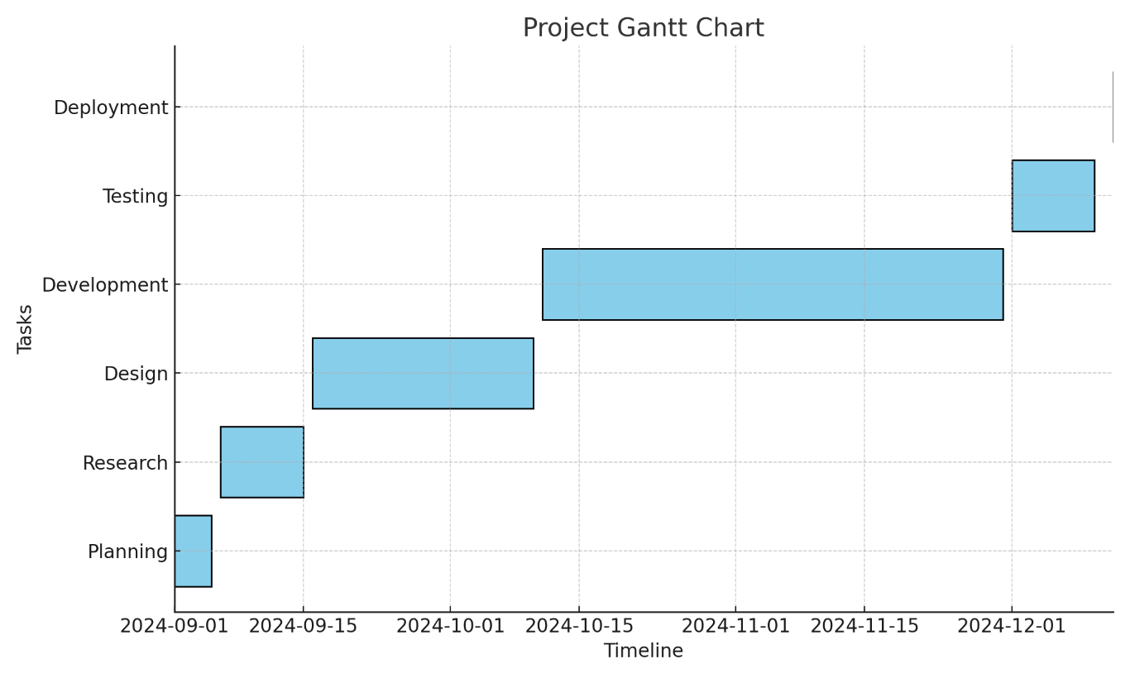
Timeline of Project

Slide 18
Timeline of Project
• Planning Phase: September 1, 2024 - September 7, 2024
• Research Phase: September 8, 2024 - September 15, 2024
• Design Phase: September 16, 2024 - October 10, 2024
• Development Phase: October 11, 2024 - November 25, 2024
• Testing Phase: November 26, 2024 - December 10, 2024
• Deployment Phase: December 11, 2024 - December 17, 2024

Slide 19
Expected Outcomes
Increased Scheme Utilization
Faster Application Processing
Data-Driven Insights
Reduced Middlemen Dependency
Enhanced Government Transparency

Slide 20
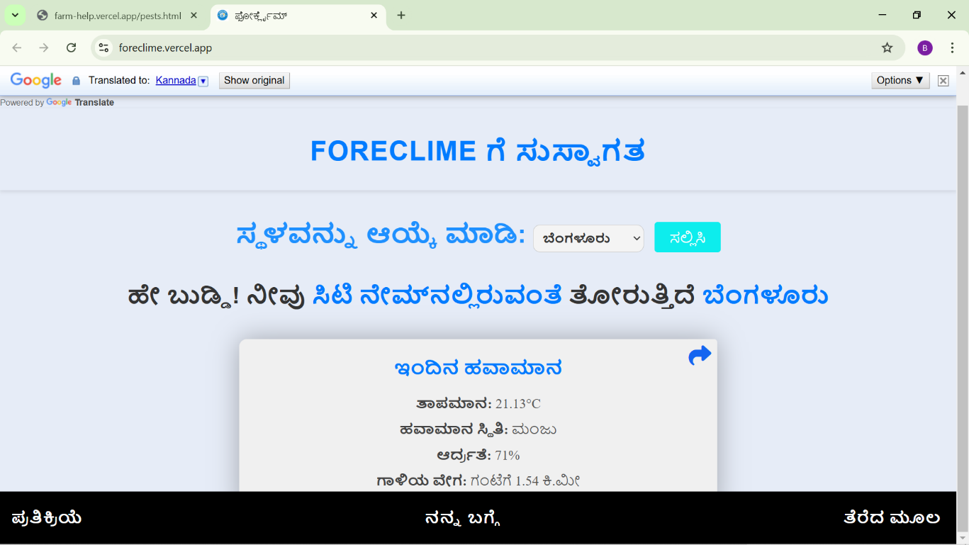
Results

Slide 21
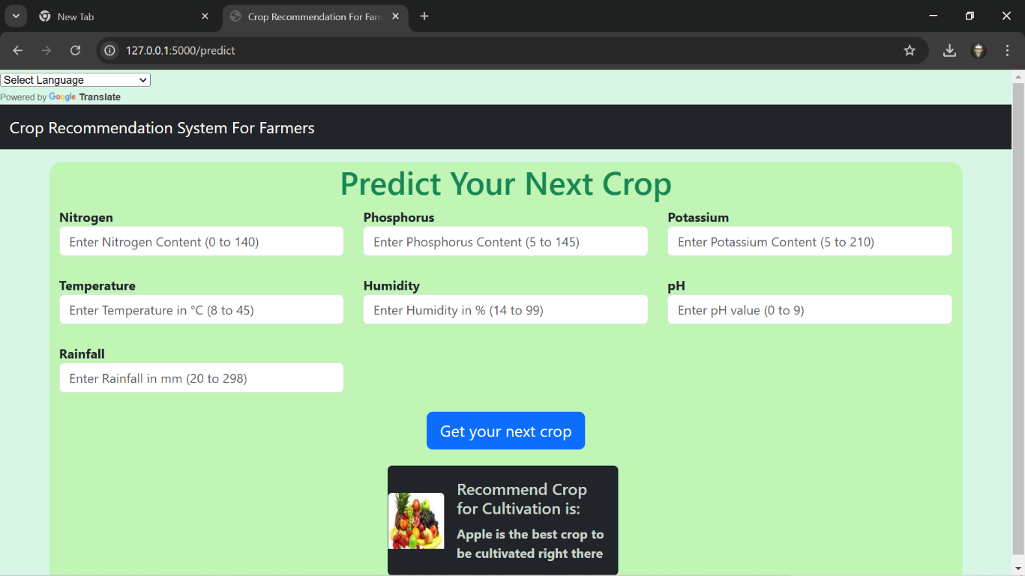
Results

Slide 22
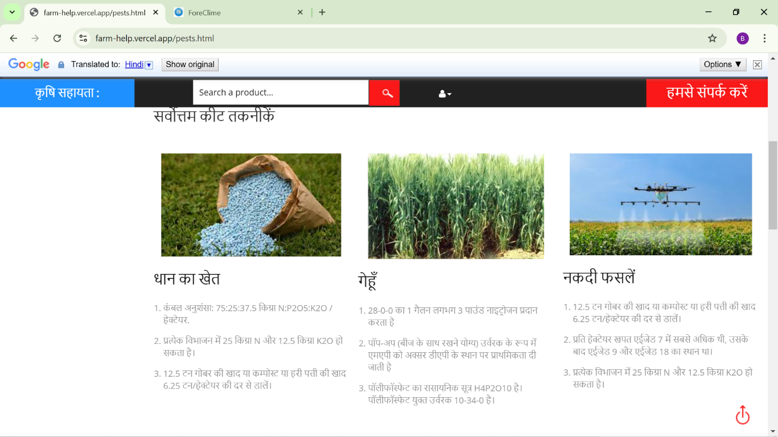
Results

Slide 23
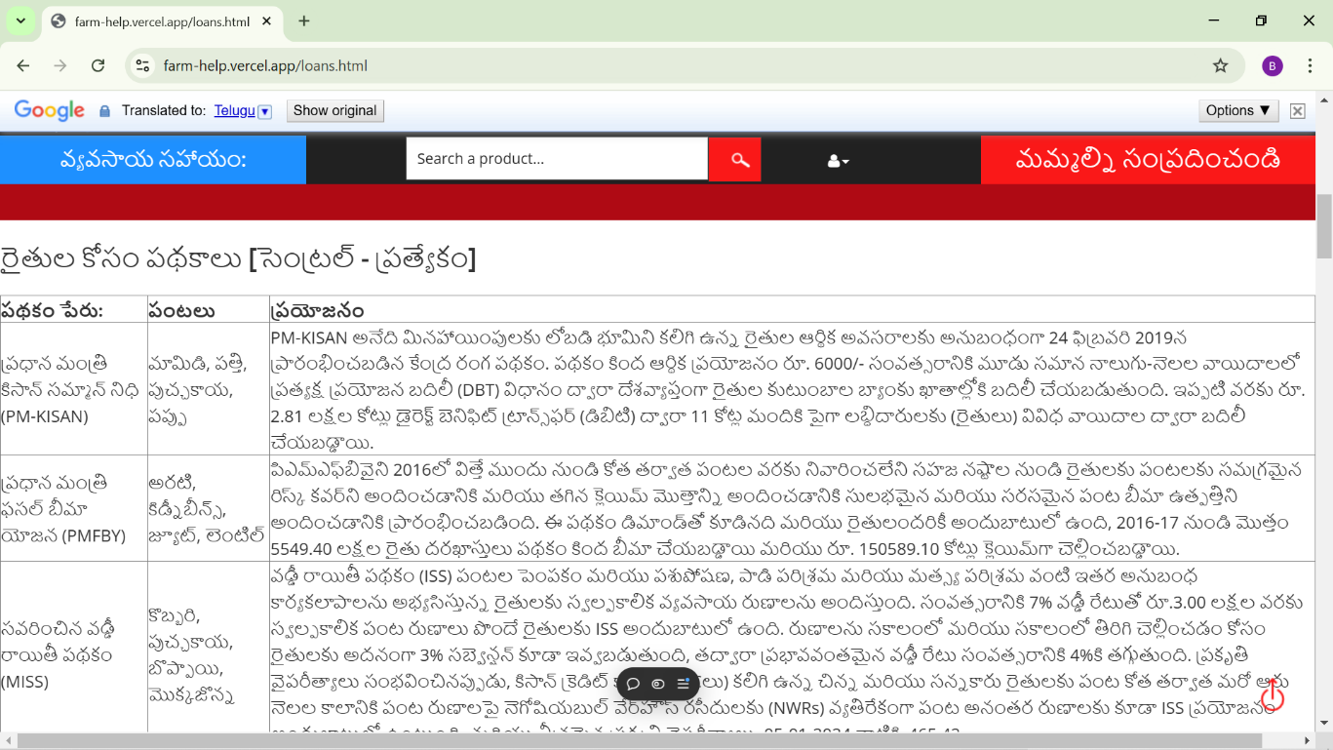
Results

Slide 24
Conclusion
Bridging the Gap Between Farmers and Government Schemes
Enhancing Efficiency and Transparency in Accessing Benefits
Empowering Farmers Through Simplified Processes and Personalized Assistance
Promoting Agricultural Growth and Rural Development
Creating a Sustainable and Equitable Agricultural Solution

Slide 25
References
1.Dr. M. Mahesh Kumar, 2 D. Gnanamani 1M.Com., M.Phil., MBA., PGDCA., PhD., Associate Professor & Head, Department of Commerce with Computer Applications, Sri Krishna Adithya College of Arts and Science, Coimbatore. Student, Department of Commerce with Computer Applications, Sri Krishna Adithya College of Arts and Science, Coimbatore.
2. Mahul, Olivier, and Charles J. Stutley. Government support to agricultural insurance: challenges and options for developing countries. World Bank Publications, 2010.
3.Chirwa, Ephraim, and Andrew Dorward. Agricultural input subsidies: The recent Malawi experience. Oxford university press, 2013.

Slide 26
References
4. Rose, David C., William J. Sutherland, Caroline Parker, Matt Lobley, Michael Winter, Carol Morris, Susan Twining, Charles Ffoulkes, Tatsuya Amano, and Lynn V. Dicks. "Decision support tools for agriculture: Towards effective design and delivery." Agricultural systems 149 (2016): 165-174.
5. Rao, N. H. "A framework for implementing information and communication technologies in agricultural development in India." Technological Forecasting and Social Change 74, no. 4 (2007): 491- 518

Slide 27


