Slide 1
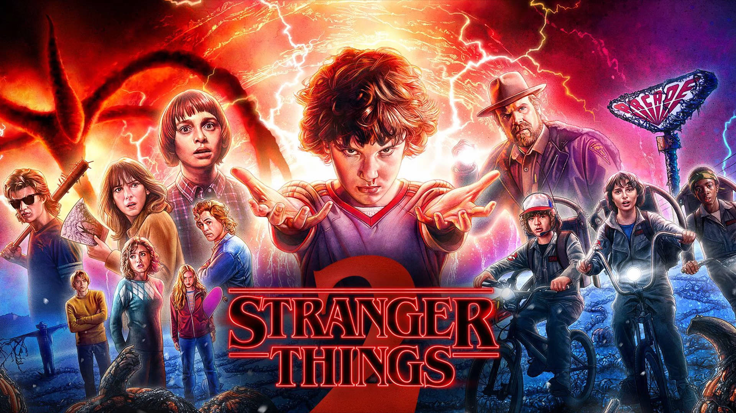
SQL ANALYSIS
by Sai Kumar Enjamuri

Slide 2

Project Overview
This project, undertaken as a data challenge by Digits N Data, explores the intricate world of the popular TV series “Stranger Things”. The challenge initiated and facilitated by Nitish Kumar, serves as an opportunity to showcase skills in database design, SQL querying and data manipulation.
The Stranger Things database project aims to organize and manage information related to this popular series.
Leveraging a relational database model, the project involves tables for characters, locations, events, relationships and monsters, providing a comprehensive framework for storing and querying essential data

Slide 3
Tables Used
Characters
Locations
Events
Relationships
Monsters

Slide 4
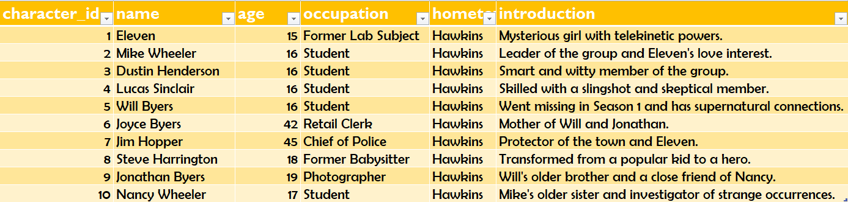

CHARACTERS TABLE

Slide 5
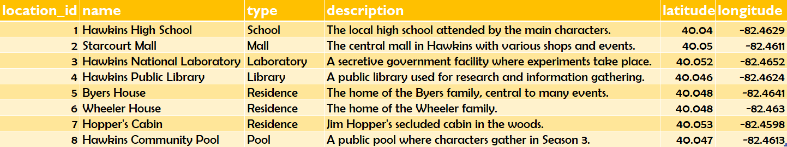
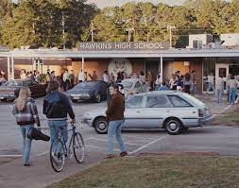
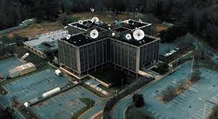

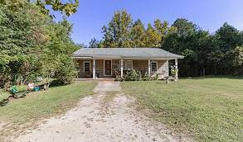
LOCATIONS TABLE
Starcourt Mall
Byer’s House
Hawkins National Laboratory
Hawkins High School

Slide 6
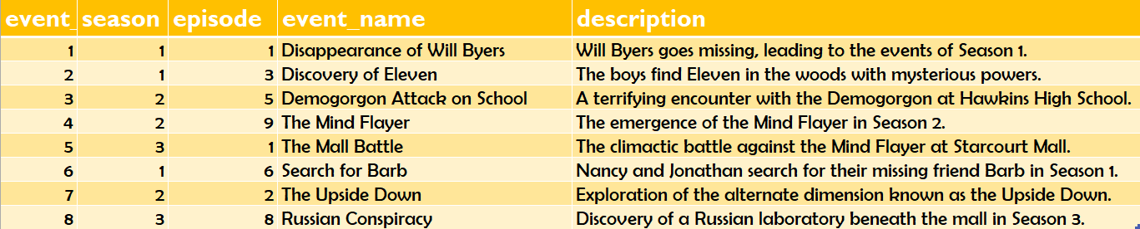
EVENTS TABLE

Slide 7
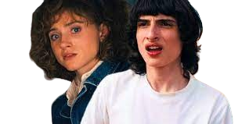
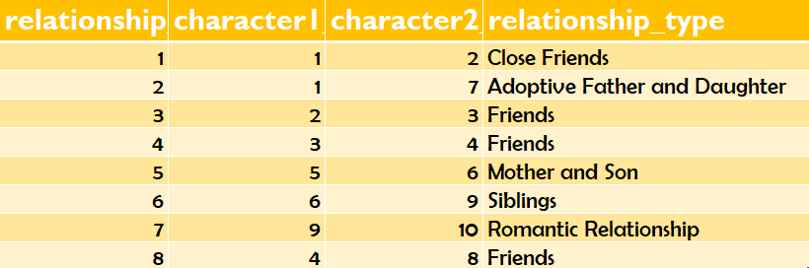
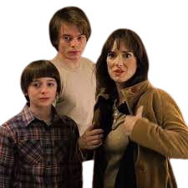

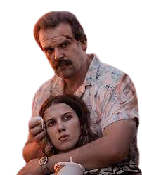
RELATIONSHIPS TABLE
MIKE & NANCY WHEELER
- Siblings
JOYCE & WILL BYERS
- Mother & Son
MIKE WHEELER & ELEVEN
- Close Friends
ELEVEN & JIM HOPPER
- Adoptive Father & Daughter

Slide 8
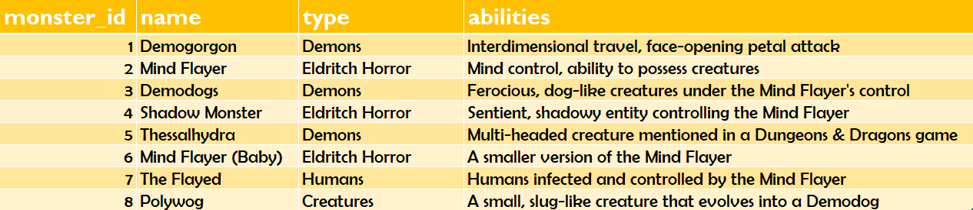
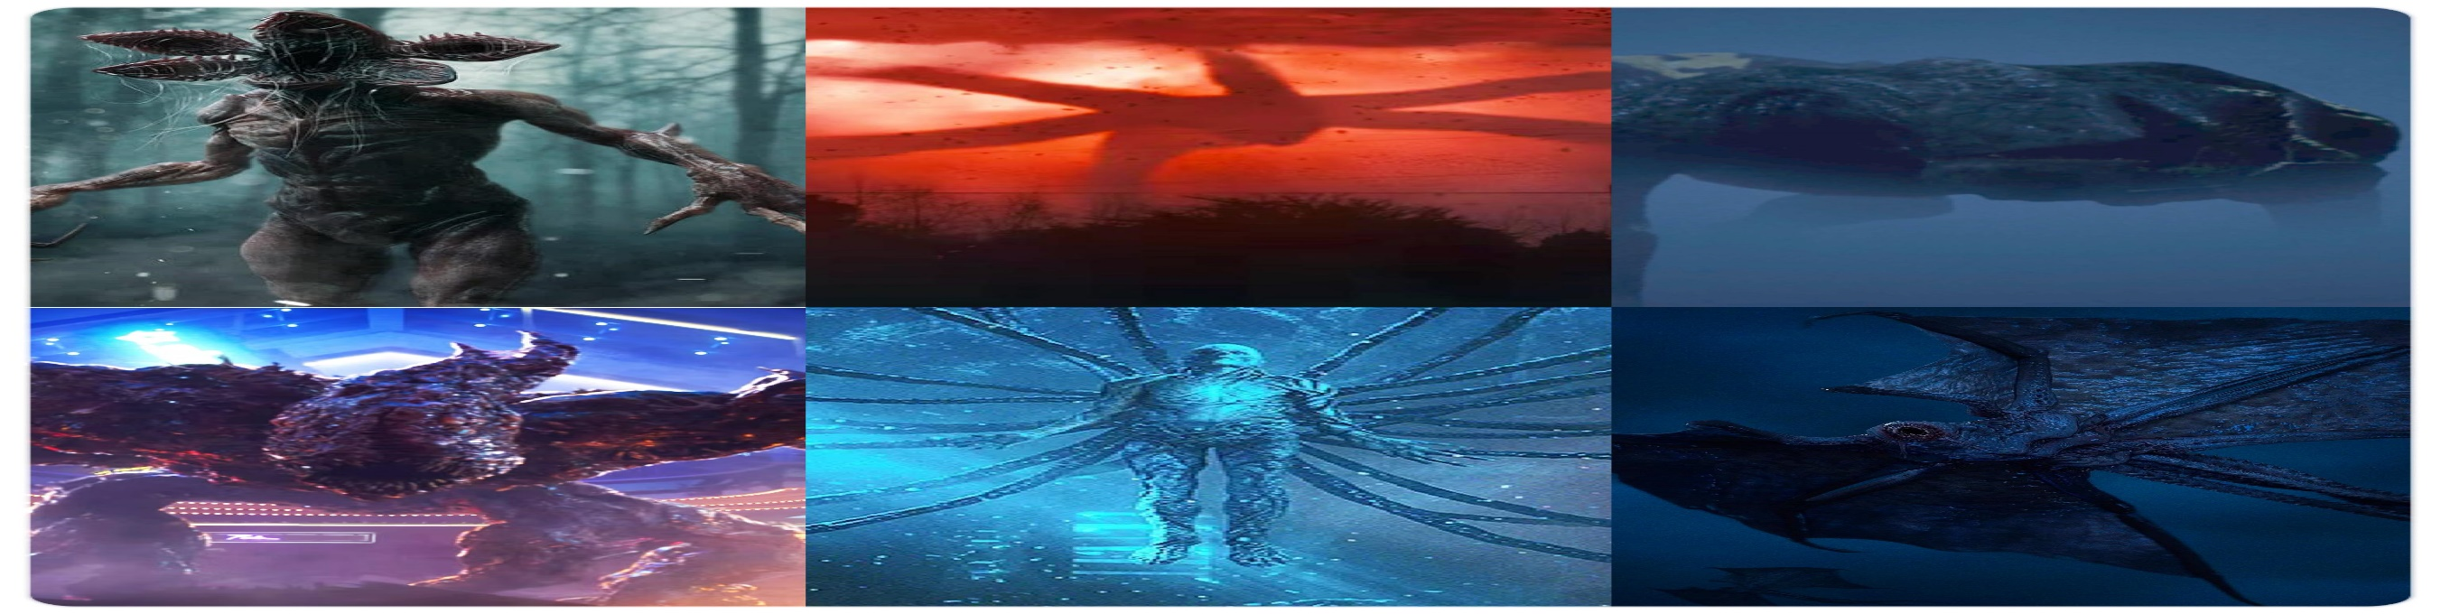
MONSTERS TABLE

Slide 9
ELEVEN
MIKE WHEELER
DUSTIN HENDERSON
JIM HOPPER
LUCAS SINCLAIR
Q1. Retrieve the names of the characters ?
Select name from characters;
STEVE HARRINGTON
WILL BYERS
JOYCE BYERS
JONATHAN BYERS
NANCY WHEELER

Slide 10

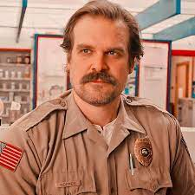
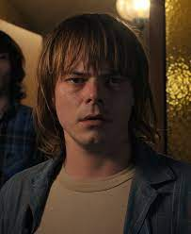
JOYCE BYERS
JIM HOPPER
JONATHAN BYERS
Q2. Find characters with age greater than 18 ?
Select name from characters where age>18;

Slide 11
The Demogorgon, also known as the Monster, was a predatory humanoid creature that entered Hawkins, Indiana in November 1983. The creature seemed to originate from the parallel dimension known as the Upside Down. When Eleven, a child test subject from Hawkins National Laboratory with psychokinetic abilities, made trans dimensional contact with the creature, a gate between dimensions opened at the lab. The creature then set foot in Hawkins, and began hunting, killing and kidnapping various local townspeople.
Q3. Find events in Season 2?
Select event_name from Events where season=2;
The Mind Flayer in Stranger Things is a malevolent entity from the Upside Down and serves as one of the main antagonists of the series. It's a hive-minded creature that can possess and control people
As they search for answers, the children unravel a series of extraordinary mysteries, experience psychokinetic powers and venture into the Upside Down. The Upside Down is described in the show as an alternate dimension that mirrors our world, an extra dimension that can be accessed through a mystical portal.

Slide 12
Q4. Get details of the 'Mind Flayer' monster ?
Select * from Monsters where name='Mind Flayer';

Slide 13

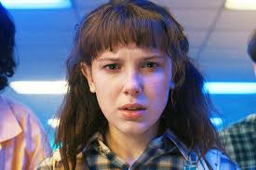

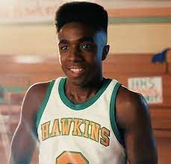
Q5. Retrieve characters and their associated events?
Select c.name as character_name,e.event_name as event_name from characters c join relationships r on c.character_id=r.character1_id or c.character_id=r.character2_id
join events e on e.event_id=r.relationship_id;
Disappearance Of Will Byers
Discovery Of Eleven
Demogorgon Attack On School
The Mind Flayer

Slide 14
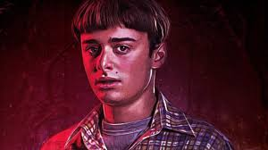
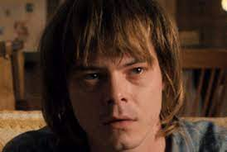
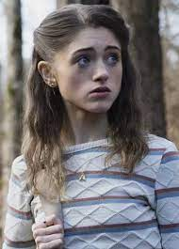
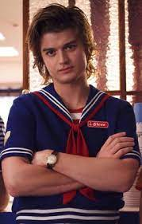
The Mind Battle
Search For Barb
The Upside Down
Russian Conspiracy

Slide 15
All the 10 characters are from Hawkins
Hawkins was a small midwestern town located in Roane County in the US state of Indiana, positioned about 80 miles outside of Indianapolis. It had an estimated population of 10,000 to 15,000.
Q6. Calculate the total number of characters from each hometown ?
Select hometown, count(character_id) as total_characters from Characters group by hometown;

Slide 16
Q7. Retrieve characters who were involved in events in Season 1 or Season 2?
Select c.name as character_name,e.season as season from characters c join relationships r on c.character_id=r.character1_id or c.character_id=r.character2_id join events e on e.event_id=r.relationship_id where e.season=1 or e.season=2;
SEASON 1
Jonathan Byers
Mike
Eleven
Jim Hopper
Joyce Byers
SEASON 2
Lucas Sinclair
Nancy Wheeler
Dustin Henderson

Slide 17
JIM HOPPER
45 yrs
JOYCE BYERS
42 yrs
Q8. Find the top 3 oldest characters?
Select name, age from Characters order by age desc limit 3;
JONATHAN BYERS
19 yrs

Slide 18
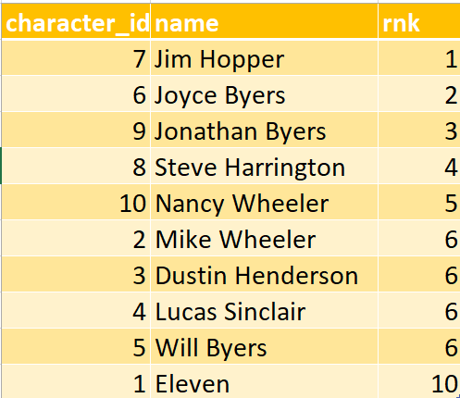
Q9. Find the average age of characters in Hawkins?
Select round(avg(age),0) as average_age from Characters where hometown='Hawkins';
Youngest
ELEVEN
15 yrs
Q10. Find the average age of characters in Hawkins?
Select character_id, name, rank() over(order by age desc) as rnk from Characters;
Oldest
JIM HOPPER
45 yrs

