Slide 1

Harmony Unit testing

Slide 2
Contents
What are Unit tests ?
Types of Unit testing
Folder structure
Tooling support
Create Test cases
Run test cases
Annotations to know
Types of Assertions
Mockito

Slide 3
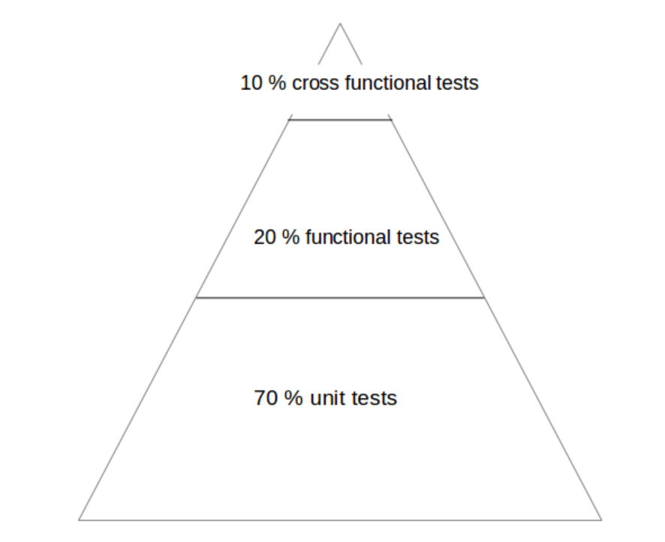
What is Unit testing
A unit test is a way of testing a unit - the smallest piece of code that can be logically isolated in a system.
Thumb rule for types of tests on application:
70-80 % unit tests to ensure stability of your
code basis
20-30 % functional tests to ensure that the
application really works
cross functional tests, if your application
integrates intensively with other Application
components

Slide 4
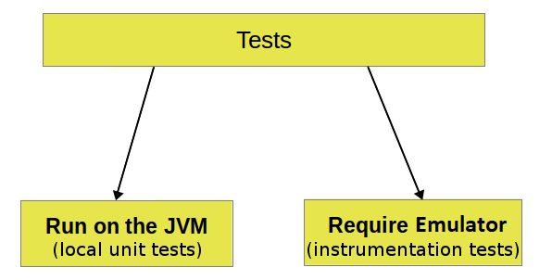
Types of Unit testing
Unit testing can be classified into:
Local unit tests - tests which can run on the JVM.
Instrumented unit tests - tests which require physical device or emulator.
NOTE : Local unit tests run much faster compared to the time required to deploy and run tests on device. Therefore, prefer writing local unit tests and only run tests on device, when necessary.

Slide 5
Folder Structure
If the package name was com.example.javademo, then unit testing folder structure will be as below -
Local Unit tests :
entry/src/test/java/com/example/javademo
Instrumentation unit tests :
entry/src/ohosTest/java/com/example/javademo

Slide 6
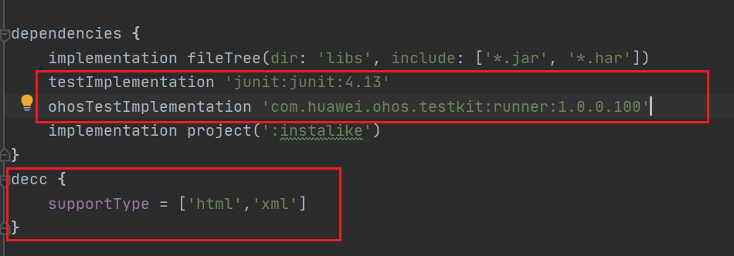
Tooling support
DevEco Studio supports the HarmonyOS application test framework and provides users with the JUnit test function, which can build instrumentation tests to run on the device

Slide 7
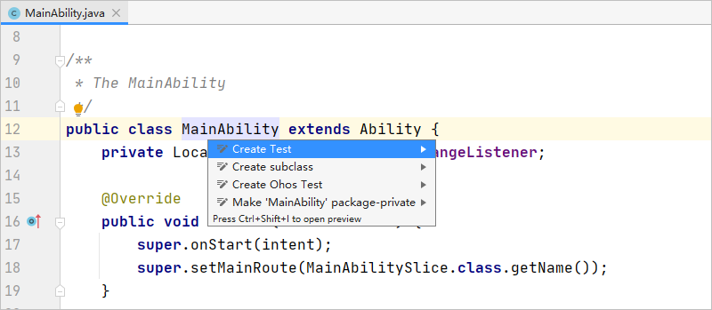
Create test cases
Create a project to be tested or open an existing project.
Open the class to be tested, right-click> Generate > Test or the shortcut key Alt+enter > Create Test to create a test class.

Slide 8
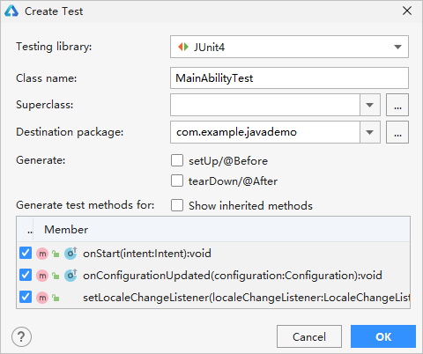
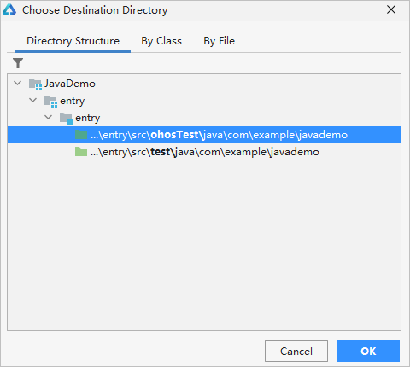
Check the method to be tested, and select JUnit4 as the test library.
Select the test case directory or select the ohosTest directory, and click OK .

Slide 9
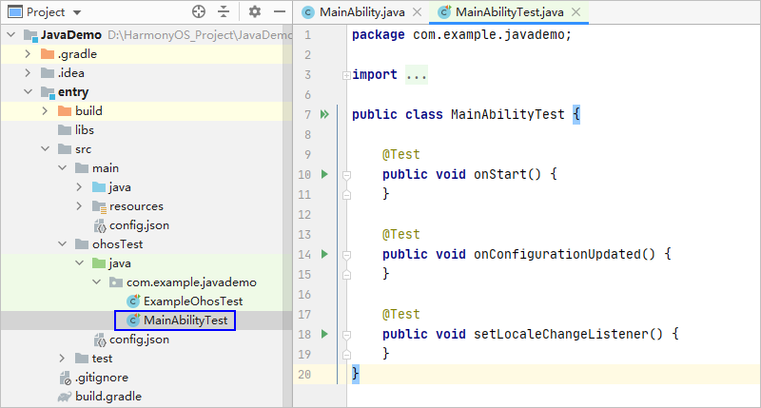
The system automatically generates the corresponding test class in the ohosTest directory. In the test class, the IDE will generate a use case template for the corresponding method. The specific test code needs to be developed by the developer according to the business logic.

Slide 10
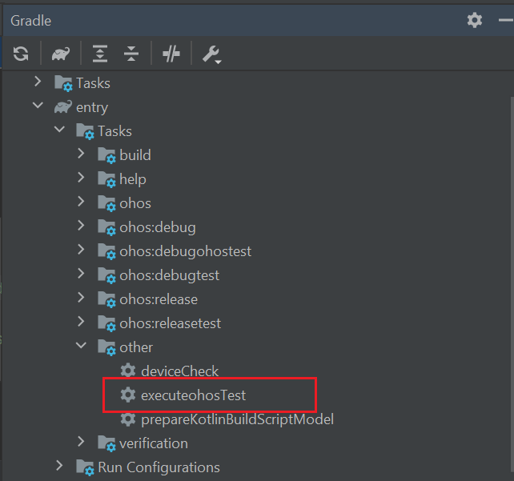
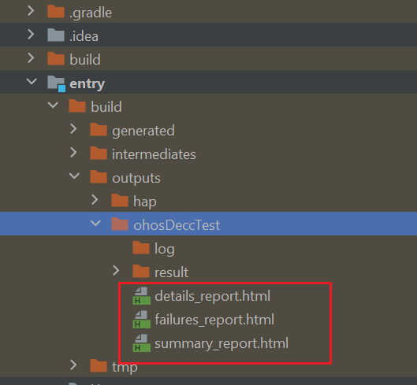
Run the test cases
Local unit test cases – Right click on the class and select Run ‘classname’ / Run ‘classname with coverage’
Instrumentation unit test cases – Gradle -> entry -> Tasks -> other -> executeOhosTest
On running the executeOhosTest, the reports will be generated in : entry -> build -> outputs -> ohosDeccTest

Slide 11
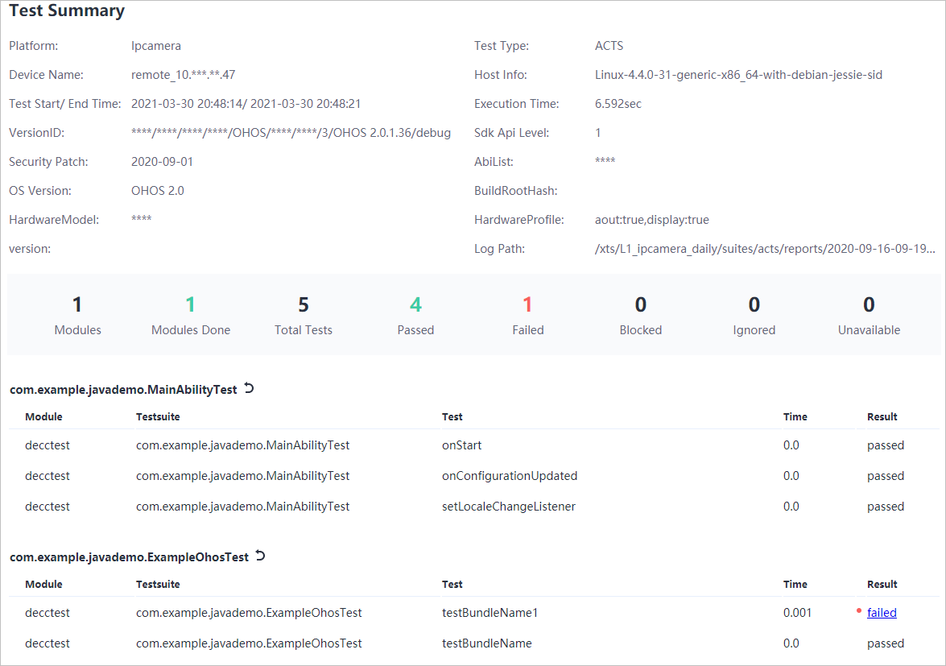
Generated test report for instrumentation test looks as below

Slide 12
Annotations to know
@Test | This annotation is used to tell JUnit that this public void method (Test Case here) to which it is attached can be run as a test case.
@Before | This annotation is used if you want to execute some statement such as preconditions before each test case.
@BeforeClass | This annotation is used if you want to execute some statements before all the test cases for e.g. test connection must be executed before all the test cases.
@After | This annotation can be used if you want to execute some statements after each test case for e.g resetting variables, deleting temporary files ,variables, etc.
@AfterClass | This annotation can be used if you want to execute some statements after all test cases for e.g. Releasing resources after executing all test cases.
@Ignores | This annotation can be used if you want to ignore some statements during test execution for e.g. disabling some test cases during test execution.

Slide 13
Types of Assertions
void assertEquals(boolean expected, boolean actual) | It checks whether two values are equals similar to equals method of Object class
void assertFalse(boolean condition) | functionality is to check that a condition is false.
void assertNotNull(Object object) | "assertNotNull" functionality is to check that an object is not null.
void assertNull(Object object) | "assertNull" functionality is to check that an object is null.
void assertTrue(boolean condition) | "assertTrue" functionality is to check that a condition is true.
void fail() | If you want to throw any assertion error, you have fail() that always results in a fail verdict.
void assertSame(String message) | "assertSame" functionality is to check that the two objects refer to the same object.
void assertNotSame(String message) | "assertNotSame" functionality is to check that the two objects do not refer to the same object.

Slide 14
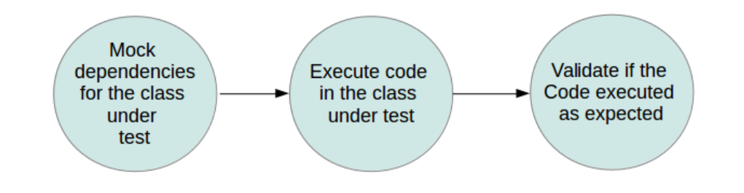
Using mocks for Unit testing
A mock object is a dummy implementation for an interface or a class. It allows to define the output of certain method calls.
Mockito is a popular mock framework which can be used in along with JUnit. Mockito allows you to create and configure mock objects.
Add the following dependency in build.gradle to use Mockito in the local junit tests
testImplementation 'org.mockito:mockito-core:3.5.2'

Slide 15
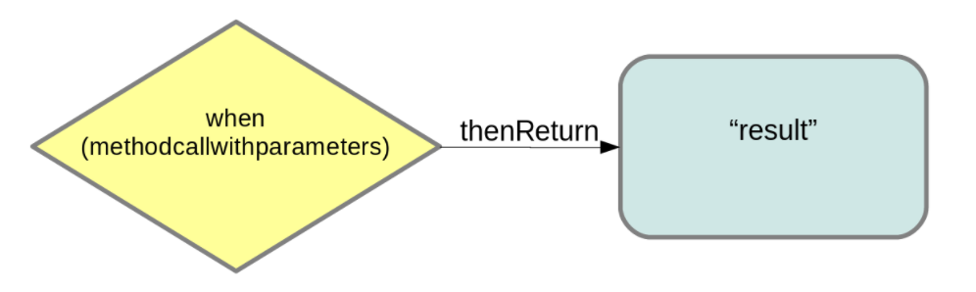
Important things in Mockito
Mock objects can be created using @Mocks or Mockito.mock(). @Mocks requires initialization of annotated fields to be triggered. This is done by @RunWith(MockitoJUnitRunner.class)
When().thenReturn() – this method chain is used to specify a return value for a method call with pre-defined parameters

Slide 16
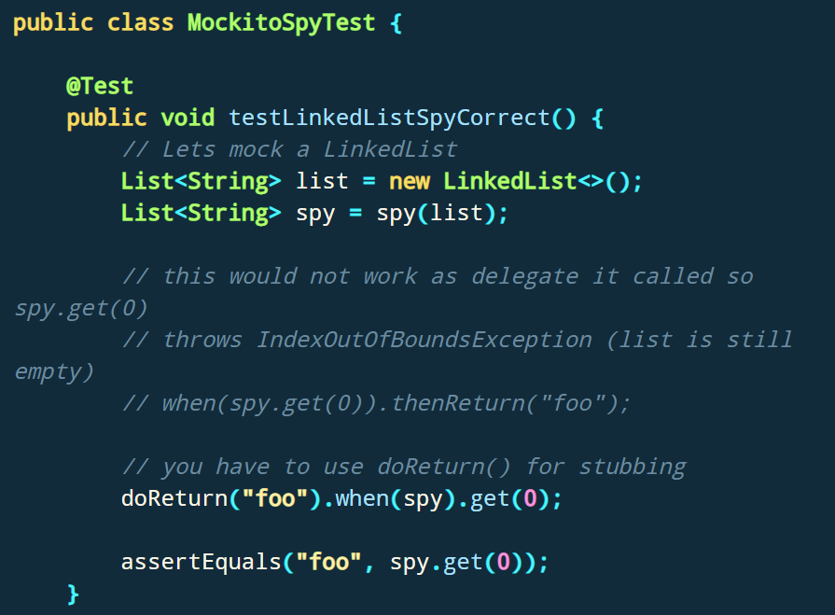
@Spy or the spy() method can be used to wrap a real object
You can use the verify() method on the mock object to verify that the specified conditions are met. For example, you can verify that a method has been called with certain parameters. This kind of testing is sometimes called behavior testing. Behavior testing does not check the result of a method call, but it checks that a method is called with the right parameters.

Slide 17
THANKS!
Any questions?

