Slide 1

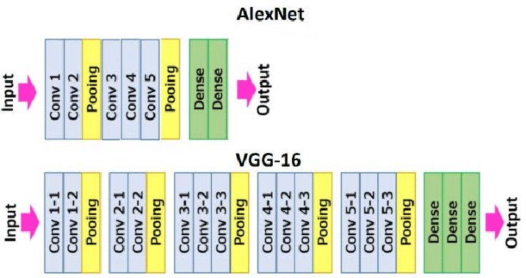
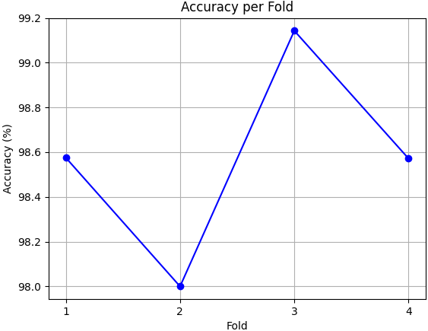
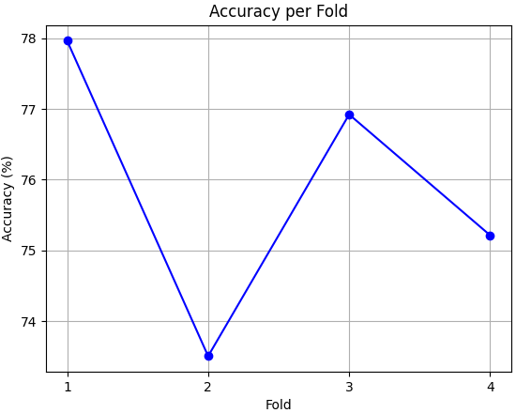
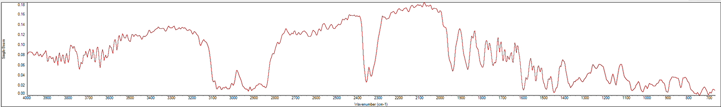
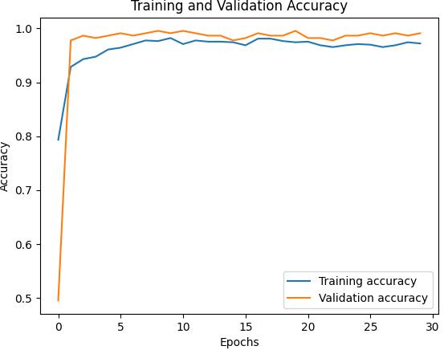
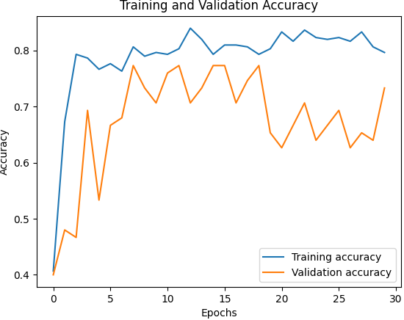
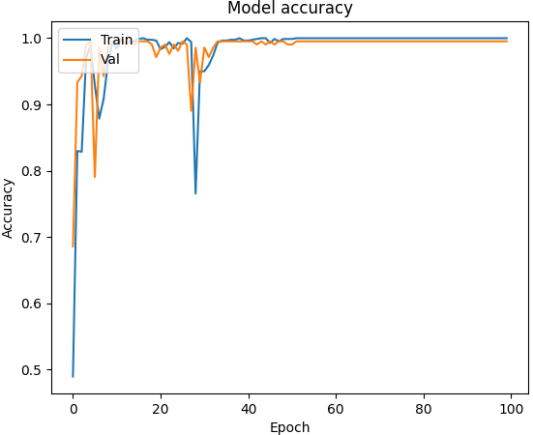
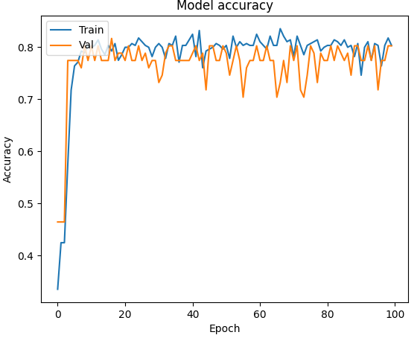
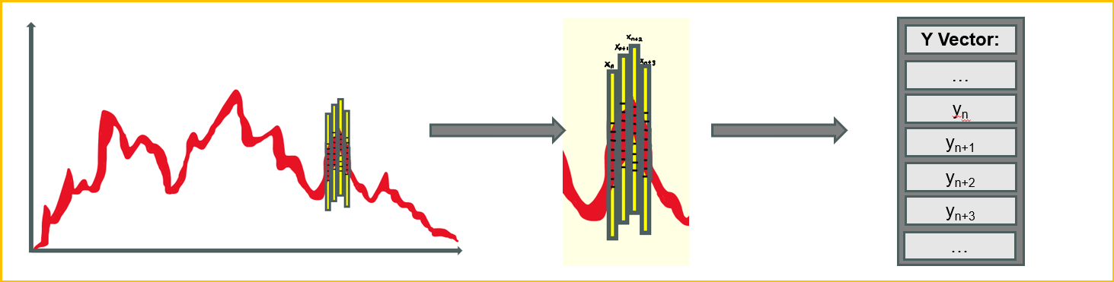
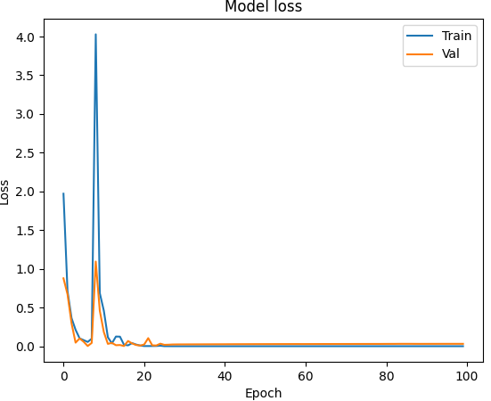
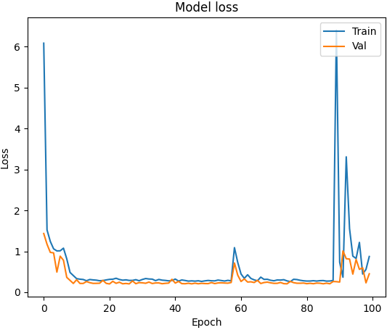
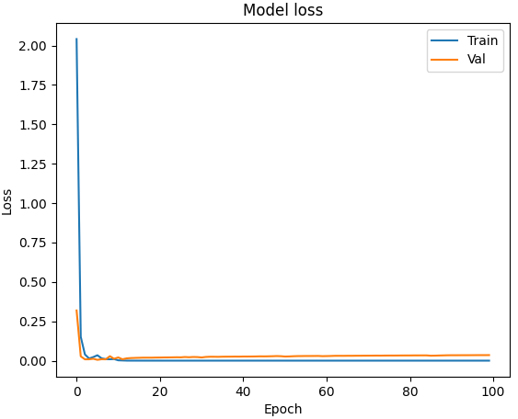
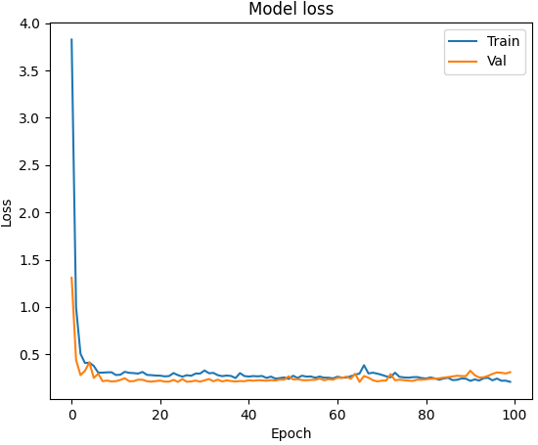
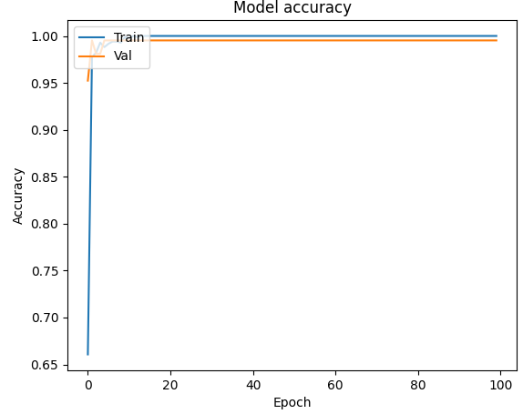
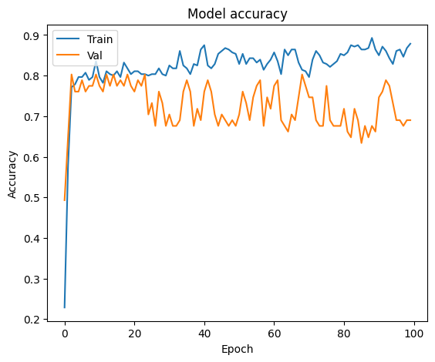
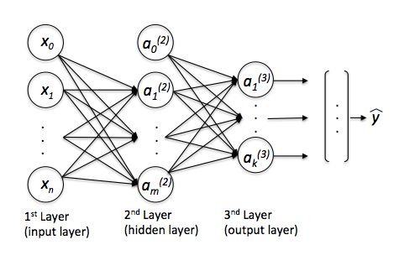
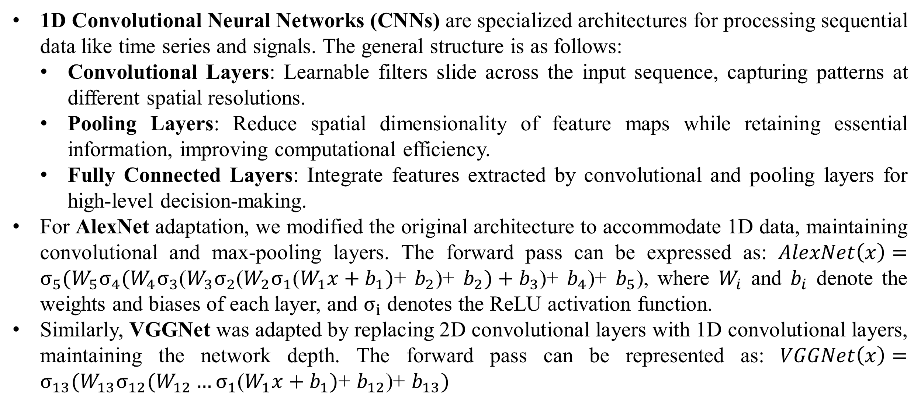
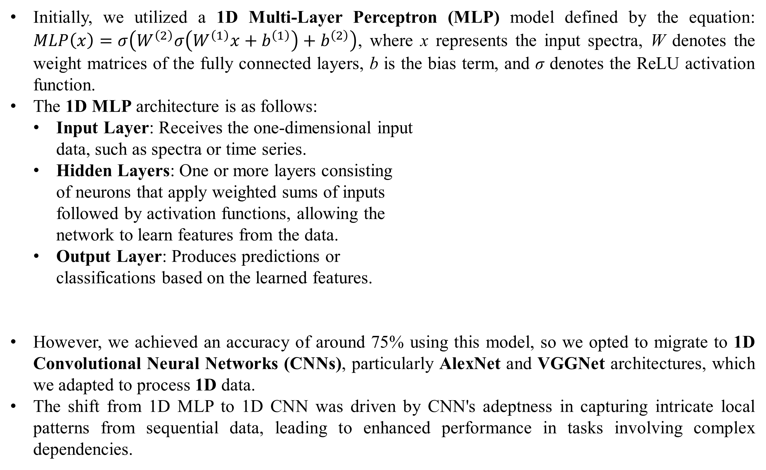
Machine Learning Model for Identifying Microplastics Using ATR-FTIR Spectroscopy
Hayden Bright¹, Sai Kumar Kantakala¹, Colin Green¹, Ali Shiri Sichani¹, Hadi Ali-Akbarpour², Maryam Salehi³
¹Electrical Engineering and Computer Science Department, University of Missouri, Columbia, MO
²Computer Science Department, Saint Louis University, St. Louis, MO
³Civil and Environmental Engineering Department, University of Missouri, Columbia, MO
I. Abstract
IV. Methodology
In recent years, microplastic (MP) pollution has emerged as a significant environmental concern worldwide. To aid in the identification and classification of MP particles, this study proposes the utilization of Attenuated Total Reflection Fourier Transform Infrared Spectroscopy (ATR-FTIR) data combined with advanced Machine Learning (ML) techniques. Specifically, we explore the transition from a basic 1D Multi-Layer Perceptron (MLP) model to more sophisticated 1D-adapted Convolutional Neural Network (CNN) architectures, namely AlexNet and VGGNet. By training and evaluating these models on a dataset comprising ATR-FTIR spectra of different types of MPs, this study aims to provide accurate and efficient MP classification tools to aid in environmental research efforts.
1D Convolutional Neural Networks (CNNs) are specialized architectures for processing sequential data like time series and signals. The general structure is as follows:
Convolutional Layers: Learnable filters slide across the input sequence, capturing patterns at different spatial resolutions.
Pooling Layers: Reduce spatial dimensionality of feature maps while retaining essential information, improving computational efficiency.
Fully Connected Layers: Integrate features extracted by convolutional and pooling layers for high-level decision-making.
For AlexNet adaptation, we modified the original architecture to accommodate 1D data, maintaining convolutional and max-pooling layers. The forward pass can be expressed as: $AlexNet\left(x\right)=σ_{5}(W_{5}σ_{4}(W_{4}σ_{3}$($W_{3}σ_{2}$($W_{2}σ_{1}$($W_{1}x+b_{1})$+ $b_{2}$)+ $b_{2})+b_{3}$)+ $b_{4}$)+ $b_{5}$), where $W_{i}$ and $b_{i}$ denote the weights and biases of each layer, and $σ_{i}$ denotes the ReLU activation function.
Similarly, VGGNet was adapted by replacing 2D convolutional layers with 1D convolutional layers, maintaining the network depth. The forward pass can be represented as: $VGGNet\left(x\right)=σ_{13}(W_{13}σ_{12}(W_{12}{…σ}_{1}$($W_{1}x+b_{1})$+ $b_{12}$)+ $b_{13})$
II. Background: FTIR Imaging
Attenuated Total Reflection Fourier Transform Infrared (ATR-FTIR) spectroscopy is a widely utilized analytical technique in polymer analysis and environmental science, allowing the characterization of molecular composition and structure by measuring changes in the intensity and phase of infrared light passed through a sample onto an ATR crystal within the range of 800-4000 cm^-1 [1].
The resulting ATR-FTIR spectra exhibit unique absorption patterns, often termed as spectral signatures or fingerprints, originating from the vibrations and rotations of chemical bonds within the sample molecules, such as C-H, C=O, and C-C bonds, enabling the identification of different chemical moieties [1].
In the realm of microplastic (MP) analysis, ATR-FTIR spectroscopy offers a rapid and non-destructive means to identify and characterize microplastic particles in environmental samples [2]. The distinctive spectral features of microplastics allow their differentiation from other materials in the sample matrix, facilitating the creation of comprehensive spectral libraries encompassing various microplastic types [2].
Machine learning (ML) algorithms, particularly those leveraging neural networks, have emerged as potent tools for analyzing complex ATR-FTIR spectra [3]. These algorithms can discern patterns in the spectra, enabling accurate predictions regarding the identity and composition of MP particles [3]. Recent studies underscore the efficacy of ML-based approaches in automating the classification and quantification of microplastics in environmental samples [4].
Both models were trained using stochastic gradient descent (SGD) with momentum and adaptive learning rate methods like Adam to minimize the cross-entropy loss function.
The models were trained on the training set with a validation set used for early stopping to prevent overfitting. Finally, the performance was evaluated on the test set using accuracy and loss.
Figure 4. AlexNet and VGGNet structures with pooling, convolution, and fully connected layers
V. Results
In Dataset 1, the 1D MLP achieved an accuracy of approximately 98.5%, whereas on Dataset 2, its accuracy dropped to around 75%.
Similarly, the 1D CNN exhibited an accuracy of approximately 98.9% on Dataset 1, but on Dataset 2, its accuracy decreased to around 67%.
For both 1D AlexNet and 1D VGGNet, their accuracies also saw a decline from Dataset 1 to Dataset 2. On Dataset 1, 1D AlexNet achieved an accuracy of approximately 99.7%, whereas on Dataset 2, it reached around 67%. Similarly, 1D VGGNet's accuracy dropped from about 99.4% on Dataset 1 to around 76% on Dataset 2.
The accuracy plots of the CNN validation and training sets provide insights into the model's performance during training. These plots depict the evolution of accuracy over epochs, indicating convergence and potential overfitting.
The 1D MLP model accuracy plot is against folds, which are the multiple partitions of the dataset that the model is evaluated against.
For both 1D AlexNet and 1D VGGNet architectures, the loss values were notably higher when trained and tested on Dataset 2 compared to Dataset 1. This difference in loss values across datasets underscores the impact of dataset size and composition on model performance and convergence dynamics.
It's important to note that the models performed significantly better on Dataset 1, which contained 1402 samples, compared to Dataset 2, which only has 470 samples. Once again, a sufficiently sized dataset is crucial to the accuracy of these models.
Figure 5. 1D MLP model accuracy versus folds plot. (a) Plot for the model trained on Dataset 1. (b) Plot for the model trained on Dataset 2.
Figure 1. ATR-FTIR mosaic imaging and reading for sample #1 of Polystyrene (PS).
III. Dataset Creation
Figure 6. 1D CNN model accuracy versus epochs plot. (a) Dataset 1. (b) Dataset 2.
In Dataset 1, 1402 ATR-FTIRs of 3 different types of MPs and 1 substance: Low Density Polyethylene (LDPE), Polystyrene (PS), Polyvinyl Chloride (PVC), and Sand Particulate were collected.
In Dataset 2, 470 ATR FTIRs of LDPE, PS, PVC, and Polyethylene Terephthalate (PET) were collected.
The dataset was split into an 80% training set and a 20% test set.
Each ATR-FTIR signature was converted into a 1D vector, with y-pixel positions corresponding to each x-pixel position. Utilizing OpenCV and NumPy in Python, we converted the ATR-FTIR graph images into textual data and then into 1D arrays, saved as .csv files for the dataset. This ensured proper formatting for machine learning model input.
Figure 7. 1D VGGNet accuracy versus epochs plot. (a) Dataset 1. (b) Dataset 2.
Figure 2. Block Diagram of the data smoothing process for y-pixel 1D vector training set data.
Figure 8. 1D VGGNet loss versus epochs plot. (a) Dataset 1. (b) Dataset 2.
IV. Methodology
Initially, we utilized a 1D Multi-Layer Perceptron (MLP) model defined by the equation: $MLP\left(x\right)=σ\left(W^{\left(2\right)}σ\left(W^{\left(1\right)}x+b^{\left(1\right)}\right)+b^{\left(2\right)}\right)$, where x represents the input spectra, W denotes the weight matrices of the fully connected layers, b is the bias term, and σ denotes the ReLU activation function.
The 1D MLP architecture is as follows:
Input Layer: Receives the one-dimensional input
data, such as spectra or time series.
Hidden Layers: One or more layers consisting
of neurons that apply weighted sums of inputs
followed by activation functions, allowing the
network to learn features from the data.
Output Layer: Produces predictions or
classifications based on the learned features.
However, we achieved an accuracy of around 75% using this model, so we opted to migrate to 1D Convolutional Neural Networks (CNNs), particularly AlexNet and VGGNet architectures, which we adapted to process 1D data.
The shift from 1D MLP to 1D CNN was driven by CNN's adeptness in capturing intricate local patterns from sequential data, leading to enhanced performance in tasks involving complex dependencies.
Figure 10. 1D AlexNet loss versus epochs plot. (a) Dataset 1. (b) Dataset 2.
Figure 9. 1D AlexNet accuracy versus epochs plot. (a) Dataset 1. (b) Dataset 2.
VI. Conclusion
Our study highlights the potential of deep learning models, specifically 1D CNN architectures like AlexNet and VGGNet, for microplastic classification, achieving validation accuracies of 67% and 76%, respectively. However, the critical importance of dataset size in optimizing these models is emphasized, with larger datasets expected to notably enhance the performance of CNN models compared to MLP approaches. This underscores the necessity of acquiring comprehensive datasets to fully exploit the potential of deep learning for microplastic detection. Further refinement and expansion of CNN-based models, alongside increased training data, offer promising avenues to improve automated microplastic classification systems and address the challenges posed by microplastic pollution. Continued research and development in this direction can significantly advance environmental conservation efforts.
Figure 3. 1D MLP structure with input layer, hidden layer, and output layer
VII. References
The FTIR image graphs used for the training and test sets for this work were provided by Dr. Salehi and the Salehi Water and Environmental Research Lab
1. J. Brandt, K. Mattsson, and M. Hassellöv, “Deep Learning for Reconstructing Low-Quality FTIR and Raman Spectra─A Case Study in Microplastic Analyses,” Anal Chem, vol. 93, no. 49, pp. 16360–16368, Dec. 2021, doi: 10.1021/acs.analchem.1c02618.
2. X. Yan, Z. Cao, A. Murphy, and Y. Qiao, “An ensemble machine learning method for microplastics identification with FTIR spectrum,” J Environ Chem Eng, vol. 10, no. 4, Aug. 2022, doi: 10.1016/j.jece.2022.108130.
3. B. Hufnagl et al., “Computer-Assisted Analysis of Microplastics in Environmental Samples Based on μFTIR Imaging in Combination with Machine Learning,” Environ Sci Technol Lett, vol. 9, no. 1, pp. 90–95, Jan. 2022, doi: 10.1021/acs.estlett.1c00851.
4. F. Weber, A. Zinnen, and J. Kerpen, “Development of a machine learning-based method for the analysis of microplastics in environmental samples using µ-Raman spectroscopy,” Microplastics and Nanoplastics, vol. 3, no. 1, Apr. 2023, doi: 10.1186/s43591-023-00057-3.

