Slide 1


Department of Information Technology
V R Siddhartha Engineering College
A Siamese Deep Learning Framework for Bi-Temporal Hyperspectral Image Change Detection
Remote Sensing
B.Tech in Information Technology
MAJOR Project Review Presentation
Presented by
Sai Kumar Kolli(228W1A12A0)
Jaya Praveen Gali(228W1A1286)
Under the guidance of
Dr.Vaddi Radhesyam,Sr.Asst.Professor

Slide 2
Agenda
Introduction and Problem statement
Objectives and Outcomes of the Project
Literature Review and Summary
Methodology
Datasets and Requirements
Algorithms used in the Project
Architecture/Project flow in diagram
Complete Results Obtained
References

Slide 3
INTRODUCTION
This project focuses on detecting changes in land surface features by analyzing bi-temporal hyperspectral images captured at different time periods.
Hyperspectral images contain rich spectral information across multiple wavelength bands, which helps in identifying subtle changes more accurately than conventional images.
The proposed framework uses preprocessing techniques such as ROI extraction, normalization, and noise removal to prepare the datasets for analysis.
A Siamese deep learning model is used to extract spectral-spatial features from both temporal images and compare them to identify changed and unchanged regions.
The project generates change maps and evaluates performance using standard metrics, making it useful for applications such as environmental monitoring, urban planning, and land-use analysis.

Slide 4
PROBLEM STATEMENT
Detecting changes in hyperspectral images acquired at different time periods is a challenging task due to the high dimensionality and complexity of spectral data.
Variations in spectral signatures and spatial patterns over time make it difficult to distinguish actual changes from normal scene differences.
Hyperspectral images are often affected by noise, atmospheric conditions, and data inconsistencies, which can reduce the accuracy of change detection.
Processing large bi-temporal hyperspectral datasets requires high computational effort and efficient analysis methods for timely results.
Hence, one of the most effective deep learning models, the Siamese network, can be used to learn spectral-spatial variations and generate accurate change detection maps.

Slide 5
OBJECTIVES:
To develop a Siamese deep learning framework for detecting changes in bi-temporal hyperspectral images.
To extract spectral-spatial features from temporal datasets for accurate change analysis.
To generate reliable change maps and evaluate performance using standard metrics.
OUTCOMES:
Automated detection of changed and unchanged regions from hyperspectral images.
Generation of accurate change probability and binary change maps.
Enhanced accuracy and consistency in identifying temporal changes across hyperspectral datasets.

Slide 6
Literature Summary
Sno | Title and Publication Details | Algorithms or Technologies Used | Dataset | Purpose | Remarks
1 | Dual Learning-Based Siamese Framework for Change Detection Using Bi-Temporal VHR Optical Remote Sensing Images (Bo Fang et al., 2019) | Dual Learning Framework, Siamese CNN | VHR Optical RS Images | Detect changes in bi-temporal images | Change detection performance enhanced; computationally intensive and requires labeled data.
2 | Land-Use/Land-Cover Change Detection Based on a Siamese Global Learning Framework (Qiqi Zhu et al., 2022) | Siamese Encoder–Decoder, Global Hierarchical Sampling | High Spatial Resolution RS Images | Semantic change detection | Can manage class imbalances effectively; however, computationally intensive.

Slide 7
Sno | Title and Publication Details | Algorithms or Technologies Used | Dataset | Purpose | Remarks
3 | A Multi-Dimensional Deep Siamese Network for Land Cover Change Detection in Bi-Temporal Hyperspectral Imagery (Seydi et al., 2022) | Multi-Dimensional Siamese CNN, DTW, Otsu Thresholding | Hyperion Hyperspectral (Farmland-1, Farmland-2) | Hyperspectral change detection | Excellent OA and few false alarms; however, susceptible to noise and atmospheric interference.
4 | RSCDNet: A Robust Deep Learning Architecture for Change Detection From Bi-Temporal High Resolution RS Images (Deepanshi et al., 2023) | Encoder–Decoder, Self-Attention, GL-ASPP | Staza-Tisadob, Onera, LEVIR, WHU | Pixel-wise change detection | F1-score is high; localization is effective; however, large amount of training data needed.

Slide 8
Datasets and Requirements
Data Requirements:
Bitemporal Hyperspectral Data :
2015 Hyperspectral Image: 5614 × 707 spatial size, 372 spectral bands
2018 Hyperspectral Image: 5614 × 707 spatial size, 372 spectral bands
Data Format: ENVI (.hdr)
Software Requirements:
Python programming language
Kaggle environment
NumPy for numerical computations
Matplotlib for visualization
Scikit-learn for preprocessing and evaluation metrics
PyTorch for Siamese deep learning model implementation

Slide 9
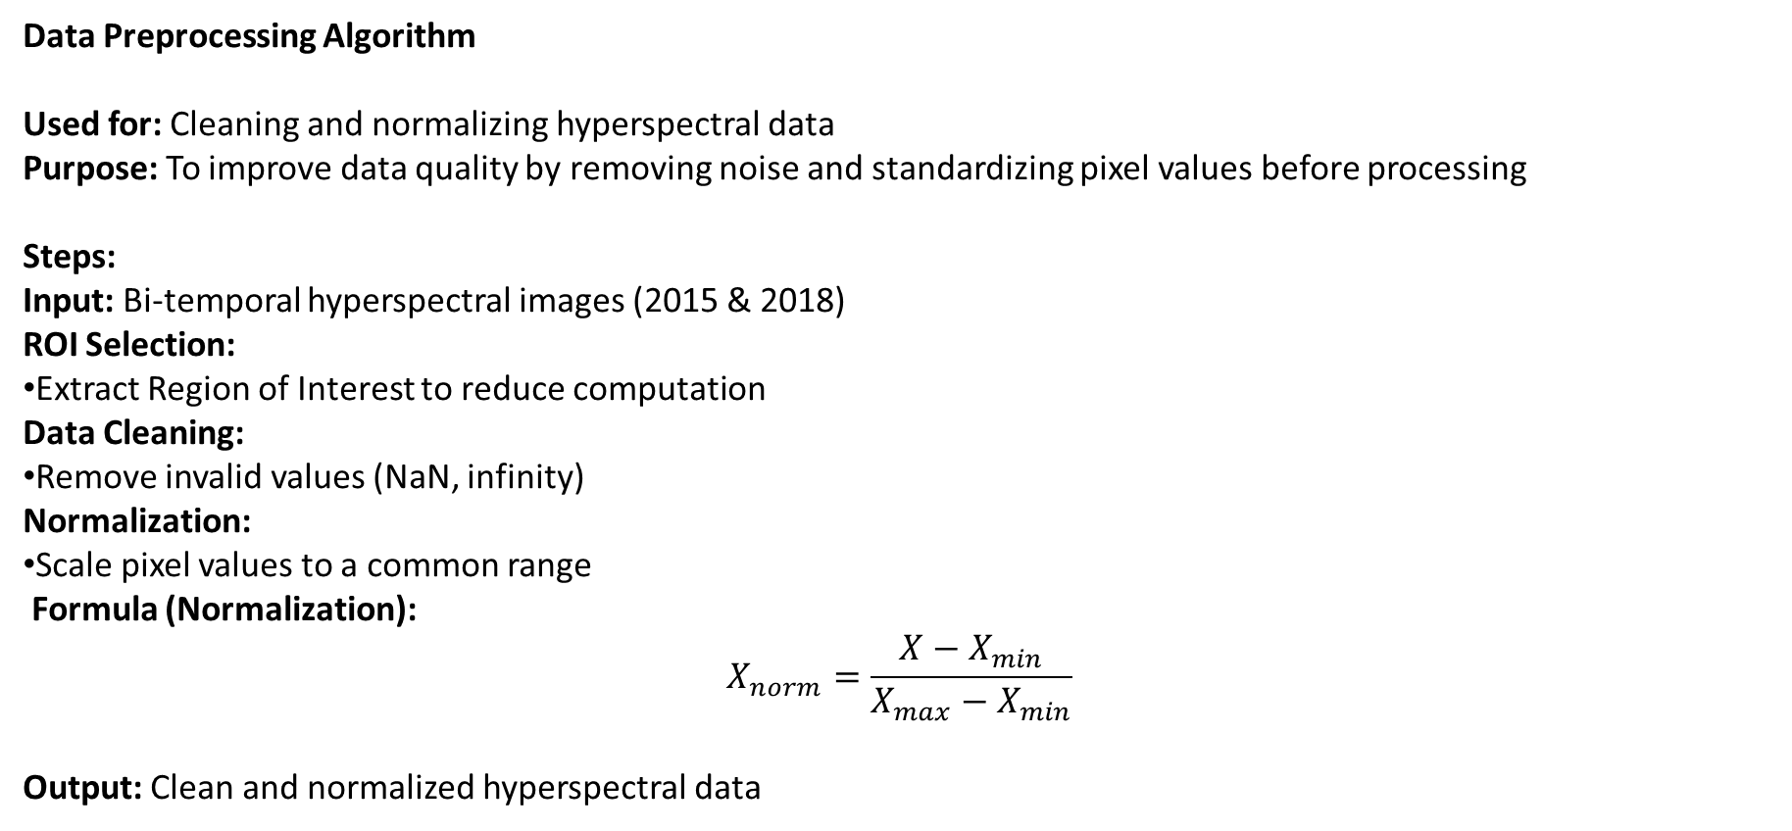
Algorithms Used
Data Preprocessing Algorithm
Used for: Cleaning and normalizing hyperspectral data Purpose: To improve data quality by removing noise and standardizing pixel values before processing
Steps:
Input: Bi-temporal hyperspectral images (2015 & 2018)
ROI Selection:
Extract Region of Interest to reduce computation
Data Cleaning:
Remove invalid values (NaN, infinity)
Normalization:
Scale pixel values to a common range
Formula (Normalization):
$$X_{norm}=\frac{X−X_{min}}{X_{max}−X_{min}}$$
Output: Clean and normalized hyperspectral data

Slide 10
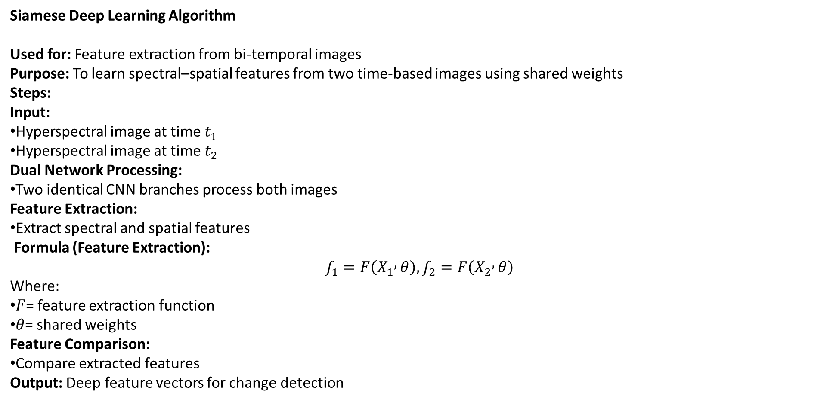
Algorithms Used
Siamese Deep Learning Algorithm
Used for: Feature extraction from bi-temporal images Purpose: To learn spectral–spatial features from two time-based images using shared weights
Steps:
Input:
Hyperspectral image at time $t_{1}$
Hyperspectral image at time $t_{2}$
Dual Network Processing:
Two identical CNN branches process both images
Feature Extraction:
Extract spectral and spatial features
Formula (Feature Extraction):
$$f_{1}=F\left(X_{1} , θ\right), f_{2}=F\left(X_{2} , θ\right)$$
Where:
$F$= feature extraction function
$θ$= shared weights
Feature Comparison:
Compare extracted features
Output: Deep feature vectors for change detection

Slide 11
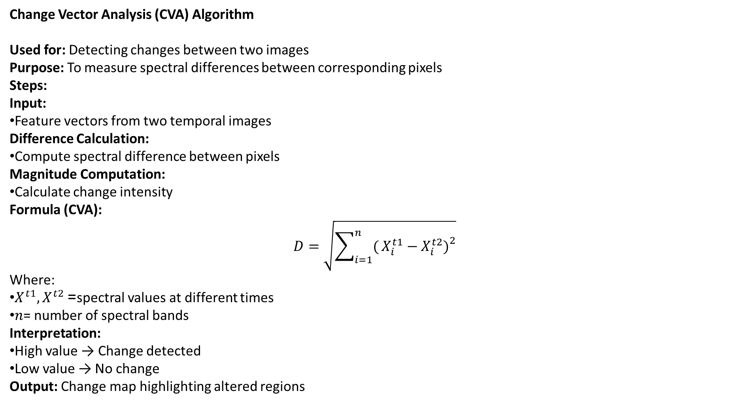
Algorithms Used
Change Vector Analysis (CVA) Algorithm
Used for: Detecting changes between two images Purpose: To measure spectral differences between corresponding pixels
Steps:
Input:
Feature vectors from two temporal images
Difference Calculation:
Compute spectral difference between pixels
Magnitude Computation:
Calculate change intensity
Formula (CVA): $$D=\sqrt{\sum_{i=1}^{n}{(}\left.X_{i}^{t1}−X_{i}^{t2}{\left.)\right.}^{2}\right.}$$
Where:
$X^{t1},X^{t2}$= spectral values at different times
$n$= number of spectral bands
Interpretation:
High value → Change detected
Low value → No change
Output: Change map highlighting altered regions

Slide 12
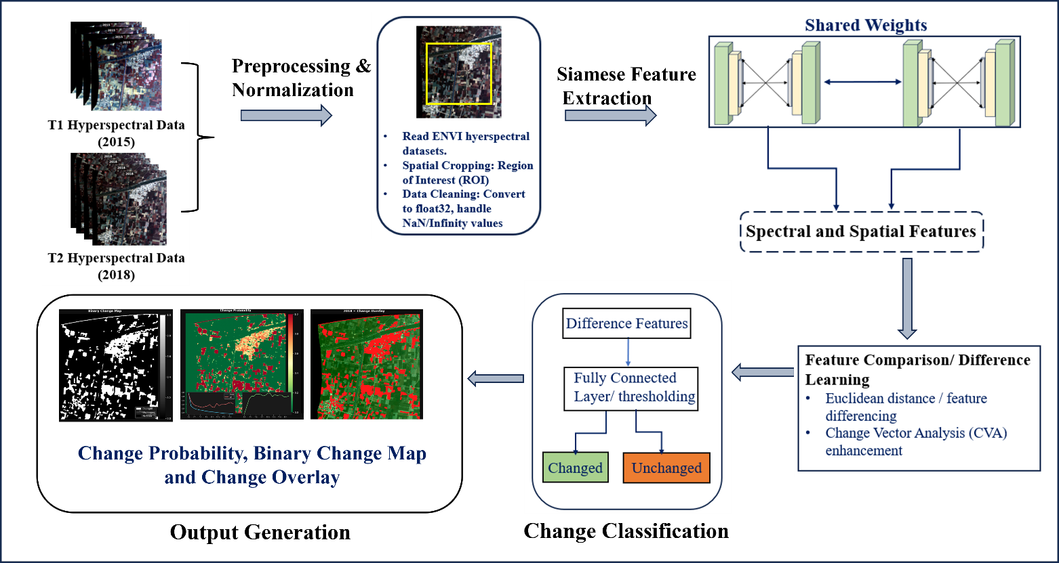
ARCHITECTURE

Slide 13
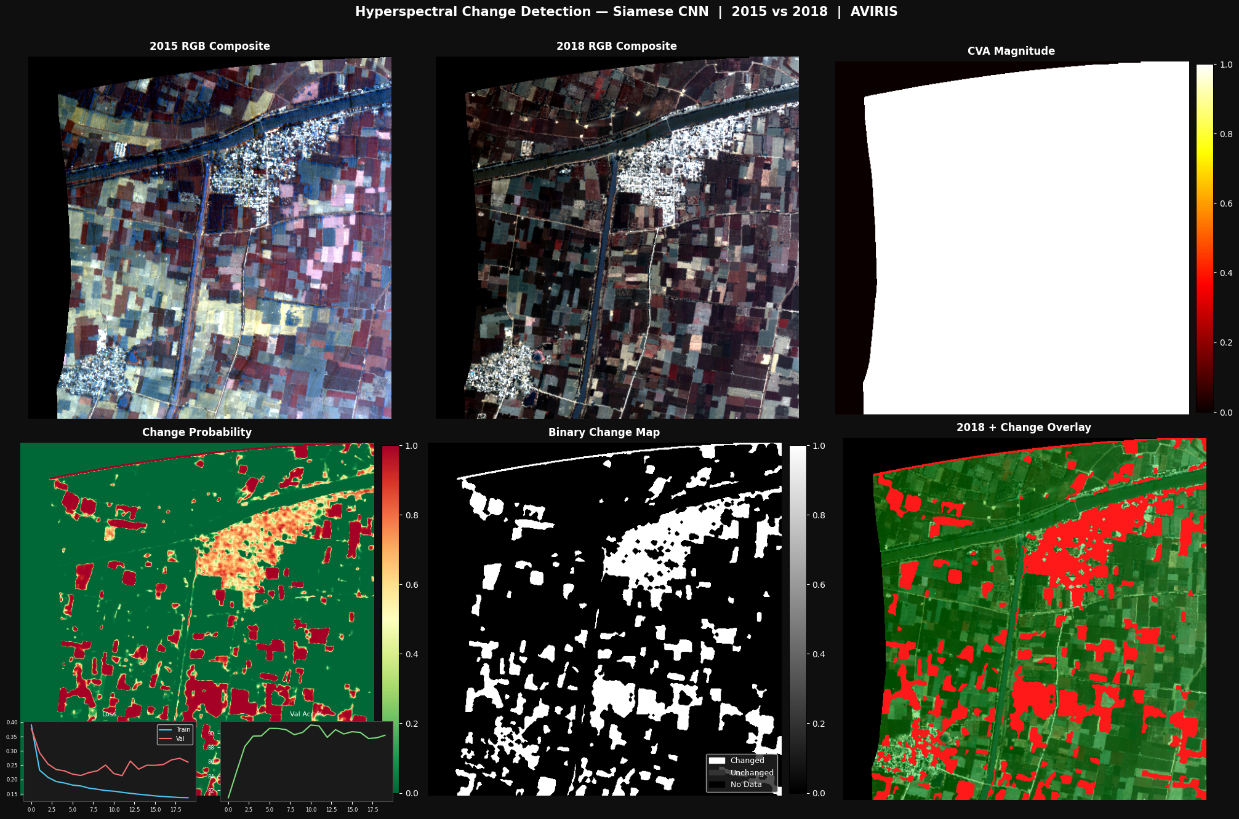
RESULTS
Output of Siamese CNN Model

Slide 14
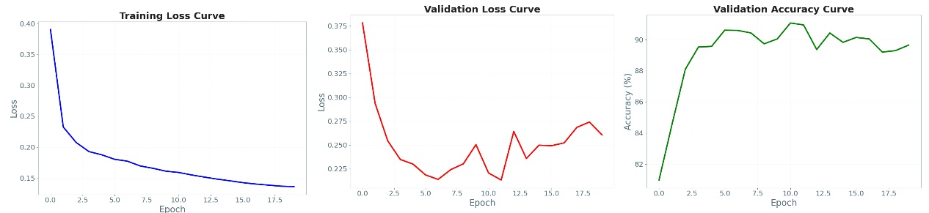
RESULTS
Graphs of Validation, Training loss, validation Accuracy Curves.

Slide 15
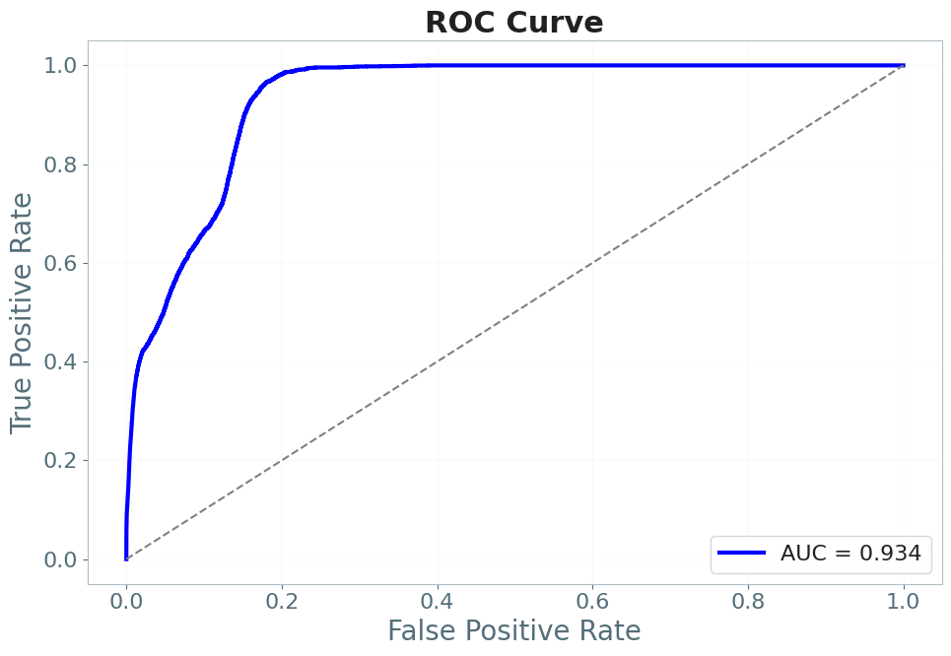
RESULTS
Graph of ROC Curve.

Slide 16
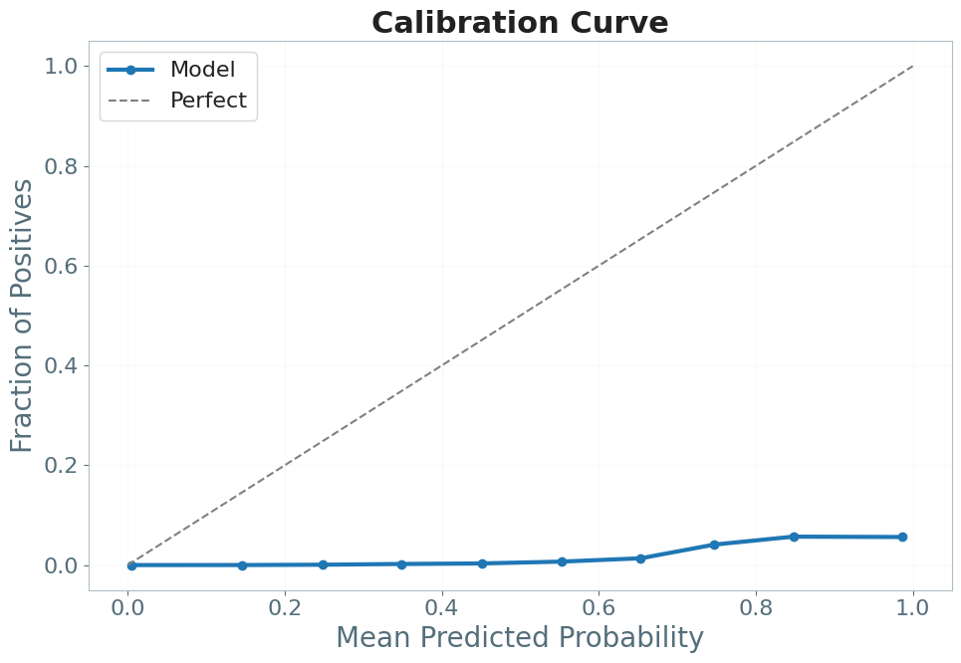
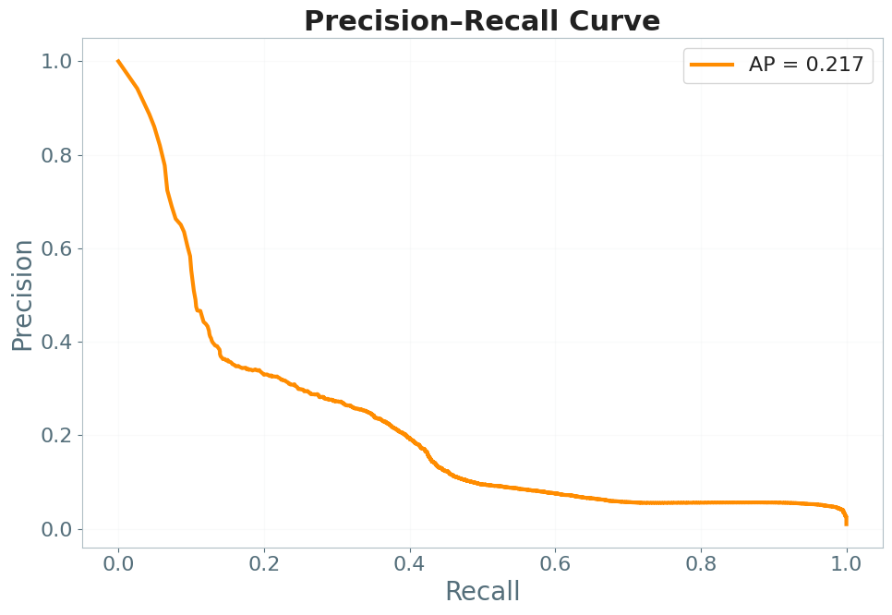
RESULTS
Graph of Precision Recall Curve.
Graph of Precision Recall Curve.

Slide 17
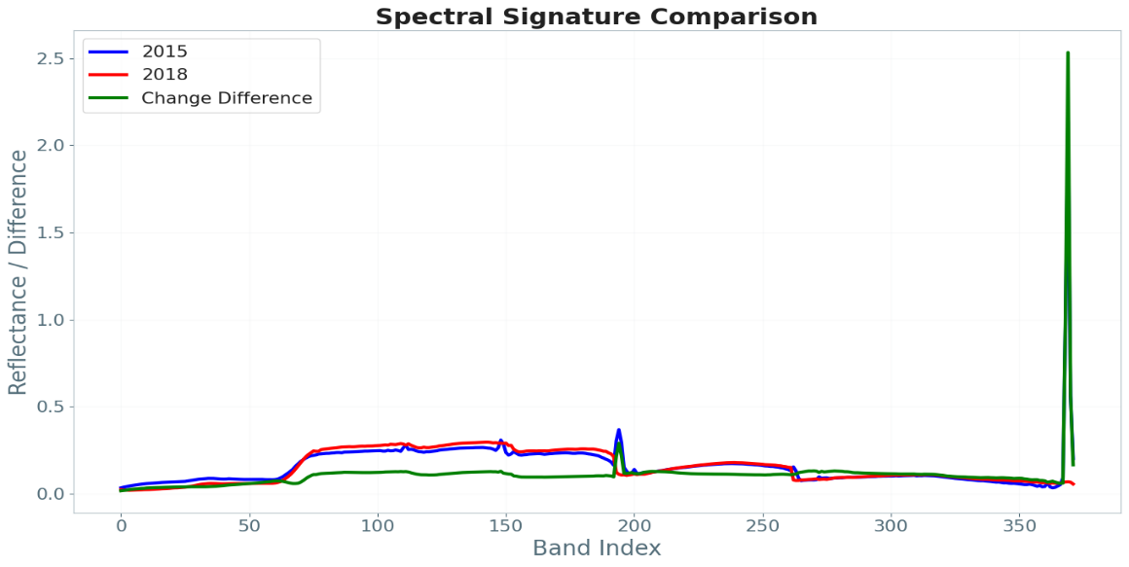
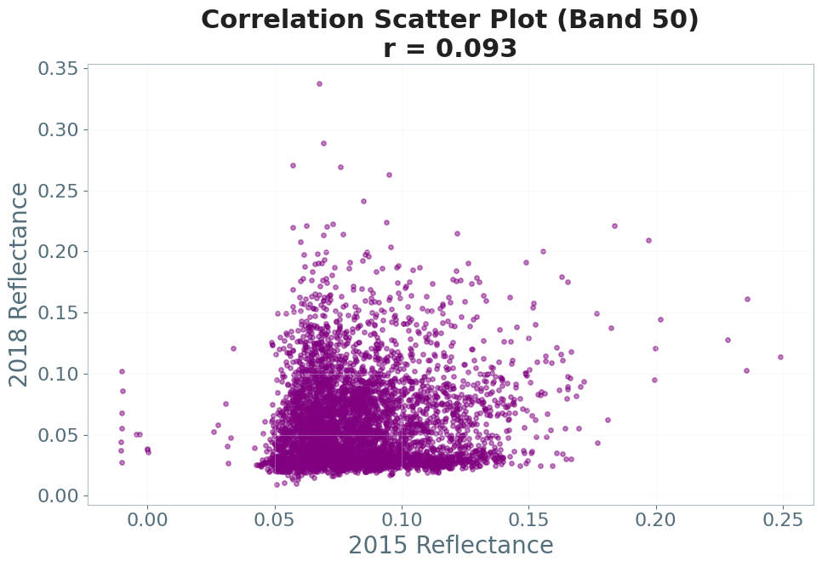
RESULTS
Spectral signature comparison using reflectance and band index.
Correlation scatter plot.

Slide 18
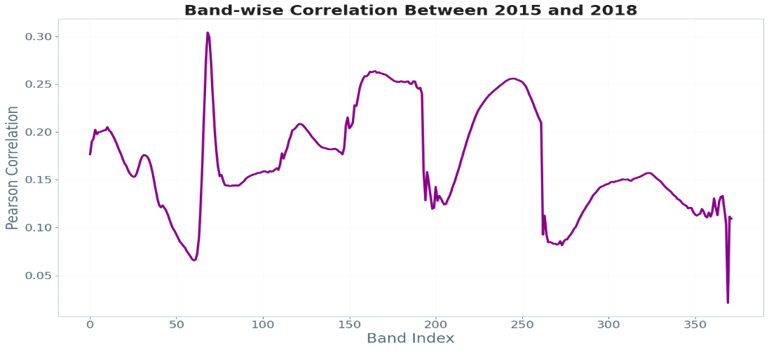
RESULTS
Metric | Value
Overall Accuracy | 78.87%
Balanced Accuracy | 87.57%
Precision | 0.0437
Recall | 0.9645
F1-score | 0.0836
MCC | 0.1803
IoU (Jaccard) | 0.0436
Dice Similarity | 0.0836
AUC | 0.9339
Average Precision (AP) | 0.2170
Correlation (Band 50) | 0.0933
Changed Pixels | 68,965
Changed Area | 22.06%
Band Wise Correlation plot.
PERFORMANCE SUMMARY

Slide 19
References
S. K. Roy, A. Deria, D. Hong, B. Rasti, A. Plaza and J. Chanussot, "Multimodal Fusion Transformer for Remote Sensing Image Classification," in IEEE Transactions on Geoscience and Remote Sensing, vol. 61, pp. 1-20, 2023, Art no. 5515620, doi: 10.1109/TGRS.2023.3286826.
Mengru Ma, Wenping Ma, Licheng Jiao ∗ , Xu Liu, Lingling Li,” A multimodal hyper-fusion transformer for remote sensing image classification ”, ISSN 1566-2535,https://doi.org/10.1016/j.inffus.2023.03.005.
Chen, X., Li, D., Liu, M., & Jia, J. (2023). CNN and Transformer Fusion for Remote Sensing Image Semantic Segmentation. Remote Sensing, 15(18), 4455. https://doi.org/10.3390/rs15184455

