Slide 1

PREDICTION OF CHRONIC KIDNEY DISEASE
NARASARAOPETA ENGINEERING COLLEGE
Submitted by:
M. Sai Kumar (18471A0530)
N. Rajesh (18471A0535)
P. John Subhani (18471A0542)
K. S.V. S. Chandra Prasad (18471A0521)
Under the esteemed guidance of:
Dr. S. N. Tirumala Rao, M.Tech., Ph.D
Professor & HoD.

Slide 2
Contents:
Abstract
Introduction
Dataset
Disease Model
Algorithm used
Comparison of algorithms used
Algorithm Description
Working of best algorithm chosen
Output screen
Future scope
References

Slide 3
Abstract
This Project proposes supervised machine learning technique to identify the presence of chronic kidney disease in humans.
This work proposes a workflow to predict CKD status based on clinical data, incorporating data prepossessing, a missing value handling method with collaborative filtering and attributes selection.
Out of the 11 machine learning methods considered, the extra tree classifier and random forest classifier are shown to result in the highest accuracy and minimal bias to the attributes.
This also considers the practical aspects of data collection and highlights the importance of incorporating domain knowledge when using machine learning for CKD prediction.

Slide 4
Introduction
Chronic Kidney Disease (CKD) or chronic renal disease has become a major issue with a steady growth rate. A person can only survive without kidneys for an average time of 18 days, which makes a huge demand for a kidney transplant and Dialysis.
It is important to have effective methods for early prediction of CKD.
There are no predictive instruments that are commonly accepted for CKD.
This lack of a common predictive instrument is becoming a bigger issue as the amount of CKD patients continues to grow.

Slide 5
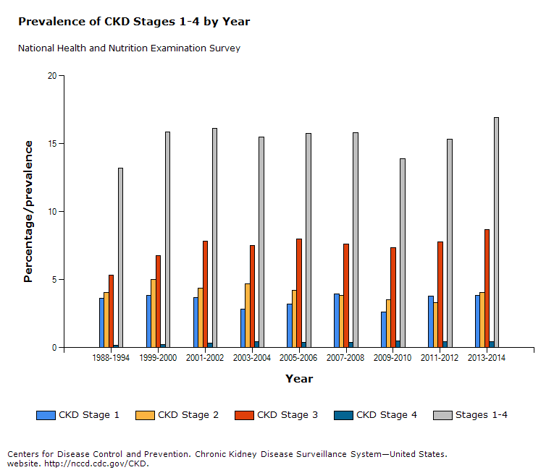
Increased growth of Chronic Kidney Disease

Slide 6
Introduction(Contd…)
To address the challenge,this model is able to identify presence of kidney disease or not based on factors like age, gender etc.
In this project, we will develop predictive analytics model using Random Forest Classifier algorithm for CKD prediction.

Slide 7
DATASET
Attribute Symbol | Attribute Type | Description
age | age in years | Numerical
bp | Blood Pressure (bp in mm/Hg) | Numerical
sg | Specific Gravity (1.005,1.010,1.015,1.020,1.025) | Nominal
al | Albumin (0,1,2,3,4,5) | Nominal
su | Sugar (0,1,2,3,4,5) | Nominal
rbc | Red Blood Cells (normal, abnormal) | Nominal
pc | Pus Cell (normal, abnormal) | Nominal
pcc | Pus Cell clumps (present, not present) | Nominal
ba | Bacteria (present, not present) | Nominal
bgr | Blood Glucose Random (bgr in mgs/dl) | Numerical
bu | Blood Urea (bu in mgs/dl) | Numerical
sc | Serum Creatinine (sc in mgs/dl) | Numerical
sod | Sodium (sod in mEq/L) | Numerical

Slide 8
DATASET
Attribute Symbol | Attribute Type | Description
pot | Potassium (pot in mEq/L) | Numerical
hemo | Haemoglobin (hemo in gms) | Numerical
pcv | Packed Cell Volume | Numerical
wc | White Blood Cell Count (wc in cells/cumm) | Numerical
rc | Red Blood Cell Count (rc in millions/cmm) | Numerical
htn | Hypertension (yes, no) | Nominal
dm | Diabetes Mellitus (yes, no) | Nominal
cad | Coronary Artery Disease (yes, no) | Nominal
appet | Appetite (good, poor) | Nominal
pe | Pedal Edema (yes, no) | Nominal
ane | Anemia (yes, no) | Nominal

Slide 9
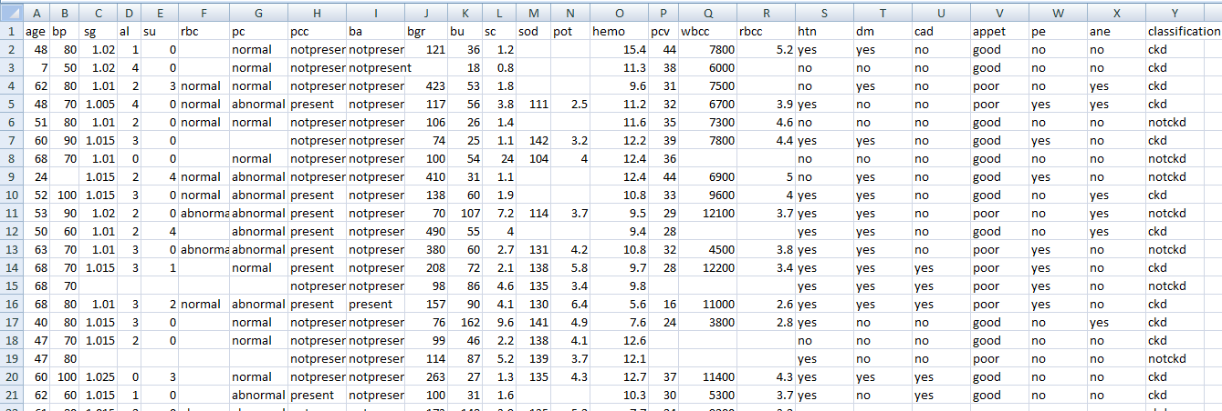
DATASET

Slide 10
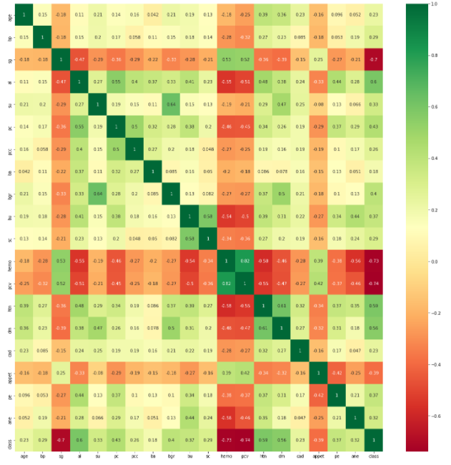
Heat Map showing the correlation of the attributes

Slide 11
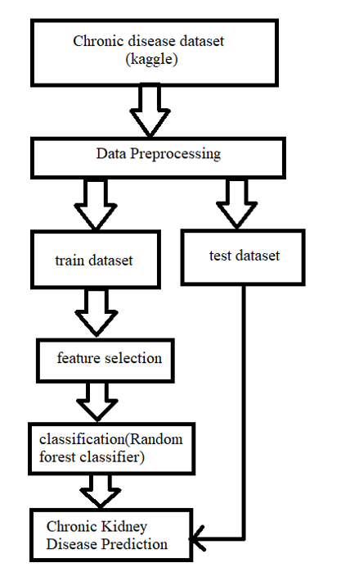
Chronic kidney disease Modeling(Contd…)

Slide 12
Algorithms used:
Decision Tree: Decision Tree Analysis is a general, predictive modelling tool that has applications spanning a number of different areas. In general, decision trees are constructed via an algorithmic approach that identifies ways to split a data set based on different conditions.
The goal is to create a model that predicts the value of a target variable by learning simple decision rules inferred from the data features.
The maximum accuracy obtained using the Decision tree is 100%.

Slide 13
Algorithms used(Contd...)
Random Forest: Random Forests are an ensemble learning method (also thought of as a form of nearest neighbour predictor) for classification and regression techniques.
It builds multiple decision trees and then merges them together in-order to get more accurate and stable predictions.
It also tries to minimize the problems of high variance and high bias by averaging to find a natural balance between the two extremes.
Maximum accuracy obtained by applying Random forest is 100%.

Slide 14
Algorithms used(Contd...)
KNN: KNN algorithm is one of the simplest classification algorithms and it is one of the most used learning algorithms. KNN is a non-parametric, lazy learning algorithm.
Its purpose is to use a dataset in which the data points are separated into several classes to predict the classification of a new sample point.
A KNN algorithm uses a data and classifies new data points based on a similarity measures (e.g. distance function, error rate). Classification is done by a majority vote to its neighbours.
Maximum accuracy obtained using KNN is 94.14%.

Slide 15
Algorithms used(Contd...)
Logistic Regression:Logistic regression is one of the most popular Machine Learning algorithms, which comes under the Supervised Learning technique.
It is used for predicting the categorical dependent variable using a given set of independent variables.
Logistic regression predicts the output of a categorical dependent variable. Therefore the outcome must be a categorical or discrete value. It can be either Yes or No, 0 or 1, true or False, etc.
Maximum accuracy obtained using Logistic Regression is 97.5%.

Slide 16
Algorithm Description
Assuming your dataset has “m” features, the random forest will randomly choose “k” features where k < m.
Now, the algorithm will calculate the root node among the k features by picking a node that has the highest information gain.
After that, the algorithm splits the node into child nodes and repeats this process “n” times.
Now you have a forest with n trees. Finally, you’ll perform bootstrapping, ie, combine the results of all the decision trees present in your forest.
It’s certainly one of the most sophisticated algorithms as it builds on the functionality of decision trees.

Slide 17
Random Forest Classifier working
Step 1: Select N random records from the given datasets.
Step 2: Create a decision tree based on the given training data set (rules)
Step 3: Suppose you want to create 5 different decision trees for your algorithm for this project, then repeat step 1 and 2, To create a total 5 decision tree.
As we know this Random Forest Algorithm works for both regression and classification task so for a new input data
classification task each decision tree of the algorithm will predict an output value based on their decision condition and Finally, the new record is assigned to the category that wins the majority vote.
The algorithm has given the maximum accuracy of 100%.

Slide 18
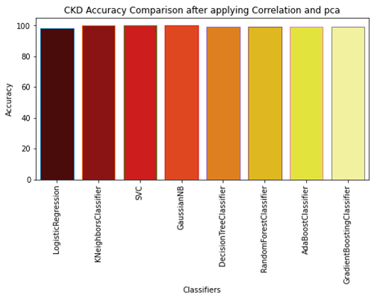
Comparison using graph:

Slide 19
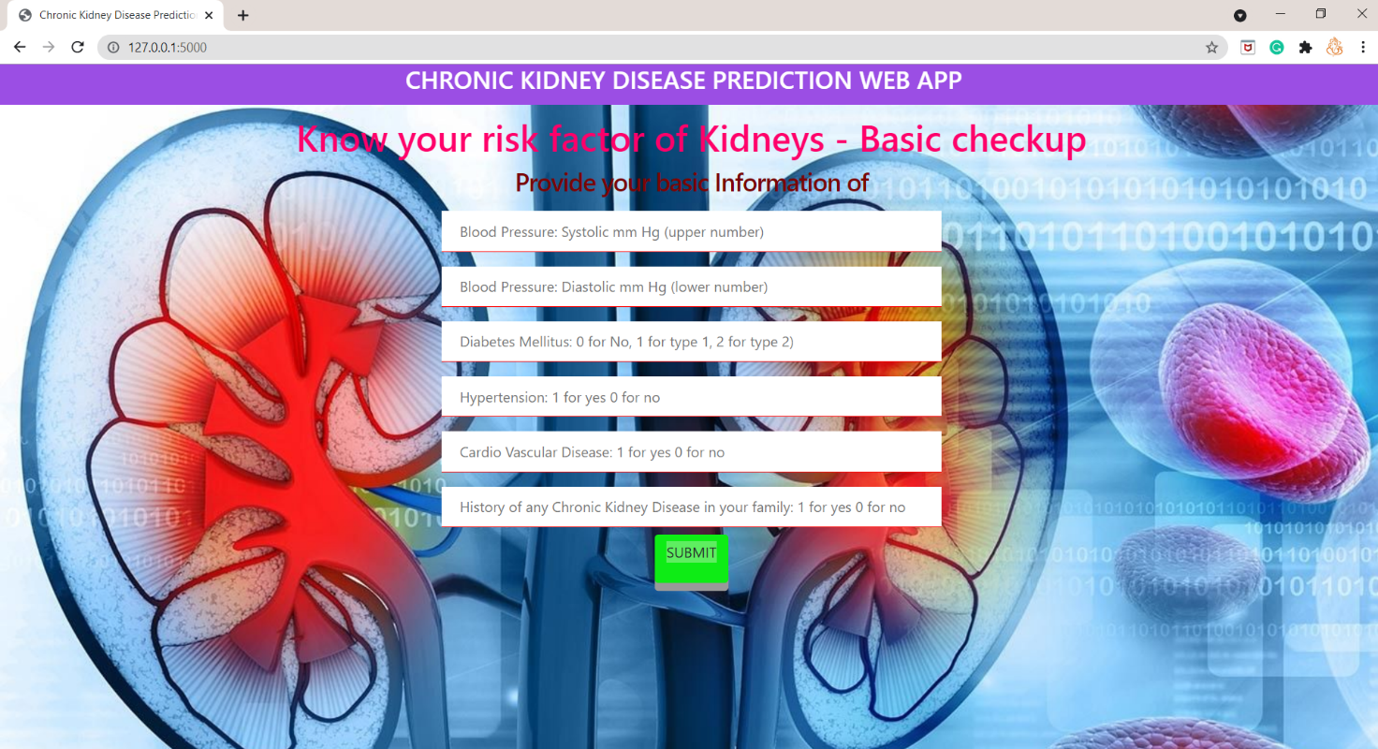
OUTPUT SCREEN

Slide 20
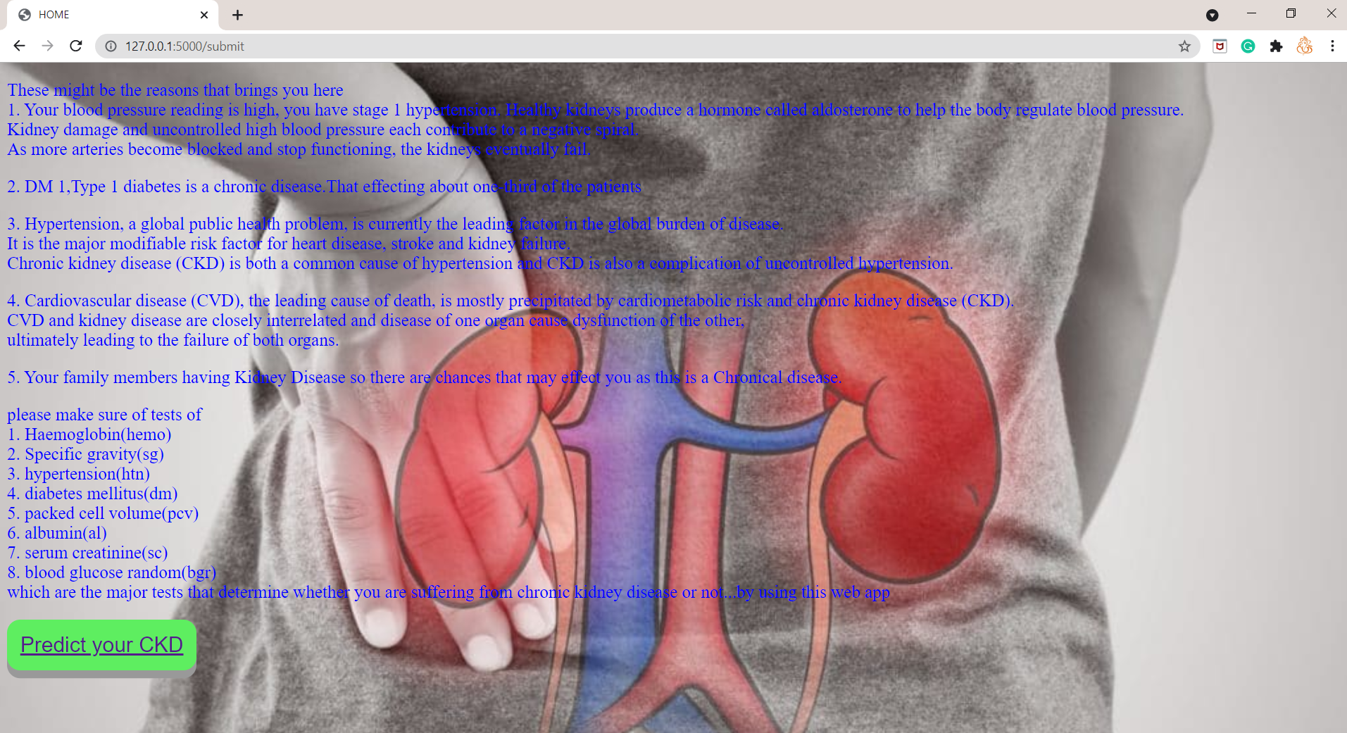
OUTPUT SCREEN

Slide 21
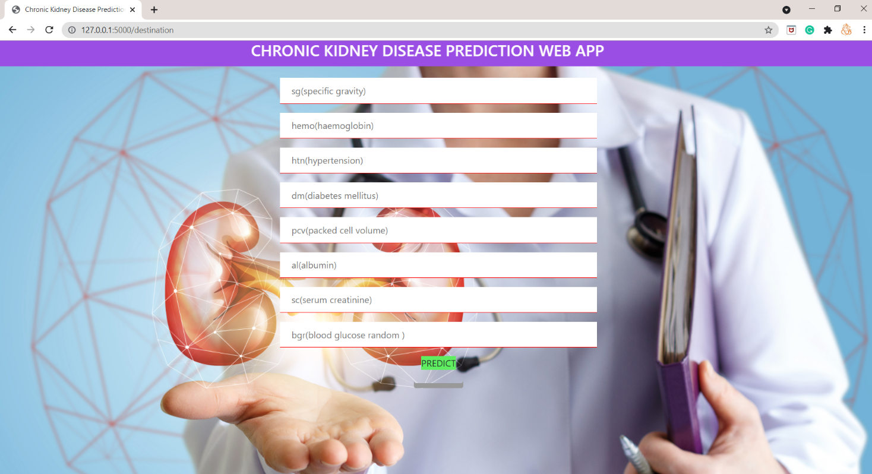
OUTPUT SCREEN

Slide 22
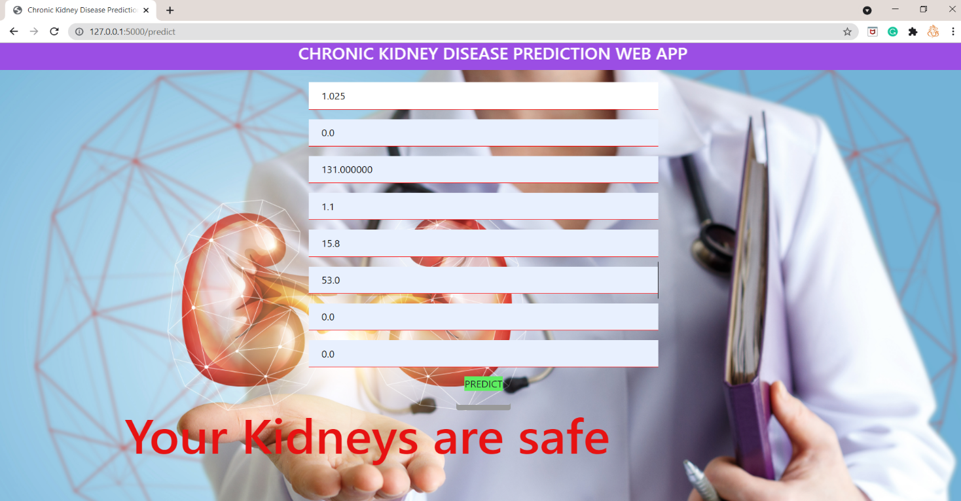
OUTPUT SCREEN

Slide 23
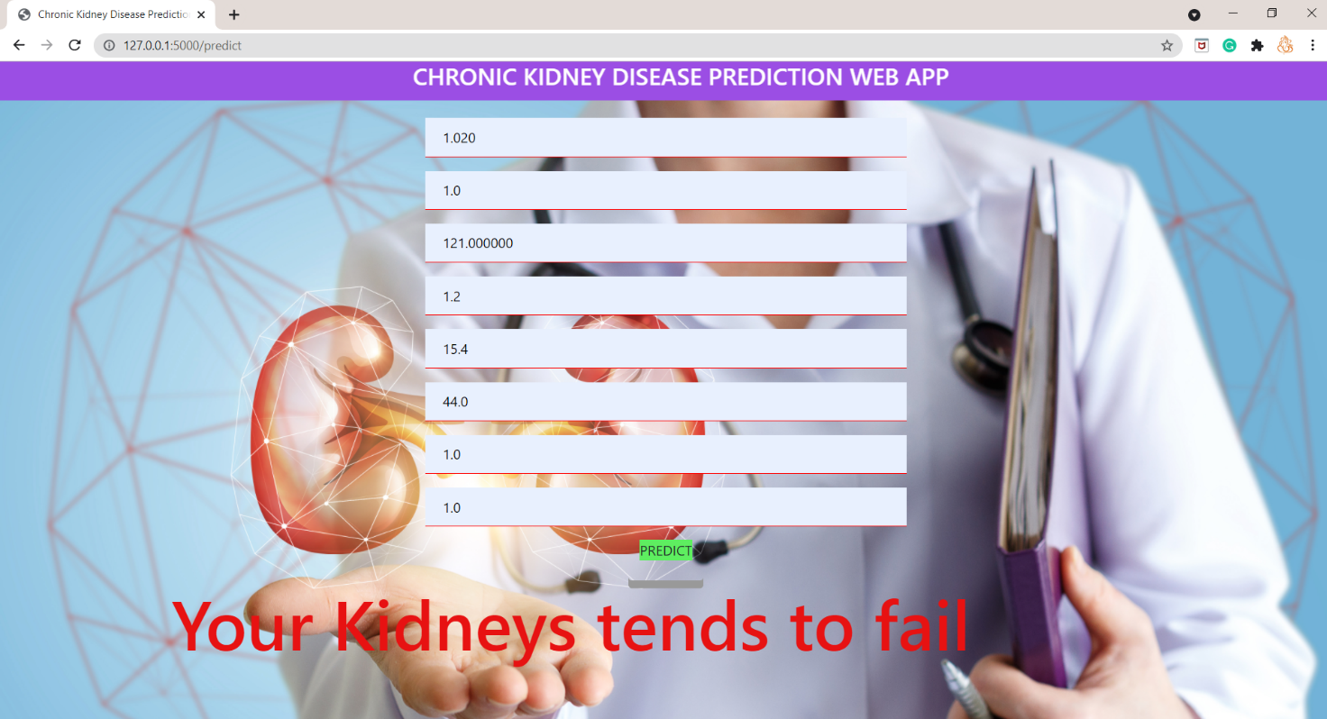
OUTPUT SCREEN

Slide 24
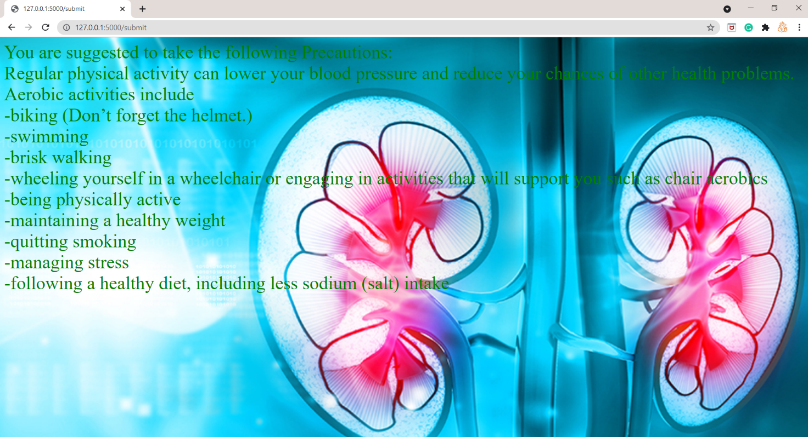
OUTPUT SCREEN

Slide 25
CONCLUSION
In this project, we proposed a probability based approach to categorize the medical chronic kidney disease records collected from kaggle.
This algorithm utilizes the probability distribution of records to identify there is disease present or not.

Slide 26
FUTURE SCOPE
This project further can be developed as Android application to overcome the limitation of accessing the system by only desktop and also suggest them about their stage in chronic kidney diseases.
Suggest the required treatment that to be taken by the person to cure from the chronic kidney disease at that particular stage.

Slide 27
References
[1] M. Chen, Y. Hao, K. Hwang, L. Wang, and L. Wang,“Disease prediction by machine learning over big data from healthcare communities”, ,” IEEE Access, vol. 5, no. 1, pp. 8869–8879, 2017.
[2] B. Qian, X. Wang, N. Cao, H. Li, and Y.-G. Jiang, “A relative similarity based method for interactive patient risk prediction,” Springer Data Mining Knowl. Discovery, vol. 29, no. 4, pp. 1070–1093, 2015.
[3] IM. Chen, Y. Ma, Y. Li, D. Wu, Y. Zhang, and C. Youn, “ Wearable 2.0: Enable human-cloud integration in next generation healthcare system,” IEEE Commun. , vol. 55, no. 1, pp. 54–61, Jan. 2017.
[4] Y. Zhang, M. Qiu, C.-W. Tsai, M. M. Hassan, and A. Alamri, “HealthCPS: Healthcare cyberphysical system assisted by cloud and big data,” IEEE Syst. J., vol. 11, no. 1, pp. 88–95, Mar. 2017.
[5] L. Qiu, K. Gai, and M. Qiu, “Optimal big data sharing approach for telehealth in cloud computing,” in Proc. IEEE Int. Conf. Smart Cloud (Smart Cloud), Nov. 2016, pp. 184– 189.

Slide 28


