Slide 1
Uber Supply-Demand Gap
Case Study
Submitted by:
Sai Kumar Reddy Baraju

Slide 2
The Problem:
Uber is an online cabs rental service provider. Uber is facing driver cancellation and non availability of cars issue for commutation from or to the Airport leading impact on the business and loss of potential revenue.

Slide 3
Challenges deep-dive
Challenge 1
Challenge 2
Challenge 3
Data Cleaning And Preparation
Identify the data quality issues and clean the data.
Format date and time fields.
Derive new variables needed for analysis.
Data Exploration And Analysis
Analyze the data for different time slot.
Identify type of requests and time slot that constitutes for supply-demand gap.
Graphical Analysis And Solution
Visualize and present the hypothesis of problem.
ways to resolve the supply demand gap.

Slide 4
Implementation

Slide 5
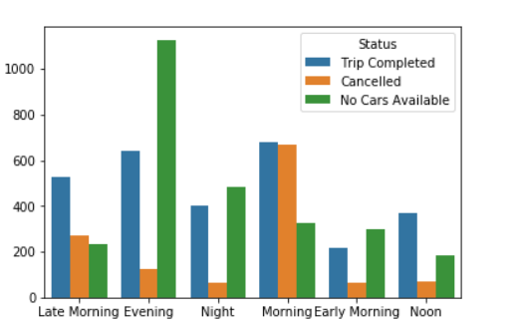
Mostly no cars are available in the evening.
Most cancelled trips are in the morning.

Slide 6
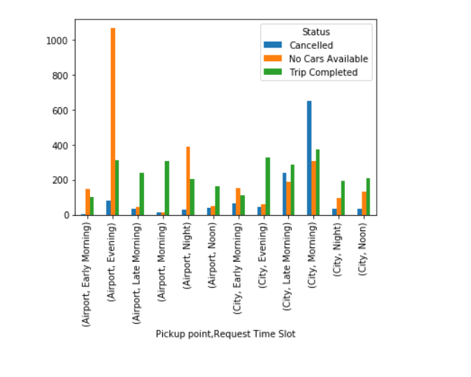
Mostly No Cars Available are in the Evening from Airport to City.
Most Cancelled trips are in the Morning from City to Airport.

Slide 7
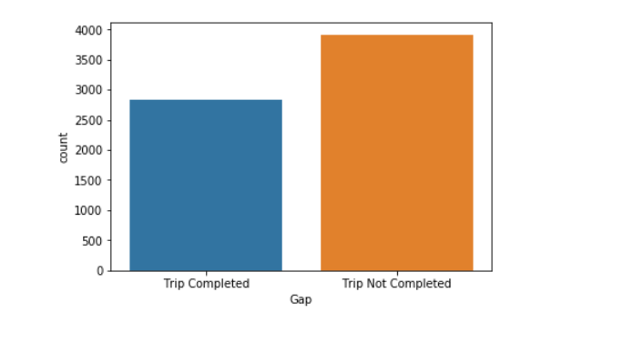
Trip not completed is greater than Trip Completed.

Slide 8
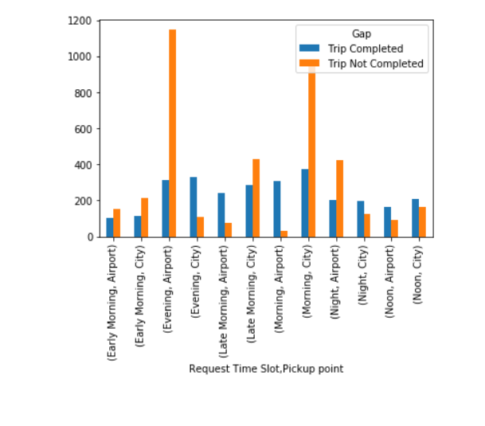
number of requests that was completed and which was not, for the final analysis.

Slide 9
Hypothesis
Pickup Point - City :- As per the analysis, the morning time slot is most problematic where the requests are being cancelled. Most probably the requests are being cancelled by the drivers due to the morning rush as it being the office hours and seeing the destination as airport which would be too far, the driver would think to earn more for the shorter trips within the city.
Pickup Point - Airport :- Upon analysis, the evening time slot seems to be most problematic for pickup points as airport where the requests being No Cars Available. The reason seems to be that not enough cars are available to service the requests as cars might not be available at the airport due to the cars serving inside the city.

Slide 10
Solution
Based on the data analysis performed, following recommendation can be used by Uber to bridge the gap between supply and demand: -
For bridging the demand supply gap from airport to city, making a permanent stand in the airport itself where the cabs will be available at all times and the incomplete requests can come down significantly.
Uber can provide some incentives to the driver who complete the trip from city to airport in the morning part. This might result the driver to not cancel the request from city to airport trips.
Last but sure solution to bring down the gap is to increase the numbers of cab in its fleet.

Slide 11
Thank You.

