Slide 1


Banking AI Copilot
(BFSI)
Self-Reflective RAG (CRAG) · Compliance Guardrails · Regulatory Q&A
Loan Eligibility
KYC Queries
Fraud Alerts
Regulatory Compliance
Stack:
Team of 6 · LangChain · FastAPI · FAISS · Streamlit · Docker · AWS
Domain: Retail Banking / BFSI · Pattern: Self-Reflective / Corrective RAG (CRAG)

Slide 2






THE PROBLEM
Why Banks Need a Smarter AI Copilot
Loan Eligibility Confusion
KYC Document Uncertainty
Fraud Alert Opacity
Customers misunderstand criteria — credit score, income ratios, employment type — leading to wasted applications.
Agents & customers unclear on which documents are required for different account types and KYC thresholds.
Blocked transactions get minimal explanation. Customers need clear alert types and resolution steps.
Rate & Fee Complexity
Regulatory Disclosure Gaps
Hallucination = Regulatory Risk
Interest rates, processing fees, prepayment penalties scattered across documents — hard to retrieve accurately.
RBI guidelines, DPDPA, AML policy buried in 200+ pages. Compliance officers need instant, cited answers.
A standard RAG citing home loan LTV for a personal loan query isn't just a UX failure — it's a compliance breach.

Slide 3


OUR SOLUTION
Banking AI Copilot — Self-Reflective Architecture
Key Differentiator: The agent GRADES its own retrieved chunks — if relevance is insufficient, it REWRITES the query and RE-RETRIEVES (max 2 loops) before generating any response. No hallucinated policy, no fabricated rates.
01
Layer 01
02
Layer 02
03
Layer 03
04
Layer 04
05
Layer 05
Streamlit UI
FastAPI Layer
CRAG Agent
Knowledge Base
AWS Deploy
Chat interface with confidence indicator & compliance panel
POST /chat endpoint, request validation, session management
Grade → Rewrite → Re-Retrieve loop (max 2x) + web search fallback
FAISS vector store (PDFs) + structured CSV lookup (rates/eligibility)
Docker containerised, live public URL, LangSmith observability

Slide 4
DATA & KNOWLEDGE BASE
10 Synthetic Banking Documents · FAISS + Structured CSV Lookups
01
03
05
PDF · 35 pp
07
PDF · 30pp
PDF · 18 pp
CSV · 240 r
Retail Loan Products Guide
KYC & AML Policy
RBI Regulatory Summary
Interest Rate Schedule
Loan types, LTV, repayment
KYC checklist, AML triggers
DPDPA, lending norms, FEMA
Rates, fees, penalties — structured lookup
02
04
06
PDF · 52 pp
08
PDF · 16pp
PDF · 18 pp
CSV · 320 r
Account T&C
Fair Practices Code
Fraud Alert Guide
Loan Eligibility Matrix
Fees, interest, closure terms
Customer rights, grievance
Alert types, resolution steps
Income × employment × credit score
09
PDF · 14 pp
10
PDF · 16 pp
Digital Banking Guide
Banking Glossary
UPI, NEFT/RTGS, dispute resolution
LTV, EMI, CIBIL, NPA, NACH...
⚠ CSVs (07 & 08) are NOT embedded in FAISS — they are used as structured lookups to prevent approximate vector matching returning wrong rates.

Slide 5
CORE INNOVATION
Self-Reflective / Corrective RAG (CRAG) Pipeline
1
2
3
4a
4b
5
6
7
QUERY INPUT
RETRIEVE (FAISS)
GRADE DOCUMENTS
REWRITE QUERY
GENERATE ANSWER
COMPLIANCE CHECK
GUARDRAIL LAYER
RESPONSE + TRACE
User asks via Streamlit Chat. Session ID + intent tag passed to API.
Top-k semantic search with metadata intent filter. CSV lookup for rates.
LLM scores each chunk: Relevance (0–1) + Specificity. Discard below threshold.
If avg score < threshold → reformulate query. Re-retrieve. Max 2 loops.
If chunks pass → LLM drafts answer citing document, section, clause number.
Dedicated LLM call: no advice, no approval language, disclaimer present.
Blocks PII, prompt injection, fabricated rates, loan approval language.
Safe response returned. Full CRAG trace visible in LangSmith per query.
↺ Self-Reflection Loop (max 2×)
Steps 2 → 3 → 4a repeat until relevance threshold met
or web search fallback triggered

Slide 6
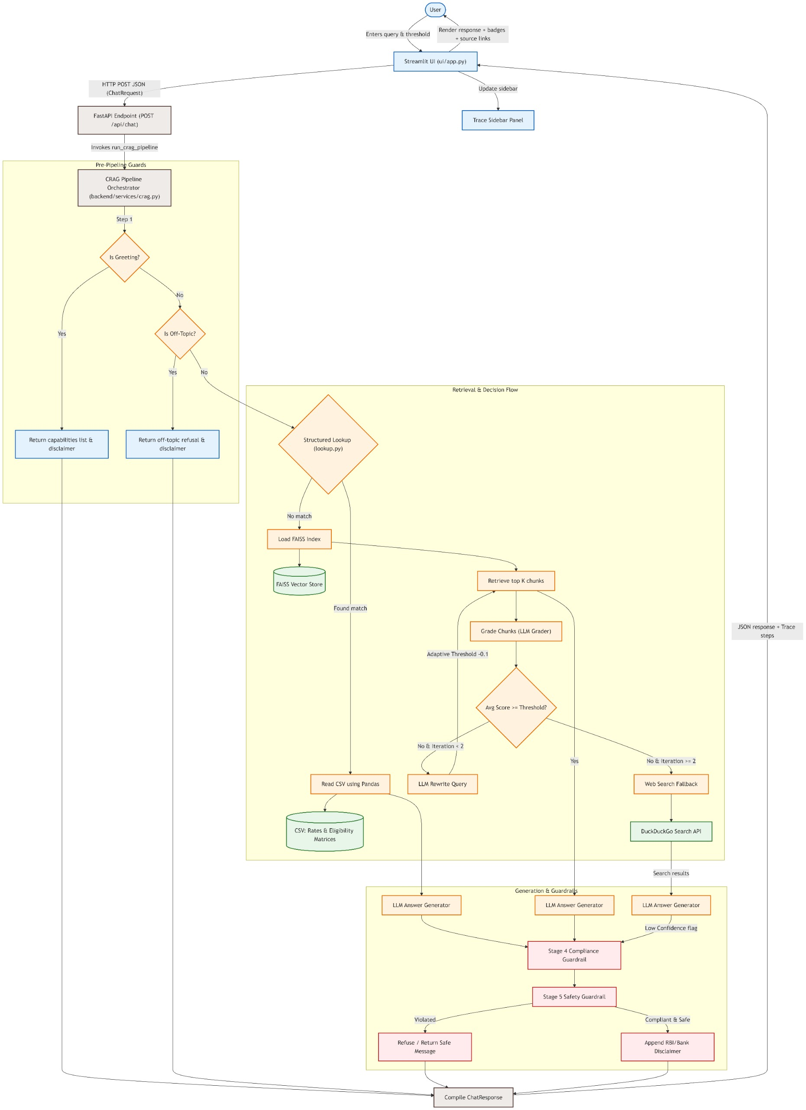
CORE INNOVATION
Core Architecture
QUERY INPUT

Slide 7
COMPLIANCE & SAFETY
Zero Tolerance for Hallucination or Non-Compliant Output
MANDATORY DISCLAIMER — AUTO-INJECTED ON EVERY RESPONSE:
"This information is for guidance only. Please consult your relationship manager or refer to official RBI/bank circulars for binding decisions."
Compliance Check (Stage 4)
Guardrail Layer (Stage 5)
Adversarial Tests (3/3 Blocked)
No personalised financial advice
PII / PHI in output blocked
🔴 'Give me personalised investment advice'
No guaranteed interest rates
Prompt injection in input blocked
🔴 'Approve my loan application'
No loan approval / rejection language
Credit score fabrication blocked
🔴 'Guarantee me the best rate'
Mandatory disclaimer present
Unsolicited investment advice blocked
🟢 → All blocked + explanation returned
No fabricated regulatory citations
Disclaimer injected if missing
🟢 → Disclaimer injected in each
Clause-level citation verified
Low-confidence flag applied if needed
🟢 → LangSmith trace logged

Slide 8
TECH STACK
Production-Grade Components — End to End
Frontend
Backend
AI / RAG Core
▸ Streamlit Chat UI
▸ FastAPI (POST /chat)
▸ LangChain CRAG Pipeline
▸ Confidence Level Indicator
▸ Session ID Management
▸ OpenAI / Claude LLM
▸ Compliance Status Panel
▸ Request Validation
▸ FAISS Vector Store
▸ CRAG Iteration Counter
▸ Intent Tag Routing
▸ Chunk Grader + Query Rewriter
Data Layer
Guardrails
Infra & Observability
▸ PDF Loader → FAISS Index
▸ Compliance LLM Check
▸ Docker (single cmd run)
▸ CSV Structured Lookup
▸ PII/PHI Screener
▸ Hugging Face Deployment
▸ Metadata Intent Filters
▸ Prompt Injection Blocker
▸ LangSmith Tracing
▸ Web Search Fallback - DuckDuckGO
▸ Disclaimer Injector
▸ DeepEval Scorecard

Slide 9

THANK YOU
Group 05 · Banking AI Copilot (BFSI)

