Slide 1
AI BASED SCARECROW AND ANIMAL DETECTION
Under the Guidance of : Mrs. V. Sravanthi
Team Details :
Lavudya Revanth (21R11A05H4)
Sende Sai Kumar (21R11A05K6)
Gujja Mokshith (21R11A05G5)

Slide 2
CONTENTS
Abstract
Existing System And Proposed System
System Configuration
System Architecture
Modules
Screenshots
Pros and Cons
Conclusion

Slide 3
Abstract
Crop damage caused by animal attacks is a significant threat to farmers, as crops are often damaged by local animals like buffaloes, cows, goats, and birds. Traditional methods like physical barriers, electric fences, and scarecrows are often ineffective or impractical for 24/7 protection. To address this, we propose an AI-based scarecrow system that uses cameras and machine learning to detect stray animals or birds. Utilizing YOLOv3 and CV2 modules, the system identifies these threats in real-time, produces deterrent sounds, and sends alerts to farmers, ensuring comprehensive crop protection.

Slide 4
Existing System
Manual methods like constructing fences and using natural repellents can be effective but are often not cost-efficient or feasible due to labor constraints. Initial projects used hardware solutions like cameras interfaced with Raspberry Pi and Arduino systems to detect animals and send alerts. However, these systems are expensive and require significant maintenance. Recent research is focusing on using Artificial Intelligence to automate animal detection and response, reducing costs and improving efficiency in protecting crops.
Limitations of Existing System
Electric fences are dangerous to animals and humans.
IOT based Sensor monitoring doesn’t provide accurate results.

Slide 5
Proposed System
Real-Time Animal Detection: The AI-Based Scarecrow uses the YOLOv3 algorithm and OpenCV's cv2 module to scan live video feeds, detect animals entering crop fields, and classify them accurately with the help of the COCO names dataset.
Automated Response System and Alert system: Upon detecting an animal, the system plays a specific deterrent sound tailored to the type of animal identified, and sends an alert to farmers.
Advanced Crop Protection: This innovative system offers a more dynamic and automated approach compared to traditional methods, providing real-time monitoring and responses, reducing the need for manual surveillance, and adapting to various farm environments.

Slide 6
System Configuration
Software Requirements
Operating System 8 or above.
Front-End Technologies HTML, CSS, JavaScript
Frameworks Bootstrap for responsive design, Animate.css for animations.
Back-End Technologies Programming Language (Python.)
Hardware Requirements
Processor Basic
Memory (RAM) Minimum 4 GB.
Network High-speed internet connection

Slide 7
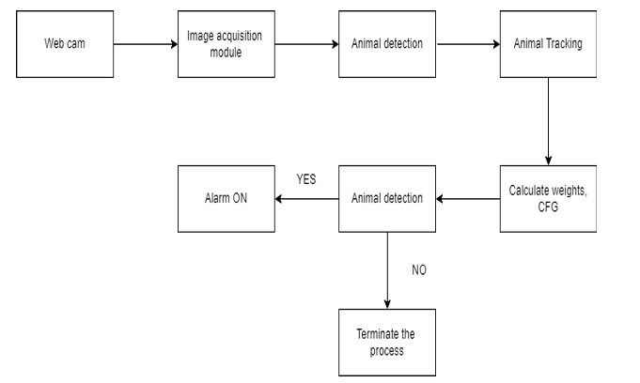
Architecture

Slide 8
Modules
User Authentication Module: Allows secure user registration and login with email verification, ensuring authenticated access to the application.
Monitoring Module: Uses a camera to continuously record the farm, providing comprehensive surveillance and real-time monitoring.
Detection Module: Utilizes the YOLOv3 algorithm for real-time animal detection in video feeds, identifying animals by analyzing frames against the coco.names dataset.
Alert Module: Plays a specific sound to deter detected animals and sends an alert message to the farmer to prevent crop damage.

Slide 9


Sign up/Login

Slide 10
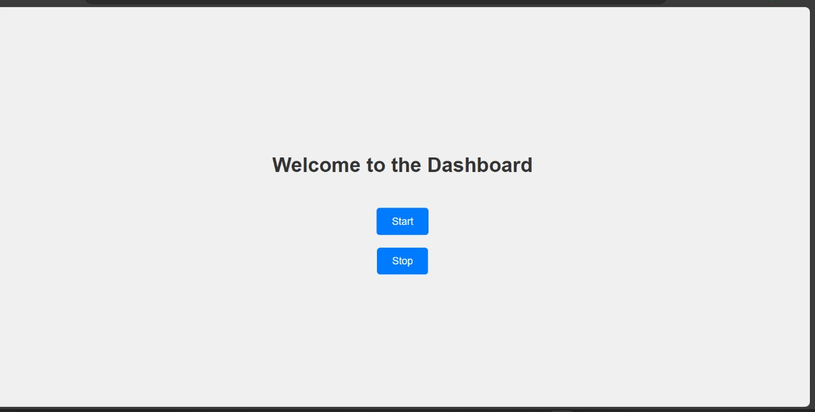
Dashboard:

Slide 11
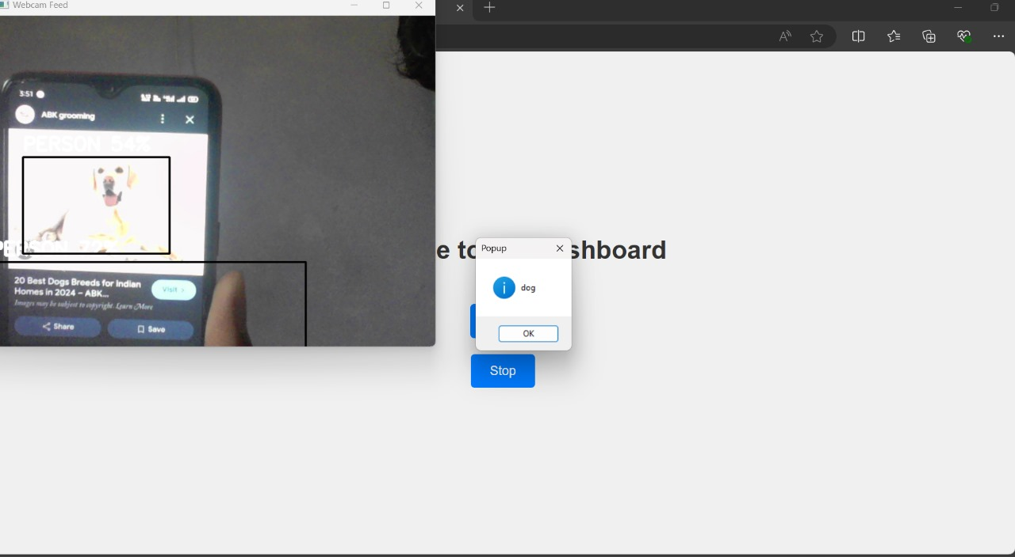
Real Time Detection

Slide 12
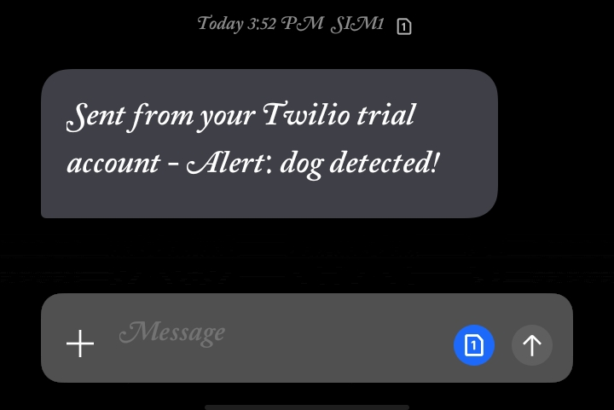
Alert Message

Slide 13
Pros and Cons
Pros
Real-time detection and response.
Automated and adaptive deterrent system.
Alert system
High accuracy and versatility.
Cons
High initial setup and cost.
Requires maintenance and technical knowledge.
Dependence on technology for effectiveness.

Slide 14
Conclusion
This system is designed to repel wild animals from entering fields by playing sounds they fear and alerting farmers. It addresses the serious issue of crop vandalization by wild animals while ensuring animal welfare. This system reduces crop loss and the need for manual labor, making it an effective, safe, and affordable solution for farmers. It protects crops without harming animals or humans, helping farmers avoid significant financial losses and unproductive efforts in safeguarding their fields.

Slide 15
THANK YOU

