Slide 1



IPBL-DS
CAPSTONE PROJECT-4
Geethanjali College of Engineering and Technology
Presented By: IPBL-DS Team 11
J.AJAY (21R11A05G8)
L. Revanth (21R11A05H4)
S. Sai Kumar (21R11A05K6) May 4,2024

Slide 2

PROJECT TITLE
Exploring Crime Analysis with LAPD Leveraging Machine Learning for Public Safety

Slide 3
CONTENTS
Executive Summary
Introduction
Methodology
Data Cleaning & Pre processing
Exploratory Data Analysis
Data Visualization
Machine Learning
Web App
Conclusion

Slide 4
EXECUTIVE SUMMARY
In this project, we will predict crime type, location, weapon using several machine learning algorithms.
The main steps in this project include:
  Data cleaning and pre-processing
  Exploratory data analysis
  Interactive data visualization(spatial analysis, time series analysis)
  Machine learning prediction
We will also build a web app to give predictions for inputs from user.

Slide 5
INTRODUCTION
Crime is a complex issue globally, posing challenges for law enforcement.
• This study analyzes LAPD crime data from 2020 to Present to understand crime patterns in Los Angeles.
• The LAPD covers four bureaus with 21 divisions across the city.
• The goal is to assist LAPD by identifying crime trends for better resource allocation.
• Rich data from 2020 to Present offers insights into crime types, locations, and victim demographics.
• This project aims to improve crime prevention and public safety through data analysis and collaboration with LAPD.

Slide 6
METHODOLOGY
The overall methodology includes:
1.Data cleaning & Preprocessing, using:
=> fillna
=>sklearn
2.Exploratory data analysis, using:
=>Pandas and NumPy
3.Data visualization, using:
=>Matplotlib ,Seaborn, Plotly and mapbox
4.Machine learning prediction, using:
=>Random Forest Classifier
=>KNN
=>Decision Tree
=>Gradient Boosting Classifier
=>SVC
5.Building Web App using,:
=>Streamlit
Data Cleaning &
Preprocessing
Exploratory Data Analysis
Data Visualization
Machine Learning Prediction
Web App

Slide 7
DATA CLEANING & PRE PROCESSING
The Dataset given by Industrial person consists of 28 features and 925720 observations.
First we have converted ‘DATE OCC’, ‘DATE Rptd’ and ‘TIME OCC’ columns into datetime.
Then created new columns, month, year and time respectively while dropping ‘DATE OCC’, ‘DATE Rptd’ columns.
We also divided all the crime three new columns, ‘violent’ ,’theft’ and ‘vehicular’.
We used a lambda function which gives 1 and 0 for the crimes in violent, theft and vehicular.

Slide 8
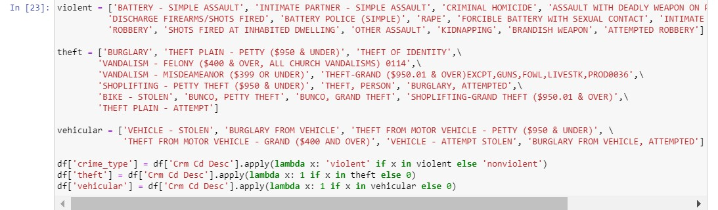
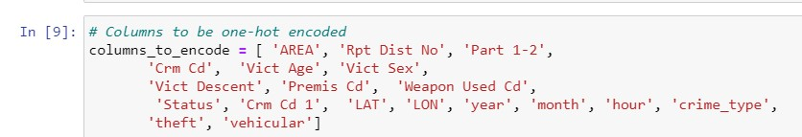
DATA CLEANING & PRE PROCESSING
1 is for true and 0 is for false.
We also used label encoder for columns_to_encode.

Slide 9
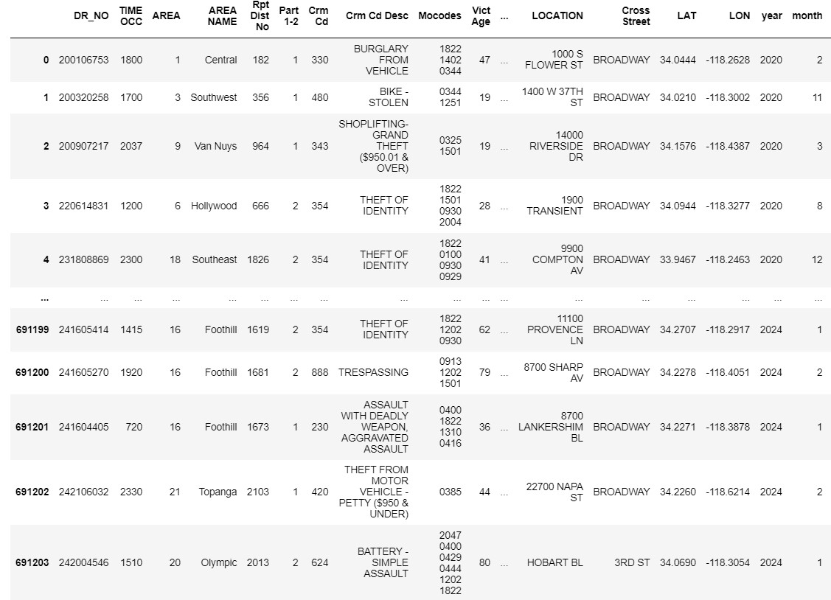
DATA CLEANING & PRE PROCESSING
After that we have used fillna method to fill missing/null values in the dataset.
This is going to be the dataset we are going to use for machine learning process.

Slide 10
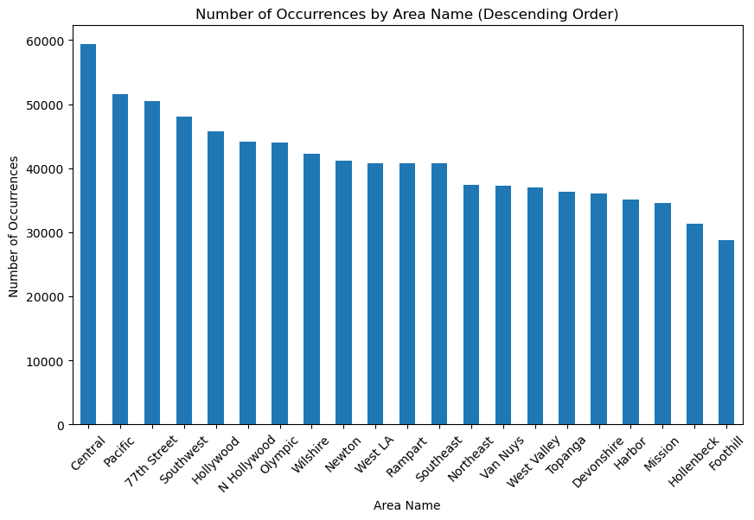
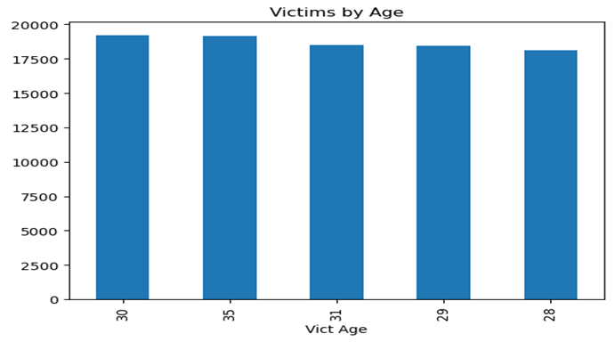
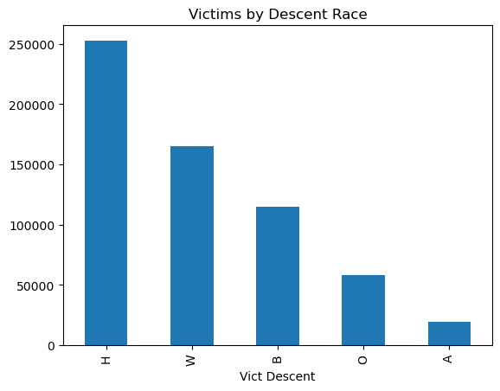
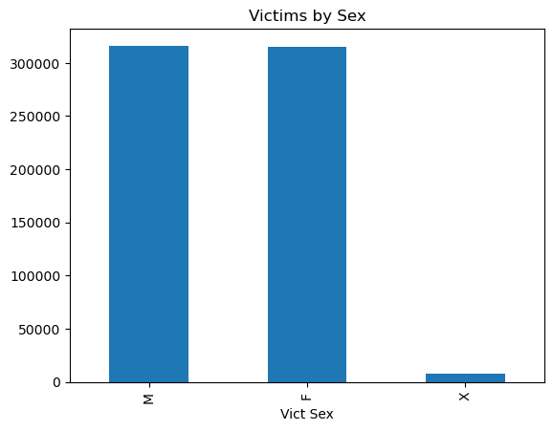
EXPLORATORY DATA ANALYSIS
From EDA we have found out that no.of crimes are
Recorded most in area ‘Central’.
We also found that the victims are mostly
Hispanic/Latin/Mexican.
The victims reports are almost same for male and female.
Age for crime reports are mostly victims are young and
Middle-aged people.

Slide 11
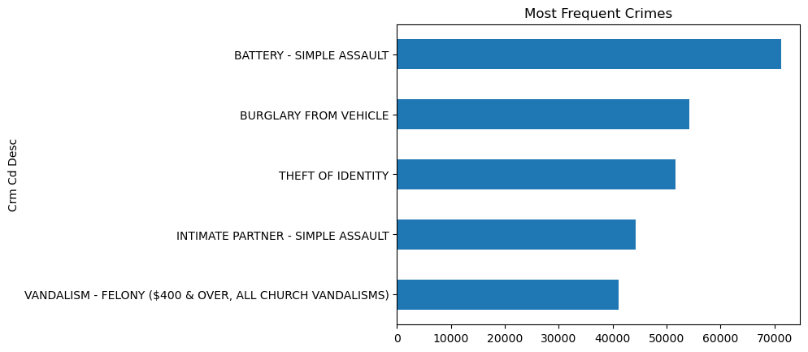
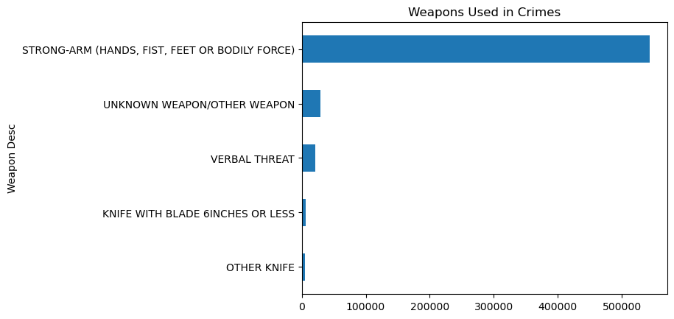
EXPLORATORY DATA ANALYSIS
From the reports we can say that the most frequent crime is SIMPLE ASSAULT’.
We also found that the most used weapon in crime is HANDS,FEET or BODILY FORCE.

Slide 12
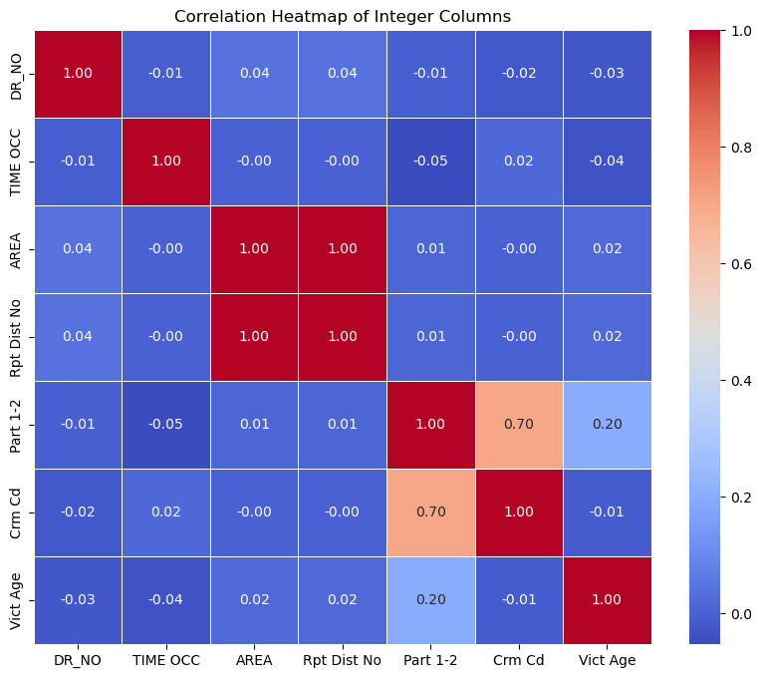
EXPLORATORY DATA ANALYSIS
From the above heat map we can say that AREA and Rpt Dist No is same so we can use only one of them in x train columns during machine learning process.
Doing this will reduce complexity.

Slide 13
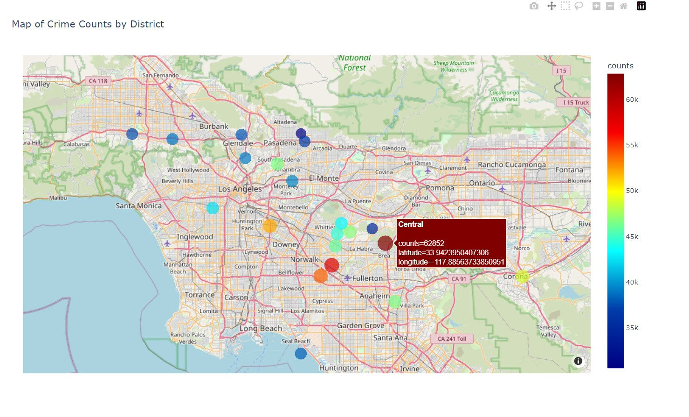
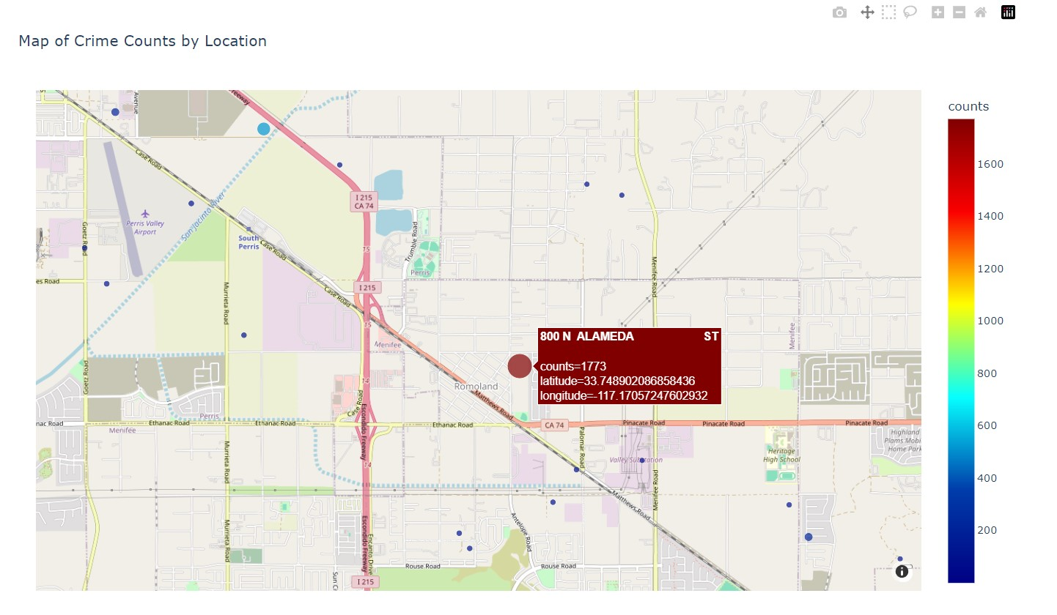
DATA VISUALIZATION
SPATIAL ANALYSIS
Using plotly express and map box and taking longitude and latitude from the data set we have build a interactive map by area and location which shows the crime hotspots in the maps as dark red.

Slide 14
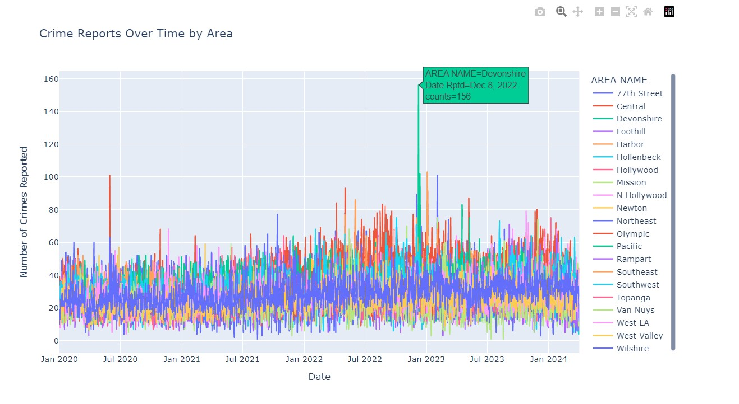
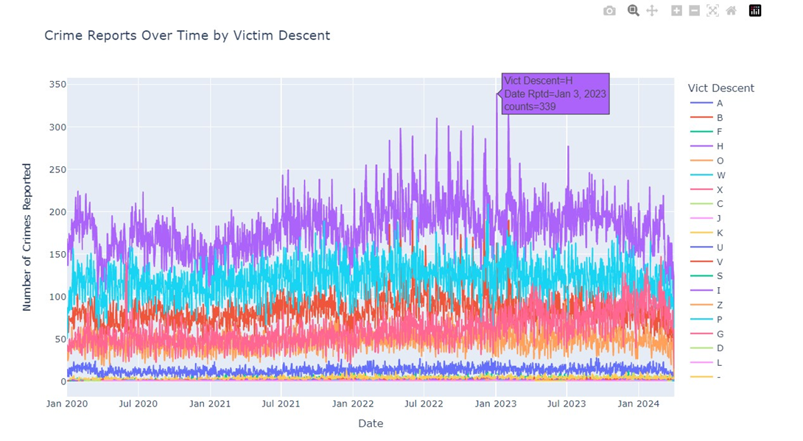
DATA VISUALIZATION
TIME SERIES ANALYSIS
From the time series graph by AREA ,
We found that in the AREA
Devonshire there are 156 crime reports
on Dec 8,2022.
From the time series graphs by
Victim Descent, we found that there
are 339 crime reports are by HISPANIC
on Jan 3, 2023.

Slide 15
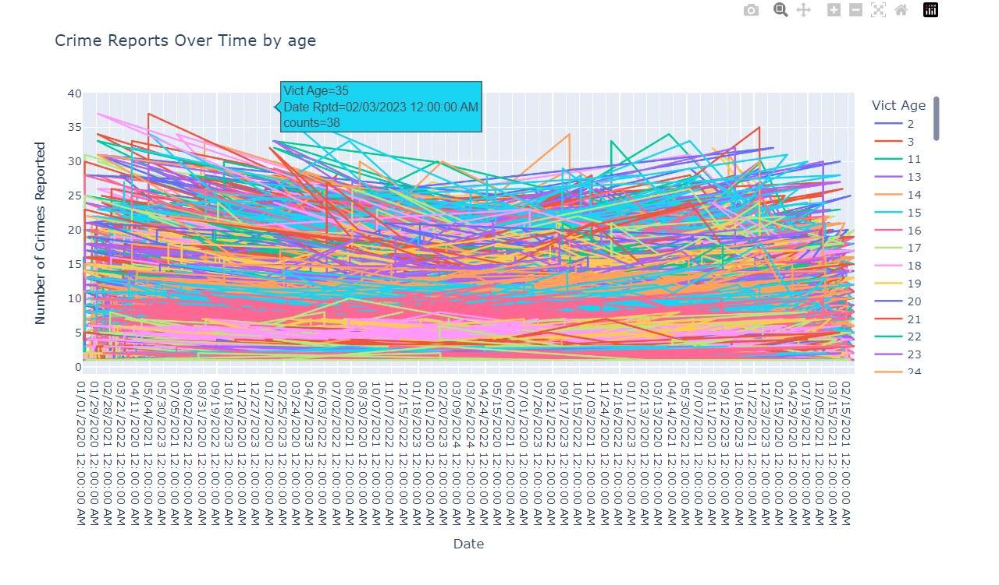
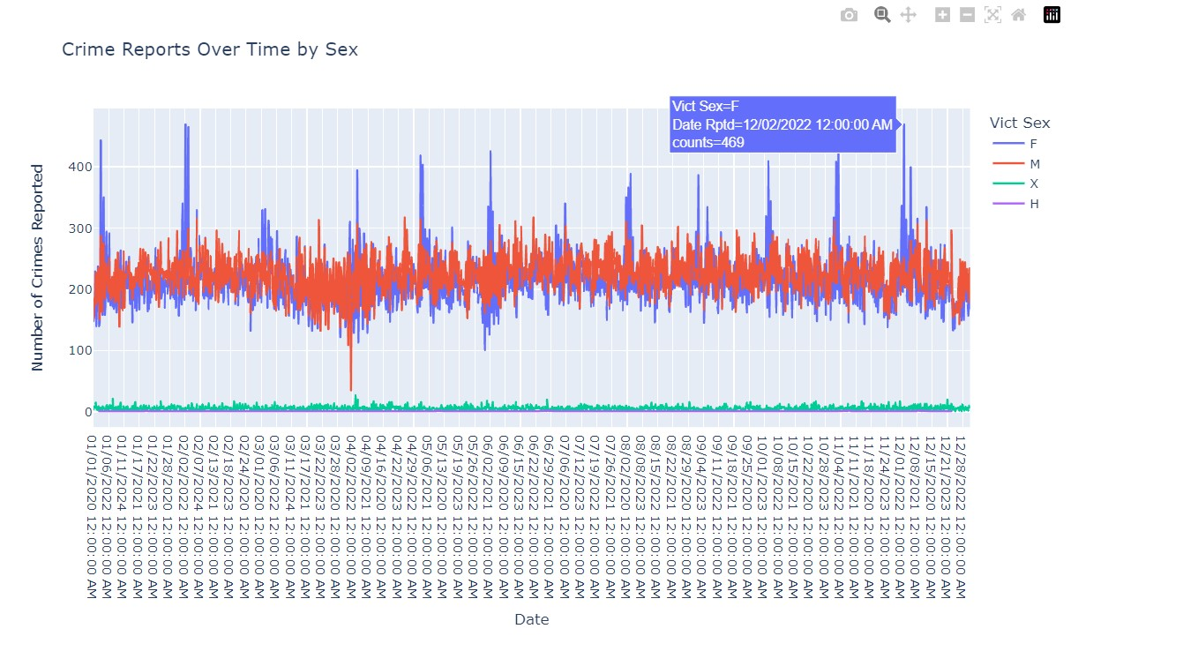
DATA VISUALIZATION
TIME SERIES ANALYSIS
From the time series graph by
Victim Age, we found out that
on the date 02/02/2023 there
are 38 crime reports for victim
Age 35.
From the time series graph by
Victim Sex, we found out that on
the date 12/02/2022 there are 469
Crime reports for victim sex Female.

Slide 16
MACHINE LEARNING
MODEL EVALUATION
1.Random Forest Classifier
2.KNN
3.Decision Tree
4. Gradient Boosting Classifier
5.SVC
From the model evaluation table
we can surely say that Gradient
Boosting Classfier with 75% split size
Since it has accuracy of 90%.
S.No | Model | Split Size | Accuracy
1. | Random Forest Classifier | 80%:20% | 86%
 |  | 75%:25% | 87%
 |  | 70%:30% | 87%
2. | KNN | 80%:20% | 76%
 |  | 75%:25% | 75%
 |  | 70%:30% | 75%
3. | Decision Tree | 80%:20% | 89%
 |  | 75%:25% | 88%
 |  | 70%:30% | 87%
4. | Gradient Boosting Classifier | 80%:20% | 89%
 |  | 75%:25% | 90%
 |  | 70%:30% | 89%
5. | SVC | 80%:20% | 71%
 |  | 75%:25% | 70%
 |  | 70%:30% | 71%

Slide 17
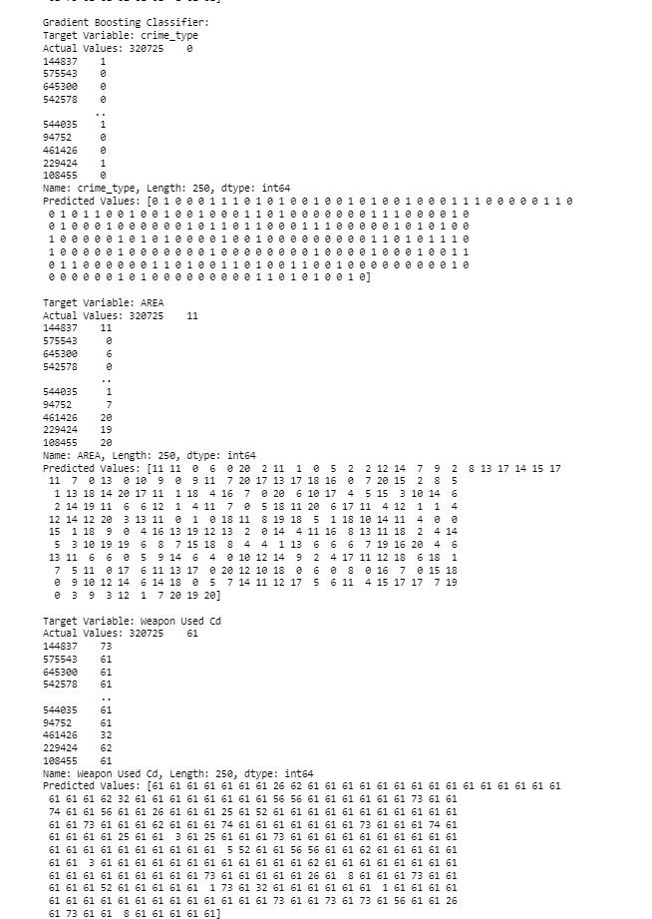
MACHINE LEARNING
MODEL TRAINING
MODEL: Gradient Boosting Classifier
Input Variables: ['Crm Cd', 'Vict Age’,
'Vict Sex', 'Vict Descent', 'theft', 'vehicular’
, 'LAT', 'LON’]
Target Variables:['crime_type', 'AREA’,
'Weapon Used Cd’]
Here we are predicting crime type,
severity , Area and Weapon used in
the crime.
Actual vs Predicted Values

Slide 18
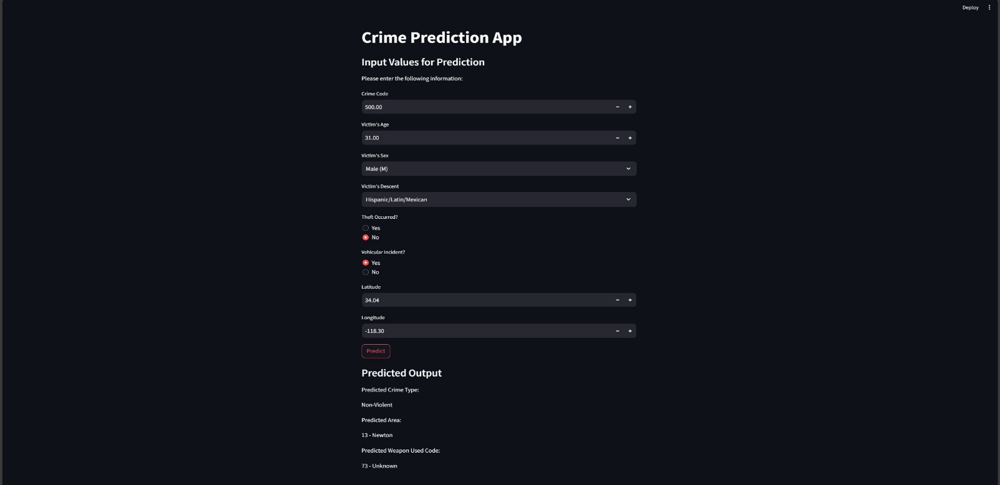
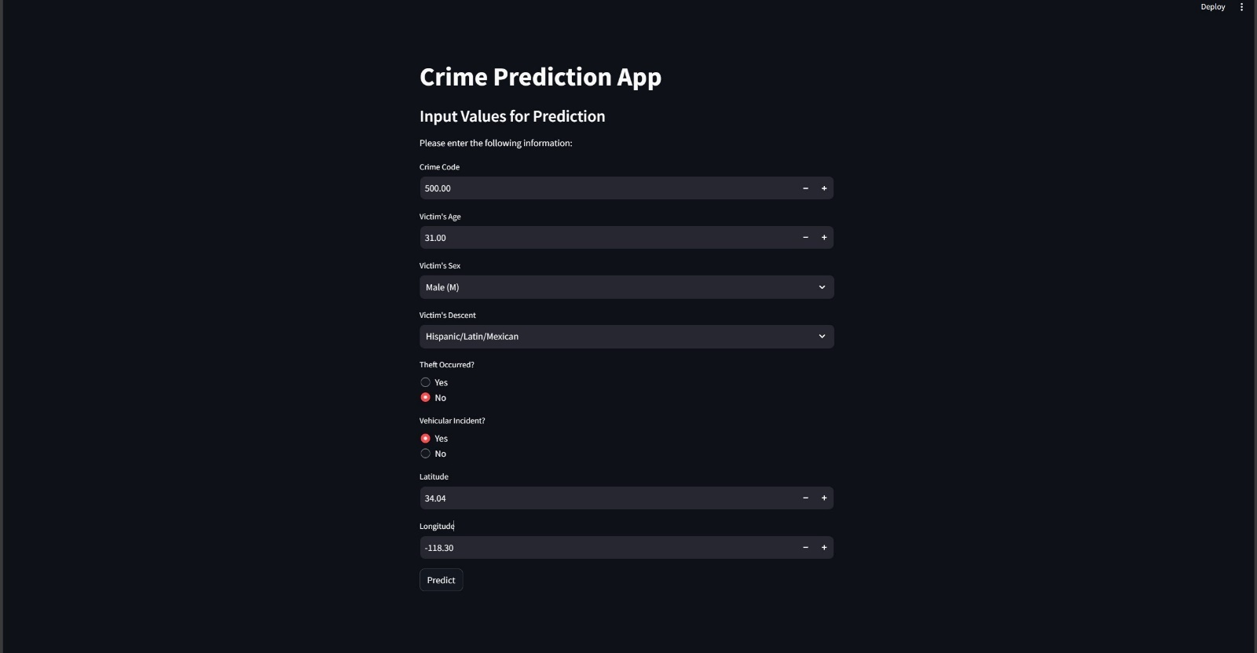
WEB APP
We have created a web app
From the machine learning
Model using streamlit library
from python.
Then we enter the input values
and click on predict button , we
get thepredicted values for
crime-type,Area and Weapon used.

Slide 19
CONCLUSION
In this projects, we have found out data with Victim demographics and also found the most crimes per area, location and for knowing most used weapons in crimes and also found out what type of crimes got reported most.
Then, we did data visualization for spatial analyses to find crime hotspots by area and location and did time series analyses to find most crimes reported on a day by area, victim sex, victim descent and victim age.
The predictive model we used for web app is gradient boosting classifier which performed the best among the algorithmns.
Then by giving inputs, we predicted crime type, weapon used and area.

Slide 20
THANK YOU

