Slide 1
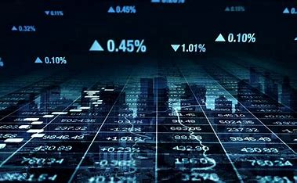
Data Visualization and Inference Modelling- The Case of Nifty
By:
J.AJAY 21R11A05G8
L.REVANTH 21R11A05H4
S.SAI KUMAR 21R11A05K6

Slide 2

OUTLINE
Abstract
Introduction
Problem statement
Objectives
Methodology
Algorithms
Results
Conclusion

Slide 3
Outline
ABSTRACT
The Capstone Project focuses on the analysis of stock market data, particularly the Nifty index, over a span of 20 years with a specific emphasis on the year 2020.
The dataset includes monthly and yearly returns, providing valuable insights into the performance of the stock market during various economic conditions, including the COVID-19 pandemic.
Through exploratory data analysis, the project aims to uncover interesting observations and insights regarding the behaviour of the Nifty index
This provides valuable information for investors and analysts in making informed decisions in the stock market.

Slide 4
Outline
INTRODUCTION
Stock market analysis plays a crucial role in investment decision-making, enabling investors to identify trends, patterns, and potential opportunities.
The Nifty index, comprising the top 50 companies listed on the National Stock Exchange of India, serves as a benchmark for the Indian equity market.
Understanding the historical performance of the Nifty index can provide valuable insights into market behaviour, economic trends, and investor sentiment.
Through exploratory data analysis (EDA), we aim to uncover patterns, trends, and anomalies in the monthly and yearly returns of the Nifty index.

Slide 5
Outline
PROBLEM STATEMENT
An important aspect of portfolio management is to know when to enter or exit a stock. This is the key to make maximum profit from the investment we make in stock market. Stock market data is widely analysed for educational, business and personal interests. This project deals with the analysis of the stock market Data. This dataset contains 20 years of stock price related data of Nifty monthly returns yearly returns data
The dataset is analysed to identify any interesting patterns and see how the stock varied during covid times. Though this has 20 year data on a whole, more emphasis is placed on the year 2020 data.

Slide 6
Outline
OBJECTIVES
Problem Definition and Scope
Data Collection and Preprocessing
Model Building and Evaluation
Interpretation, Deployment, and Reporting

Slide 7

Outline
METHODOLOGY
The data comprised of 14 features and 23 observations.
Exploratory Data Analysis(EDA):
By performing EDA, we can identify any missing or erroneous data, outliers, and inconsistencies in the data, which can be addressed before training any machine learning models.
As we can see there is 14 numerical columns in the given dataset.
We can also see that there are no missing values present in the dataset.
There are 0 duplicate values in the dataset.
Test of Normality is done and not much variation is observed(Normal).

Slide 8
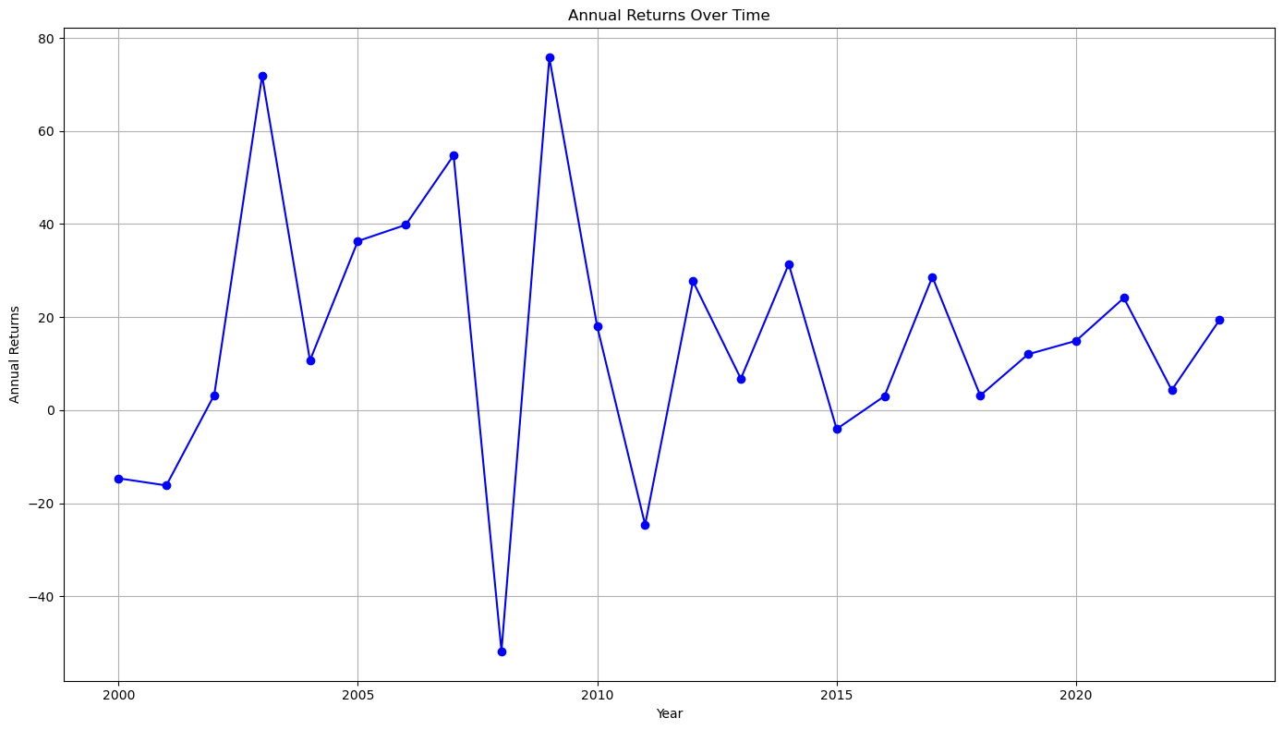
Outline
METHODOLOGY
Data Visualization:
Time series plot:
From this graph, we can observe that in the years 2009, 2003 the annual returns are high and in year 2008, 2011 the annual returns are low.

Slide 9
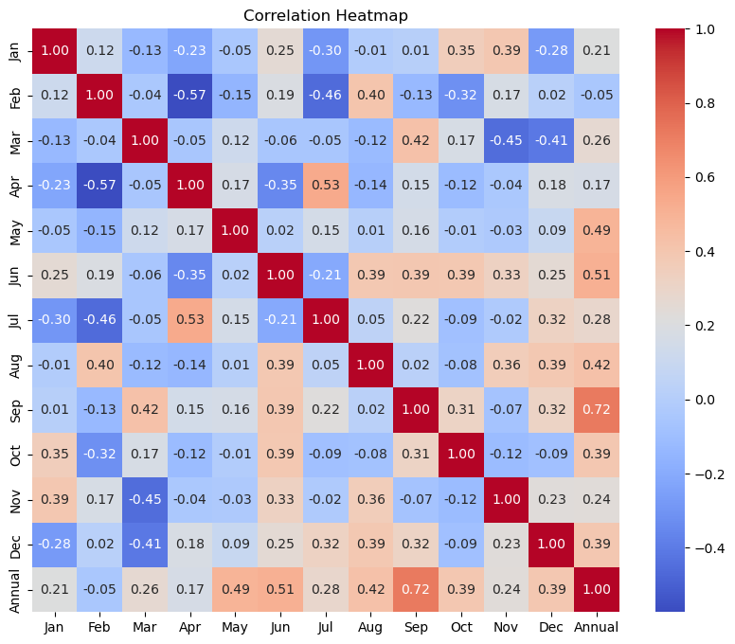
METHODOLOGY)
Correlation Heat Map:
A positive correlation is shown in shades of red, with a deeper red indicating a stronger positive correlation.
A negative correlation is shown in shades of blue, with a deeper blue indicating a stronger negative correlation.

Slide 10
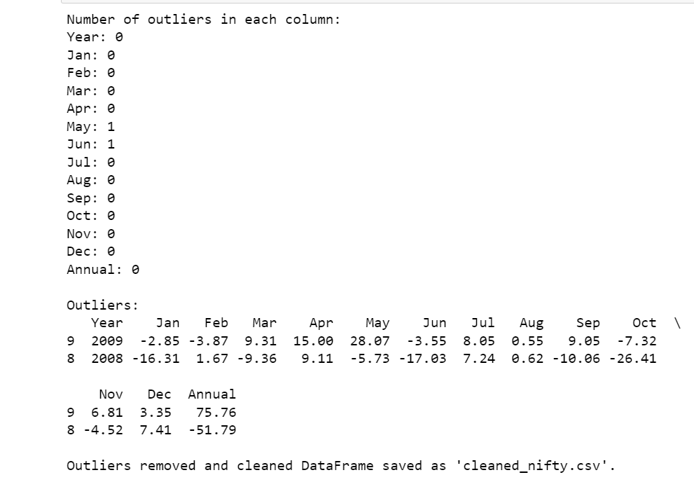
Outline
METHODOLOGY
Outlier Analysis:
From this we can clearly interpret that there are outliers in the dataset and we have removed them and created a new cleaned dataset.
Train & Test datasets:
We split the data for model building as train data(70%) and test data(30%).
We split the data for model building as train data(75%) and test data(25%).
We split the data for model building as train data(80%) and test data(20%).

Slide 11
Outline
ALGORITHMS
Accuracy of different algorithms:
1.Linear Regression
2.Ridge Regression
3.Lasso Regression
4. Elastic net Regression

Slide 12
Outline
ALGORITHMS
S.no | Model | Split Size | MSE | MDAPE | Accuracy | Param_grids
1. | Linear Regression | 80%:20% | 4.80 | 17.08 | 82.91% | none
 |  | 75%:25% | 42.23 | 34.86 | 65.13%
 |  | 70%:30% | 39.23 | 38.11 | 61.88%
2. | Ridge Regression | 80%:20% | 2.29 | 13.02 | 86.97% | model__alpha: [0.1, 1.0, 10.0]
 |  | 75%:25% | 10.52 | 16.82 | 83.17%
 |  | 70%:30% | 8.79 | 22.69 | 77.30%
3. | Lasso Regression | 80%:20% | 2.09 | 10.26 | 89.73% | model__alpha: [0.1, 1.0, 10.0]
 |  | 75%:25% | 4.68 | 12.35 | 87.64%
 |  | 70%:30% | 92.33 | 43.46 | 56.53%
4. | Elastic Net Regression | 80%:20% | 21.31 | 27.68 | 72.31% | model__alpha : [0.1, 1.0, 10.0]
 |  | 75%:25% | 11.19 | 16.15 | 83.84%
 |  | 70%:30% | 13.50 | 27.89 | 72.10%
From the above table we can safely say that lasso regression model with 80% split size and parameters as given will perform better than all the models with different split sizes(89.73% accuracy).
Here the accuracy is calculated with 100- MDAPE
Then, We have created a pipeline which has StandardScaler() and lasso regression model from from sklearn library to fit them in GridSearchCV for training and predictions.

Slide 13
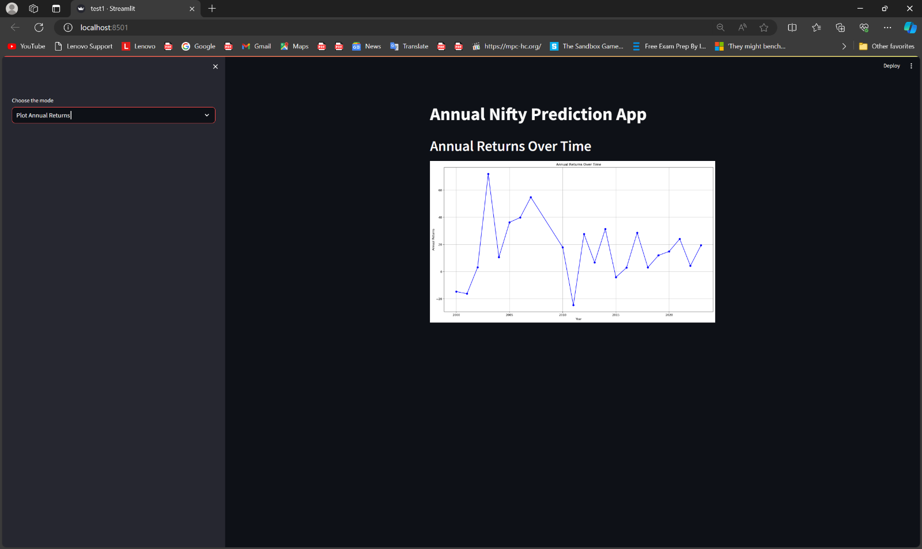
Outline
RESULTS
We have created a web app using streamlit library in python.
The Web UI has 2 modes one is Plot Annual Returns and Input Monthly Returns.
Currently the Web UI is in Plot Annual Returns which shows Time Series Plot.

Slide 14
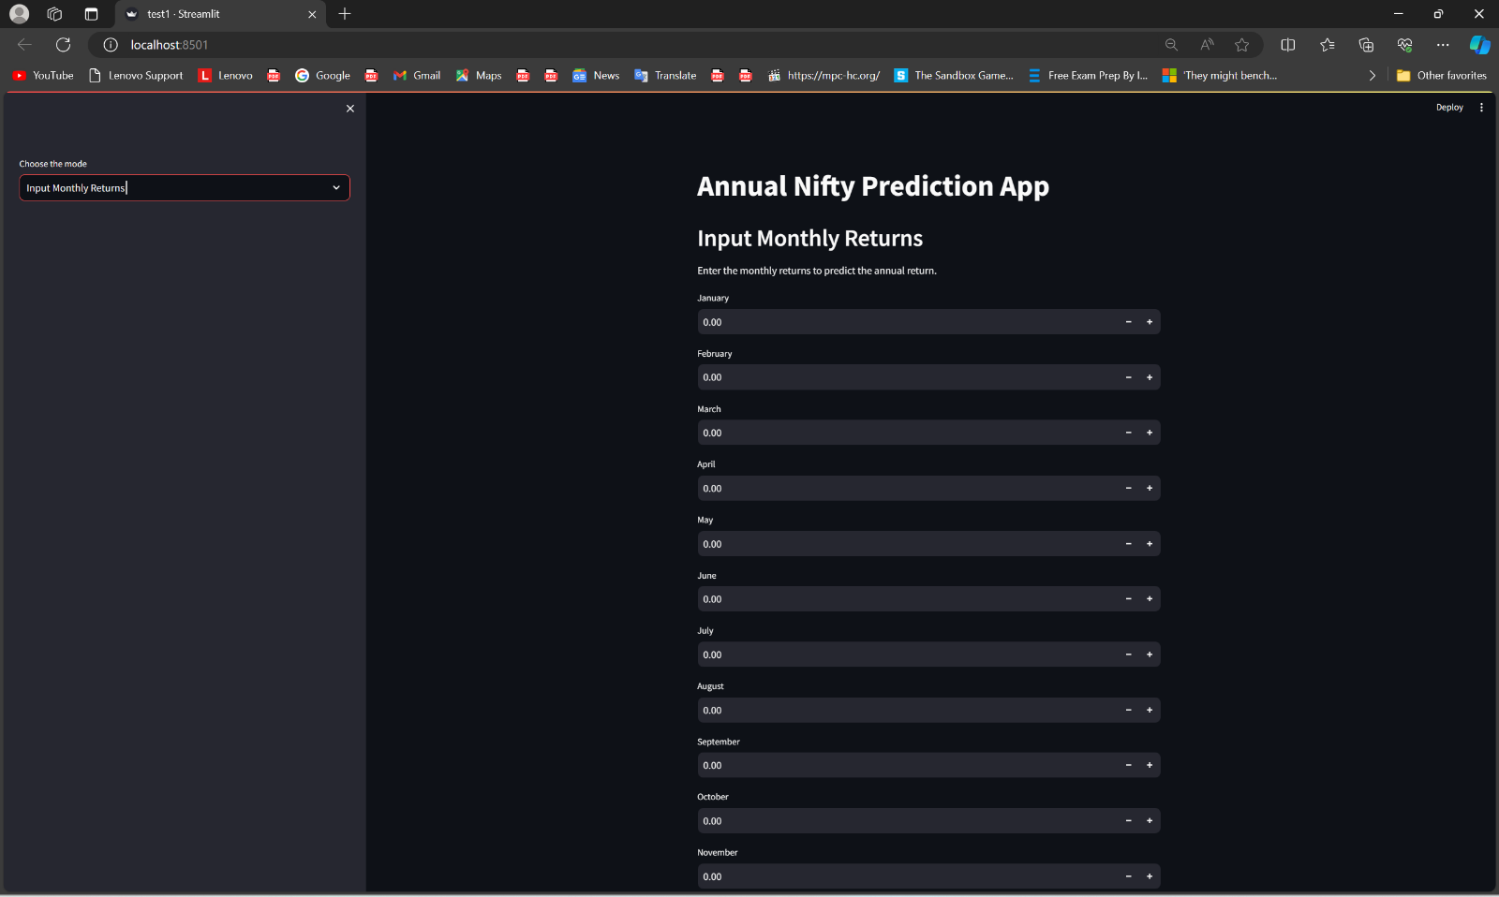
Outline
RESULTS
Then we can change app mode using the selection bar which is marked in the picture.
Now, In Plot Annual Returns mode we can see that there are input bars.
In these bars, we have to enter our return by month.

Slide 15
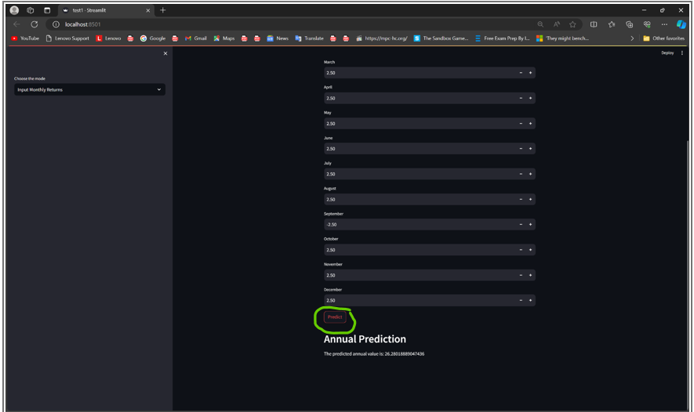
Outline
RESULTS
After entering the returns, We have to click on Predict button to predict the annual returns.

Slide 16
Outline
CONCLUSION
This project focuses on predicting annual Nifty returns based on monthly returns data provided by the user.
Utilizing Lasso Regression model as the predictive model and Streamlit for deploying a local web app, the aim is to provide users with insights into potential annual returns.
Future scope includes conducting larger-scale surveys to collect more extensive datasets for machine learning applications.
Analysed 20 years of Nifty index data, focusing particularly on the year 2020, a year marked by significant volatility and uncertainty due to the COVID-19 pandemic.

