Slide 1
UNDER THE GUIDANCE OF V. SRAVANTHI Assistant Professor(CSE)
Suicidal Tendencies Detection Using CNN and Random Forest Algorithm
TEAM MEMBERS:
L . REVANTH 21R11A05H4
S. SAI KUMAR 21R11A05K6
G. MOKSHITH 21R11A05G5

Slide 2
AGENDA
ABSTRACT
PROBLEM STATEMENT
LITERATURE OVERVIEW
EXISTING SYSTEM
PROPOSED SYSTEM
SYSTEM CONFIGURATION
SYSTEM ARCHITECTURE
METHODOLOGY
USER INTERFACE/OUTCOME
CONCLUSION
REFERENCES

Slide 3
ABSTRACT
This project presents a multifaceted approach to detecting suicidal tendencies by integrating Human-Computer Interaction, Natural Language Processing, and voice pattern analysis. The system captures and analyzes facial gestures, speech patterns, and messaging behaviours to identify early signs of suicidal intent. By employing machine learning techniques such as Convolutional Neural Networks (CNN) and Random Forest, the model processes data from various sources, including social media and messaging platforms. The use of a correlation ensures reliable predictions across multiple data types, significantly improving detection accuracy compared to existing single-method approaches. This system aims to provide timely alerts to family and healthcare professionals, potentially preventing suicidal actions.

Slide 4
PROBLEM STATEMENT
Suicide is one of the leading causes of death worldwide, with a significant rise in cases over the years. A key challenge is identifying individuals at risk before an attempt is made. Existing methods often lack reliability and accuracy due to their single-factor analysis, such as only relying on facial expressions or text-based cues.
The problem lies in developing a robust and comprehensive system capable of analyzing multiple behavioral indicators. The system should also be accessible and user-friendly, ensuring it can be deployed widely to save lives. Ethical considerations, such as data privacy and non-invasive methods, are also critical to ensure the system's acceptance and reliability.

Slide 5
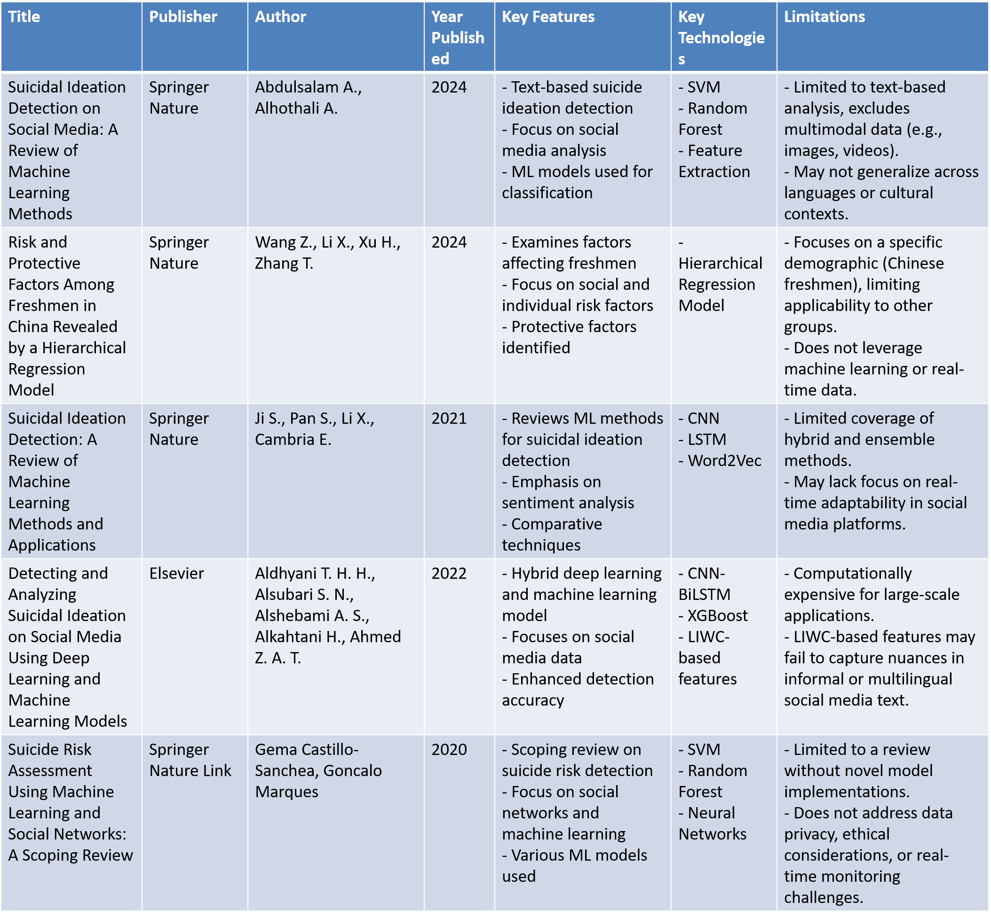
LITERATURE OVERVIEW

Slide 6
LITERATURE OVERVIEW

Slide 7
EXISTING SYSTEM
The existing systems for detecting suicidal tendencies often rely on isolated methods such as:
Facial expression detection using basic image analysis.
Analysis of text messages for suicidal language patterns.
Speech tone and sentiment analysis through standalone NLP models.
These systems, while functional, lack the robustness required for reliable predictions due to their single-method approach. The lack of integration among multiple behavioral indicators results in limited accuracy and high false-positive rates. Furthermore, these systems often fail to address privacy and ethical concerns, making them less practical for real-world use.

Slide 8
PROPOSED SYSTEM
The proposed system leverages a multi-modal approach, integrating various behavioral indicators such as:
Facial Gesture Recognition: Using CNN to detect subtle expressions associated with distress.
Voice Tone Analysis: Applying NLP techniques to identify emotional states through speech patterns.
Text Messaging Patterns: Tokenizing and analyzing text messages using NLP to identify potential warning signs.
The system employs a correlation matrix to combine data from these sources, ensuring a more accurate prediction. By utilizing machine learning models like Random Forest for classification, the system improves reliability and reduces false positives. Additionally, it emphasizes non-invasive methods and ensures user privacy, making it ethically sound and deployable in real-world scenarios.

Slide 9
SYSTEM CONFIGURATION
i. Hardware Requirements
Processor Intel Core i5 or above
Memory (RAM) Minimum 16 GB
Storage 512 GB or above
ii. Software Requirements
Operating System Windows, Linux, or macOS
Programming Language Python
Frameworks/Libraries PyTorch, TensorFlow, OpenCV etc.
iii. Development Environment
IDE/Code Editor Visual Studio Code or PyCharm
Version Control Git for managing source code

Slide 10
Functional Requirements
Detect suicidal intent using text, speech, and facial expressions.
Use Natural Language Processing (NLP) for analyzing messages.
Use Convolutional Neural Networks (CNN) for facial recognition.
Implement voice pattern analysis to detect emotional distress.
Non-Functional Requirements
System should be fast and accurate in detection.
Ensure privacy and security of user data.
Should work in real-time for timely intervention.

Slide 11
FEASIBILITY STUDY
Technical Feasibility: Uses existing ML models (CNN, SVM, LSTM), making it practically implementable.
Economic Feasibility: Low-cost implementation using open-source tools like PyTorch, TensorFlow, OpenCV.
Operational Feasibility: Can be integrated into smartphones, mental health apps, or chatbot systems.

Slide 12
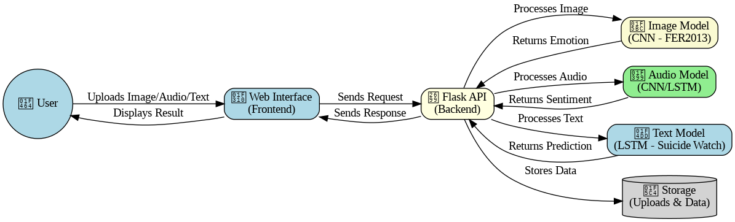
SYSTEM ARCHITECTURE

Slide 13
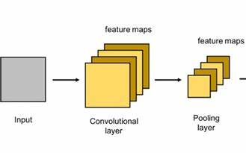
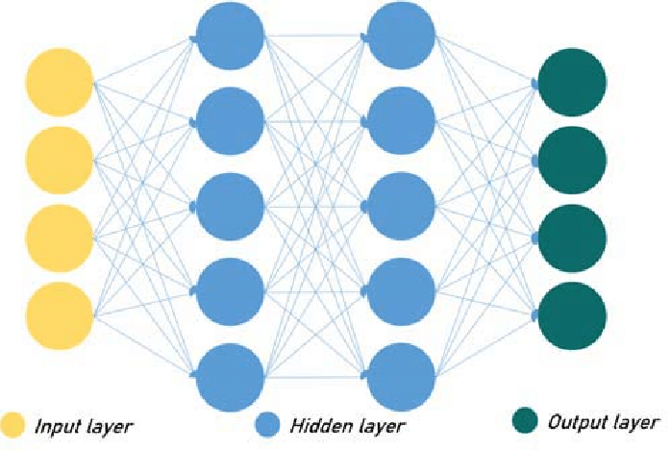

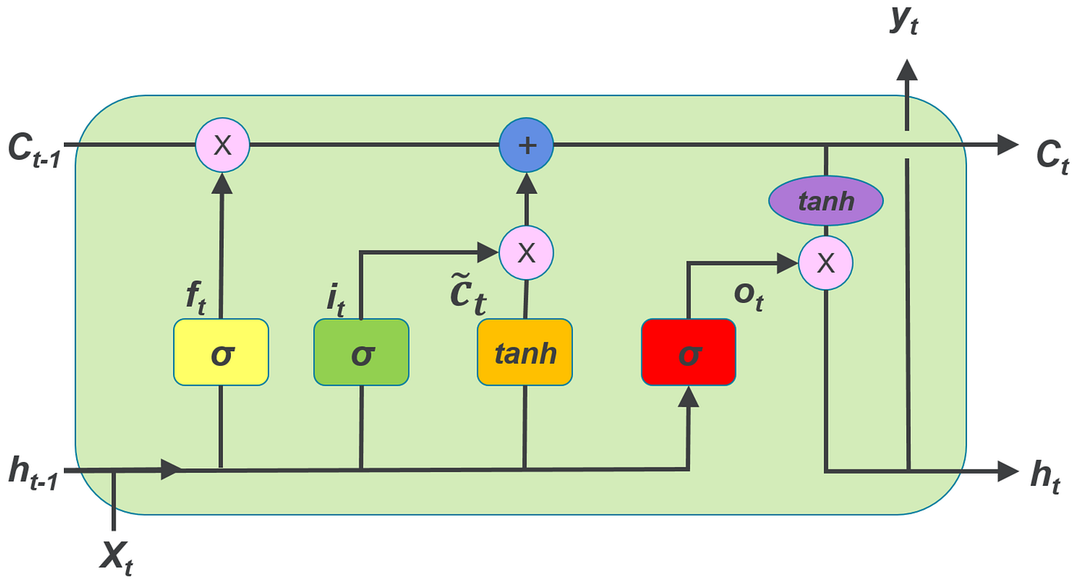


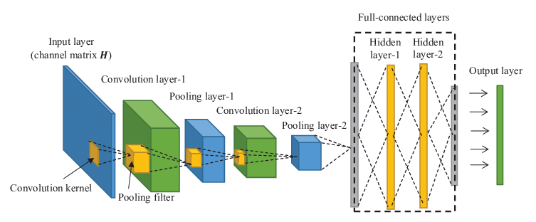
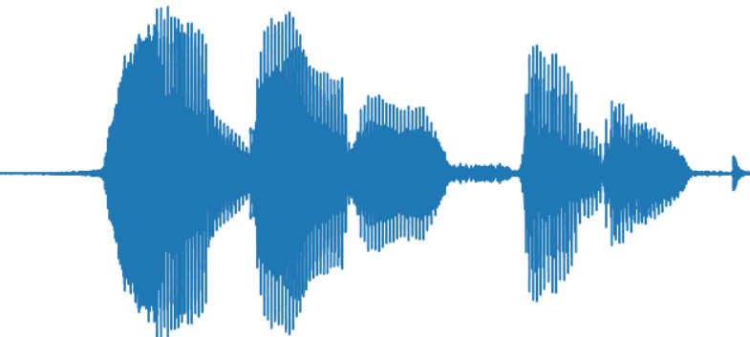
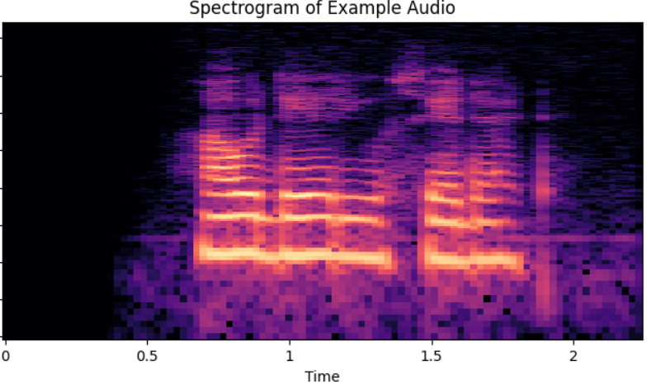
Emotions
CNN + ANN
Anger
Disgust
Fear
Happiness
Sadness
Surprise
+
Predictions
LSTM
Final output
Messages
Probability of commiting a suicide
Suicide
Non-Suicide
Predictions
SPECTROGRAM
Audio
Positive
Neutral
Negative
Predictions

Slide 14
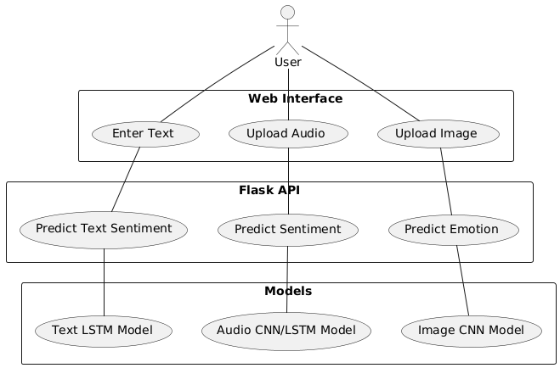
USECASE DIAGRAM

Slide 15
METHODOLOGY
Image Emotion Classification
Dataset: FER2013
Model: CNN-based deep learning architecture
Load grayscale images.
Convert to RGB and resize.
Normalize pixel values.
Pass through CNN model.
Output emotion prediction.
Audio Sentiment Analysis
Dataset: Speech sentiment dataset from Kaggle.
Model: CNN/LSTM-based classification model.
Extract MFCC features.
Normalize input.
Pass through deep learning model.
Output sentiment prediction.
Text Sentiment Analysis
Dataset: Suicide Watch dataset from Kaggle.
Model: LSTM-based NLP model.
Tokenize and pad input text.
Pass through LSTM.
Predict probability of suicidal tendency.

Slide 16
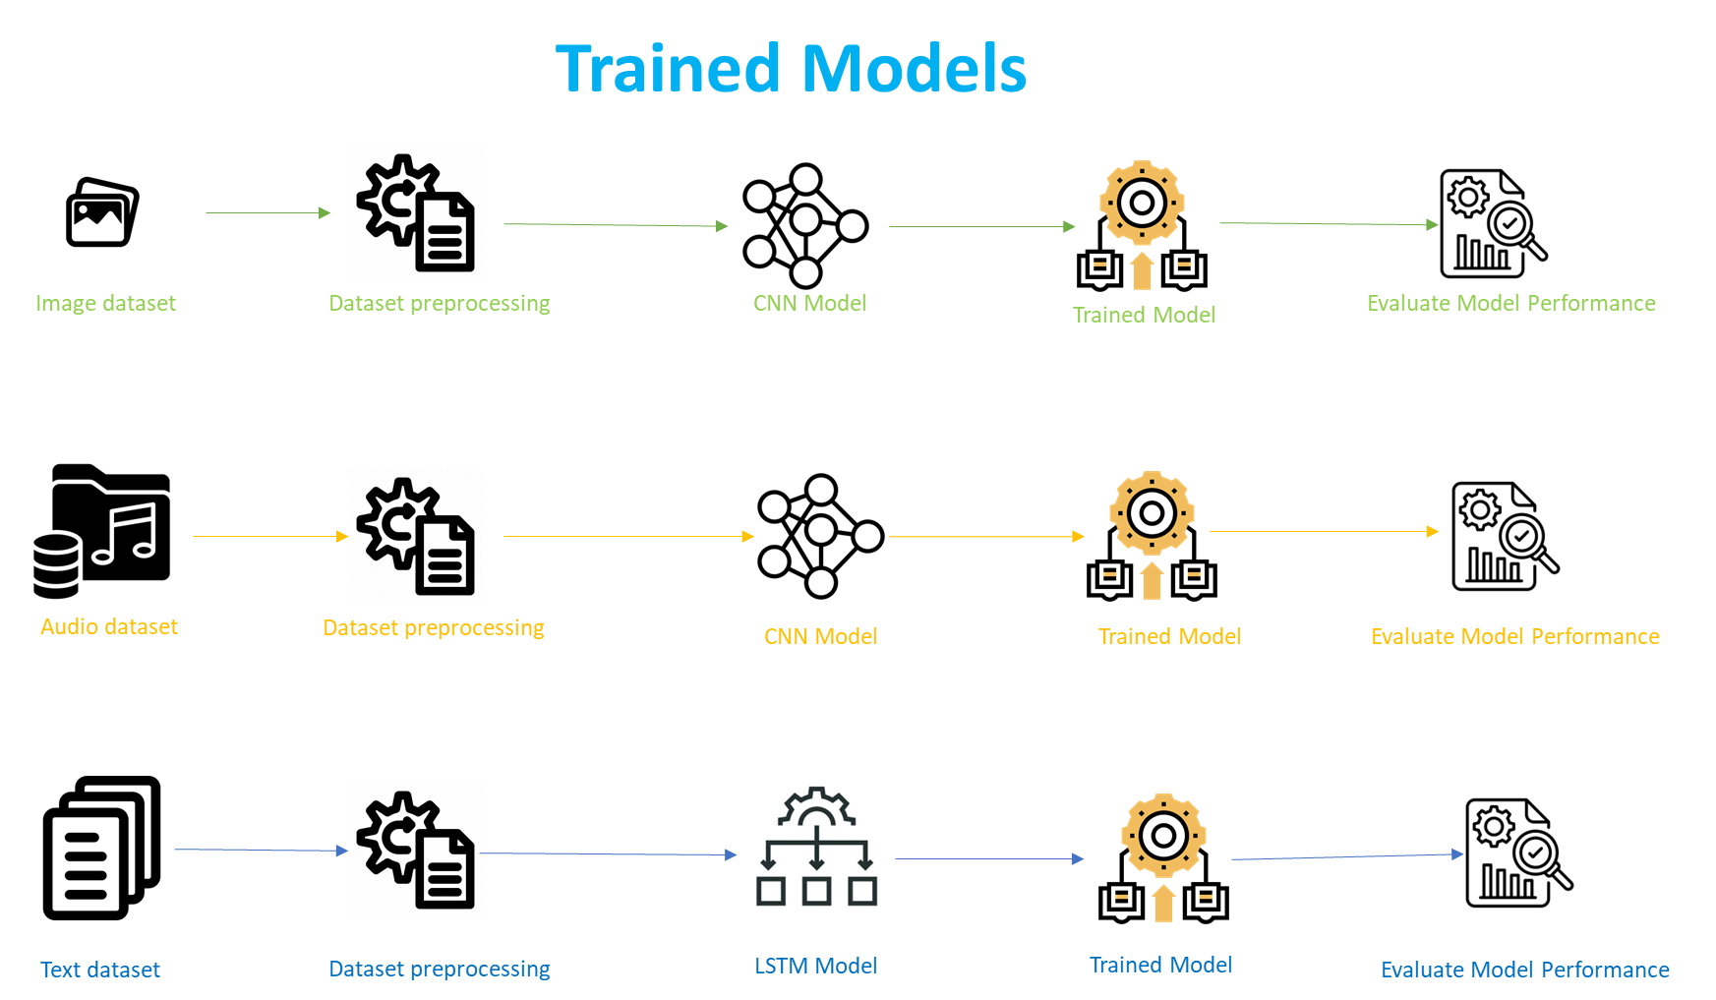

Slide 17
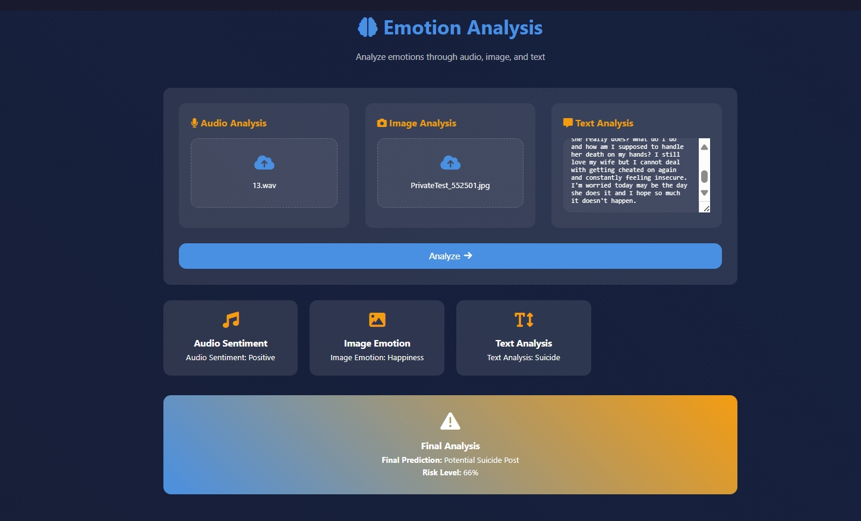
USER INTERFACE

Slide 18
CONCLUSION
This project introduces an advanced system for detecting suicidal tendencies by integrating facial gesture detection, speech recognition, and messaging behavior analysis. Using machine learning techniques like CNN and Random Forest, the system processes data from multiple sources to ensure accurate and reliable predictions. Unlike traditional methods that rely on a single aspect, this model employs a correlation to combine diverse inputs, significantly enhancing detection capabilities. The ultimate objective is to provide timely alerts to families and healthcare providers, enabling early intervention to prevent potential suicides.

Slide 19
REFERENCES
1. World Health Organization (WHO). “Suicide statistics and prevention strategies.”
2. Lecrubier, Yves. “The burden of depression and anxiety in general medicine.” *Journal of Clinical Psychiatry*, 2001.
3. Ekman, P., & Friesen, W. V. “Facial Action Coding System (FACS).” 1978.
4. Pennebaker, J. W., & King, L. A. “Linguistic styles: Language use as an individual difference.” *Journal of Personality and Social Psychology*, 1999.
5. Breiman, L. “Random Forests.” *Machine Learning*, 2001.
6. Krizhevsky, A., Sutskever, I., & Hinton, G. E. “ImageNet classification with deep convolutional neural networks.” *Advances in Neural Information Processing Systems (NeurIPS)*, 2012.
7. Xu, T., & Shen, H. “Natural language processing for mental health applications.” *IEEE Transactions on Neural Systems and Rehabilitation Engineering*, 2017.

Slide 20

THANK YOU…

