Slide 1




IPBL-DS CAPSTONE PROJECT-3
Geethanjali College of Engineering and Technology
Presented By: IPBL-DS Team 11
J.AJAY (21R11A05G8)
L. Revanth (21R11A05H4)
S. Sai Kumar (21R11A05K6) May 4,2024

Slide 2
PROJECT TITLE
Contextual Text Extraction from PDF files Using Machine Learning Practices

Slide 3
CONTENTS
Executive Summary
Introduction
Methodology
Data Pre processing
Exploratory Data Analysis
Implementation
Web App
Conclusion

Slide 4
EXECUTIVE SUMMARY
In this project, we will extract text data using pdfplumber and PyPDF2
From python.
The main steps in this project include:
Data pre-processing
Exploratory data analysis
Implementation of libraries
We will also build a web app to give extracted data if the pdf file is given as input.

Slide 5
INTRODUCTION
Extracting key information from PDFs is important for businesses.
Extracting director information from company documents is crucial for compliance, governance, and decision-making.
Manual extraction is slow and error-prone.
This web application automates director information extraction from PDFs, including names, types, DINs, and parts of speech.
The application improves efficiency, reduces effort, and minimizes errors in director information extraction.

Slide 6
METHODOLOGY
The overall methodology includes:
1.Data Preprocessing, using:
=> Regular Expressions
2.Exploratory data analysis, using:
=>Word Cloud
=>Parts of speech
3.Implementation, using:
=>pdfplumber
=>PyPDF2
4.Building Web App using,:
=>Streamlit
Data
Preprocessing
Exploratory Data Analysis(word cloud and parts of speech)
Implementation of pdfplumber and PyPDF2
Web App

Slide 7
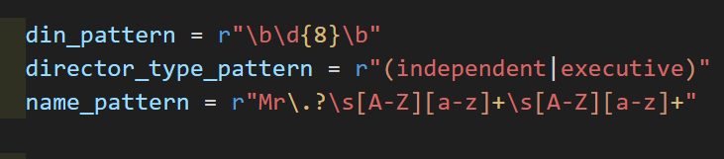
DATA PRE PROCESSING
Here, we are using regular expressions to pre process the data,It is a form of data cleaning as it removes irrelevant text and focuses on desired information.
Here, we give patterns to director id, director type and name pattern so it can easily filter out useless data.

Slide 8
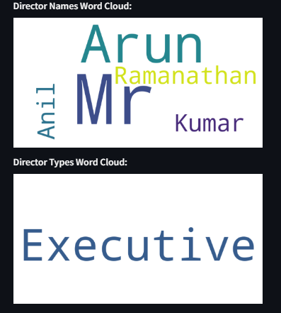
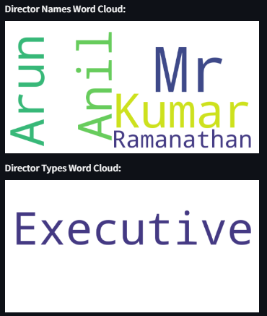
EXPLORATORY DATA ANALYSIS Word Cloud for example pdf equitas
Using Pdfplumber:
Using PyPDF2:

Slide 9
IMPLEMENTATION
By using pdfplumber
By using PyPDF2
Pdfplumber directly extracts text from pdf’s.
It iterates through each page and accumulates text into single string variable.
Uses regular expressions to filter out unnecessary text.
Uses spaCy for parts of speech counts.
Generates director names, types and gives word cloud for it.
PyPDF2 is used to just open the pdf and uses page_extract_text() to extract data.
Here, we define a separate function extract_text_from_pdf that handles PDF reading and text extraction. This promotes code modularity.
Uses regular expressions to filter out unnecessary text.
Uses spaCy for parts of speech counts.
Generates director names, types and gives word cloud for it.

Slide 10

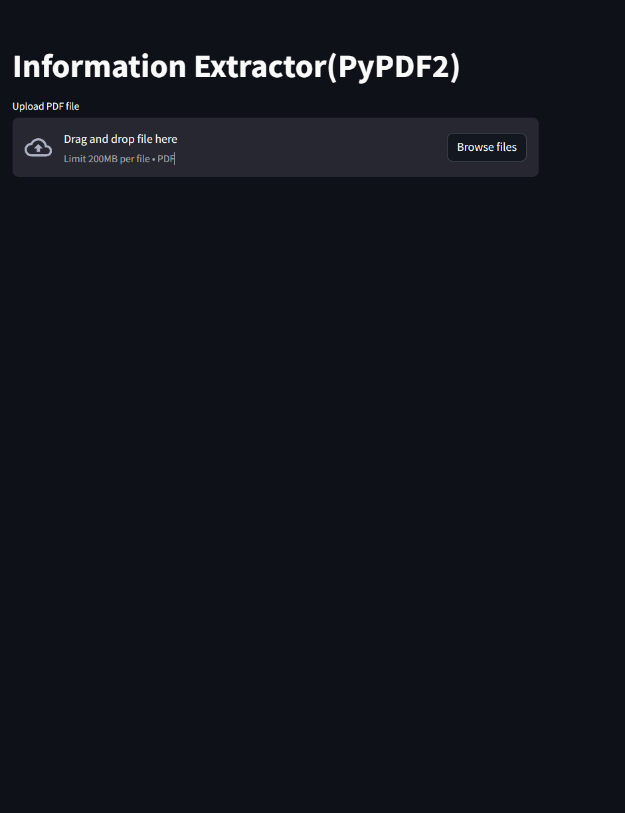
WEB APP
We used a streamlit from python to build web app.
Pdfplumner.app
Pypdf2.app

Slide 11
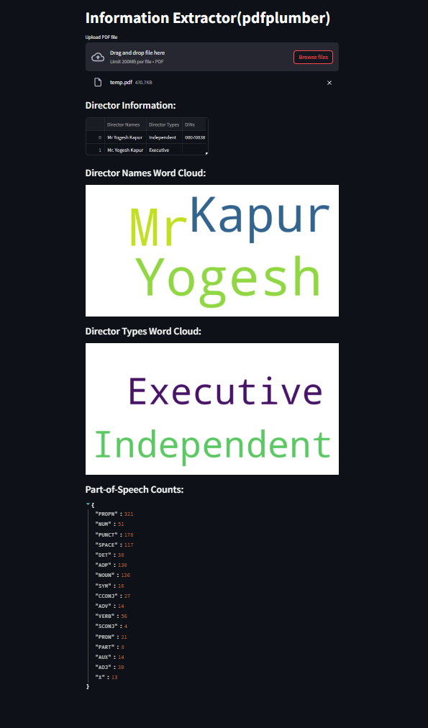
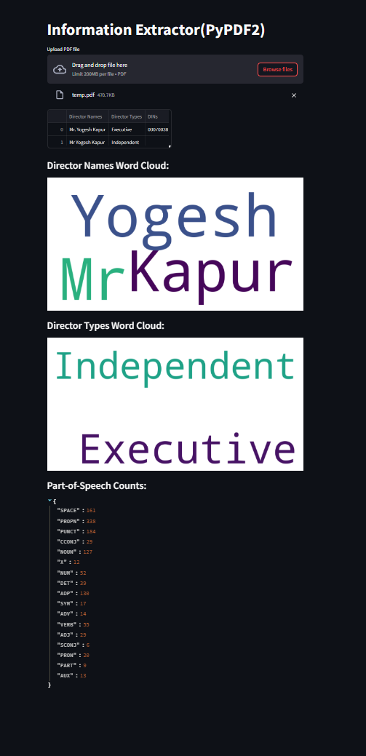
WEB APP
Results for pdf temp
Pdfplumner.app
Pypdf2.app

Slide 12
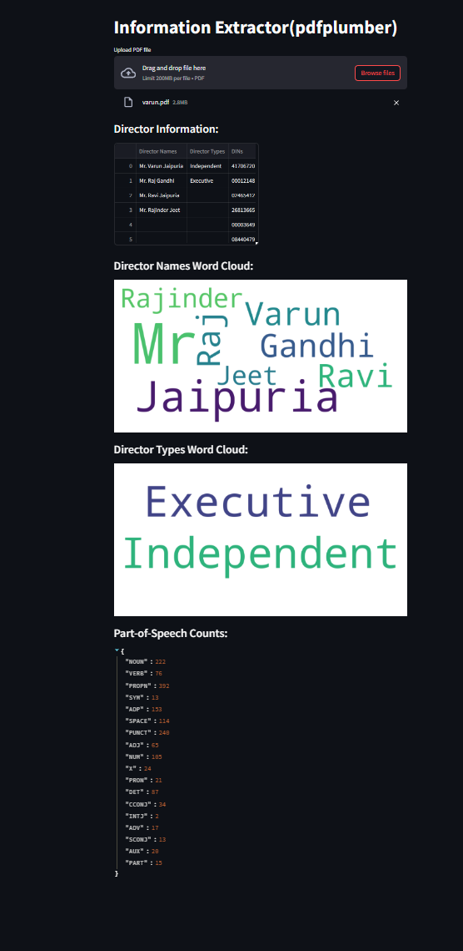
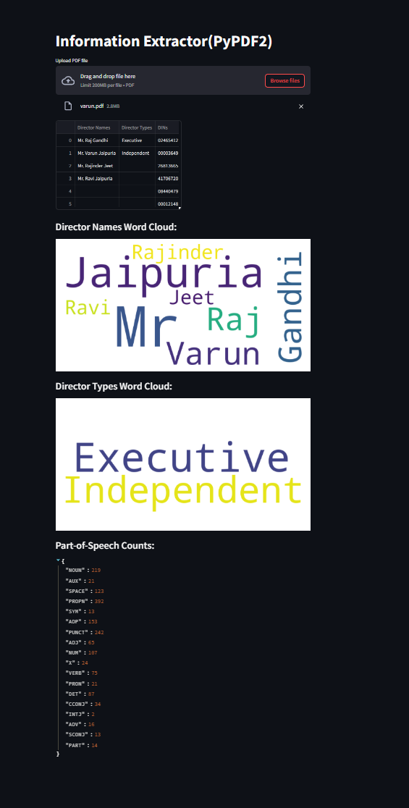
WEB APP
Results for pdf varun
Pdfplumner.app
Pypdf2.app

Slide 13
CONCLUSION
Project Success: Extracts valuable director information (names, types, IDs) from PDFs using pdfplumber, regular expressions, and spaCy.
• Addresses a Need: Efficiently extracts structured data from PDFs for analysis, reporting, and decision-making.
• Applications: Corporate governance, compliance, and business intelligence.
• Future Enhancements: Improved accuracy, broader document format support, better user experience, advanced text analytics integration.
• Overall Value: Valuable contribution to data extraction, empowering users to efficiently gain insights from PDFs.

Slide 14
THANK YOU

