Slide 1



SPREADSHEET PROJECT · CALL CENTER OPTIMIZATION
Astro Sage Analysis
Allocating a ₹1 crore investment with data operational efficiency, customer satisfaction & profitability.
Kvss Bharadwaj
15 / 06 / 2026

Slide 2



ASTROSAGE · CALL CENTER ANALYTICS
Introduction & Objectives
78.7%
Analyze the Data
Mine historical call data, performance metrics and market trends to surface what drives volume, cost and satisfaction.
of AstroSage's revenue comes from calls alone, yet the average customer rating sits at just 2.9 out of 10.
Allocate ₹1 Crore Wisely
Decide between hiring more agents, improving training programs, or upgrading call center technology backed by evidence.
AstroSage has received a ₹1 crore investment to transform its call center operations. This study analyzes 28,027 cleaned consultation records (Dec 2023 – Jan 2024) call volumes, costs, guru performance and ratings to decide where every rupee should go.
Maximize Business Impact
Boost operational efficiency, lift customer satisfaction, and grow profitability across every consultation type.
02

Slide 3



THE DATASET
Data Overview
28,027
35 → 29
Data Cleaning Performed
Removed system columns (_id, user, guru, isWhiteListUser, queue, statementEntryId); searched & deleted duplicate records.
cleaned consultation records (Dec 1, 2023 – Jan 3, 2024)
attributes after dropping 6 ID / system columns
Consistency Checks
Standardized timestamps, validated statuses, and handled missing values before any pivot analysis.
8,365
131
voice calls tracked via unique CallSid
gurus (astrologers) serving customers
Why This Data Matters
It captures every consultation touchpoint volume, duration, earnings, ratings the exact levers a ₹1 Cr investment must move.
34
15
days of continuous operations data
categorical columns driving segmentation
03

Slide 4




HOW THE ANALYSIS WAS DONE
Methodology
1 · Clean
2 · Pivot
3 · Aggregate
Drop ID columns, remove duplicates, fix inconsistencies → 'Cleaned data' sheet.
PivotTables for daily / monthly volumes, earnings, ratings and consultation types.
COUNTIF, SUMIF, AVERAGE, COLUMNS & CORREL for conditional metrics and correlation.
4 · Analyze Trends
5 · Dashboard
6 · Recommend
Day-by-day change in call volume, peak/off-peak hours, and month-wise patterns.
Interactive dashboard with KPI cards and slicers (gid, website, consultation type).
Translate findings into a justified ₹1 crore allocation across 5 initiatives.
04

Slide 5
OBJECTIVE ANALYSIS · CALL VOLUME
Daily Call Volume & Day-by-Day Change
246
average calls per day across the 34-day window
430 ▲
peak day - Dec 10 (largest +142 daily jump)
107 ▼
lowest day - Jan 3, post-festive cooldown
05

Slide 6
OBJECTIVE ANALYSIS · SEASONALITY & COST
Monthly Volumes & Operational Cost
Operational Cost (Astrologer Earnings)
₹93,786
paid out in December 2023 - the high-volume month
₹5,360
paid out in January 2024 - volumes (and costs) collapsed
₹99,147
total operational cost across the analysis window
06

Slide 7



OBJECTIVE ANALYSIS · REVENUE MIX
Where the Money Comes From
Calls carry the business - 78.7%
₹1,68,442 of ₹2,13,987 net revenue flows from voice consultations. Protecting call quality is protecting revenue.
₹2.14 L
Chat is an underused asset - 21.3%
₹45,495 from chat despite massive failure rates. Fixing chat is the cheapest growth lever available.
Complementary & live ≈ 0%
Free consultations earn nothing directly - their job is onboarding users into paid funnels. Today that conversion is invisible.
07

Slide 8
OBJECTIVE ANALYSIS · SATISFACTION
Customer Satisfaction Runs Low
2.93
2.95→2.68
average rating overall (out of 10)
Dec → Jan: satisfaction slipped further
+0.481
correlation between call duration & rating - longer, unhurried consultations genuinely satisfy customers more
Half of every experience is a bad one. 13,784 of 28,027 consultations (≈49%) are rated 2 or below, a service-quality red flag that no top line of revenue can hide.
08

Slide 9
OBJECTIVE ANALYSIS · LOYALTY & WORKLOAD
Repeat Callers & Agent Workload
56.63%
246
calls handled per day on average across the 34-day window
of all calls come from repeat callers. 1,275 of 3,628 callers (35.1%) phoned in more than once loyalty is real, but they keep returning to a 2.9 rated experience.
111
active gurus taking calls over the period
≈ 4.7
calls per repeat caller loyal users phone in nearly five times each
3,628
unique callers reached through voice in just over a month
09

Slide 10



SUBJECTIVE INSIGHT 1 OF 3
Should We Hire More Agents?
What the ratings say
Average rating per guru (gid) splits the bench sharply: a handful sit at 5.9 – 7.5, while many languish below 2 including gurus with 100+ consultations.
Stars are overloaded
High-rated gurus attract disproportionate volume, creating dependency risk: if a top performer leaves, satisfaction and revenue leave with them.
Verdict
Don't simply add headcount. Re-balance load with smart routing first, hire selectively only where peak-hour demand (6 AM – 4 PM) outstrips supply.
10

Slide 11
SUBJECTIVE INSIGHT 2 OF 3
Where Training Moves the Needle
Short calls · High ratings
Long calls · High ratings
Product mastery + strong communication. These gurus are your training blueprint capture and codify what they do.
Great quality, slow tools or process. Don't retrain give them better tech and templates.
Short calls · Low ratings
Long calls · Low ratings
Rushed, scripted handling. Coach on depth and empathy, pair with top performers.
Skill gaps in queries & domain knowledge the priority cohort for structured training programs.
11

Slide 12
SUBJECTIVE INSIGHT 3 OF 3
The Technology Case Is Loudest
> 71%
of chats end failed or incomplete, broken flows and bot/agent handoffs
≈ 35%
of calls hit no-answer or busy, contactability, not demand, is the problem
Routing, retry timing, caller-ID trust and chat escalation are technology problems, no amount of hiring fixes them.
12

Slide 13

STRATEGIC RECOMMENDATIONS
The ₹1 Crore Allocation Plan
Protect the 78.7%
Biggest share goes to the channel that earns the most - AI routing, skill-based allocation, workforce tools.
Fix the leakiest funnel
₹25 L attacks the 71% chat failure rate - Building chatbots, scripts, SLAs and agent QA.
Earn the loyalty back
₹15 L + ₹15 L + ₹5 L lift satisfaction, technology and onboarding - converting repeat traffic into delight.
13

Slide 14


STRATEGIC RECOMMENDATIONS
What Each Rupee Buys and Returns
Call Ops · ₹45 L
Chat · ₹25 L
Technology · ₹15 L
AI call routing, skill-based allocation, off-peak optimisation. Impact: fewer no-answer/busy outcomes, higher revenue per guru hour.
First-level chatbots, response templates, faster SLAs, agent QA. Impact: completion up from 28%, unlocking a low-cost revenue channel.
CRM integration, speech & sentiment analytics, cloud call-center stack. Impact: unified customer view, smarter retries, less manual work.
Satisfaction · ₹15 L
Complementary · ₹5 L
Net Effect
Loyalty programs, repeat-user incentives, personalised recommendations, feedback loops. Impact: rating climbs from 2.9 toward 5+.
Promotional live sessions and onboarding consultations. Impact: trust-building funnel that converts free users into paying ones.
Efficiency, satisfaction and profitability move together; each initiative reinforces the others across the same 8,365-call engine.
14

Slide 15
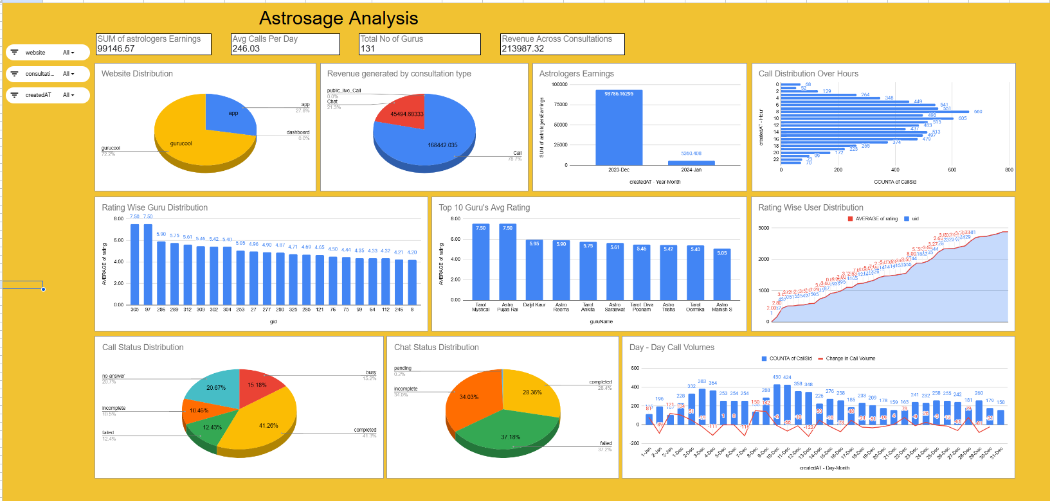
Interactive Dashboard & Visualizations
15

Slide 16

CLOSING THE LOOP
Conclusion
Calls are the business: 78.7% of revenue, ₹1.68 L of ₹2.14 L protect and optimise this channel first.
Chat is the broken growth engine: 71% failure/incomplete is a fixable technology and process problem.
The data has spoken; the stars now need the systems to match.”
Satisfaction (2.93/10) is the existential risk, yet 71.9% repeat traffic proves customers want to stay.
Invest in efficiency, fix the funnels, and the 2.9 becomes a 5+ star with revenue to show for it.
The ₹1 Cr split 45/25/15/15/5 funds exactly these gaps, in order of revenue at stake.
16

Slide 17
CREDITS
Acknowledgements & References
Acknowledgements
References & Sources
Sincere thanks to my mentors and program instructors for guidance on analytical methodology and dashboard design.
Gratitude to peers who reviewed the pivot logic and the recommendations.
AstroSage call-center dataset - - (Dec 2023 – Jan 2024), provided as project data 28,027 cleaned records.
Spreadsheet - - PivotTables, COUNTIF / SUMIF / CORREL, charts & slicers. cleaned data, 17 analysis sheets and interactive dashboard.
Word Document - - full written analysis, approaches and justifications.
17

Slide 18
ASTRO SAGE ANALYSIS · KVSS BHARADWAJ
Thank You
Questions, challenges and deeper dives into the data are most welcome.

