Slide 1
Summarizing Visual Data Using Bidirectional Similarity
By
Hema
Sailaja

Slide 2
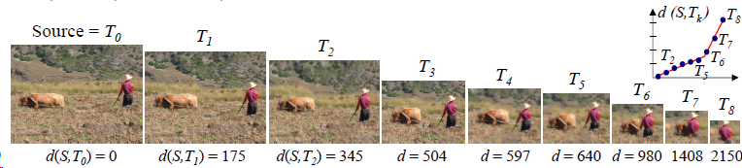
Visual Summary
Goal:
Produce a smaller image that summarizes the content of the larger image

Slide 3

Comparing two images
Completeness
Coherence

Slide 4
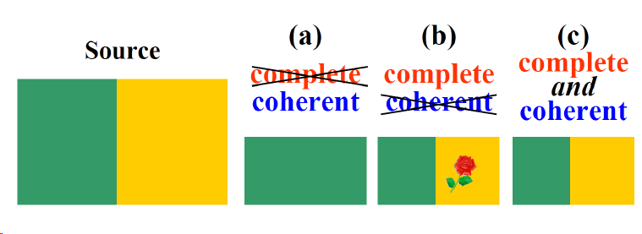
Similarity Distance

Slide 5
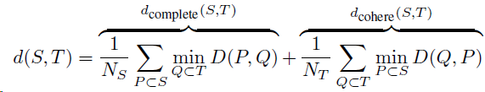
Bidirectional similarity measure
Error or dissimilarity measure
Where,
S and T are the source and Target images, P and Q are the patches of fixed size of S and T. D is the Sum of Squared Difference between the patches.

Slide 6
The Summarization
(Retargeting) Algorithm

Slide 7

The Iterative Update rule: contribution of a pixel to the coherence measure
Let q be a pixel of T, q lies inside m neighboring patches Q₁,Q₂,....Q_{m}
These patches are matched to P₁, P₂, ....P_{m} in source image S
The positions corresponding to q in P₁, P₂, ....P_{m} are p₁, p₂, ....p_{m}
Hence, the contribution is

Slide 8
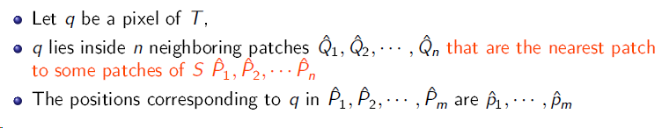

The Iterative Update rule: contribution of a pixel to the completeness measure
Hence, the contribution is

Slide 9
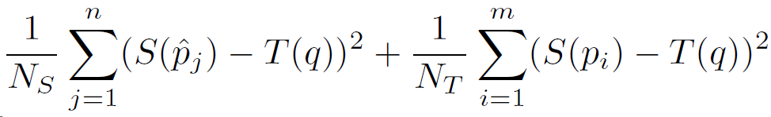
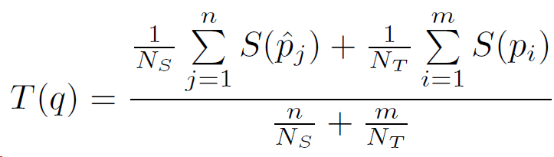
Color Update
The best T(q) should minimise
Color Update:

Slide 10
Iterative Update rule
Given a source signal S, we want to reconstruct a target signal T that optimizes the similarity measure

Slide 11
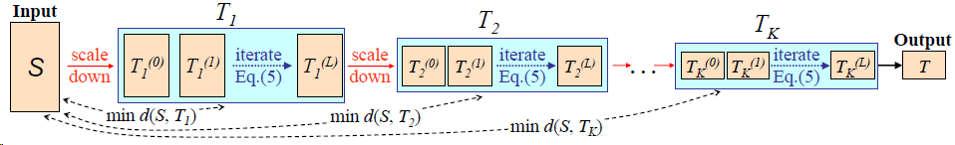
Gradual Resizing
When the target has a very different size from the source: what is a good initial guess?
Iterative process: downsample the image and apply the reconstruction

Slide 12
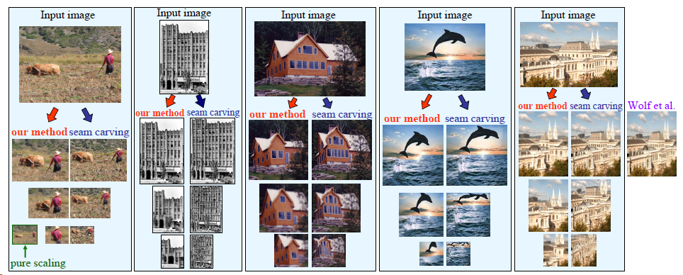
Visual Summary

Slide 13
Applications

Slide 14
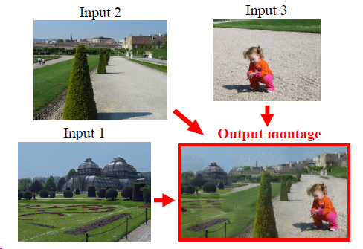
Image Montage

Slide 15
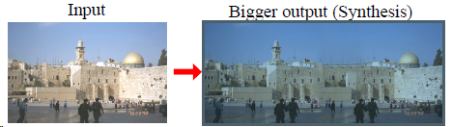
Image Completion and Synthesis

Slide 16
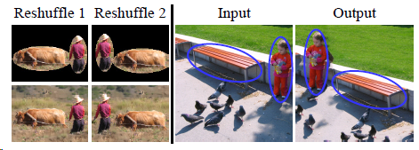
Photo Reshuffling

Slide 17
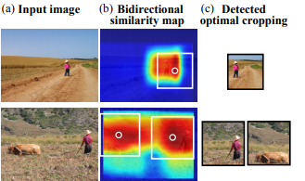
Automated Optimal Cropping

Slide 18
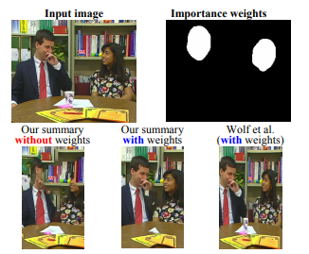
Incorporating Non Uniform Importance

Slide 19
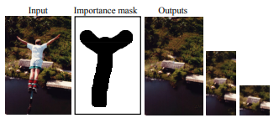
Summarization with object removal constraints

Slide 20
Thank you

