Slide 1
OPEN GL ES

Slide 2
Introduction
OpenGL ES is the lowest-level API that you use to program 2D and 3D graphics on the iPhone.

Slide 3
Open GL ES 1.0 vs OpenGL ES 2.0
First things first – you should know that there are two different versions of OpenGL ES (1.0 and 2.0), and they are very different.
OpenGL ES 1.0 uses a fixed pipeline, which is a fancy way of saying you use built-in functions to set lights, vertexes, colors, cameras, and more.
OpenGL ES 2.0 uses a programmable pipeline, which is a fancy way of saying all those built-in functions go away, and you have to write everything yourself.

Slide 4
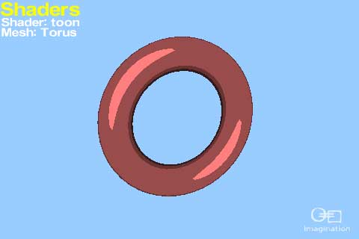

Slide 5


Slide 6
OpenGL Rendering Pipeline
OpenGL Pipeline has a series of processing stages in order. Two graphical information, vertex-based data and pixel-based data, are processed through the pipeline, combined together then written into the frame buffer. Notice that OpenGL can send the processed data back to your application. (See the grey colour lines)

Slide 7
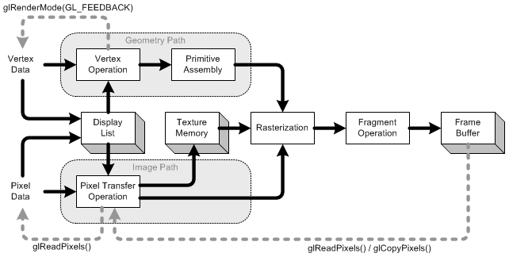

Slide 8
THANK YOU

