Slide 1
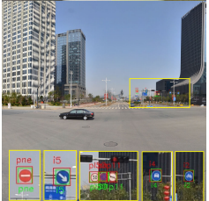
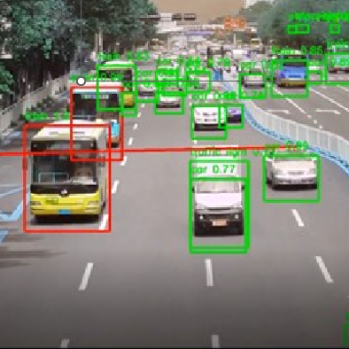
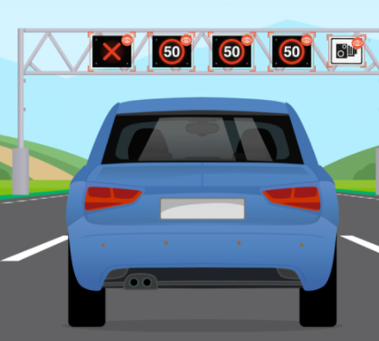
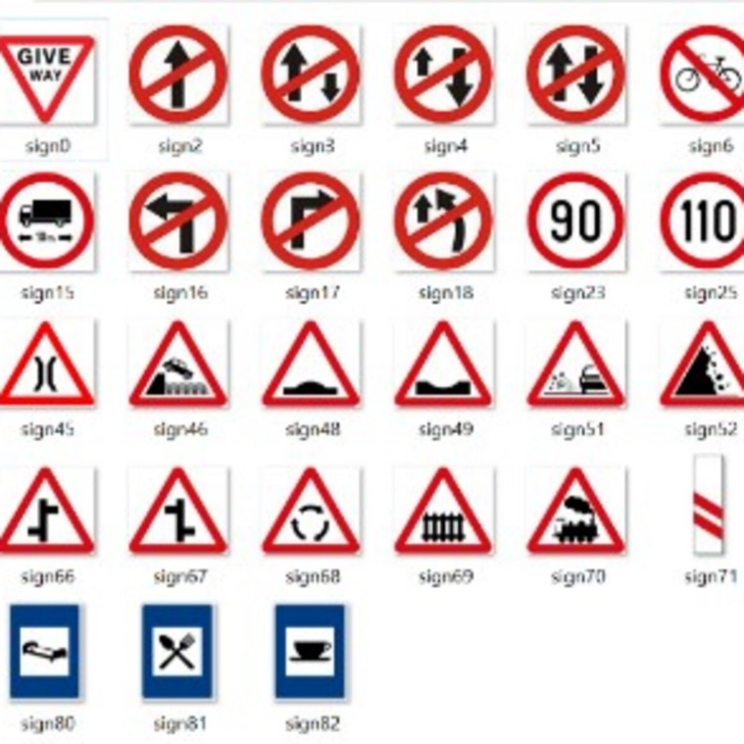
Traffic Sign Recognition using Machine Learning

Slide 2
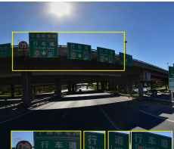
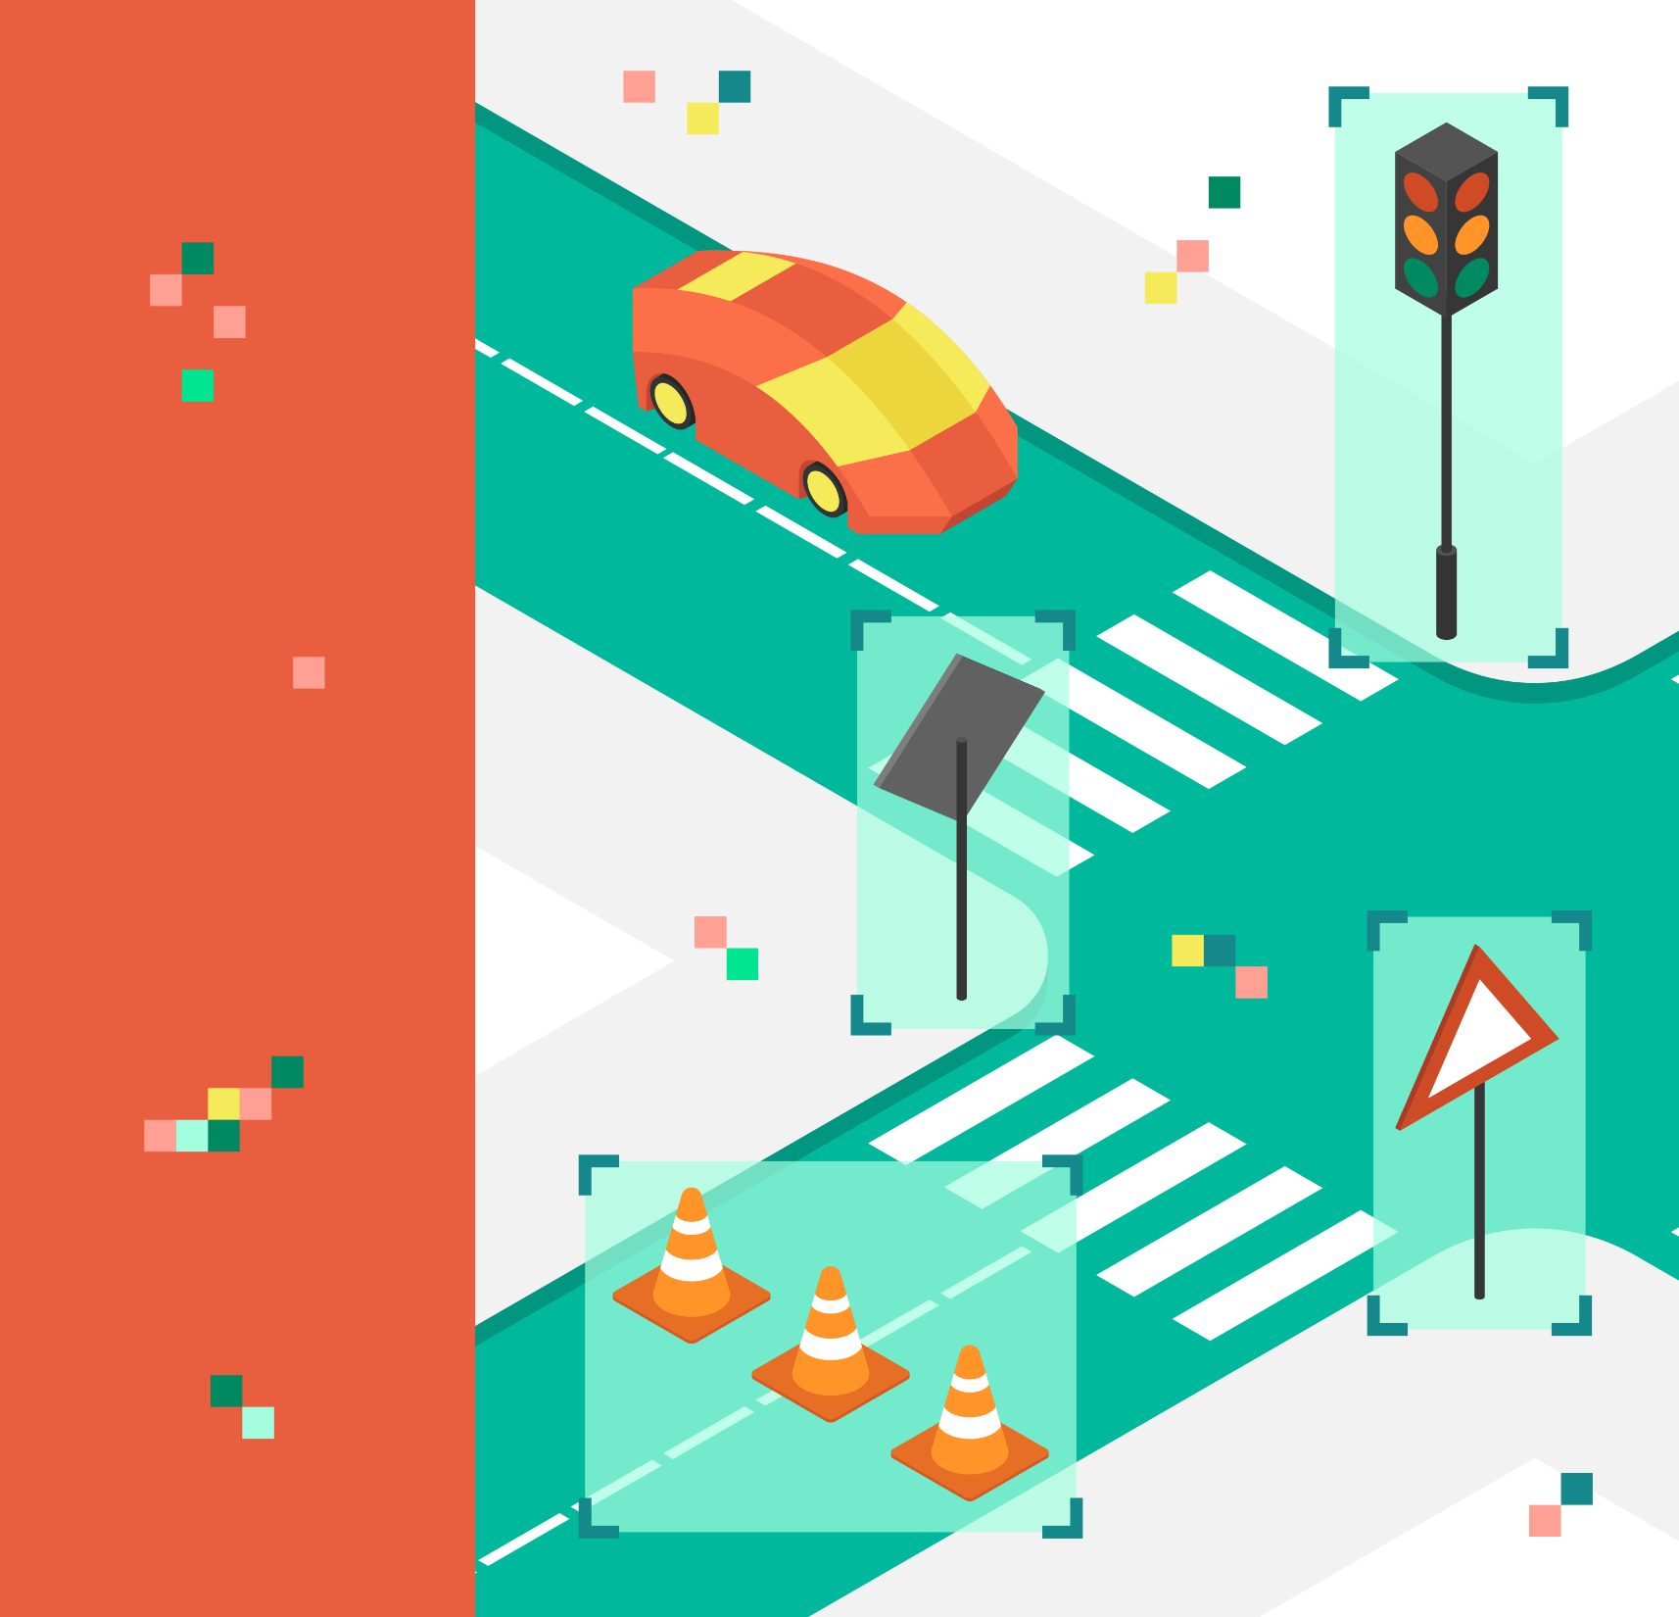
Introduction
Problem Definition:
Global Movement: We are witnessing rapid advancements in autonomous vehicle technology with major investments from leading companies like Tesla, Uber, Google, Mercedes-Benz, Toyota, Ford, Audi, and others.
Critical Need: As these vehicles integrate more deeply into our daily lives, their ability to understand and adhere to all traffic regulations becomes not just beneficial, but essential for safe operation.
Importance of Traffic Sign Recognition:
Safety and Compliance
Technological Challenge
Dual Benefit
Objective:
Develop a machine learning model that can accurately recognize and interpret traffic signs from static images.
By improving recognition accuracy, we aim to contribute to the development of smarter, safer autonomous driving systems and support driver assistance technologies.

Slide 3
Software/Tools Requirements
The project has been implemented using Python Programming.
The experiments are executed and conducted in JUPYTER platform.

Slide 4
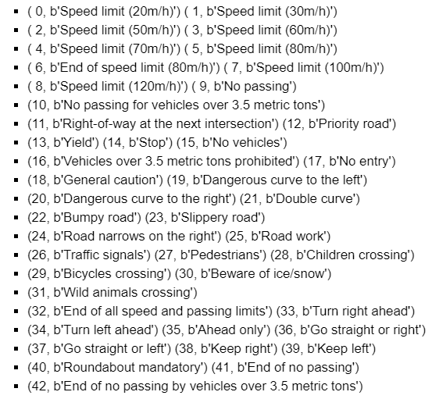
About the dataset
The dataset consists of 43 different classes.
Images are 32 x 32 pixels
The dataset is divided into three folders : Training set(34799 images) , Validation Set(4410 images) & Test set(12630 images).
Notes:
Change the image

Slide 5



Packages & Modules
Numpy: Used for data manipulation and processing.
Skimage: Used for tasks like image resizing and transformations.
Pyplot: Useful for plotting graphs and images within the notebook.
Sklearn: Used for data pre-processing and performance matrix.
Opencv: Used to manipulate image data.
Pickle: Used for saving and loading the trained machine learning models

Slide 6
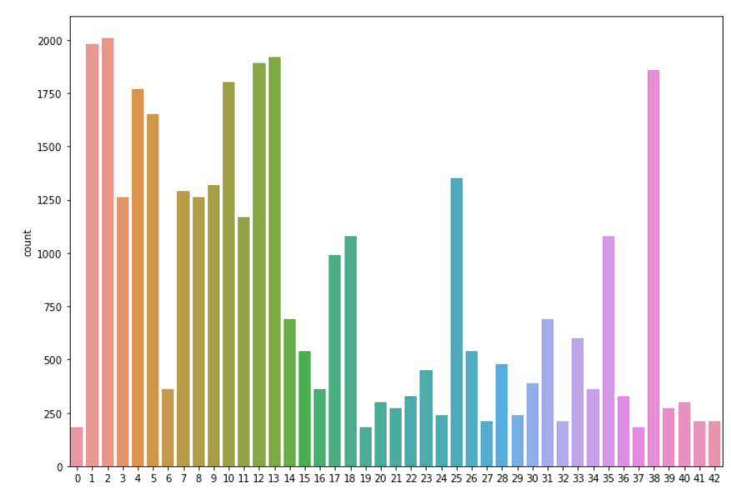
Architecture Methodology- 1
1. Import Libraries and Datasets
2. Data Loading:
Objective: Efficiently load and access the dataset for preprocessing and model training.
Package Used: Pickle
3. Preprocessing Steps:
a)Conversion to Grayscale:
Reducing the image from three color channels (RGB) to one grayscale channel simplifies the model's task by focusing on the structure and edges instead of color.
Package Used: OpenCV
b)Application of the Prewitt Filter:
Enhances the detection of edges in the grayscale images, which is crucial for recognizing the shapes and boundaries of traffic signs.
Package Used: Skimage
4. Visualization:
Display an original RGB image next to its grayscale and edge-detected versions.
Package Used: Matplotlib

Slide 7
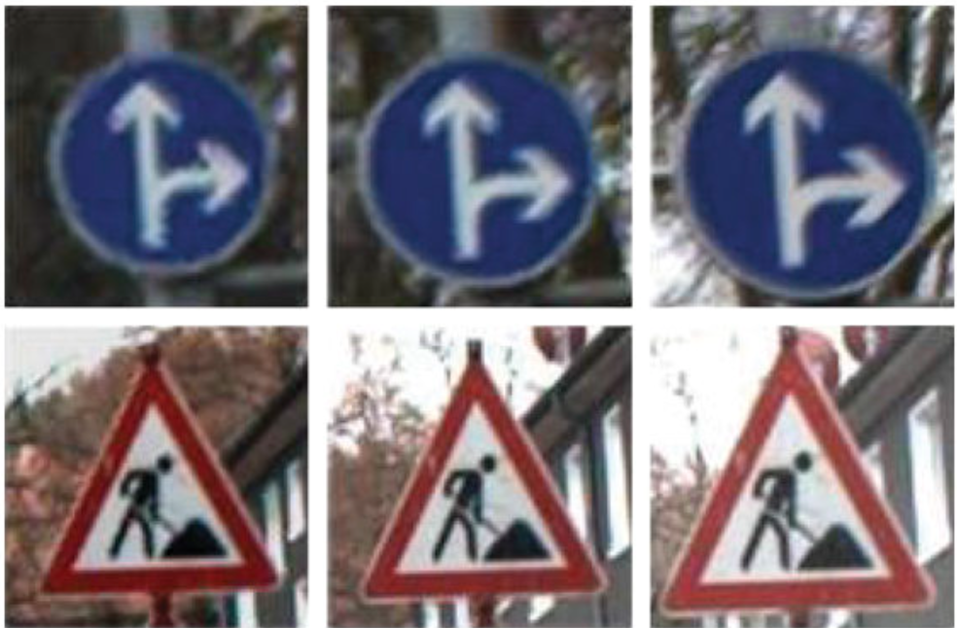
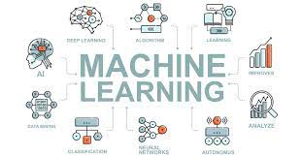
Architecture Methodology- 2
5.Image Resizing:
Objective: To standardize the input dimensions for all images in the dataset, ensuring that they are compatible with the machine learning models which require a fixed size input.
Tool Used: OpenCV
6. Normalization:
Objective: Scale pixel values to a range of [0,1] which helps in speeding up the convergence of the model during training.
7. Data Augmentation:
Objective: Enhance the robustness and generalization ability of the model by artificially increasing the diversity of data available for training.
Techniques Used: Rotation, Flipping &Translation
8. Model Training and Filtering:
Objective: To Train and Filtering out the model using cross validation for its efficacy in handling image data and its simplicity in classification tasks to monitor performance and ensure generalizability
Tasks Done: Hyperparameter tuning like K Value and Distance Metric.
Tool Used: Sckit-Learn

Slide 8


Architecture Methodology- 3
9. Evaluating the Model:
a) Metrics:
Accuracy to assess performance across various classes of traffic signs.
b) Validation:
Use a separate validation dataset to test the model's performance, ensuring that the evaluation is unbiased and indicative of real-world usability.
Tool Used: Sckit-Learn

Slide 9
Architecture Diagram
ML Algorithms
Preprocessing
Start
Select Images
Stop
Model Evaluation
Testing the Model

Slide 10

OUTPUT
Variations in most of the models
Overfitting
Random Forest gave the best accuracy
Random Forest: 90%
SVM: 75%
Naïve Bayes: 35%
KNN: 54%
INPUT IMAGE
TARGET CLASSES
20 m/h
50 m/h
100 m/h
Stop
Yield
CLASSIFIER
32
32

Slide 11



Conclusion and Future Scope
This project underscores the significant potential of machine learning in enhancing the cognitive capabilities of autonomous systems. As we continue to refine these technologies, we move closer to realizing fully autonomous vehicles that are safe, reliable, and efficient.
The next step involves leveraging deeper architectures such as CNNs to further improve the accuracy and real-time processing capabilities of our system.
Encouraging collaborative ventures with academic and industrial partners to enhance the dataset and improve algorithmic approaches through shared knowledge and technology.

Slide 12
References
https://www.kaggle.com/meowmeowmeowmeowmeow/gtsrb-german-traffic-sign
https://medium.com/@YearsOfNoLight/intro-to-image-classification-with-knn-987bc112f0c2
https://www.datacamp.com/community/tutorials/k-nearest-neighbor-classification-scikit-learn
https://drive.google.com/drive/folders/1Wkw109jSbA3QSpVgHxBtp9kwfetev77i

Slide 13

THANK YOU

