Slide 1
CYBER SHOPPING
Guided By:
K.Narasimhulu Presented By:
K.Amrutha
Reg.no:20091f0003

Slide 2
Contents
Introduction
Abstraction
Existing System and Drawbacks
Proposal System and Advantages
Software Development Life cycle
Modules
Hardware Requirements
Software Requirements
Conclusion

Slide 3
Introduction
Digital Marketing is rapidly growing sector were all countries Customers searching for Latest and best products with unbelievable offers.
As digital Marketing is Dynamic optimization model for a wholesaler’s mart price promotions of various brands in products categories.
In Current Digital Marketing a customer can meet thousands of suppliers with different price bands.
There is no general consensus in online digital or empirical marketing, various literatures shows the impacts of price promotions on bargain of consumer behavior activity.

Slide 4
ABSTRACT
Digital Marketing is rapidly growing sector were all countries Customers searching for Latest and best products with unbelievable offers.
In current Exiting system of e-commerce, a growing number of customers choose to go shopping online because it saves time and effort.
The products in the skyline are the best possible tradeoffs between all the factors that customers care about.
Provide combinations which both meet a customer’s willingness to pay and bring the maximum discount rate, the user quoted rate is intimated to various vendors for best price promotions.
Secondly brand substitution where some consumers are provided with branded combination substitution with lower priced promoted from various vendors.

Slide 5
Existing System
Skyline query, a product which is not dominated by any other product is said to be a skyline product or it is in the skyline.
The products in the skyline are the best possible tradeoffs between all the factors that customers care about.
As the the systems are not able to provide skyline query attractive products.

Slide 6
Drawbacks
Skyline query aims to return the points that are not dominated by any other product combinations.
Not possible for group skyline queries.
Does Not Provides customer’s willingness Price Promotions.
Does not provide branded combination substitution.

Slide 7
Proposed System
Immediate and positive impact of price deal on the sales of promoted brand.
Brand Substitution and Brand Combination with lowered price from various suppliers.
Impact of discount on the demand for brand increase, the depth of a discount should be increased.
Discount on a brand should be smaller, the more damaging a promotion of the brand will be for the current demand for the other brand.
Promotes two are more brands with many suppliers.

Slide 8
Advantages
Our proposed scheme finds to be much more efficient for finding optimal skyline products.
Retrieve optimal skyline product combinations that satisfy the customer’s payment constraint and bring the maximum discount rate.

Slide 9
System Requirements
Hardware Requirements
System : Intel core
Hard Disk : 20 GB min
RAM : 4 GB
Software Requirements
Operating System : Linux/Windows 7/8/10
Coding Language : Java 1.5
Web Server : TOMCAT
Database : MYSQL

Slide 10
Software development life cycle
SDLC is a process followed for a software project, within a software organization.
It consists of a detailed plan describing how to develop, maintain, replace and alter or enhance specific software.
The life cycle defines a methodology for improving the quality of software and the overall development process.
The SDLC stages are Communication, Design, Construction, Implementation, Deployment.

Slide 11
Architecture Design
Communication
Design
Construction
Implementation
Deployment

Slide 12
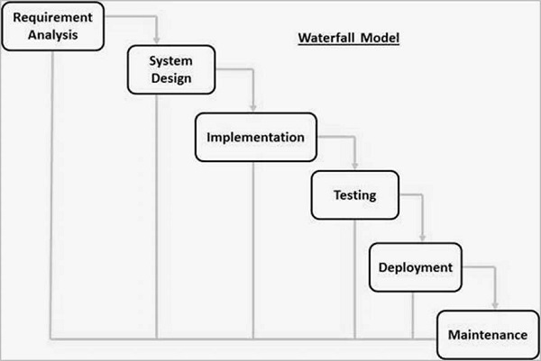

Waterfall model
The Waterfall approach was first SDLC Model to be used widely in Software Engineering to ensure success of the project.
In "The Waterfall" approach, the whole process of software development is divided into separate phases.

Slide 13
Modules
Administrator Module
Online Shopping
Different Seller Integration
Sellers Information Monitoring
Backups & Restore of Sellers and Buyers Data.

Slide 14
Seller Module
Maintains of Products
Promote Brands
Promote Discounts
Provide Combination of Products
View User Bargained Price
Offer Seller Price
Provide Combination Offers

Slide 15
Buyer Module
Registration
Login
Search of Products
View Products
Bargain for Price
View Combination Offers
View willing Price Vendors List

Slide 16
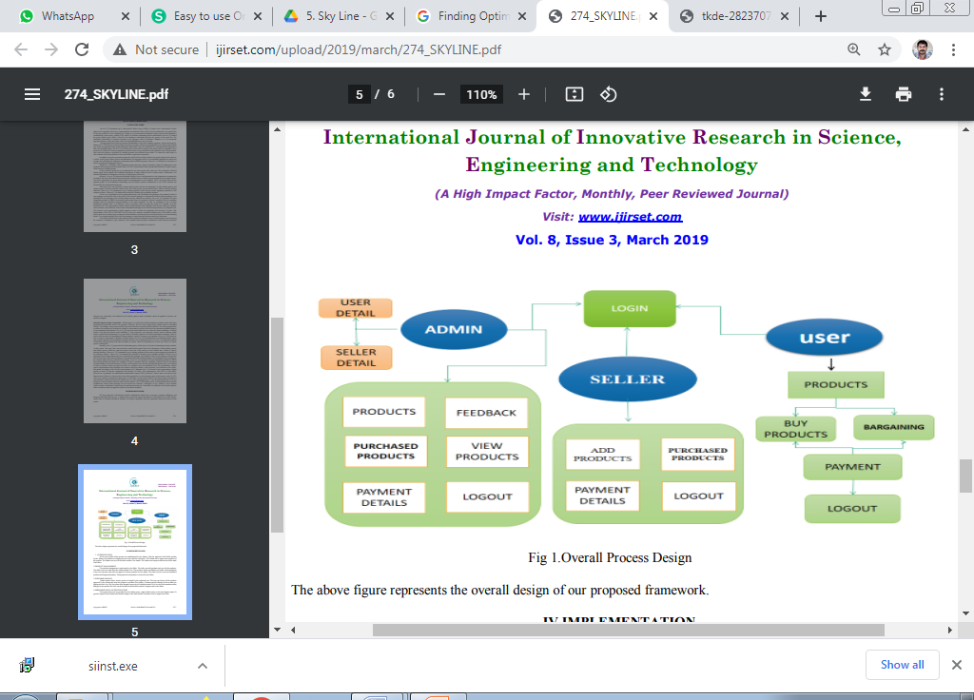
Architecture Design

Slide 17
UML Diagrams
Products Management
Orders Management
Adminstrator
Bargain
Promotion
Commerce Pattern

Slide 18
Class Diagram
Domain
+Website
Admin
+Products
+Login name
+Product Management
+Password
+Registration
+Location Based
+Submit()
+Computations
+Segmentations
+Analysis
+Store inside database()
DomainActivities
Reports
+Process Product Management
+View Customers
User
+Process Product Rating
+View Shopping
+Location Based Analysis
+View Products
+Registration
+Effective Pattern
+View Locations
+login
+Mobile Commerce Mining
+Computations
+shopping
+Process Analysis
+View Data Analysis Reports
+user activities
+View Reports
+View Data Mining Reports
+View Customers
+View Other Reports
+various methods for analysis
+ various methods for analysis()

Slide 19
Sequence Diagram
Registration
Login
Registration
Search Product
Shopping
Payment
Analysis
Admin
1: Store the new user information ( )
2: Registration Failed ( )
3: Enter the username and password ( )
4: Login Failed ( )
5: Adding domain details ( )
6: Search Product ( )
7: Transaction Completion ( )
8: Analysis ( )
9: Payment ( )

Slide 20
Activity Diagram for Administrator
User
Buy Products
No
Select Products
Search page
Yes
Bargain
View Bargain Price
Buy

Slide 21
CONCLULSION
Project Provides retrieve optimal skyline product combinations that satisfy the customer’s payment constraint and bring the maximum discount rate.
Propose an exact algorithm, design an approximate algorithm with an approximate bound, and develop an incremental performance.
Customer’s demands are diversification and individuation, and it is significant and interesting to compute optimal product combinations that meet different customer demands such as save or spend the most money under their budgets.

Slide 22


