Slide 1


Slide 2

Stock Market Analysis
CAP5610 PROJECT
Presented by:
Shruti Kamtekar
Sai Lalitha
Nishit Prasad

Slide 3
Outline
Introduction
Can we predict stocks?
Overview of training model
Feature Generation
Training
Conclusion and Future Work

Slide 4
Can We Predict Stocks?
Stocks generally follow Efficient Market Hypothesis (EMH)
Stock price considers all available info and stocks only respond to new info
This makes stocks unpredictable → random walk
Stock prediction accuracy ~50% and not exceed it (fair trading metric)
Short term & seasonal trends “can” contradict EMH
Momentum : Stocks that have recently been increasing continue to increase for few days; same applies for decreasing stocks
Adds predictability to the stock price over short term
Long-term price trend follows seasonal variation : holidays quarters rock for retail / electronics

Slide 5
Introduction
Stock Market Prediction using
Fundamental Analysis – revenues, earnings, future growth etc
Technical Analysis – price, volume transformation , moving averages etc
Sentiment Analysis – news articles, social media
Popular Algorithms for prediction
SVM
Reinforcement Learning
Logistic Regression
Neural Networks
Project Focuses on short term prediction of stocks (1-10 days)
Uses technical indicators to classify trends as up or down.
Technical indicators are referred from paper Stock Trend Prediction with Technical Indicators.
Prediction is based on price index movement for past 6 months; with accuracy ~ 70%

Slide 6
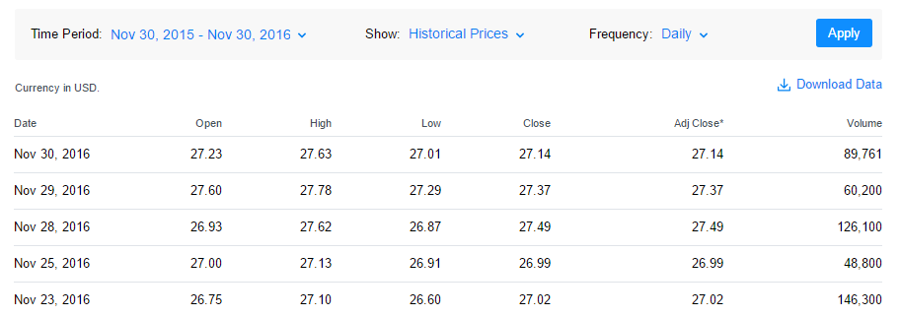
Data Set
Yahoo finance data from 2015-10-01 to 2016-07-15
Web data reader to extract the raw data as a panel from various stocks like AAPL, GOOGLE, MICROSOFT, FACEBOOK.

Slide 7
Overview of Training Model For Each Trade
X_{train/test}
Y_{train}
Price Data
Feature Generation
Feature Selection
Training Labels
6-month data from Yahoo finance
26 features calculated from price trend
Down select key features
Logistic Regression and RBF kernel SVM
Raw Data
Attributes = fn (time)
Y(t) = fn (future price trend)
Date
Momentum (MOM)
Rank the features
Open/Close
Rate of change (ROCR)
Up
Extreme Randomized Tree Algorithm
Volume
Relative Strength (RSI)
Down
High/Low
Moving Average (MACD)
Top 50% features retained

Slide 8
Feature Generation
Part-1: Building X-matrix

Slide 9
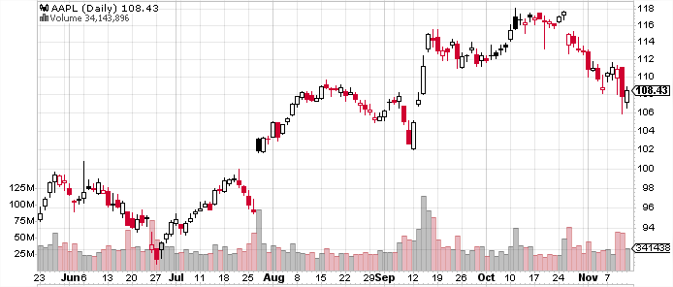
Plotting Raw Data:
AAPL
Price Value
Volume
6 month data
Raw data: Open / Close each day ; Volume; intraday highs & lows
Candlestick plot shows price “change” trend – red box → loss; open box → gain

Slide 10
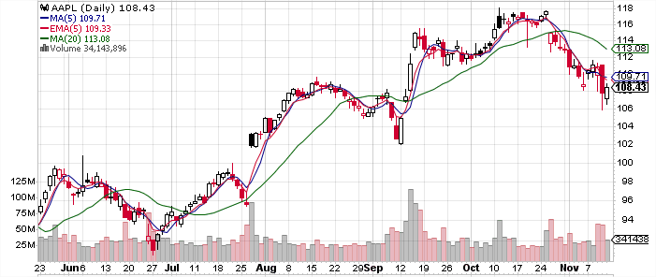

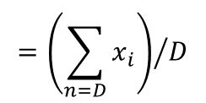
Features : Trends
$X_{i}=\{$SMA3, EMA3, EMA6$\}$
SMA5
EMA5
SMA50
$$={\left(\sum_{n=D}{x_{i}}\right)}/D$$
SMA : Simple Moving Average For ‘D’ days
EMA : Exponential Moving Average For ‘D’ days
EMA gives more weightage to recent prices while SMA doesn’t.
Notes:
Noise elimination and data smoothing – TRIX
SMA - Was designed to smooth out the effects of price volatility and create a clearer picture of changing price trends

Slide 11


SMA/EMA Crossovers
SMA5
SMA50
Shorter term moving average = SMA5
Longer term moving average = SMA50
At crossover points, traders decide either to buy / sell – important indicators

Slide 12
-ve
+ve
SMA5
EMA5
-ve
+ve
SMA50

Slide 13
Popular Indicators
Momentum
Rate of changes (ROCR, MOM); Williams % R – slope of time series
Trend-Based
SMA & EMA (3-day & 14 day); MACD, time-series regression (TSF)
Volatility
Based on std. dev. of daily trend: ATR (true range), ADX (directional)
Sector averages (NASDAQ for tech, S&P for small-cap etc.)
Market-Driven
We calculate 27 features for comprehensive analysis : Summarized in report

Slide 14
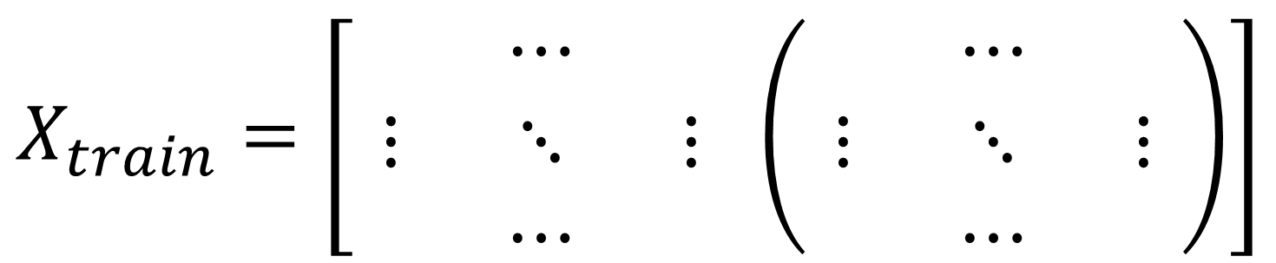
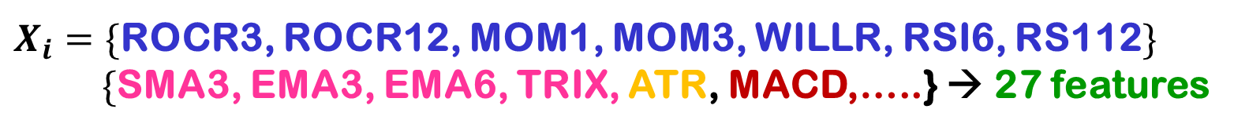
Summary of Features Extracted:
$X_{i}=\{$ROCR3, ROCR12, MOM1, MOM3, WILLR, RSI6, RS112$\}$
$\{$SMA3, EMA3, EMA6, TRIX, ATR, MACD,…..} → 27 features
Xi (t) for the stock
Xi (t) for the S&P 500
$$X_{train}=\left[\begin{matrix} & ⋯ & \\ ⋮ & ⋱ & ⋮ \\ & ⋯ & \end{matrix} \left(\begin{matrix} & ⋯ & \\ ⋮ & ⋱ & ⋮ \\ & ⋯ & \end{matrix}\right)\right]$$
Date (t)
For each stock, we also add S&P 500 which captures overall trend of market

Slide 15
Feature Generation
Part-2: Feature Ranking

Slide 16
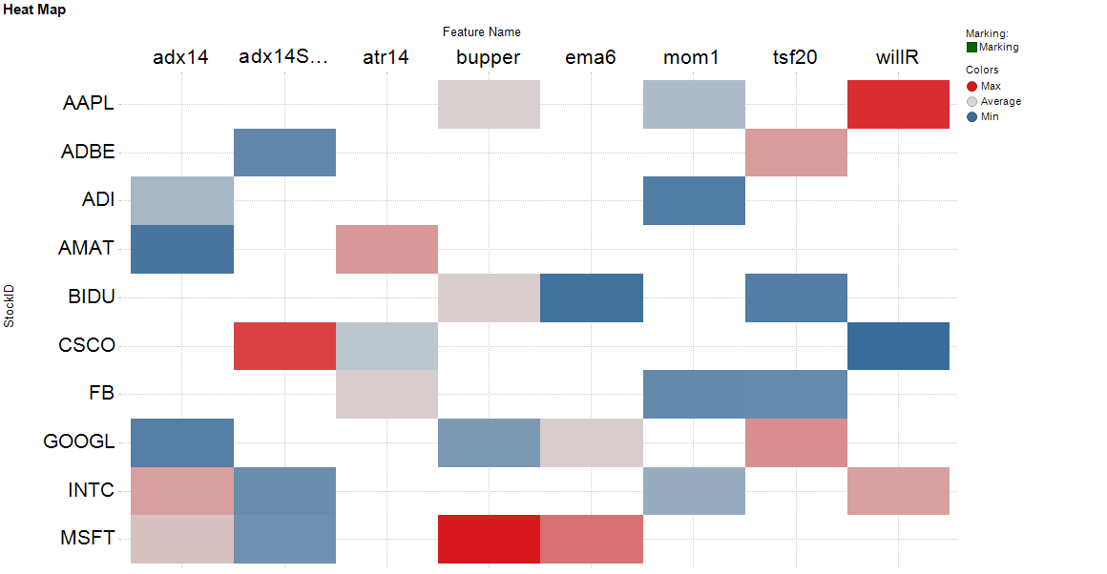
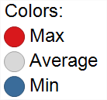
Feature Ranking – Tech Stocks (I)
Momentum
Momentum
Volatility
S&P
Volatility
Trend
Trend
Features
StockID
Top ranking features for 10 tech stocks

Slide 17
Feature Ranking – Tech Stocks (I)
Momentum
Momentum
Volatility
S&P
Volatility
Trend
Trend
Features
StockID
Top ranking features for 10 tech stocks

Slide 18
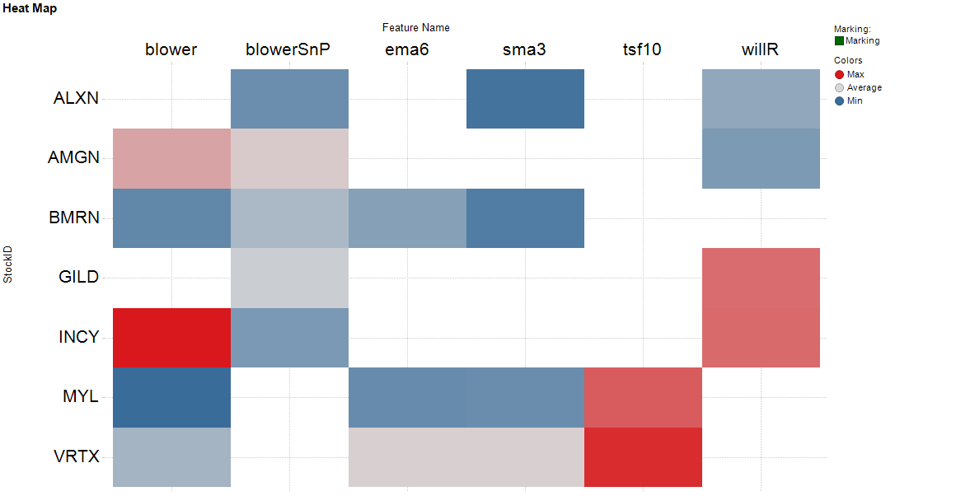
Feature Ranking – Health & Drugs Stocks (II)
Volatility
S&P
Trend
Trend
Trend
Momentum
Features
StockID
Top ranking features for 7 pharma stocks

Slide 19
Training Model

Slide 20
How To Create Training Labels Y
Two classes: Down or Up.
The Y(t) has the value in {-1, 1}.
For predicting next day trend,
1, if Price(t+1) > Price(t)
Y(t) =
-1, if Price(t+1) < Price(t)
For predicting next 3-day trend average price trend,
1, if SMA(t+3) > SMA(t)
Y(t) =
-1, if SMA(t+3) < SMA(t)
SMA – Simple Moving Average
p(n) + p(n-1) + .. + p(1)
SMA = --------------------------------
n
Where, p(n), p(n-1), . ., etc. are the closing prices of past n days.

Slide 21
Dependence of Accuracy With N_Features
FEATURES | CATEGORIES | ACCURACY
RSI6, MOM1, MOM3, ROCR3, WILLR, SMA3 | Momentum | 82%
outMACD, ADX14, EMA6, EMA12, TRIX, SMA3 | Trend Indicators | 57%
OBV, MFI14, SMA3 | Volume | 46%
Total 27 common features for Apple stock!
Lot of noisy features existing
Results in overfitting the training data and mislead the prediction.
Feature selection is important to handle above issues.

Slide 22
How Well In Future is Model Accurate?
With increasing month range for training data,
the accuracy increases
Minimum of 6 months data needed to get reasonable accuracy
in months

Slide 23
Stocks Considered
Consumer Ser.
Comcast Corporation
Starbucks Corporation ..
Health Care
Amgen Inc.
Biogen Inc. ..
Miscellaneous
The Priceline Group Inc.
NetEase, Inc…
Public Utilities
T-Mobile US, Inc. …
Technology
Apple Inc.
Google …
Transportation
CSX Corporation
American Airlines Group, Inc. …
Capital Goods
Tesla Motors, Inc.
Illumina, Inc. …
Consumer ND
The Kraft Heinze Company
Monster Beverage …
Notes:
For RBF-SVM, we grid-search for best combination of C, gamma to avoid overfit

Slide 24

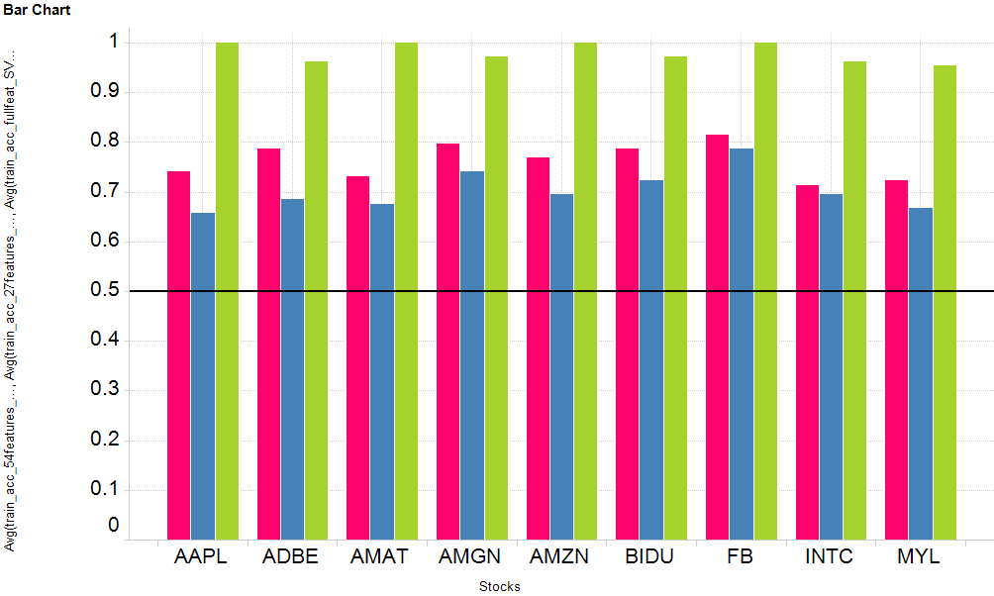
Training Set Accuracy:
Full feature LR (stock + S&P)
Stock feature LR (stock only)
Full feature SVM (RBF)
Train set accuracy
Train set data: 6 months
n_features: 27
n_classes: 2
Stock ID
Notes:
For RBF-SVM, we grid-search for best combination of C, gamma to avoid overfit

Slide 25
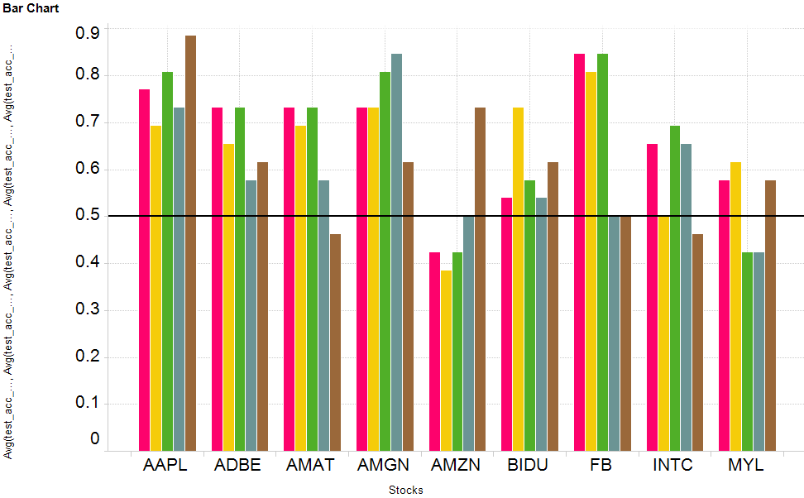
Test Set Accuracy:
Stock feature LR (stock only)
Full feature LR (stock+SnP)
Select feature LR (stock+SnP)
Full feature SVM
Select feature SVM
Test data:
2 months

Slide 26
Conclusion & Future Work
1. Increasing decision label classes to 5, namely:
Very Bullish (1)
Bullish (2)
Neutral (3)
Bearish (4)
Very Bearish (5)
2. Analyzing the SVM model test accuracy.

Slide 27


Summary : Indispensable Tool For Investors
Advise on nature : volatile, trend-based or momentum driven
Informed Investor
Features & Indicators
Portfolio Mix
Stock Sentiment
Confidence in prediction : Bearish or Bullish in coming weeks
Comprehensive feature extraction from time series data

Slide 28
References
1. Stock Trend Prediction with Technical Indicators using SVM, Xinjie Di. http://cs229.stanford.edu/proj2014/Xinjie%20Di,%20Stock%20Trend%20Prediction%20with%20Technical%20Indicators%20using%20SVM.pdf
2. Machine Learning in Stock Price Trend Forecasting, Yuqing Dai, Yuning Zhang
http://cs229.stanford.edu/proj2013/DaiZhang-MachineLearningInStockPriceTrendForecasting.pdf
3. Predicting Stock Price Direction using Support Vector Machines, Saahil Madge
https://www.cs.princeton.edu/sites/default/files/uploads/saahil_madge.pdf

Slide 29
Thank You

Slide 30
Supplementary

Slide 31
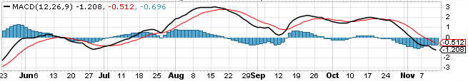

Features : Trends + Changes
$X_{i}=\{$MACD, MACDSig, MACDHist$\}$
MACD line
Signal line
MACD(12,26,9) : Moving Average Convergence Divergence
MACD Series = (EMA for 12 days – EMA for 26 days)
Signal Line = Calculate EMA of MACD series for 9 days
Histogram = MACD Series – Signal Line
Buy/ Sell signals generated based on “crossover” between MACD and signal line

Slide 32
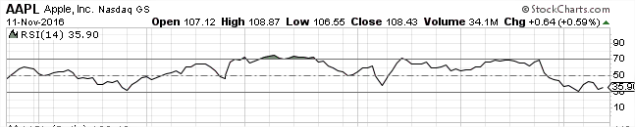

Features : Changes
$X_{i}=\{$ROCR3, ROCR12, MOM1, MOM3, WILLR, RSI6, RS112$\}$
ROCR : Rate of Change = (Price(t)/Price(t-n))*100
MOM : Momentum = Price(t) - Price(t-n)
WILLR: Williams %R = (High-Closed)/ (High-Low)*100
RSI : Relative Strength =
$100−\frac{100}{1+RS}$ where $RS=\frac{Avg. Losses}{Avg.gains}$
Extremely popular indicator
RSI

