Slide 1
Background
The capability of communication system is limited by the channel propagation characteristics.
For high rate data transmission, the channel delay spreadτ may be larger than the symbol durationT, which will cause severe inter-symbol interference (ISI), and degrade system performance dramatically.
Channel equalization is classic technology to remove ISI, and most mobile communication systems will apply Channel equalization.

Slide 2
Multipath channel
In wireless telecommunications, multipath is the propagation phenomenon that result in radio signals reaching the receiving antenna by two or more paths.
Causes of multipath include reflection from terrestrial(陆地的) objects such as mountains and buildings.
Delay spread(时延扩展): multiple paths arrived at different time

Slide 3
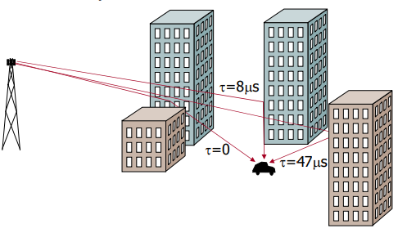
Multipath channel

Slide 4
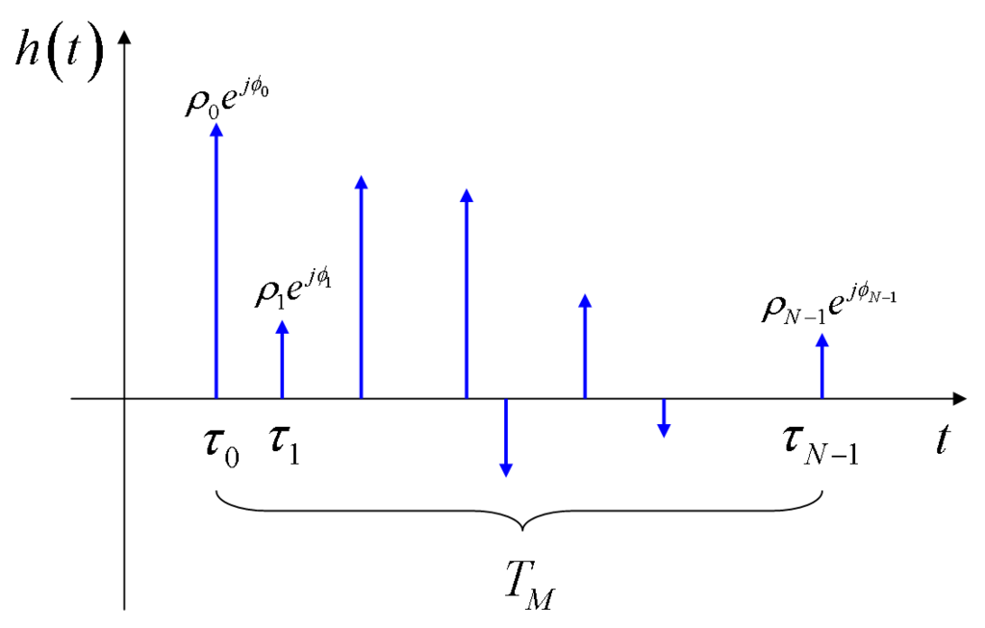
Multipath channel
Attenuation（衰减）
and
Phase shift（相移）

Slide 5
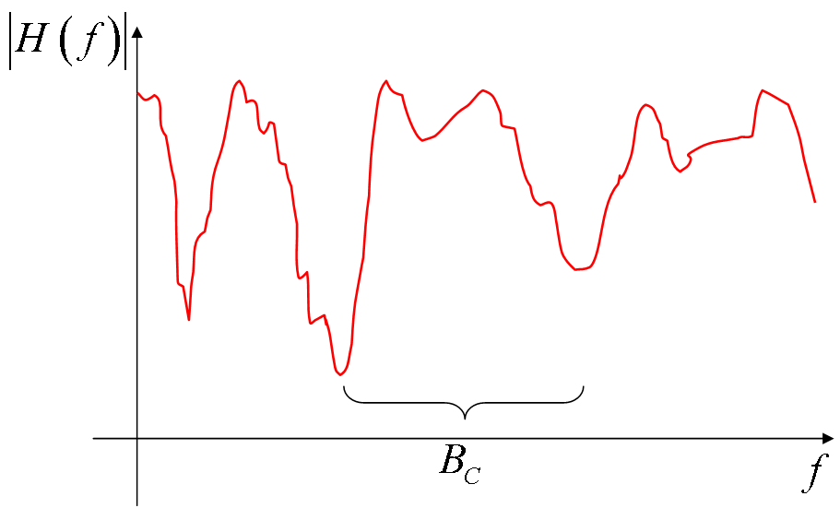
Channel Transfer Characteristic

Slide 6
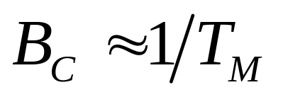
Channel Transfer Characteristic
The obtained channel transfer characteristic has a typical appearance of a sequence of peaks and valleys; --所获得的信道传输特性具有典型的峰谷序列
It can be shown that, on average, the distance (in Hz) between two consecutive valleys (or two consecutive peaks), is roughly inversely proportional to the multipath time.
-- 两个连续谷(或两个连续峰)的间距(Hz)与多径时间大致成反比
The so-called coherence bandwidth（相干带宽）Bc is thus defined as (T_{M} /τ _{max}：最大(多径)时延扩展)

Slide 7
信道扩展主要可以分为三方面：多径(时延)扩展(delay spread)；多普勒扩展；角度扩展。
相干带宽(coherence bandwidth) 是描述时延扩展的：相干带宽是表征多径信道特性的一个重要参数，它指某一特定的频率范围，在该频率范围内任意两个频率分量都具有很强的幅度相关性。即: 在相干带宽范围内，多径信道具有恒定的增益和线性相位。通常，相干带宽Bc近似等于最大多径时延Tm的倒数。
从频域看，如果相干带宽小于发送信道的带宽，则该信道特性会导致接收信号波形产生频率选择性衰落，即某些频率成分信号的幅值可以增强，而另外一些频率成分信号的幅值会被削弱。

Slide 8
而相干时间(coherence time)是描述多普勒扩展的：相干时间在时域描述信道的频率色散的时变特性。相干时间与多普勒扩展成反比，是信道冲激响应维持不变的时间间隔的统计平均值。
如果基带信号的符号周期大于信道的相干时间，则在基带信号的传输过程中信道可能会发生改变，导致接收信号发生失真，产生时间选择性衰落，也称快衰落；
如果基带信号的符号周期小于信道的相干时间，则在基带信号的传输过程中信道不会发生改变，也不会产生时间选择性衰落，也称慢衰落。

Slide 9
定义相干带宽一般是用来划分平坦衰落信道和频率选择性衰落信道的量化参数。如果信道的最大多径时延扩展为 Tm，那么信道的相干带宽 Bc=1/Tm；
若发射信号的射频带宽 B<Bc，那么认为接收信号经历的是平坦衰落，此时接收信号的包络起伏变化，但是一般不存在码间串扰(ISI)，其信号模型为 r(t)=h(t)s(t)+n(t)，其中h(t)一般为瑞利分布的随机变量；
若发射信号的射频带宽 B>Bc，那么认为接收信号经历的是频率选择性衰落，此时除了接收信号的包络起伏变化，一般还存在码间串扰(ISI)，其信号模型为r(t)=h(t-τ0)s(t-τ0)+h(t-τ1)s(t-τ1)+...+n(t)其中τ0、τ1...等为可分辨多径的时延，每个h(t-τ)一般为瑞利分布的随机变量。

Slide 10
定义相干时间一般是用来划分时间非选择性衰落信道和时间选择性衰落信道，或叫慢衰落信道和快衰落信道的量化参数。如果信道的最大多普勒频移为fm，那么信道的相干时间Tc=0.423/fm。
若发射信号的符号周期 T<Tc，那么认为接收信号经历的是慢衰落，即h(t)在若干个符号间隔内保持不变；
若发射信号的符号周期 T>Tc，那么认为接收信号经历的是时间选择性衰落/快衰落，即h(t)的变化速度快与符号速率，此时如果对信道进行比较精确的估计或是均衡都是十分困难的。

Slide 11
对于两个平稳信号 S1(t) 和 S2(t)，它们的相关系数的绝对值大于0小于1时，两个信号相关。相关系数等于1时，两个信号相干。当两个信号相干时，它们之间只相差一个复常数。复常数既一有幅度成分，又有频率成分。
由此我们可见，若两个信号相干，它们其中一个可以看作是另一个的幅度的衰减，频率上衰落造成的，其实二者可以看作同一个信号。相关系数越是接近1，相关性越大。

Slide 12
相干时间和相干带宽都是描述信道特性的参数，当两个发射信号的频率间隔小于信道的相干带宽，那么这两个经过信道后的，受到的信道传输函数是相似的，由于通常的发射信号不是单一频率的，即一路信号也是占有一定带宽的，如果，这路信号的带宽小于相干带宽，那么它整个信号受到信道的传输函数是相似的，即信道对信号而言是平坦特性的，非频率选择性衰落的。
同样在相干时间内，两路信号受到的传输函数也是相似的特性，通常发射的一路信号由于多径效应，有多路到达接收机，若这几路信号的时间间隔在相干时间之内，那么他们具有很强的相关性，接收机都可以认为是有用信号，若大于相干时间，则接收机无法识别，只能认为是干扰信号。

Slide 13
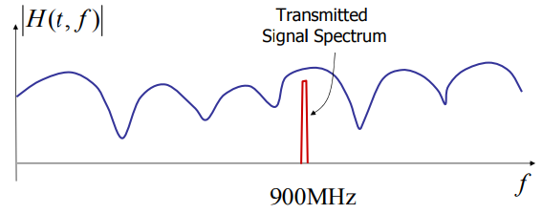
Flat fading (平坦衰落)
Flat fading: the signal bandwidth B is much smaller than the coherent bandwidth Bc
The channel appears to be flat to the signal

Slide 14
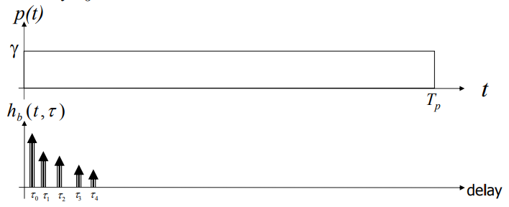
Flat fading
Delay spread Tm is much smaller than symbol duration T (符号持续时间)
“the multipath is not resolved”

Slide 15
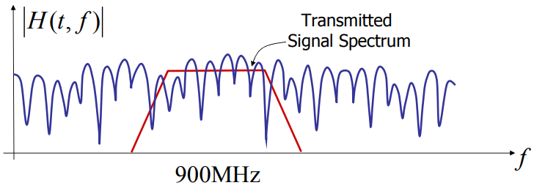
Frequency selective fading
The signal bandwidth B is much larger than the coherent bandwidth Bc;
The frequency response of the channel varies significantly with frequency over the bandwidth of the transmitted signal B;

Slide 16
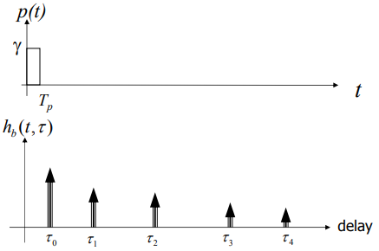
Frequency Selective Fading
Delay spread Tm is much larger than symbol duration T
Inter-symbol interference (ISI)

Slide 17
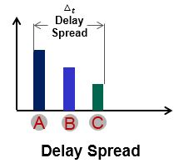
同一个信息的信号由于到达目的地的路径不同，导致了到达时间不同。也就是接收端在时间1收到第一条路径发来的该信息，可能在时间4收到2条路径发来的该信息。假设这个信息有这两条到达路径，那么接收端本来应该在时间1接收完所有关于该信息的信号，结果却在时间4之后才全部收完。
这样的情况，就是信号由于多径产生了时延。(从1个时间间隔延迟到4个间隔) 这就是时延扩展的物理意义。

Slide 18
Summary of multipath channel
Multipath is objective physical phenomenon.
The channel characteristic is unchanged (e.g. delay spread Tm, coherent bandwidth Bc);
Flat fading or Frequency selective fading, ISI or not, is determined by the signal property(信号特性), including the symbol duration T and signal bandwidth B;

Slide 19
Equalization
In telecommunication, equalization is the reversal of distortion incurred by a signal transmitted through a channel;
-- 均衡是通过信道传输的信号引起的失真的逆转
Equalizers are used to render the frequency response—for instance of a telephone line—flat from end-to-end.
When a channel has been equalized the frequency domain attributes(频域属性) of the signal at the input are faithfully reproduced(再现) at the output.

Slide 20
Equalization
In digital communications, the equalizer's purpose is to reduce inter-symbol interference to allow recovery of the transmit symbols. It may be a simple linear filter or a complex algorithm;
Linear equalizer: processes the incoming signal with a linear filter;
Zero forcing equalizer(迫零均衡器): approximates (近似) the inverse of the channel with a linear filter;
MMSE equalizer: designs the filter to minimize E[|e|²], where e is the error signal;

Slide 21
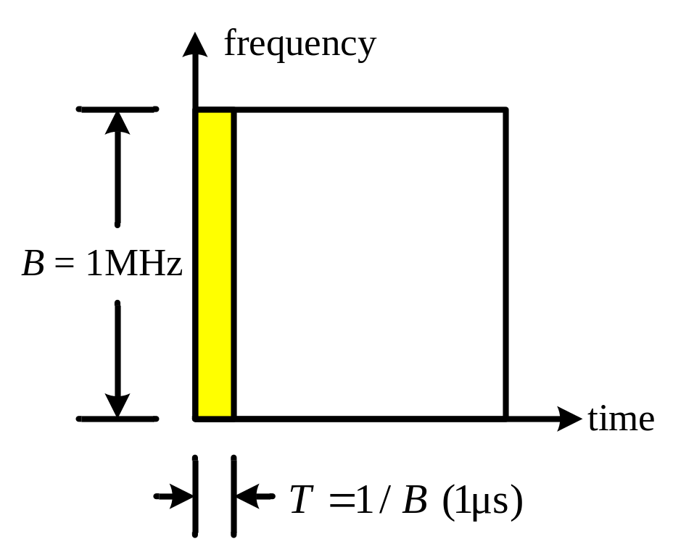
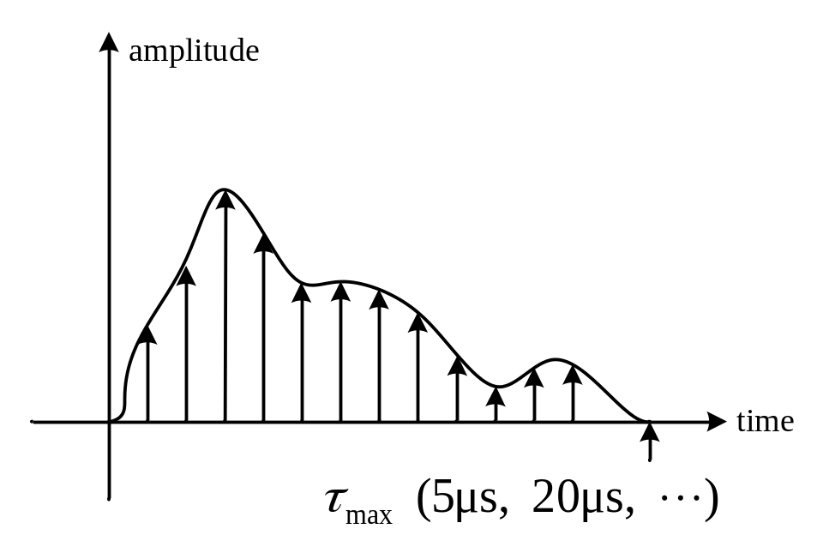
Single Carrier System
Bandwidth: B
Symbol duration: T = 1/B
Max delay spread: τ_{max} > T
Inter-symbol interference (ISI)
Equalization is used
to remove ISI
注意：最大时延扩展τ_{max} 或Tm 和
相干时间Tc的概念有别！

Slide 22
Equalization for SC systems
  If bandwidth B is very large (即：data rate(数据速率) is very high), equalizer with multiple tens or hundreds of taps(抽头) is required, which is nightmare for hardware design;

Slide 23
A possible solution
  A high rate data stream is divided to multiple low rate data streams, and each stream is transmitted by an independent carrier. Multiple carriers transmit in parallel;
  At receiver, each low rate data stream is demodulated separately, and then combined to recover the high rate data stream.
  The symbol duration T for each low rate stream is much larger than the delay spread Tm, so equalization is simple.
  (由于高速/宽带数据被分成N个低速/窄带数据，由T=1/B，它们的时间增大N倍)
  High rate data transmission can be supported with simple equalization；
  (由于B分割成B/N，对应时间为NT >> Tm，消除ISI，均衡器便无需大量抽头了)

Slide 24
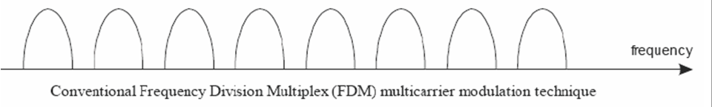
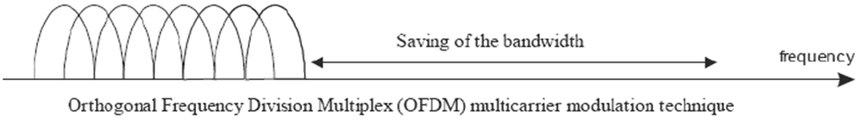
Multi-carrier Modulation
FDM
OFDM
频域选择性衰落信道

Slide 25
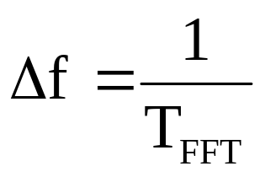
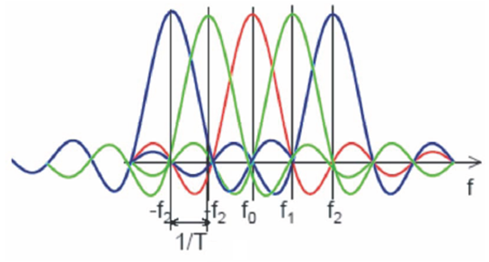
OFDM Definition
OFDM = Orthogonal FDM
Carrier centers are put on orthogonal frequencies
orthogonality –indicates that there is a precise mathematical relationship between the frequencies of the carriers in the system.
Subcarriers are spaced by 1/T 子载波间隔
Modulation
and
Multiplexing
Techniques

Slide 26
OFDM Definition
In OFDM, the sub-carrier frequencies are chosen so that the sub-carriers(子载波) are orthogonal to each other, meaning that cross-talk(串扰) between the sub-channels is eliminated and inter-carrier guard bands are not required. This greatly simplifies the design of both the transmitter and the receiver;
Unlike conventional FDM, a separate filter for each sub-channel is not required.

Slide 27
History of OFDM
OFDM was introduced by Robert W. Chang of Bell Labs in 1966, “Synthesis of band-limited orthogonal signals for multichannel data transmission”
OFDM was improved by Weinstein and Ebert in 1971 with the application of DFT in modulation and demodulation process and introduction of a guard interval to provide better orthogonality in multipath transmission channels. Each sub-carrier is modulated with a conventional modulation scheme (such as QAM or PSK) at a low symbol rate. This maintains total data rates similar to conventional single-carrier modulation schemes in the same bandwidth.

Slide 28
History of OFDM
In 1980, Peled and Ruiz introduced cyclic prefix (CP) into OFDM system to solve the orthogonality problem with low complexity in paper “Frequency domain data transmission using reduced computational complexity algorithms

Slide 29
History of OFDM
1985: Cimini described use of OFDM for mobile communications
1987: Alard & Lasalle COFDM for digital broadcasting
1997: ETSI DVB-T standard
1999: IEEE 802.11a wireless LAN standard (Wi-Fi)
2000: Proprietary fixed wireless access (V-OFDM, FLASH-OFDM, etc.)
2002: IEEE 802.11g standard for wireless LAN
2004: IEEE 802.16 standard for wireless MAN (WiMAX)
2004: ETSI DVB-H standard
2004: Candidate for IEEE 802.11n standard for next generation WLAN
2005: OFDMA is candidate for the 3GPP Long Term Evolution (LTE) air interface E-UTRA downlink.
2007: The first complete LTE air interface implementation was demonstrated, including OFDM-MIMO, SC-FDMA and MU-MIMO
2011: LTE-Advanced is standardized by the 3rd Generation Partnership Project (3GPP) as 3GPP Release 10

Slide 30
Single Carrier System
Bandwidth: B
Symbol duration:T = 1/B
Max delay spread:τ_{max} > T
Inter-symbol interference (ISI)
Equalization is used
to remove ISI

Slide 31
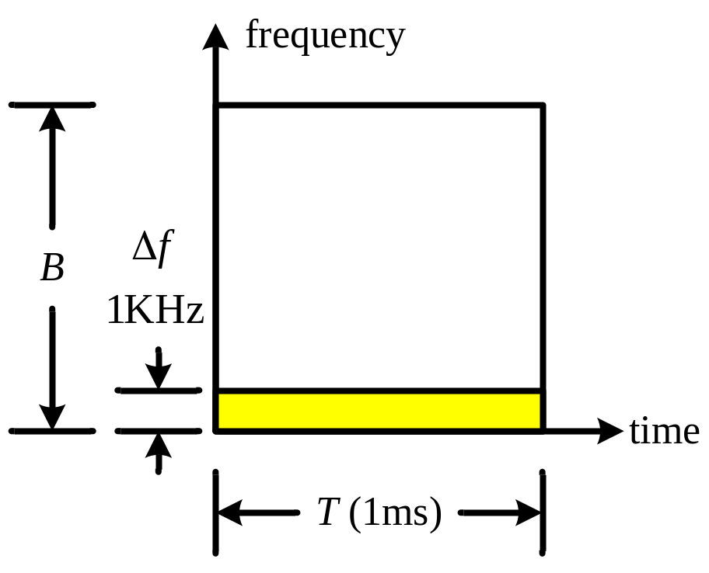
OFDM system with N subcarriers
The total bandwidth B are divided into N sub-carriers
The bandwidth for each sub-carrier is narrow(窄), but the symbol duration becomes much longer
Δf = B / N
T = N / B
Δf = 1 / T

Slide 32
OFDM system with N subcarriers
The orthogonality requires that the sub-carrier spacing (子载波间隔) is Δf = 1/T Hz, where T seconds is the symbol duration (符号持续时间).
Therefore, with N sub-carriers, the total bandwidth B will be B ≈ N·Δf (Hz).
The sub-carriers have the minimum frequency separation required to maintain orthogonality of their corresponding time domain waveforms.
-- 子载波具有维持其相应时域波形正交性所需的最小频率间隔

Slide 33
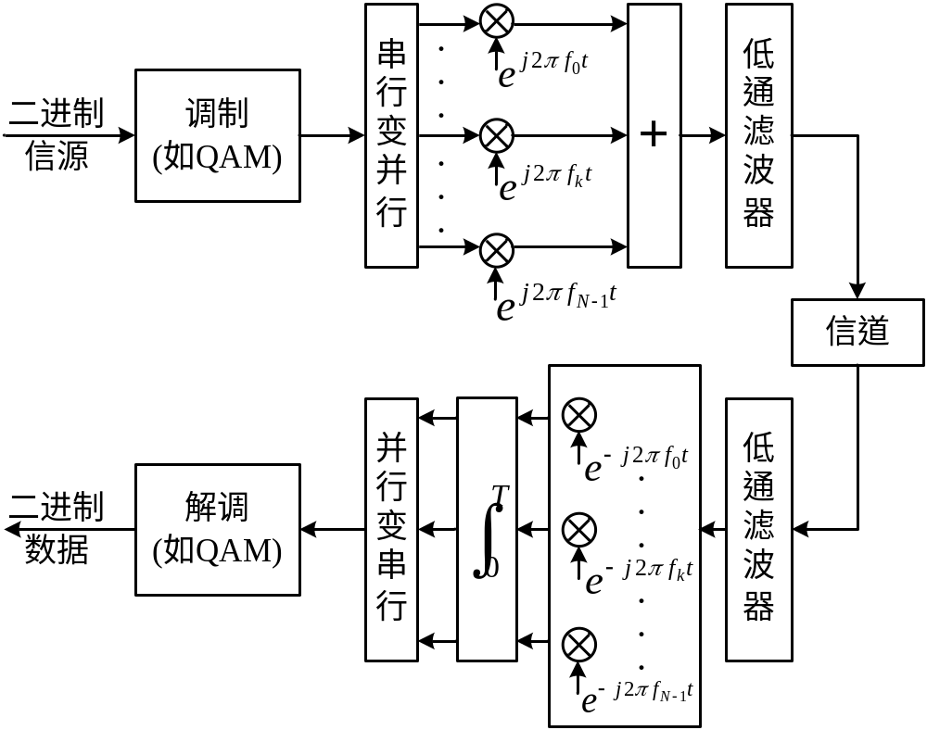

Multicarrier Transmission Systems
Sub-carrier Spacing

Slide 34
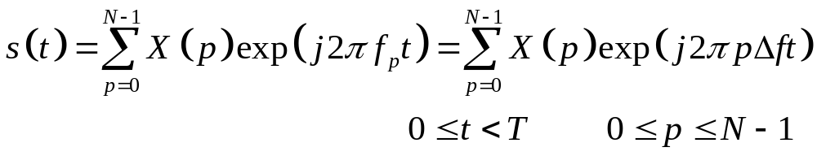
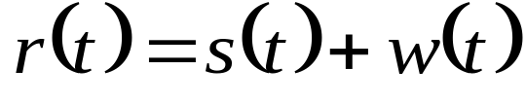
Mathematical Description
Tx Signal
  Information symbols: X(p), p = 0, 1, …, N -1
  Tx Signal (传输/发送信号) s(t) can be expressed as
  in which T = 1 /Δf is the duration of an OFDM symbol
The Rx signal (传输/发送信号) r(t) under AWGN channel can be expressed as

Slide 35
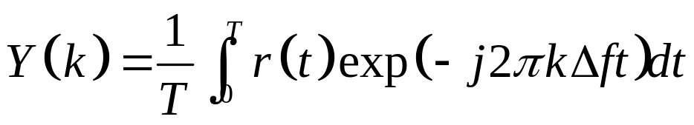
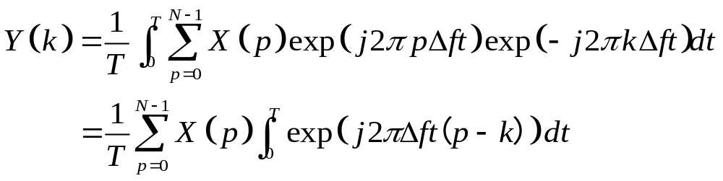
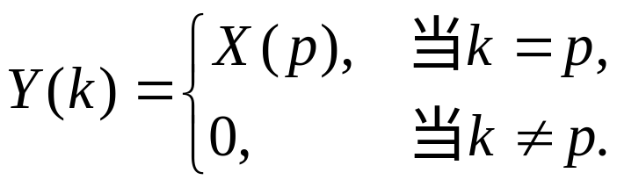
Mathematical Description
The signal on the k-th subcarrier can be obtained by
If w(t) = 0 (ideal case), Y(k) can be expressed as
Orthogonal property

Slide 36
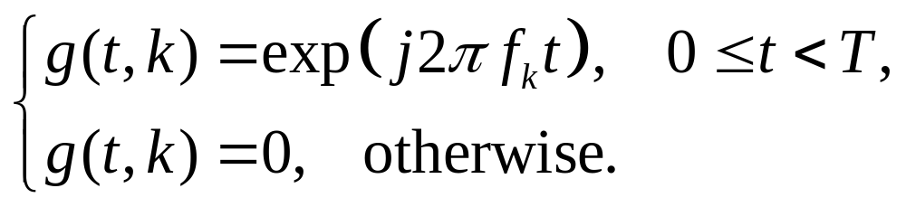
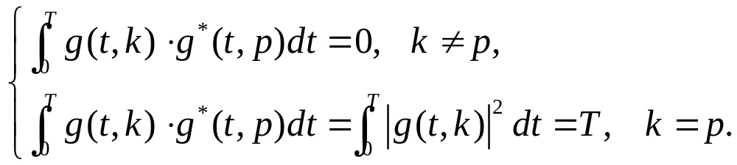
Orthogonal Basis
The Orthogonal basis function for the k-th subcarrier is expressed as
Orthogonality between orthogonal basis functions

Slide 37
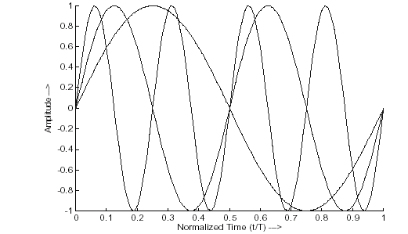
Orthogonality between subcarriers
  ☆Every subcarrier has integer number of periods with symbol duration T (每个子载波在符号周期T内拥有整数个周期)
  ☆Difference of number of periods for adjacent subcarriers is one
  (相邻子载波间相差周期数为1)

Slide 38
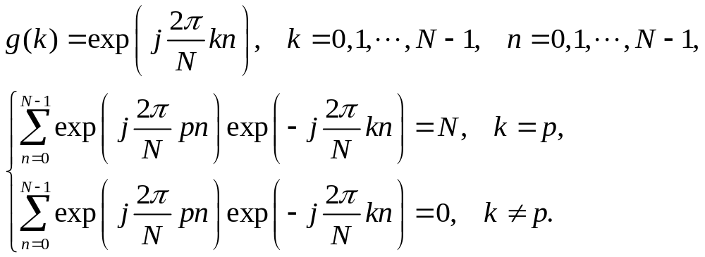
Discrete Orthogonal Basis

Slide 39
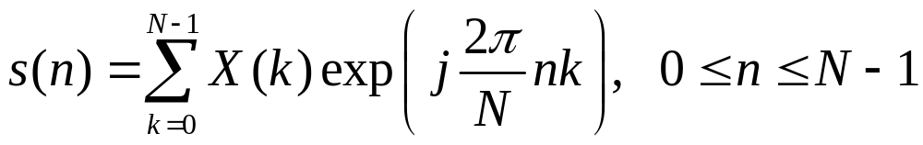
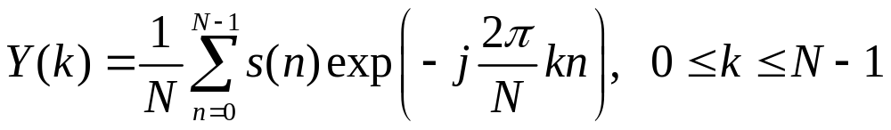
Implementation of OFDM based on IDFT and DFT
With signal on the k-th subcarrier of X(k), the Tx signal in the time domain is
At the receiver, the signal on the k-th subcarrier can be obtained by
In practice, modulation and demodulation of parallel data is implemented baed on FFT and IFFT

Slide 40
A comment
Page 23 in “OFDM for Wireless Multimedia Communications”
“Recent advances in very-large-scale integration (VLSI) technology make high-speed, large-size FFT chips commercially affordable. Using this method, both transmitter and receiver are implemented using efficient FFT techniques that reduce the number of operations from N² in DFT down to NlogN”

Slide 41
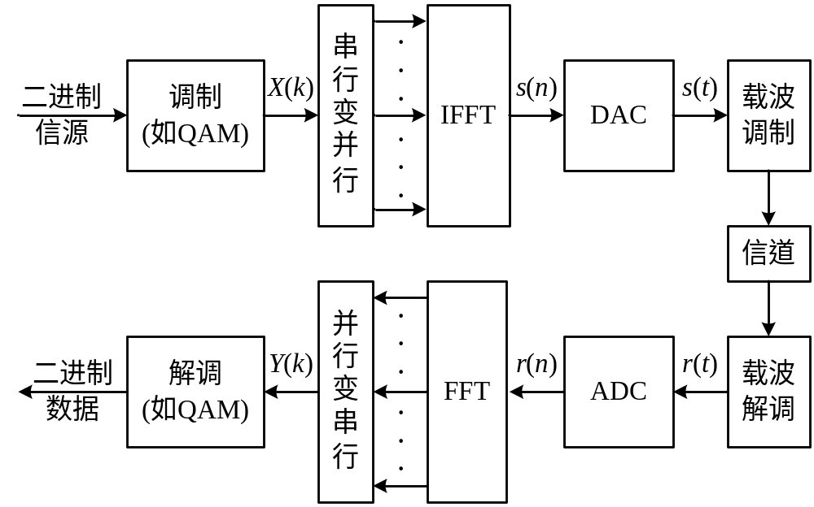
OFDM system structure based on FFT and IFFT

Slide 42

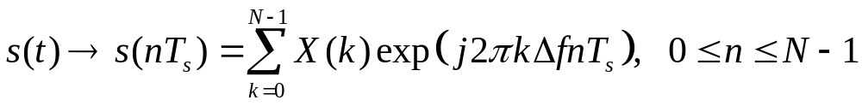
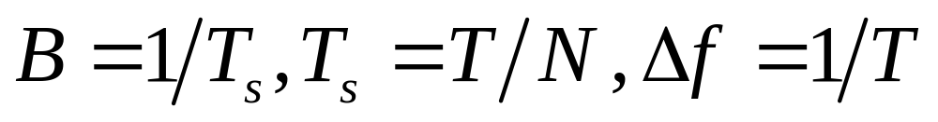
Mathematical Description of OFDM
Tx signal with continuous basis
Tx signal with discrete basis

Slide 43
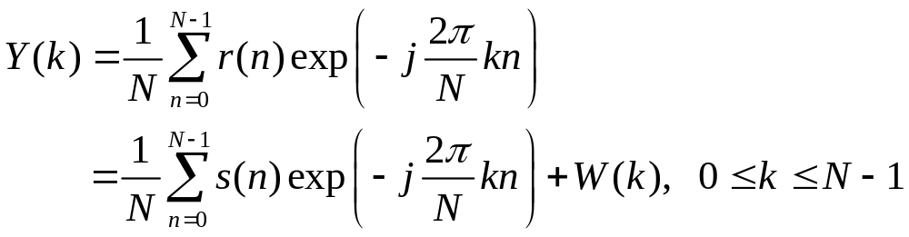
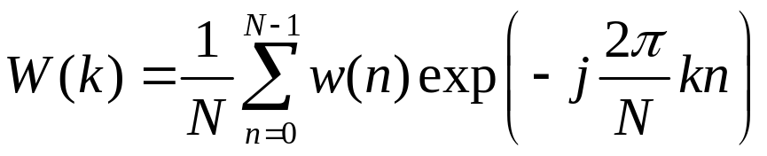
Mathematical Description of OFDM
Rx signal: r(t) = s(t) + w(t)
Sampling of r(t): r(n) = s(n) + w(n)
Symbol on the k-th subcarrier can be obtained by

Slide 44
Comments
The orthogonality also allows high spectral efficiency, with a total symbol rate near the Nyquist rate for the equivalent baseband signal. Almost the whole available frequency band can be utilized.

Slide 45


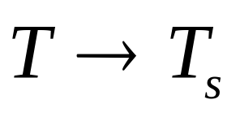
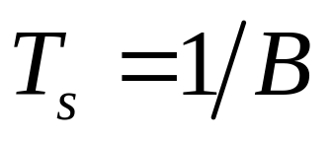
SC vs. OFDM

Slide 46
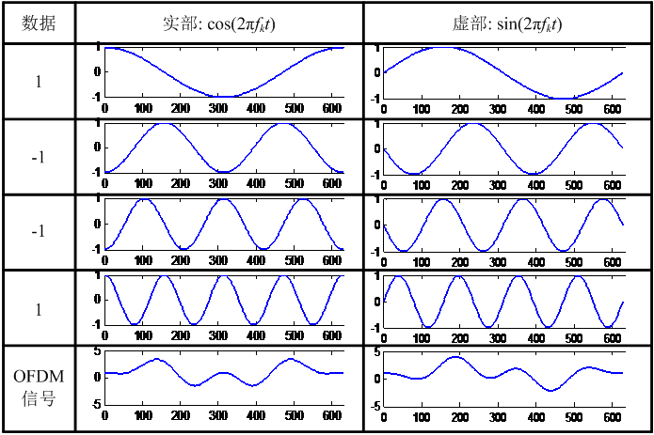
An example of OFDM signal：
BPSK symbols of 1, -1, -1, 1 on 4 subcarriers
Symbols in frequency domain
Signal
in time domain

Slide 47
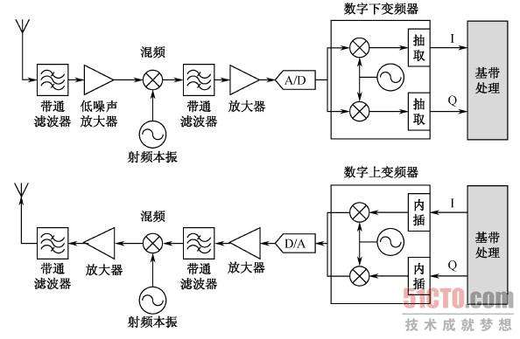
超外差软件无线电结构
组成结构如图所示：

Slide 48
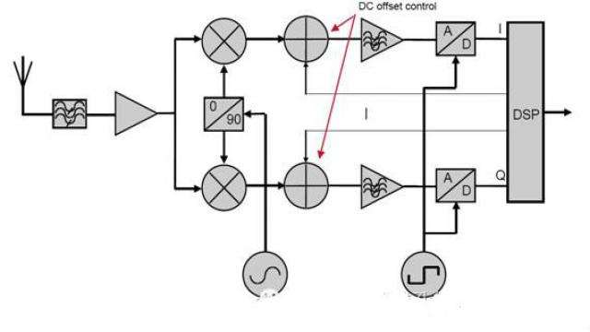
零中频接收机

Slide 49
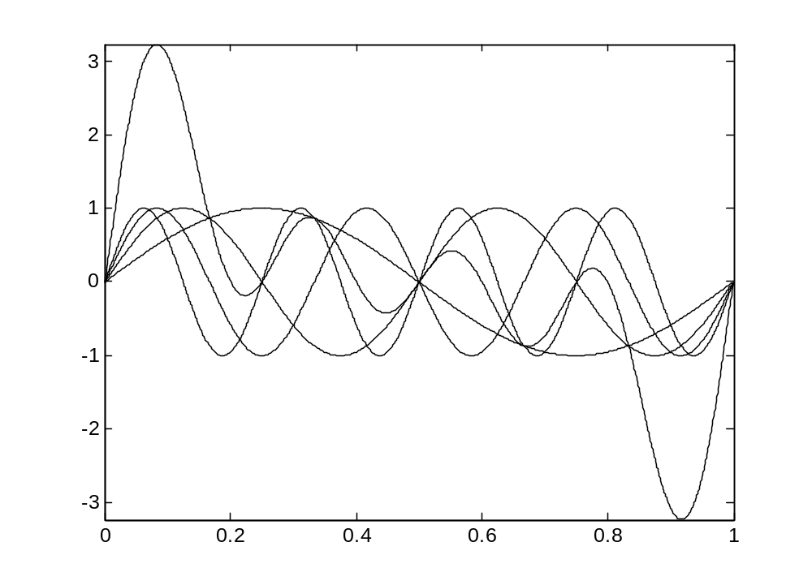
An example of OFDM signal：
BPSK symbols of 1, 1, 1, 1 on 4 subcarriers
High peak-to-average-power ratio (PAPR)

Slide 50
Discrete Orthogonal Basis

Slide 51
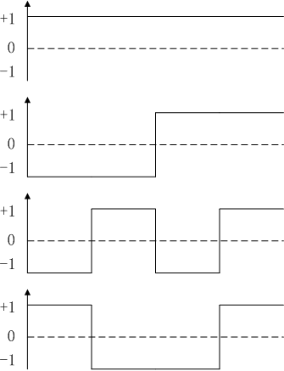
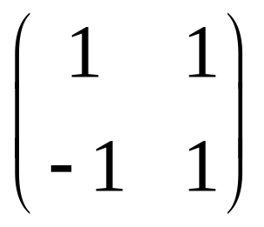
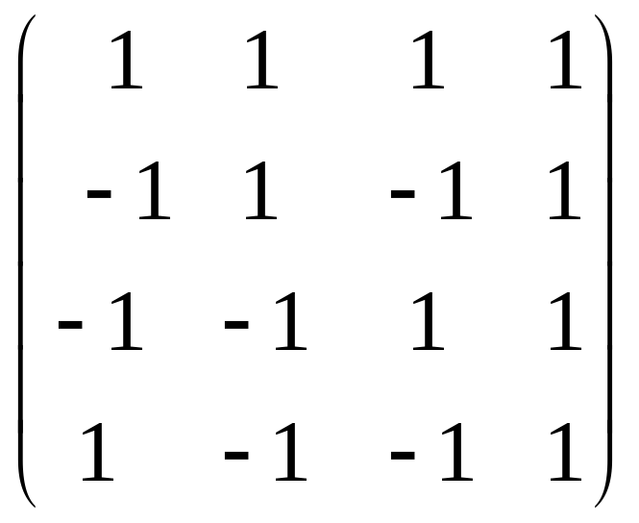
Hardamad Matrix

Slide 52
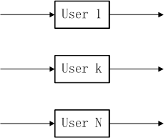
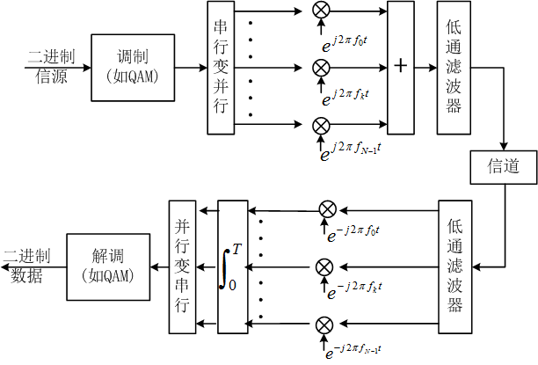
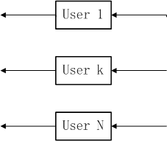
OFDM System
CDMA System

Slide 53
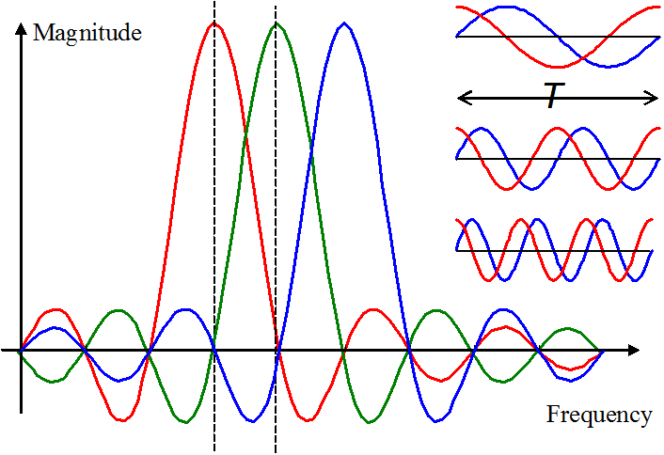
Spectra of OFDM Signal
  Rectangular windowing causes sinc spectrum in frequency domain with zeros at 1/T

Slide 54
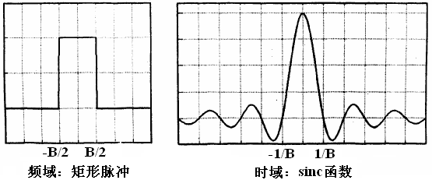
Signal shape in Freq/Time Domain

Slide 55
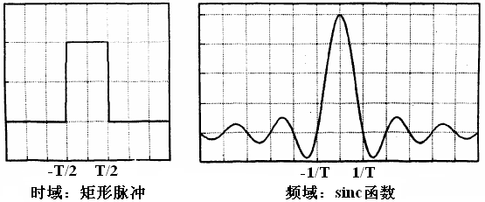
Signal shape in Freq/Time Domain

Slide 56
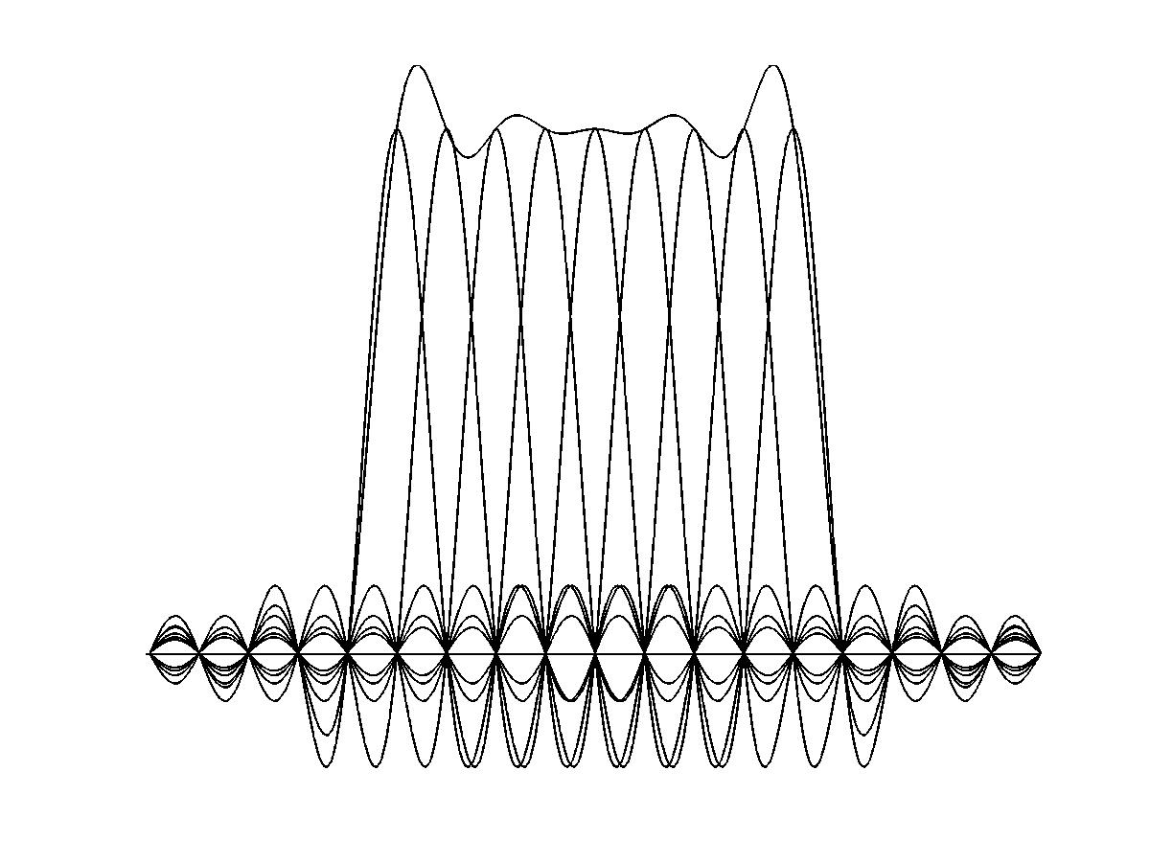
Spectra of OFDM Signal
The orthogonality allows high spectral efficiency

Slide 57
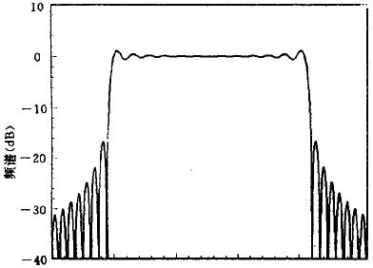
Spectra of OFDM Signal
When N is very large, the spectra of OFDM signal is close to rectangle

Slide 58

Spectra of OFDM Signal

Slide 59

Frequency Analysis of
Time Domain Signal

Slide 60
OFDM system structure based on FFT and IFFT
AWGN

Slide 61

Serial to Parallel (S/P)

