Slide 1
Outline
Tx and Rx process of OFDM system
Main parameters
Example of System Design
Overview of Key Modules
System Design for 802.11a

Slide 2
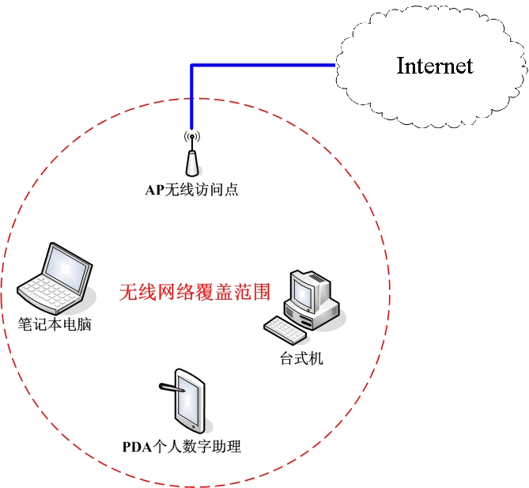
Overview of WLAN system
WLAN: Wireless Local Area Network
Wireless access to Internet within 100m
Scenarios(场景)
  No wired infrastructure
  Change position, Low mobility
  Temporary networks

Slide 3



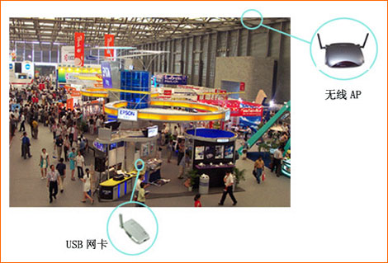
Scenarios for WLAN
Office
Airport
Stadium
Exhibition Hall

Slide 4
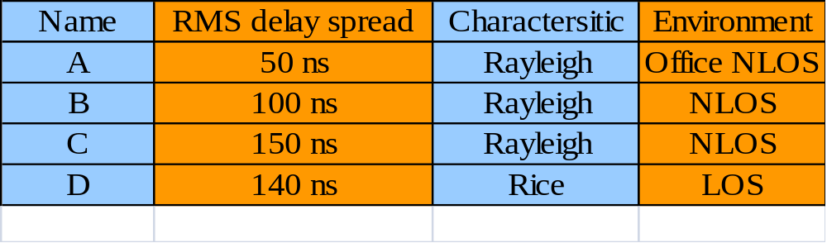
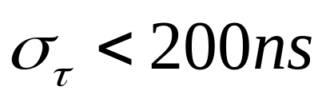
Channel Modeling
IEEE 802.11a系统广泛应用的场合如办公室、工业建筑、展示厅和居民区安装。目前已提出了代表这些不同环境的不同信道模型。

Slide 5
IEEE 802.11 Standard (这些是比较老的)
 | 802.11 | 802.11b | 802.11a | 802.11g
标准发布时间 | July 1997 | Sept 1999 | Sept 1999 | June 2003
合法频宽 | 83.5MHz | 83.5MHz | 325MHz | 83.5MHz
频段 | 2.4GHz | 2.4GHz | 5.1/5.7GHz | 2.4GHz
非重叠信道 | 3 | 3 | 12 | 3
调制技术 | FHSS/DSSS | CCK/ DSSS | OFDM | CCK/OFDM
物理发送速率 (Mbps) | 1, 2 | 1,2,5.5, 11 | 6, 9, 12, 18, 24, 36, 48, 54 | b + a
无线覆盖范围 | N/A | 100M | 50M | <100M
最大UDP吞吐量 | 1.7 Mbps | 7.1 Mbps | 30.9 Mbps | 30.9 Mbps
最大TCP/IP吞吐量 | 1.6 Mbps | 5.9 Mbps | 24.4 Mbps | 24.4 Mbps
兼容性 | N/A | 与11g互通 | 与11b/g不互通 | 与11b互通

Slide 6
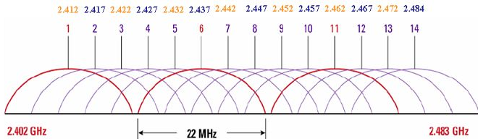
802.11 is a set of IEEE standards that govern wireless networking transmission methods. They are commonly used today in their 802.11a, 802.11b, 802.11g, 802.11n, and 802.11ac versions to provide wireless connectivity in homes and businesses.
IEEE 802.11 Standard

Slide 7
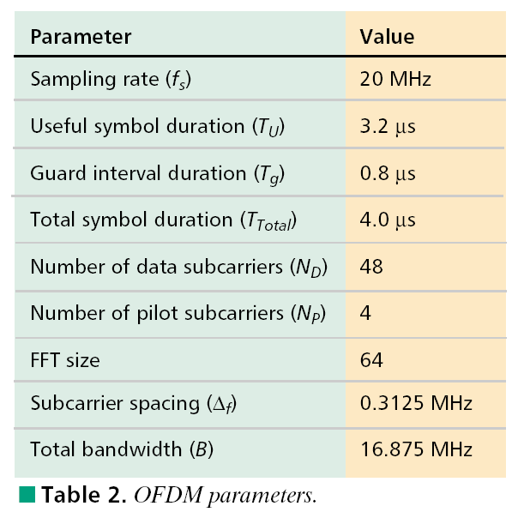
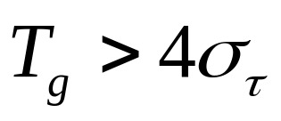
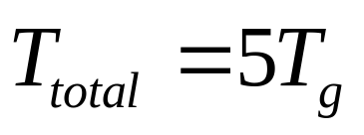
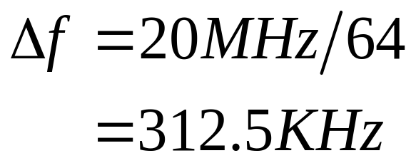
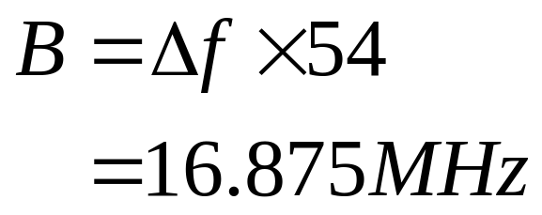
Main Parameters of 802.11a

Slide 8
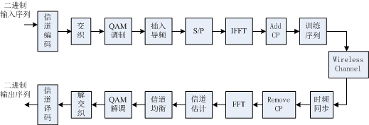
Tx/Rx process of OFDM system
Modulation: BPSK/QPSK/16QAM/64QAM
Coding: 1/2 Convolutional code
Coding Rate (Punctuate (打孔)): 1/2、2/3、3/4

Slide 9
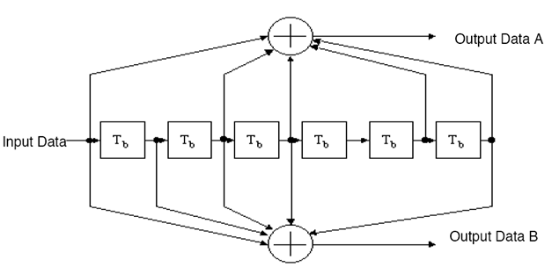
Convolutional code
[1 0 1 1 0 1 1]=(133)₈
1/2编码，约束长度为7
[1 1 1 1 0 0 1]=(171)₈
test_coding.m

Slide 10


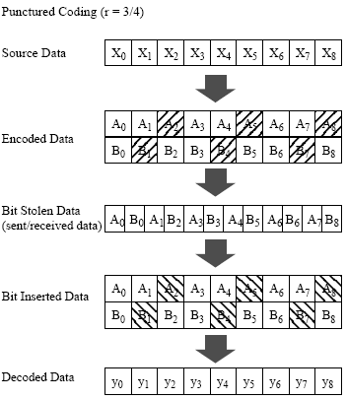
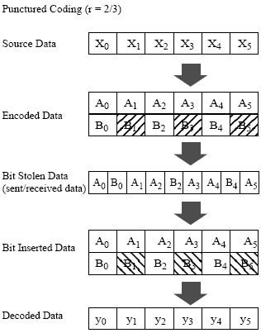
Puncturing (打孔)
# 1/2编码，多一倍
然后打孔punctuate
# 进去9个，出来12个
就有 r = 3/4
# 进去6个，出来9个
就是r = 2/3

Slide 11
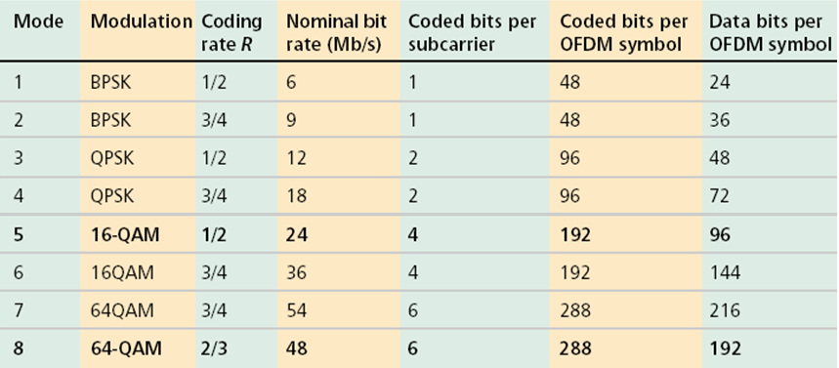
Adaptive Modulation and Coding
1/2卷积码和打孔可以组成各种速率的编码。设共有48个数据子载波，当采用BPSK时，每个子载波上有一个bit，经1/2编码后，有效bit为0.5个，所以每个OFDM符号里有24bit数据，每个OFDM符号长度为4us，因此速率为6Mb/s
Nominal bit rate: 标称的速率，名义上的速率

Slide 12
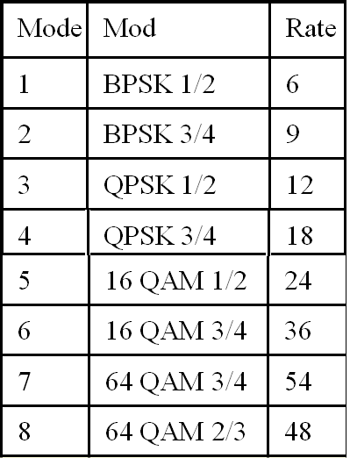
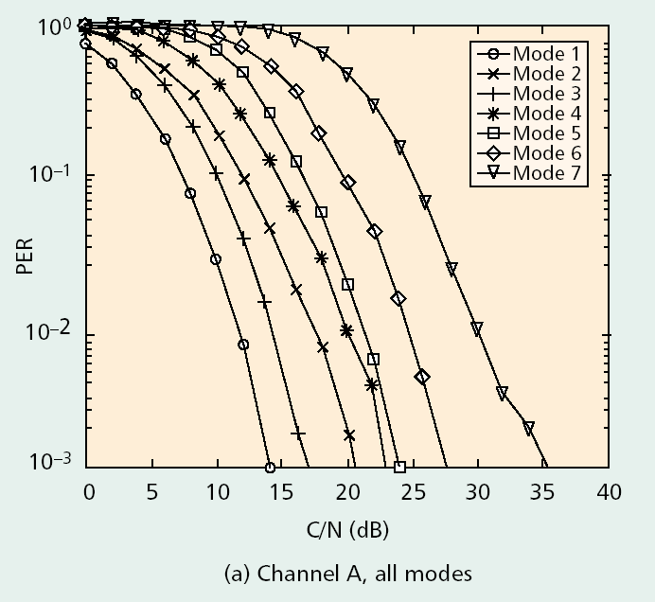
Adaptive Modulation and Coding
PER=Packet Error Rate
A packet is composed of several OFDM symbols. PER: packet with error bits is an error packet.
C/N Ratio (CNR) stands for Carrier to Noise Ratio. It is measured before de-modulation.
S/N Ratio (SNR) stands for Signal to Noise Ratio. It is measured after de-modulation.

Slide 13
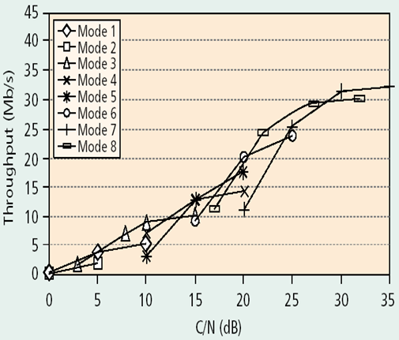
Adaptive Modulation and Coding
In the context of communication networks, throughput or network “throughput” is the rate of successful message delivery over a communication channel. Throughput is usually measured in bits per second (bps) or packets per second (pps)

Slide 14
Adaptive Modulation and Coding
PER=Packet Error Rate

Slide 15
Interleaving
All encoded data bits shall be interleaved by a block interleaver (块交织器) with a block size corresponding to the number of bits in a single OFDM symbol, N_{CBPS}.
(块大小与单个OFDM符号中的比特数相对应)
The interleaver is defined by a two-step permutation (置换).
The first permutation ensures that adjacent coded bits are mapped onto nonadjacent subcarriers.
The second ensures that adjacent coded bits are mapped alternately onto less and more significant bits of the constellation and, thereby, long runs of low reliability (LSB) bits are avoided. ( Least Significant Bit 还需要好好理解！)
Intra-symbol Interleaving

Slide 16
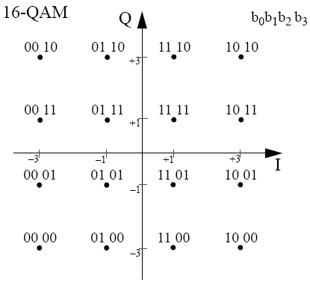

Slide 17

Interleaving
Index notation:
  k: index before first permutation
  i: index after first permutation
  j: index after second permutation
CBPS: coded bits per symbol
BPSC: bits per subcarrier
test_interleave.m

Slide 18
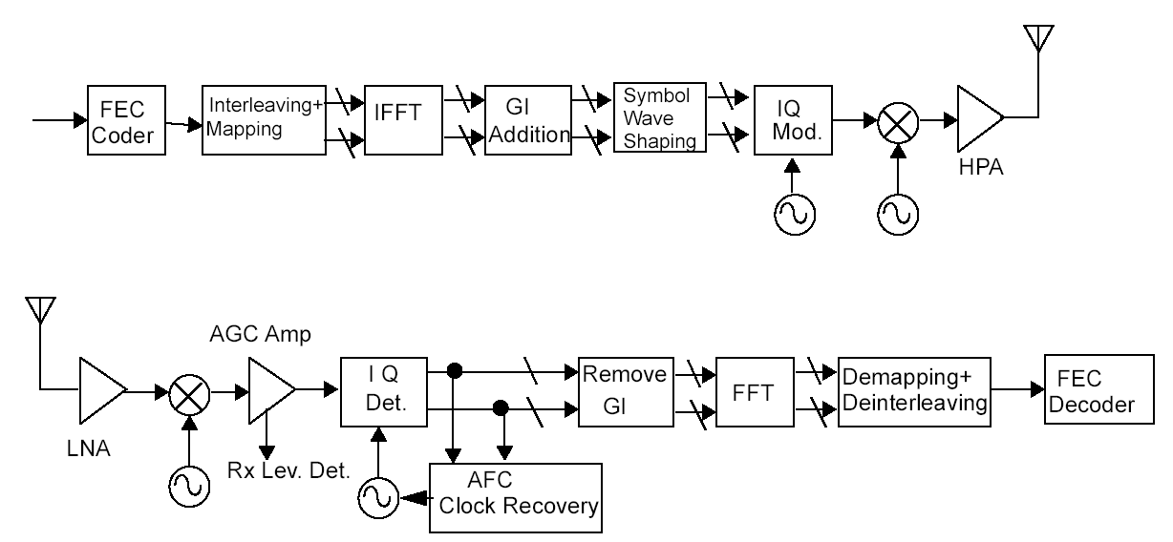
Transmitter and receiver block diagram for the OFDM PHY
扰码+交织+映射+IFFT+保护间隔+整形（抑制带外辐射），
正交调制，在变频（2.4G，5.8G频段），功放再到输出
AGC:自动增益控制： 输入信号强放大倍数低，反之则高
AFC: 自动频谱控制：得到0中频的信号

Slide 19
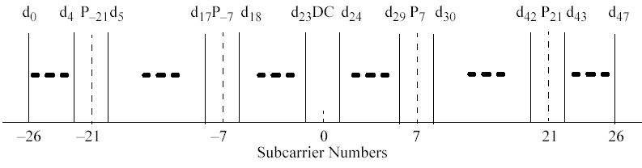
Mapping
52个子载波(0不用)
Data Subc Patt: [1:5 7:19 21:26 27:32 34:46 48:52]
Pilot Subc Patt: [6 20 33 47]
Used Subc Idx: [7:32 34:59]
Data Subc Idx: [7:11 13:25 27:32 34:39 41:53 55:59];
Pilot Subc Idx: [12 26 40 54];
Reorder: [33:64 1:32];
52个子载波映射到64个子载波

Slide 20
Pilots in OFDM symbols
In each OFDM symbol, 4 subcarriers are used to carry pilot symbols (-21, -7, 7, 21);
Phase compensation(相位补偿) for residual CFO(残余频偏(会带来相位旋转)) or phase noise;
Known BPSK (+1/-1) symbols

Slide 21
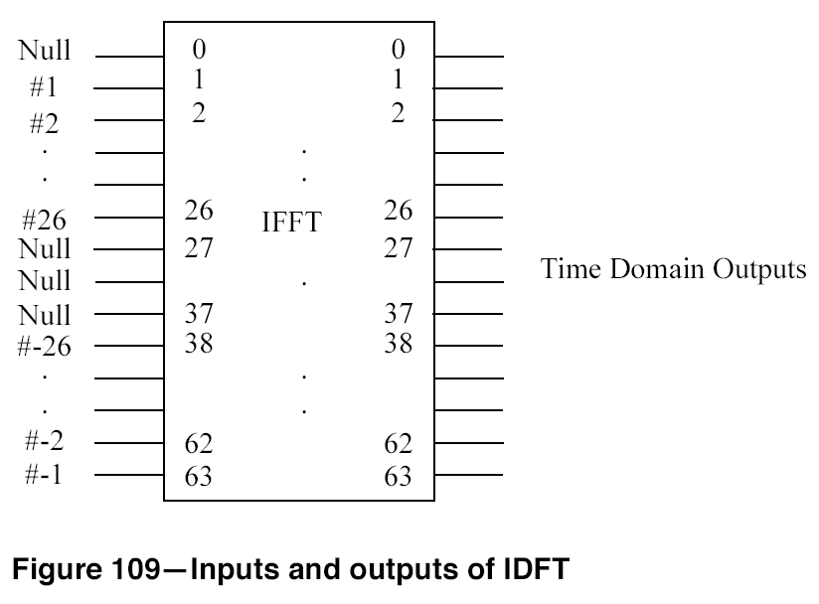
Mapping
Symbols for subcarrier
1 to 26 mapped to #1 to #26 input of IFFT;
Symbols for subcarrier -26 to -1 mapped to #38 to #63 input of IFFT;
#27 to #37 and the #0 inputs of IFFT set to be 0
BasicOFDM_Map.m

Slide 22
Tx/Rx process of OFDM system

Slide 23
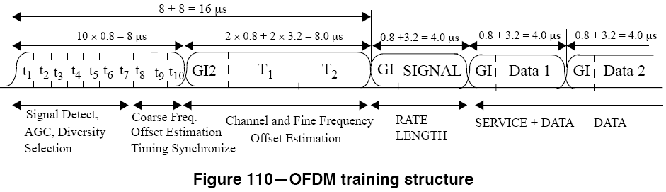
Frame Structure of 802.11a
Identical symbols
10 short training symbols; (10 * 16 = 160 samples)
2 long training symbols; (2 * 80 = 160 samples)
GI2表示是正常GI长度的两倍
SIGNAL不是信号，而是信令的意思，用于说明包的信息

Slide 24
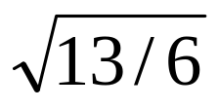
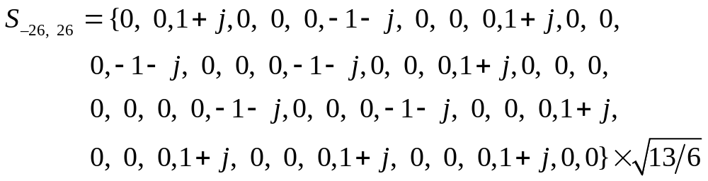
Short Training Symbols
12 non-zero subcarriers among 52 subcarriers
[-24, -20, -16, -12, -8, -4, 4, 8, 12, 16, 20, 24]
Factor is used for power normalization
(52子载波，只有12个有数，希望平均功率为1,52/12 = 13/3 ，又如1+j功率是2，所以13/6)
Nonzero subcarrier every 4 subcarriers
Periodicity(周期性) of T_{FFT}/4 = 0.8us in time domain

Slide 25
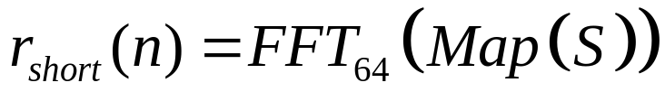
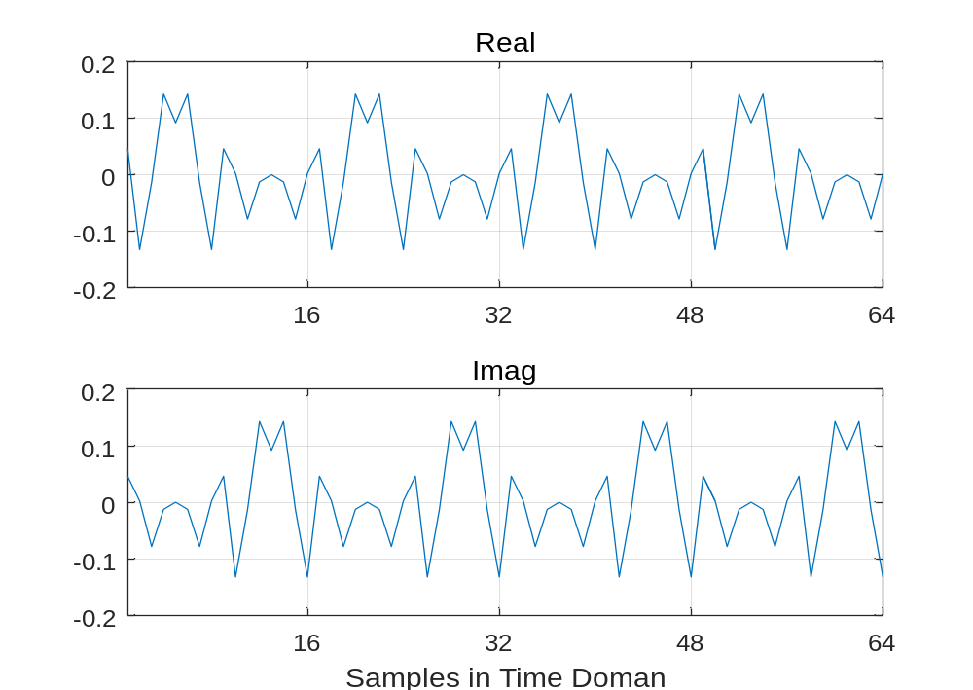
Short Training Symbols

Slide 26
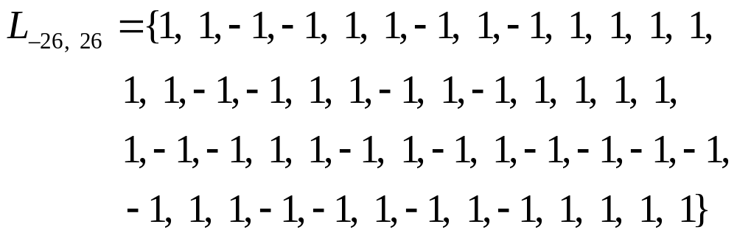
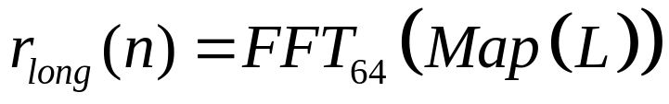
Long Training Symbols
A long OFDM training symbol consists of 52 subcarriers, which are modulated by the elements of the sequence L
test_preamble.m

Slide 27
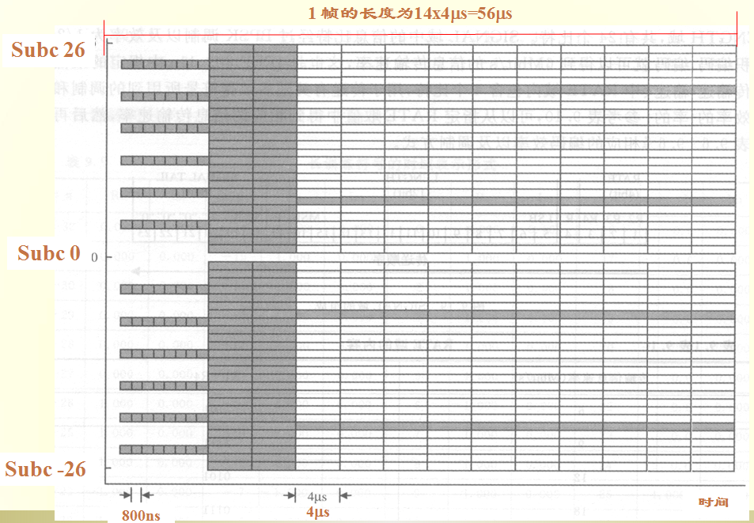
Pilots and Training Sequence

Slide 28
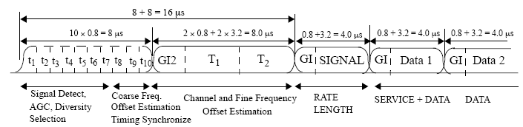
Synchronization all together
Steps: -- 接收端做的事
  Detect packet beginning(检测包头)
  Perform coarse(粗糙的) frequency/timing synchronization
  Perform fine(精细的) frequency/timing synchronization
  Channel Estimation/Equalization
  Track(跟踪) changes in channel as needed

