Slide 1
Outline
Channel Estimation
Synchronization for OFDM symbols
  Symbol Synchronization
  Carrier Frequency Synchronization
Packet detection for burst communication
Receiver design for 802.11a

Slide 2
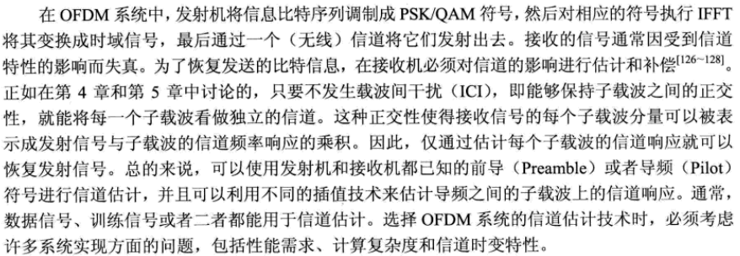

Slide 3
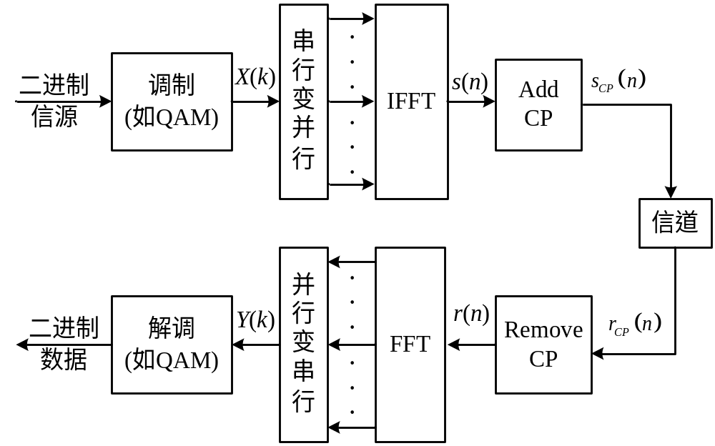
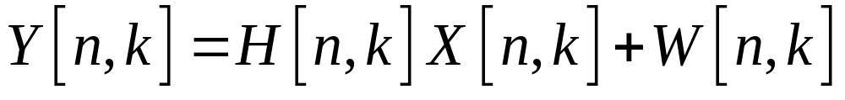
Channel Estimation for OFDM systems
n：第n个OFDM块 k：subcarrier index

Slide 4
Channel Estimation for OFDM systems
Blind estimation and non-blind estimation
Blind method: (盲估计算法) (non-data-aided)
  statistical characteristics of channel(信道统计特性);
  Needs large amount of data for training;
  Bad performance for fast fading channels (快衰落信道)
Non-blind: -- 要设计一些接收机已知的辅助信号来用于信道估计
  data-aided: training symbol or pilots
  decision-aided: decision and feedback
  盲估计：接收端只能根据接收到的发送信息而没有其他信息
  来估计信道，若信道响应函数变化快则不好用
训练序列/导频符号
辅助的信道估计

Slide 5
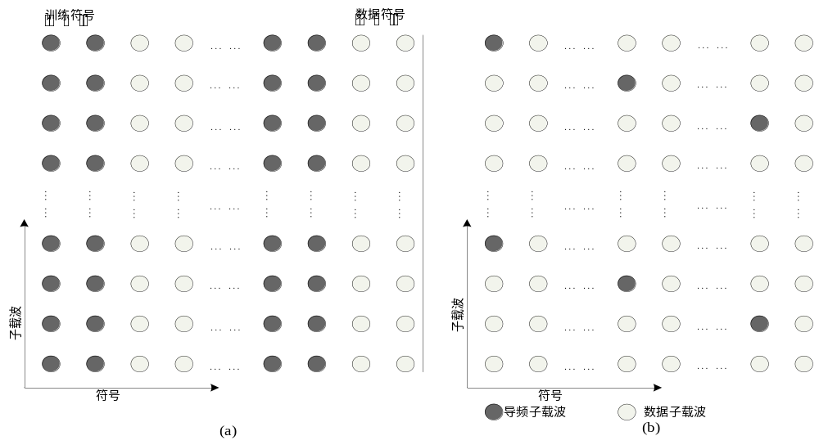
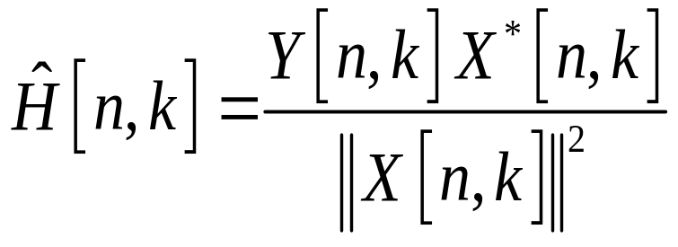
Training Symbols and Pilots
黑点：已知数据
白点：用户传输的未知数据

Slide 6
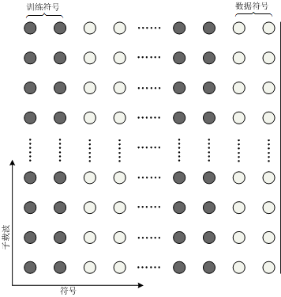
Channel Est based on Training Seq
H(1,k) and H(2,k)
for all subcarriers
Used for following
OFDM symbols;
Strong frequency
selectivity;
(所有子载波都放了pilot)
Weak time selectivity;
High overhead
(付出的高额外的代价)
Low complexity
(接收端的复杂度低)
频域离散
时域离散
k:子载波的位置
H( ):信道频率响应

Slide 7
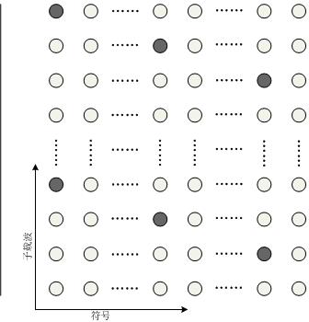
Channel Est based on Pilots
H(n,k_{p}) for pilot
subcarriers in some
symbols;
Get H(n,k_{d}) for
data subcarriers in
all symbols by 2D
interpolation (2维内插)
Weak selectivity in
frequency and time
Low overhead
High complexity
频域离散
时域离散

Slide 8
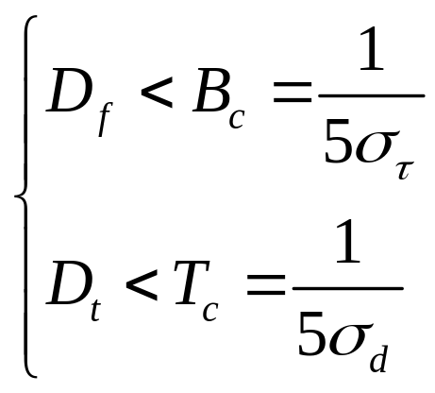
Channel Est based on Pilots
Pilots should meet 2D
Nyquest sampling theory
(采样用于估计信道响应H(k))
D_{f} : interval between
subcarriers
D_{t} : interval between
OFDM symbols
Bc：相干带宽 Tc：相干时间(在此时间内信道不怎么变化)

Slide 9
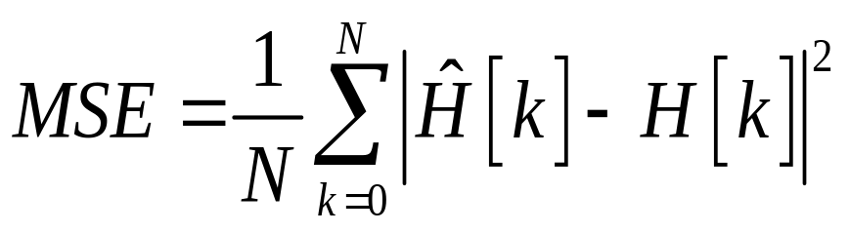
Channel Est. Evaluation
Evaluation：评价信道估计的结果好坏
MSE (mean square error)

Slide 10
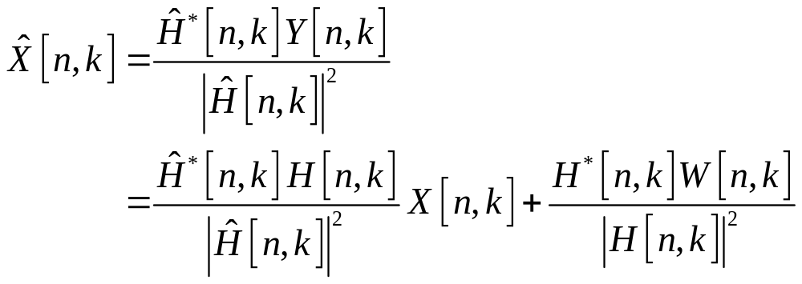
Channel Equalization
Zero Forcing
Equalization
(只管信道不管噪声)
Zero forcingequalizer(迫0均衡器) is a linear equalization algorithm applying the inverse(反转: 原来乘改为除) of the frequency response of the channel.

Slide 11
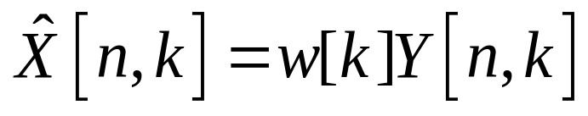
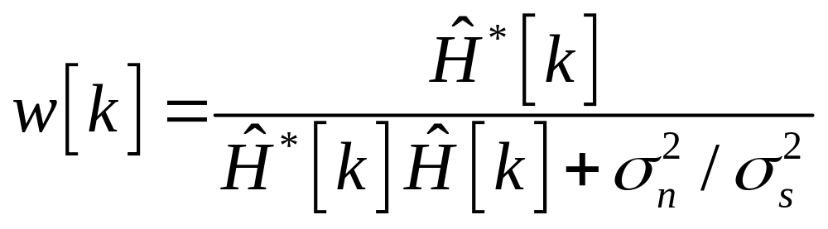
Channel Equalization
MMSE
Equalization
For high SNR, MMSE equalizer approaches to ZF equalizer;
For low SNR, MMSE outperforms ZF equalizer;

Slide 12
Synchronization
Two phases: Capture(捕获) and Track(跟踪)
  Capture: Initial synchronization
  Larger range
  More complex algorithm and longer processing time
Track: compensate miner changes/residual errors
  Smaller Range (Track的errors：频率或时间的误差)
  Less complex algorithm
Synchronization for OFDM systems
  Coarse symbol/frequency synchronization
  Fine symbol/frequency synchronization
  Tracking in frequency domain

Slide 13

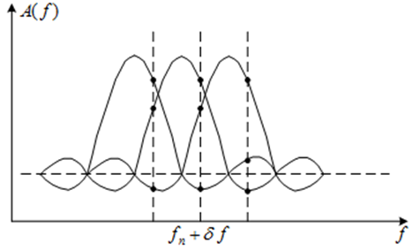
Synchronization for OFDM systems
Symbol Synchronization
  Get the start of the OFDM symbols
  Avoid inter-symbol interference (ISI)
Frequency Synchronization
  Estimate and compensate
  carrier frequency offset (CFO)
  Avoid inter-carrier interference
  (ICI)

Slide 14
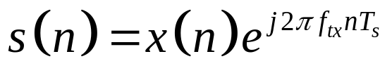
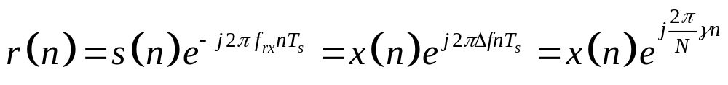
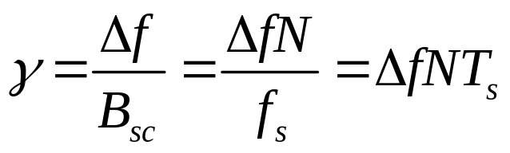

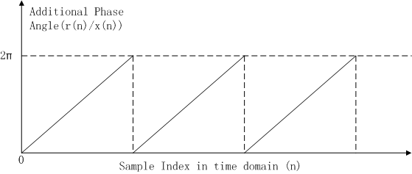
Effect of CFO in time domain
Tx signal in time domain
Rx signal in time domain
△f:频偏 γ:频偏归一化
x(n)做了一个下变频 s(n)做了一个上变频

Slide 15
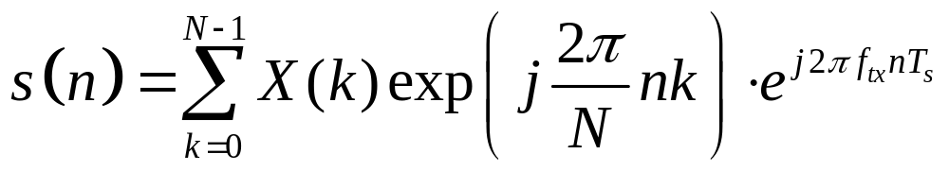
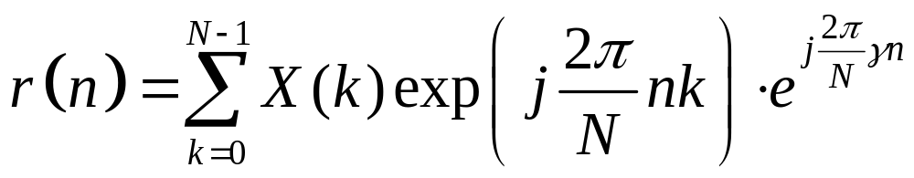
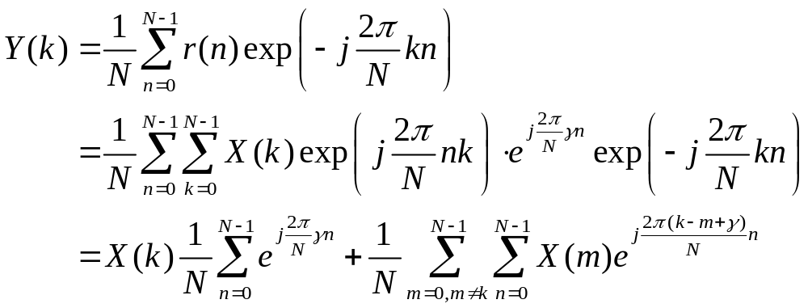
Effect of CFO in frequency domain
Tx signal in time domain
Rx signal in time domain

Slide 16
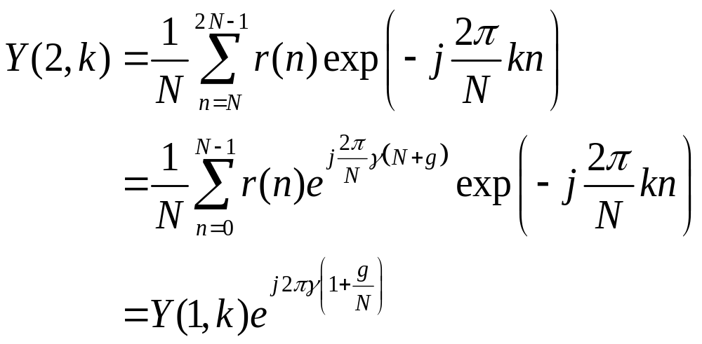
Effect of CFO in frequency domain

Slide 17
Synchronization for OFDM systems
Symbol and frequency coarse synchronization (粗同步) are performed together
Basic Methods:
  CP based method
  Training sequence based method
    Auto-correlation (自相关)
    Cross-correlation (本地的跟接收的信号互相关)

Slide 18
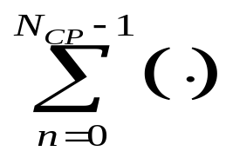
CP-based Synchronization
CP is same with the last part of an OFDM symbol
This property can be used for symbol and frequency synchronization
Frequency
offset
Estimate phase
of maximum
T_{FFT} delay
conj
OFDM
signal
Find maximum
correlation
Timing
两个支路(上支路延时加共轭)进入乘法器再相加，就是做相关

Slide 19
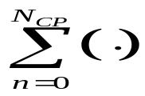
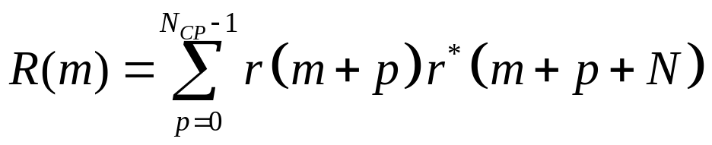
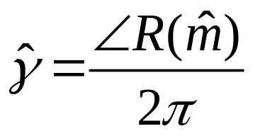
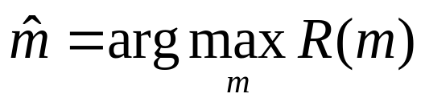
CP-based Synchronization
Frequency
offset
Estimate phase
of maximum
T_{FFT} delay
conj
OFDM
signal
Find maximum
correlation
Timing
Output of self-correlator(自相关的输出)
Estimation of symbol boundary
Estimation
of CFO

Slide 20
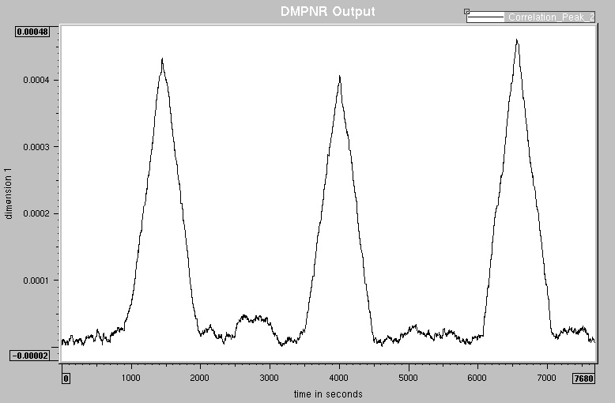
CP-based Symbol Synchronization
Output of self-correlator
Samples
The correlation function for OFDM synchronization (ideal condition)
没有频偏的时候，Symbol Synchronization 结果如上

Slide 21
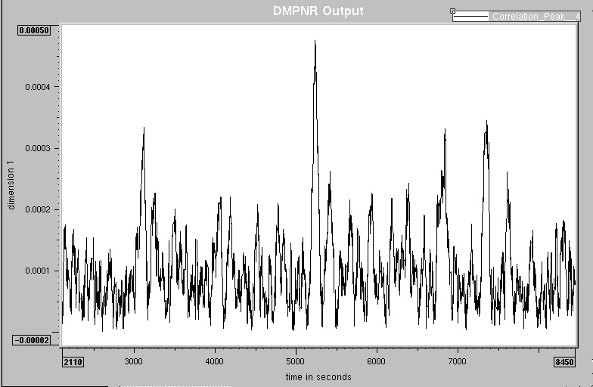
CP-based Symbol Synchronization
Output of self-correlator
Samples
The correlation function for OFDM synchronization
(SNR = 3dB, Multipath channel, carrier frequency error)
有噪声、多径效应干扰，很多峰来自第二径和第三径

Slide 22
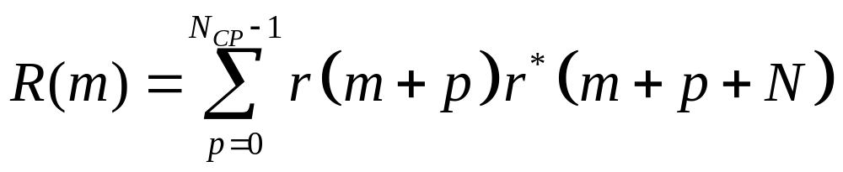
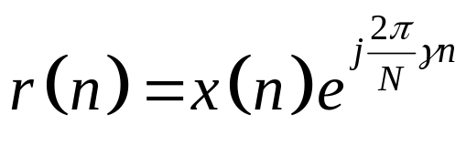
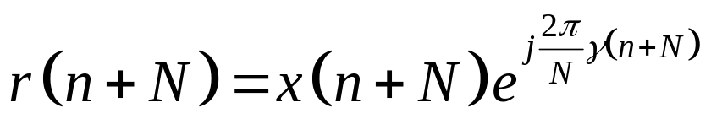
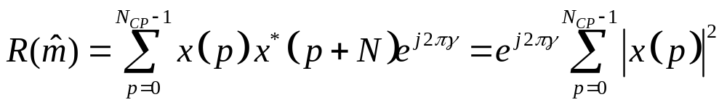
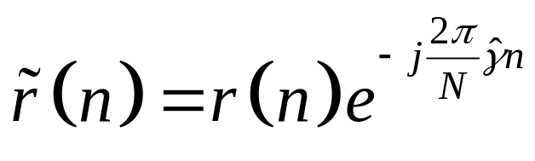
CP-based frequency Synchronization
引入频偏：
Estimation Range
[0, B_{sc})
CFO Estimation
CFO Compensation

Slide 23
CP-based Synchronization
Long time needed for accurate synchronization
Useful for cases
  No training sequence is available
  Phase tracking
Not suitable for cases
  Short synchronization time required (packet)
  High synchronization accuracy required
CP-based Synchronization 用的不多，要很长时候才达到好的效果
Special Training Sequence for synchronization

Slide 24
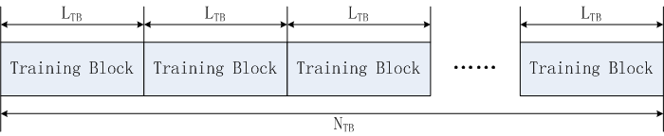
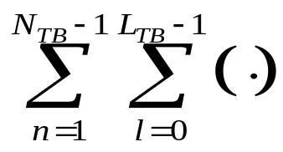
Training seq based synchronization
Auto-correlation based method
Frequency
offset
Estimate phase
of maximum
L_{TB} delay
conj
OFDM
signal
Find maximum
correlation
Timing

Slide 25
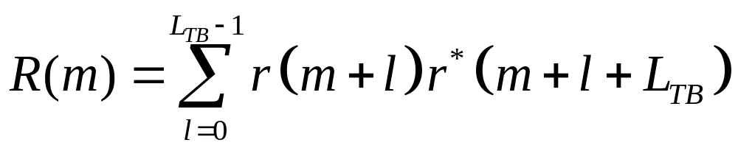
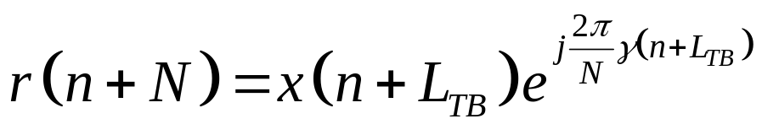
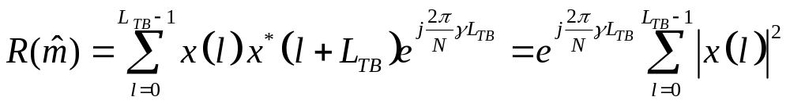
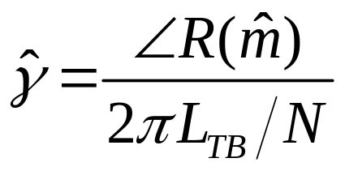
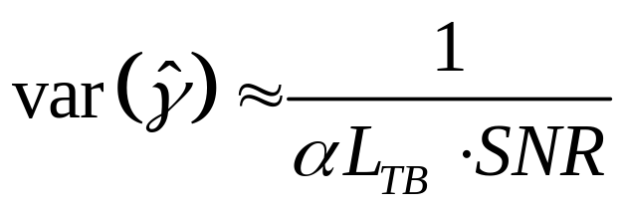
Training auto-corr based Synchronization
Two blocks
CFO Estimation
Estimation Range
[0, (N/L_{TB})B_{sc})
Estimation Accuracy
最简单情况 -- 相邻的 two blocks 计算自相关
注意block length LTB的大小要权衡 Estimation Range 和 Estimation Accuracy

Slide 26
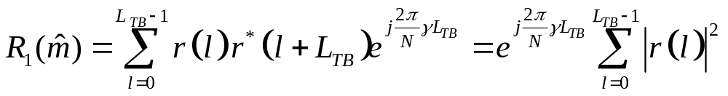
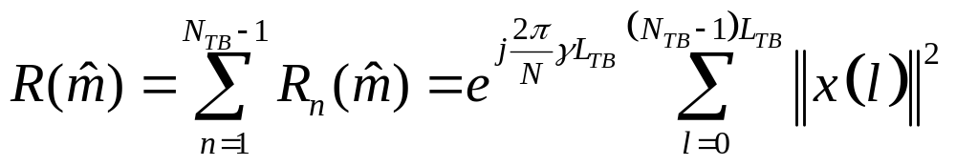
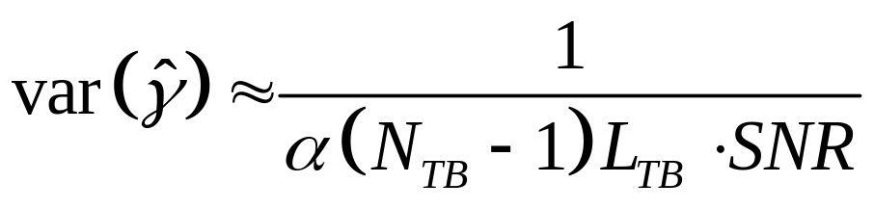
Training auto-corr based Synchronization
N_{TB}
blocks
Estimation Range
[0, (N/L_{TB})B_{sc}]
CFO Estimation
Estimation Accuracy
用多块 (NTB - 1) 的计算和估计提高精度 (Estimation Accuracy)

Slide 27
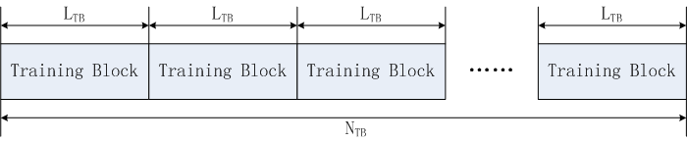
CP vs.Training auto-corr
CP based synchronization
Training auto-correlation based synchronization
Effect of multi-path channel are different!
delay spreads 小的时候适合 CP based synchronization，delay spreads 大了就不合适，因为：
Multi-path channel destroy the similarity between CP and the last part of OFDM symbol
而 Training auto-correlation based synchronization 就无此问题，不受multi-path channel影响

Slide 28
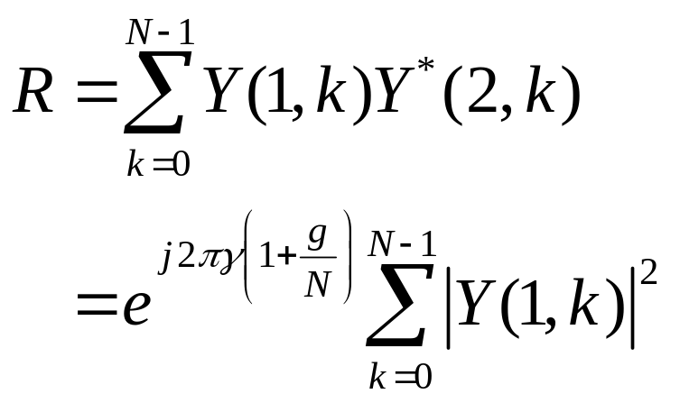
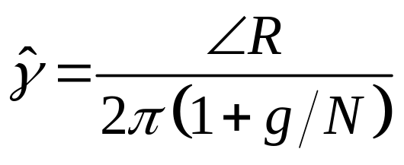
Training based Freq Synch (Freq Domain)
Estimation Range
[0, B_{sc/}(1+g/N)]

Slide 29
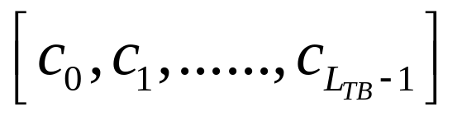
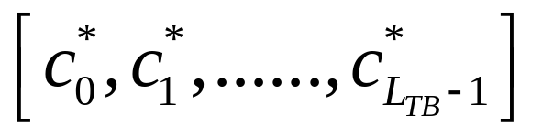
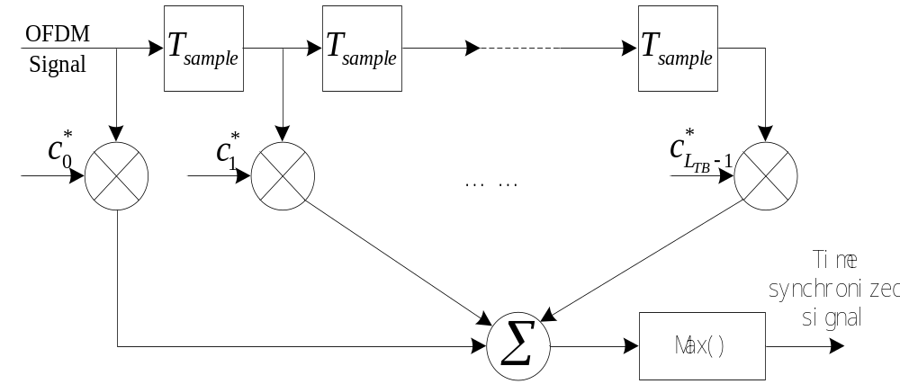
Cross Corr based Timing Synch
Tx training sequence
Rx match filter with
Effect of multi-path channel
Effect of CFO

Slide 30
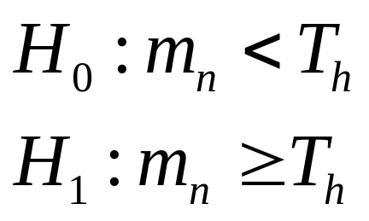
Packet detection for burst communication
Bursts reach the receiver randomly
Receiver needs to know when burst arrived and approximate the beginning of the bursts
Basic principle:
  Two events: H₀ (no packet) and H₁ (packet)
  Design a decision variable m_{n}
  Define a threshold T_{h}

Slide 31
Packet Detection
Performance evaluation
  P_{D}: Probability for “packet, detected”
  P_{FA}: Probability for “No packet, detected”
  P_{M}: Probability for “ Packet, not detected”
Relationship
  Smaller T_{h}: higher P_{D} and P_{FA}, lower P_{M}
  Larger T_{h}: lower P_{D} and P_{FA}, higher P_{M}
Effect of FA and M:
  FA: useless processing
  M: miss data
Ensure high P_{D}
Trade-off between P_{FA} and P_{M}

Slide 32
Packet Detection
Basic Methods:
  Energy detection
  Double window method
  Training based detection

Slide 33


Energy detection
Measure the energy of received signal
When no signal received, only noise measured
Define a window for measurement
Practical implementation: Moving sum

Slide 34

  Energy detection
Threshold is determined by signal energy
Signal energy is related to transmit power and channel attenuation
Noise and Interference

Slide 35




Double window method
Decision variable
T_{h} ?

Slide 36





Double window method
T_{h}=0.75SNR

Slide 37

  Double window method
Threshold is independent from signal energy, but determined by SNR
m_{n} is about 1 before and after the packet start point

Slide 38

Training seq based synchronization
Auto-correlation based method
Frequency
offset
Estimate phase
of maximum
L_{TB} delay
conj
OFDM
signal
Find maximum
correlation
Timing

Slide 39



Training based detection
Normalized Auto-Correlation

Slide 40




Packet detection
Threshold
T_{h} = 0.75
前一块与后一块相关，门限Th设为0.75，没有SNR

Slide 41

Training based detection
m_{n} and threshold are independent from signal energy
找到包/training block，就出现这个上升沿

