Slide 1
Outline
Channel Estimation
Synchronization for OFDM symbols
  Symbol Synchronization
  Carrier Frequency Synchronization
Packet detection for burst communication
Receiver Design for 802.11

Slide 2
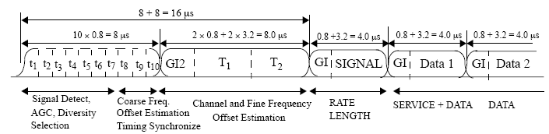
Synchronization in 802.11a
Steps:
  Detect packet boundary
  Perform frequency synchronization
  Perform fine timing synchronization
  Track changes in channel as needed
Identical symbols
802.11a Framing

Slide 3
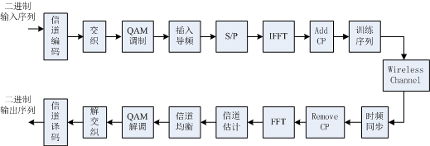
Tx/Rx Processing of OFDM systems

Slide 4
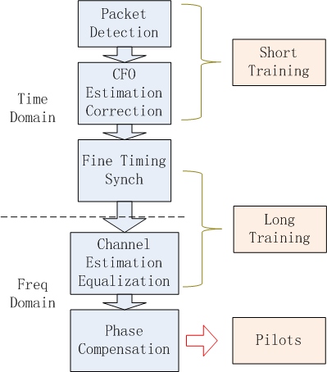
Rx
Processing
Overview
1.接收部分要依次做这些
2.补偿相位不用做仿真

Slide 5
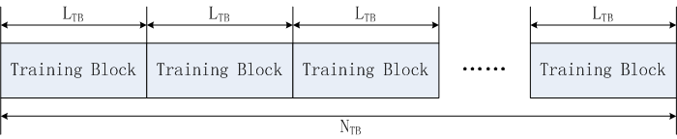
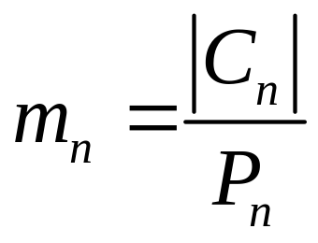
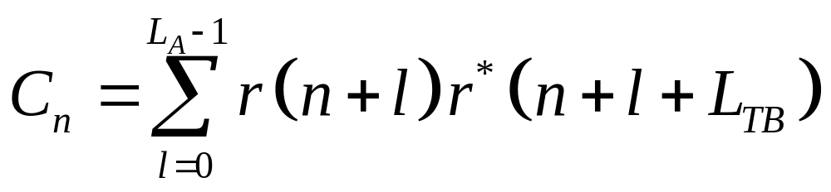
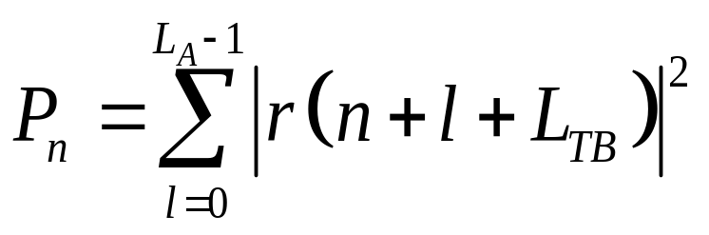
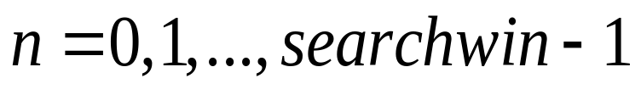
Packet detection for 802.11a
Normalized Auto-Correlation
Cn: 相邻前后两块做一个相关 Pn: 求后一块功率 （LA：auto-correlation length） mn: 二者相除

Slide 6
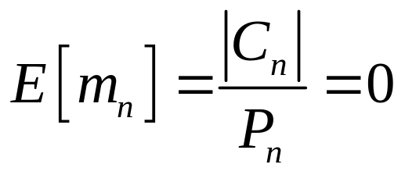
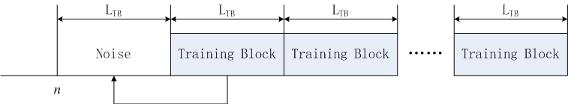
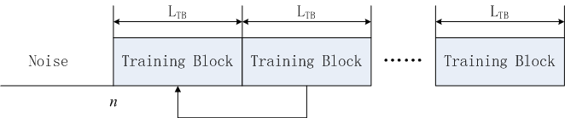
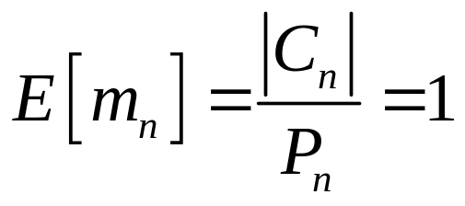
Packet detection for 802.11a
Threshold
T_{h}=0.75
test_packet_detect.m

Slide 7
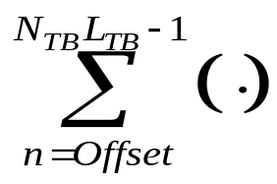
Freq Synch for 802.11a
Auto-correlation based method
CFO
Compensation
L_{TB} delay
conj
OFDM
signal
CFO
Estimate
Offset: synch error and dirty samples

Slide 8
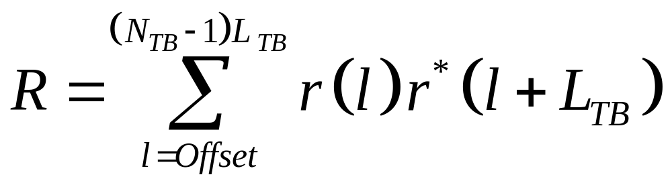
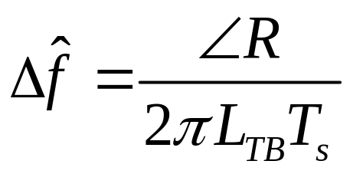
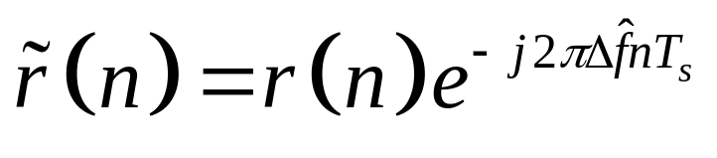
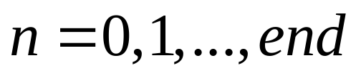
Freq Synch for 802.11a
CFO Estimation
test_freq_synq.m
CFO
Compensation
Show the effect of offset in the code.
Since length of h is 10, for offset = 1, 5, 10, the performance improves.
For offset = 10, 20, 30, the performance degrades a little due to shorter range for average.

Slide 9
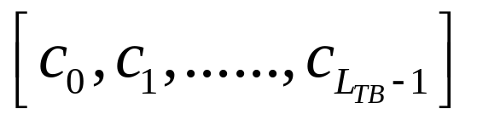
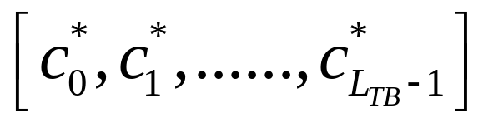
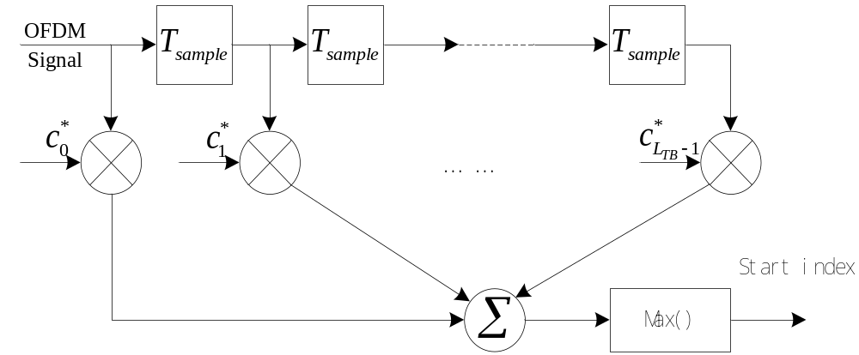
Fine Timing Synchronization
Tx training sequence
Rx match filter with

Slide 10
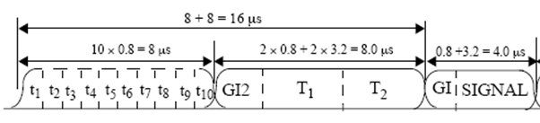

Fine Timing Synchronization
conj
sum
Max
Cross correlation with long training sequence
Find the maximum correlated point
CFO has been compensated
Remove short trainings
test_fine_time_sync.m

Slide 11
Coarse vs. Fine Time Sync
Coarse sync:
  Large Range (R_{c})
  Multiplication: 2R_{c}
Fine sync:
  Small Range (R_{f})
  Multiplication: R_{f} N_{L}

Slide 12
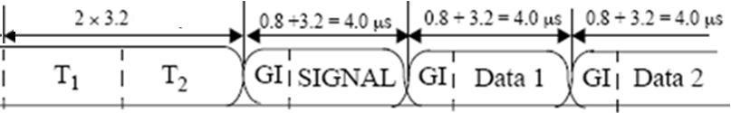
Frequency Domain Signal
[1:128]: long_tr_syms[64,2]
[129:129+N*80-1]: data_syms[80, N_{sym}];
Remove CP: data_syms[64, N];
freq_tr_syms [52,2]
freq_data [52,N_{sym}]

Slide 13
Channel Estimation/Equalization
[52,2] 做信道估计 one symbol 就可以做，这里用 two symbols平均一下来做
freq_tr_syms [52,2]
Combine two symbols
Channel estimation
Channel Equalization
Mean(·)
freq_tr_syms [52,1]
H(k) = conj(LongTrainingSyms)* freq_tr_syms
freq_data [52,N_{sym}]
freq_data = conj(H(k)) * freq_data/|H(k)|²
Zero Forcing
Equalization
test_channel_est.m
test_channel_equ.m

Slide 14
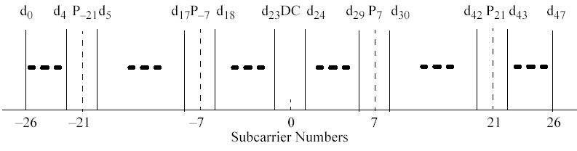
Phase Compensation
test_phase_track.m
Data subcarriers
Pilot subcarriers
freq_data [52,N_{sym}]
做补偿：*exp(-j*Phase) 这部分可以不作为重点
freq_data_syms [48, N_{sym}]
freq_pilot_syms [4, N_{sym}]
Phase = angle(sum(conj(ref_pilots)*freq_pilot_syms))
freq_data_syms = exp(-j*Phase)* freq_data_syms

