Slide 1
Digital Systems
EIC 0844091
Digital Circuit and Logic Design
Associate Prof. Luo Jie
Huazhong University of Science & Technology
Office: South first building（middle）210
南一楼（中）210

Slide 2
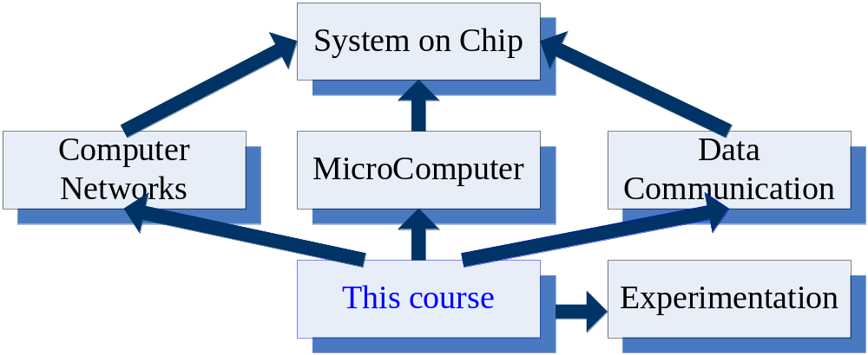
Elementary

Slide 3
Class Material
“Digital fundamentals” , 7thed.
by Thomas L. Floyd.(“TN79 W6/7”)
“Introduction to logic design” , 2nd ed.
by Marcovitz Alan B. (“TP302 W1/2Y” in our library)
“Digital Design”, 4th ed.
by M. Morris Mano,MichaelD.Ciletti.
“Digital design : principles & practices” , 3thed .
by John F. Wakerly. (“TN431.2 W26/3Y ”)
“数字逻辑基础与Verilog设计”, 2th ed.
(Stephen Brown，Zvonko Vranesic著, 夏宇闻译. )
“电子技术基础（数字部分，第6版）”. 康华光主编. 高教社
“数字电子技术基础 (第3版)”.罗杰, 彭容修 主编. 高教社

Slide 4
Class Material
Lecture Slides:
  http://pan.baidu.com/s/1hqszsMg
不是英文字母，而是数字1

Slide 5
Class topics
Introductory digital concepts
Number system, Operation, and Codes
Logic operation fundamentals
Logic gate circuits
Combinational logic
Functions of combinational logic
Latches and Flip-flops
Counters
Shift registers
Memory and storage
Introduction to programmable logic devices
DAC and ADC
Verilog HDL and EDA Tools

Slide 6
What will You Learn in this Course?
Towards the end of this course, you should be able to:
  Carry out arithmetic computation in various number systems
  Apply rules of Boolean algebra to simplify Boolean expressions
  Translate Boolean expressions into equivalent truth tables and logic gate implementations and vice versa
  Design efficient combinational and sequential logic circuit implementations from functional description of digital systems
  Carry out simple CAD simulations to verify the operation of logic circuits

Slide 7
Is it Worth the Effort?
Absolutely!
Digital circuits are employed in the design of: (…用于设计：)
  Digital computers
  Data communication
  Digital phones
  Digital cameras
  Digital TVs, etc.
This course presents the basic tools for the design of digital circuits and provides the fundamental concepts used in the design of digital systems

Slide 8
Class objective
The development of the skills of analysis and design of digital circuit
It requires sustained（持续的） problem-solving exercises, so you will be asked to do some exercises as assignment (homework).

Slide 9
Grading Policy
Assignments 20%
Final Exam 80%
Announcement
Don’t plagiarize each other in the assignment.
If this case would be found, the marks of this assignment of both plagiarist and plagiarized person would be assigned 0 point.

Slide 10
Presentation Outline
Analog versus Digital Systems
Digitization of Analog Signals
Binary Numbers and Number Systems
Number System Conversions
Representing Fractions
Binary Codes

Slide 11
Analog versus Digital
Analog means continuous
Analog parameters have continuous range of values
  Example: temperature is an analog parameter
  Temperature increases/decreases continuously
  Like a continuous mathematical function, No discontinuity points
  Other examples?
Digital means using numerical digits
Digital parameters have fixed set of discrete values
  Example: month number ∈ {1, 2, 3, …, 12}
  Thus, the month number is a digital parameter (cannot be 1.5!)
  Other examples?

Slide 12
Analog versus Digital System
Are computers analog or digital systems?
Computer are digital systems
Which is easier to design an analog or a digital system?
Digital systems are easier to design, because they deal with a limited set of values rather than an infinitely large range of continuous values
The world around us is analog
It is common to convert analog parameters into digital form
This process is called digitization

Slide 13
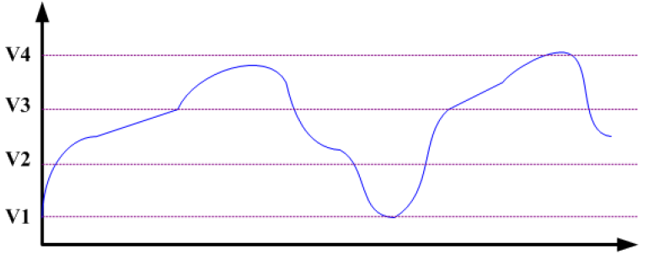
Digitization of Analog Signals
Digitization is converting an analog signal into digital form
Example: consider digitizing an analog voltage signal
Digitized output is limited to four values = {V1,V2,V3,V4}
Voltage
Time

Slide 14
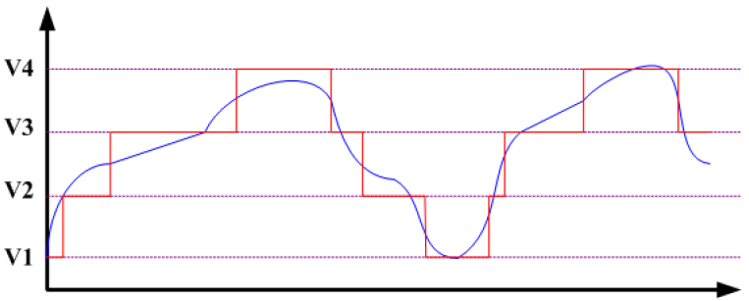
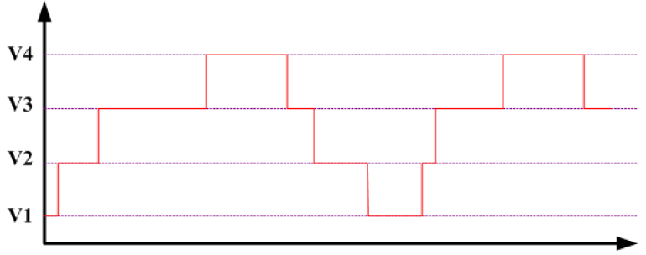
Digitization of Analog Signals – cont’d
Voltage
Time
Voltage
Time
Some loss of accuracy(精度), why?
How to improve accuracy?
Add more voltage values

Slide 15
ADC and DAC Converters
Analog-to-Digital Converter (ADC)
  Produces digitized version of analog signals
  Analog input => Digital output
Digital-to-Analog Converter (DAC)
  Regenerate analog signal from digital form
  Digital input => Analog output
Our focus is on digital systems only
  Both input and output to a digital system are digital signals
input analog signals
Analog-to-Digital Converter (ADC)
input digital signals
Digital System
output digital signals
Digital-to-Analog Converter (DAC)
output analog signals

Slide 16
Next . . .
Analog versus Digital Systems
Digitization of Analog Signals
Binary Numbers and Number Systems
Number System Conversions
Representing Fractions
Binary Codes

Slide 17
How do Computers Represent Digits?
Binary digits (0 and 1) are used instead of decimal digits
Using electric voltage
  Used in processors and digital circuits
  High voltage = 1, Low voltage = 0
Using electric charge
  Used in memory cells
  Charged memory cell = 1, discharged memory cell = 0
Using magnetic field
  Used in magnetic disks, magnetic polarity indicates 1 or 0
Using light
  Used in optical disks, surface pit(表面凹洞) indicates 1 or 0
High = 1
Unused
Voltage Level
Low = 0

Slide 18
Binary Numbers
Each binary digit (called a bit) is either 1 or 0
Bits have no inherent meaning, they can represent …
  Unsigned and signed integers
  Fractions
  Characters
  Images, sound, etc.
Bit Numbering(位编号)
  Least significant bit (LSB) is rightmost (bit 0)
  Most significant bit (MSB) is leftmost (bit 7 in an 8-bit number)
Most
Significant Bit
Least
Significant Bit
7
6
5
4
3
2
1
0
1
0
0
1
1
1
0
1
2
7
2
6
2
5
2
4
2
3
2
2
2
1
2
0

Slide 19
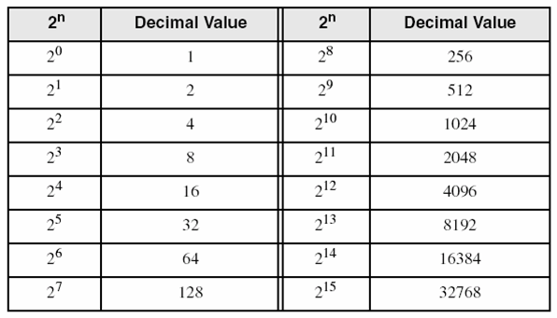
Decimal Value of Binary Numbers
Each bit represents a power of 2
Every binary number is a sum of powers of 2
Decimal Value = (d_{n-1} × 2^{n-1}) + ... + (d₁ × 2¹) + (d₀ × 2⁰)
Binary (10011101)₂ =
2⁷ + 2⁴ + 2³ + 2² + 1 = 157
7
6
5
4
3
2
1
0
1
0
0
1
1
1
0
1
2
7
2
6
2
5
2
4
2
3
2
2
2
1
2
0
Some common powers of 2

Slide 20
Positional Number Systems
Different Representations of Natural Numbers
XXVII Roman numerals (not positional)
27 Radix-10 or decimal number (positional)
11011₂ Radix-2 or binary number (also positional)
Fixed-radix positional representation with n digits
Number N in radix r = (d_{n–1}d_{n–2} . . . d₁d₀)_{r}
N_{r} Value = d_{n–1}×r ^{n–1} + d_{n–2}×r ^{n–2} + … + d₁×r + d₀
Examples: (11011)₂ =
(2107)₈ =
1×2⁴ + 1×2³ + 0×2² + 1×2 + 1 = 27
2×8³ + 1×8² + 0×8 + 7 = 1095

Slide 21
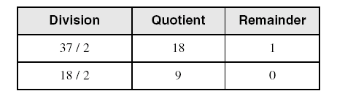
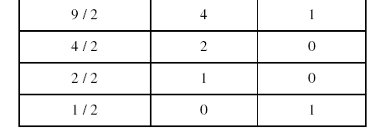
Convert Decimal to Binary
Repeatedly divide the decimal integer by 2
Each remainder is a binary digit in the translated value
Example: Convert 37₁₀ to Binary
least significant bit
37 = (100101)₂
most significant bit
stop when quotient is zero

Slide 22
Decimal to Binary Conversion
N = (d_{n-1} × 2^{n-1}) + ... + (d₁ × 2¹) + (d₀ × 2⁰)
Dividing N by 2 we first obtain
  Quotient₁ = (d_{n-1} × 2^{n-2}) + … + (d₂ × 2) + d₁
  Remainder₁ = d₀
  Therefore, first remainder is least significant bit of binary number
Dividing first quotient by 2 we first obtain
  Quotient₂ = (d_{n-1} × 2^{n-3}) + … + (d₃ × 2) + d₂
  Remainder₂ = d₁
Repeat dividing quotient by 2
  Stop when new quotient is equal to zero
  Remainders are the bits from least to most significant bit

Slide 23
Popular Number Systems
Binary Number System: Radix = 2
  Only two digit values: 0 and 1
  Numbers are represented as 0s and 1s
Octal Number System: Radix = 8
  Eight digit values: 0, 1, 2, …, 7
Decimal Number System: Radix = 10
  Ten digit values: 0, 1, 2, …, 9
Hexadecimal Number Systems: Radix = 16
  Sixteen digit values: 0, 1, 2, …, 9, A, B, …, F
  A = 10, B = 11, …, F = 15
Octal and Hexadecimal numbers can be converted easily to Binary and vice versa(反之亦然)

Slide 24
Octal and Hexadecimal Numbers
Octal = Radix 8
Only eight digits: 0 to 7
Digits 8 and 9 not used
Hexadecimal = Radix 16
16 digits: 0 to 9, A to F
A=10, B=11, …, F=15
First 16 decimal values (0 to15) and their values in binary, octal and hex. Memorize table
Decimal Radix 10 | Binary Radix 2 | Octal Radix 8 | Hex Radix 16
0 | 0000 | 0 | 0
1 | 0001 | 1 | 1
2 | 0010 | 2 | 2
3 | 0011 | 3 | 3
4 | 0100 | 4 | 4
5 | 0101 | 5 | 5
6 | 0110 | 6 | 6
7 | 0111 | 7 | 7
8 | 1000 | 10 | 8
9 | 1001 | 11 | 9
10 | 1010 | 12 | A
11 | 1011 | 13 | B
12 | 1100 | 14 | C
13 | 1101 | 15 | D
14 | 1110 | 16 | E
15 | 1111 | 17 | F

Slide 25
Binary, Octal, and Hexadecimal
Binary, Octal, and Hexadecimal are related:
Radix 16 = 2⁴ and Radix 8 = 2³
Hexadecimal digit = 4 bits and Octal digit = 3 bits
Starting from least-significant bit, group each 4 bits into a hex digit or each 3 bits into an octal digit
Example: Convert 32-bit number into octal and hex
3
5
3
0
5
5
2
3
6
2
4
Octal
1
1
1
0
1
0
1
1
0
0
0
1
0
1
1
0
1
0
1
0
0
1
1
1
1
0
0
1
0
1
0
0
32-bit binary
E
B
1
6
A
7
9
4
Hexadecimal

Slide 26
Converting Octal & Hex to Decimal
Octal to Decimal: N₈ = (d_{n-1} × 8^{n-1}) +... + (d₁ × 8) + d₀
Hex to Decimal: N₁₆ = (d_{n-1} × 16^{n-1}) +... + (d₁ × 16) + d₀
Examples:
(7204)₈ = (7 × 8³) + (2 × 8²) + (0 × 8) + 4 = 3716
(3BA4)₁₆ = (3 × 16³) + (11 × 16²) + (10 × 16) + 4 = 15268

Slide 27
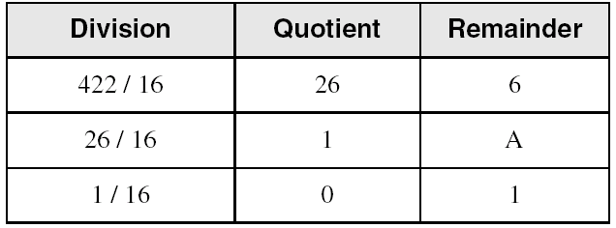
Converting Decimal to Hexadecimal
Repeatedly divide the decimal integer by 16
Each remainder is a hex digit in the translated value
Example: convert 422 to hexadecimal
least significant digit
most significant digit
422 = (1A6)₁₆
stop when quotient is zero
To convert decimal to octal divide by 8 instead of 16

Slide 28
Important Properties
How many possible digits can we have in Radix r ?
r digits: 0 to r – 1
What is the result of adding 1 to the largest digit in Radix r?
Since digit r is not represented, result is (10)_{r} in Radix r
Examples: 1₂ + 1 = (10)₂ 7₈ + 1 = (10)₈
9₁₀ + 1 = (10)₁₀ F₁₆ + 1 = (10)₁₆
What is the largest value using 3 digits in Radix r?
In binary: (111)₂ = 2³ – 1
In octal: (777)₈ = 8³ – 1
In decimal: (999)₁₀ = 10³ – 1
In Radix r:
largest value = r³ – 1

Slide 29
Important Properties – cont’d
How many possible values can be represented …
Using n binary digits?
Using n octal digits
Using n decimal digits?
Using n hexadecimal digits
Using n digits in Radix r ?
2^{n} values: 0 to 2^{n} – 1
8^{n} values: 0 to 8^{n} – 1
10^{n} values: 0 to 10^{n} – 1
16^{n} values: 0 to 16^{n} – 1
r^{n} values: 0 to r^{n} – 1

Slide 30
Next . . .
Analog versus Digital Systems
Digitization of Analog Signals
Binary Numbers and Number Systems
Number System Conversions
Representing Fractions
Binary Codes

Slide 31
Representing Fractions(小数)
A number N_{r} in radix r can also have a fraction part:
N_{r} = d_{n-1}d_{n-2} … d₁d₀ . d₋₁ d₋₂ … d_{-m+1} d_{-m}
The number N_{r} represents the value:
N_{r} = d_{n-1} × r^{n-1} + … + d₁ × r + d₀ + (Integer Part)
d₋₁ × r ⁻¹ + d₋₂ × r ⁻² … + d_{-m} × r ^{–m} (Fraction Part)
0 ≤ d_{i} < r
Integer Part
Fraction Part
Radix Point
i = n-1
j = -1
∑
∑
N_{r} =
d_{i} × r^{i}
+
d_{j} × r^{j}
i = 0
j = -m

Slide 32
Examples of Numbers with Fractions
(2409.87)₁₀
(1101.1001)₂
(703.64)₈
(A1F.8)₁₆
(423.1)₅
(263.5)₆
= 2×10³ + 4×10² + 9 + 8×10⁻¹ + 7×10⁻²
= 2³ + 2² + 2⁰ + 2⁻¹ + 2⁻⁴ = 13.5625
= 7×8² + 3 + 6×8⁻¹ + 4×8⁻² = 451.8125
= 10×16² + 16 + 15 + 8×16⁻¹ = 2591.5
= 4×5² + 2×5 + 3 + 5⁻¹ = 113.2
Digit 6 is NOT allowed in radix 6

Slide 33
Converting Decimal Fraction to Binary
Convert N = 0.6875 to Radix 2
Solution: Multiply N by 2 repeatedly & collect integer bits
Stop when new fraction = 0.0, or when enough fraction bits are obtained
Therefore, N = 0.6875 = (0.1011)₂
Check (0.1011)₂ = 2⁻¹ + 2⁻³ + 2⁻⁴ = 0.6875
Multiplication | New Fraction | Bit
0.6875 × 2 = 1.375 | 0.375 | 1
0.375 × 2 = 0.75 | 0.75 | 0
0.75 × 2 = 1.5 | 0.5 | 1
0.5 × 2 = 1.0 | 0.0 | 1
First fraction bit
Last fraction bit

Slide 34
Converting Fraction to any Radix r
To convert fraction N to any radix r
N_{r} = (0.d₋₁ d₋₂ … d_{-m})_{r} = d₋₁ × r ⁻¹ + d₋₂ × r ⁻² … + d_{-m} × r ^{–m}
Multiply N by r to obtain d₋₁
N_{r} × r = d₋₁ + d₋₂ × r ⁻¹ … + d_{-m} × r ^{–m+1}
The integer part is the digit d₋₁ in radix r
The new fraction is d₋₂ × r ⁻¹ … + d_{-m} × r ^{–m+1}
Repeat multiplying the new fractions by r to obtain d₋₂ d₋₃ ...
Stop when new fraction becomes 0.0 or enough fraction digits are obtained

Slide 35
More Conversion Examples
Convert N = 139.6875 to Octal (Radix 8)
Solution: N = 139 + 0.6875 (split integer from fraction)
The integer and fraction parts are converted separately
Therefore, 139 = (213)₈ and 0.6875 = (0.54)₈
Now, join the integer and fraction parts with radix point
N = 139.6875 = (213.54)₈
Division | Quotient | Remainder
139 / 8 | 17 | 3
17 / 8 | 2 | 1
2 / 8 | 0 | 2
Multiplication | New Fraction | Digit
0.6875 × 8 = 5.5 | 0.5 | 5
0.5 × 8 = 4.0 | 0.0 | 4

Slide 36
Conversion Procedure to Radix r
To convert decimal number N (with fraction) to radix r
Convert the Integer Part
  Repeatedly divide the integer part of number N by the radix r and save the remainders. The integer digits in radix r are the remainders in reverse order of their computation. If radix r > 10, then convert all remainders > 10 to digits A, B, … etc.
Convert the Fractional Part
  Repeatedly multiply the fraction of N by the radix r and save the integer digits that result. The fraction digits in radix r are the integer digits in order of their computation. If the radix r > 10, then convert all digits > 10 to A, B, … etc.
Join the result together with the radix point

Slide 37
Simplified Conversions
Converting fractions between Binary, Octal, and Hexadecimal can be simplified
Starting at the radix pointing, the integer part is converted from right to left and the fractional part is converted from left to right
Group 4 bits into a hex digit or 3 bits into an octal digit
Use binary to convert between octal and hexadecimal
integer: right to left
fraction: left to right
7
2
6
1
3
.
2
4
7
4
5
2
Octal
1
1
1
0
1
0
1
1
0
0
0
1
0
1
1
.
0
1
0
1
0
0
1
1
1
1
0
0
1
0
1
0
1
Binary
7
5
8
B
.
5
3
C
A
8
Hexadecimal

Slide 38
Important Properties of Fractions
How many fractional values exist with m fraction bits?
(在二进制数中，有m位小数，其小数值有多少个？)
2^{m} fractions, because each fraction bit can be 0 or 1
What is the largest fraction value if m bits are used?
Largest fraction value = 2⁻¹ + 2⁻² + … + 2^{-m} = 1 – 2^{-m}
Because if you add 2^{-m} to largest fraction you obtain 1
In general, what is the largest fraction value if m fraction digits are used in radix r ?（在r进制数中，有m位小数，则最大的小数值是多少？）
Largest fraction value = r ⁻¹ + r ⁻² + … + r ^{-m} = 1 – r ^{-m}
For decimal, largest fraction value = 1 – 10^{-m}
For hexadecimal, largest fraction value = 1 – 16^{-m}

Slide 39
Next . . .
Analog versus Digital Systems
Digitization of Analog Signals
Binary Numbers and Number Systems
Number System Conversions
Representing Fractions
Binary Codes

Slide 40
Binary Codes
How to represent characters, colors, etc?
Define the set of all represented elements（定义所有要表示元素的集合）
Assign a unique binary code to each element of the set
Given n bits, a binary code is a mapping from the set of elements to a subset of the 2^{n} binary numbers
Coding Numeric Data (example: coding decimal digits)
  Coding must simplify common arithmetic operations
  Tight relation to binary numbers
Coding Non-Numeric Data (example: coding colors)
  More flexible codes since arithmetic operations are not applied

Slide 41
Example of Coding Non-Numeric Data
Suppose we want to code 7 colors of the rainbow
As a minimum, we need 3 bits to define 7 unique values
3 bits define 8 possible combinations
Only 7 combinations are needed
Code 111 is not used
Other assignments are also possible
Color | 3-bit code
Red | 000
Orange | 001
Yellow | 010
Green | 011
Blue | 100
Indigo (青) | 101
Violet | 110

Slide 42
Minimum Number of Bits Required
Given a set of M elements to be represented by a binary code, the minimum number of bits, n, should satisfy:
2^{(n - 1)} < M ≤ 2^{n}
n = log₂ M where x , called the ceiling function, is the integer greater than or equal to x
How many bits are required to represent decimal digits with a binary code?
Notes:
M = 10
Therefore n = 4 since:
2⁴ =16 is ≥ 10 > 2³ = 8
and the ceiling function for log₂ 10 is 4.

Slide 43
Decimal Codes
Binary number system is most natural for computers, But people are used to the decimal system
Must convert decimal numbers to binary, do arithmetic on binary numbers, then convert back to decimal
To simplify conversions, decimal codes can be used Define a binary code for each decimal digit
  (为了简化转换，为每个十进制数字定义一个二进制代码，这样就可以使用十进制代码了)
Since 10 decimal digits exit, a 4-bit code is used.
But a 4-bit code gives 16 unique combinations, 10 combinations are used and 6 will be unused

Slide 44
Binary Coded Decimal (BCD)
Simplest binary code for decimal digits
Only encodes ten digits from 0 to 9
BCD is a weighted code
The weights are 8,4,2,1
Same weights as a binary number
There are six invalid code words
1010, 1011, 1100, 1101, 1110, 1111
Example on BCD coding:
13 ⇔ (0001 0011)_{BCD}
Decimal | BCD
0 | 0000
1 | 0001
2 | 0010
3 | 0011
4 | 0100
5 | 0101
6 | 0110
7 | 0111
8 | 1000
9 | 1001
Notes:
Answer 1: 6
Answer 2: 1010, 1011, 1100, 1101, 1110, 1111

Slide 45
Warning: Conversion or Coding?
Do NOT mix up conversion of a decimal number to a binary number with coding a decimal number with a binary code
13₁₀ = (1101)₂ This is conversion
13 ⇔ (0001 0011)_{BCD} This is coding
In general, coding requires more bits than conversion
A number with n decimal digits is coded with 4n bits in BCD
  (对于一个n位的十进制数，在BCD中需要用4n位编码)

Slide 46
Other Decimal Codes
Many ways to assign 4-bit code to 10 decimal digits
  (将4位代码分配给10个十进制数字，有许多方式)
Each code uses only 10 combinations out of 16
BCD and 8, 4, -2, -1 are
weighted codes
Excess-3 and 8,4,-2,-1 are
self-complementing codes
Note that BCD is NOT
self-complementing
Decimal | BCD | Excess-3 | 8,4,-2,-1
0 | 0000 | 0011 | 0000
1 | 0001 | 0100 | 0111
2 | 0010 | 0101 | 0110
3 | 0011 | 0110 | 0101
4 | 0100 | 0111 | 0100
5 | 0101 | 1000 | 1011
6 | 0110 | 1001 | 1010
7 | 0111 | 1010 | 1001
8 | 1000 | 1011 | 1000
9 | 1001 | 1100 | 1111

Slide 47
Gray Code
As we count up/down using binary codes, the number of bits that change from one binary value to the next varies
000 → 001 (1-bit change)
001 → 010 (2-bit change)
011 → 100 (3-bit change)
Gray code: only 1 bit changes
as we count up or down
Binary reflected code
Gray code can be used in low-power logic circuits that count up or down, because only 1 bit changes per count
Digit | Binary | Gray Code
0 | 000 | 000
1 | 001 | 001
2 | 010 | 011
3 | 011 | 010
4 | 100 | 110
5 | 101 | 111
6 | 110 | 101
7 | 111 | 100

Slide 48
Character Codes
Character sets
  Standard ASCII: 7-bit character codes (0 – 127)
  Extended ASCII: 8-bit character codes (0 – 255)
  Unicode: 16-bit character codes (0 – 65,535)
  Unicode standard represents a universal character set
    Defines codes for characters used in all major languages
    Used in Windows-XP: each character is encoded as 16 bits
  UTF-8: variable-length encoding used in HTML
    Encodes all Unicode characters
    Uses 1 byte for ASCII, but multiple bytes for other characters
Null-terminated String
  Array of characters followed by a NULL character

Slide 49
Printable ASCII Codes
 | 0 | 1 | 2 | 3 | 4 | 5 | 6 | 7 | 8 | 9 | A | B | C | D | E | F
2 | space | ! | " | # | $ | % | & | ' | ( | ) | * | + | , | - | . | /
3 | 0 | 1 | 2 | 3 | 4 | 5 | 6 | 7 | 8 | 9 | : | ; | < | = | > | ?
4 | @ | A | B | C | D | E | F | G | H | I | J | K | L | M | N | O
5 | P | Q | R | S | T | U | V | W | X | Y | Z | [ | \ | ] | ^ | _
6 | ` | a | b | c | d | e | f | g | h | i | j | k | l | m | n | o
7 | p | q | r | s | t | u | v | w | x | y | z | { | | | } | ~ | DEL
Examples:
  ASCII code for space character = 20 (hex) = 32 (decimal)
  ASCII code for 'L' = 4C (hex) = 76 (decimal)
  ASCII code for 'a' = 61 (hex) = 97 (decimal)

Slide 50
Control Characters
The first 32 characters of ASCII table are used for control
Control character codes = 00 to 1F (hexadecimal)
  Not shown in previous slide
Examples of Control Characters
  Character 0 is the NULL character ⇒ used to terminate a string
  Character 9 is the Horizontal Tab (HT) character
  Character 0A (hex) = 10 (decimal) is the Line Feed (LF)
  Character 0D (hex) = 13 (decimal) is the Carriage Return (CR)
  The LF and CR characters are used together
    They advance the cursor to the beginning of next line
One control character appears at end of ASCII table
  Character 7F (hex) is the Delete (DEL) character

Slide 51
Parity Bit & Error Detection Codes
Binary data are typically transmitted between computers
Because of noise, a corrupted bit will change value
To detect errors, extra bits are added to each data value
Parity bit: is used to make the number of 1’s odd or even
Even parity: number of 1’s in the transmitted data is even
Odd parity: number of 1’s in the transmitted data is odd
7-bit ASCII Character | With Even Parity | With Odd Parity
‘A’ = 1000001 | 0 1000001 | 1 1000001
‘T’ = 1010100 | 1 1010100 | 0 1010100

Slide 52
Detecting Errors
Sender
7-bit ASCII character + 1 Parity bit
Receiver
Sent ‘A’ = 01000001, Received ‘A’ = 01000101
Suppose we are transmitting 7-bit ASCII characters
A parity bit is added to each character to make it 8 bits
Parity can detect all single-bit errors
  If even parity is used and a single bit changes, it will change the parity to odd, which will be detected at the receiver end
  The receiver end can detect the error, but cannot correct it because it does not know which bit is erroneous
Can also detect some multiple-bit errors
  Error in an odd number of bits

