Slide 1
Care Can Cure
INDIAN INNOVATION SERIES
Team : 20
Team Name: Dynamites
Presented By
M. Sai Laya
A. Sai Santhoshi
T. Laxmi
Rs. Revathi
IoT Hackathon 2019

Slide 2
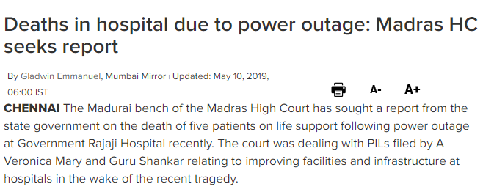
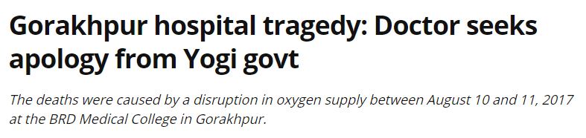
Problem Statement
Lack of knowledge on hospital facilities and famous specialist.
Difficulty to know the availability of doctors.
No pre-booking of ambulance for old-agers and paralysis patients.
Unable to purchase the medicine due to lack of time.
IoT Hackathon 2019

Slide 3
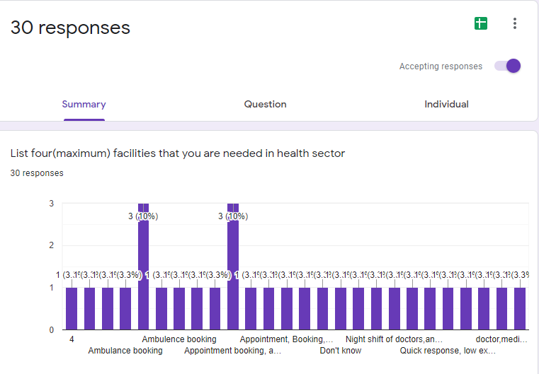
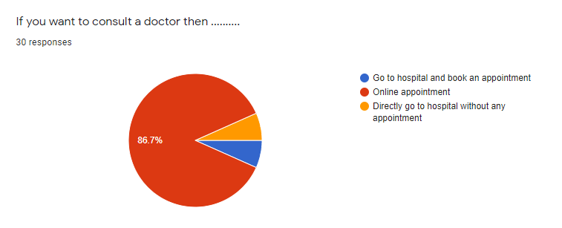
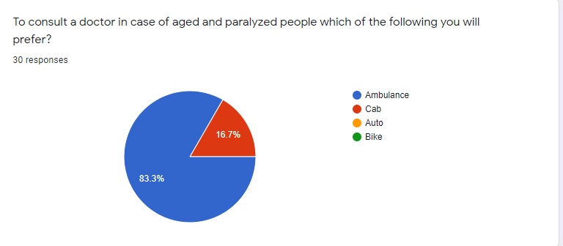
Customer Survey
IoT Hackathon 2019

Slide 4
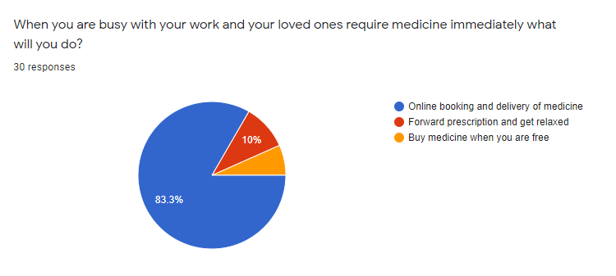
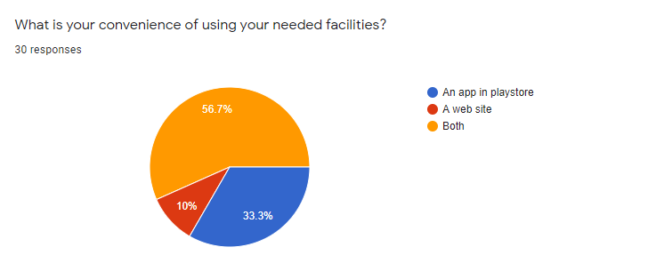
Customer Survey URL : https://forms.gle/fG3MWadzttTn5Pzh7
SpreadSheet URL: https://docs.google.com/spreadsheets/d/1NGn-mhfhIP0fEc4GxmnbkLdWBR00Ar0aTVanFH2bhdo/edit?usp=sharing

Slide 5
Existing Solutions
For appointment we Practo, DocsApp, Setmore Appointments(App).Acuity, SimpltBook.me(Web Site).
For ambulance booking we have Medlife, VMEDO, Ambus(Android). Medulance, Siren(Web Site).
For ambulance booking we have pharmEasy, MedPlus(Android). Netmeds, Zoylo(Web Site).
Today, according to practo blog nearly 2 million consumers perform 4 million searches every month on the applications.
Customers are not satisfied for using different apps for a single healthcare sector. We thought of having improvement by providing all the facilities in a single app.
IoT Hackathon 2019

Slide 6
Our Solution and Uniqueness
Our solution for the problem is to have all the facilities together like appointment booking, ambulance booking, order medicine and having a look on the facilities and infrastructure.
Pre ambulance booking for aged and paralyzed people can be provided for there checkups.
Patients can consult the doctors according to their required specialists without any difficulty.
On more usage of our application visibility and transparency of hospitals will increase.
As rating can be faked, it enables the patients to communicate with previous consulted patients.
Improves time management and efficiency.
Vendors will be profitable as they get information about the hospitals which are in lack of required equipment.
IoT Hackathon 2019

Slide 7
Customers & Consumers
Who would be the consumers who uses your product?
Hospitals
Who would be the customers who purchases your product for the consumer?
Patients
IoT Hackathon 2019

Slide 8
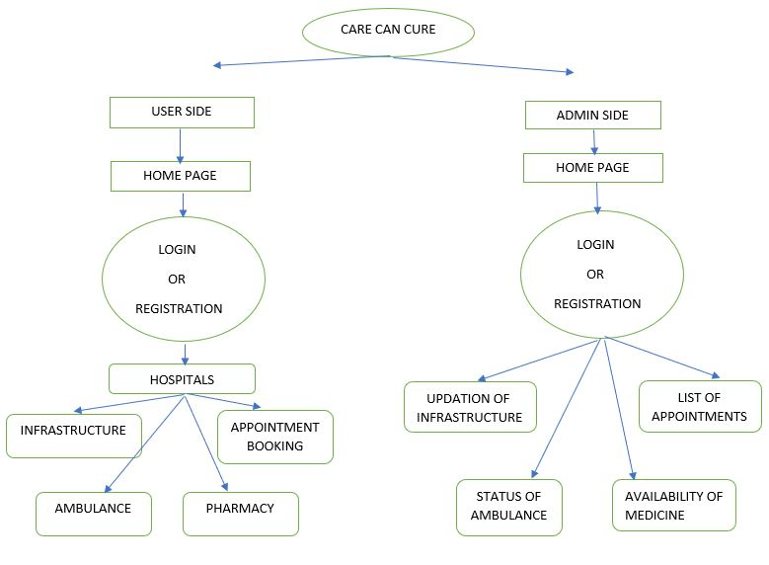
Design - Blueprint
FLOW CHAT:
IoT Hackathon 2019

Slide 9

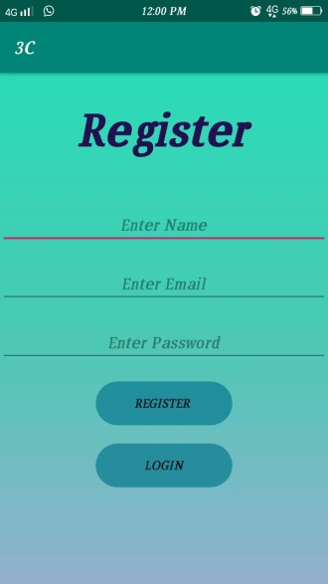
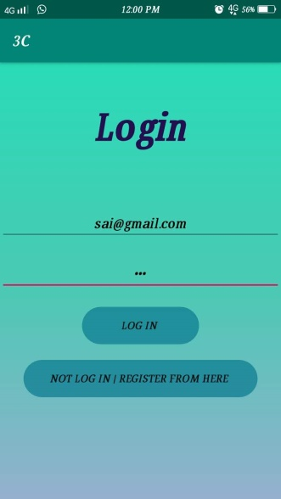
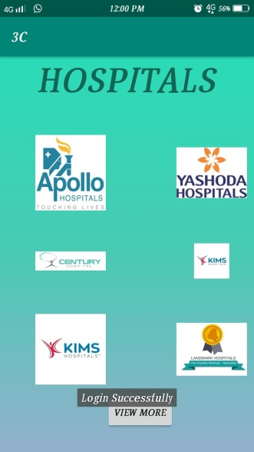
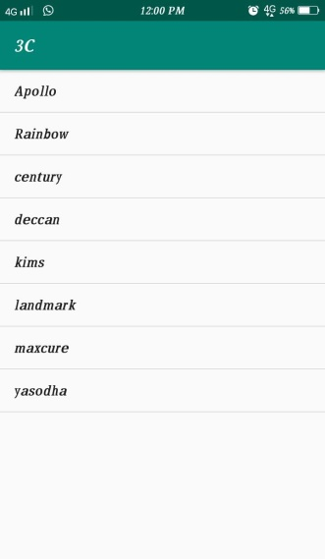
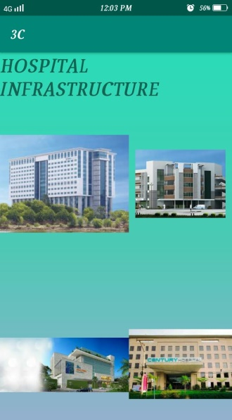
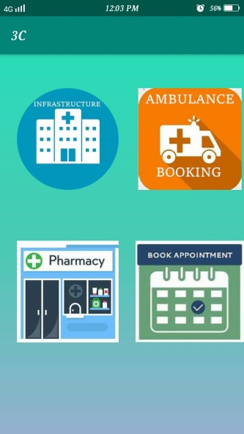
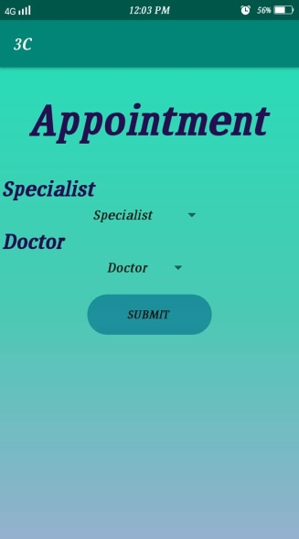
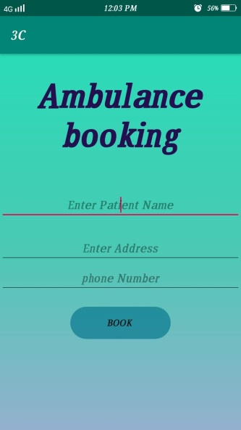
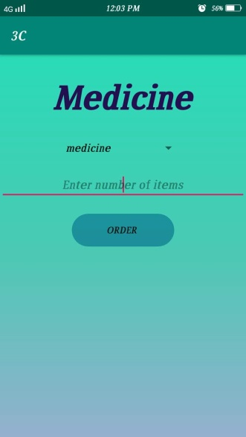
Output – Screen Shots Android
IoT Hackathon 2019

Slide 10
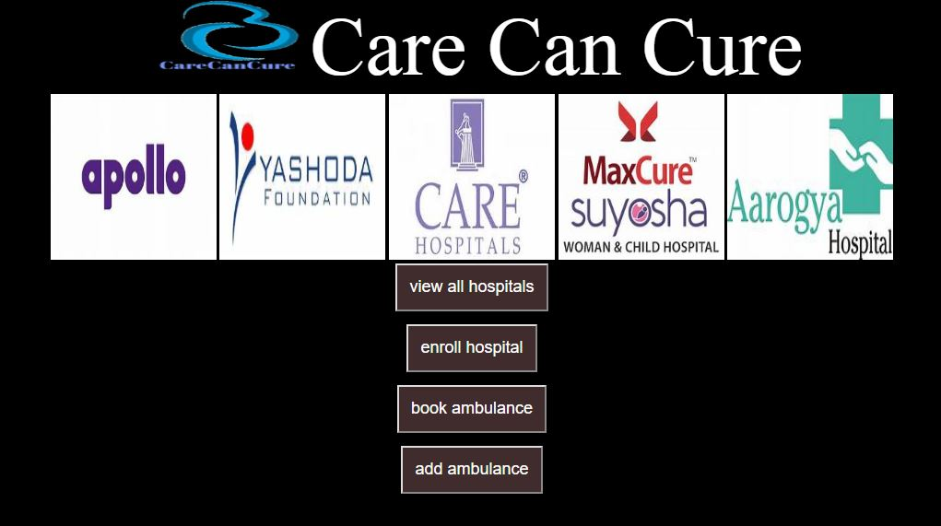
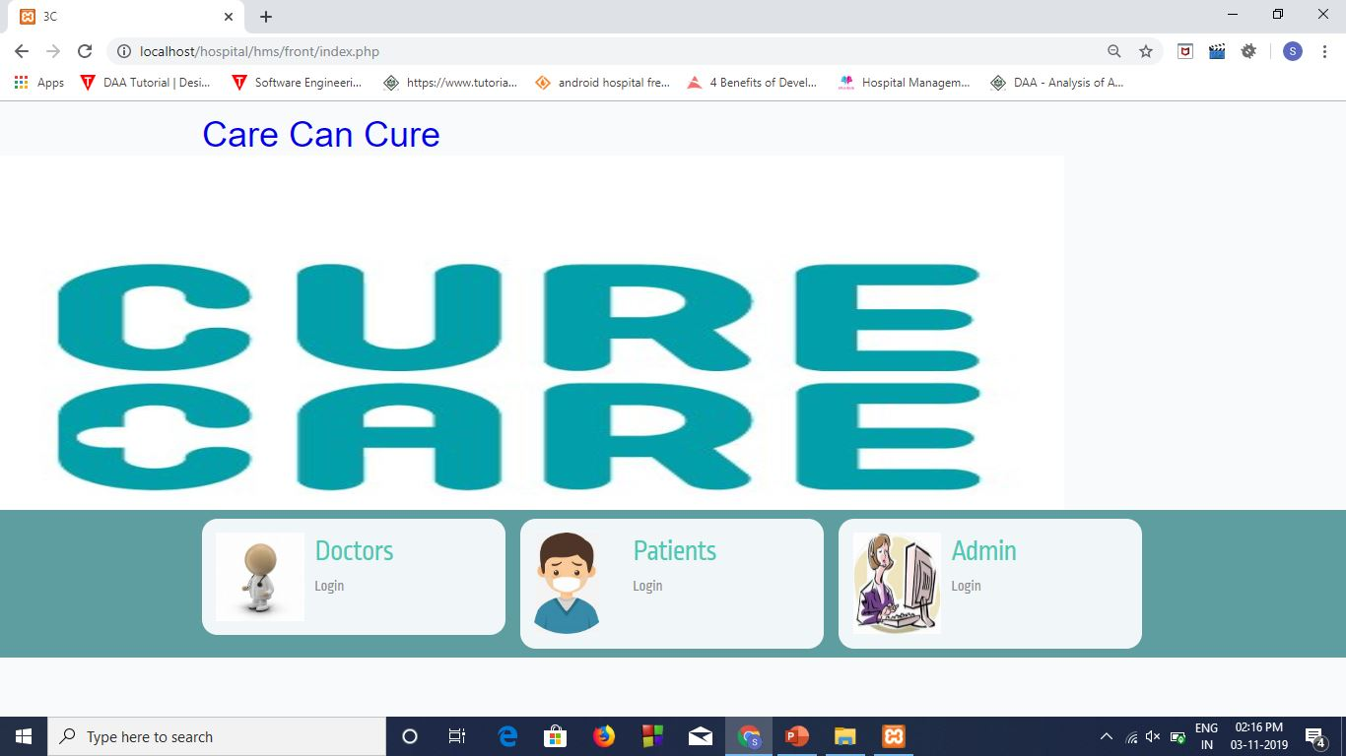
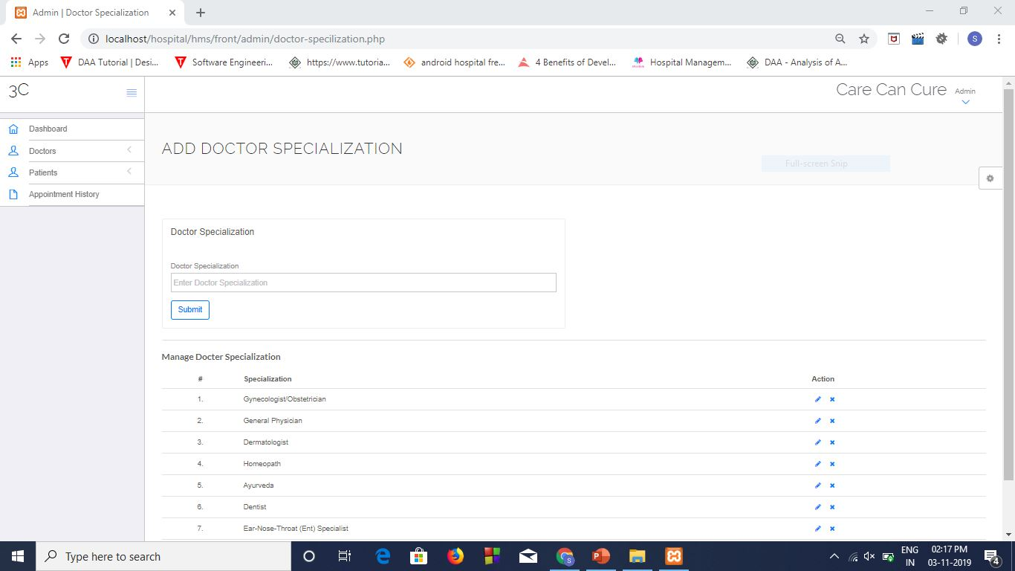

Web side

Slide 11
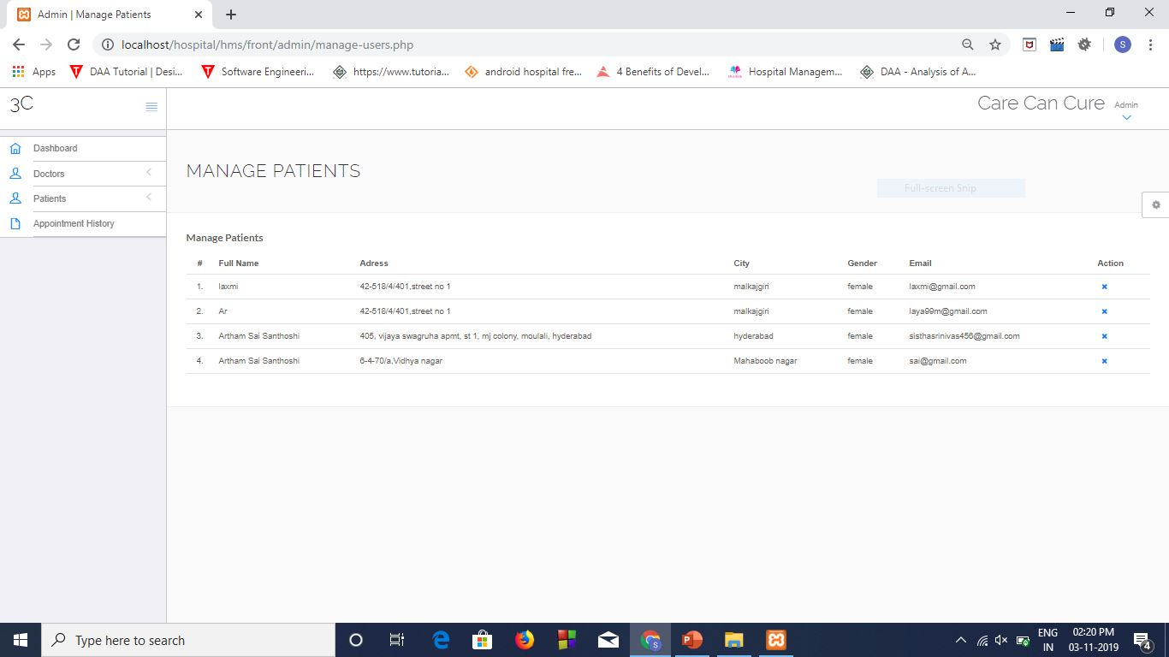
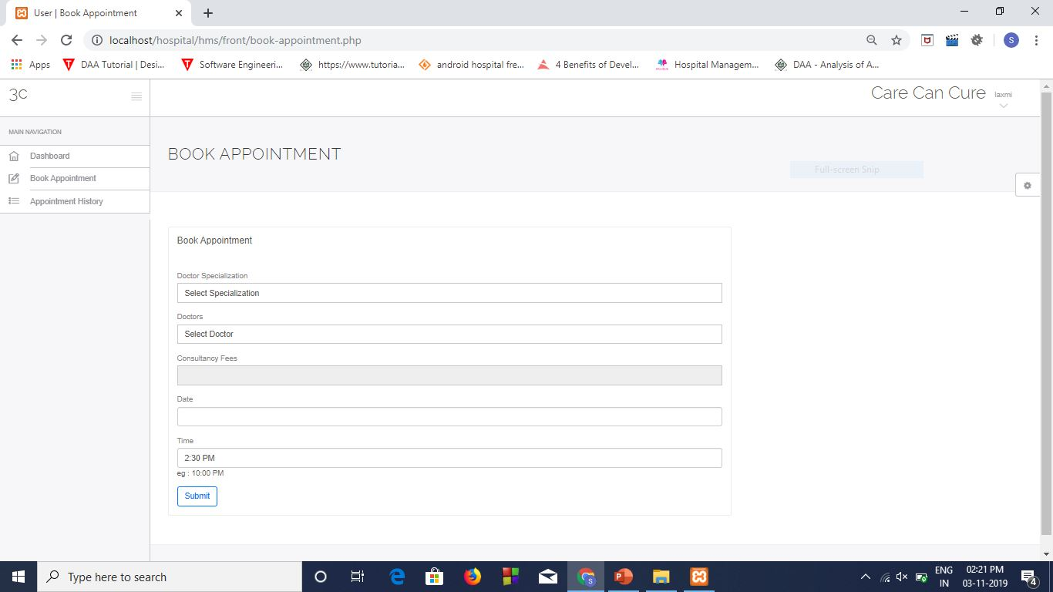
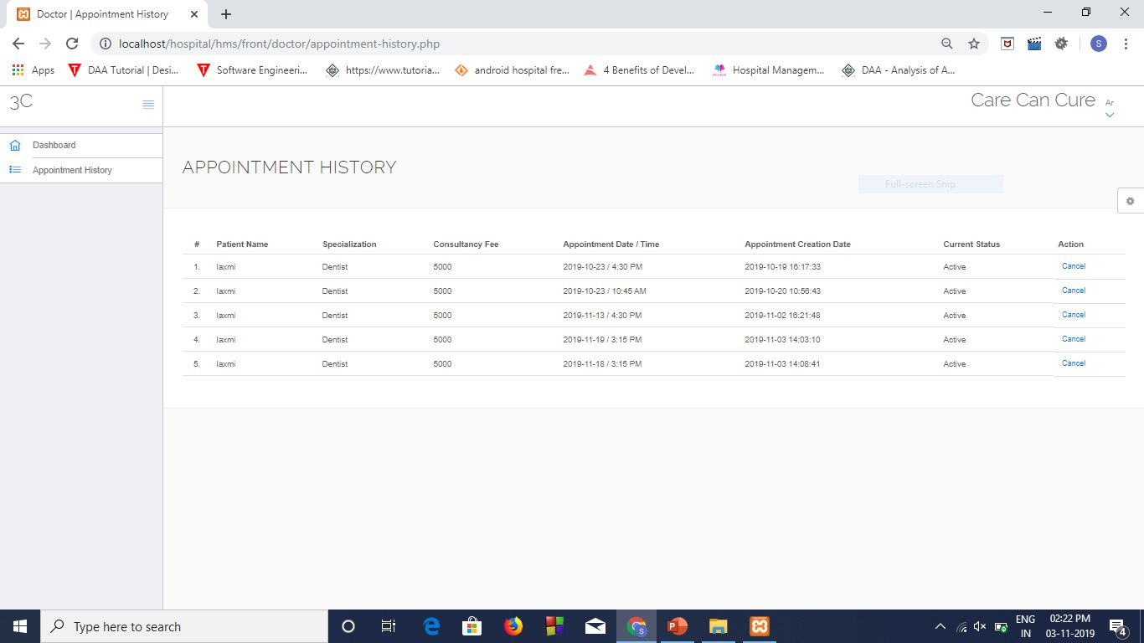
Android Demo URL : https://photos.app.goo.gl/pFfhHFfAEktzzqqY8
Web Demo URL : https://photos.app.goo.gl/bdxjPduzfQLqLmop6

Slide 12
Thank You!
IoT Hackathon 2019

