Slide 1

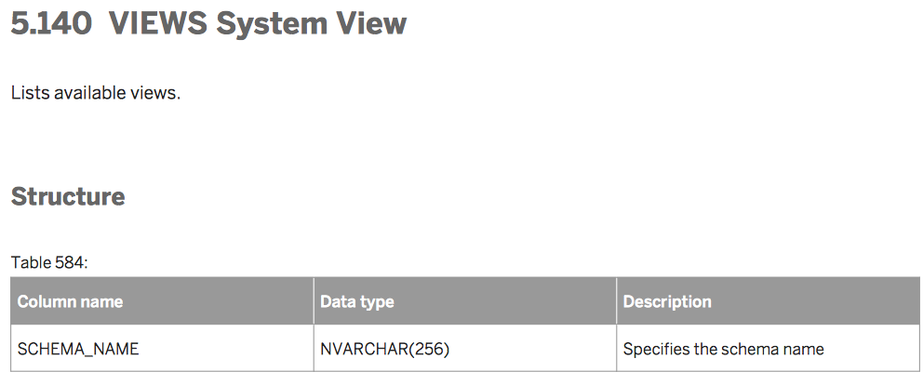
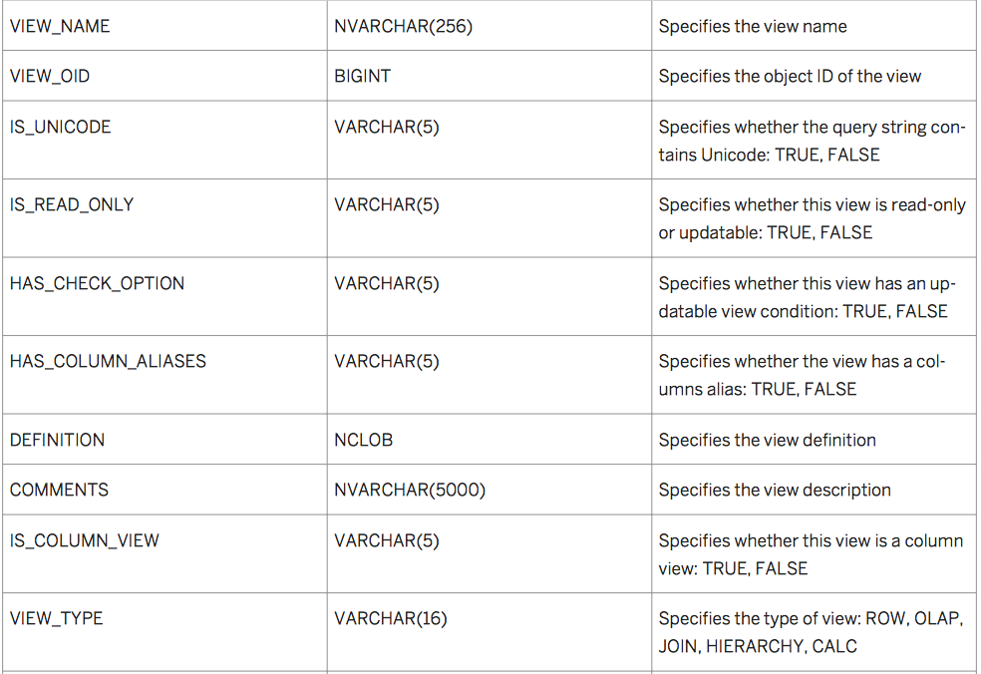
The main table in the middle is called a fact table, which is where our transactional data is stored.
The transactional data stored in the fact table is referred to as either key figures (показатели) or
measures(метрики).

Slide 2
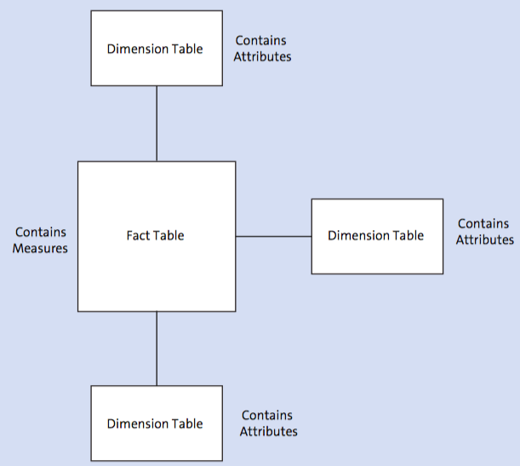
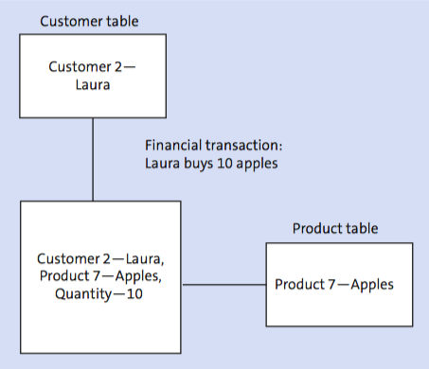
Транзакция
Сургутефтегаз произвел 9,8 млрд м3 газа в 2016 году (KPI «Производство газа»)
Business area table
KPI table
Company 1 - Surgutneftegas
IND 2 - Gas Production
Units - billion m3
Year table
Year - 2016
Product table
Company I - Surgutneftegas,
Product 2 - Gas,
Quantity - 9,8,
Year - 2016,
KPI - Gas Production
Product 2 - Gas
The main table in the middle is called a fact table, which is where our transactional data is stored.
The transactional data stored in the fact table is referred to as either key figures (показатели) or measures(метрики).
The side tables are called dimension tables, and this is where our master data is stored, which is referred to as characteristics, attributes

Slide 3
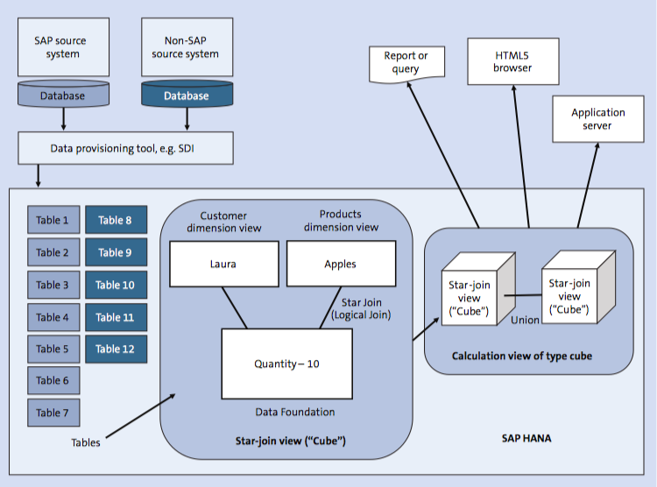
SAP Lumira 2.x, SAP Crystal Reports
Analytical Fiori Apps with the SAP Smart Business Modeler (VDM)
Business area dimension view
KPI dimension view
Surgutneftegas
IND - 2
Quantity - 9,8

Slide 4
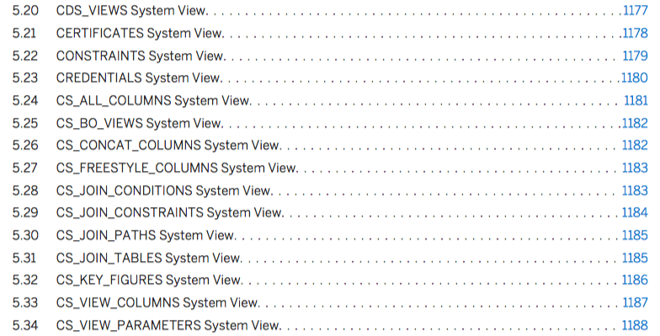
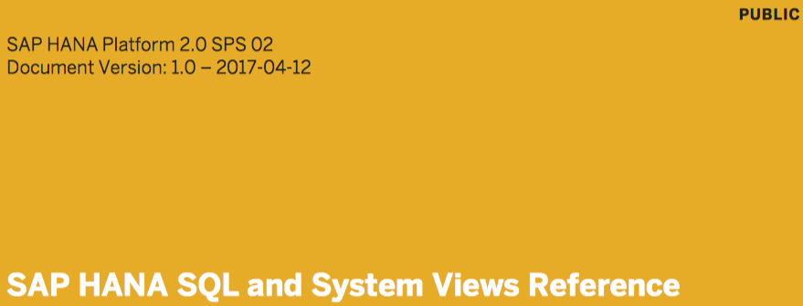
Генерация библиотеки показателей из системных ракурсов SAP Hana XSA
(Hana 1.0 SP12 или Hana 2.0 SP02).
Задача: выбрать

