Slide 1
Skout Android Tests

Slide 2
Prerequisites for running the tests
Appium
Android SDK Tools
Android Emulator/ Physical Devices
Android Studio
Python
Eclipse with setup for Running Android Tests

Slide 3
API Levels and Devices
Android Emulator – Galaxy Nexus
API Level 19 – Android Version 4.4.2 – KitKat
Android Emulator – Nexus 4
API Level 22 – Android Version 5.1.1- Lollipop
Physical Device – Motorola
API Level 22 – Android Version 5.1.1 - Lollipop

Slide 4
Test Scenarios

Slide 5
Scenario 1 - Sign up for Skout
Open the App/Install the App and Open
Click on the ‘Sign Up’ button
Enter the user details
Handle the Captcha
Check if sign up is successful!

Slide 6
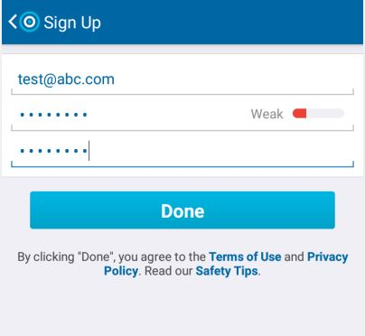
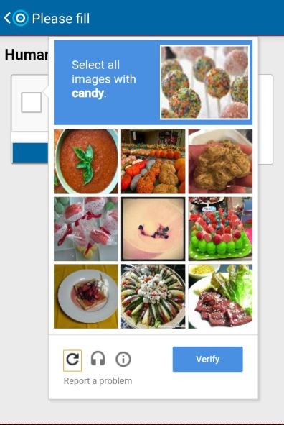
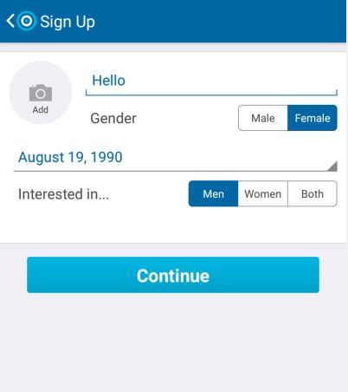
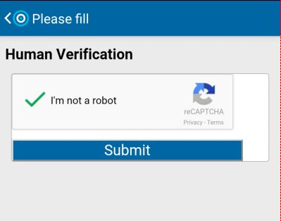

Slide 7
Scenario 2 - Login using Facebook account
Open the App/Install the App and Open
Click on ‘Connect with Facebook’
Enter the credentials
Click on ‘OK’
Check if Login is successful!

Slide 8
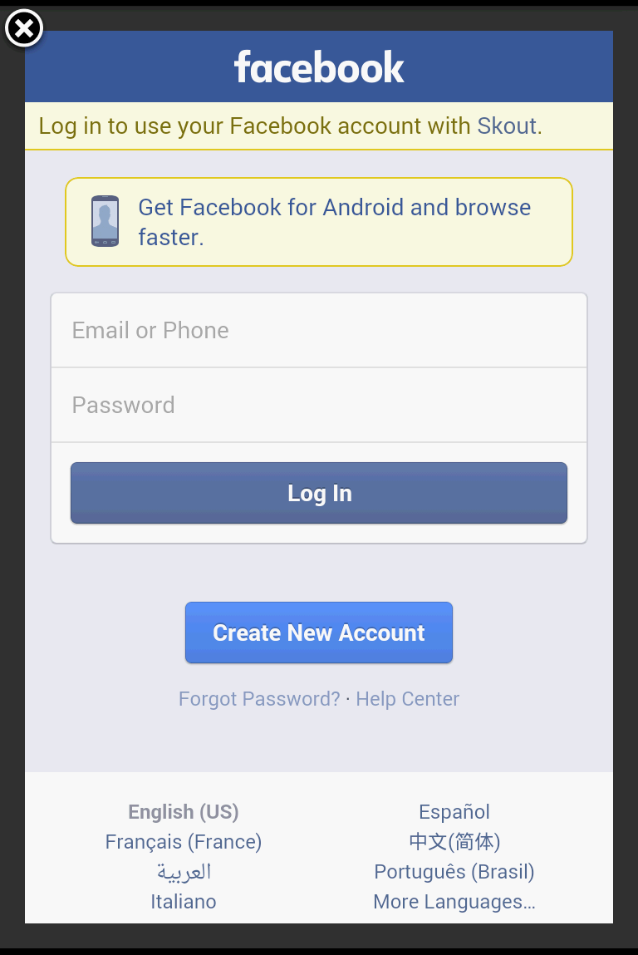
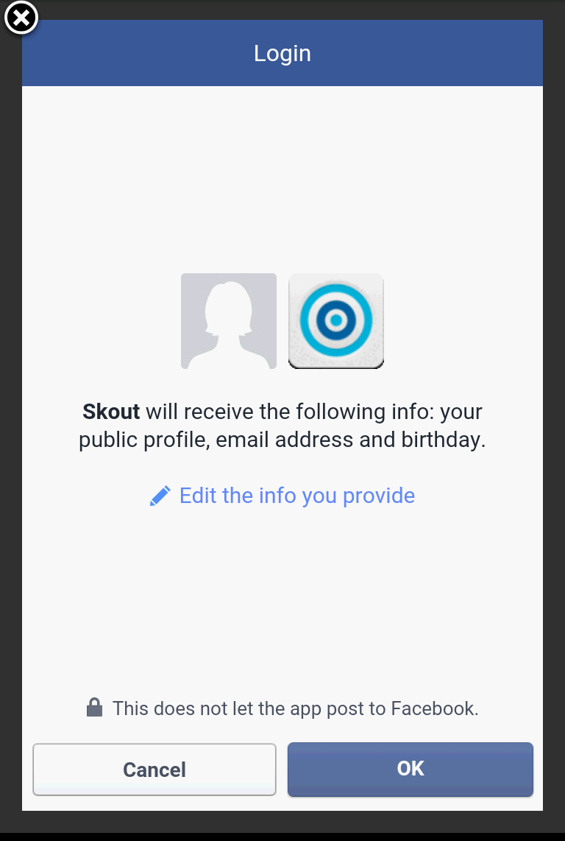

Slide 9
Scenario 3 – Check if a menu element is present or not using different login and if ‘Go Premium’ is available for that login
Open the App/Install the App and Open
Click on ‘Login Here’
Enter login credentials
After successful login, check if a menu element is present (Meet People, Buzz, Shake to Chat, etc.)
Check if ‘Go Premium’ is available
Print the results

Slide 10
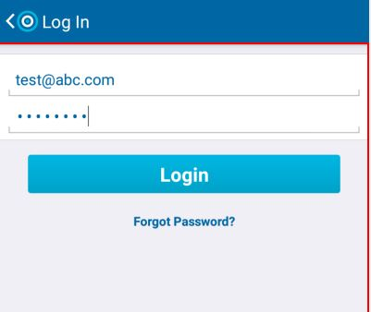
Test if all elements are present ...
'Meet people' is present
'Buzz' is present
'Chats' is present
'Shake to chat' is present
Go Premium not available …
'Who Checked Me Out' is present
'Who Favorited Me?' is present
'Skout Travel' is present
'Rate Us!' is present
'Logout' is present

Slide 11
Scenario 4 – Login with a user and check 10 random profiles
Pre Requisite - Have a user ready whose search settings is show me -> Men who like women, age between 18-21.
Open the App/Install the App and Open
Click on ‘Login Here’
Enter the credentials
Click on ‘Tap to edit Search Settings’ – Set Settings
Check profiles randomly to find if gender, age, interested in fields are as desired!

Slide 12
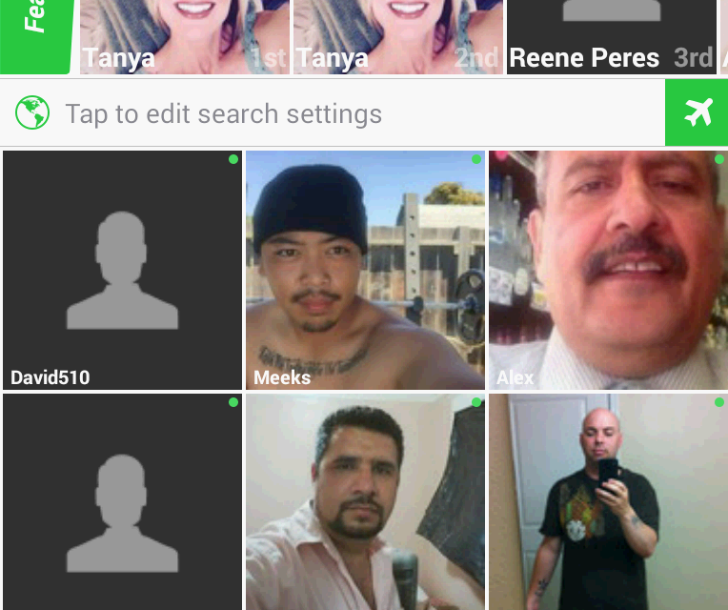
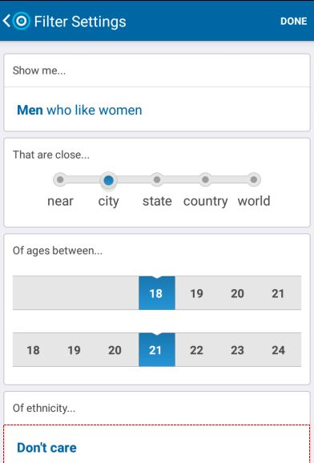
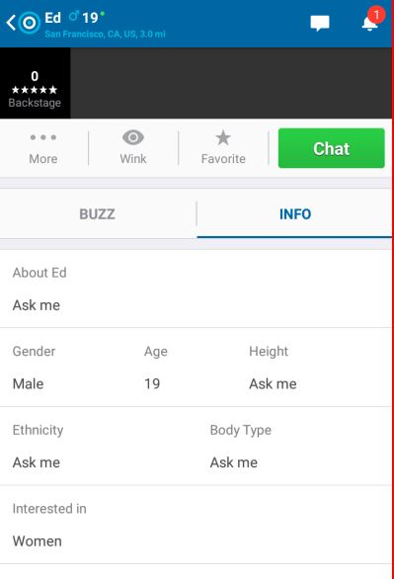
Jesus
Male
19
Interested in Women
....
Gabriel
Male
21
Error - Interested in Men & Women
Joseph
Male
18
Interested in Women

Slide 13
Questions?

