Slide 1

H-1B Visa Data Analysis

Slide 2
Agenda
Problem Definition
States and Companies Which You Definitely Don’t Want to Miss Out
New Opportunities
Prediction on Job Market
Conclusion

Slide 3

Problem Definition

Slide 4
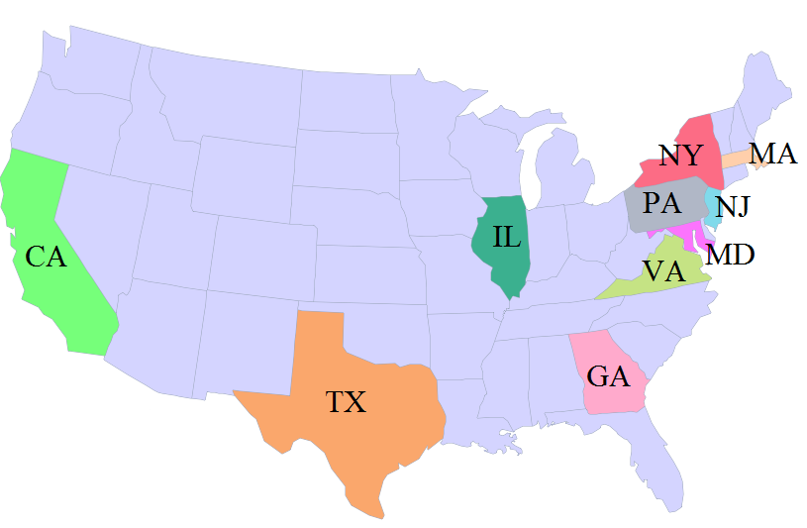
Top 10 States!
Notes:
software

Slide 5
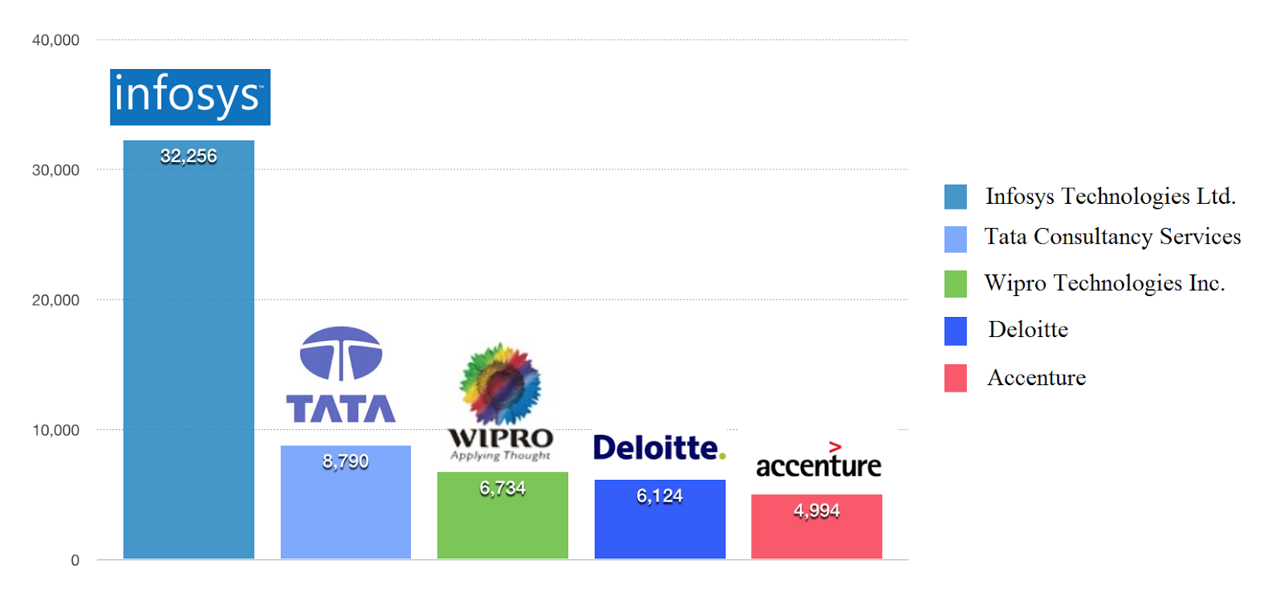
Top 5 employers!

Slide 6
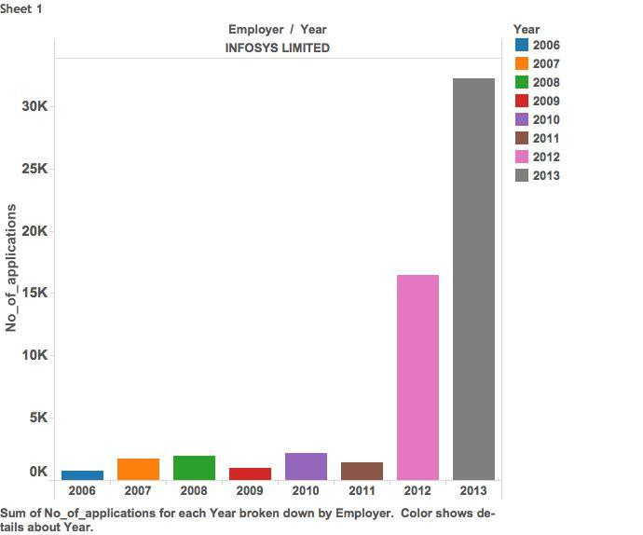
Who Is Hiring?

Slide 7

New Opportunities!
When the company changes the business model!
New employment opportunities open up!

Slide 8

Example!!
Increased their small and medium enterprise clients
from
130 to 1000
Why is this significant?

Slide 9
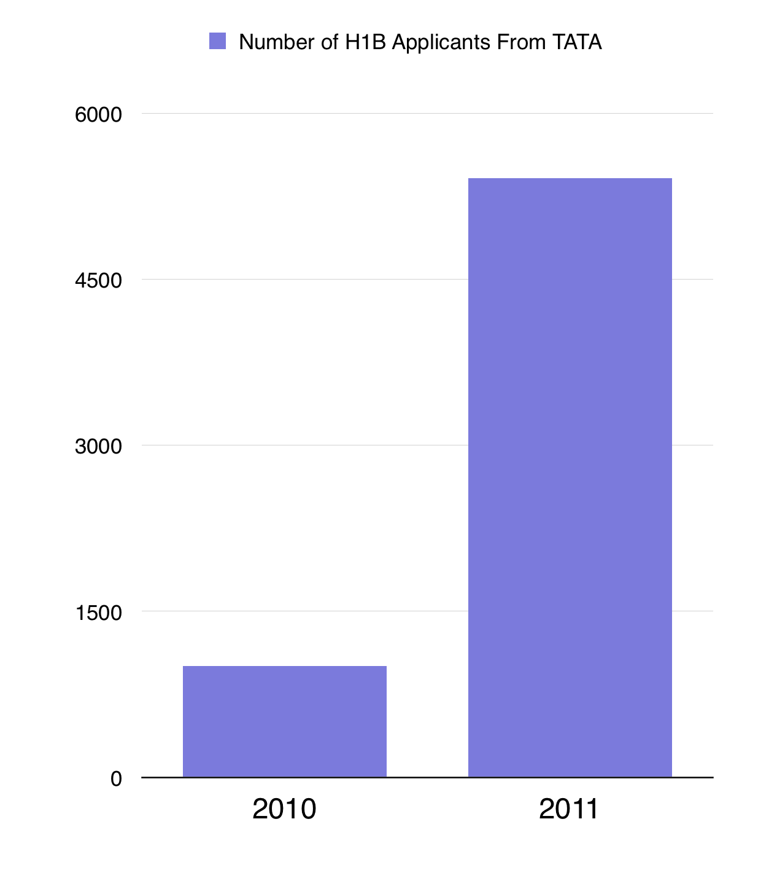
Boom!

Slide 10
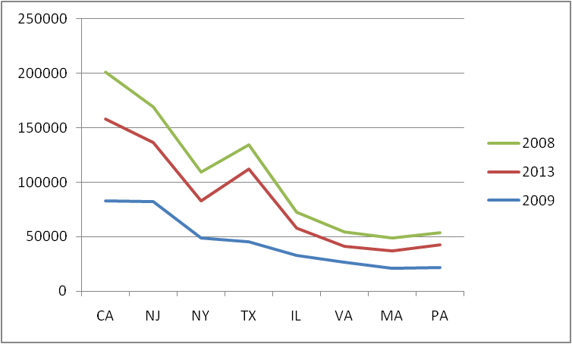
Job Market Statistics!

Slide 11

Are We Close to Recession Again?

Slide 12

Questions?

Slide 13

Thank You!!

