Slide 1

TripAdvisor Hotel Reviews

Slide 2
Agenda
Introduction
Top 5 destinations states
Most reviewed hotels in NY City
Top hotels with highest ratings in NY City
Worst hotels
Location with the most number of hotels

Slide 3

Introduction

Slide 4
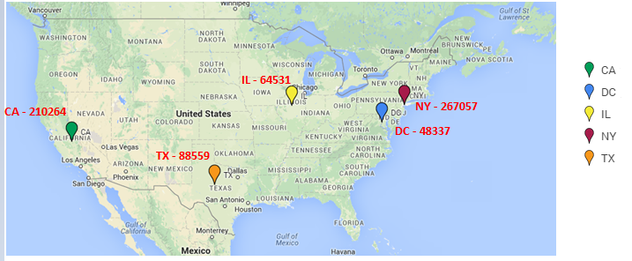
Top 5 Destination States!

Slide 5
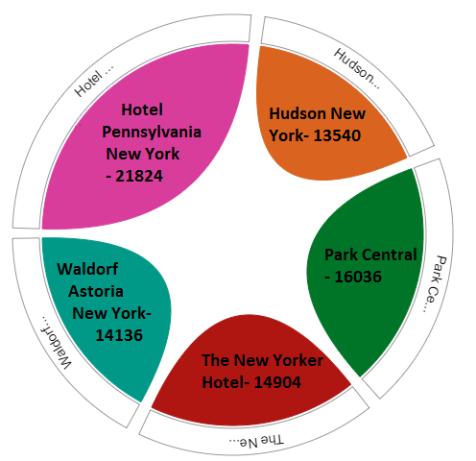
Most Reviewed Hotels in New York City!

Slide 6
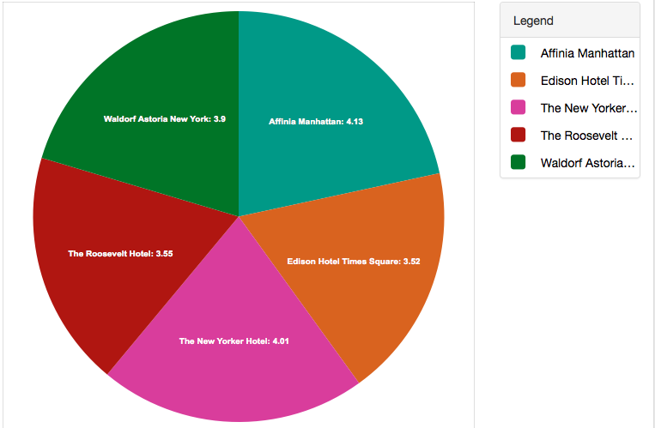
Top Hotels According to Ratings!!

Slide 7
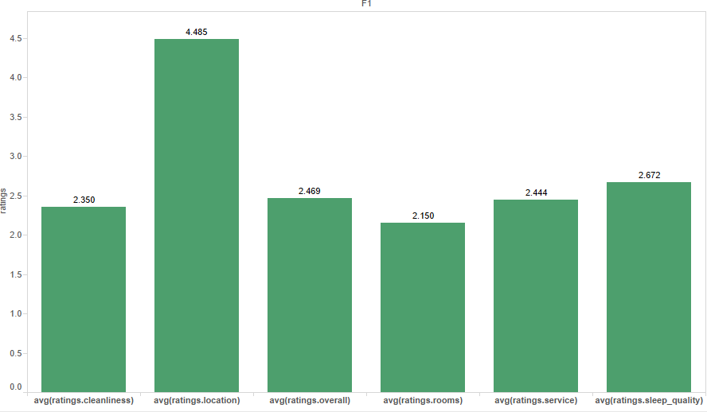
Hotel Pennsylvania Statistics!

Slide 8


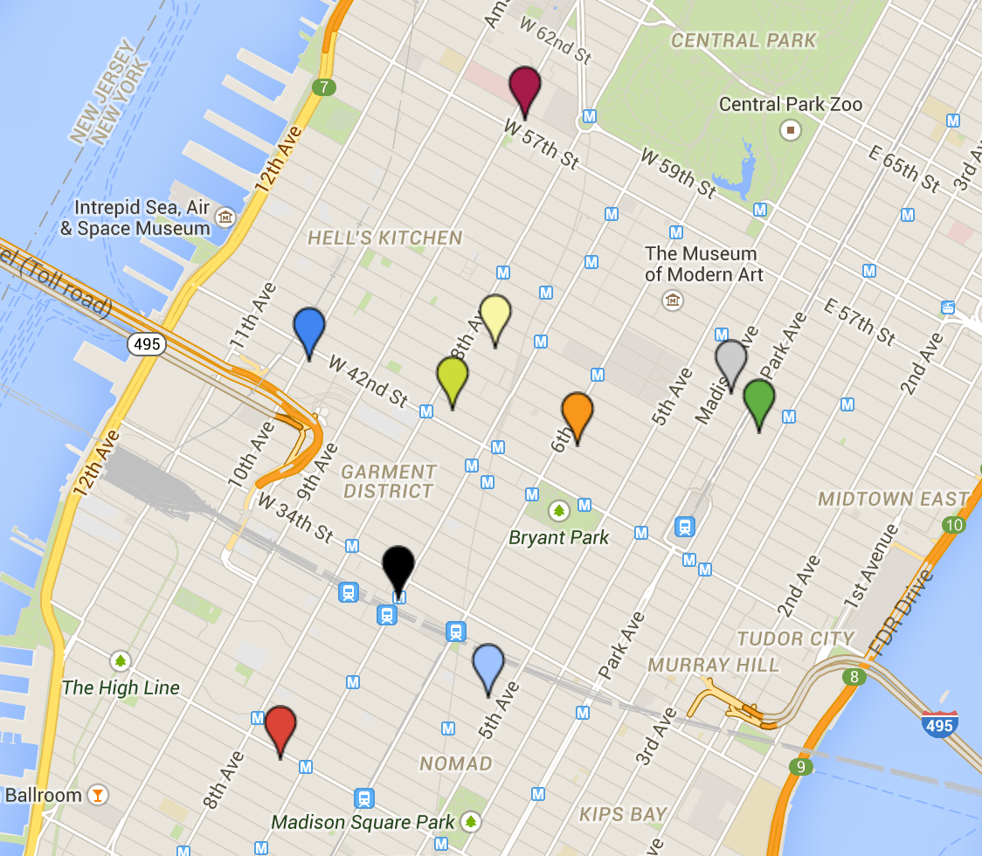










Haunted!!!
Chelsea Hotel
Wolcott Hotel
Hotel Carter
Waldorf Astoria New York
YOTEL New York at Times Square West
The New York Palace Hotel
Hudson New York
Algonquin Hotel Times Square, Autograph Collection
Edison Hotel Times Square
Hotel Pennsylvania New York

Slide 9
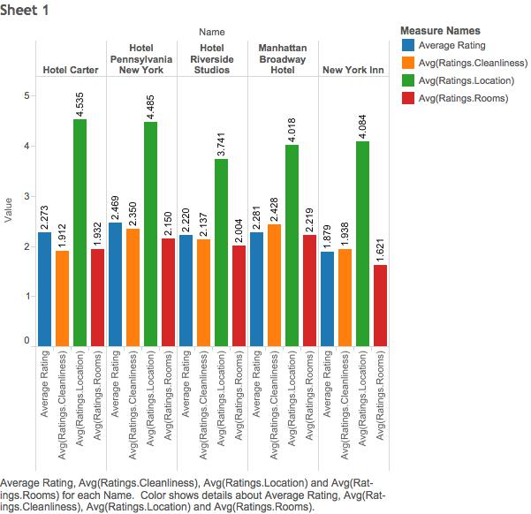
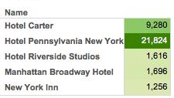
Worst hotels!

Slide 10
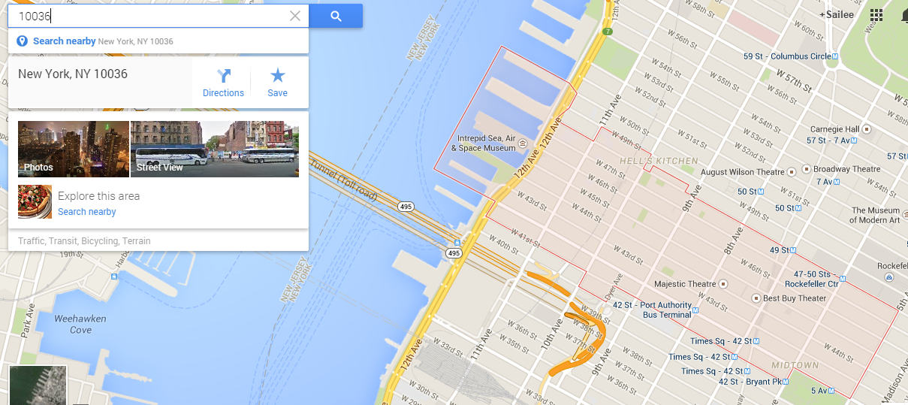
Postal Code with most number of hotel bookings!!

Slide 11
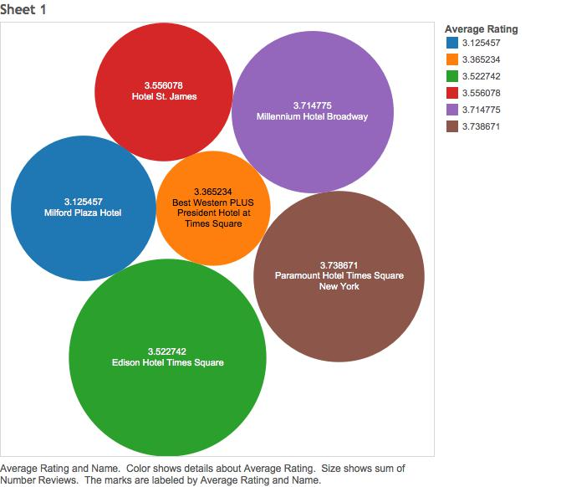
Hotels in this area which average user will prefer!!

Slide 12


Slide 13
Thank You!!!

