Slide 1
Web Scraping with Python
Sailendra P Mishra

Slide 2
Recommended Applications
Install Anaconda
Python + Spyder + Jupyter Notepad
Chrome driver : https://chromedriver.chromium.org/downloads

Slide 3
Essential Packages
BeautifulSoup
Selenium
Pandas
Open Anaconda Command Prompt
>> pip install beautifulsoup4 or conda install beautifulsoup4
>> pip install selenium or conda install selenium

Slide 4
Simple Website Scrap
Step 1: Import packages
Step 2: Read from the following url (https://www.imdb.com/chart/top/?ref_=nv_mv_250)
Step 3: Scrape content from the url

Slide 5
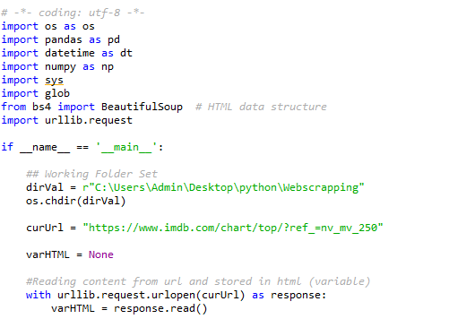
Reading IMDB Top 250 Movies

Slide 6
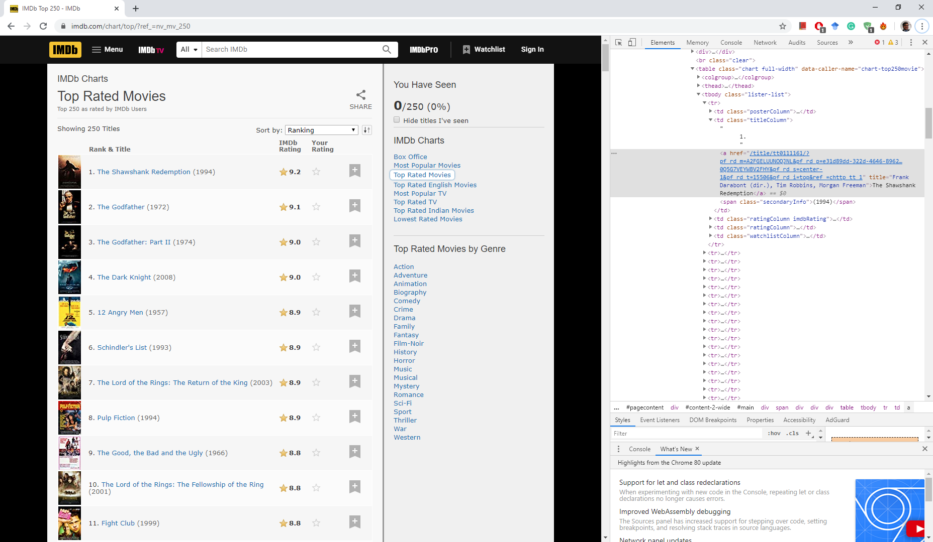
Inspect the Website

Slide 7
Get Links to Top Movies
Get the table
Get all rows
Read column values in each row
Get the links from column values

Slide 8
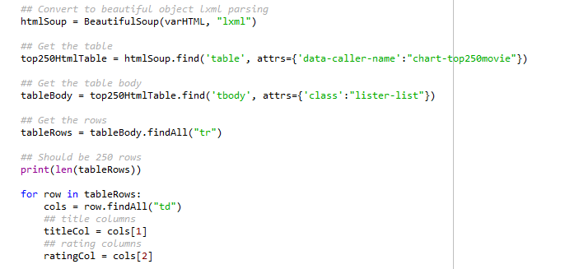
Sample Code

Slide 9
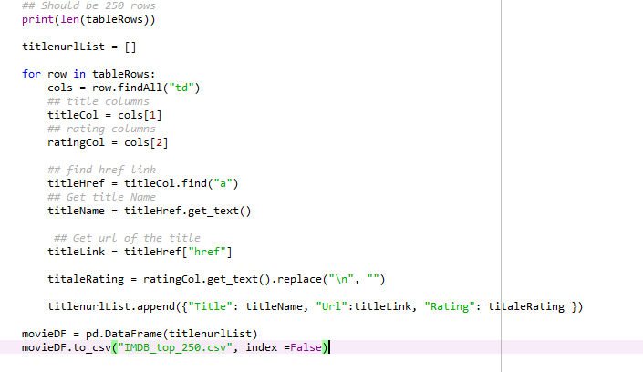
Save to CSV

Slide 10
Advanced Version
Open
Open a browser
Hit
Hit a URL
Read
Read html
Click
Automatically Click links

Slide 11
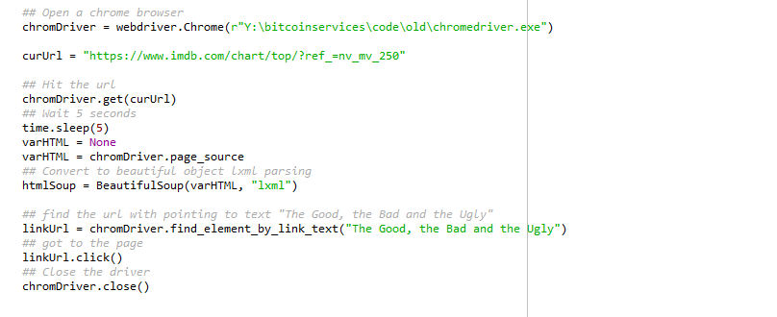
Automate Navigation

Slide 12
Sample Code
https://github.com/sailendramishra/samplecode

