Slide 1
QM640 DATA ANALYTICS CAPSTONE
Credit Default Prediction: Explainable AI & Bias Mitigation
A responsible-AI credit-risk pipeline: accurate, explainable, and fairness-audited
Prepared for Senior Stakeholder Review | Sailen Kumar
Notes:
Welcome and thank you for the time. This is a 15-minute walkthrough of the capstone project: a credit-default model built to be simultaneously accurate, explainable to a human reviewer, and audited/corrected for demographic bias.

Slide 2
EXECUTIVE SUMMARY
The 60-second version
0.769
Best model ROC-AUC (XGBoost, tuned)
0.677 → 0.821
Gender fairness ratio pre → post mitigation
2
Datasets audited (Home Credit + HMDA)
▪ We built and tuned a default-risk model on 307,511 real Home Credit loan applications, reaching ROC-AUC 0.769 — a meaningful lift over both baselines.
▪ Every prediction is explainable: SHAP shows loan officers and regulators exactly why a score was assigned, down to the individual applicant.
▪ An initial fairness audit found real disparities by gender and age group (both failed the four-fifths rule). We applied bias mitigation (reweighing) and closed most of the gap.
▪ The same audit methodology was independently re-validated on a second, unrelated dataset (HMDA mortgage data, 716K records) — it generalizes.
▪ Bottom line: the model is materially more accurate than baseline, its decisions are explainable, and its fairness gaps are measured and actively being corrected — not just claimed.
1
Notes:
Frame the whole talk before the details: we have a strong, explainable model; we found real bias; we measured it and materially reduced it; and we proved the audit approach isn't a one-off by repeating it on an independent dataset.

Slide 3
WHY THIS PROJECT
The business problem
▪ Credit-default models drive real lending decisions — approve, decline, or price a loan.
▪ Three failure modes stakeholders care about:
– A model that's inaccurate → bad loans approved, good customers declined
– A model that's a black box → can't justify a decision to a customer, auditor, or regulator
– A model that's biased → legal, reputational, and regulatory exposure (fair-lending laws: ECOA / Reg B)
▪ This project treats all three as first-class, measurable requirements — not after-the-fact add-ons.
Project objective
Accurate: Beat baseline default-prediction performance under real class imbalance (~8% default rate).
Explainable: Every score traceable to feature-level reasons via SHAP — global and per-applicant.
Fair: Formally audit for disparate impact by gender/age/race and mitigate what we find.
2
Notes:
Ground the technical work in why a senior audience should care: accuracy is table stakes, but explainability and fairness are what keep the model deployable and defensible.

Slide 4
SCOPE
What we built — and what we deliberately didn't
▪ Home Credit Default Risk (Kaggle): the full pipeline — EDA, feature engineering, baseline + tuned models, evaluation, SHAP, fairness audit, and bias mitigation.
▪ HMDA mortgage data (CFPB): fairness-audit-only, on an independent dataset and target, to test whether the fairness methodology generalizes beyond Home Credit.
Scoped down from the original proposal, deliberately
▪ Original plan: 2 full pipelines × 2 model families × 3 mitigation techniques — judged infeasible for a single capstone term.
▪ Delivered: 1 full pipeline (Home Credit) + 1 fairness-audit-only pipeline (HMDA) + 1 mitigation technique (reweighing), chosen because it's model-agnostic and needs no architecture changes.
3
Notes:
Be upfront about scope reduction — stakeholders respect a clearly reasoned MVP cut far more than an over-promised plan. The reasoning: the full matrix was infeasible in the timeframe; reweighing was chosen because it works identically for both model families with zero architecture change.

Slide 5
DATA
Two real-world datasets, two different roles
Home Credit Default Risk (Kaggle)
Size 307,511 rows × 122 columns
Role Primary modeling dataset
Target TARGET — loan default (8.07% positive rate)
HMDA — CFPB Mortgage Data
Size 715,927 rows × 22 columns (nationwide 2008–2017 sample)
Role Fairness audit-only, second opinion on methodology
Target high_cost_flag — pricing proxy (5.77% positive rate)
Both are real data (no synthetic fallback used for this run). HMDA's target is derived (rate_spread reported ⇒ high-cost loan), not a raw approval/denial field — so it is never compared apples-to-apples with Home Credit's default target.
4
Notes:
Two datasets, two jobs. Home Credit is the real modeling target. HMDA exists purely to stress-test whether our fairness-auditing approach holds up on a completely independent dataset with different features and a different label.

Slide 6
HOW IT WORKS
End-to-end pipeline, one config, ten stages
1. Load data
2. EDA
3. Feature engineering
4. Baseline training
5. Hyper- tuning
6. Evaluation
7. SHAP explain
8. Fairness audit
9. Bias mitigation
10. HMDA audit
▪ One config file (config/config.yaml) drives every stage — paths, seeds, hyperparameter ranges, and the fairness threshold are defined exactly once.
▪ Protected attributes (gender, age group, race, sex) are excluded from model features by design — used only for the post-hoc fairness audit, matching standard fair-lending practice.
▪ Fully reproducible: python scripts/run_pipeline.py regenerates every model, figure, and metric in this deck from raw data.
5
Notes:
This is meant to build confidence in rigor, not to be read line by line: the whole thing is one reproducible, config-driven pipeline, and sensitive attributes never leak into the model itself — only into the audit step.

Slide 7
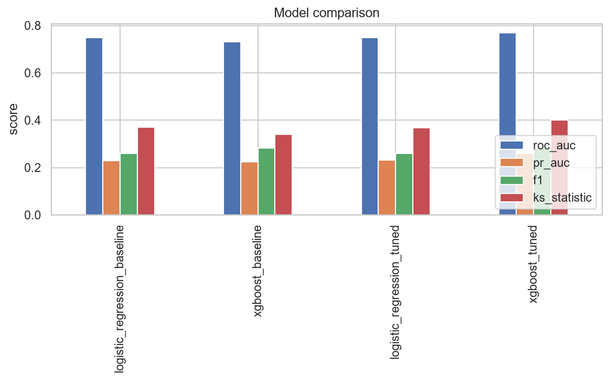
MODEL PERFORMANCE
Tuning improved every model — XGBoost wins
Metric | LogReg Baseline | LogReg Tuned | XGBoost Baseline | XGBoost Tuned ★
ROC-AUC | 0.748 | 0.749 | 0.730 | 0.769
PR-AUC | 0.230 | 0.232 | 0.225 | 0.259
KS stat. | 0.370 | 0.368 | 0.341 | 0.401
▪ XGBoost (tuned) is the best model: ROC-AUC 0.769, PR-AUC 0.259, KS 0.401.
▪ PR-AUC and Brier are tracked alongside ROC-AUC because the ~8% default rate makes ROC-AUC alone misleading under class imbalance.
▪ Hyperparameters tuned via RandomizedSearchCV (LR) and Optuna/TPE (XGBoost), both optimizing cross-validated ROC-AUC.
6
Notes:
XGBoost tuned is the production candidate. Emphasize we didn't cherry-pick ROC-AUC — PR-AUC and Brier score are reported because the class imbalance (~8% defaults) can make ROC-AUC look better than the model really is.

Slide 8
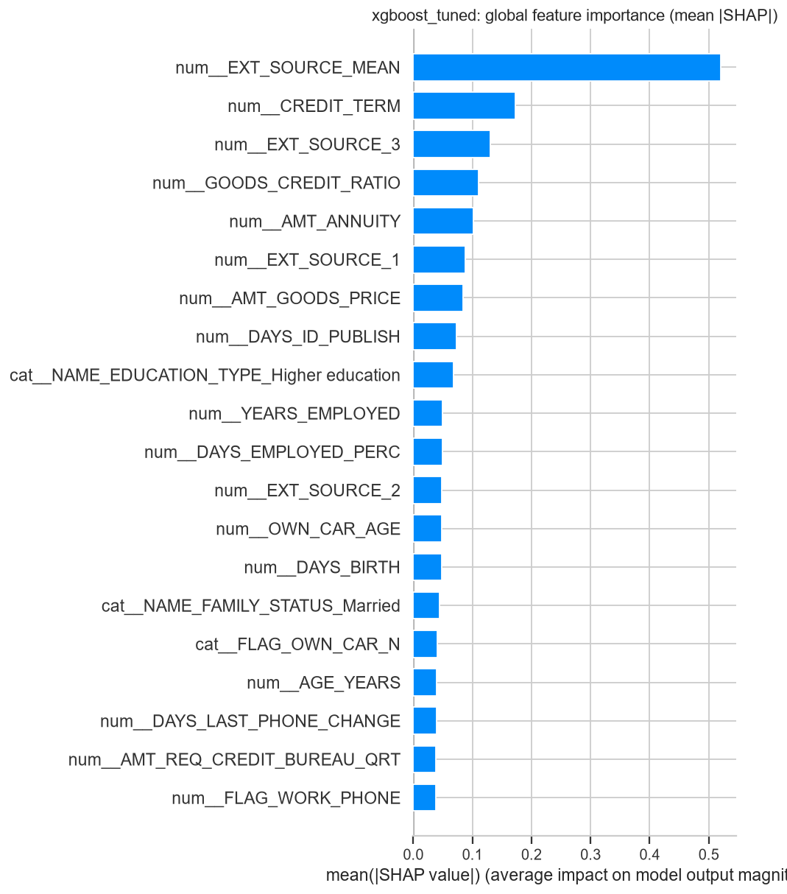
EXPLAINABILITY
Every prediction has a reason — not a black box
▪ Top global drivers of the default score:
▪ External credit bureau score (avg) — mean |SHAP| 0.52
▪ Credit term (annuity / loan amount) — mean |SHAP| 0.17
▪ External credit bureau score #3 — mean |SHAP| 0.13
▪ Goods price vs. credit ratio — mean |SHAP| 0.11
▪ Loan annuity amount — mean |SHAP| 0.10
What this means in practice
▪ Global (bar/beeswarm) plots show which features drive risk across the whole portfolio.
▪ Local (waterfall) plots exist per applicant — a loan officer or regulator can see exactly why one specific application scored the way it did.
7
Notes:
External bureau scores and the credit-term ratio dominate — intuitive, auditable drivers, not opaque interactions. And this isn't only a portfolio-level view: every single applicant gets their own waterfall explanation.

Slide 9
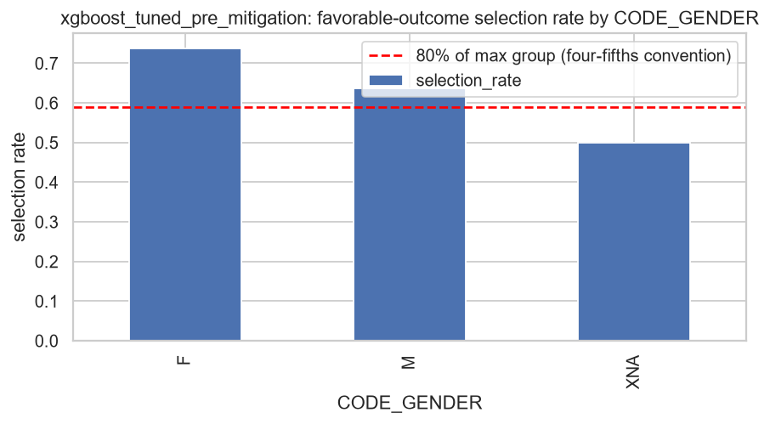
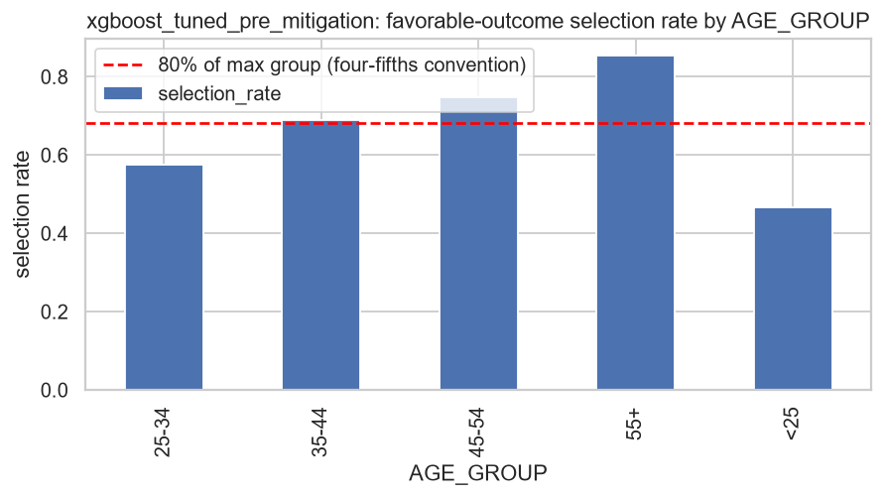
FAIRNESS AUDIT
We looked for bias — and found it
0.677
Gender parity ratio (fails 0.80 threshold)
0.547
Age-group parity ratio (fails 0.80 threshold)
▪ Method: Fairlearn MetricFrame audit — selection rate, demographic-parity ratio/difference, and equalized-odds difference per protected group.
▪ Threshold: the “four-fifths rule” (selection-rate ratio ≥ 0.80). It's a borrowed EEOC convention, not a codified ECOA/Reg B legal standard — used here as a practical flag for materially large gaps.
▪ Gender: female applicants approved at 74% vs. male 64% predicted selection rate.
▪ Age: the youngest group (<25) is approved far less often than the oldest (55+) — the largest gap in the audit.
8
Notes:
This is the uncomfortable-but-necessary slide: on the untouched tuned model, both gender and age group fail the four-fifths rule. We're not hiding this — it's exactly what the audit stage exists to catch, and it's what motivates the next slide.

Slide 10
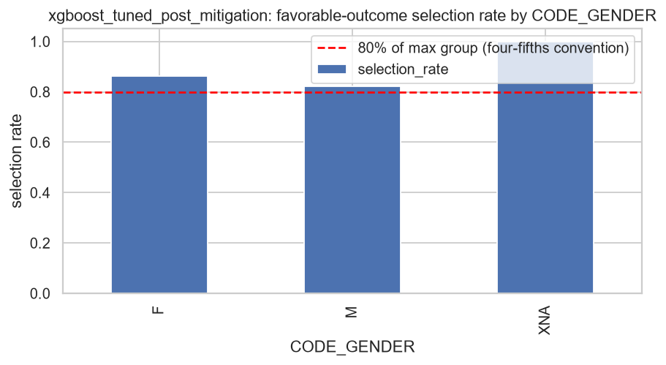
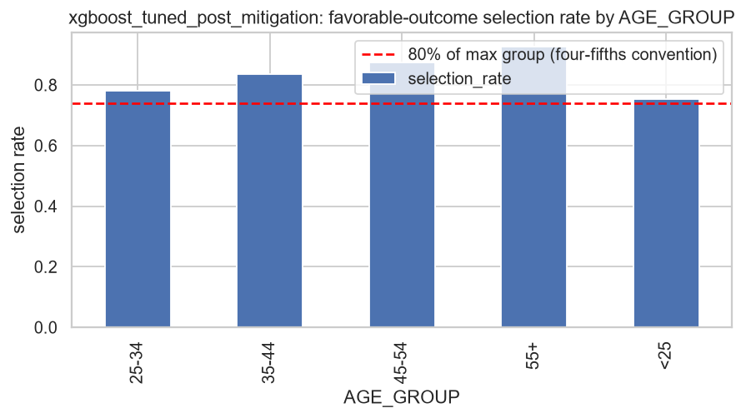
BIAS MITIGATION
Reweighing closes most of the gap
0.68 → 0.82
Gender parity ratio (now passes 0.80)
0.55 → 0.81
Age parity ratio (now passes 0.80)
▪ Method: Kamiran & Calders (2012) reweighing — per-row sample weights that decorrelate the protected attribute from the label before retraining. Model-agnostic, no architecture change required.
▪ Result: both gender (0.677→0.821) and age (0.547→0.813) now pass the four-fifths rule.
▪ Honest tradeoff: ROC-AUC moved 0.769 → 0.722 (PR-AUC 0.259 → 0.214); Brier (calibration) improved to 0.119.
▪ This is a fairness/accuracy tradeoff curve, not a free lunch — the business decision is how much of that ~5-point ROC-AUC to spend to fix a fair-lending exposure.
9
Notes:
Reweighing meaningfully closes the gap on both attributes without touching model architecture. Be candid about the cost: ROC-AUC drops about 5 points. Frame it as a deliberate, quantified tradeoff for stakeholders to weigh — not a hidden cost.

Slide 11
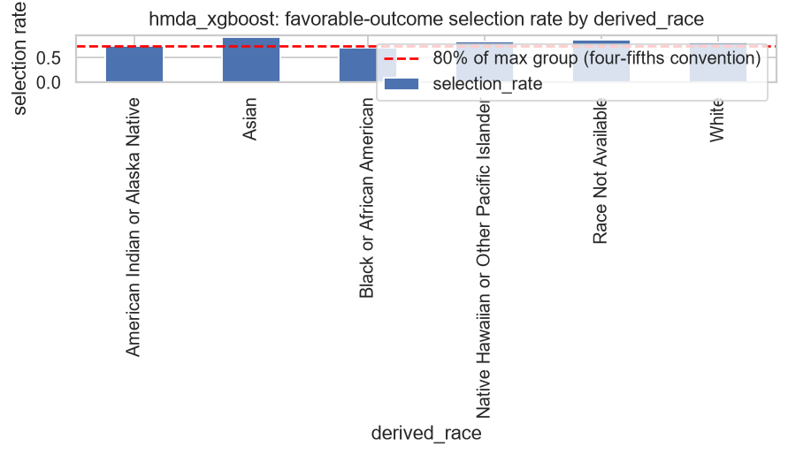
INDEPENDENT VALIDATION
Does the audit methodology generalize? Yes.
716K real HMDA mortgage records, 2008–2017, nationwide sample
0.892
Model ROC-AUC (pricing-proxy target)
0.760
Race parity ratio (fails 0.80)
▪ Same audit code, independently re-run on a completely different dataset, feature set, and label — the methodology is not overfit to Home Credit.
▪ Race: parity ratio 0.760 — fails the four-fifths rule (flagged).
▪ Sex: parity ratio 0.887 — passes.
▪ HMDA here is fairness-audit-only by design — its target is a pricing proxy (high-cost flag), never treated as a default model or compared apples-to-apples with Home Credit.
10
Notes:
This slide exists to answer the skeptical question: 'did you just get lucky tuning the audit to one dataset?' No — rerun cold on HMDA mortgage data, the same audit catches a real race-based disparity there too.

Slide 12
LIMITATIONS
What this project does not claim
▪ The four-fifths rule is a borrowed EEOC employment-discrimination convention — not a codified ECOA / Reg B legal fair-lending standard. Treat it as a practical screen, not a compliance certification.
▪ HMDA's target (high_cost_flag) is a rate-spread pricing proxy on originated loans only (this extract has no denials) — it is not an approval/denial model and is never compared 1:1 against Home Credit's default target.
▪ Reweighing was the single mitigation technique implemented for this MVP (vs. the original proposal's reweighing + adversarial debiasing + equalized-odds postprocessing matrix) — other techniques may trade off accuracy and fairness differently.
▪ Fairness was audited on the attributes available (gender/age for Home Credit, race/sex for HMDA) at a single ~50% classification threshold — results can shift at other operating thresholds.
▪ This is a capstone-scope MVP, not a production-certified compliance pipeline — deploying to real lending decisions would need legal/compliance sign-off beyond this audit.
11
Notes:
Precommit to intellectual honesty here: this slide heads off the hardest questions before they're asked. None of these are surprises we're hiding — they're documented limitations from day one of the design.

Slide 13
RECOMMENDATIONS
Where we'd take this next
Near-term (next iteration)
▪ Decide the acceptable fairness/accuracy tradeoff point with legal & risk stakeholders before any production discussion.
▪ Extend the mitigation comparison to adversarial debiasing and equalized-odds postprocessing (originally scoped, deferred for MVP).
▪ Re-run the fairness audit across multiple decision thresholds, not just 0.50.
Longer-term
▪ Formal legal/compliance review of the four-fifths screen against ECOA / Reg B before any real lending use.
▪ Expand HMDA to post-2018 modern LAR data (adds denials) to enable a true approval/denial fairness audit, not just a pricing proxy.
▪ Add model monitoring for fairness/performance drift once (if) deployed.
12
Notes:
Close on forward motion: a concrete near-term list stakeholders can greenlight today, and a longer-term list that needs their sponsorship (legal review, more data, monitoring).

Slide 14
Thank you
Questions & discussion
Full pipeline, code, and reports: see project README and Developer Guide
Notes:
Open the floor. Likely questions to be ready for: the ROC-AUC/fairness tradeoff number, why reweighing over other mitigation techniques, and the legal standing of the four-fifths rule — all three are covered on the limitations slide if needed.

