Slide 1

IE-5374 Applied Generative AI
Rebalance AI Hackathon
Group-9 Members
Aditya Kumar
Nishant Upadhyay
Sailesh Ananthanarayanan

Slide 2
Index Slide
Problem Statement and Objective
Data Pipeline Overview
AI Agent Tools, Memory & Agent Type
Prompt Template and Prompt Output
Multi Model Comparison
Rebalance AI Portfolio Analysis Dashboard
Learning and Future Works
Contribution

Slide 3

Problem statement and objective
Build a Langhian powered AI agent is required to be built for analysing a quantitative finance data and with the ongoing market sentiment for an explainable portfolio recommendations
Rebalance AI – Your AI Investment solution provider with data driven decision
User → Agent → Tool → LLM → Recommendations

Slide 4
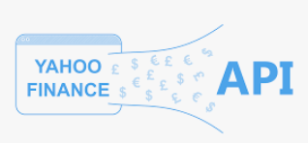


Data Pipeline Overview
Usage of live data sources for real time insights
Yahoo Finance API- Fetches historical and live stock data
News API – Retrieves financial related news
Lang chain – Co-ordinating Agents, Tools, Memory and LLM API providing analysis and explanations

Slide 5
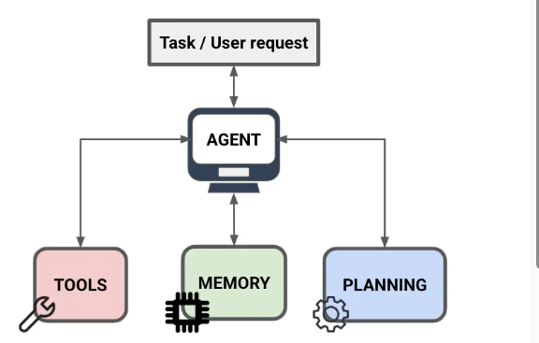
AI Agent Tools, Memory & Agent Type
Fetch stock data tool - Fetches and shows data through yahoo finance API such as average volume, period return, volatility, Sharpe ratio
Analyze sentiment tool - Collects financial headlines and classifies into qualitative sentiment
Compare stocks tool - Analyze and compare stock metrics of different organization
Optimize portfolio tool - Allocates assets based on investor risk profile and balances reward and risk using volatility and Sharpe ratio weightage
Agent Memory - ConversationBufferMmeory which holds the storage of entire conversation
Agent type - React Agent which showcases output in the form of Action, Observation, Thought, Final Answer

Slide 6
Prompt Template and Prompt Output
Prompt Template: Rebalance AI blends quantitative metrics and market sentiment to deliver clear, risk-based portfolio insights. It follows a Reason → Action → Explanation flow for transparent investment decisions.
Input Prompt | Tools Used | Key Insight | Output Obtained
AAPL Stock Analysis, key metrics and recent sentiment | Fetch stock data, Analyze sentiment | AAPL shows moderate 7.86% return, 32.5% volatility, and mixed sentiment- indicating steady but uncertain outlook. | Yes
Stock Comparison (AAPL vs MSFT), recent news sentiment | Fetch stock data, Analyze sentiment | MSFT outperformed AAPL with higher Sharpe (0.99) and lower volatility (24.8%), both with positive sentiment - MSFT more stable choice | Yes
Portfolio recommendation for 10,000$ investment | Fetch stock data, Compare Stocks, Analyze sentiment, Optimize Portfolio | Suggested balanced tech portfolio - 25% AAPL, 25% MSFT, 25% GOOGL, 25% NVDA Blends growth and stability, aligning with moderate-risk investor profile. | Yes

Slide 7
Multi Model Comparison
Two AI agents - one powered by GPT-4 and another by Claude -3 were created using the same Rebalance AI framework.
Both were tested on an identical Tesla (TSLA) investment analysis prompt to compare reasoning, sentiment interpretation, and portfolio recommendations.
Model | Word Count | Character Count | Summary | Output Obtained
GPT - 4 | 92 | 591 | Gave a clear, balanced analysis despite data gaps - used sentiment to offer practical and diversified advice. | Partially
Claude-3-haiku- 20240307 | 174 | 1086 | Explained missing data well but stopped early, offering no actionable insights. | No
Key Takeaway: GPT-4 was adaptive and insightful, while Claude was clear but too cautious when data was missing.

Slide 8
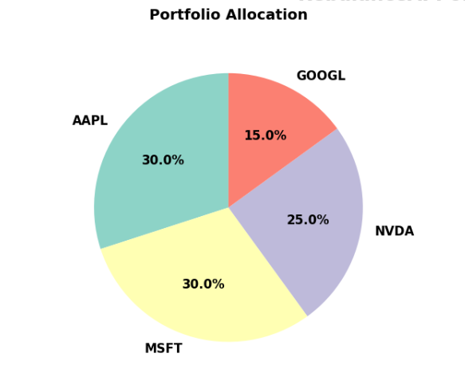
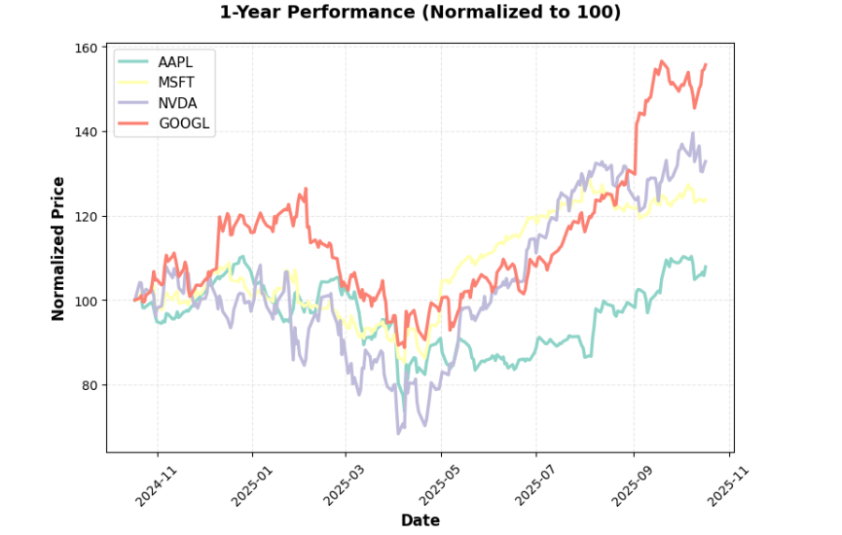
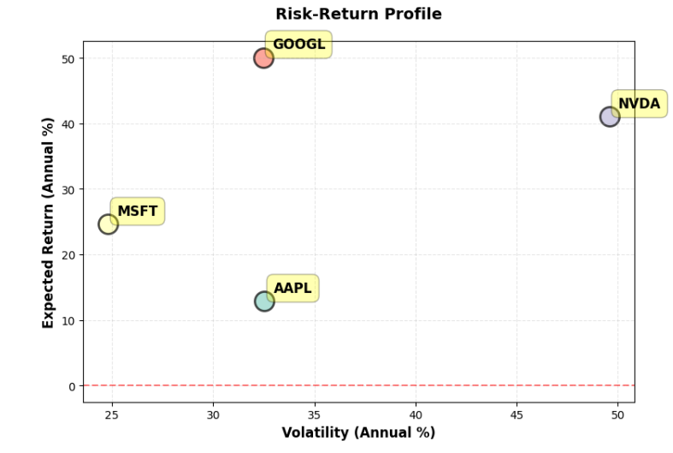
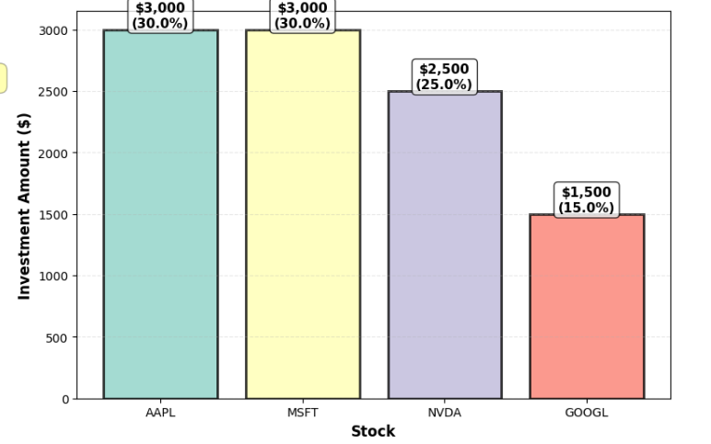
Rebalance AI Portfolio Analysis Dashboard
AI-generated portfolio dashboard showing stock allocation, performance trends, risk-return distribution, and investment weighting for $10,000 diversified across AAPL, MSFT, NVDA, and GOOGL.

Slide 9

Learnings and Future Works
API Integration Skills: Strengthened ability to merge financial APIs, sentiment analysis, and visualization into one coherent AI-driven portfolio system.
Agent Workflow Design: Gained hands on experience of prompt templates, tools and Agents to make AI decision explainable
Model Adaptability: Learned how different models(GPT4, Claude model) interpret and act over a dataset
Multi Asset Expansion: Extension of analysis beyond stocks like bonds and crypto currencies
Reinforcement Learning Integration: Add reinforcement learning to enable smarter, adaptive rebalancing decisions

Slide 10
Contribution
All members contributed equally in providing inputs, API findings, code generation, readme, creation and presentation of slides.
Person Name | Percentage of Contribution
Aditya | 33.33%
Nishant | 33.33%
Sailesh | 33.33%
Total | 100%

Slide 11
Thank You!

