Slide 1
Text2Scene

Slide 2
Problem Statement
Given a textual description of orientation of objects, the code should be able to generate a model of that description.
Input: Text/Statement
Output: Image/model

Slide 3
Pre-process Dataset
Dataset:
.csv files - contains object description
.obj files - object (3D)
Read and collect data to identify every object’s characteristics by forming ‘vectors’.

Slide 4
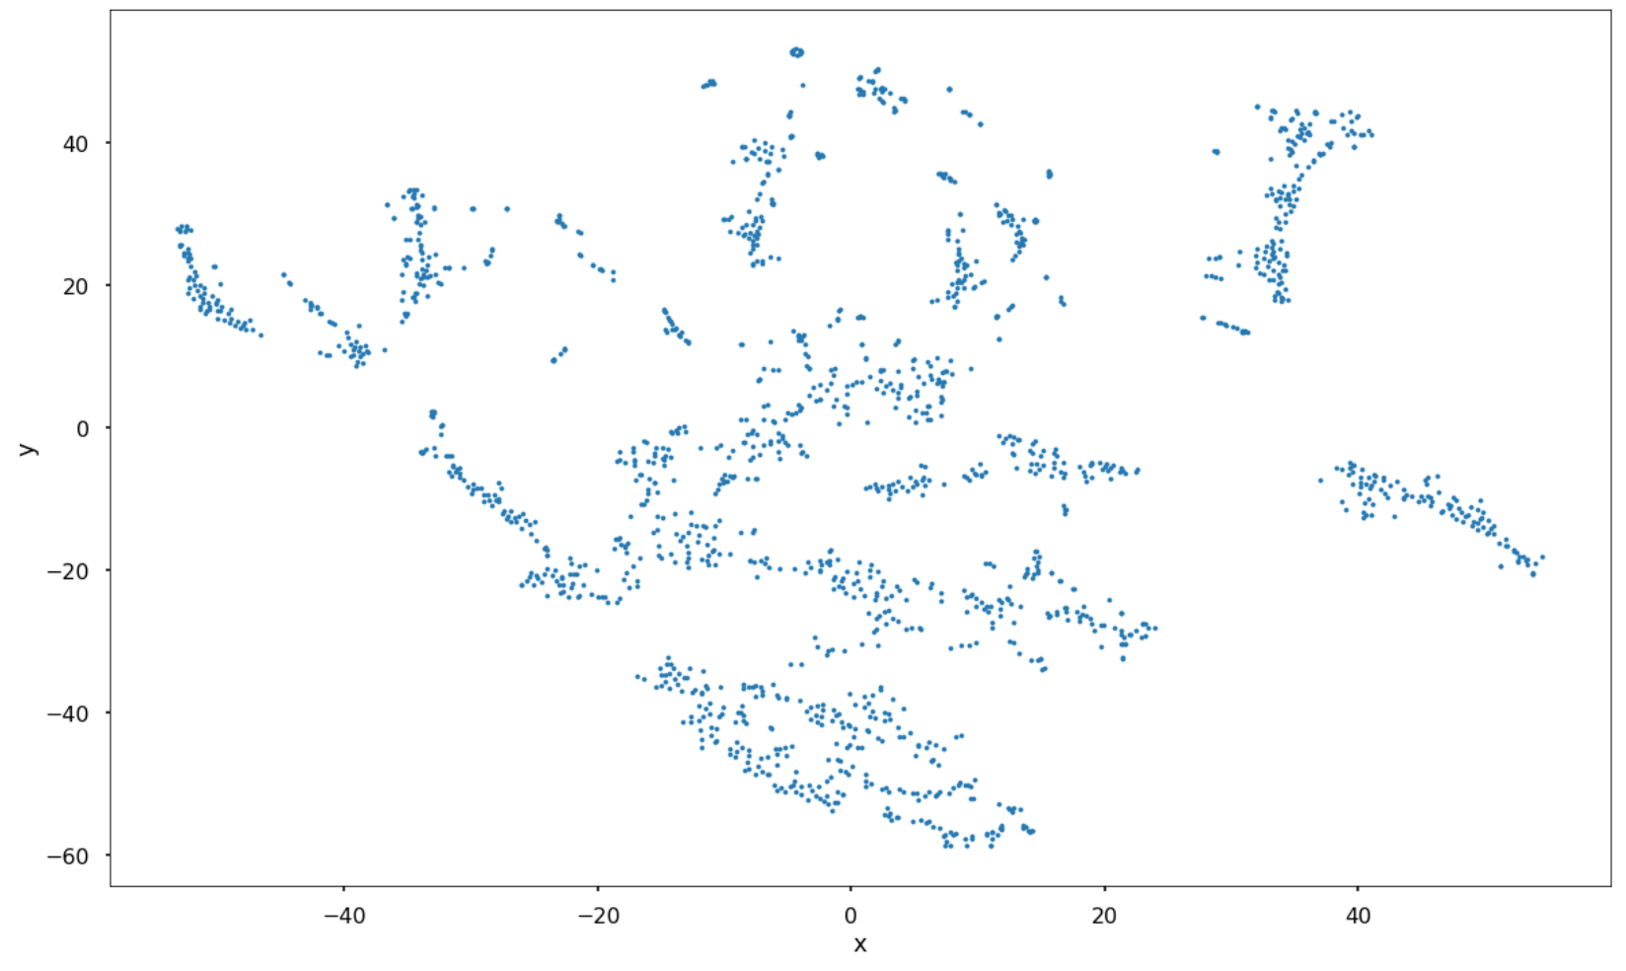
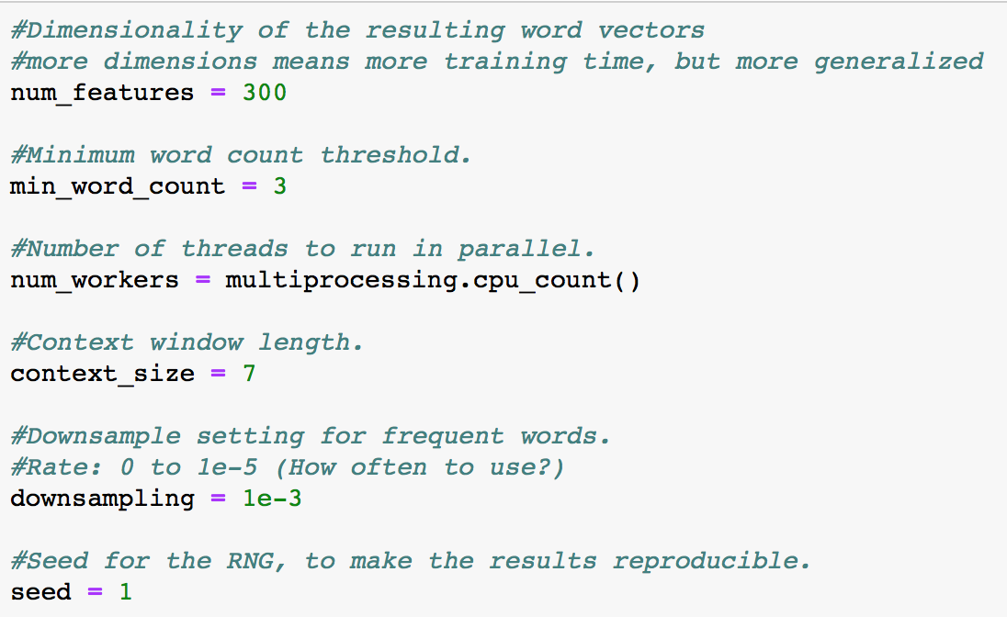
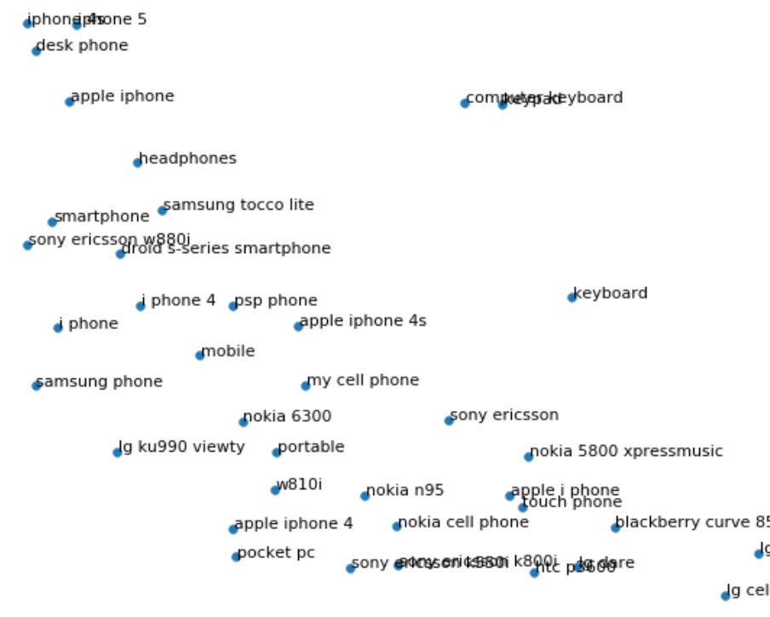
Word2vec
Vector Plot
Converting words(objects) to vectors.
Clustering

Slide 5
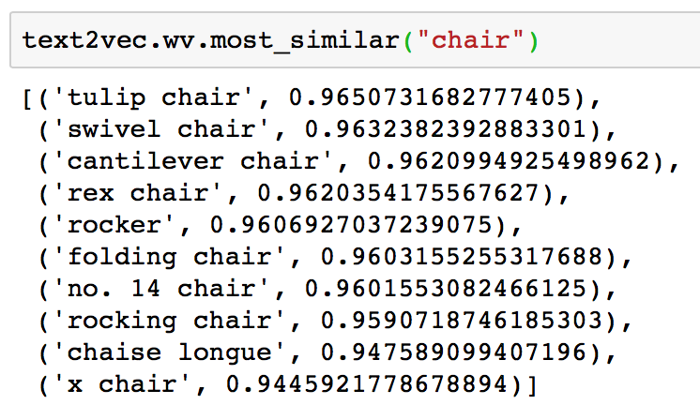
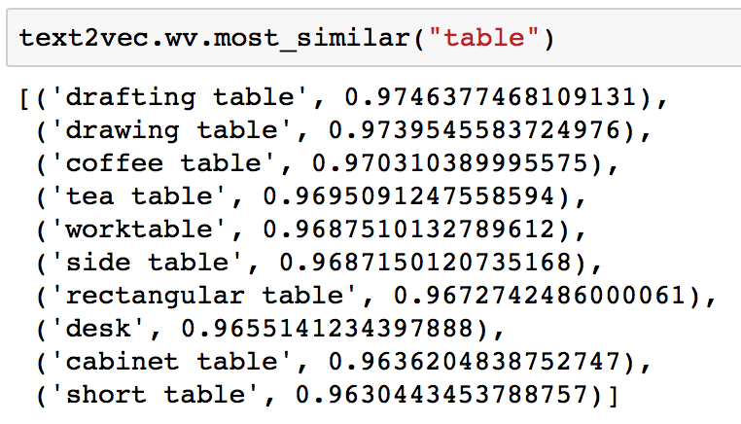
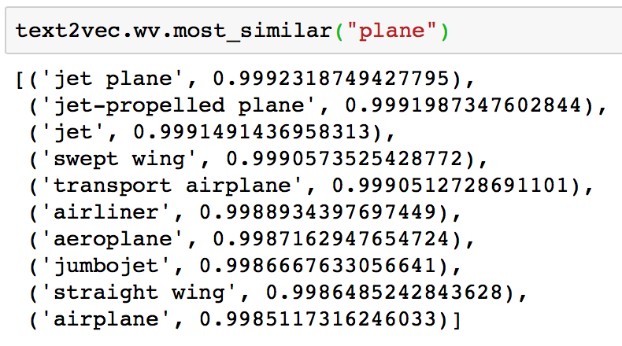
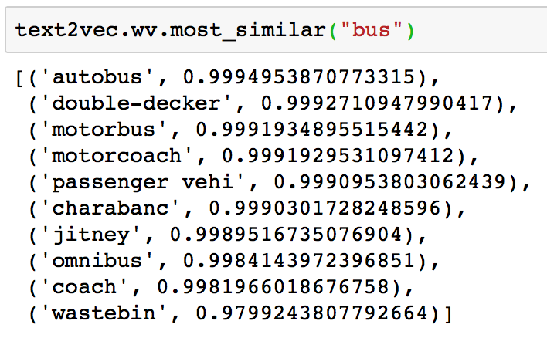
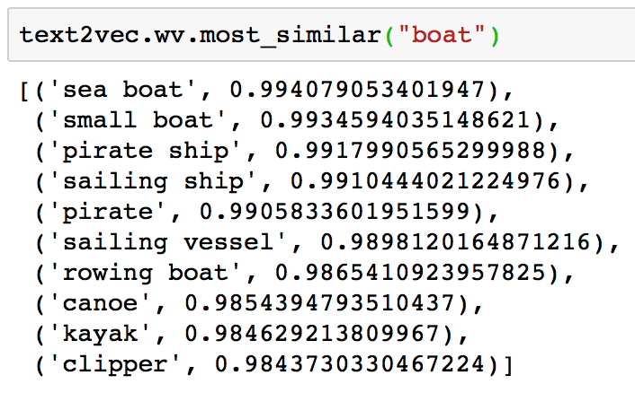
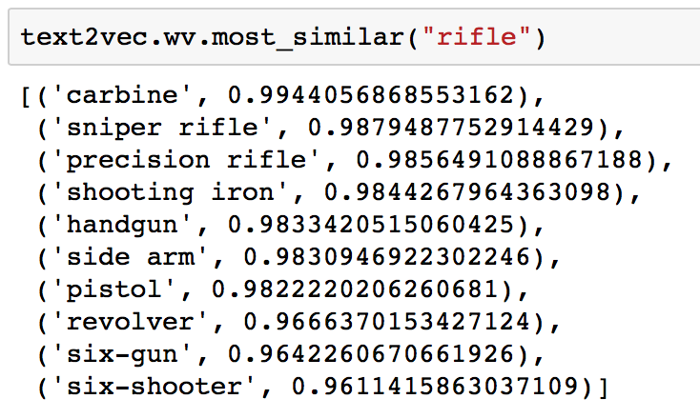
Word2vec - Identifying Most Similar

Slide 6

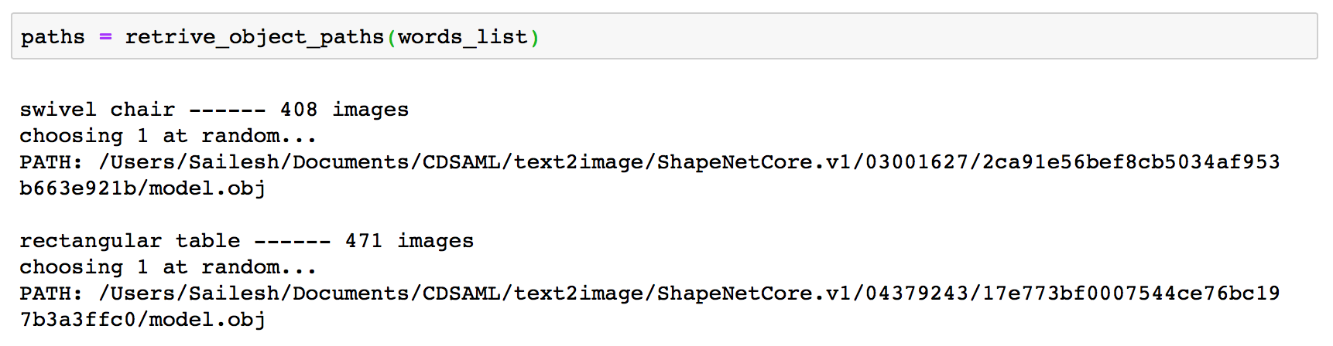
Processing Input
Identify objects
Use Machine Learning
Retrieve path and save to a file

Slide 7
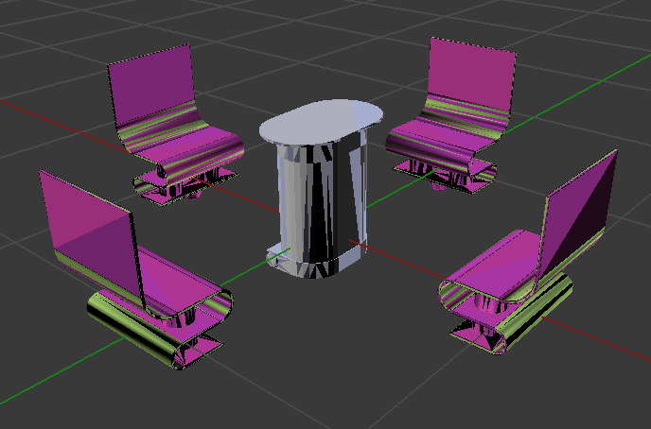
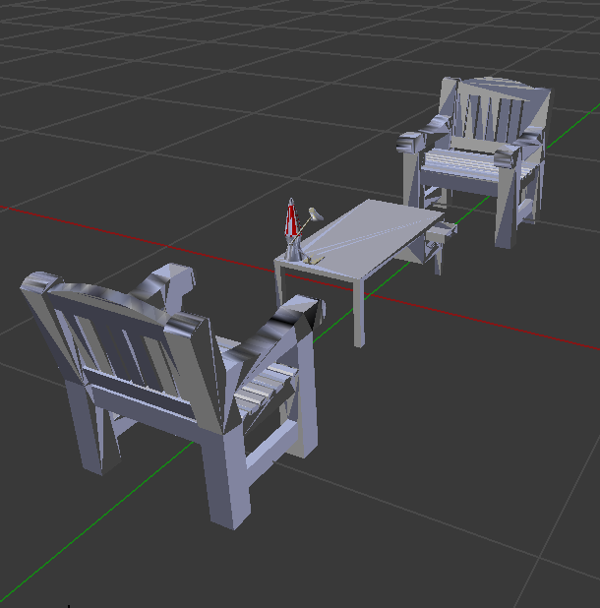
Displaying the scene...
There are 4 chair around a table
There are 2 chair and a table

Slide 8
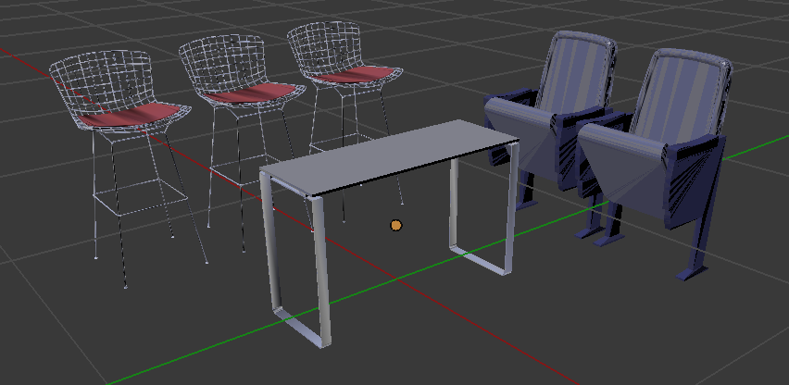
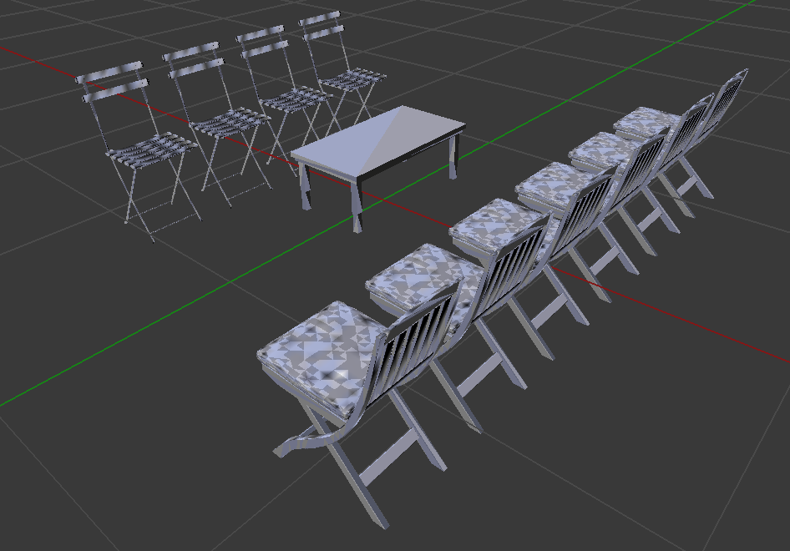
Displaying the scene...
There are 3 chair at the front and 2 chair at the left side of a table
There are 6 chair placed at the front and 4 chair at the back of a table

Slide 9
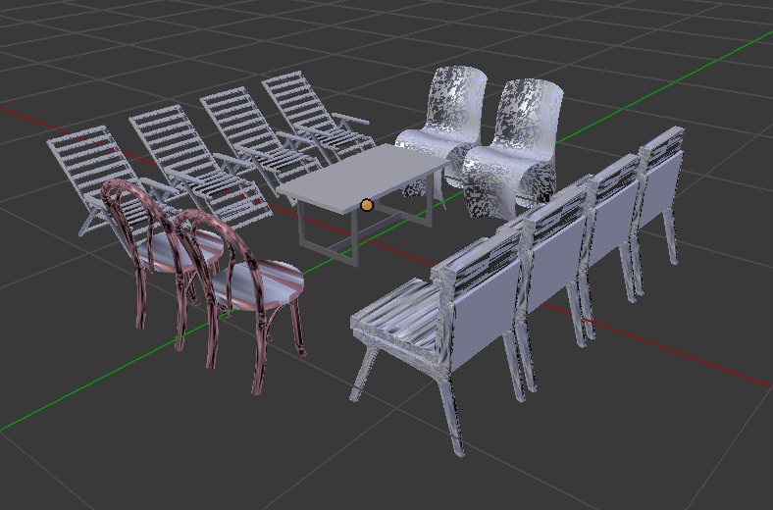
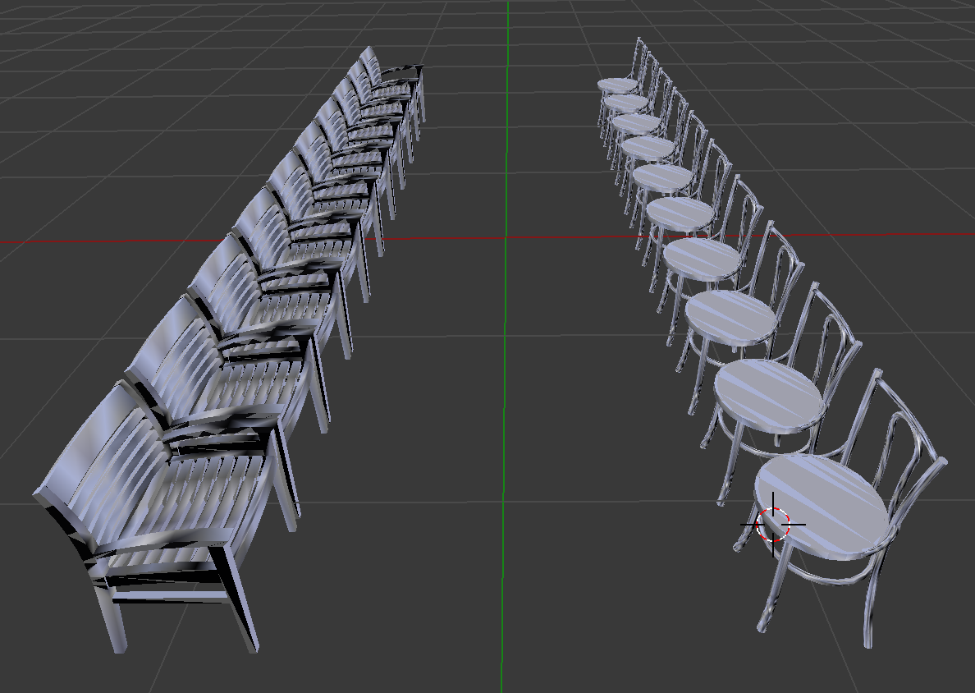
Displaying the scene...
There are 4 chair at the front 4 chair at the back 2 chair at the left and 2 chair at the right of a table
There are 10 chair placed at the front of 10 chair

Slide 10
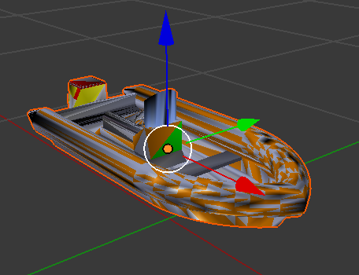
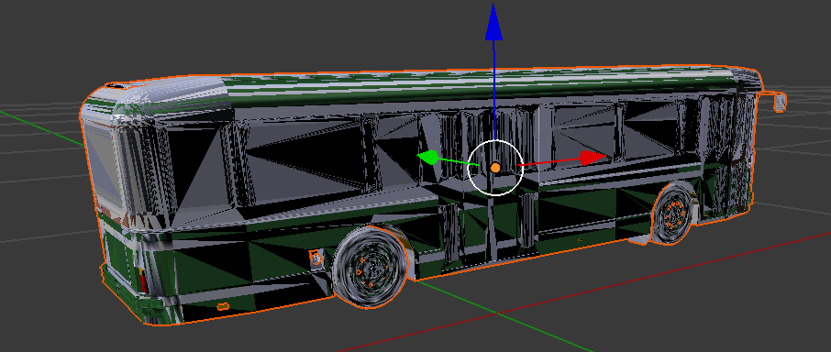
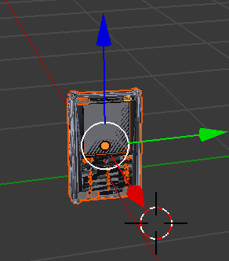
Displaying the scene...
Boat
Bus
Phone

Slide 11
Applications
Home interior designs
Construction industry
City development plans
Education

Slide 12
Future Enhancements
Scaling objects
Identifying object collisions
Extend to many more scenes
Add background

Slide 13
Thank You

