Slide 1
Music Recommendation System Based on Emotion
Group - 15
CB.EN.U4ECE21250 S V SOWMYA NITHISHWAR
CB.EN.U4ECE21253 SAILESH KUMAR T V
CB.EN.U4ECE21258 SRINIDHIH P V

Slide 2
Tools used
Visual Studio Code
Libraries
Numpy
Matplotlib
Scikit-Learn
Librosa
Tkinter
Pygame
CSV
OS

Slide 3
Important Libraries
Scikit-Learn
Scikit-learn, also known as Sklearn, is a popular Python library for machine learning that provides a wide range of tools and algorithms for tasks such as classification, regression, clustering, and dimensionality reduction.
Librosa
Librosa is a Python library for audio and music signal analysis. It provides tools for loading audio files, extracting various audio features, and performing tasks such as spectrogram computation, beat tracking and pitch estimation.

Slide 4
Music Features
Tempo: The perceived speed or rhythm of the music
Spectral Centroid: The weighted mean of the frequencies present in the audio signal
Zero-crossing Rate: The rate at which the audio signal changes its sign (from positive to negative or vice versa)
MFCCs (Mel-frequency Cepstral Coefficients): Mel-scaled frequency cepstral features that represent the spectral shape of the audio
Chroma Features: Represents the 12 different pitch classes present in the audio

Slide 5
Music Features
Spectral Contrast: Measures the difference in amplitude between peaks and valleys in the audio spectrum
Spectral Roll off: This represents the frequency below which a particular percentage of the total spectral energy lies
Spectral Bandwidth: Measures the width of the frequency range in which a certain percentage of the total spectral energy lies
Mel-scaled Spectrogram: Represents the power spectrum of the audio signal, converted to the Mel scale.

Slide 6
Structure of code
Dataset – Used for Training and Testing
Extracting features of music using Librosa, saving it in a CSV file
Clustering of features using Kmeans with 80/20 rule
A song is given as input to which we need similar songs
Identifying the songs from the dataset that are similar to the given input
Visualizing the extracted features in a 2D plot using PCA

Slide 7
Dataset
GTZAN8 - Tensorflow
1000 tracks – Each 30 seconds
10 Genres – Each 100 tracks
Mono 16-bit audio files in .wav format
The genres are blues, classical, country, disco, hip-hop, jazz, metal, pop, reggae, and rock.

Slide 8
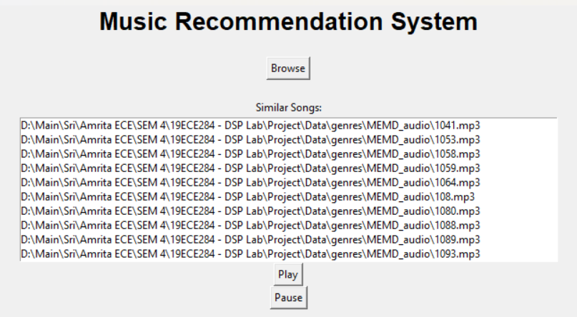
Output

Slide 9
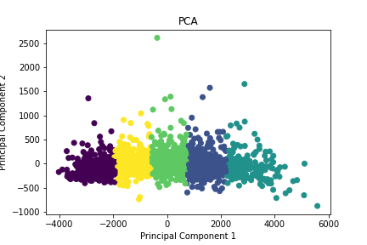
Output
Feature Distribution
Cluster Label | Emotion
0 | Calm
1 | Happy
2 | Angry
3 | Anticipation
4 | Sad

Slide 10
Scope for future research
Music recommendation depends upon various factors beyond user interaction with the application.
Accuracy can be improved by modeling the external factors to train the model.
Geographic location, time, etc. can be incorporated into this system.

Slide 11
Reference Papers
https://towardsdatascience.com/part-iii-building-a-song-recommendation-system-with-spotify-cf76b52705e7
https://www.geeksforgeeks.org/music-recommendation-system-using-machine-learning/
More, I., Shirpurkar, V., Gautam, Y., & Singh, N. (2021). Melomaniac – Emotion-Based Music Recommendation System. International Journal of Advance Research and Innovative Ideas in Education, Vol-7, Issue-3
Chidambaram, G., Dhanush Ram, A., Kiran, G., Shivesh Karthic, P., & Abdul Kaiyum. Music Recommendation System Using Emotion Recognition. International Research Journal of Engineering and Technology, ISO Certified Journal, Volume, Page 1219.
Shivananda, S., Dutt, R., Perumal, B., Anagha, H., & Latha, A.P. (2022). Mood-based music recommendation system: VIBY. International Research Journal of Modernization in Engineering, Technology and Science
Vani, M. Sree, and Divya, N. Sree. "Emotion Based Music Recommendation System." International Journal of Current Research and Technology

