Slide 1
Segmenting USA State Capital City And Finding Out Most Common Venue In Each Cluster

Slide 2
Introduction
As we all know that U.S.A is a large country with many states.
. But there are many cities to explore in each state. So knowing about the capital of each state will brief us about each state.
This project will segment these capitals on the basis of similarity of the venue found around them which will help the explorer/visitor

Slide 3
Data acquisition and cleaning
Data used in this project was acquired from https://www.britannica.com/topic/list-of-state-capitals-in-the-United-States-2119210
Data was scraped using beautifulsoup library.
Data was cleaned using pandas.
Dataset consists of 50 state with their respective capital city and rest of unused data were removed.

Slide 4
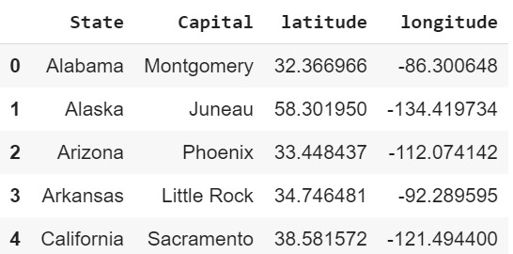
Geopy libraries was used to obtain the locaton of capital city.
Foursquare API was used to fetch the venue located in the Capital city of each state within radius 500.
Fig: after using geopy libraries

Slide 5
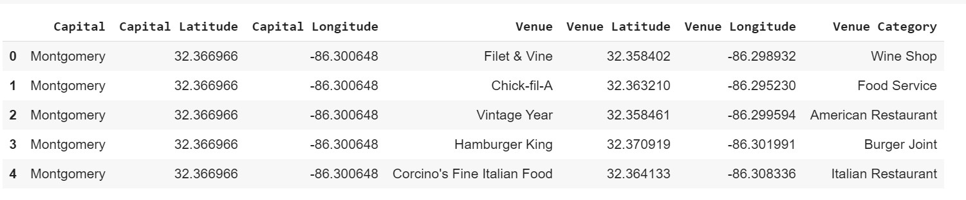
Fig: after using foursquare API

Slide 6
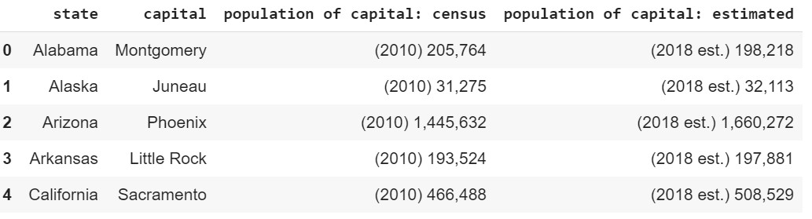
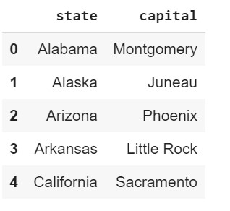
Fig: Before cleaning
Fig: after cleaning

Slide 7
Segmenting the capital city using K-Means
Capitals city of each state was segmented into five cluster.
Number of capital city in cluster 0, cluster 1, cluster 2, cluster 3 and cluster 4 was found to be 11, 12, 8, 18, and 1 respectively

Slide 8
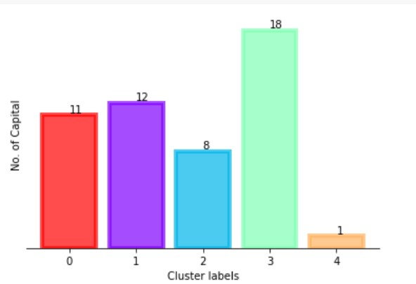

Slide 9
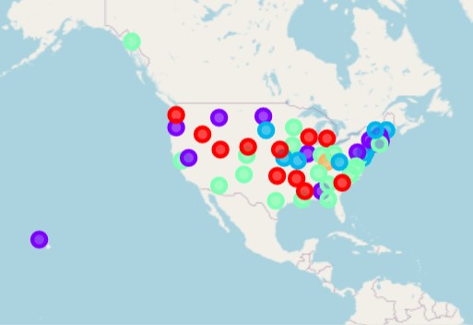
Visualizing Cluster in Map
Using follium libraries the cluster was visualized in map of USA.

Slide 10
Conclusion and future directions
The most common venue found in cluster 0, cluster 1, cluster 2, cluster 3 and cluster 4 was coffee shop, coffee shop, pizza shop, bar, history museum.
cluster 4 only contains 1 capital city so this capital city must be unique.
We conclude that know that bar, pizza shop, coffee shop are very common and a nice startup business to anyone who wants to start their own business in USA.

