Slide 1





Home Credit Default Risk
DURGA SAI SAILESH CHODABATTULA, MANIDEEP VARMA PENUMATSA, SAHITH REDDY PEDDIREDDY, MADHUMITHA REDDY MUDUGANTI

Slide 2



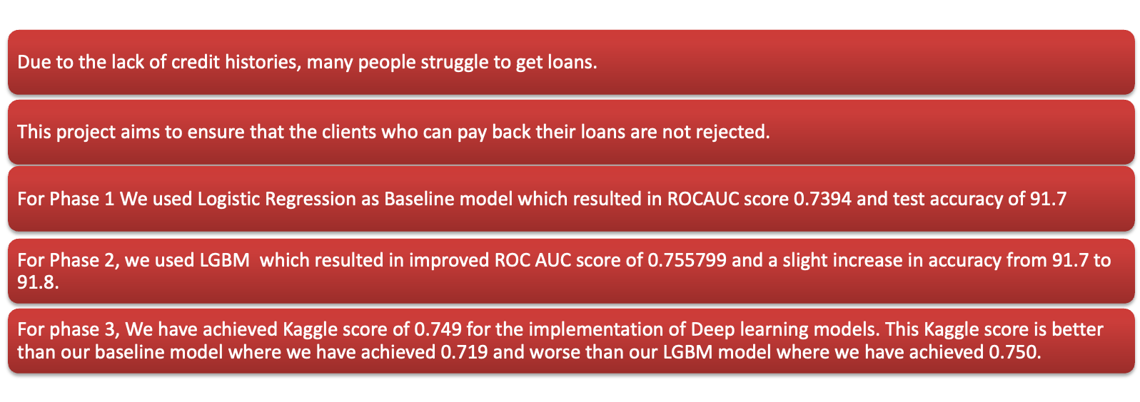



Abstract

Slide 3
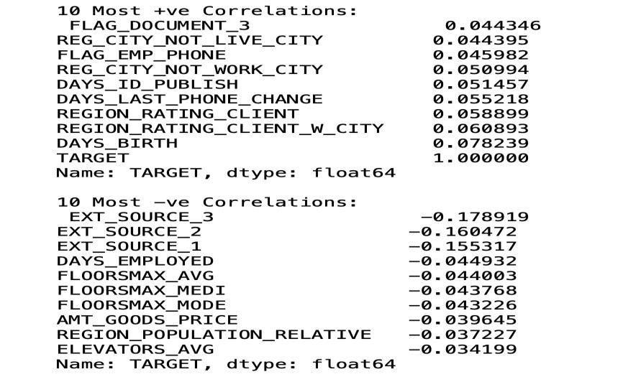
Previous Work
In Phase 1, we have performed EDA Analysis and implemented baseline model.
Here we have got an ROC AUC score of 0.739 with the help of Linear Regression.
In Phase 2, we performed different models and increased our ROC AUC score to 0.745.

Slide 4
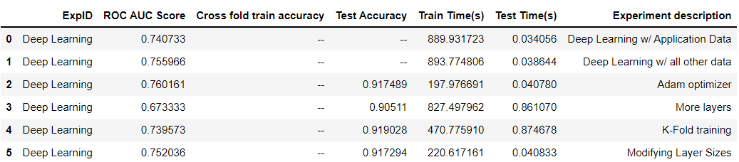
Phase 3
In Phase 3, we have implemented many architectures and changed optimizers and loss functions.
Due all these changes we can see variations in ROC AUC scores and training time.
After implementation of all these models we have our best model with Adam Optimizer which consists of 173 neurons as input, 1 hidden layer of 20 neurons, 2 neurons as output.

Slide 5
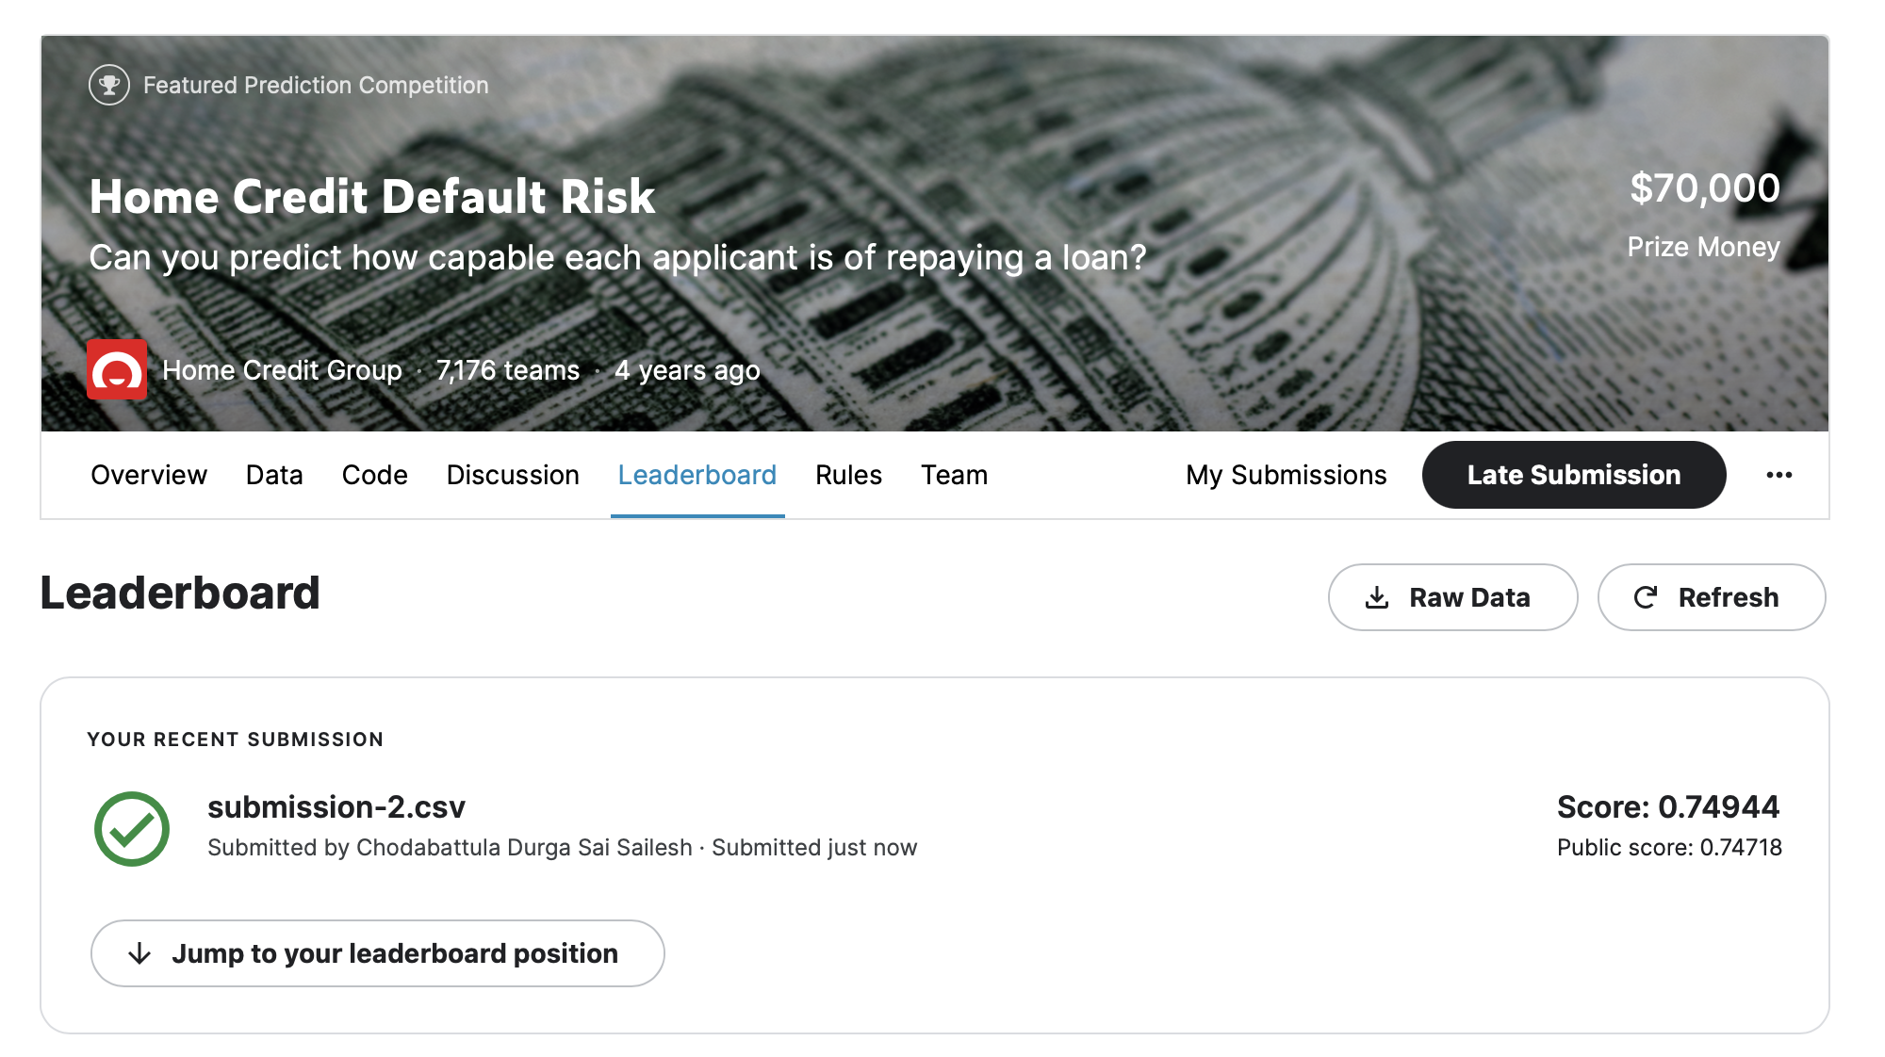
Kaggle Submission
After implementation of many architectures we have achieved Kaggle score of 0.749 which is better than our baseline model.
Its worst than our LGBM Model.

Slide 6
Conclusion
The results for Part 3 were pretty disappointing to us.
We expected to beat our LGBM scores after tuning the architecture of our model.
Instead we found that each change didn’t affect the model or made it worse

