Slide 1
INTERNSHIP PROJECT REPORT · DATA VISUALIZATION
Cyber Threat
Analytics Platform
with Incident Visualization System
Saileshbabu T S
Infosys Springboard Internship 7.0 — Data Visualization
Tool Used: Microsoft Power BI

Slide 2
PROJECT OVERVIEW
Four Milestones, One Intelligence Pipeline
277K
132
21
6.27
Recorded Incidents
Distinct Crime Types
Covered Areas
Avg. Reporting Delay (Days)
1
Advance Threat Incidents Analytics & Security Visualization
Foundational classification dashboard — incident volume by category, area, victim demographics, and case status.
2
Threat Intelligence & Geospatial Risk Analytics
Maps incident hotspots across all 21 areas and benchmarks reporting-time performance city-by-city.
3
Temporal Incident & Incident Response Analytics
Daily, weekly, monthly, and seasonal patterns paired with case-response and closure performance.
4
Security Risk Assessment & Predictive Executive Analytics
Risk-scoring and forward-looking predictive views for analysts and executive leadership.
CYBER THREAT ANALYTICS PLATFORM | Infosys Springboard 7.0
2

Slide 3
1
MILESTONE 1
Advance Threat Incidents Analytics & Security Visualization Framework
OBJECTIVE
Build the foundational incident-analytics dashboard for the Cyber Threat Analytics Platform — consolidating raw crime and incident records into a single classification view for exploring volume by category, geographic area, victim demographics, and case status.
Crime ID · Type · Area
Year–Month–Day
4 Groups
Core Fields Modelled
Date Hierarchy Built
Victim Age Buckets
CYBER THREAT ANALYTICS PLATFORM | Infosys Springboard 7.0
3

Slide 4
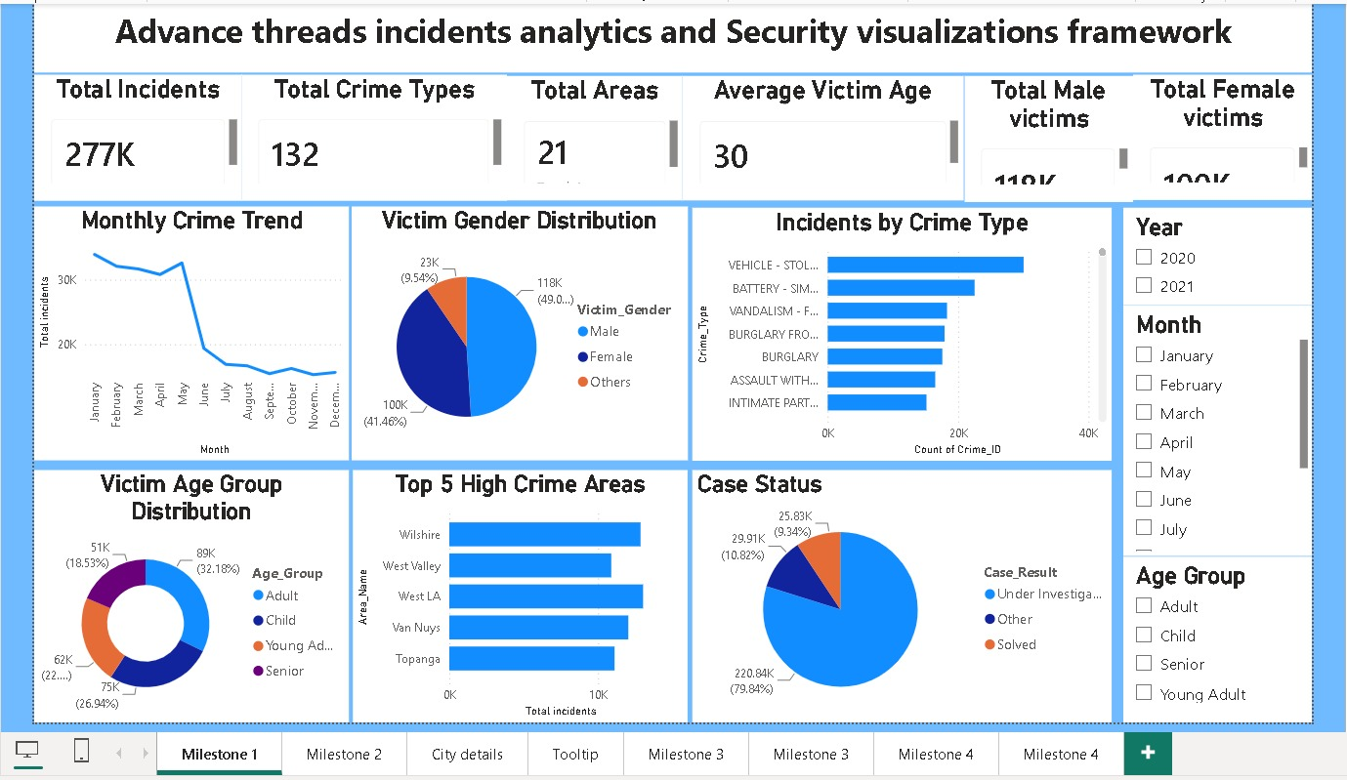
MILESTONE 1 DASHBOARD
Advance Threat Incidents Analytics & Security Visualization Framework
Figure 1 — Milestone 1 Dashboard
CYBER THREAT ANALYTICS PLATFORM | Infosys Springboard 7.0
4

Slide 5
1
MILESTONE 1 — KEY INSIGHTS
Advance Threat Incidents Analytics & Security Visualization Framework
KEY INSIGHTS
Vehicle theft (Vehicle – Stolen) leads all incident categories, followed by Battery – Simple Assault and Vandalism – Felony.
Victim gender split is close to even: Male 49.0% (118K), Female 41.46% (100K), Others 9.54% (23K).
Adults form the largest victim age group (32.18% / 89K), followed by Child (26.94% / 75K) and Young Adult (22% / 62K); Seniors are the smallest (18.53% / 51K).
Wilshire, West Valley, West LA, Van Nuys, and Topanga are the Top 5 high-crime areas by incident count.
Monthly trend shows sustained high volume from January–May, followed by a sharp decline from June onward.
Case status reveals a significant backlog: 79.84% (220.84K) remain 'Under Investigation', while only 9.34% (25.83K) are 'Solved'.
CYBER THREAT ANALYTICS PLATFORM | Infosys Springboard 7.0
5

Slide 6
1
MILESTONE 1 — BUSINESS RECOMMENDATIONS
Advance Threat Incidents Analytics & Security Visualization Framework
RECOMMENDATIONS
Prioritize patrol and prevention resources toward the Top 5 high-crime areas: Wilshire, West Valley, West LA, Van Nuys, Topanga.
Investigate the low case-closure rate (~9%) and strengthen the investigation-to-resolution workflow to reduce the backlog.
Launch targeted prevention programs for vehicle theft and assault-related categories, since these dominate incident volume.
Align staffing and monitoring schedules with the January–May peak period observed in the monthly trend.
CYBER THREAT ANALYTICS PLATFORM | Infosys Springboard 7.0
6

Slide 7
2
MILESTONE 2
Threat Intelligence & Geospatial Risk Analytics
OBJECTIVE
Extends the initial classification view into full-scale geospatial threat intelligence — mapping incident hotspots across all 21 covered areas, benchmarking reporting-time performance city-by-city, and identifying the highest-risk zones for security planning.
6.27 days
58.91%
Top 5
Avg. Reporting Delay
Critical-Severity Share
Riskiest Cities Flagged
CYBER THREAT ANALYTICS PLATFORM | Infosys Springboard 7.0
7

Slide 8
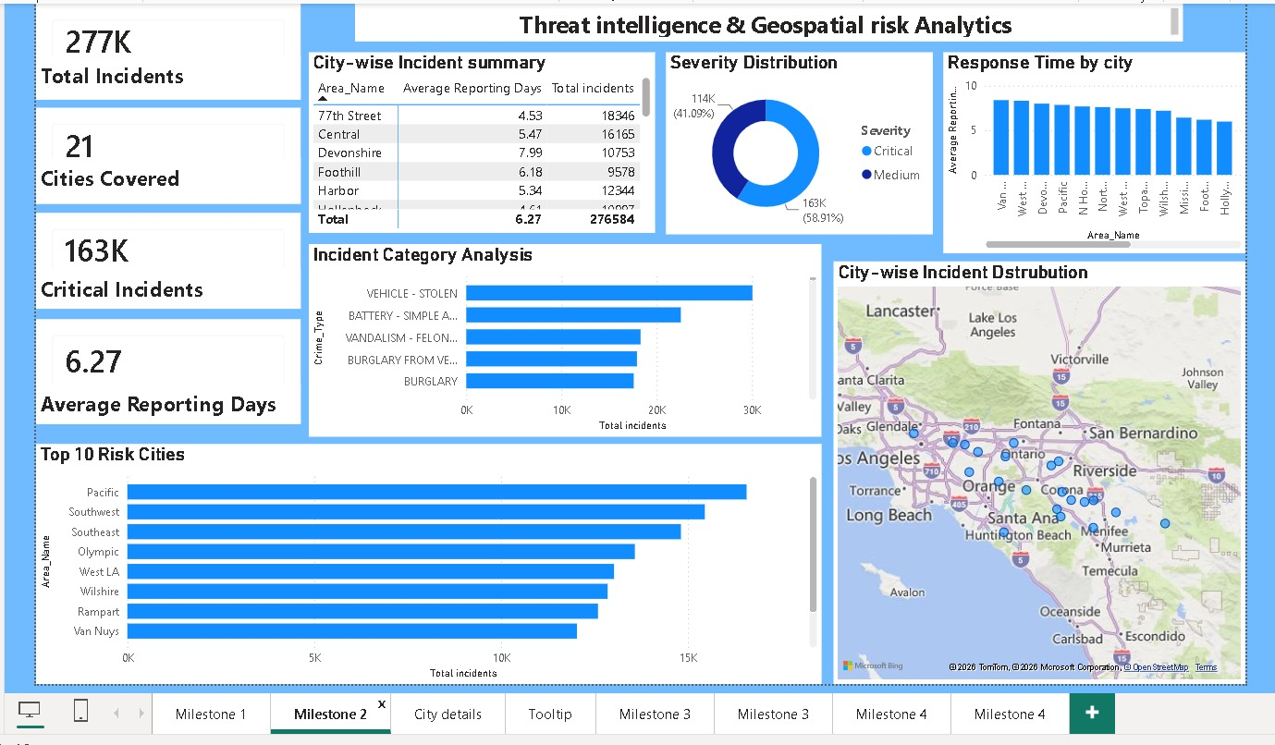
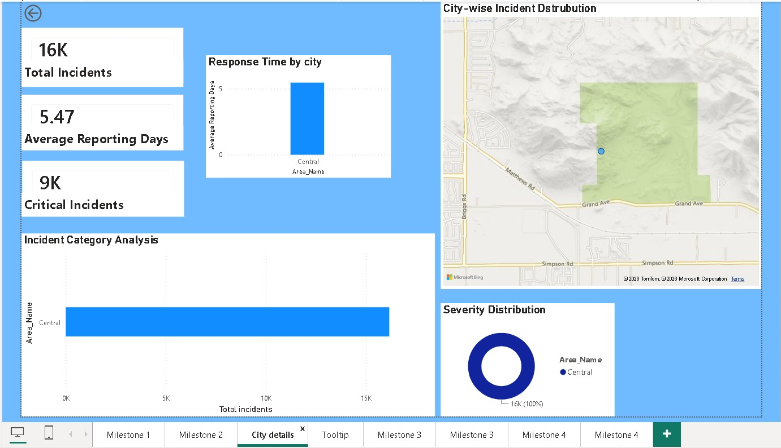
MILESTONE 2 DASHBOARD
Geospatial Risk Analytics — Main View & City Drill-Through
Figure 2 — Main View
Figure 3 — City Drill-Through
CYBER THREAT ANALYTICS PLATFORM | Infosys Springboard 7.0
8

Slide 9
2
MILESTONE 2 — KEY INSIGHTS
Threat Intelligence & Geospatial Risk Analytics
KEY INSIGHTS
Across all 21 cities, the platform tracks 277,000 total incidents with an overall average reporting delay of 6.27 days.
Critical-severity incidents (163K, 58.91%) outnumber Medium-severity incidents (114K, 41.09%) — the majority skew high-severity rather than a typical low-to-high pyramid.
Pacific, Southwest, Southeast, Olympic, and West LA emerge as the Top 5 riskiest cities by total incident volume.
77th Street has the highest incident count (18,346) with a below-average reporting delay (4.53 days); Devonshire has fewer incidents (10,753) but the longest delay (7.99 days) — reporting speed doesn't track with volume.
The City Details drill-through (Central) shows 16K incidents with 9K (56%) classified Critical — risk concentration varies significantly by area.
CYBER THREAT ANALYTICS PLATFORM | Infosys Springboard 7.0
9

Slide 10
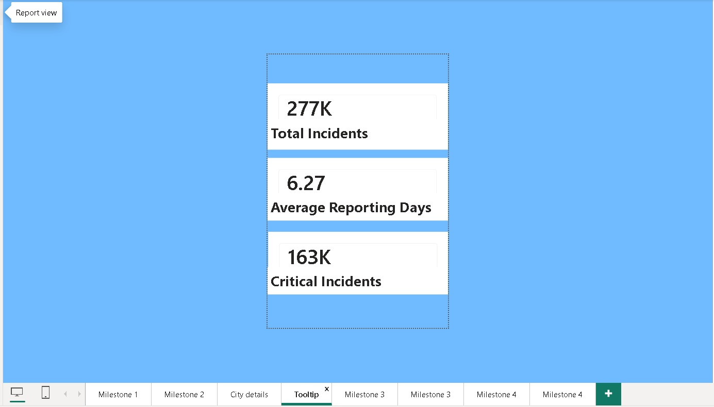
2
MILESTONE 2 — TOOLTIP & RECOMMENDATIONS
Threat Intelligence & Geospatial Risk Analytics
QUICK-GLANCE TOOLTIP
RECOMMENDATIONS
Figure 4 surfaces key city metrics on hover — incident count, severity mix, and reporting delay — for fast operational triage without leaving the main map view.
Investigate Devonshire's longer reporting delay (7.99 days) despite lower incident volume — a possible resourcing or process gap.
Direct additional geospatial-based patrol resources toward the Top 10 Risk Cities on the hotspot map.
Standardize reporting-time targets across areas, since current delays vary widely without a clear link to volume.
Enable area commanders to use the City Details drill-through as a self-service view for their zone's performance.
Figure 4 — Quick-Glance Tooltip Summary
CYBER THREAT ANALYTICS PLATFORM | Infosys Springboard 7.0
10

Slide 11
3
MILESTONE 3
Temporal Incident & Incident Response Analytics
OBJECTIVE
Analyzes incident data through the time dimension — daily, weekly, monthly, and seasonal patterns — and evaluates case-response and closure performance to support staffing decisions and surface operational efficiency gaps.
~90K
~500 / day
79.84%
Spring Peak Incidents
Steady Daily Baseline
Investigation Continued
CYBER THREAT ANALYTICS PLATFORM | Infosys Springboard 7.0
11

Slide 12
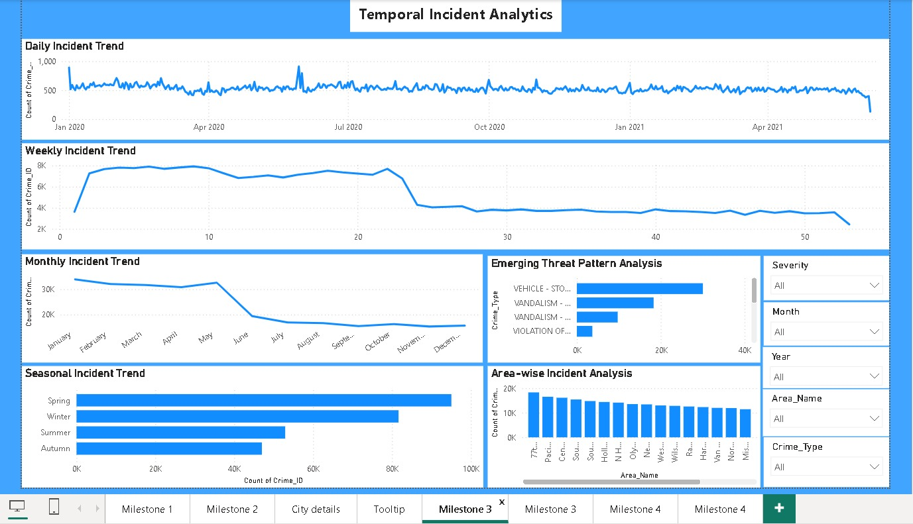
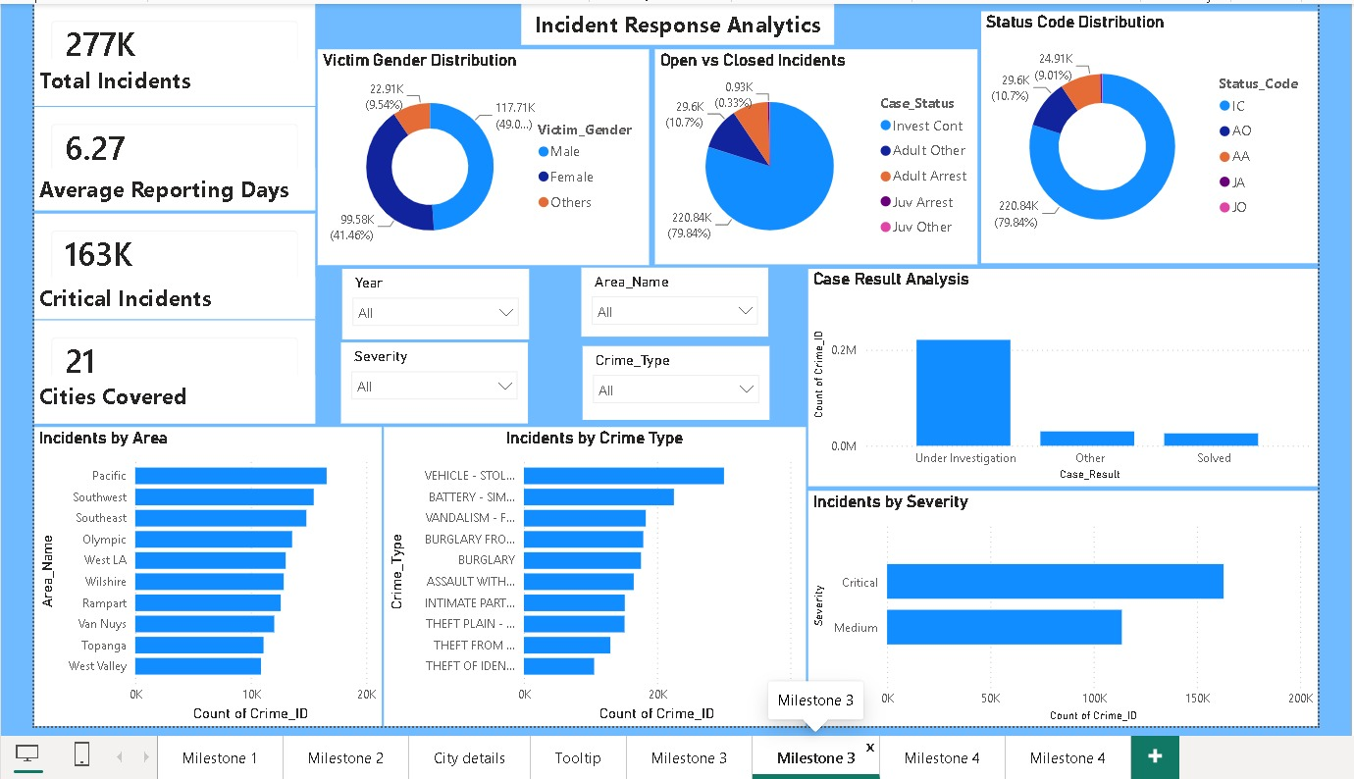
MILESTONE 3 DASHBOARD
Temporal Analytics & Incident Response Analytics
Figure 5 — Temporal Incident Analytics
Figure 6 — Incident Response Analytics
CYBER THREAT ANALYTICS PLATFORM | Infosys Springboard 7.0
12

Slide 13
3
MILESTONE 3 — INSIGHTS & RECOMMENDATIONS
Temporal Incident & Incident Response Analytics
KEY INSIGHTS
RECOMMENDATIONS
Spring is the peak season for incidents (~90K), nearly double Autumn, the lowest season (~40K) — a clear seasonal pattern for staffing plans.
Daily trend holds a steady baseline of ~500 incidents/day with occasional spikes, and a visible decline toward the end of the window (Apr 2021) to validate against data completeness.
Case-handling mirrors Milestone 1: ~79.84% remain 'Investigation Continued'; arrests account for only a small fraction of outcomes.
Vehicle theft and vandalism dominate the Emerging Threat Pattern view, consistent with earlier milestones.
Critical-severity cases (~163K) exceed Medium-severity (~114K), reinforcing the severity skew seen in Milestone 2.
Reallocate staffing to align with the Spring peak and scale down monitoring during the lower-volume Autumn season.
Given the low arrest/closure rate, review investigative capacity and case-management workflow.
Monitor the declining end-of-window trend in the next refresh to confirm a genuine drop vs. incomplete data.
Cross-check resource allocation against the geospatial hotspots identified in Milestone 2.
CYBER THREAT ANALYTICS PLATFORM | Infosys Springboard 7.0
13

Slide 14
4
MILESTONE 4
Security Risk Assessment, Predictive Intelligence & Executive Analytics
OBJECTIVE
Consolidates the platform into risk-scoring and forward-looking predictive views — giving analysts and executives a unified perspective on current risk exposure and forecasted risk trends across all 21 covered locations.
79.45 / 100
58.91%
21
Predictive Risk Score
Incident Risk Probability
Locations Covered
CYBER THREAT ANALYTICS PLATFORM | Infosys Springboard 7.0
14

Slide 15
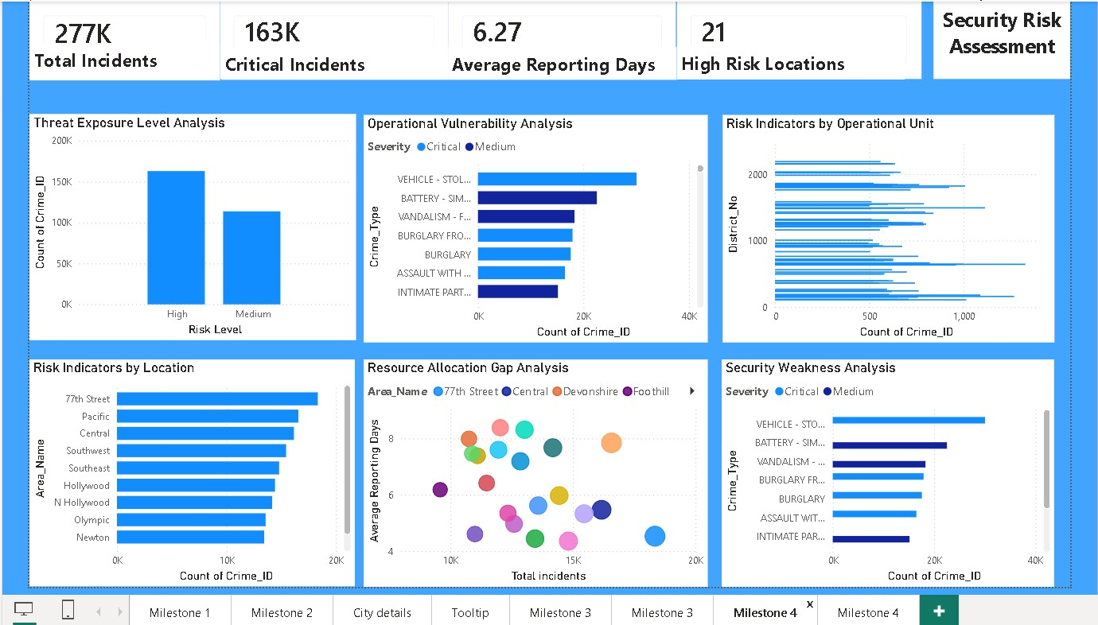
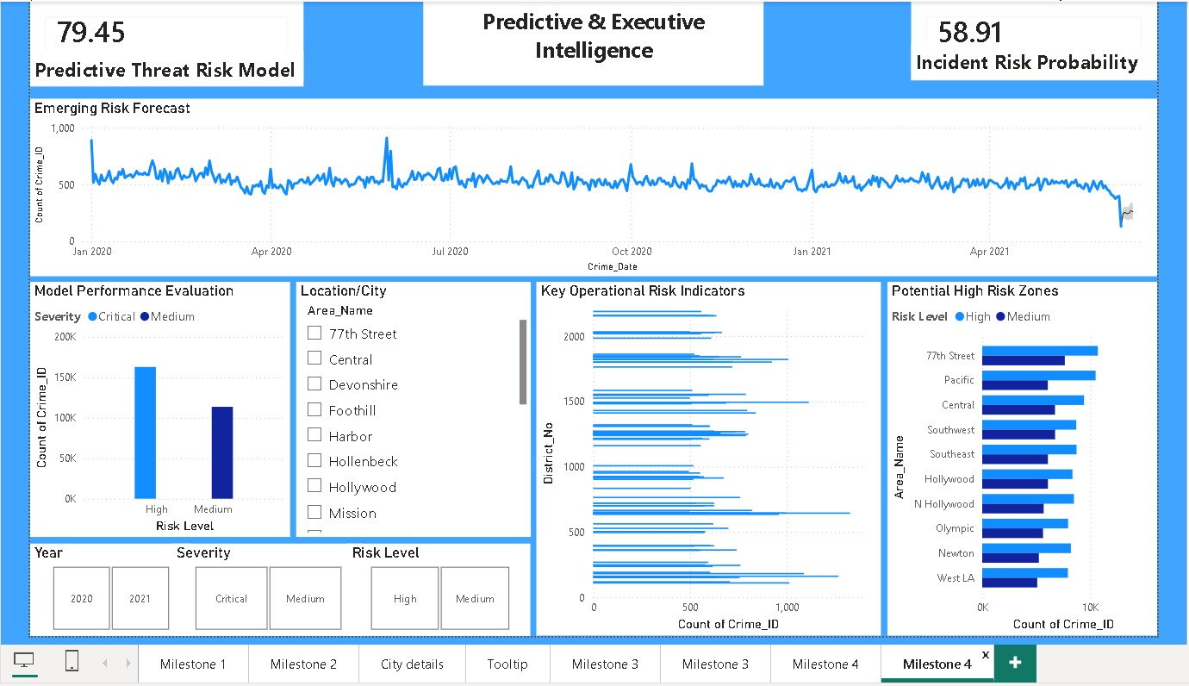
MILESTONE 4 DASHBOARD
Security Risk Assessment & Predictive Executive Intelligence
Figure 7 — Security Risk Assessment
Figure 8 — Predictive & Executive Intelligence
CYBER THREAT ANALYTICS PLATFORM | Infosys Springboard 7.0
15

Slide 16
4
MILESTONE 4 — KEY INSIGHTS & PREDICTIVE FINDINGS
Security Risk Assessment, Predictive Intelligence & Executive Analytics
KEY INSIGHTS & PREDICTIVE FINDINGS
Threat Exposure Level Analysis confirms High-risk incidents (163K) outnumber Medium-risk incidents (114K), consistent with earlier milestones.
The Predictive Threat Risk Model returns a score of 79.45 / 100, indicating an elevated overall risk posture across covered areas.
Incident Risk Probability is calculated at 58.91% — a majority likelihood of continued high-severity incident occurrence.
77th Street, Pacific, and Central consistently rank among the Potential High-Risk Zones, matching Milestone 2's Top Risk Cities.
The Resource Allocation Gap Analysis scatter plot highlights areas combining high incident volume and above-average reporting delay — the highest-priority gap areas.
The Emerging Risk Forecast (Jan 2020–Apr 2021) stays range-bound with a sharp dip at the very end of the window, to be monitored for a genuine easing vs. data-completeness artifact.
CYBER THREAT ANALYTICS PLATFORM | Infosys Springboard 7.0
16

Slide 17
4
MILESTONE 4 — STRATEGY RECOMMENDATIONS
Security Risk Assessment, Predictive Intelligence & Executive Analytics
STRATEGY RECOMMENDATIONS
Direct additional patrol and investigation resources toward the confirmed persistent high-risk zones — 77th Street, Pacific, and Central.
Track the Predictive Threat Risk Model score as a recurring monthly KPI to detect early shifts in overall risk trend.
Close the resource-allocation gap identified in the scatter analysis by adjusting staffing in areas with both high volume and long reporting delay.
Integrate Milestone 3's case-closure improvements with the risk-scoring model, since persistently low closure rates likely inflate the standing risk score.
CYBER THREAT ANALYTICS PLATFORM | Infosys Springboard 7.0
17

Slide 18
CONCLUSION
A Complete Incident-Intelligence Pipeline
Together, the four milestones form a complete incident-intelligence pipeline — from initial classification and geospatial mapping, through temporal and response analysis, to risk assessment and predictive forecasting. This layered design lets stakeholders, from area-level analysts to executive leadership, work from the same underlying incident data at the level of detail relevant to their role.
1
→
2
→
3
→
4
Classification
Geospatial Mapping
Temporal & Response
Risk & Prediction
Saileshbabu T S | Infosys Springboard Internship 7.0 — Data Visualization | Microsoft Power BI

