Slide 1
Using Charts in Flutter

Slide 2
Requirements
Latest version of Flutter installed
Android Studio with Dart and Flutter plugins installed
Android Debugging Device (Emulator or Physical Device)
Working internet connection for fetching pub.dev packages

Slide 3
Open Android Studio
Install Flutter and Dart Plugins if not already installed
Restart Android Studio if required

Slide 4
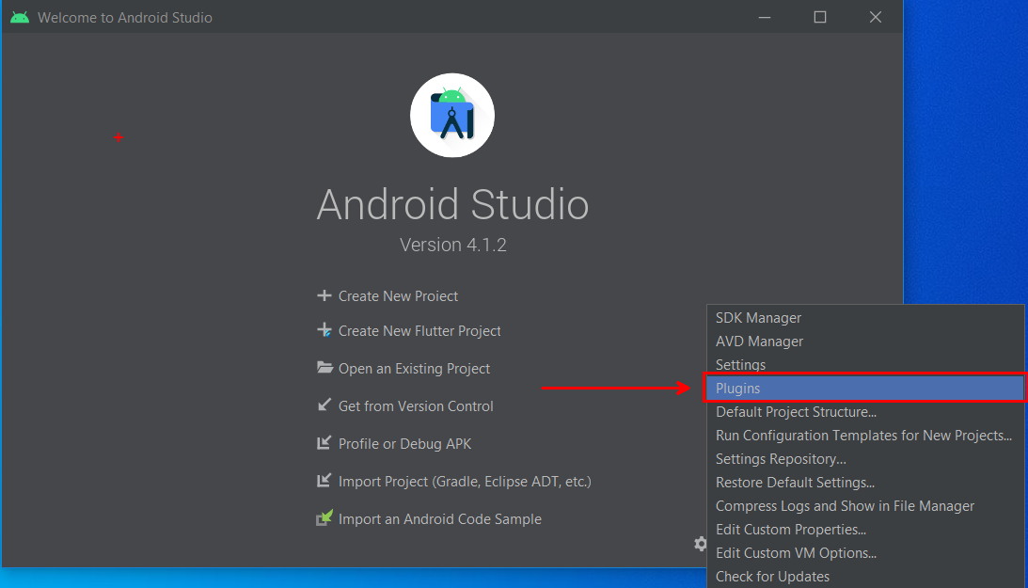
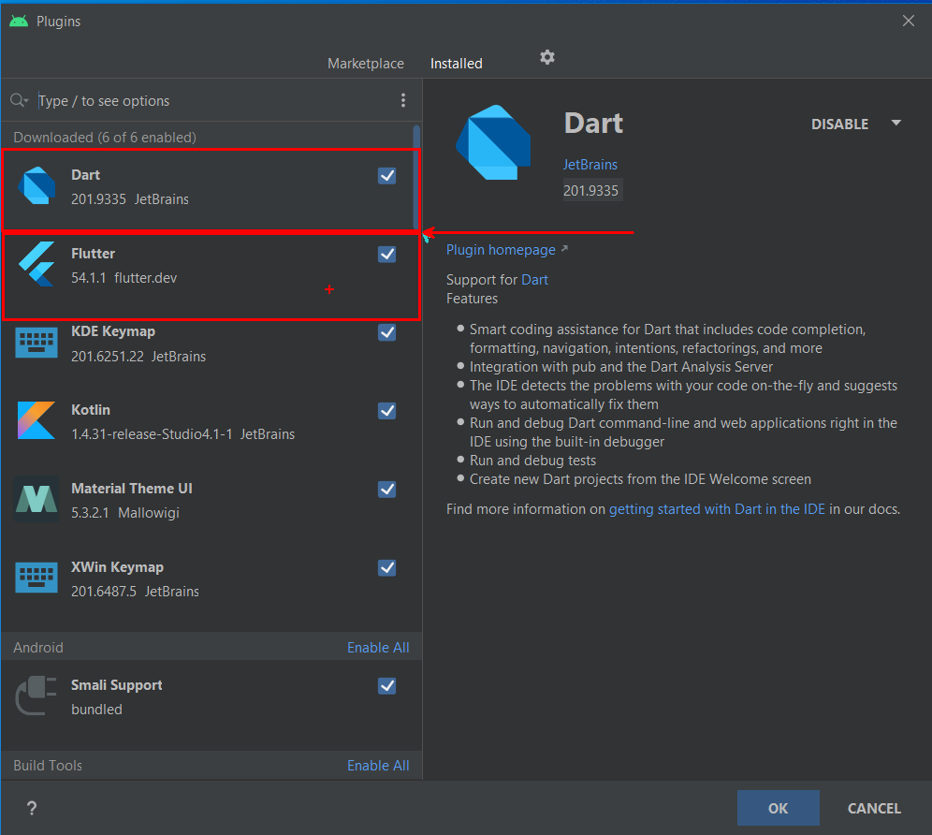

Slide 5
New Flutter Project in Android Studio

Slide 6
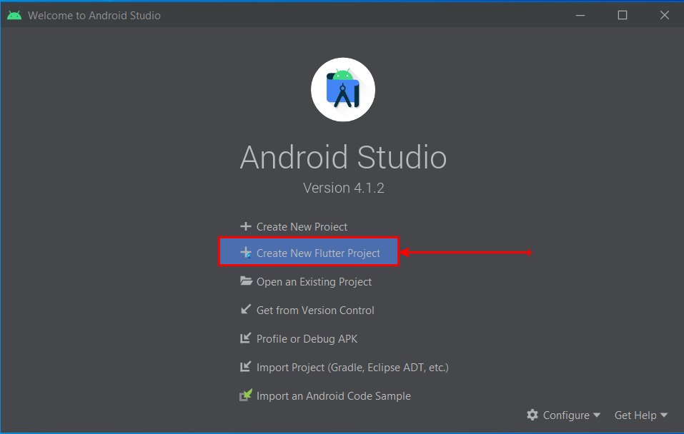
Create new Flutter Project
Open Android Studio
Click on “Create New Flutter Project”

Slide 7
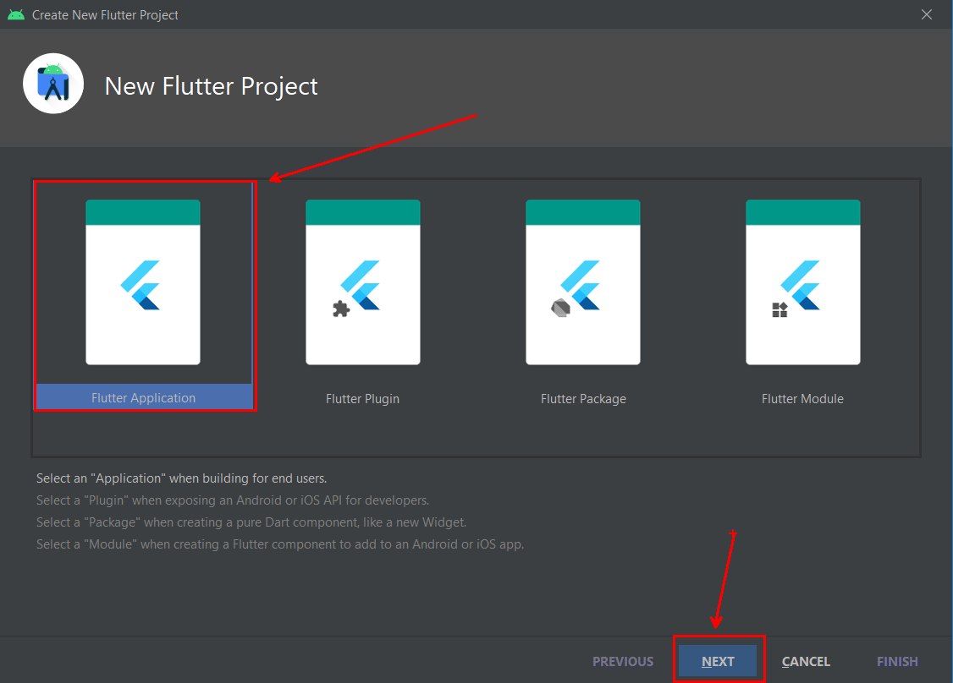
Select “Flutter Application” and click “Next”

Slide 8
Add a project name
Make sure Flutter SDK path is set
Select Project location
Project location is where your new project will be saved

Slide 9
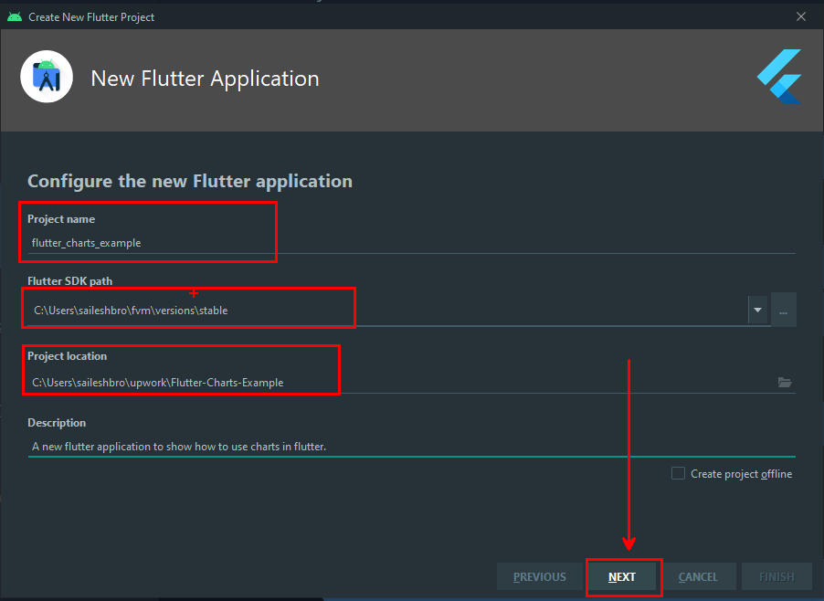
Add a project description (optional)
Click on Next

Slide 10
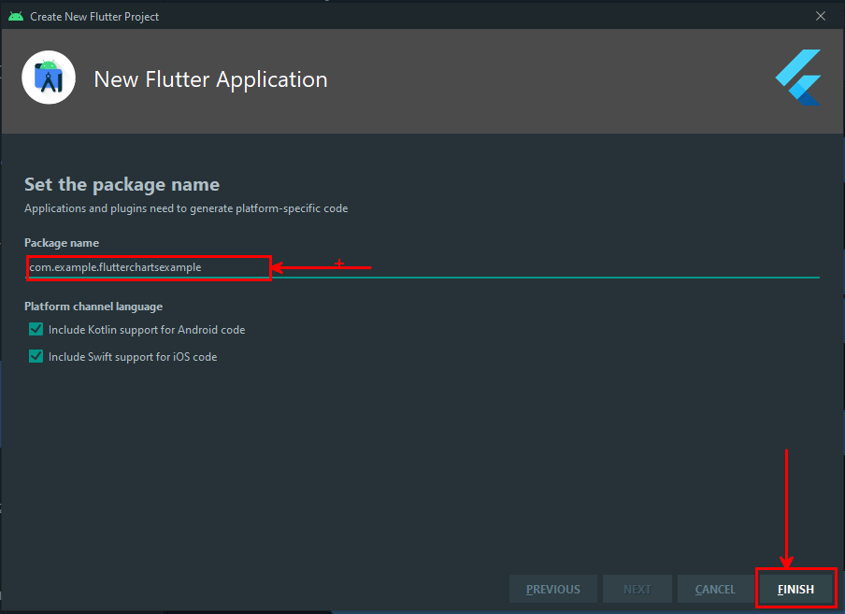
Select a package name and click on finish
Wait till the process finishes

Slide 11
Running New Flutter Project

Slide 12
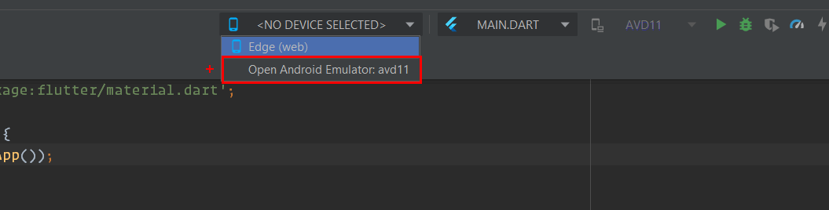
Start emulator
Select a device and open an emulator
If you cant see a emulator listed, create a new one
Wait for the emulator to start

Slide 13
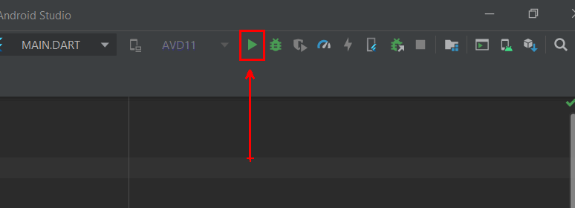
After emulator loads, press this button to debug the application
This may take a while for first time.
Wait for it to start patiently.

Slide 14
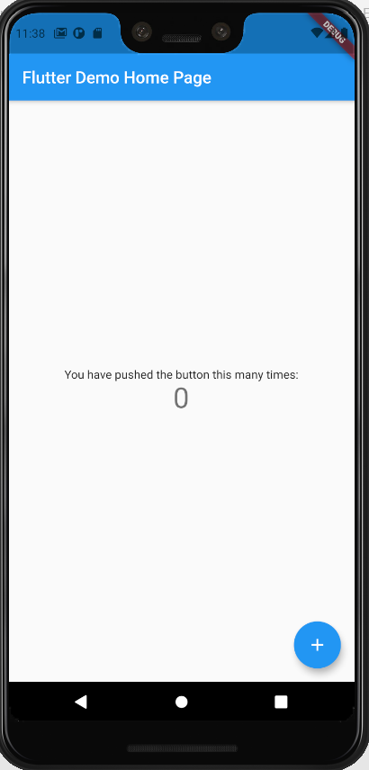
New flutter app will open in emulator
You can try clicking the + button to increment

Slide 15
Cleaning up generated code

Slide 16
Remove all the commented codes
Remove “MyHomePage” widget from main.dart
Add a “Scaffold()” as home for MaterialApp for now
main.dart looks something like now.
import 'package:flutter/material.dart'; void main() { runApp(MyApp()); }
class MyApp extends StatelessWidget { @override Widget build(BuildContext context) { return MaterialApp( title: 'Flutter Demo', theme: ThemeData( primarySwatch: Colors.blue, ), home: Scaffold(), ); } }

Slide 17
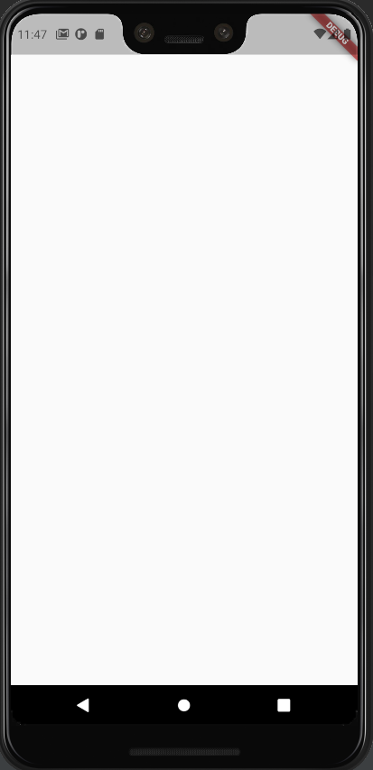
Now the App looks something like this
Now lets start designing the UI using placeholders

Slide 18
What are we building?

Slide 19
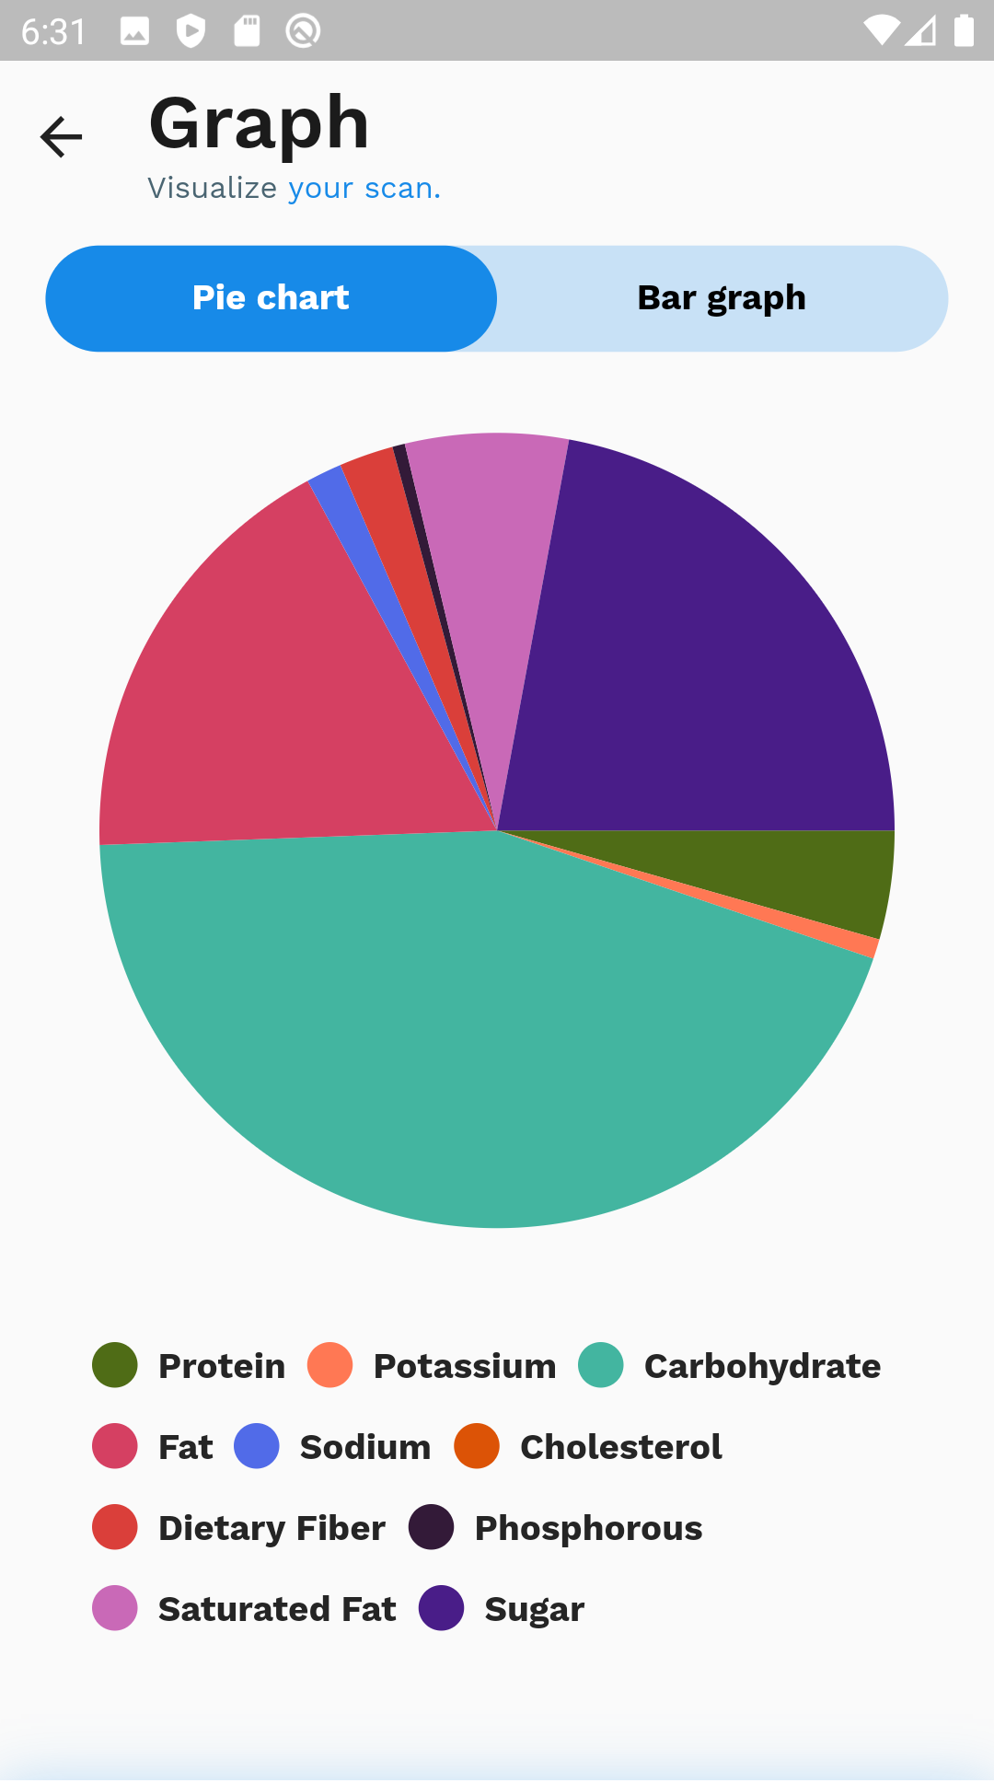
We are trying to build this UI.

Slide 20
This ui shows nutritional content of some hypothetical food
We will start by modeling each nutrient information
In lib folder, create a new folder called `models`
Create a new file inside this folder called `nutrient.dart`
Create a data model for a nutrient in this file
import 'package:flutter/material.dart'; class Nutrient { String type; num value; String unit; Nutrient({this.type, this.value, this.unit}); Color color; Nutrient.fromJson(Map<String, dynamic> json) { type = json['type'] as String; value = ((json['value'] ?? 0) as num).ceil(); unit = json['unit'] as String; } }

Slide 21
Lets create a dummy data for Oreo food
In nutrient.dart, we will create a list of nutrient values for oreo
final List<Map<String, dynamic>> json = [ {"type": "Calories", "value": 112, "unit": "kcal"}, {"type": "Total", "value": 24, "unit": "g"}, {"type": "Carbohydrate", "value": 17.04, "unit": "g"}, {"type": "Sugar", "value": 9.76, "unit": "g"}, {"type": "Fat", "value": 4.59, "unit": "g"}, {"type": "Saturated Fat", "value": 1.36, "unit": "g"}, {"type": "Protein", "value": 1.25, "unit": "g"}, {"type": "Dietary Fiber", "value": 0.7, "unit": "g"}, {"type": "Sodium", "value": 93.12, "unit": "mg"}, {"type": "Potassium", "value": 56.16, "unit": "mg"}, {"type": "Phosphorous", "value": 22.32, "unit": "mg"}, {"type": "Cholesterol", "value": 0, "unit": "mg"} ];

Slide 22
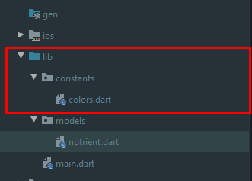
Create a file inside lib->constants->colors.dart and add a list of colors for displaying different colors for different nutrient value
const List<Color> chartColors = [ Color(0xfffa448c), Color(0xfffec859), Color(0xff43b5a0), Color(0xff491d88), Color(0xFFD54062), Color(0xffc969b7), Color(0xff4f6c16), Color(0xffda3f3a), Color(0xff516be8), Color(0xffff7854), Color(0xff331a38), Color(0xFFDC5306), Color(0xff58de87), Color(0xffff577d), Color(0xffffccdc), Color(0xff0a9cf5), Color(0xFF86899F), Color(0xffff4a67), Color(0xFFF5DB7E), Color(0xFFEE624A), Color(0xFF056676), Color(0xFFBD461C), ];

Slide 23
In nutrient.dart file create a static method for converting the json data to data model
Add conversion line in nutrient.dart to convert json to list which will be used in the ui.
static fromJsonList(List<Map<String, dynamic>> json) { { final data = <Nutrient>[]; json.asMap().forEach((key, value) { data.add(Nutrient.fromJson(value)..color = chartColors[key]); });
return data; } }
final nutrients = Nutrient.fromJsonList(json);

Slide 24
Creating widget to show pie-chart

Slide 25
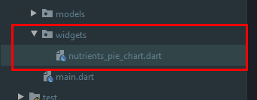
Inside widgets folder, create a new file named nutrients_pie_chart.dart
We will be using pie_chart package to make the piechart
Create a stateless widget, which takes list of Nutrients and a radius argument
PieChart( dataMap: data, colorList: _colors, chartRadius: radius ?? MediaQuery.of(context).size.width * 0.5, animationDuration: Duration(milliseconds: 600), chartLegendSpacing: 42.0, chartValuesOptions: const ChartValuesOptions( showChartValues: false, ), legendOptions: LegendOptions( showLegends: true, legendPosition: LegendPosition.bottom, showLegendsInRow: true, legendTextStyle: Theme.of(context) .textTheme .button .copyWith(fontWeight: FontWeight.bold), ), );

Slide 26
We will return the widget from the build method
Also we will add a little logic for mapping the colors and arranging the values based on the unit
This will be placed inside the build method of nutrient_pie_chart.dart
final Map<String, double> data = {}; final List<Color> _colors = []; final List<Nutrient> nutrientsCopy = [...nutrients]; nutrientsCopy.shuffle(); nutrientsCopy.forEach((e) { if (e.type.toLowerCase() != 'total' && e.unit.toLowerCase() != 'kcal') { _colors.add(e.color); if (e.unit.toLowerCase() == "g") { data[e.type] = e.value.toDouble() * 1000.0; } else { data[e.type] = e.value.toDouble() * 7.0; } } });

Slide 27
Creating widget to show bar graph

Slide 28
Inside widgets folder, create a new file named nutrients_pie_chart.dart
We will be using charts_flutter package to make the bar graph
Add this package to pubspec.yaml
Create a stateless widget which takes the nutrient list to show
Import package like this
Add code and we will make the function for Gram chart and MiliGram chart
import 'package:charts_flutter/flutter.dart' as chart;
return Column( children: [ Expanded(child: _buildGramChart(context)), const SizedBox(height: 16), Expanded(child: _buildMiliGramChart(context)), const SizedBox(height: 16), ], );

Slide 29
Expanded( child: chart.BarChart( [ chart.Series<Nutrient, String>( displayName: "Micronutrients", id: "Nutrient mgs Bar Graph", strokeWidthPxFn: (_, __) => 4, colorFn: (_, __) => chart.Color.transparent, fillColorFn: (_, __) => chart.ColorUtil.fromDartColor(Colors.pinkAccent), measureFn: (Nutrient nutrient, _) => nutrient.value / 100, domainFn: (Nutrient nutrient, _) => nutrient.type.replaceAll(" ", "\n"), data: nutrients .where((element) => element.type.toLowerCase() != 'total' && element.unit.toLowerCase() != 'kcal' && element.unit.toLowerCase() != 'g') .toList(), ), ], domainAxis: chart.OrdinalAxisSpec( showAxisLine: true, renderSpec: chart.SmallTickRendererSpec( labelStyle: chart.TextStyleSpec( fontSize: 9, fontWeight: '600', color: chart.ColorUtil.fromDartColor(Colors.black)), lineStyle: chart.LineStyleSpec( color: chart.ColorUtil.fromDartColor(Colors.black), ), minimumPaddingBetweenLabelsPx: 12, ), ), primaryMeasureAxis: chart.NumericAxisSpec( renderSpec: chart.GridlineRendererSpec( minimumPaddingBetweenLabelsPx: 12, labelStyle: chart.TextStyleSpec( fontSize: 10, color: chart.ColorUtil.fromDartColor(Colors.black)), lineStyle: chart.LineStyleSpec( color: chart.ColorUtil.fromDartColor(Colors.black), ), ), ), ), ),
In _buildMiliGramChart function return widget which will show the information for nutrients having gram unit

Slide 30
In _buildGramChart function return widget which will show the information for nutrients having gram unit
Expanded( child: chart.BarChart( [ chart.Series<Nutrient, String>( id: "Nutrient gs Bar Graph", strokeWidthPxFn: (_, __) => 4, radiusPxFn: (_, __) => 10, measureFn: (Nutrient nutrient, _) { return nutrient.value; }, colorFn: (_, __) => chart.Color.transparent, fillColorFn: (_, __) => chart.ColorUtil.fromDartColor(Color(0xFF178AE8)), domainFn: (Nutrient nutrient, _) => nutrient.type.replaceAll(" ", "\n"), data: nutrients.where((element) { return element.type.toLowerCase() != 'total' && element.unit.toLowerCase() != 'kcal' && element.unit.toLowerCase() != 'mg'; }).toList(), ), ], domainAxis: chart.OrdinalAxisSpec( showAxisLine: true, renderSpec: chart.SmallTickRendererSpec( labelRotation: 10, labelAnchor: chart.TickLabelAnchor.after, labelStyle: chart.TextStyleSpec( fontSize: 9, fontWeight: '600', color: chart.ColorUtil.fromDartColor(Colors.black)), lineStyle: chart.LineStyleSpec( color: chart.ColorUtil.fromDartColor(Colors.black), ), ), ), primaryMeasureAxis: chart.NumericAxisSpec( renderSpec: chart.GridlineRendererSpec( labelStyle: chart.TextStyleSpec( fontSize: 10, color: chart.ColorUtil.fromDartColor(Colors.black), ), minimumPaddingBetweenLabelsPx: 12, lineStyle: chart.LineStyleSpec( color: chart.ColorUtil.fromDartColor(Colors.black), ), ), ), ), ),

Slide 31
Creating a progress indicator to show the value of nutrient

Slide 32
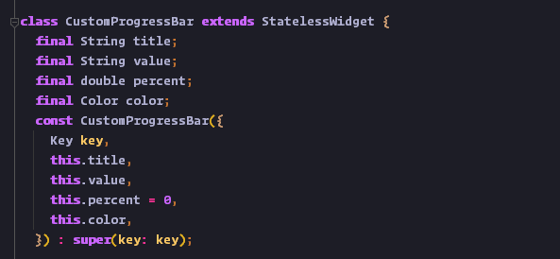
In widgets folder create a new file called custom_progress_bar.dart
Create a stateless widget called CustomProgressBar
This widget will take title, value, color and percent as a parameter
Title and value will display values like “Carbohydrate” and “40 gm”
Color and percent will show percentage length and color

Slide 33
@override Widget build(BuildContext context) { return Column( children: <Widget>[ Row( mainAxisAlignment: MainAxisAlignment.spaceBetween, children: <Widget>[ Text(title, style: Theme.of(context) .textTheme .button .copyWith(fontWeight: FontWeight.bold)), Text( value, style: Theme.of(context).textTheme.subtitle1, ) ], ), const SizedBox(height: 10), Container( height: 6, width: MediaQuery.of(context).size.width, decoration: BoxDecoration( color: const Color(0xffe5e5e5).withOpacity(0.7), borderRadius: BorderRadius.circular(4), ), child: Row( children: <Widget>[ Expanded( flex: (percent + 3.5).ceil().clamp(0, 100).toInt(), child: Container( height: 6, decoration: BoxDecoration( color: color, borderRadius: BorderRadius.circular(4), ), ), ), Expanded( flex: (100 - (percent + 3.5).ceil()).clamp(0, 100).toInt(), child: const SizedBox.shrink(), ), ], ), ), const SizedBox(height: 16), ], ); } }
The build method is shown as such

Slide 34
Creating a custom tabbar

Slide 35
In widgets folder, create a new file called custom_tab_bar.dart
This will take index, and onchanged method and will show a selected tab
import 'package:flutter/material.dart'; class CustomTabBar extends StatelessWidget { final List<String> items; final int defaultIndex; final Function(int) onChanged; const CustomTabBar({ Key key, @required this.items, this.defaultIndex = 0, this.onChanged, }) : super(key: key); @override Widget build(BuildContext context) { return Container( height: 42, decoration: BoxDecoration( color: const Color(0xFF178AE8).withOpacity(0.22), borderRadius: BorderRadius.circular(42), ), child: DefaultTabController( length: items.length, initialIndex: defaultIndex, child: TabBar( onTap: onChanged, indicatorSize: TabBarIndicatorSize.tab, indicator: BoxDecoration( color: const Color(0xFF178AE8), borderRadius: BorderRadius.circular(42), ), unselectedLabelColor: Colors.black, labelStyle: Theme.of(context) .textTheme .button .copyWith(fontWeight: FontWeight.bold), tabs: items.map((item) => Tab(child: Text(item))).toList(), ), ), ); } }

Slide 36
Creating Screen to show the graph

Slide 37
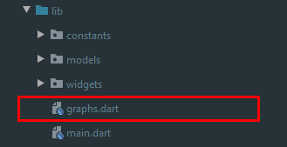
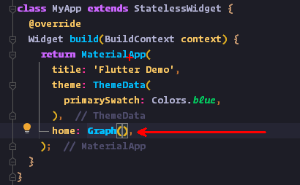
In lib folder create a file called graphs.dart
Return Scaffold from the build function and use this Graph widget in main.dart in MaterialApp widget.
class Graph extends StatefulWidget { const Graph({ Key key, }) : super(key: key); @override _GraphState createState() => _GraphState(); } class _GraphState extends State<Graph> { @override Widget build(BuildContext context) { return Scaffold( body: buildGraphsDisplay(context), ); }
}

Slide 38
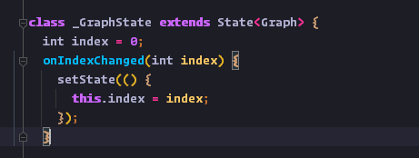
We will create a state to store the tab index, and a method to set the state when the tab is changed
In buildGraphsDisplay function return a
Column of widgets starting with the name
Of the page
See the next slide for the title of the page and the preview

Slide 39
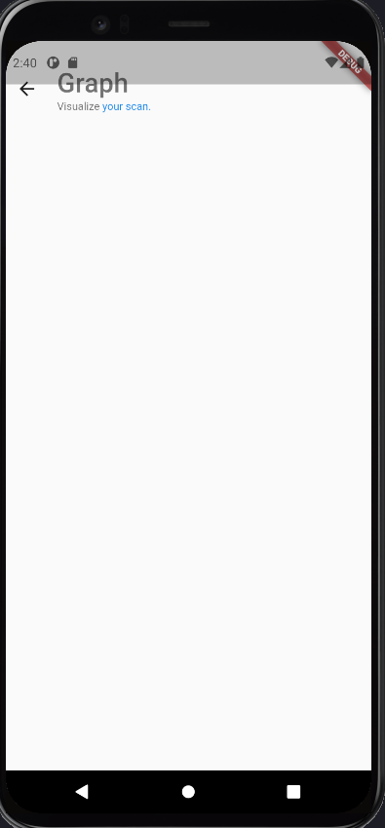
const SizedBox(height: kToolbarHeight), Row( mainAxisAlignment: MainAxisAlignment.spaceBetween, children: [ Row( crossAxisAlignment: CrossAxisAlignment.start, children: <Widget>[ Row( children: [ IconButton( icon: const Icon( Icons.arrow_back, size: 25, ), onPressed: () {}, ), const SizedBox(width: 10), ], ), Column( crossAxisAlignment: CrossAxisAlignment.start, children: <Widget>[ Text( "Graph", style: Theme.of(context).textTheme.headline4.copyWith( fontWeight: FontWeight.w600, fontSize: 30, ), ), const SizedBox(height: 2), RichText( text: TextSpan( children: [ TextSpan( text: "Visualize", style: Theme.of(context).textTheme.caption, ), TextSpan( text: " your scan.", style: Theme.of(context) .textTheme .caption .copyWith(color: Color(0xFF178AE8)), ), ], ), ) ], ), ], ), ], ),

Slide 40
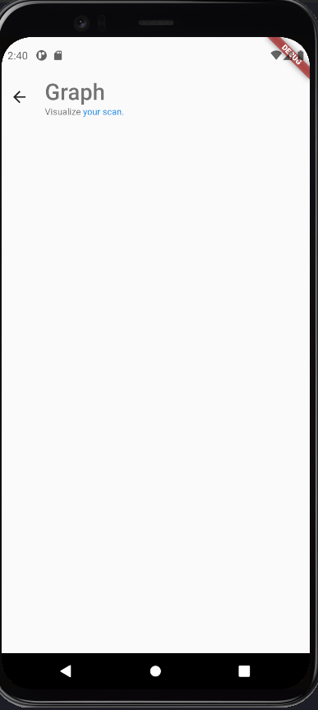
For the overlay on top of the page, this can be fixed by adding following code in main.dart
Restart the debug process to see the result
void main() { SystemChrome.setSystemUIOverlayStyle(SystemUiOverlayStyle( statusBarColor: Colors.transparent, )); runApp(MyApp()); }

Slide 41
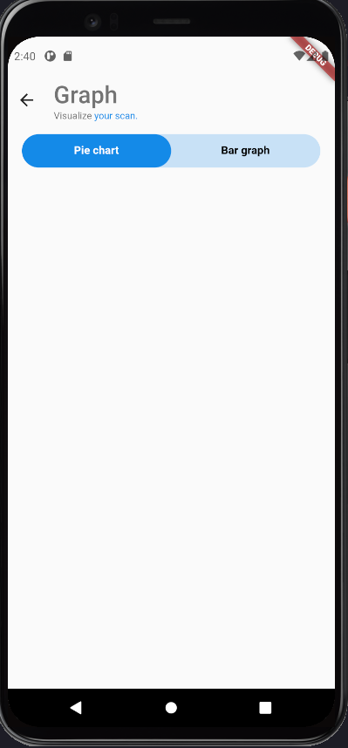
Now we will show the tabbar, in the Column children use the CustomTabBar widget
const SizedBox(height: 16), Expanded( child: Column( mainAxisSize: MainAxisSize.min, children: [ Padding( padding: const EdgeInsets.symmetric(horizontal: 18), child: CustomTabBar( items: const ["Pie chart", "Bar graph"], defaultIndex: index, onChanged: onIndexChanged, ), ),
], ), ) ],

Slide 42
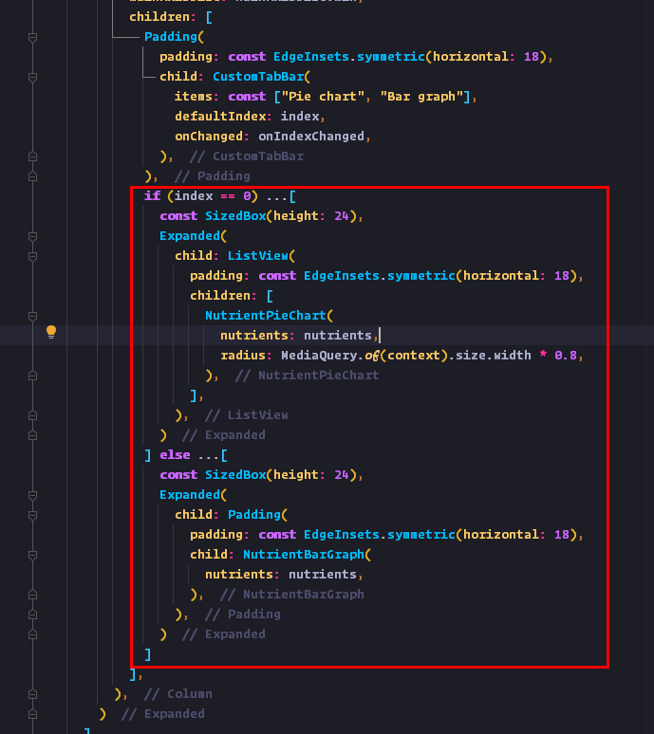
Now we will show the widgets based on the index of the tabbar.
Inside the column of CustomTabBar show the charts based on the index
if (index == 0) ...[ const SizedBox(height: 24), Expanded( child: ListView( padding: const EdgeInsets.symmetric(horizontal: 18), children: [ NutrientPieChart( nutrients: nutrients, radius: MediaQuery.of(context).size.width * 0.8, ), ], ), ) ] else ...[ const SizedBox(height: 24), Expanded( child: Padding( padding: const EdgeInsets.symmetric(horizontal: 18), child: NutrientBarGraph( nutrients: nutrients, ), ), ) ]

Slide 43
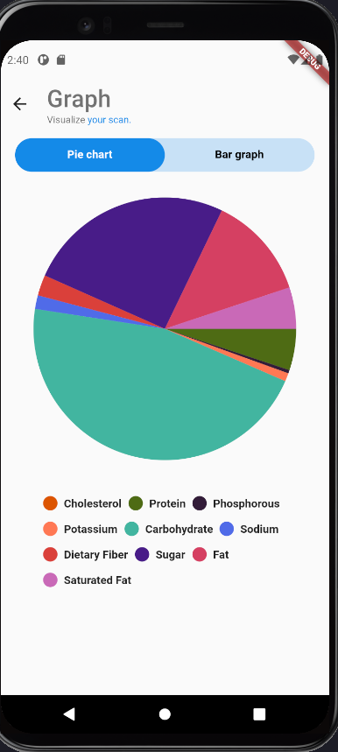
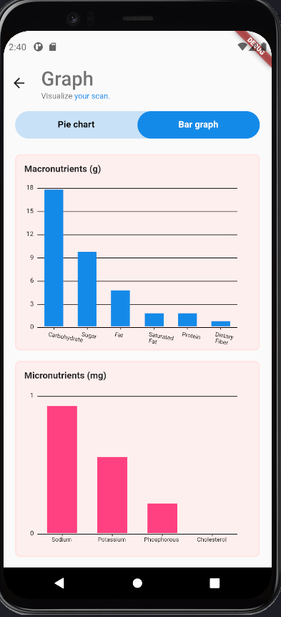
After this the UI will look something like this

Slide 44
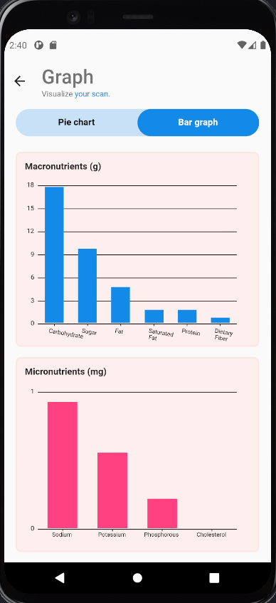
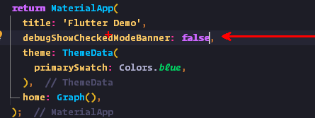
To remove the debug banner from the top, add this line in MaterialApp in main.dart

Slide 45
BONUS
Added a theme.dart file to specify fonts globally
Added WorkSans font from
You can change the styles from themes.dart file for changing the font sizes and other values

Slide 46
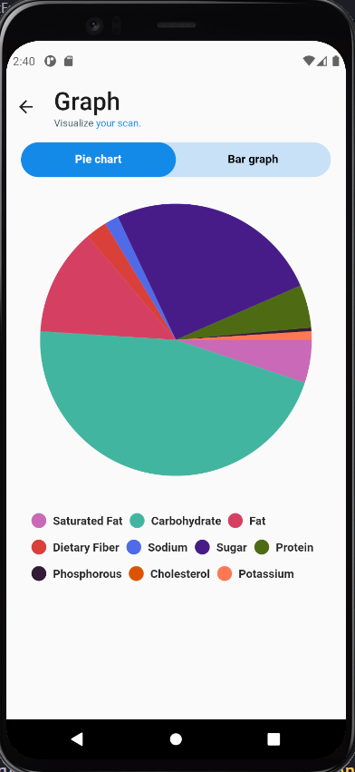
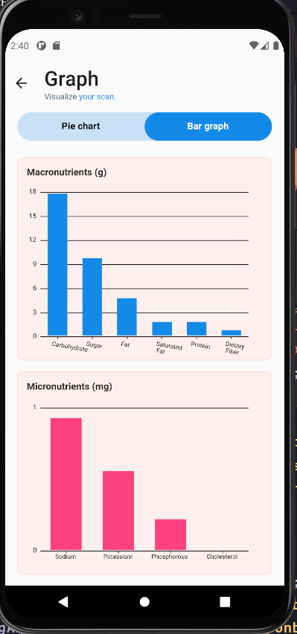
Final results

Slide 47
Thankyou 😀

