Slide 1

HAMI NIROGI
ANKIT KUMAR KARNA
AWAN SHRESTHA
SABIL SHRESTHA
SKANDA ARYAL
UJWAL BASNET
SUPERVISED BY
DR. GAJENDRA SHARMA
(Associate Professor, Department of Computer Science and Engineering, Kathmandu University)

Slide 2
Outline
Project Inception
Objectives
Literature Review
Tools used
Project features
Challenges in Implementation
Innovative features
Conclusion
Future Enhancements

Slide 3



PROJECT INCEPTION
TOTAL POPULATION OF NEPAL - 29,624,035
TOTAL NUMBER OF DOCTORS IN NEPAL 16,432
DOCTOR TO POPULATION RATIO 1:1803
Source: worldometers
Source: Graph Nepal

Slide 4
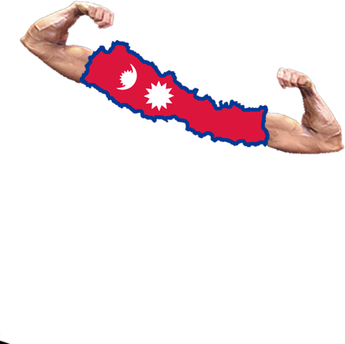
OBJECTIVES
To improve overall health condition in Nepal
Provide health related information to people
Platform for interaction between public and doctors
Aware people about endemics by area

Slide 5
LITERATURE REVIEW
Nirogi Nepal
Health at Home
Mero Lagi
Hamro Doctor

Slide 6
LITERATURE REVIEW
There are few health related websites and apps in Nepal working for betterment of health condition of Nepalese People.
Advancement in IT can create a strong impact in rural health condition.

Slide 7





Tools used
Html
CSS
JavaScript
NodeJS
MySQL

Slide 8
Project features
Health Forum
Video Calling
Cardio Risk Predictor
Geography Health Information
Health Tips

Slide 9
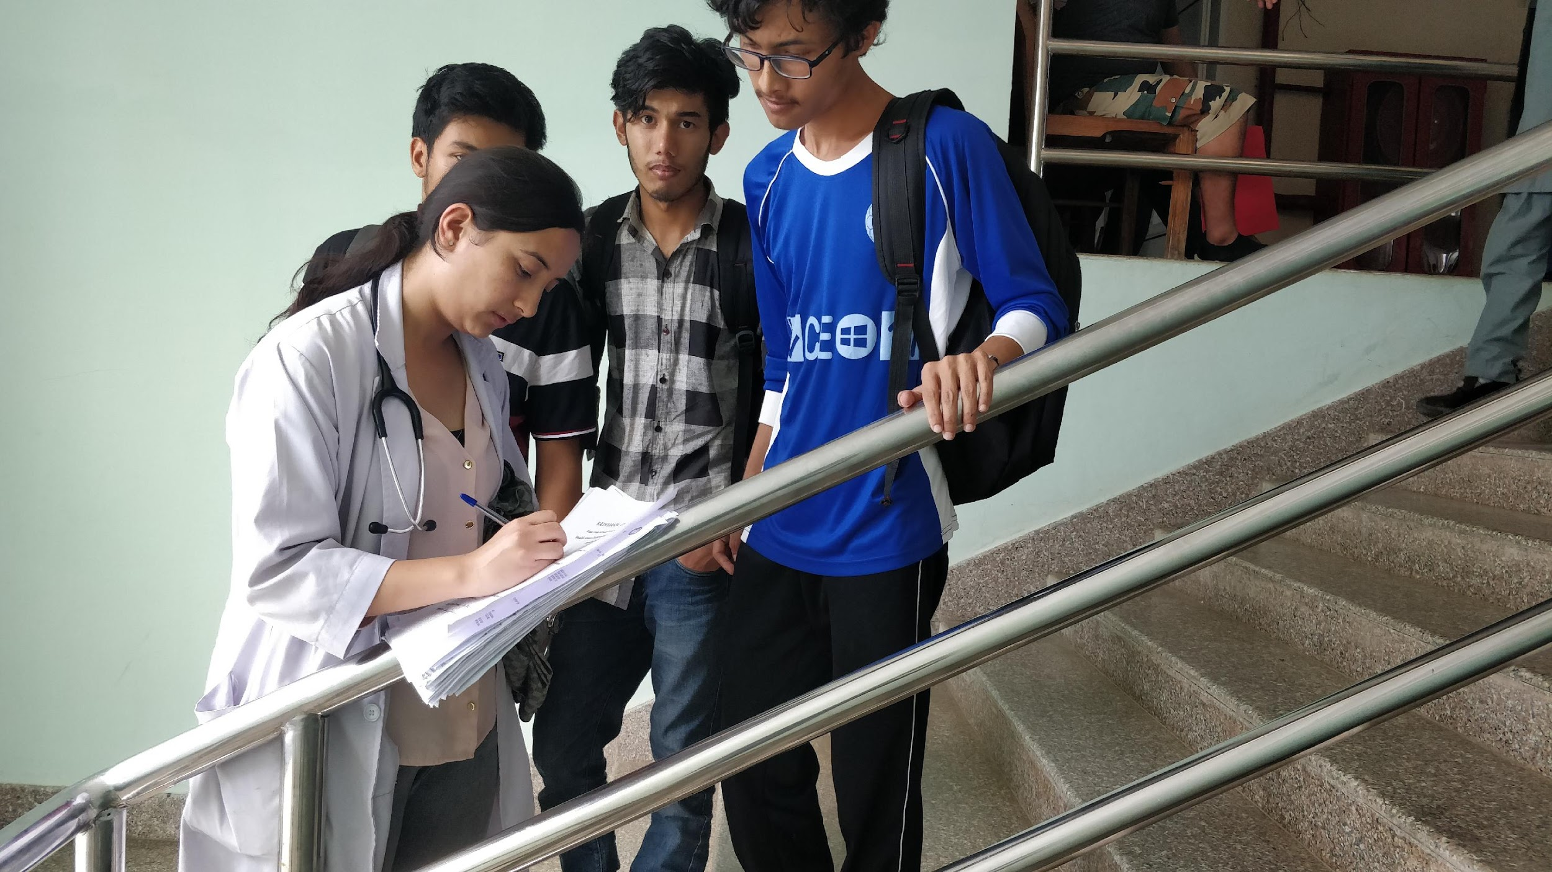
RESEARCH

Slide 10
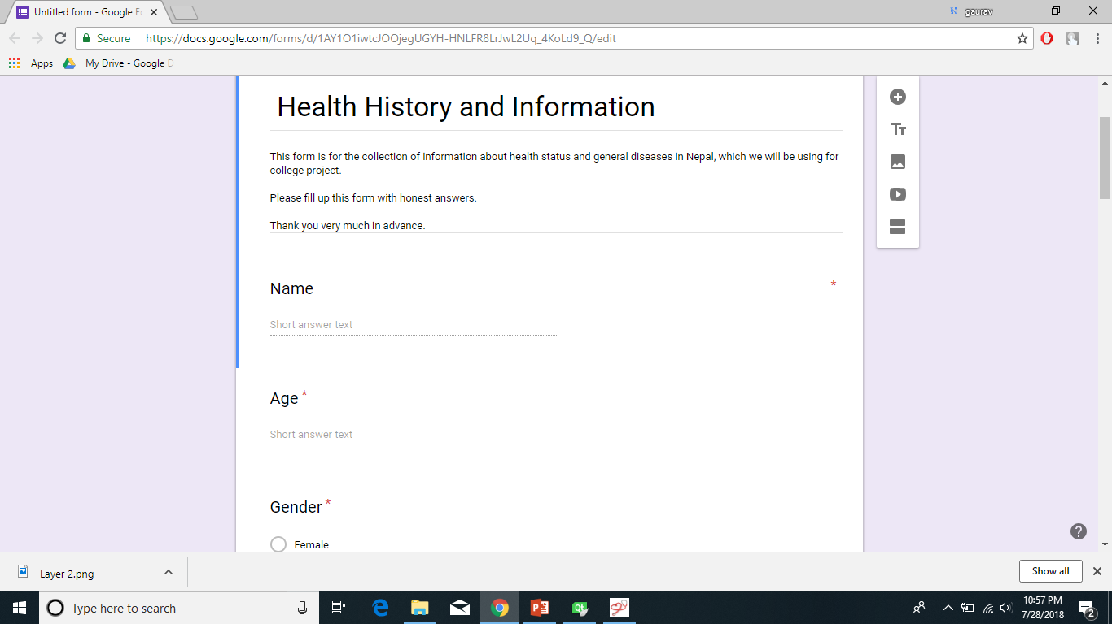
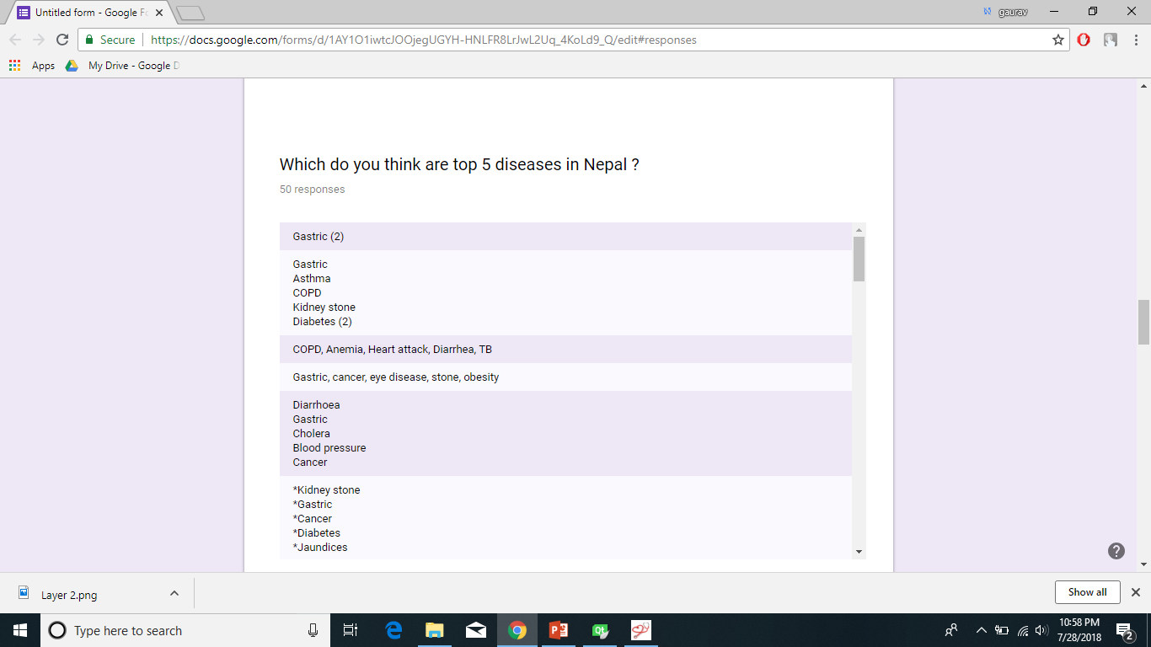
GOOGLE FORM

Slide 11

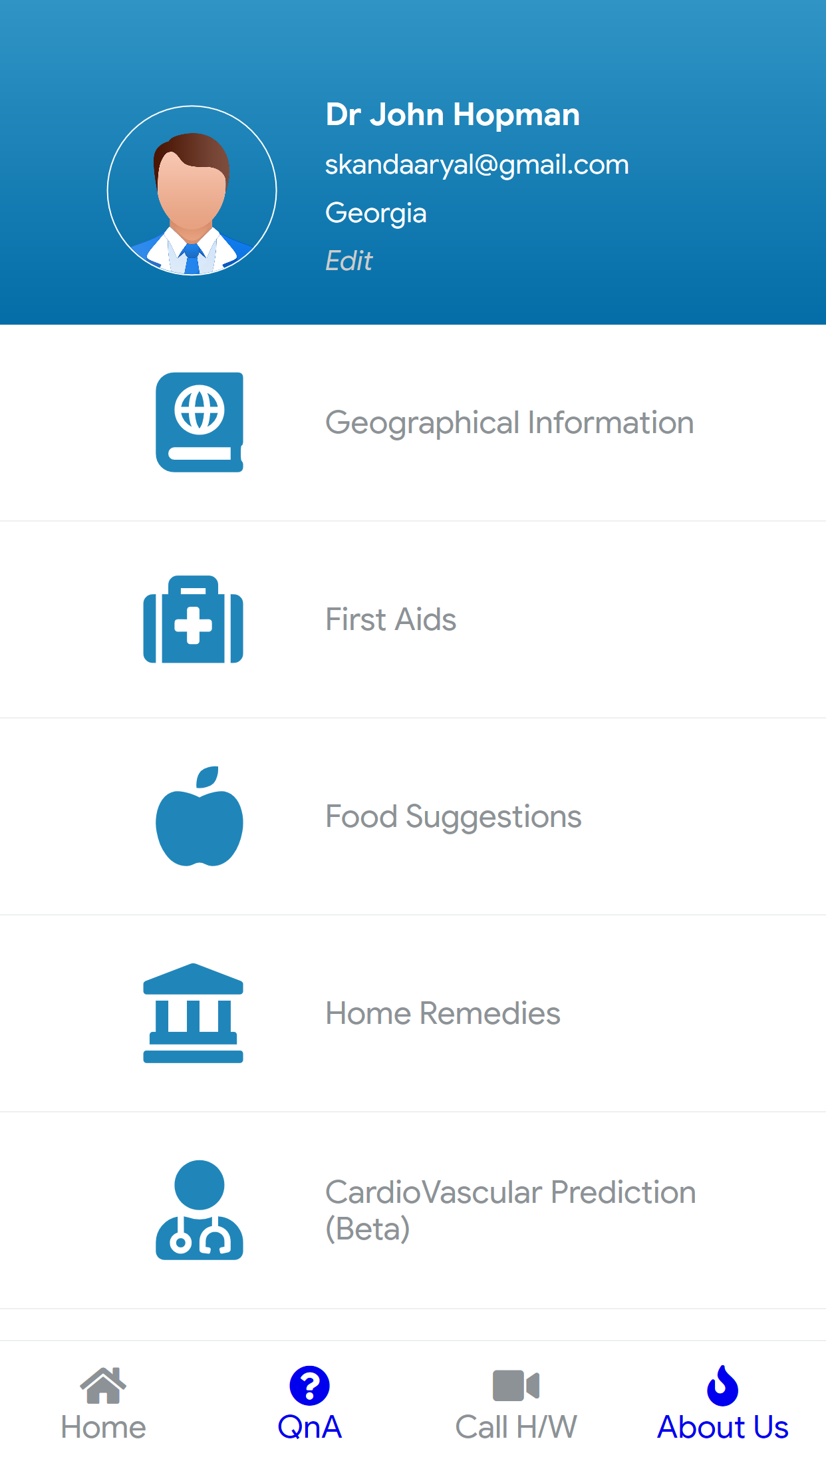

Slide 12
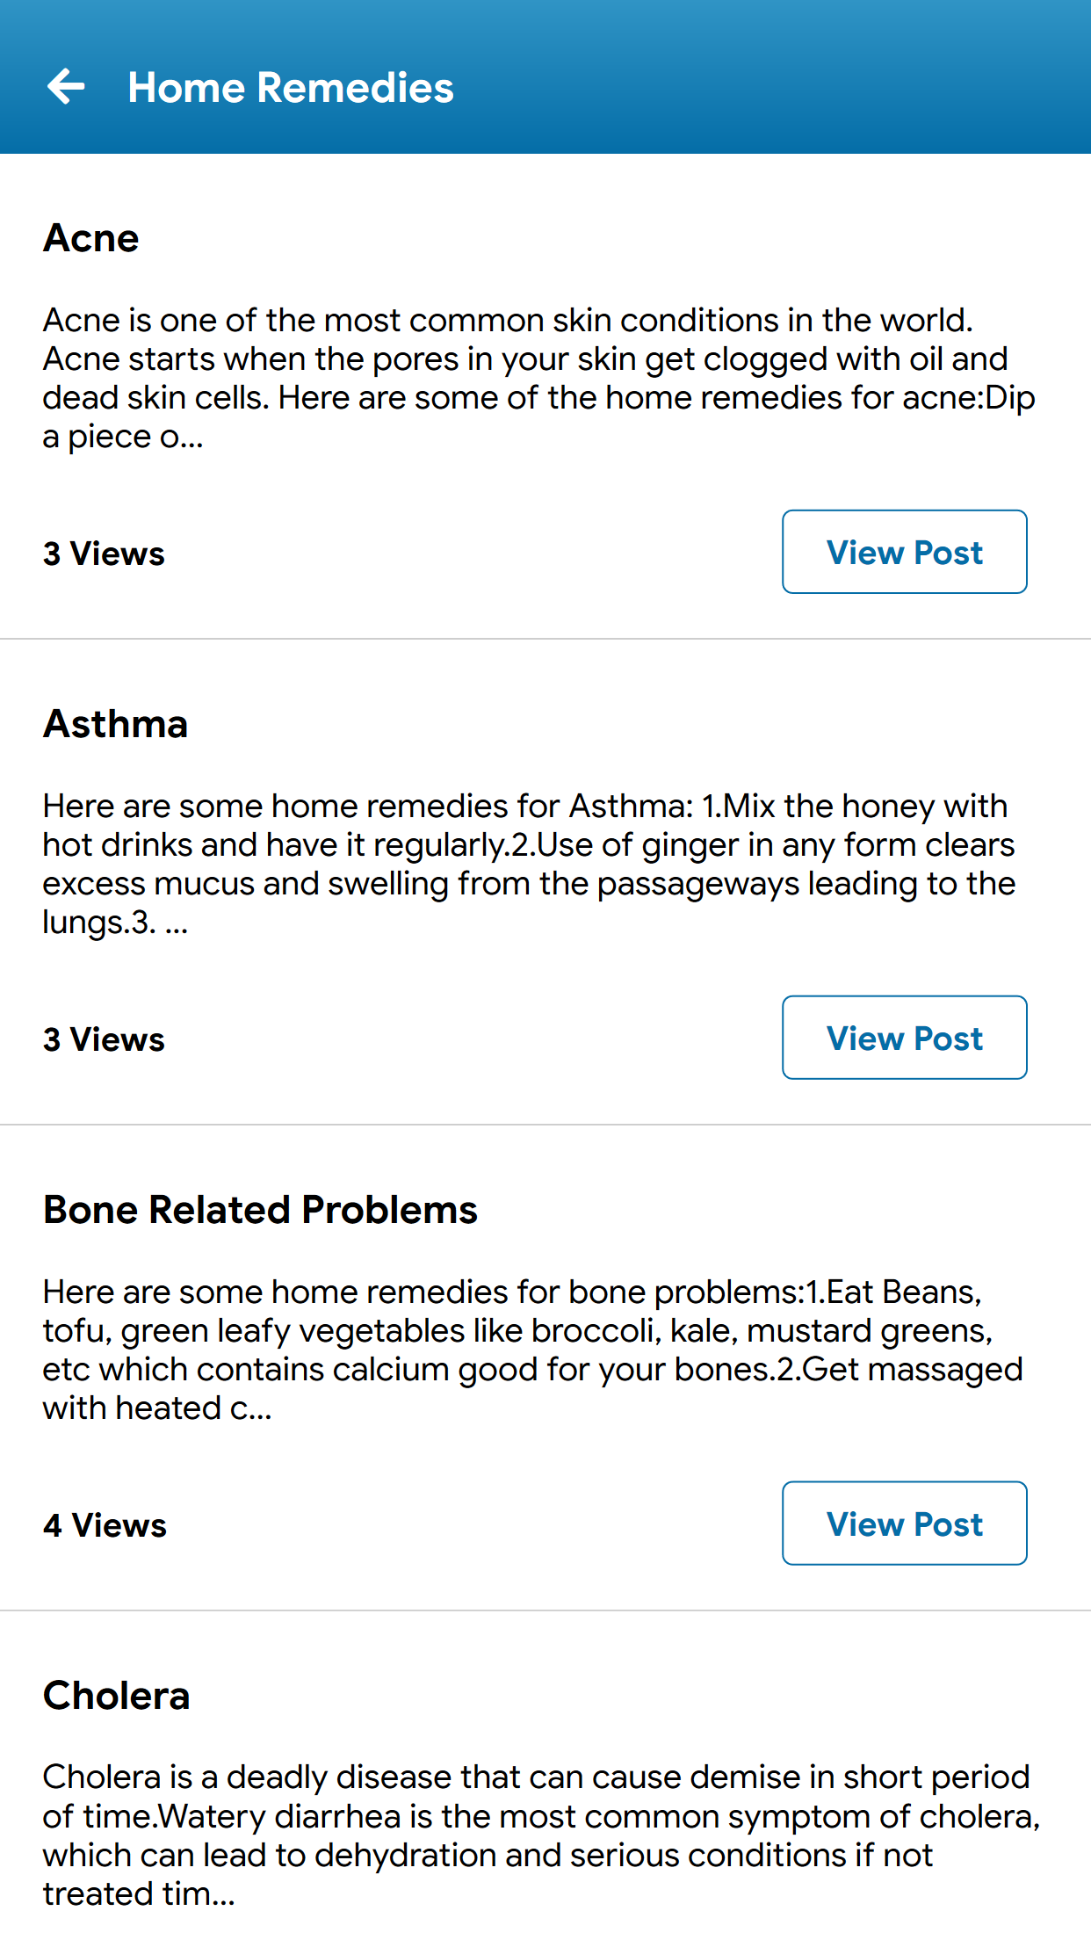
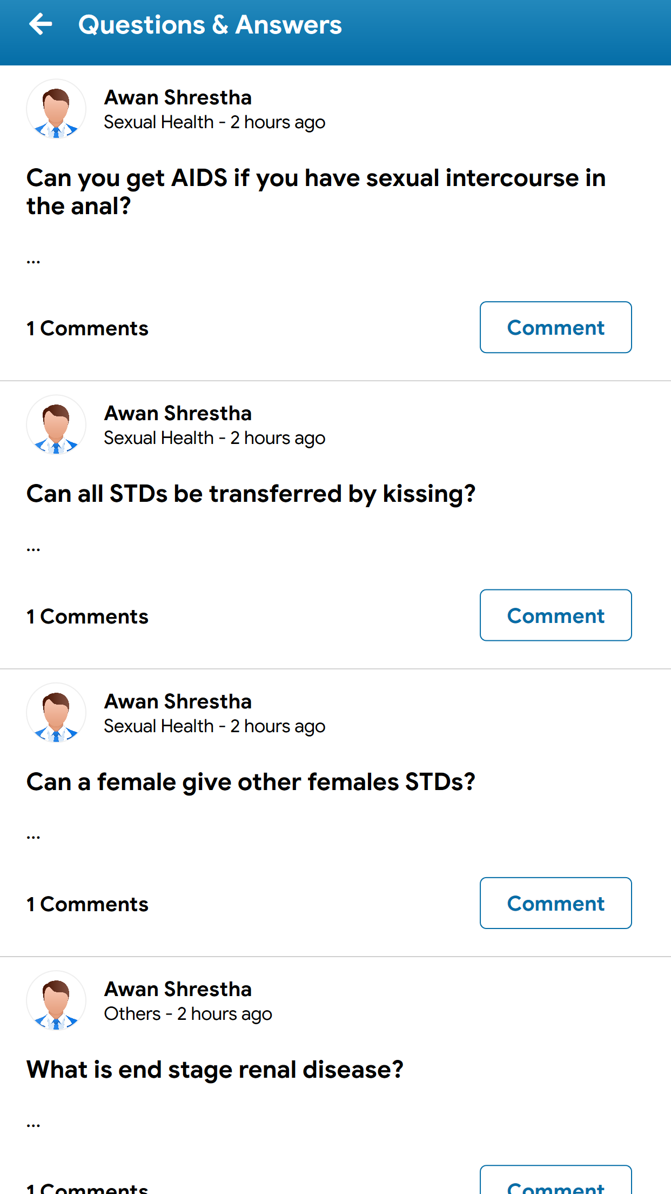
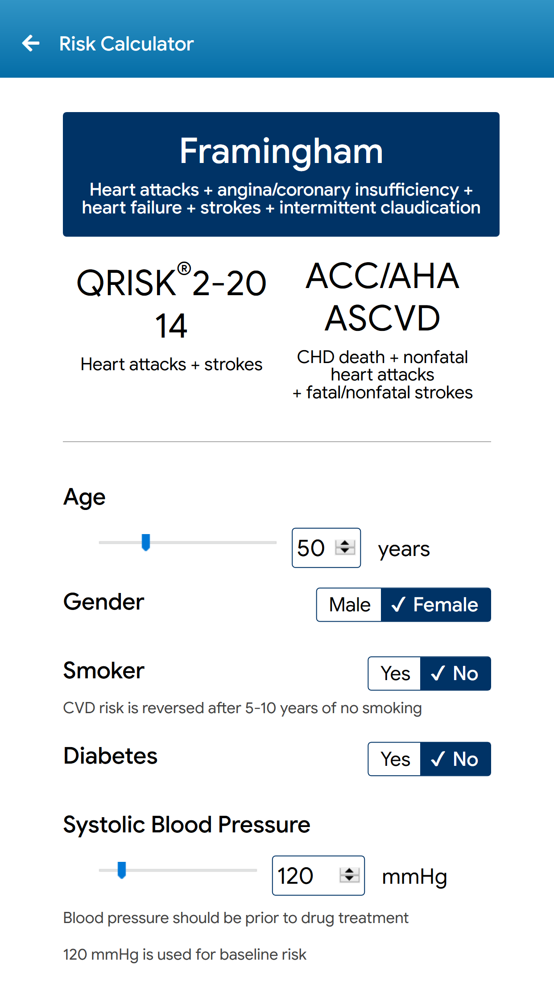

Slide 13
Challenges in implementation
Anonymous
Responsive
Hard Access
High Initial Investment

Slide 14



Innovative Features
Video Calling
Geography Health Information
Direct Doctor User Interaction

Slide 15
Future enhancements
Appointment
AI
More Information
Find nearby doctors

Slide 16
Conclusion
Health condition of Nepalese people is not satisfactory.
Information Technology can play vital role in upgrading health condition.
Hami Nirogi : A web application for people to get health related information and connect with health professionals.

Slide 17


THANK YOU

