Slide 1
EXAMINATION RECORD SYSTEM
Team: ABHIMANYU NEUPANE
SIZAR AWALE
SESIL CHAKRADHAR
SAILESH KHADKA

Slide 2
Topics
Introduction
Methodology
Technology and Tools
Design
Testing
Question and Answer session

Slide 3
Introduction
Background:
This is a system which is completed in C language
To conduct entrance examination record in automated way.
System holds the all data in a file with different students name and id
Easy to find the students details

Slide 4
Problems:
wait too long for their result
waste of time of candidates.
Objectives:
encloses the needs and scope of the development of the project
conduct entrance examination record in automated way

Slide 5
Methodology
Waterfall model
This system is developed in waterfall model
All the requirements are well known.

Slide 6
Technology and tools
Technology:
This system is developed in C-language
For use-case and activity we use the UML (Unified Modeling Language)
Tools:
To develop this system Code Blocks is used and is compiled.
For use-case and activity Creately online tools is used to design a diagram

Slide 7
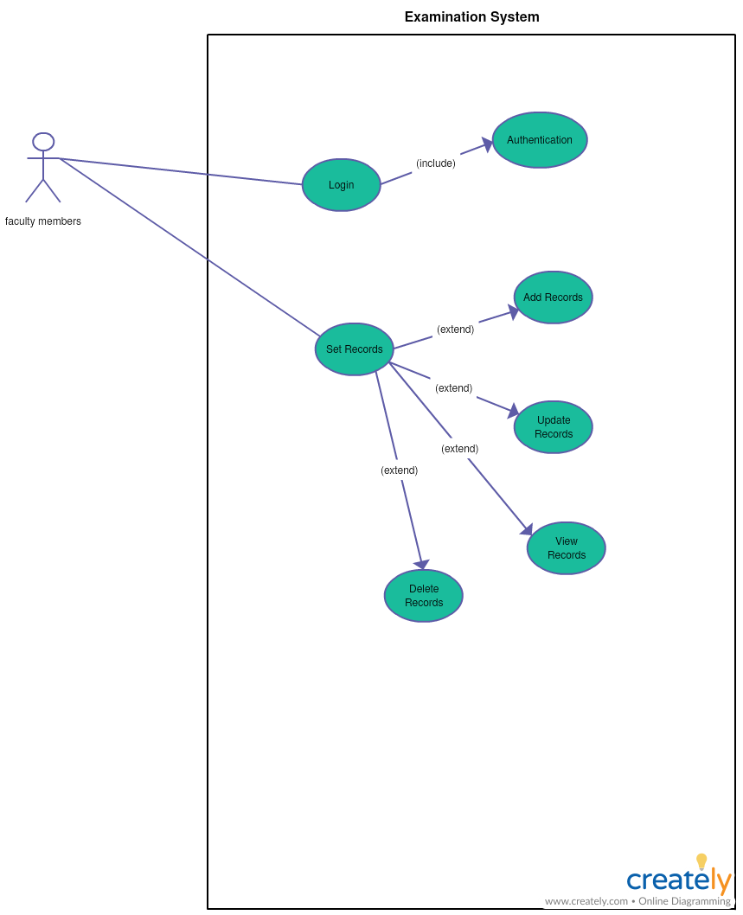
Design
Use-case

Slide 8
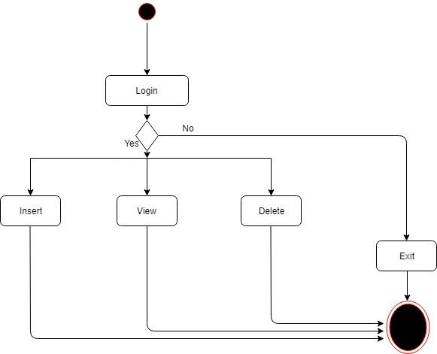
Activity Diagram

Slide 9
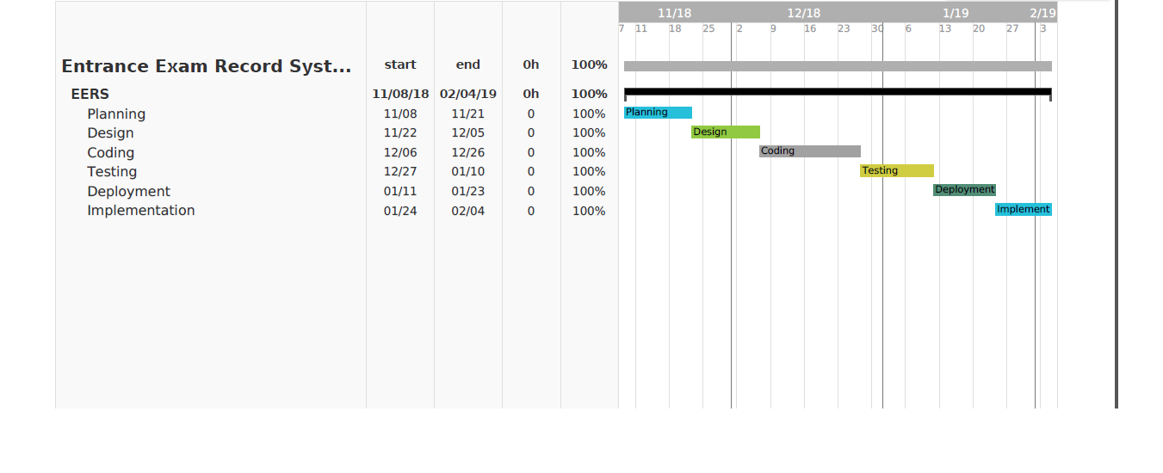
Gantt Chart

Slide 10
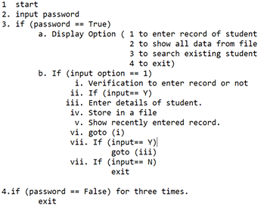
Algorithm

Slide 11
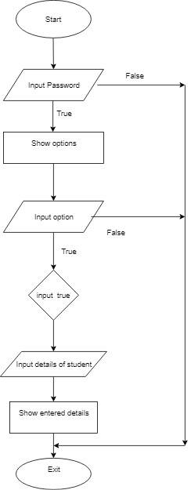
Flowchart

Slide 12
Testing
Since we have passed students details in main function for better result.

Slide 13
Any Queries??
Thank you!!

