Slide 1
S A I L F I S H

Slide 2
A free CFD solver
CUDA / OpenCL
Lattice Boltzmann Method

Slide 3
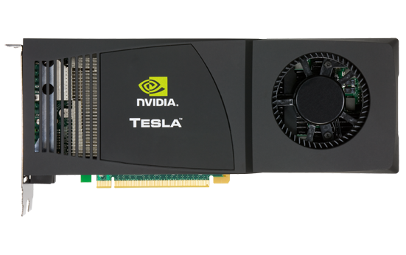
Works on Nvidia

Slide 4
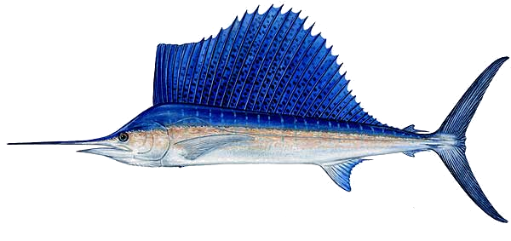
S A I L F I S H

