Slide 1
ML Team 1 Final Presentation
STEM-Away July 2020 NLP Annotation Tool with Active Learning
Notes:
A lot of information to cover and will be going over concepts at a high level. Please feel free to ask us to clarify anything during the Q&A.

Slide 2
Agenda
Team Introduction
Project Outline
Software Architecture
Data Collection and Processing
User Interface
Hyperparameters and Metrics
Benchmarking Results
Future Work
Questions and Discussion

Slide 3
ML Team 1 Introduction
Project Lead: Kevin Dong
Project Manager Lead: Kitty Gu
Participants: Akim Borbuev, Chanh Bui, Maxim Gorshkov, Christopher Lee, Kushal Shah
Observers: Khanh Ho
Mentor: Sara El-Ateif

Slide 4
Project Outline
Notes:
Hi everyone, this is Kitty, and I am now going to introduce some background information about our project.

Slide 5
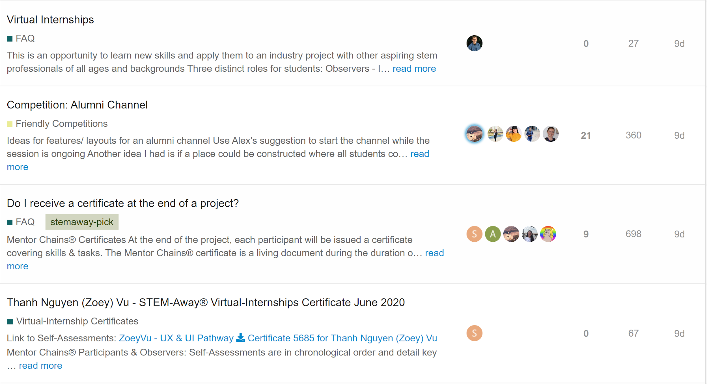
Problem Statement
Topics in the STEM-Away forum are not tagged properly.
Notes:
As of August 2020, the majority of topics on the STEM-Away forum are not tagged properly, as you can see in the picture, the topics are either untagged or have tags that are incorrect/vague.

Slide 6
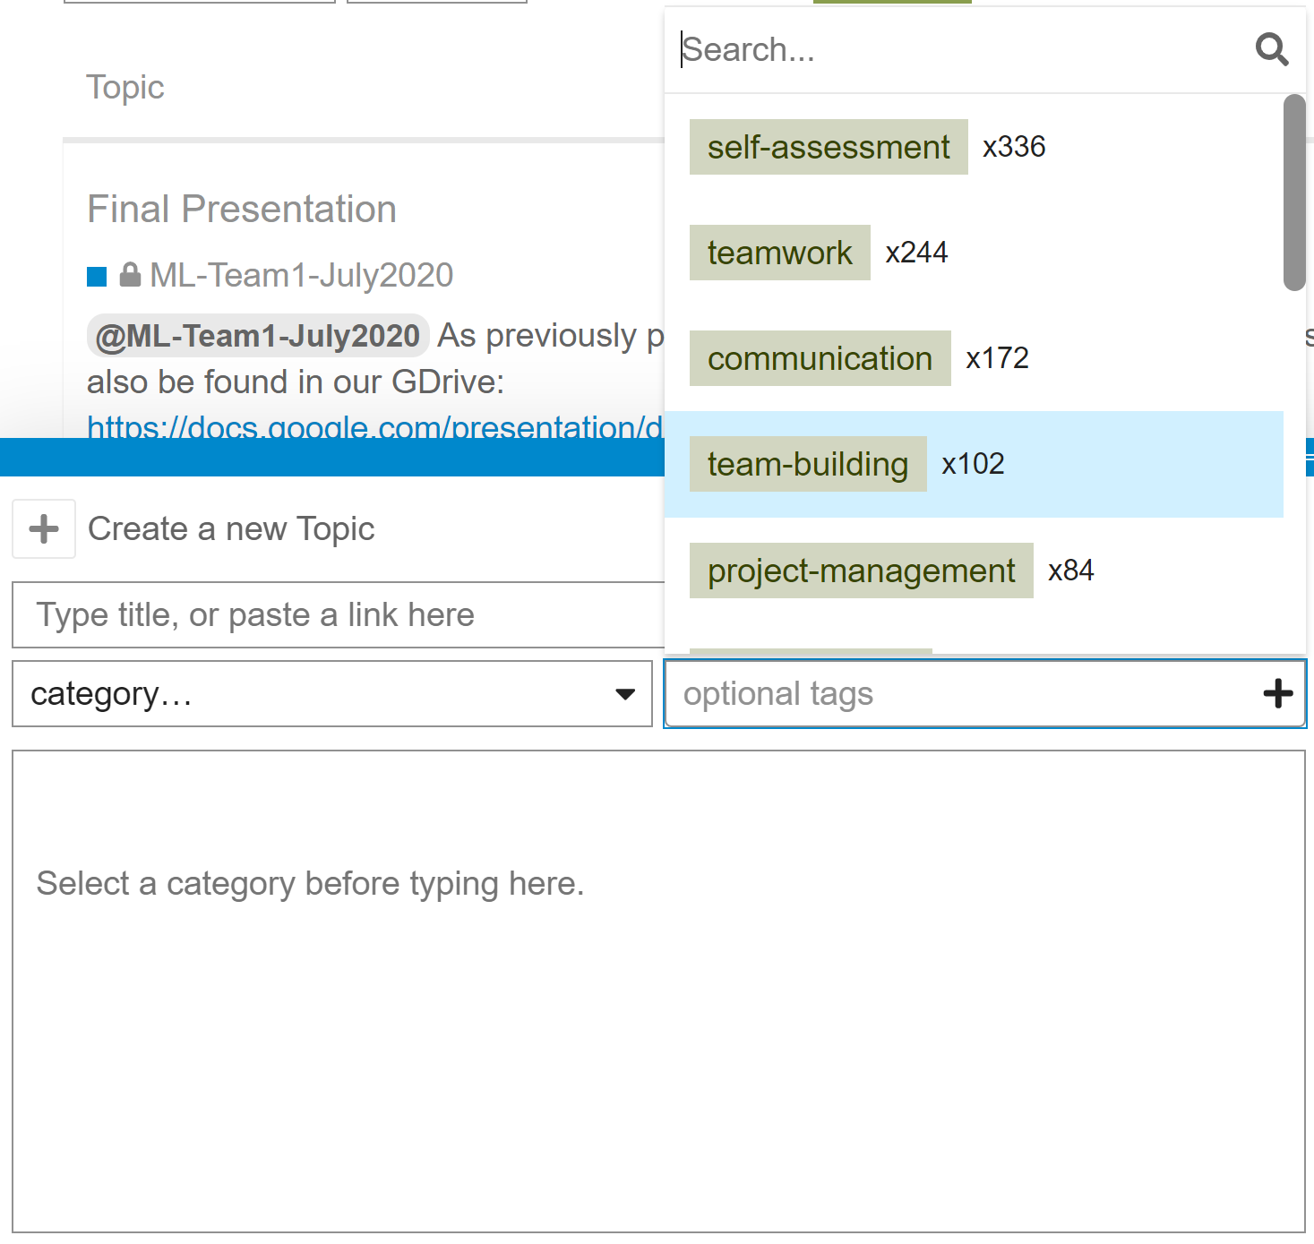
Problem Statement
The current tagging interface has proved to be ineffective at prompting users to correctly tag topics in a way that would be beneficial to STEM-Away’s needs.
Notes:
The current STEM-Away tagging interface is not very effective in helping the users to correctly label their posts. So our goal is to develop a system that uses machine learning techniques to provide high quality tag suggestions. The posts can then be more properly tagged and the user experience on STEM-Away will hopefully be more efficient and pleasant.

Slide 7
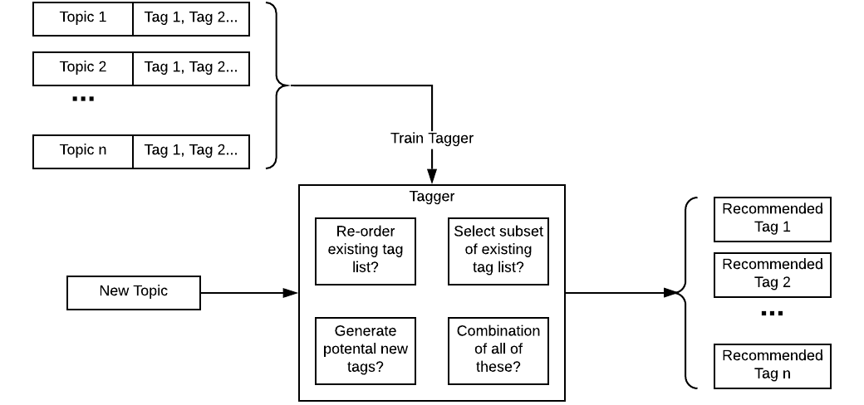
STEM-Away Tagger
Create a system to facilitate the tagging process in STEM-Away when a new topic is created
Notes:
So the final product of our solution is going to be a STEM-Away Tagger that will be presented via a user interface. As the graphic shows, the system is going to take in the new topic/post that the user is inputting and spit out a number of recommended tags for users to choose from according to the content of this newly written post. But how can the tagger know what category the post belongs to/ what are the appropriate tags to suggest? That is when we realize we need this second part to our solution, which will provide a set of correctly labeled dataset to train the STEM-Away Tagger so that it can do its job effectively.

Slide 8
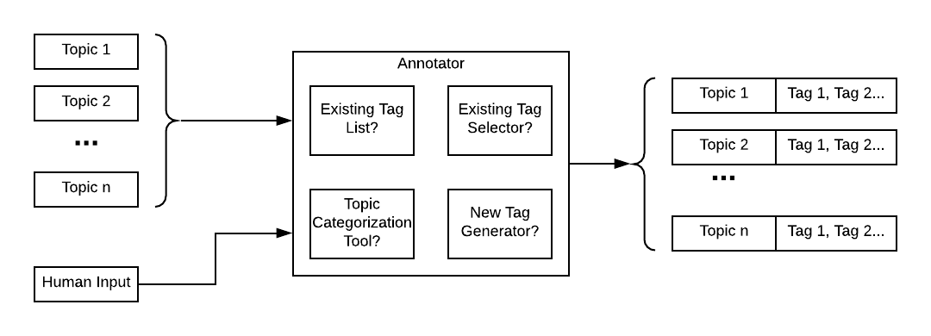
Topic Annotator
Create a system to assist in the manual annotation (labeling) of Discourse forum topics using tags
Notes:
We name this second part to the solution the Topic Annotator, which is what our team mainly focused and worked on for this past month. The topic annotatoe essentially takes in a list of Topics, and with the help of a human labeler, it will finally output a correctly labeled dataframe that we will use to train the STEM-Away Tagger, that was just shown in the last slide.

Slide 9
Project Goals
Create a modular annotation tool that uses active learning to assist in the creation of a properly labeled dataset of topics and lists of tags
Perform benchmarking analysis on Stack Exchange data in order to understand the behaviour and parameters of the active learning architecture
Deploy the annotation tool on AWS with a user-friendly interface that will enable users to easily tune and run the tool
Notes:
So here are our team’s project goals. First, we want to create the Topic Annotator, which will take in a dataset of unabled topics and a list of potential tags, and construct a dataset of properly labeled topics. After some research, We decided to use Active Learning to achieve this goal. Active Learning is a method puts a human the the training process to optimize training results.
Our second goal is to perform benchmarking analysis on Stack Exchange data to understand the behavior and parameters of this Active Learning architecture we choose.
Thirdly, we want to deploy the annotation tool on AWS for it to be easily used and accessed.

Slide 10
Software Architecture
Notes:
Now I am going to dive a little deeper into the actual architecture of the Topic Annotator our team came up with.

Slide 11
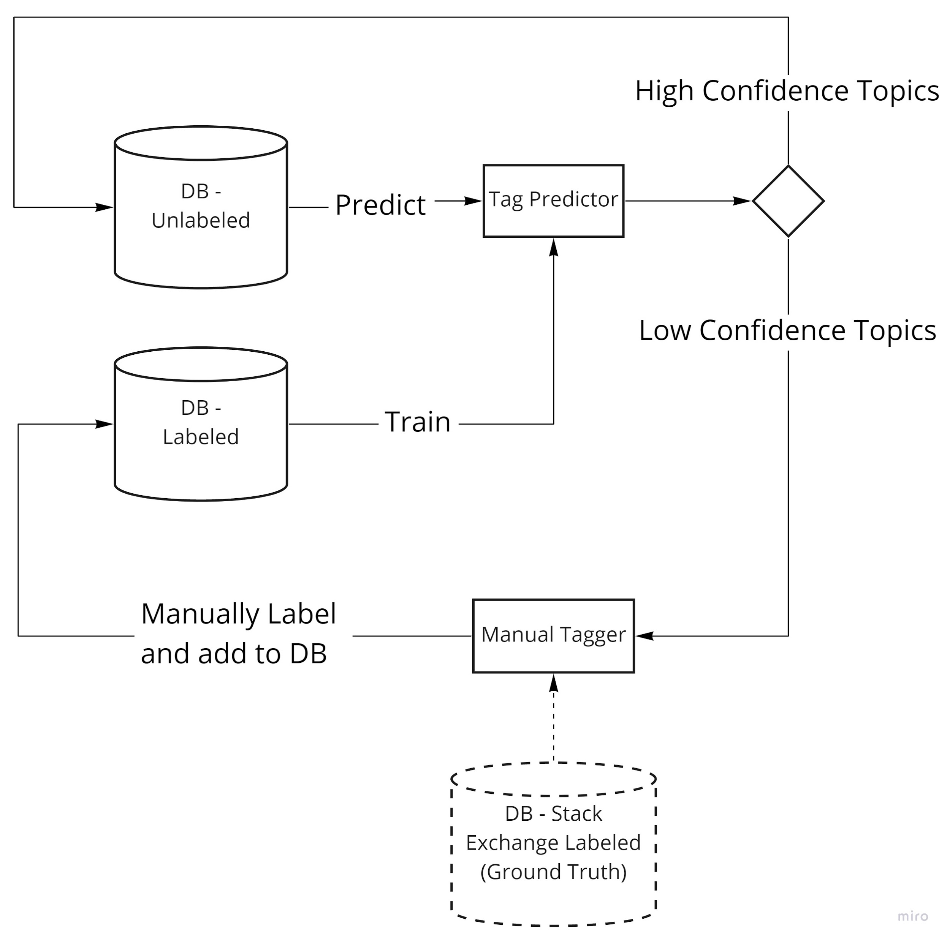
Annotator Architecture
The initial labeled database (DB) will be be generated by manually labeling topics one by one.
A formal method will be used to calculate a prediction’s confidence at the rightmost decision gate.
The Manual Tagger shall be interchangeable between a user interface and simple lookup table for benchmarking.
Notes:
So this image shows the basic structure of our annotator. This loop starts with the “DB-Unlabled” Cylinder shown on the upper left, which is our initial labeled database, which is partially labeled. The labeled portion of this database is simply manually labeled. So a person basically would manually label these topic one by one to start this loop off.
This initial database is going to be send to the tag predictor to predict appropriate tags for the passed in topics. The tag predictor will then do a Confidence Calcuation, and it will only send the topics which it has low confidence labeling to the Manual Tagger.
The Manual Tagger would be a user interface, but because we want to do some benchmarking on the StackExchange data(the second goal of our project), it also can be a “Truth Table” the corresponding tags to the topics are simply looked up. So the Manual Tagger is kind of special in the way that it can have two forms, one is the user interface where we ask a user to choose the correct tags for the low confidence topic, or it can be a “Truth Table” where the correct tags can just simply be looked up from the scraped data from StackExchange.
So after the Manual Tagger, we will have a dataset of labeled data, which will be appended to a dataset of labeled database and be used to train the Tag Predictor. After training, the Tag Predictor will make another attempt to predict the initial database and pass the low confidence topics to the manual Tagger. This entire process will occur again and again until we have a well trained tag predictor that produce a set of properly labeled data for us.

Slide 12
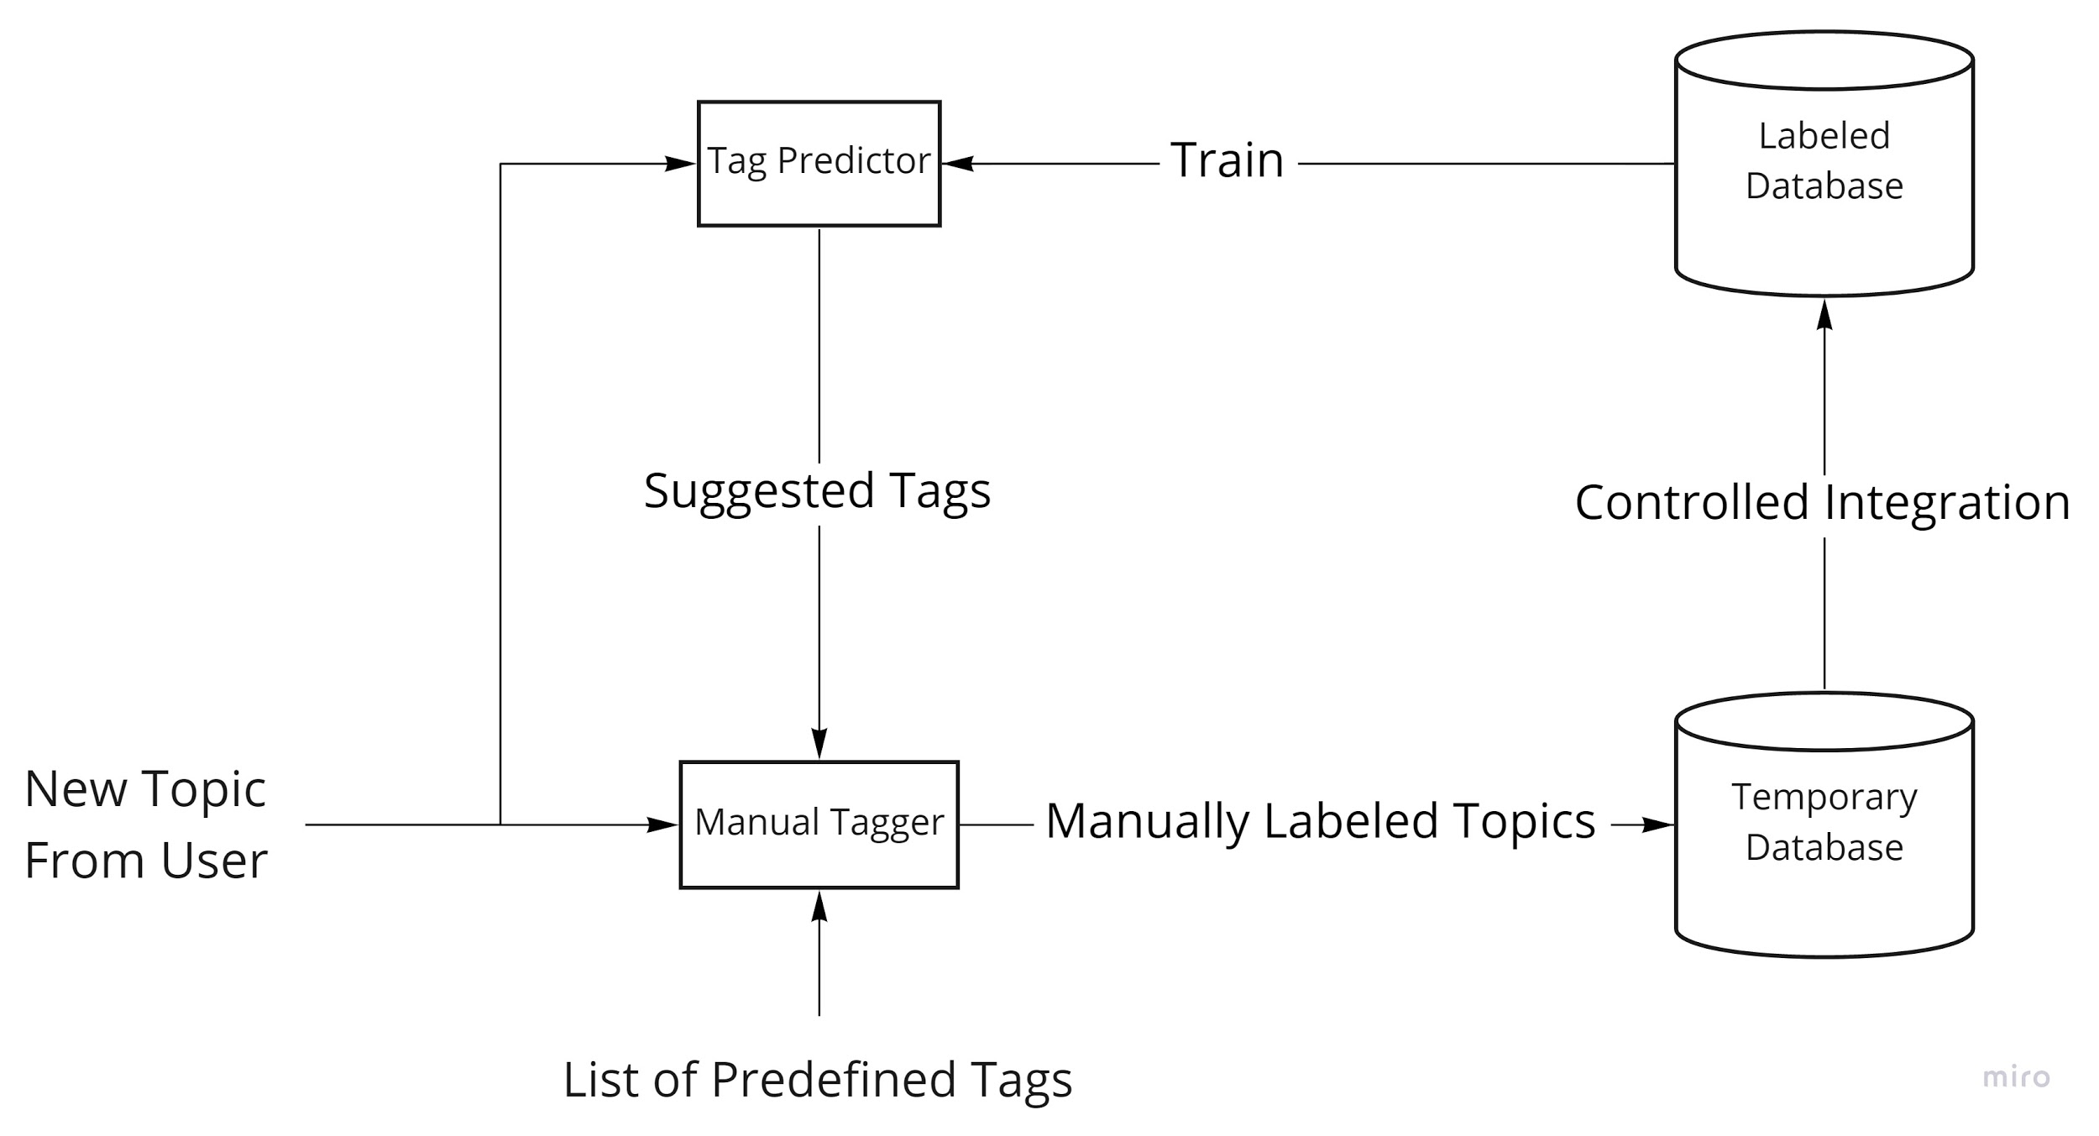
STEM-Away Tagger Architecture
The same components in the annotator can be used for the STEM-Away tagger in a different configuration.
Note that although both architectures use active learning, the purpose of each implementation is different.
Notes:
Just for your information, The final product, which is the STEM-Away Tagger will have a similar active learning structure. The labeled database in this case will be the labeled data base we get from the Topic Annotator we just introduced. The new topics that the user inputs will be tagged with one of the suggested tags by the Tag Predictor, based on the user’s choice. This new pair of topic and tags will them be added to the labeled database, which will continue to be used to train the Tag Predictor. So ideally, the Tag Predictor is going to perform better and better as time goes on.

Slide 13
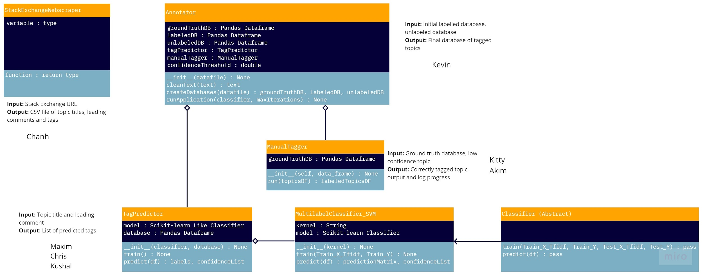
Annotator UML Diagram
Notes:
For the topic annotator that we are developing, we decided to use Object oriented programing, which provide us with an organized structure to work with. This UML Diagram shows how our classes are structured, with the annotator as the overarching class that brings in the Tag Predictor and the Manual Tagger Class. The webscraper class on the side helps us to the the StackExchange data that we need. And that should be all about our Topic Annotator strcture!

Slide 14
Data Collection and Processing

Slide 15
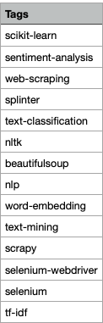
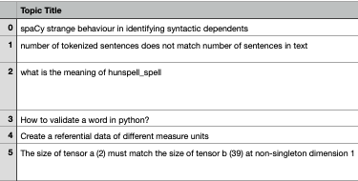
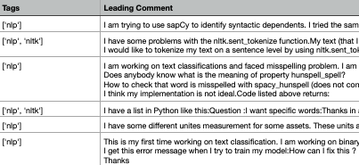
Web Scraping
Collected 7330 posts of 14 different tag categories from https://stackoverflow.com.
Implemented the webscraper architecture from June session, which uses Selenium and BeautifulSoup.

Slide 16
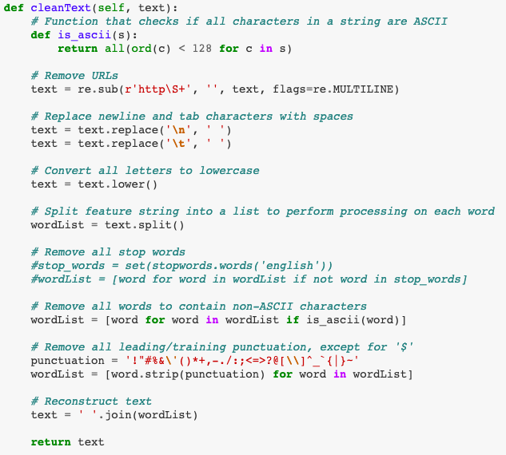
Data Cleaning
Combined the Leading Comment and Topic Title columns into Bag of Words in order to make the model training easier.
Performed basic data cleaning by calling cleanText() function on every row.
Notes:
We decided to perform minimal data cleaning because from our last session’s experience, over cleaning of data can lead to lost of essential data, which in turn leads to poor model performance.

Slide 17
User Interface
Notes:
To facilitate the STEM-Away tagging process we created a user interface for the manual tagger. Manual tagger labelling low confidence samples

Slide 18
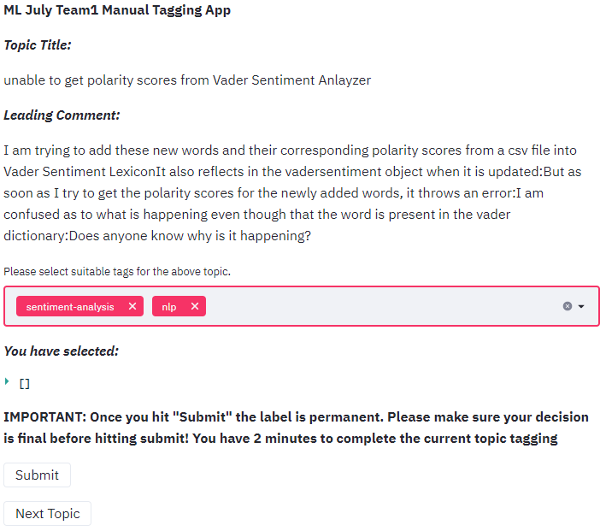
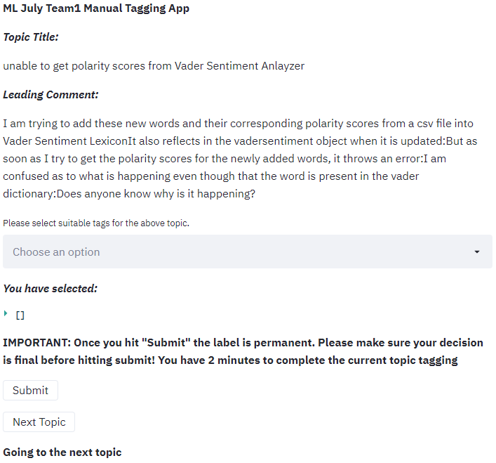
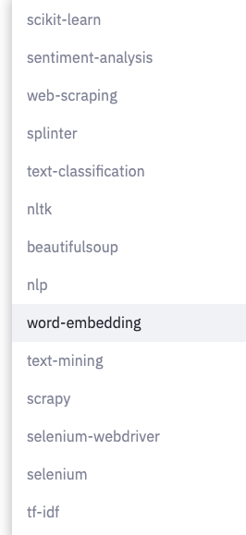
Streamlit
After Tagging
Dropdown menu for users to choose from
Click to save the tagging solution.
Click to tag the next low confidence topic.
Notes:
We also created Flask version of the manual tagger. Streamlit is more user-friendly compared to Flask

Slide 19
Hyperparameters and Metrics

Slide 20
Active Learning Hyperparameters
Ratio of labeled to unlabeled database size (eg. 20-80)
Tag list prediction confidence threshold (eg. 90%)
Method 1 (Average) - Average all prediction probabilities for all tags in the list
Method 2 (Low-5) - Average only the 5 lowest prediction probabilities in the list
Sample Prediction Output:
Pred: 10110000000000000000000000000000000
True: 11010000000000000000000000000000000
Interesting
Not Interesting
Notes:
Because the model is skewed to always predict a low number of tags, it will tend to have very high probabilities when a tag is predicted as not present

Slide 21
Prediction Evaluation Metrics
Accuracy:
(TP + TN) / (TP + TN + FP + FN)
Applied at the tag list level
Counts a prediction as a failure even if one of the tags do not match the ground truth
Hamming Loss:
sum( XOR(True, Pred) ) / (total number of unique tags)
The accuracy equation applied at the tag level
Formally, it is the complement of tag level accuracy
Notes:
Accuracy is applied at the tag list level. It underestimates performance.
Hamming loss is accuracy applied at the tag level. It overestimates performance because of the true negatives.

Slide 22
Prediction Evaluation Metrics
Precision (Tag Level):
TP / (TP + FP)
Penalizes tags that should not have been flagged in the prediction
Recall (Tag Level):
TP / (TP + FN)
Penalizes tags that should have been flagged in the prediction, but were not
F1 Score (Tag Level):
(2 * Precision * Recall) / (Precision + Recall)
Penalizes for both of the scenarios above
Notes:
Precision and recall are preferred metrics since they ignore true negatives and only operate on the segment of the tag list we are interested in
F1 is simply a balance between the two

Slide 23
Benchmarking Results

Slide 24
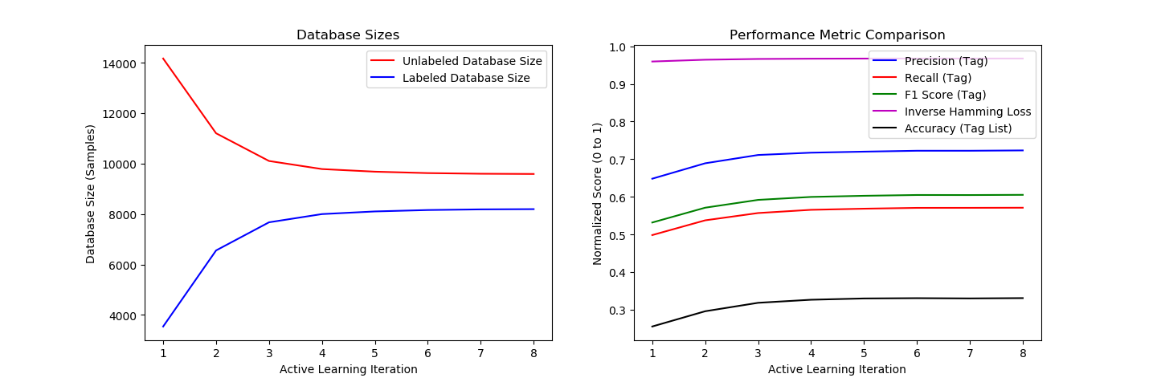
Metric Comparison (Average Confidence, 20-80, 96)
Notes:
Database lines evolution
Metric evolution
Precision is always higher than F1 Score

Slide 25
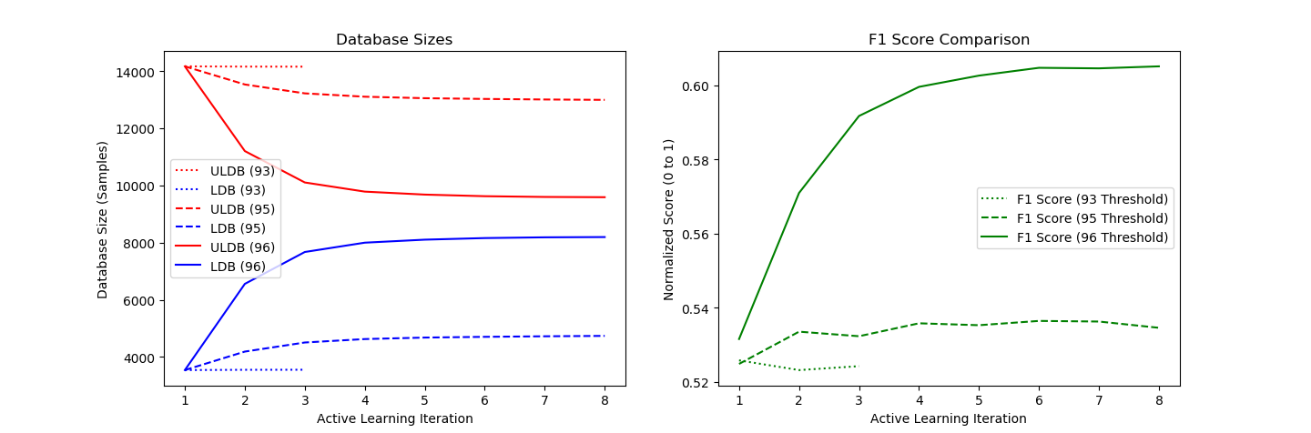
Threshold Comparison (Average Confidence, 20-80)
Notes:
Threshold increase causes performance increase due to more topics forwarded to the Manual Tagger
Note the consequence of setting a threshold too low (early termination of active learning loop)

Slide 26
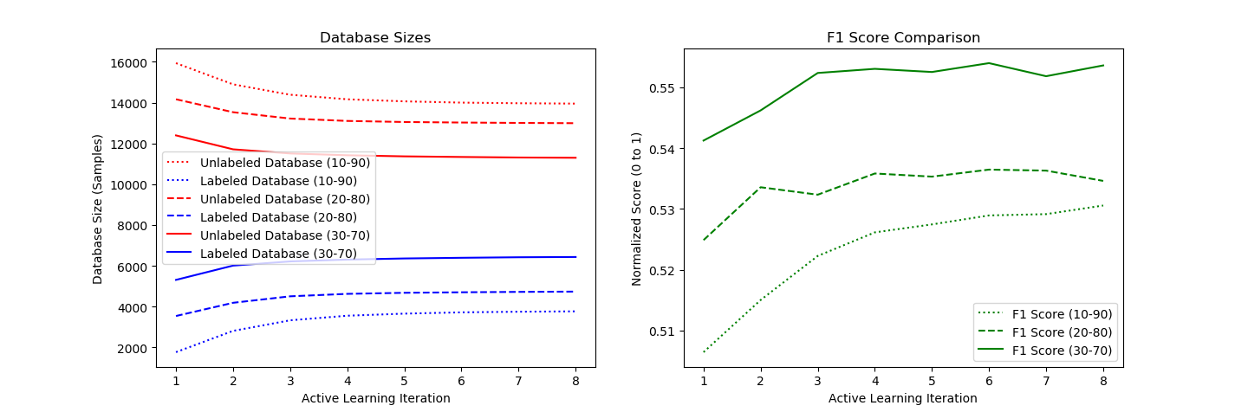
Database Size Comparison (Average Confidence, 95)
Notes:
A larger initial labeled database seem to result in better performance, but don’t draw conclusions yet

Slide 27
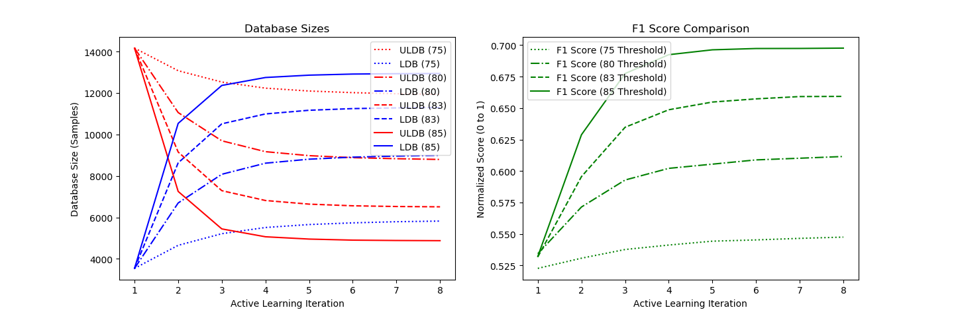
Threshold Comparison (Low-5 Confidence, 20-80)
Notes:
Same observation as before; threshold increase causes performance increase, up to 70% this time
Note the drawback with the database sizes; break-even point is reached when the lines cross; consequence of setting threshold too high

Slide 28
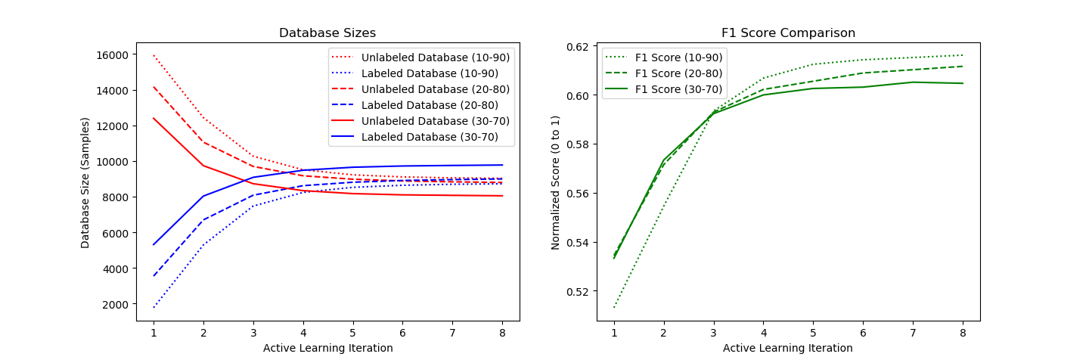
Database Size Comparison (Low-5 Confidence, 80)
Notes:
Still begin to see some DB lines crossing, but not as much as before
Note how the performance of the 10-90 split overtakes the other two in the long run. This is because a larger portion of the labeled DB is comprised of topics selected by the annotator. This behaviour is not seen with the Average confidence because it is not effective and selecting good topics to optimize training.

Slide 29
Key Conclusions
The Low-5 method for calculating prediction confidence is superior to the Average method, both in terms of topic selection and ease of tuning.
Proper tuning of the confidence threshold is important. Very low/high thresholds introduce various consequences.
A smaller size for the initial labeled database may result in better performance in the long run, since a larger portion of it is comprised of topics selected to optimize training, rather than selected randomly.
Using active learning is advantageous to not using it. A model trained on a random 90% of the full dataset (~16 000 samples) only achieved an F1 score of 56%!

Slide 30
Future Work
Use Flask instead of Streamlit for the user interface, or investigate ways to work around the current limitations with Streamlit.
Create more TagPredictor classes for different ML models and continue to collect more benchmarking results.
Utilize our annotator on STEM-Away data.
Begin to create the STEM-Away tagger by reconfiguring the components of our annotator.

Slide 31
Questions and Discussion

