Slide 1
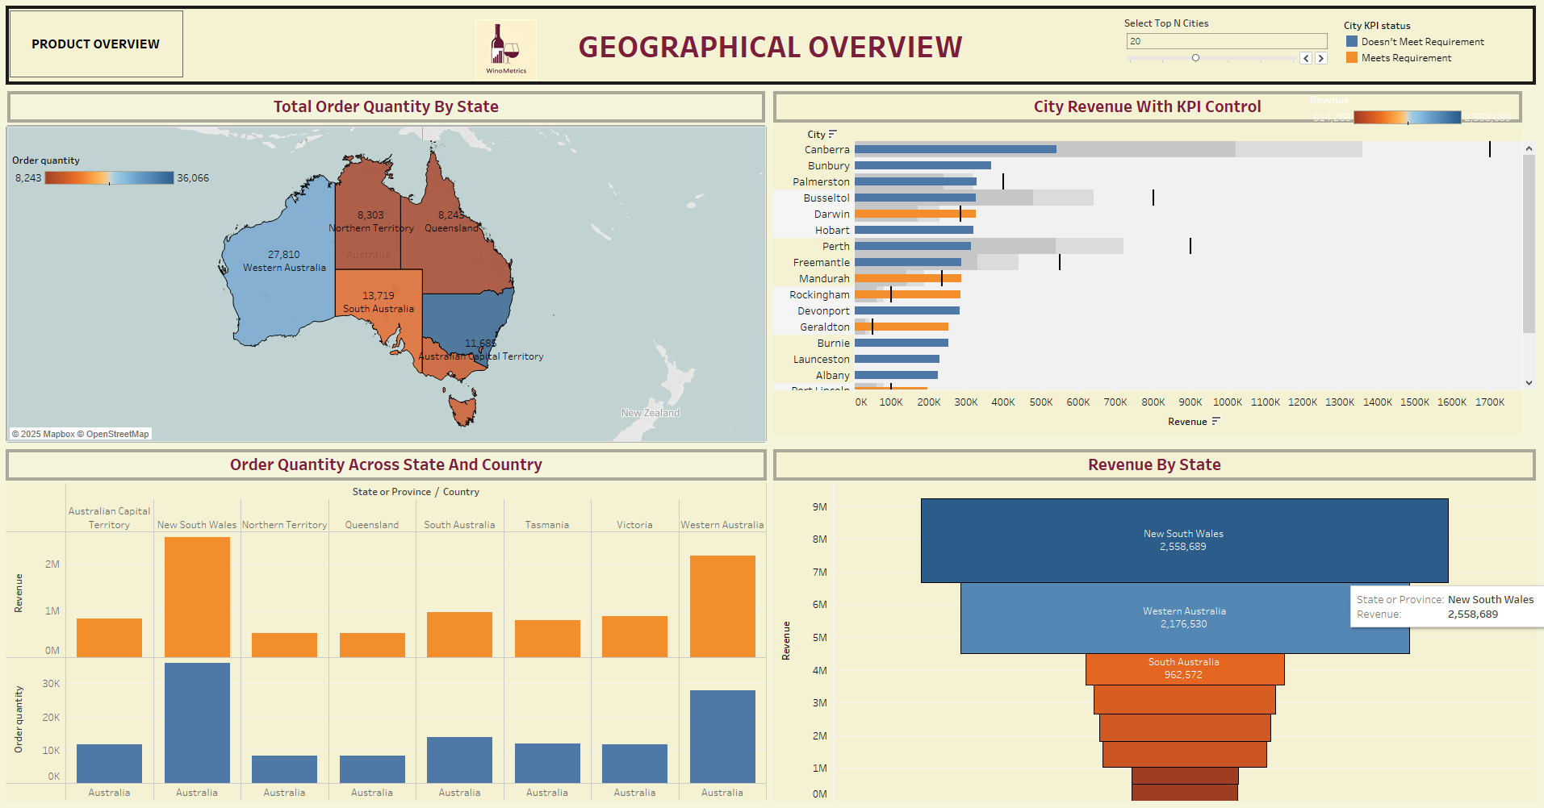

Slide 2
GEOGRAPHICAL OVERVIEW
Let’s start with the Geographical Overview tab. This section focuses on regional wine performance in terms of order quantity and revenue across different states and cities in Australia.
On the top-left, we see a map displaying Total Order Quantity by State. Western Australia leads in terms of volume with over 27,000 orders, while Queensland and Northern Territory are on the lower end.
To the right, we have a City Revenue KPI Control bar chart. It visualizes revenue generated by top cities, with a clear distinction between those that meet performance requirements and those that don’t. For example, Canberra and Perth are high-performing cities, while places like Rockingham and Bunbury are underperforming relative to the target.
Below the map is a chart showing Order Quantity Across State and Country, which gives a side-by-side comparison of sales volume and revenue.
And finally, on the bottom-right is a funnel chart showing Revenue by State, where New South Wales and Western Australia are clearly leading contributors."

Slide 3
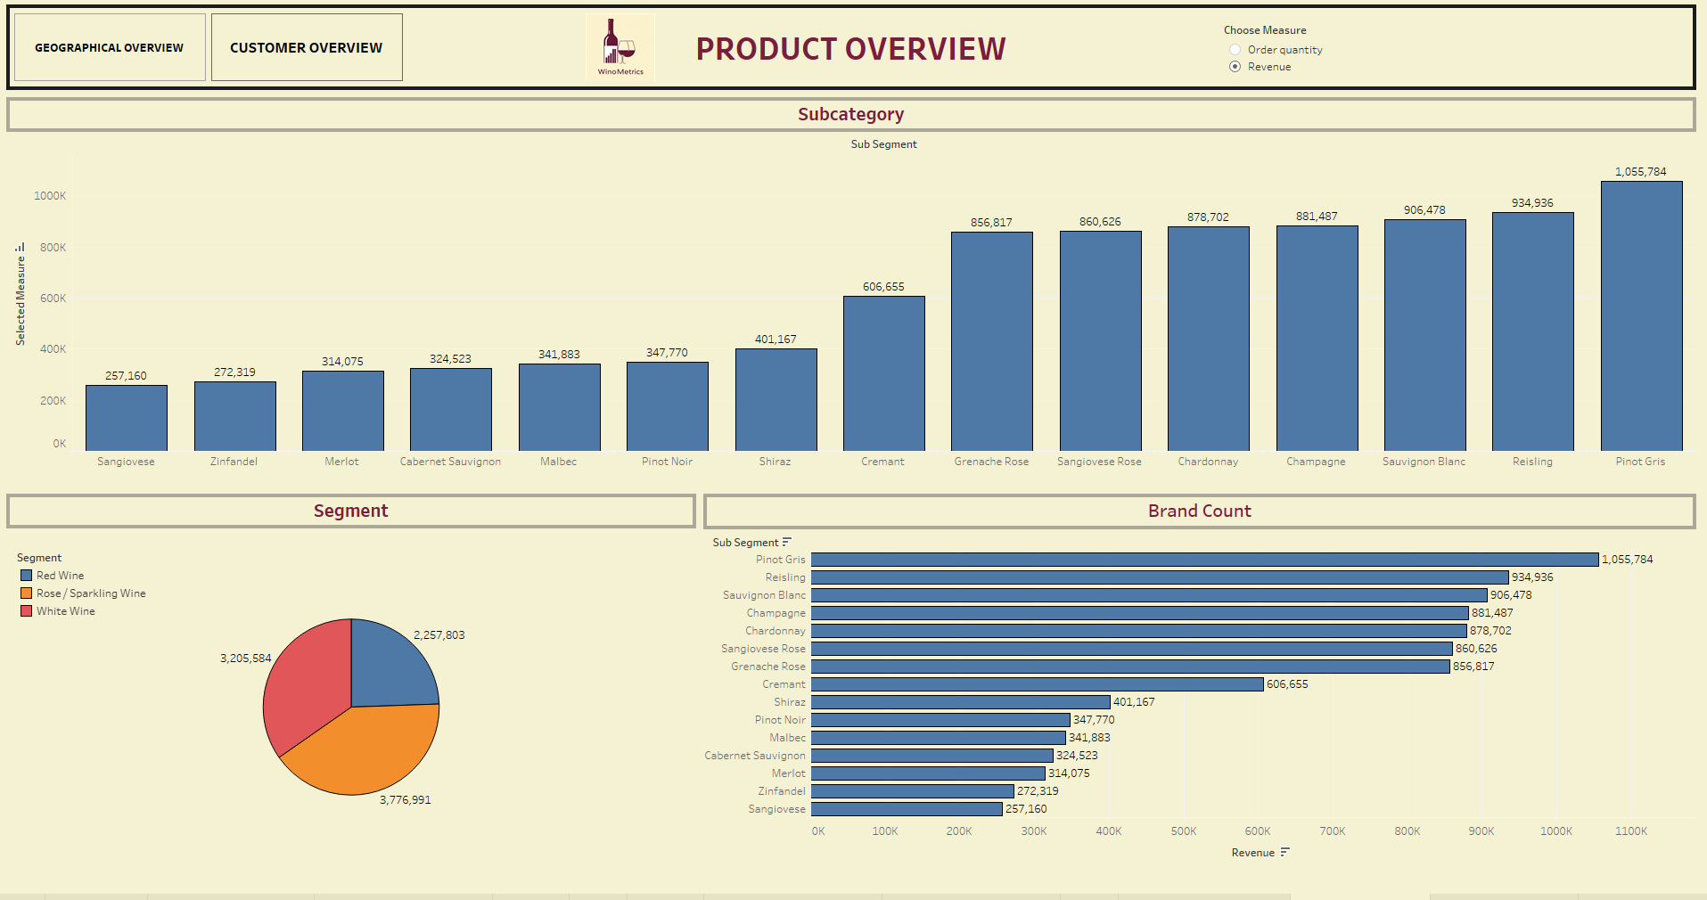

Slide 4
PRODUCT OVERVIEW
Moving on to the Product Overview tab. This dashboard helps us understand which wine types and subcategories are driving our performance.
The top chart shows the performance of different wine subcategories such as Pinot Gris, Riesling, and Sauvignon Blanc. Pinot Gris tops the chart with over 1 million in revenue.
In the middle-left, we have a pie chart under the 'Segment' section that breaks down total sales into Red Wine, White Wine, and Rose/Sparkling Wine. Rose/Sparkling Wine leads with over 3.7 million, followed by White and Red Wine.
Finally, on the bottom right, the Brand Count bar chart aligns closely with the subcategories, further validating which wines are the most preferred by consumers.

Slide 5
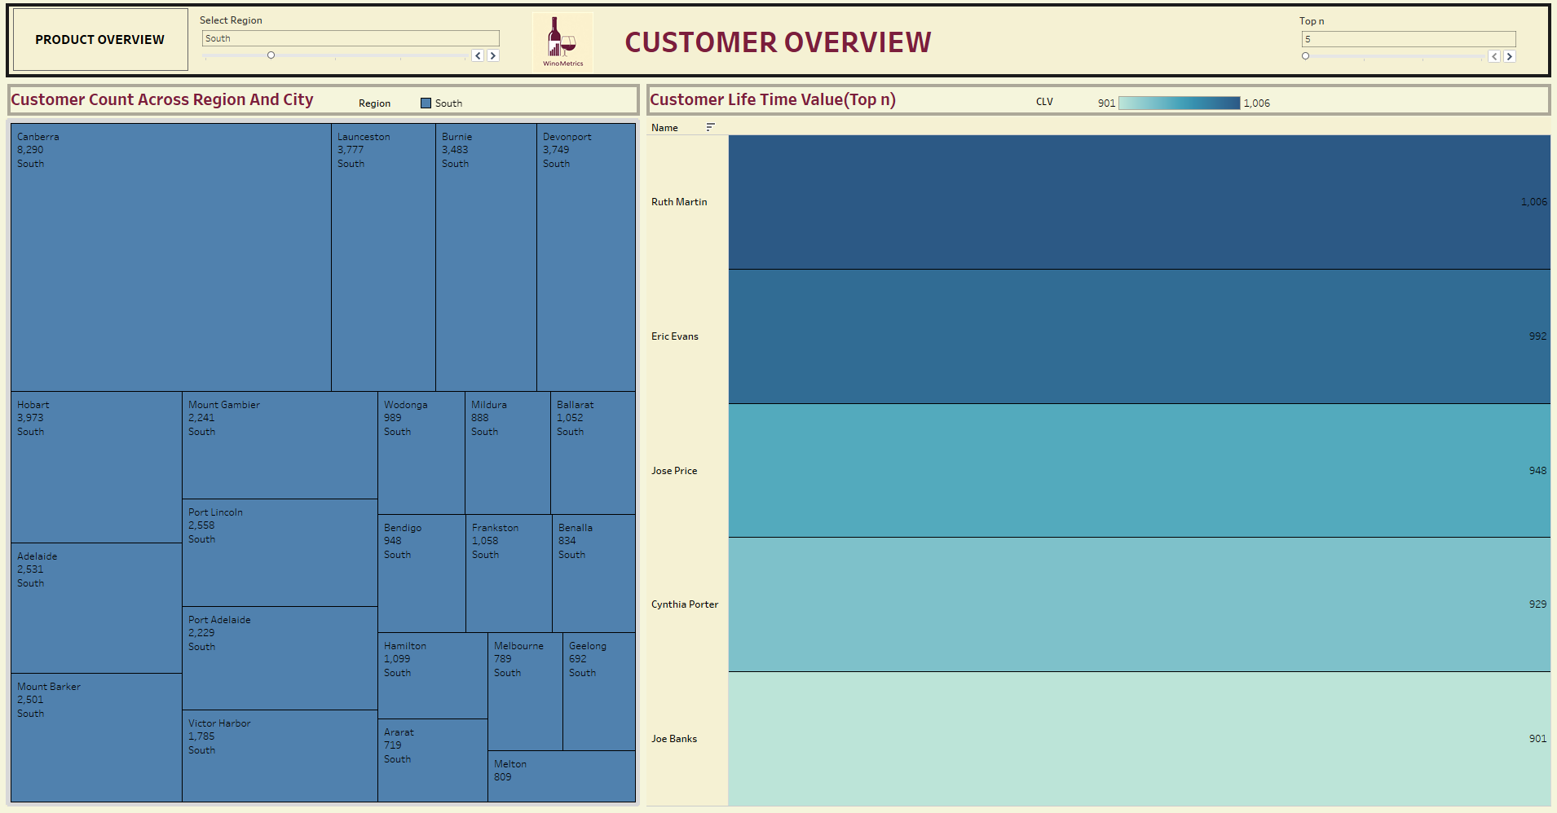

Slide 6
CUSTOMER OVERVIEW
Now let’s look at the Customer Overview tab. This section tells us about customer distribution and value.
On the left, we have a treemap of Customer Count across Region and City. The darker the block, the higher the number of customers in that city. Canberra, Hobart, and Port Lincoln are some of the cities with the largest customer bases.
On the right, there’s a bar chart showing the Top Customers by Lifetime Value. For example, Ruth Martin has the highest Customer Lifetime Value (CLV) at 1,006. This helps us identify key customers and plan retention strategies accordingly.

