Slide 1
杂题选讲
雷涛

Slide 2
组合数学部分
容斥原理
基本的组合计数（加法、乘法原理，排列组合）
一些基本知识就可以组合成很有难度的题目了

Slide 3
Endless Knight (Google code jam 2008)
In the game of chess, there is a piece called the knight. A knight is special -- instead of moving in a straight line like other pieces, it jumps in an "L" shape. Specifically, a knight can jump from square (r1, c1) to (r2, c2) if and only if (r1 - r2)² + (c1 - c2)² = 5.
In this problem, one of our knights is going to undertake a chivalrous quest of moving from the top-left corner (the (1, 1) square) to the bottom-right corner (the (H, W) square) on a gigantic board. The chessboard is of height H and width W.
Here are some restrictions you need to know.
  The knight is so straightforward and ardent that he is only willing to move towards the right and the bottom. In other words, in each step he only moves to a square with a bigger row number and a bigger column number. Note that, this might mean that there is no way to achieve his goal, for example, on a 3 by 10 board.
  There are R squares on the chessboard that contain rocks with evil power. Your knight may not land on any of such squares, although flying over them during a jump is allowed.
Your task is to find the number of unique ways for the knight to move from the top-left corner to the bottom-right corner, under the above restrictions. It should be clear that sometimes the answer is huge. You are asked to output the remainder of the answer when divided by 10007, a prime number.

Slide 4
Solution
Only 2 possible moves : (+1,+2) and (+2,+1)
Number of such moves can be determined by the equations:
  X+2Y = H-1
  2X+Y = W-1
If we do not consider the R evil squares, the number of ways is :
  C(X+Y, X)
  → So applying Principle of Inclusion and Exclusion.
One problem remains:
  How to calculate C(n,m) mod prime ?

Slide 5
计算几何部分
O(nlogn)时间求凸包
O(logn)时间求凸包与直线的交点
求最远（最近）点对

Slide 6
Equations (POJ 3689)
Given 3 × n positive integers:
  A₁, A₂, A₃, ... A_{n};
  B₁, B₂, B₃, ... B_{n};
  C₁, C₂, C₃, ... C_{n};
and a set of m pairs of integer < S_{i}, T_{i} >, your task is to find a non-negative real solution for the following equations:
  A₁X₁ + A₂X₂ + A₃X₃ + ... + A_{n}X_{n} = S_{i}
  B₁X₁ + B₂X₂ + B₃X₃ + ... + B_{n}X_{n} = T_{i}
that maximizes C₁X₁ + C₂X₂ + C₃X₃ + ... + C_{n}X_{n}
(1 ≤ n ≤ 100000) (1 ≤ m ≤ 10000).
(1 ≤ A_{i}, B_{i}, C_{i} ≤ 10000) (1 ≤ S_{i}, T_{i} ≤ 10000).

Slide 7
Beauty Contest (POJ 2187)
Bessie, Farmer John's prize cow, has just won first place in a bovine beauty contest, earning the title 'Miss Cow World'. As a result, Bessie will make a tour of N (2 <= N <= 50,000) farms around the world in order to spread goodwill between farmers and their cows. For simplicity, the world will be represented as a two-dimensional plane, where each farm is located at a pair of integer coordinates (x,y), each having a value in the range -10,000 ... 10,000. No two farms share the same pair of coordinates.
Even though Bessie travels directly in a straight line between pairs of farms, the distance between some farms can be quite large, so she wants to bring a suitcase full of hay with her so she has enough food to eat on each leg of her journey. Since Bessie refills her suitcase at every farm she visits, she wants to determine the maximum possible distance she might need to travel so she knows the size of suitcase she must bring.Help Bessie by computing the maximum distance among all pairs of farms.

Slide 8
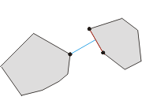
Bridge across islands (POJ 3608)
Thousands of thousands years ago there was a small kingdom located in the middle of the Pacific Ocean. The territory of the kingdom consists two separated islands. Due to the impact of the ocean current, the shapes of both the islands became convex polygons. The king of the kingdom wanted to establish a bridge to connect the two islands. To minimize the cost, the king asked you, the bishop, to find the minimal distance between the boundaries of the two islands.
N,M ≤ 10000 (number of vertices)

Slide 9
一类线性方程问题
水果（《算法艺术与信息学竞赛》）
骑士（POI 04/05）
超级马（POI 01/02）

Slide 10
线性方程解存在性问题——水果
作为一名水果商，你拥有各种各样的水果。一天，你接到了一位十分有钱的顾客的电话，他需要订购3种水果，要求每种水果的数量一样多。由于他十分有钱，你可以认为，只要每种水果数量一样多，无论总数量多少都没有关系。
关键就是如何装箱。你拥有N(N<10^5)种箱子，你对每个箱子检查了一遍，发现第i种箱子，只能恰好装三种水果各（Ai,Bi,Ci）个。现在假设每种箱子都有无限多个，那么，到底能不能满足顾客的要求呢？

Slide 11
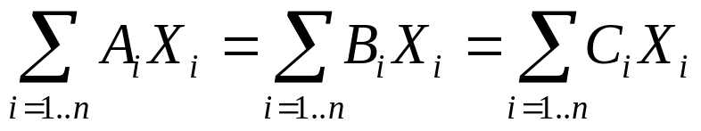
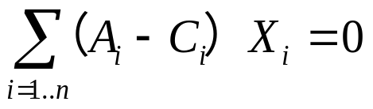
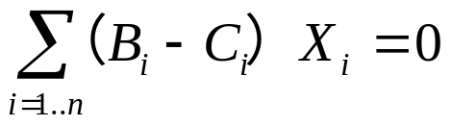
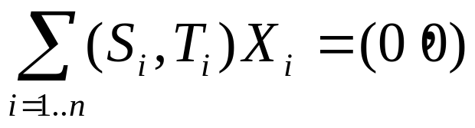
分析(一)
题目是要求一组非负整数
它们不能都为0，使得它们满足如下条件：

Slide 12
分析(二)
将(Si,Ti)视作向量
求一个从原点出发，经过若干步，最后回到原点的可行路线

Slide 13





分析（二）

Slide 14



分析（二）

Slide 15
初步结论
性质一：若所有向量组成的夹角小于180度，则可以找到一条过原点的直线，使所有向量在此直线的同一侧，问题肯定无解
若所有向量组成的夹角大于等180度，则问题肯定有解 ？

Slide 16


证明
存在两个向量，它们在同一直线上且方向相反（即它们的夹角等于180度）

Slide 17




证明
存在三个向量,它们围成的三角形区域覆盖了(0,0)

Slide 18
向量组等价问题——骑士
A super knight can move in a 2-dimentional space. Each move it can perform is described by a 2-dimentional vector (x,y), indicating a move from (a,b) to (a+x,b+y) or (a-x,b-y) is possible. Each knight has a prescribed set of vectors, describing the moves this knight can make.
We say two knights are equivalent, if they can reach exactly the same point starting from (0,0) (by making many moves, perhaps). It can be shown that for every knight there exists an equivalent one whose moves are described by only 2 vectors.
Now you are given a set of n vectors. These vectors are linear independent. Please find an equivalent knight which has a set of n vectors.

Slide 19
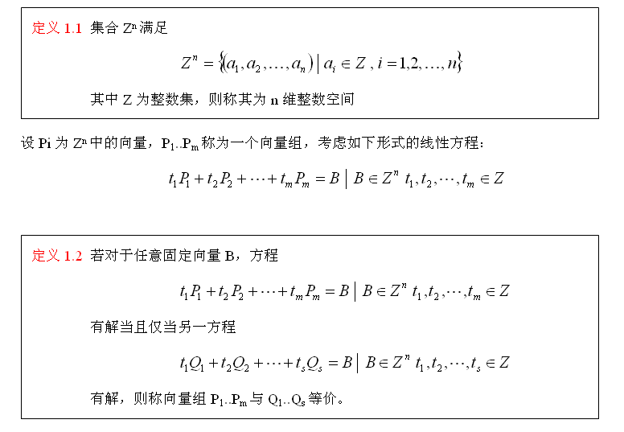


Slide 20
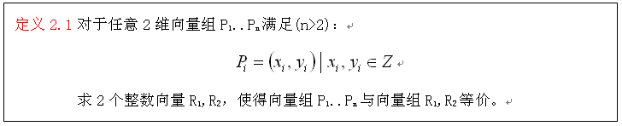
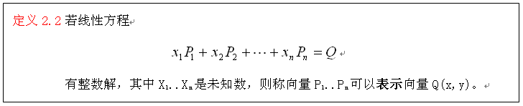
原问题的抽象

Slide 21
两个性质
两组向量P1..Pn，Q1..Qm是等价的当且仅当它们可以互相表示
若存在整数a,b,c,d，以及向量P1,P2，且ad-bc=1，另有Q1=aP1+bP2，Q2=cP1+dP2，则P1,P2，Q1,Q2是等价的

Slide 22
3个向量用2个向量来等价表示
方法同“水果”类似，分两种情况讨论
二维向量组可以推广到n维 （ POJ 3235）
具体证明

Slide 23
超级马
在一个无限的棋盘上有一个超级马，它可以完成各种动作。每一种动作都是通过两个整数来确定——第一个数说明列的数（正数向右，负数向左），第二个数说明行的数（正数向上，负数向下），移动马来完成这个动作。
任务
编写一个程序
对每一个超级马进行确认，是否通过自己的行动可以到达盘面上的每一个区。

Slide 24
抽象后的问题
给定n个2维向量P₁..P_{n}，坐标都是整数，判断对于任意坐标是整数的向量Q，方程：
  X₁P₁+X₂P₂+…+X_{n}P_{n}=Q
是否都存在非负整数解

Slide 25
分析
相对“骑士”，本题的难点在于解非负的条件
考虑简化：非负整数解→整数解
再添加一个条件：
X₁P₁+X₂P₂+…+X_{n}P_{n}=(0,0)
存在正整数解
不难证明，此时问题和原问题等价
得到了一个等价的两个子问题

Slide 26
谢谢

