Slide 1

DEPARTMENT OF COMPUTER SCIENCE AND ENGINEERING
YOLOv8-YOLACT Hybrid Framework for Real-Time Garbage Classification and Segmentation
BATCH ID : 23MPCS-G14
S. No | Roll. No | Student Name
1 | 23881A05DD | Kondreddy Nava Sandesh Reddy
2 | 23881A05DT | Nelluri Sai Lokesh
3 | 23881A0545 | Dokuru Rakshitha
Guide Details
Dr. Chunduri Madhurya
Assistant Professor
Department of CSE

Slide 2
Mini Project Outlines
Introduction
Existing System Vs Proposed
Research Gaps
Problem Statement
Proposed Project Objectives
Proposed Project Outcomes
Software and Hardware Requirements
Architectural Diagram
Proposed Methods and Algorithms
Results
Research Paper (Acceptance Proofs)
Conclusion

Slide 3
Introduction
What is the Problem?
Global surge in solid waste causes major environmental, economic and public health challenges.
Incorrect disposal leads to soil/water pollution, greenhouse gases and spread of disease.
Manual waste sorting is slow, error-prone and exposes workers to hazardous materials.
Why Deep Learning?
CNN-based systems improved automated waste classification over traditional methods.
YOLO (You Only Look Once) enabled real-time single-stage object detection.
YOLACT introduced prototype-based mask generation for fast instance segmentation.
Our Approach
YOLOv8-YOLACT hybrid framework for automated, real-time garbage classification and segmentation.
Detects and segments: Plastic, Metal, Glass, Paper, Organic, Styrofoam, Battery and more.
Suitable for smart bins, recycling centers and automated waste monitoring systems.

Slide 4
Existing System Vs Proposed
Existing Systems
Manual sorting: labor-intensive, inconsistent, exposes workers to biohazards.
Traditional ML/CNN models: limited accuracy in cluttered real-world environments.
Detection-only YOLO models: no pixel-level segmentation, poor boundary localization.
Mask R-CNN: high accuracy but too slow for real-time deployment (two-stage).
Proposed System
YOLOv8 Instance Segmentation with YOLACT-inspired prototype-based mask generation.
Single-stage detection + segmentation in one unified real-time pipeline.
Handles occlusion, poor lighting and cluttered environments effectively.
Achieves overall mAP50 = 0.880 and Mask mAP50 = 0.831 across all waste categories.
Deployable on GPU-enabled smart bins, recycling equipment and edge devices.
DEPARTMENT OF CSE : MINI PROJECT

Slide 5
Research Gaps
Gaps in Existing Literature
Most CNN-based waste classifiers lack pixel-level instance segmentation capability.
Detection-only YOLO models cannot distinguish overlapping or adjacent waste items.
Two-stage segmentation (Mask R-CNN) is too computationally expensive for real-time use.
Existing datasets lack balanced multi-category polygon-annotated waste images.
Few studies address waste classification under occlusion, low-light and cluttered backgrounds.
YOLACT-inspired prototype mask generation has not been applied broadly to waste management.
Limited scalability of existing solutions for smart city and large-scale industrial deployment.
How This Work Fills the Gaps
Combines YOLOv8 speed with prototype masks for accurate real-time instance segmentation.
Trained on a diverse 10-class polygon-annotated waste dataset processed via Roboflow.
Validated under adverse conditions: occlusion, varying lighting, messy backgrounds.
DEPARTMENT OF CSE : MINI PROJECT

Slide 6
Problem Statement
Context
Rapid urbanization has led to exponential growth in solid waste generation, creating serious environmental and public health hazards. Conventional manual sorting is inefficient, hazardous and not scalable.
Limitation of Current Automated Systems
Existing CNN and YOLO-based methods lack pixel-level segmentation of individual waste items, especially in cluttered, overlapping environments. Multi-stage methods like Mask R-CNN are too slow for real-time applications.
What is Needed?
A unified real-time framework combining fast detection with precise instance segmentation.
Ability to classify multiple waste types simultaneously: plastic, metal, glass, paper, organic.
Robust performance under occlusion, low lighting and complex cluttered backgrounds.
Scalable, deployable solution for smart bins, recycling plants and waste monitoring systems.
DEPARTMENT OF CSE : MINI PROJECT

Slide 7
Proposed Project Objectives
Core Objectives
Design and implement a YOLOv8 instance segmentation model with YOLACT-inspired architecture.
Achieve real-time detection and pixel-level segmentation of multiple waste categories simultaneously.
Classify waste into 10+ types: Plastic, Metal, Glass, Paper, Plastic Bag, Battery, Clothing, Styrofoam, Organic.
Train using transfer learning from pre-trained YOLOv8 weights for faster convergence.
Prepare and annotate a multi-class waste dataset using Roboflow with polygon-level labels.
Evaluation Objectives
Evaluate using standard metrics: Precision, Recall, F1-Score, mAP50 and Mask mAP50.
Demonstrate robustness under adverse conditions: occlusion, low lighting, cluttered scenes.
Develop a scalable framework deployable in smart bins, recycling plants and monitoring systems.
DEPARTMENT OF CSE : MINI PROJECT

Slide 8
Proposed Project Outcomes
Model Performance Outcomes
Overall mAP50 = 0.880 and Mask mAP50 = 0.831 across all 10 waste categories.
High per-class accuracy: Battery 91.7%, Glass 92.2%, Plastic Bag 95.3%, Styrofoam 88.9%.
Real-time GPU inference suitable for practical deployment on edge platforms.
Accurate pixel-level segmentation even for overlapping and partially occluded items.
Application Outcomes
Municipal authorities: improved waste collection efficiency and recycling rates.
Recycling industry: reduced operational costs and increased material recovery.
Smart city: integration into IoT-connected smart waste bins and monitoring platforms.
Worker safety: eliminates direct human contact with hazardous waste materials.
Research Outcome
Submitted IEEE-format research paper demonstrating practical utility of YOLOv8-YOLACT for waste management.
DEPARTMENT OF CSE : MINI PROJECT

Slide 9
Software and Hardware Requirements
Software Requirements
Language: Python 3.8+
Framework: Ultralytics YOLOv8 (official segmentation framework)
Training Platform: Google Colab with GPU (T4 / A100)
Dataset Management: Roboflow (annotation, preprocessing, export in YOLOv8 format)
Hardware Requirements
GPU: NVIDIA CUDA-enabled (Google Colab T4/A100 used for training)
RAM: 12 GB minimum (16 GB recommended for batch training)
DEPARTMENT OF CSE : MINI PROJECT

Slide 10
Architectural Diagram
YOLOv8-YOLACT Hybrid Architecture Overview
Stage 1 - Input & Preprocessing
Garbage images resized to 640x640 px, normalized and auto-oriented before model input.
Stage 2 - Backbone: CSPDarknet
Extracts multi-scale hierarchical feature maps for both fine-grained and semantic understanding.
Stage 3 - Neck: PAN-FPN
Path Aggregation + Feature Pyramid Network aggregates features across scales for multi-size object detection.
Stage 4 - Detection Head
Predicts bounding boxes, class probabilities and mask coefficients per detected object.
Stage 5 - Prototype Mask Network (YOLACT-Inspired)
Generates global prototype masks. Final masks = linear combination of prototypes + predicted coefficients.
Stage 6 - Post-Processing
NMS removes duplicate predictions. Output: color-coded masks + class labels + confidence scores.
DEPARTMENT OF CSE : MINI PROJECT

Slide 11
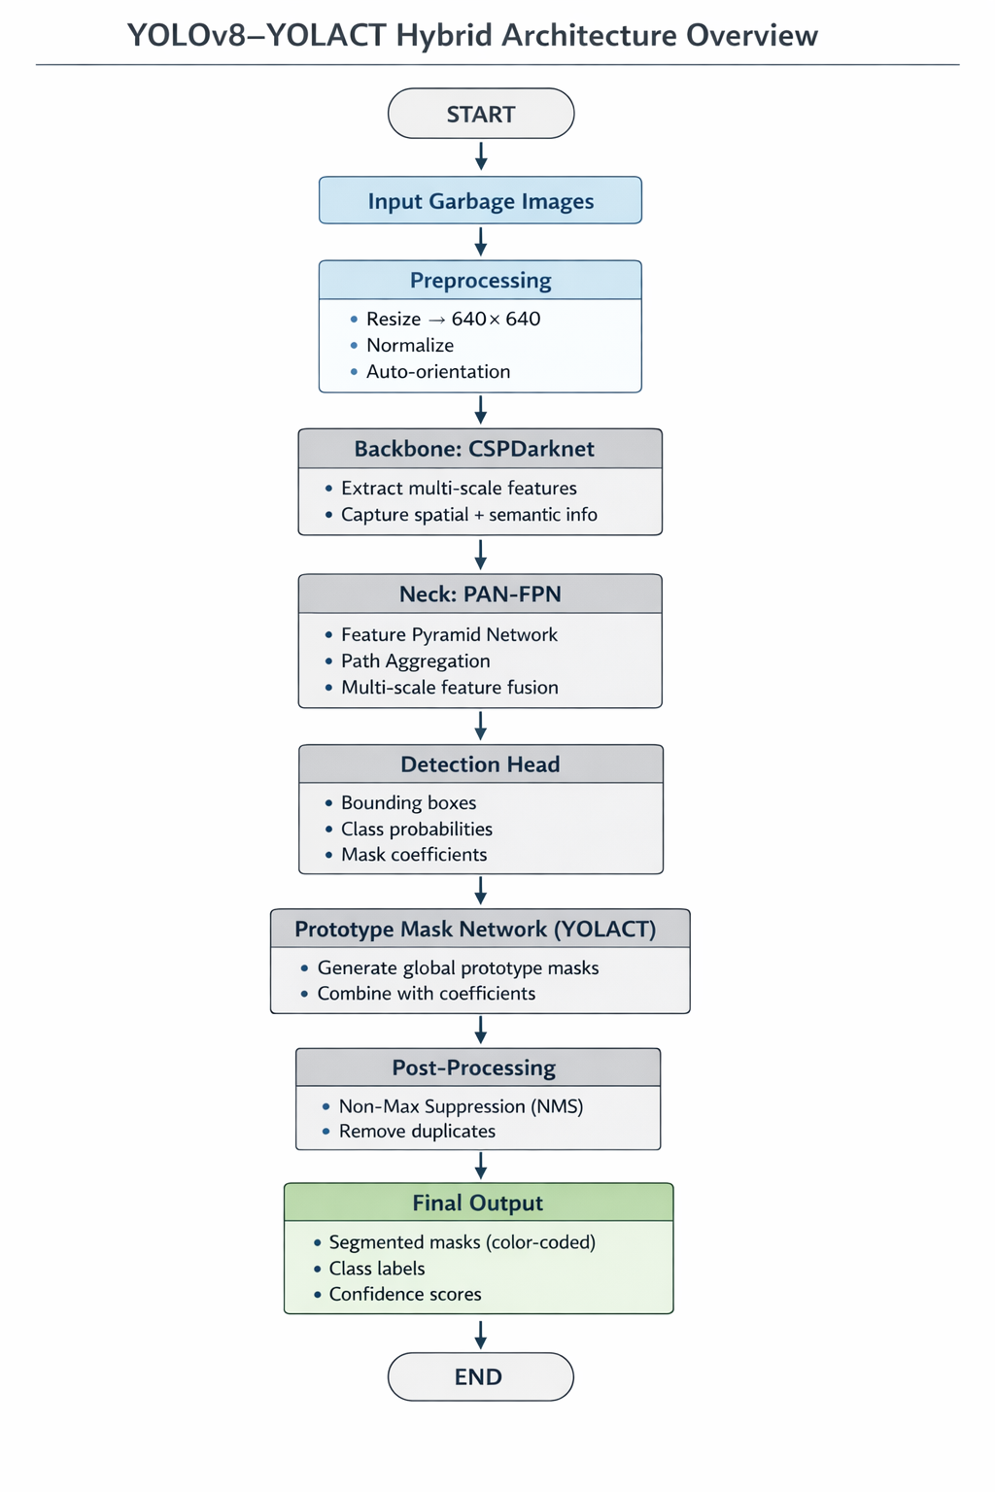

Slide 12
Proposed Method and Algorithms
Dataset Preparation
Public waste dataset processed via Roboflow with polygon-based segmentation annotations.
10 categories: Plastic, Metal, Glass, Paper, Paper Pack, Plastic Bag, Battery, Clothing, Styrofoam, General Trash.
Train/Val/Test split: 70:20:10 | All images resized to 640x640 px.
Training Strategy
Transfer learning from pre-trained YOLOv8 COCO weights for faster convergence.
Optimizer: Adam | Batch size: 8 | Epochs: 50 | Input: 640x640.
Combined loss: bounding box loss + classification loss + mask segmentation loss.
Validation monitored each epoch; early stopping prevents overfitting.
Inference Pipeline
Model predicts waste class, bounding box and pixel-level instance mask for each item.
NMS filters overlapping duplicate predictions for clean output.
Color-coded segmentation masks visualized with class labels and confidence scores.
DEPARTMENT OF CSE : MINI PROJECT
DEPARTMENT OF CSE : MINI PROJECT

Slide 13
Results
Performance Metrics (Overall + Per Class)
All Classes: mAP50 = 0.880 | Mask mAP50 = 0.831 | mAP50-95 = 0.749
Battery: mAP50 = 0.917 | Mask mAP50 = 0.917 | mAP50-95 = 0.888
Glass: mAP50 = 0.929 | Mask mAP50 = 0.922 | mAP50-95 = 0.768
Plastic Bag: mAP50 = 0.964 | Mask mAP50 = 0.953 | mAP50-95 = 0.873
Styrofoam: mAP50 = 0.956 | Mask mAP50 = 0.889 | mAP50-95 = 0.848
Metal: mAP50 = 0.900 | Mask mAP50 = 0.899 | mAP50-95 = 0.750
Paper: mAP50 = 0.896 | Mask mAP50 = 0.807 | mAP50-95 = 0.737
Key Observations
Stable convergence across 30 epochs; validation loss closely tracked training loss.
Box F1 = 0.83 @ 0.475 confidence | Mask F1 = 0.81 @ 0.510 confidence (all classes).
Real-time GPU inference achieved; accurate masks even under occlusion and low-light.
DEPARTMENT OF CSE : MINI PROJECT

Slide 14
Research Paper (Submission Proof)
Research Paper Details
Title:
YOLOv8-YOLACT Hybrid Framework for Real-Time Garbage Classification and Segmentation
Authors:
K. N. Sandesh Reddy, N. Sai Lokesh, D. Rakshitha, C. Madhurya
Affiliation:
Dept. of CSE, Vardhaman College of Engineering, Hyderabad, India
Publication Format:
IEEE Conference Paper - Index Terms: Garbage Classification, YOLOv8, YOLACT, Instance Segmentation, Deep Learning, Waste Management.
DEPARTMENT OF CSE : MINI PROJECT
DEPARTMENT OF CSE : MINI PROJECT

Slide 15
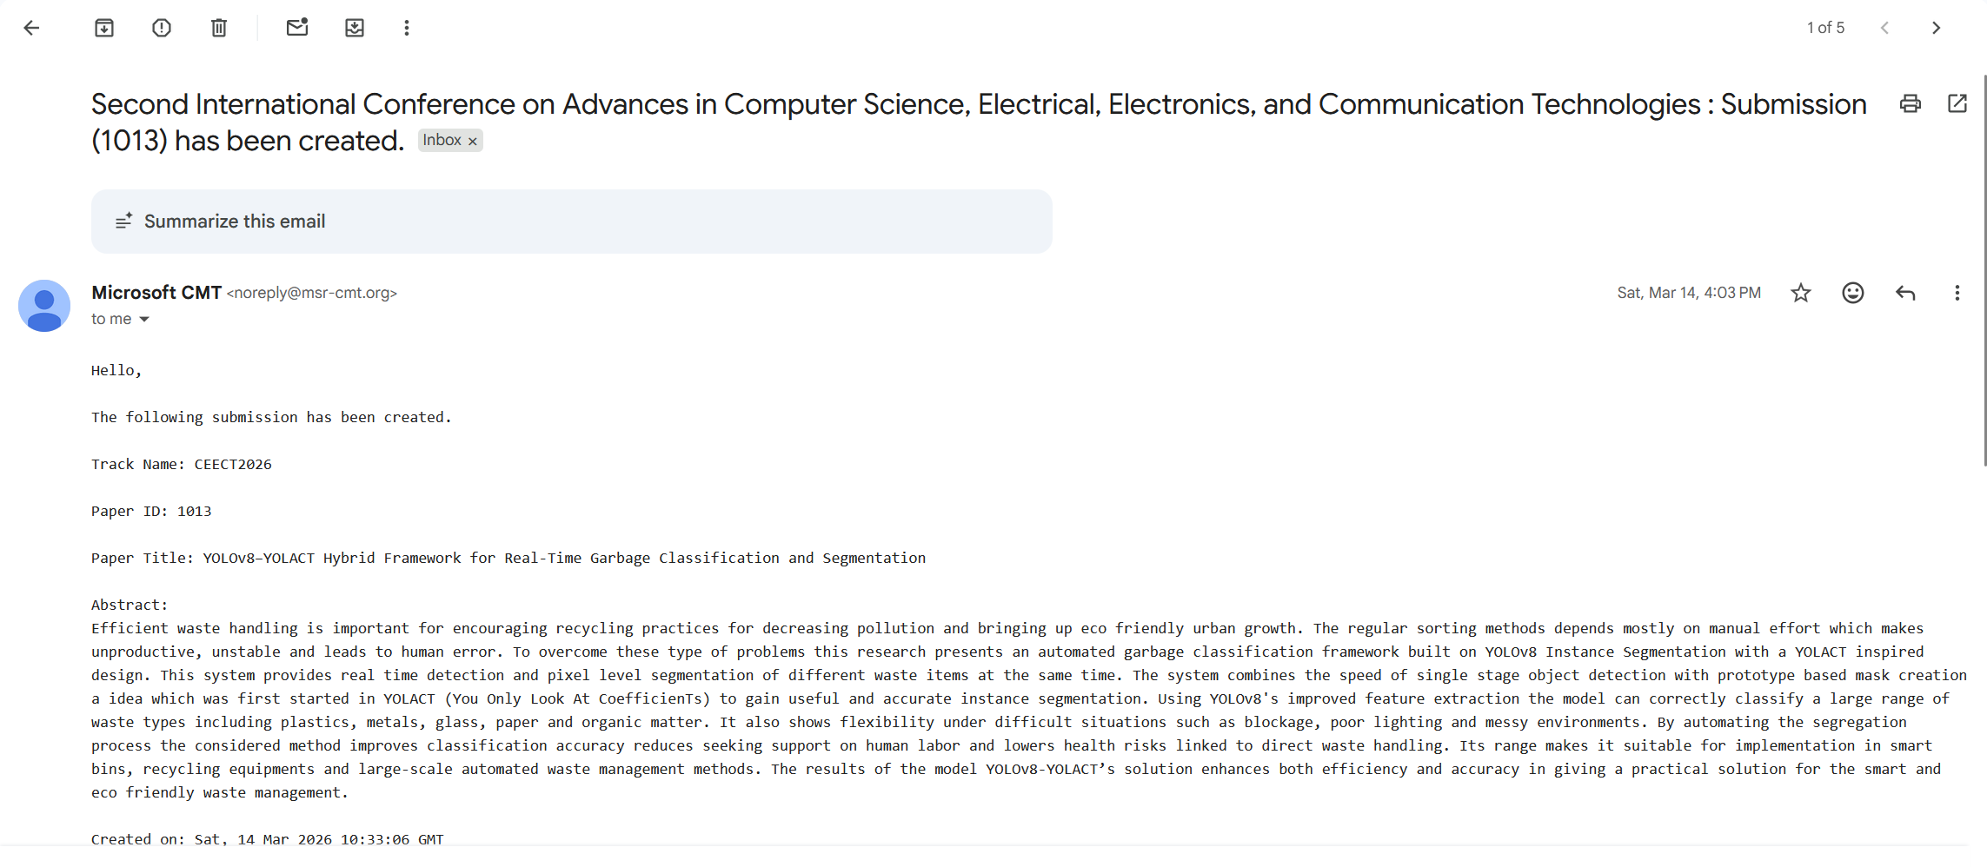
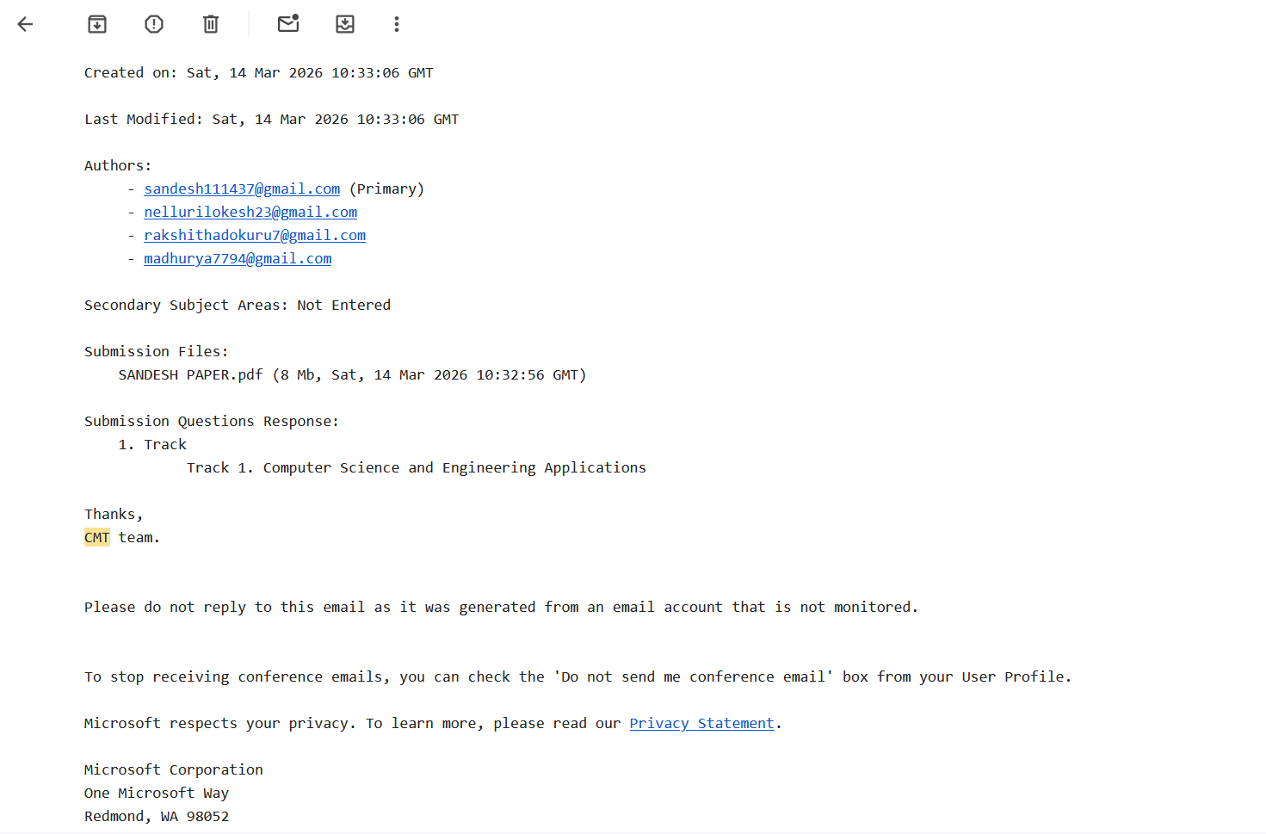

Slide 16
Conclusion
Conclusion
Proposed YOLOv8-YOLACT hybrid achieves automated real-time garbage classification and segmentation.
Combines single-stage detection with prototype-based instance segmentation in one pipeline.
Classifies 10+ waste types with overall mAP50 = 0.880 and Mask mAP50 = 0.831.
Robust under occlusion, varying lighting and cluttered real-world waste environments.
Real-time GPU inference confirms practical deployability in smart bins and recycling plants.
Future Scope
Expand with more diverse datasets to improve generalization across waste types.
Explore YOLOv8l/YOLOv8x variants and advanced augmentation for higher accuracy.
Deploy on Jetson Nano/Raspberry Pi for IoT-connected smart waste bins.
Benchmark against state-of-the-art models; optimize for low-power edge deployment.
Extend to video stream processing for continuous industrial waste monitoring.
DEPARTMENT OF CSE : MINI PROJECT

Slide 17
Thank You
DEPARTMENT OF CSE : MINI PROJECT

